Slide 1
Module 17:Attacking What We Do
Instructor Materials
CyberOps Associate v1.0
Notes:
Cisco Networking Academy Program
CyberOps Associate v1.0
Module 17: Attacking What We Do

Slide 2
Instructor Materials – Module 17 Planning Guide
This PowerPoint deck is divided in two parts:
Instructor Planning Guide
Information to help you become familiar with the module
Teaching aids
Instructor Class Presentation
Optional slides that you can use in the classroom
Begins on slide # 8
Note: Please remove the Planning Guide from this presentation before sharing with anyone.
For additional help and resources, go to the Instructor Home Page and Course Resources for this course. You also can visit the professional development site on www.netacad.com, the official Cisco Networking Academy Facebook page, or Instructor Only FB group.
Notes:
2

Slide 3
What to Expect in this Module
To facilitate learning, the following features within the GUI may be included in this module:
Feature | Description
Hands-On Labs | Labs designed for working with physical equipment.
Animations | Expose learners to new skills and concepts.
Check Your Understanding (CYU) | Per topic online quiz to help learners gauge content understanding.
Module Quizzes | Self-assessments that integrate concepts and skills learned throughout the series of topics presented in the module.
Module Summary | Briefly recaps module content.

Slide 4
Check Your Understanding
Check Your Understanding activities are designed to let students quickly determine if they understand the content and can proceed, or if they need to review.
Check Your Understanding activities do not affect student grades.
There are no separate slides for these activities in the PPT. They are listed in the notes area of the slide that appears before these activities.
Notes:
4

Slide 5
Module 17: Activities
What activities are associated with this module?
Page # | Activity Type | Activity Name | Optional?
17.1.1 | Animation | ARP Vulnerabilities | Recommended
17.1.7 | Lab | Exploring DNS Traffic | Recommended
17.2.6 | Lab | Attacking a MySQL Database | Recommended
17.2.7 | Lab | Reading Server Logs | Recommended
17.2.8 | Check Your Understanding | Network Services Attacks | Recommended
Notes:
5

Slide 6
Module 17: Best Practices
Prior to teaching Module 17, the instructor should:
Review the activities and assessments for this module.
Try to include as many questions as possible to keep students engaged during classroom presentation.
Topic 17.1
Provide an overview of ARP
Play an animation to demonstrate the ARP process
Explain ARP Cache Poisoning with example
Ask the learners if they are aware of DNS attacks.
Notes:
6

Slide 7
Module 17: Best Practices
Topic 17.2
Demonstrate a short video to the learners on web attack and then explain the concept.
Discuss Malicious iFrames and its prevention.
Explain HTTP 302 Cushioning and then ask the class to brainstorm on the preventive measures that can be taken to avoid these malicious attacks.
Define Domain Shadowing.
Explain how threat actors use code injection and SQL injection attacks.
Notes:
7

Slide 8
Module 17:Attacking What We Do
CyberOps Associates v1.0
Notes:
Cisco Networking Academy Program
CyberOps Associates v1.0
Module 17: Attacking What We Do
In-Session Activities / Explanations:
Time: 5 min
Instructor Notes:
Welcome the audience in a warm and cordial manner. Ensure that everyone is set up with the required resources.
Introduce the topic and encourage learners to come up with a list of expectations from the session. Collate topics on the white board or Desktop while using learner’s inputs to interpret them in words.
Read out the Objectives and briefly describe each.
Key Points: NA

Slide 9
Module Objectives
Module Title: Attacking What We Do
Module Objective: Explain how common network applications and services are vulnerable to attack.
Topic Title | Topic Objective
IP Services | Explain IP service vulnerabilities
Enterprise Services | Explain how network application vulnerabilities enable network attacks
Notes:
9
17 – Attacking What We Do
17.0 – Introduction
17.0.2 – What will I learn to do in this module?

Slide 10
17.1 IP Services
Notes:
Source:
17 - Attacking What We Do
17.1 - IP Services
In-Session Activities / Explanations:
Time: 10 min
Instructor Notes:
Discuss ARP Vulnerabilities
Describe the DNS attacks along with its malicious activities.
Define the ARP Cache Poisoning process
Explain DHCP
Walk the learners through the DHCP spoofing attack.
At the end of the topic, enquire how the learners have performed during the Exploring DNS Traffic Lab.
Key Points: ARP Vulnerabilities , ARP Cache Poisoning, ARP Request , ARP Reply, DNS Attacks , DHCP , DHCP spoofing attacks.

Slide 11
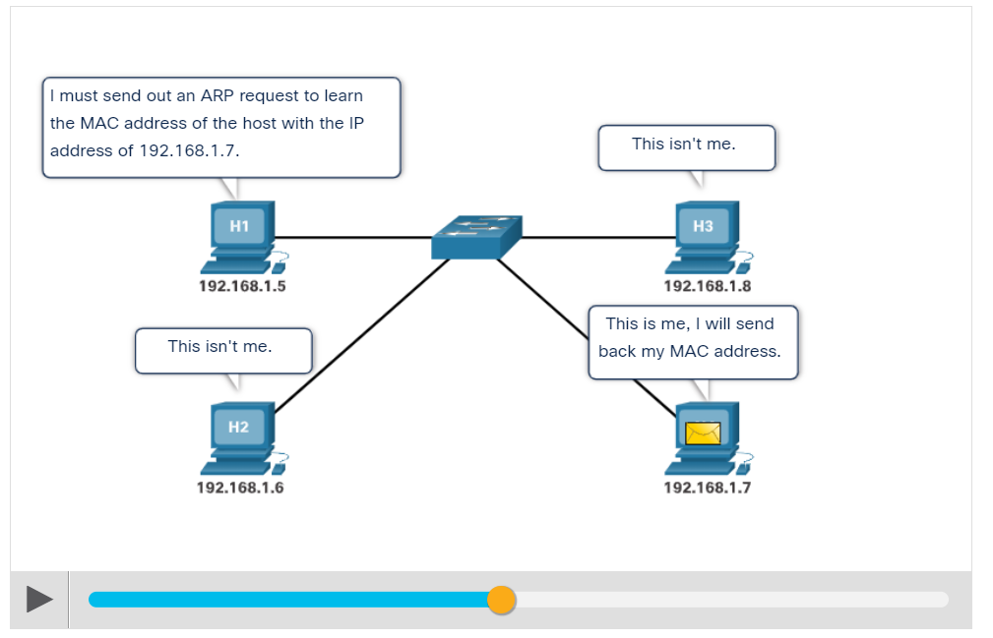
Attacking What We Do
ARP Vulnerabilities
Hosts broadcast an ARP Request to other hosts on the network segment to determine the MAC address of a host with a particular IP address.
The host with the matching IP address in the ARP Request sends an ARP Reply called “gratuitous ARP.”
A threat actor can poison the ARP cache of devices on the local network
The goal is to associate the threat actor’s MAC address with the IP address of the default gateway in the ARP caches of hosts on the LAN segment.
Play the animation to see the ARP process at work.
Notes:
17 - Attacking What We Do
17.1 – IP Services
17.1.1 – ARP Vulnerabilities

Slide 12
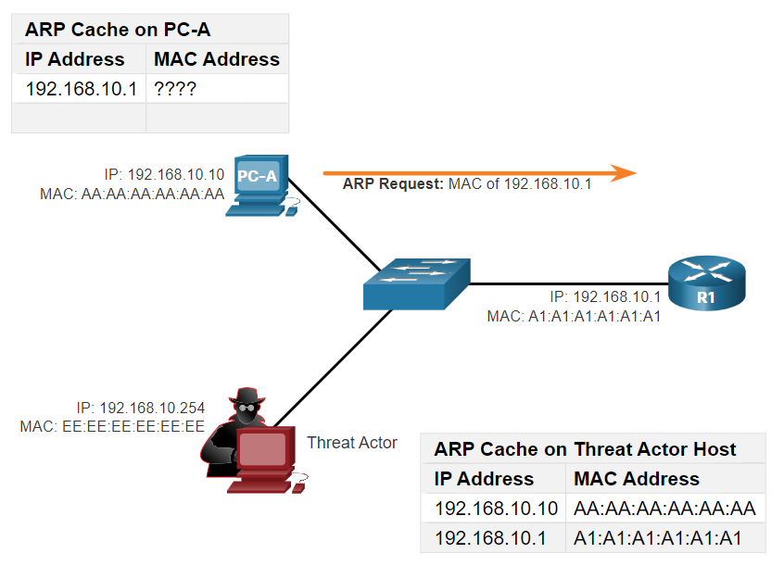
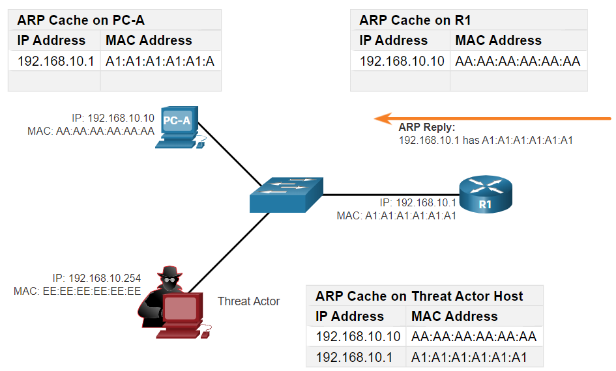
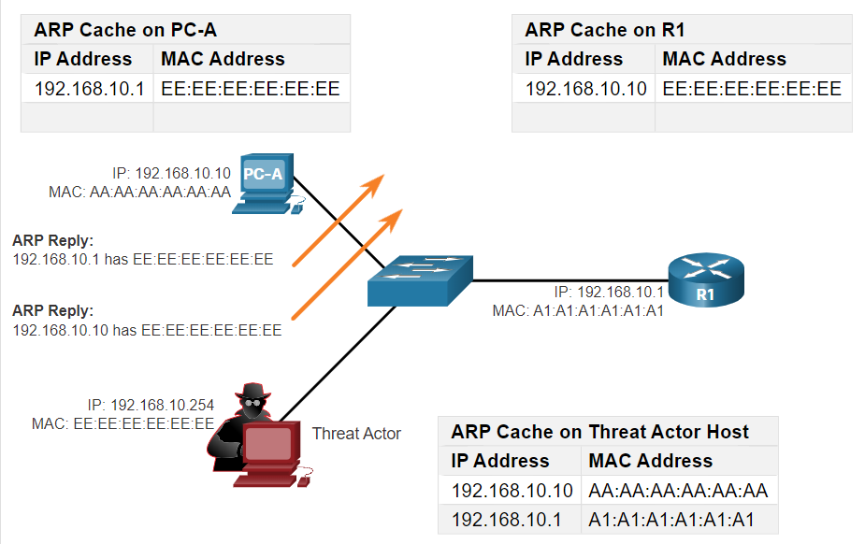
Attacking What We Do
ARP Cache Poisoning
ARP cache poisoning can be used to launch various man-in-the-middle attacks.
ARP cache poisoning process
ARP Request
ARP Reply
Spoofed Gratuitous ARP replies
Note: There are many tools available on the internet to create ARP MITM attacks including dsniff, Cain & Abel, ettercap, Yersinia, and others.
Notes:
17 - Attacking What We Do
17.1 – IP Services
17.1.2 – ARP Cache Poisoning

Slide 13
Attacking What We Do
DNS Attacks
DNS attacks include the following:
DNS open resolver attacks:
A DNS open resolver is a publicly open DNS server such as Google DNS (8.8.8.8) that answers client’s queries outside its administrative domain. DNS open resolvers are vulnerable to multiple malicious activities described in the table.
DNS Resolver Vulnerabilities | Description
DNS cache poisoning attacks | Threat actors send spoofed, falsified Record Resource (RR) information to a DNS resolver to redirect users from legitimate sites to malicious sites.
DNS amplification and reflection attacks | Threat actors send DNS messages to the open resolvers using the IP address of a target host.
DNS resource utilization attacks | This DoS attack consumes all the available resources to negatively affect the operations of the DNS open resolver.
Notes:
17 - Attacking What We Do
17.1 – IP Services
17.1.3 – DNS Attacks

Slide 14
Attacking What We Do
DNS Attacks (Contd.)
DNS Stealth Attacks
To hide their identity, threat actors also use the DNS stealth techniques described in the table to carry out their attacks.
DNS Stealth Techniques | Description
Fast Flux | Threat actors use this technique to hide their phishing and malware delivery sites. The DNS IP addresses are continuously changed within minutes.
Double IP Flux | Threat actors use this technique to rapidly change the hostname to IP address mappings and to also change the authoritative name server. This increases the difficulty of identifying the source of the attack.
Domain Generation Algorithms | Threat actors use this technique in malware to randomly generate domain names that can then be used as rendezvous points to their command and control (C&C) servers.
Notes:
17 - Attacking What We Do
17.1 – IP Services
17.1.3 – DNS Attacks

Slide 15
Attacking What We Do
DNS Attacks (Contd.)
DNS Domain Shadowing Attacks
In Domain Shadowing, threat actor gather domain account credentials in order to create multiple sub-domains which will be used during the attacks.
These subdomains typically point to malicious servers without alerting the actual owner of the parent domain.
Notes:
17 - Attacking What We Do
17.1 – IP Services
17.1.3 – DNS Attacks

Slide 16
Attacking What We Do
DNS Tunneling
It is necessary for the cybersecurity analyst to be able to detect when an attacker is using DNS tunneling to steal data, and prevent and contain the attack.
To accomplish this, the security analyst must implement a solution that can block the outbound communications from the infected hosts.
Threat actors who use DNS tunneling place non-DNS traffic within DNS traffic. This method often circumvents security solutions.
For the threat actor to use DNS tunneling, the different types of DNS records such as TXT, MX, SRV, NULL, A, or CNAME are altered. For example, a TXT record can store the commands that are sent to the infected host bots as DNS replies.
To stop DNS tunneling, a filter that inspects DNS traffic must be used.
Notes:
17 - Attacking What We Do
17.1 – IP Services
17.1.4 – DNS Tunneling

Slide 17
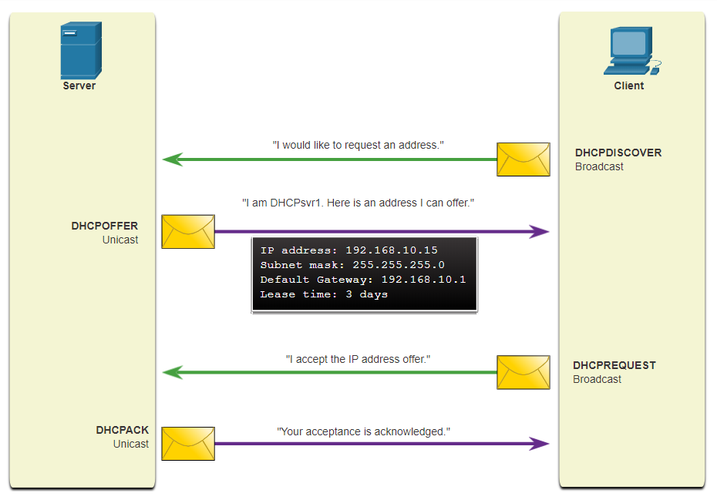
Attacking What We Do
DHCP
DHCP servers dynamically provide IP configuration information to clients.
In the figure, a client broadcasts a DHCP discover message.
The DHCP server responds with a unicast offer that includes addressing information the client can use.
The client broadcasts a DHCP request to tell the server that the client accepts the offer.
The server responds with a unicast acknowledgment accepting the request.
Normal DHCP Operation
Notes:
17 - Attacking What We Do
17.1 – IP Services
17.1.5 – DHCP

Slide 18
Attacking What We Do
DHCP Attacks
DHCP Spoofing Attack
A DHCP spoofing attack occurs when a rogue DHCP server is connected to the network and provides false IP configuration parameters to legitimate clients.
A rogue server can provide a variety of misleading information such as:
Wrong default gateway - Threat actor provides an invalid gateway, or the IP address of its host to create a MITM (Man In The Middle) attack.
Wrong DNS server - Threat actor provides an incorrect DNS server address pointing the user to a malicious website.
Wrong IP address - Threat actor provides an invalid IP address, invalid default gateway IP address, or both. The threat actor then creates a DoS attack on the DHCP client.
Notes:
17 - Attacking What We Do
17.1 – IP Services
17.1.6 – DHCP Attacks

Slide 19
Attacking What We Do
Exploring DNS Traffic
In this lab, you will complete the following objectives:
Capture DNS Traffic
Explore DNS Query Traffic
Explore DNS Response Traffic
Notes:
17 - Attacking What We Do
17.1 – IP Services
17.1.7 – Lab – Exploring DNS Traffic

Slide 20
17.2 Enterprise Services
Notes:
Source:
17 - Attacking What We Do
17.2 - HTTP and HTTPS
In-Session Activities / Explanations:
Time:
Instructor Notes:
List the stages of a web attack.
Explain the common HTTP exploits and the prevention mechanism.
Discuss email threats.
Describe code Injection and SQL Injection.
Explain cross-site scripting (XSS) and ways to reduce XSS attacks.
Key Points: Web attacks , connection status codes, email threats, malicious iFrame, code injection, SQL injection, cross- site scripting.

Slide 21
Enterprise Services
HTTP and HTTPS
To investigate web-based attacks, security analysts must have a good understanding of how a standard web-based attack works.
Common stages of a typical web attack:
The victim unknowingly visits a web page that has been compromised by malware.
The compromised web page redirects the user to a site containing malicious code.
The user visits this site with malicious code and their computer becomes infected.
After identifying a vulnerable software package running on the victim’s computer, the exploit kit contacts the exploit kit server to download the malicious code.
After the victim’s computer has been compromised, it connects to the malware server and downloads a payload.
The final malware package is run on the victim’s computer.
Notes:
17 - Attacking What We Do
17.2 – Enterprise Services
17.2.1 - HTTP and HTTPS

Slide 22
Enterprise Services
HTTP and HTTPS (Contd.)
Server connection logs can often reveal information about the type of scan or attack.
The different types of connection status codes are:
Informational 1xx
Successful 2xx
Redirection 3xx
Client Error 4xx
To defend against web-based attacks:
Always update the OS and browsers with current patches and updates.
Use a web proxy to block malicious sites.
Use the best security practices from the Open Web Application Security Project (OWASP) when developing web applications.
Educate end users by showing them how to avoid web-based attacks.
Notes:
17 - Attacking What We Do
17.2 – Enterprise Services
17.2.1 - HTTP and HTTPS

Slide 23
Enterprise Services
Common HTTP Exploits
Malicious iFrames
An iFrame is an HTML element that allows the browser to load another web page from another source.
In iFrame attacks, the threat actors insert advertisements from other sources into the page.
Threat actors compromise a webserver and modify web pages by adding HTML for the malicious iFrame.
As the iFrame is running in the page, it can be used to deliver a malicious exploit. such as spam advertising, exploit kits, and other malware.
Steps to prevent or reduce malicious iFrames:
Use a web proxy like to block malicious sites.
Ensure web developers do not use iFrames.
Use a service such as Cisco Umbrella to prevent users from navigating to malicious websites.
Ensure the end user understands what an Iframe is.
Notes:
17 - Attacking What We Do
17.2 – Enterprise Services
17.2.2 - Common HTTP Exploits

Slide 24
Enterprise Services
Common HTTP Exploits (Contd.)
HTTP 302 Cushioning
Threat actors use the 302 Found HTTP response status code to direct the user’s web browser to a new location.
The browser believes that the new location is the URL provided in the header. The browser is invited to request this new URL. This redirect function can be used multiple times until the browser finally lands on the page that contains the exploit.
Steps to prevent or reduce HTTP 302 cushioning attacks:
Use a web proxy to block malicious sites.
Use a service such as Cisco Umbrella to prevent users from navigating to malicious websites.
Ensure the end user understands how the browser is redirected through a series of HTTP 302 redirections.
Notes:
17 - Attacking What We Do
17.2 – Enterprise Services
17.2.2 - Common HTTP Exploits

Slide 25
Enterprise Services
Common HTTP Exploits (Contd.)
Domain Shadowing
When a threat actor create a domain shadowing attack, first they compromise a domain. Then they must create multiple subdomains of that domain to be used for the attacks using Hijacked domain registration logins.
After these subdomains have been created, attackers can use them even if they are found out to be malicious domains. They can simply make more from the parent domain.
Steps to prevent or reduce Domain shadowing attacks:
Secure all domain owner accounts.
Use a web proxy to block malicious sites.
Use a service such as Cisco Umbrella to prevent users from navigating to web sites that are known to be malicious.
Make sure that domain owners validate their registration accounts and look for any subdomains that they have not authorized.
Notes:
17 - Attacking What We Do
17.2 – Enterprise Services
17.2.2 - Common HTTP Exploits

Slide 26
Enterprise Services
Email
As the level of use of email rises, security becomes a greater priority.
The way users access email today also increases the opportunity for the threat of malware to be introduced.
Examples of email threats:
Attachment-based attacks - Threat actors embed malicious content in business files such as an email from the IT department.
Email spoofing - Threat actors create email messages with a forged sender address that is meant to fool the recipient into providing money or sensitive information.
Spam email - Threat actors send unsolicited email containing advertisements or malicious files.
Open mail relay server - This is an SMTP server that allows anybody on the internet to send mail.
Notes:
17 - Attacking What We Do
17.2 – Enterprise Services
17.2.3 - Email

Slide 27
Enterprise Services
Web-Exposed Databases
Web applications commonly connect to a relational database to access data.
As relational databases often contain sensitive data, databases are a frequent target for attacks.
Code Injection
The attacker’s commands are executed through the web application and has the same permissions as the web application.
This type of attack is used because often there is insufficient validation of input.
SQL Injection
Threat actors use SQL injections to breach the relational database, create malicious SQL queries, and obtain sensitive data from the relational database.
A successful SQL injection exploit can read sensitive data from the database, modify database data, execute administration operations on the database, and sometimes, issue commands to the operating system.
Notes:
17 - Attacking What We Do
17.2 – Enterprise Services
17.2.4 - Web-Exposed Databases

Slide 28
Enterprise Services
Client-side Scripting
Cross-Site Scripting
Cross-Site Scripting (XSS) is where web pages that are executed on the client-side, within their own web browser, are injected with malicious scripts.
These scripts can be used by Visual Basic, JavaScript, and others to access a computer, collect sensitive information, or deploy more attacks and spread malware.
The two main types of XSS are Stored (persistent) and Reflected (non-persistent).
Ways to prevent or reduce XSS attacks:
Ensure that web application developers are aware of XSS vulnerabilities and how to avoid them.
Use an IPS implementation to detect and prevent malicious scripts.
Use a web proxy to block malicious sites.
Use a service such as Cisco Umbrella to prevent users from navigating to malicious websites.
Notes:
17 - Attacking What We Do
17.2 – Enterprise Services
17.2.5 - Client-side Scripting

Slide 29
Enterprise Services
Attacking a MySQL Database
In this lab, you will complete the following objective :
View a PCAP file from a previous attack against a SQL database.
Notes:
17 - Attacking What We Do
17.2 – Enterprise Services
17.2.6 – Lab - Attacking a MySQL Database

Slide 30
Enterprise Services
Reading Server Logs
In this lab, you will complete the following objectives:
Reading Log Files with cat, more, and less
Log Files and Syslog
Log Files and journalctl
Notes:
17 - Attacking What We Do
17.2 – Enterprise Services
17.2.7 – Lab - Reading Server Logs
17.2.8 - Check Your Understanding – Network Services Attacks

Slide 31
17.3 Attacking What We Do Summary
Notes:
17 - Attacking What We Do
17.3 – Module Practice and Quiz
In-Session Activities / Explanations:
Time: 5 min
Instructor Notes:
Read out the summary points mentioned on the slide.
Discuss the same with the participants.
Ask if they have any questions or doubts.
At the end,ask the students how they done in the quiz.
Key Points: Network Protocols

Slide 32
Attacking What We Do Summary What Did I Learn in this Module?
Any client can send an unsolicited ARP Reply called a “gratuitous ARP.”
A threat actor can poison the ARP cache of devices on the local network, creating an MiTM attack to redirect traffic.
The Domain Name Service (DNS) protocol uses Resource Records (RR) to identify the type of DNS response.
DNS open resolvers are vulnerable to multiple malicious activities, including DNS cache poisoning, in which falsified records are provided to the open resolver.
In DNS amplification and reflection attacks, the benign nature of the DNS protocol is exploited to cause DoS/ DDoS attacks.
In DNS resource utilization attacks, a DoS attack is launched against the DNS server itself.
Threat actors use Fast Flux, in which malicious servers will rapidly change their IP address.
To stop DNS tunneling, a filter that inspects DNS traffic must be used.
Notes:
17 – Attacking What We Do
17.3 – Attacking What We Do Summary
17.3.1 - What did I learn in this module?

Slide 33
Attacking What We do Summary What Did I Learn in this Module?
A DHCP spoofing attack occurs when a rogue DHCP server is connected to the network and provides false IP configuration parameters to legitimate clients.
The compromised web page redirects the user to a site that hosts malicious code which is known as a drive-by download.
Cross-Site Scripting (XSS) attacks occur when browsers execute malicious scripts on the client and provide threat actors with access to sensitive information on the local host.
The OWASP Top 10 Web Application Security Risks is designed to help organizations create secure web applications.
Notes:
17 – Attacking What We Do
17.3 – Attacking What We Do Summary
17.3.1 - What did I learn in this module?
17.3.2 - Module 17: Attacking What We Do Quiz

Slide 34
Module 17 New Terms and Commands
Record resource (RR) Command and Control (C&C) iFrame | Open Web Application Security Project (OWASP) Cross-Site Scripting (XSS) Domain Shadowing
Notes:
17 – Attacking What We Do
New Terms and Commands

