Slide 1
Module 18: Understanding Defense
Instructor Materials
CyberOps Associate v1.0
Notes:
Cisco Networking Academy Program
CyberOps Associate v1.0
Module 18: Understanding Defense

Slide 2
Instructor Materials – Module 18 Planning Guide
This PowerPoint deck is divided in two parts:
Instructor Planning Guide
Information to help you become familiar with the module
Teaching aids
Instructor Class Presentation
Optional slides that you can use in the classroom
Begins on slide # 7
Note: Remove the Planning Guide from this presentation before sharing with anyone.
For additional help and resources go to the Instructor Home Page and Course Resources for this course. You also can visit the professional development site on www.netacad.com, the official Cisco Networking Academy Facebook page, or Instructor Only FB group.
Notes:
2

Slide 3
What to Expect in this Module
To facilitate learning, the following features within the GUI may be included in this module:
Feature | Description
Module Quizzes | Self-assessments that integrate concepts and skills learned throughout the series of topics presented in the module.
Module Summary | Briefly recaps module content.

Slide 4
Check Your Understanding
Check Your Understanding activities are designed to let students quickly determine if they understand the content and can proceed, or if they need to review.
Check Your Understanding activities do not affect student grades.
There are no separate slides for these activities in the PPT. They are listed in the notes area of the slide that appears before these activities.
Notes:
4

Slide 5
Module 18: Best Practices
Prior to teaching Module 18, the instructor should:
Review the activities and assessments for this module.
Try to include as many questions as possible to keep students engaged during classroom presentation.
Topic 18.1
Explain the concept of Defense-in-Depth.
Explain the ways used by cybersecurity analysts to identify the assets, vulnerabilities and threats.
Explain the Security Onion and the Security Artichoke analogies of defense-in-depth approach.
Notes:
5

Slide 6
Module 18: Best Practices (Contd.)
Topic 18.2
Ask the class if they are familiar with the security policies and standards. If so, ask them to share their knowledge on the same.
Discuss the business policy and security policy with the class and ask them to find the basic difference between them.
Explain the BYOD Policies and its benefits to the class.
Brief the regulatory and standards compliance to the participants.
Notes:
6

Slide 7
Module 18: Understanding Defense
CyberOps Associate v1.0
Notes:
Cisco Networking Academy Program
CyberOps Associate v1.0
Module 18: Understanding Defense
In-Session Activities / Explanations:
Time: 5 min
Instructor Notes:
Welcome the audience in a warm and cordial manner. Ensure that everyone is set up with the required resources.
Introduce the topic and encourage learners to come up with a list of expectations from the session. Collate topics on the white board or Desktop while using learner’s inputs to interpret them in words.
Interact with the audience to provide an overview of network security defense and security policies.
Read out the Objectives and briefly describe each.
Key Points: NA

Slide 8
Module Objectives
Module Title: Understanding Defense
Module Objective: Explain approaches to network security defense.
Topic Title | Topic Objective
Defense-in-Depth | Explain how the defense-in-depth strategy is used to protect networks.
Security Policies, Regulations, and Standards | Explain security policies, regulations, and standards.
Notes:
8
18 – Understanding Defense
18.0 – Introduction
18.0.2 – What Will I Learn in this Module?

Slide 9
18.1 Defense-in-Depth
Notes:
Source:
18 – Understanding Defense
18.1 – Defense-in-Depth
In-Session Activities / Explanations:
Time: 10 min
Instructor Notes:
Introduce the topic and explain how the defense-in-depth strategy is used to protect networks.
Ensure the learners understand the analogies to describe a defense-in-depth approach.
Key Points: Assets, Vulnerabilities, Threats, Security Onion, Security Artichoke

Slide 10
Understanding Defense Assets, Vulnerabilities, Threats
Cybersecurity analysts must prepare for any type of attack. It is their job to secure the assets of the organization’s network.
To do this, cybersecurity analysts must first identify:
Assets - Anything of value to an organization that must be protected including servers, infrastructure devices, end devices, and the greatest asset, data.
Vulnerabilities - A weakness in a system or its design that could be exploited by a threat actor.
Threats - Any potential danger to an asset.
Notes:
18 – Understanding Defense
18.1 – Defense-in-Depth
18.1.1 – Assets, Vulnerabilities, Threats

Slide 11
Understanding Defense Identify Assets
The collection of all the devices and information owned or managed by the organization are the assets.
These assets must be inventoried and assessed for the level of protection needed to thwart potential attacks.
Asset management consists of inventorying all assets, and then developing and implementing policies and procedures to protect them.
This task can be daunting considering many organizations must protect internal users and resources, mobile workers, and cloud-based and virtual services.
Further, organizations need to identify where critical information assets are stored, and how access is gained to that information.
Information assets vary, as do the threats against them. Each of these assets can attract different threat actors who have different skill levels and motivations.
Notes:
18 – Understanding Defense
18.1 – Defense-in-Depth
18.1.2 – Identify Assets

Slide 12
Understanding Defense Identify Vulnerabilities
Threat identification provides an organization with a list of likely threats for a particular environment.
When identifying threats, it is important to ask several questions:
What are the possible vulnerabilities of a system?
Who may want to exploit those vulnerabilities to access specific information assets?
What are the consequences if system vulnerabilities are exploited and assets are lost?
Notes:
18 – Understanding Defense
18.1 – Defense-in-Depth
18.1.3 – Identify Vulnerabilities

Slide 13
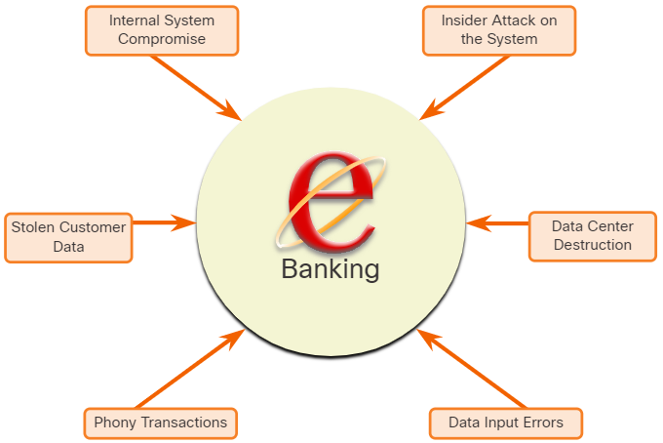
Understanding Defense Identify Vulnerabilities (Contd.)
The threat identification for an e-banking system would include:
Internal system compromise - The attacker uses the exposed e-banking servers to break into an internal bank system.
Stolen customer data - An attacker steals the personal and financial data of bank customers from the customer database.
Phony transactions from an external server - An attacker alters the code of the e-banking application and makes transactions by impersonating a legitimate user.
Notes:
18 – Understanding Defense
18.1 – Defense-in-Depth
18.1.3 – Identify Vulnerabilities

Slide 14
Understanding Defense Identify Vulnerabilities (Contd.)
Phony transactions using a stolen customer PIN or smart card - An attacker steals the identity of a customer and completes malicious transactions from the compromised account.
Data input errors - A user inputs incorrect data or makes incorrect transaction requests.
Data center destruction - A cataclysmic event severely damages or destroys the data center.
Identifying vulnerabilities on a network requires an understanding of the important applications used as well as the different vulnerabilities of that application and hardware. This requires a significant amount of research on the part of the network administrator.
Notes:
18 – Understanding Defense
18.1 – Defense-in-Depth
18.1.3 – Identify Vulnerabilities

Slide 15
Understanding Defense Identify Threats
Organizations must use a defense-in-depth approach to identify threats and secure vulnerable assets.
This approach uses multiple layers of security at the network edge, within the network, and on network endpoints.
In this approach, a router first screens the traffic before forwarding it to a dedicated firewall appliance, for example, the Cisco ASA.
Routers and firewalls are not the only devices that are used in a defense-in-depth approach.
Other security devices include Intrusion Prevention Systems (IPS), advanced malware protection (AMP), web and email content security systems, identity services, network access controls and more.
In the layered defense-in-depth security approach, the different layers work together to create a security architecture in which the failure of one safeguard does not affect the effectiveness of the other safeguards.
Notes:
18 – Understanding Defense
18.1 – Defense-in-Depth
18.1.4 – Identify Threats

Slide 16
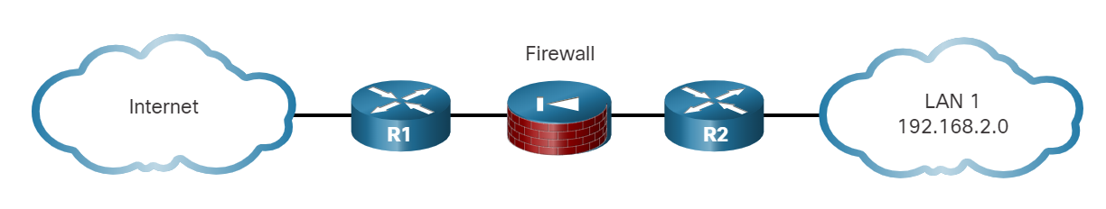
Understanding Defense Identify Threats (Contd.)
The figure displays a simple topology of a defense-in-depth approach:
Edge router - The first line of defense is known as an edge router (R1 in the figure). The edge router has a set of rules specifying which traffic it allows or denies. It passes all connections that are intended for the internal LAN to the firewall.
Firewall - A second line of defense is the firewall. The firewall is a checkpoint device that performs additional filtering and tracks the state of the connections. It denies the initiation of connections from the untrusted networks to the trusted network while enabling internal users to establish two-way connections to the untrusted networks.
Internal router - Another line of defense is the internal router (R2 in the figure). It can apply final filtering rules on the traffic before it is forwarded to its destination.
Notes:
18 – Understanding Defense
18.1 – Defense-in-Depth
18.1.4 – Identify Threats

Slide 17
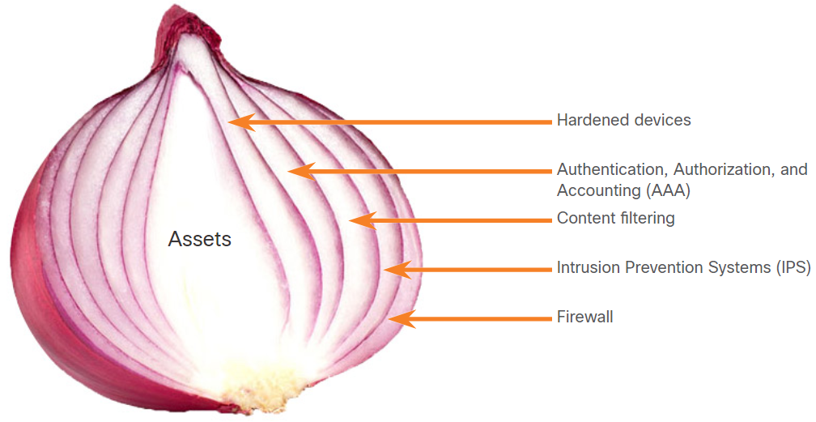
Understanding Defense The Security Onion and The Security Artichoke
There are two common analogies that are used to describe a defense-in-depth approach.
Security Onion
A common analogy used to describe a defense-in-depth approach is called "the security onion."
As illustrated in figure, a threat actor would have to peel away at a network’s defenses layer by layer in a manner similar to peeling an onion.
Only after penetrating each layer would the threat actor reach the target data or system.
Note: The security onion described on this page is a way of visualizing defense-in-depth. This is not to be confused with the Security Onion suite of network security tools.
Notes:
18 – Understanding Defense
18.1 – Defense-in-Depth
18.1.5 – The Security Onion and The Security Artichoke

Slide 18
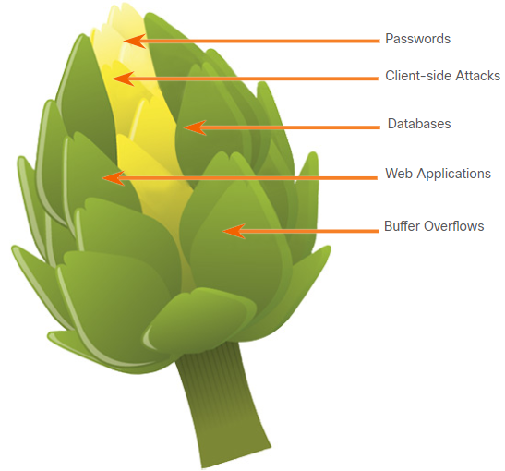
Understanding Defense The Security Onion and The Security Artichoke (Contd.)
Security Artichoke
The evolution of borderless networks has changed the analogy to the "security artichoke", which benefits the threat actor.
As illustrated in the figure, threat actors no longer have to peel away each layer. They only need to remove certain "artichoke leaves."
The bonus is that each "leaf" of the network may reveal sensitive data that is not well secured.
In order to get at the heart of the artichoke, the hacker chips away at the security armor along the perimeter.
While internet-facing systems are very well protected, persistent hackers do find a gap in that hard-core exterior through which they can enter.
Notes:
18 – Understanding Defense
18.1 – Defense-in-Depth
18.1.5 – The Security Onion and The Security Artichoke

Slide 19
18.2 Security Policies, Regulations, and Standards
Notes:
Source:
18 – Understanding Defense
18.2 – Security Policies, Regulations, and Standards
In-Session Activities / Explanations:
Time: 10 min
Instructor Notes:
Give a brief introduction of the topic to the learners.
Ensure the learners have knowledge regarding the business policies and security policies.
Discuss the BYOD policies and its benefits with the learners.
By the end of the topic, discuss the regulatory and standards compliance with the learners.
Key Points: BYOD policies, business policies, security policies

Slide 20
Security Policies, Regulations, and Standards Business Policies
Business policies are the guidelines that are developed by an organization to govern its actions.
The policies define standards of correct behavior for the business and its employees.
In networking, policies define the activities that are allowed on the network.
This sets a baseline of acceptable use. If behavior that violates business policy is detected on the network, it is possible that a security breach has occurred.
Notes:
18 – Understanding Defense
18.2 – Security Policies, Regulations, and Standards
18.2.1 – Business Policies

Slide 21
Security Policies, Regulations, and Standards Business Policies (Contd.)
An organization may have several guiding policies, as listed in the table.
Policy | Description
Company policies | It establishes the rules of conduct and the responsibilities of both employees and employers. It protect the rights of workers as well as the business interests of employers. Depending on the needs of the organization, various policies and procedures establish rules regarding employee conduct, attendance, dress code, privacy and other areas related to the terms and conditions of employment.
Employee policies | These policies are created and maintained by human resources staff to identify employee salary, pay schedule, employee benefits, work schedule, vacations, and more. They are often provided to new employees to review and sign.
Security policies | These policies identify a set of security objectives for a company, define the rules of behavior for users and administrators, and specify system requirements. These objectives, rules, and requirements collectively ensure the security of a network and the computer systems in an organization. It is a constantly evolving document based on changes in the threat landscape, vulnerabilities, and business and employee requirements.
Notes:
18 – Understanding Defense
18.2 – Security Policies, Regulations, and Standards
18.2.1 – Business Policies

Slide 22
Security Policies, Regulations, and Standards
Security Policy
Security policies are used to inform users, staff, and managers of an organization’s requirements for protecting technology and information assets.
A comprehensive security policy has a number of benefits, including the following:
Demonstrates an organization’s commitment to security
Sets the rules for expected behavior
Ensures consistency in system operations, software and hardware acquisition and use, and maintenance
Defines the legal consequences of violations
Gives security staff the backing of management
A security policy also specifies the mechanisms that are needed to meet security requirements and provides a baseline from which to acquire, configure, and audit computer systems and networks for compliance.
Notes:
18 – Understanding Defense
18.2 – Security Policies, Regulations, and Standards
18.2.2 – Security Policy

Slide 23
Security Policies, Regulations, and Standards
Security Policy (Contd.)
The following table lists the policies that may be included in a security policy:
Policy | Description
Identification and authentication policy | It specifies authorized persons that can have access to network resources and identity verification procedures.
Password policies | These ensure passwords meet minimum requirements and are changed regularly.
Acceptable use policy (AUP) | It identifies network applications and uses that are acceptable to the organization. It may also identify ramifications if this policy is violated.
Remote access policy | It identifies how remote users can access a network and what is accessible via remote connectivity.
Network maintenance policy | It specifies network device operating systems and end user application update procedures.
Incident handling procedures | These describe how security incidents are handled.
Notes:
18 – Understanding Defense
18.2 – Security Policies, Regulations, and Standards
18.2.2 – Security Policy

Slide 24
Security Policies, Regulations, and Standards BYOD Policies
Bring Your Own Device (BYOD) enables employees to use their own mobile devices to access company systems, software, networks, or information.
It provides key benefits to enterprises, including increased productivity, reduced costs, better mobility for employees, and so on. These benefits also bring an increased security risk as BYOD can lead to data breaches and greater liability for the organization.
Therefore, a BYOD security policy should be developed to accomplish the following:
Specify the goals of the BYOD program
Identify which employees can bring their own devices
Identify which devices will be supported
Identify the level of access employees are granted when using personal devices
Describe the rights to access and activities permitted to security personnel on the device
Identify which regulations must be adhered to when using employee devices
Identify safeguards to put in place if a device is compromised
Notes:
18 – Understanding Defense
18.2 – Security Policies, Regulations, and Standards
18.2.3 – BYOD Policies

Slide 25
Security Policies, Regulations, and Standards BYOD Policies (Contd.)
The following table lists the BYOD security best practices to help mitigate BYOD vulnerabilities:
Best Practice | Description
Password protect access | Use unique passwords for each device and account.
Manually control wireless connectivity | Turn off Wi-Fi and Bluetooth connectivity when not in use. Connect only to trusted networks.
Keep updated | Always keep the device OS and other software updated. Updated software often contains security patches to mitigate against the latest threats or exploits.
Back up data | Enable backup of the device in case it is lost or stolen.
Enable "Find my Device" | Subscribe to a device locator service with remote wipe feature.
Provide antivirus software | Provide antivirus software for approved BYOD devices.
Use Mobile Device Management (MDM) software | MDM software enables IT teams to implement security settings and software configurations on all devices that connect to company networks.
Notes:
18 – Understanding Defense
18.2 – Security Policies, Regulations, and Standards
18.2.3 – BYOD Policies

Slide 26
Security Policies, Regulations, and Standards Regulatory and Standards Compliance
There are also external regulations regarding network security.
Network security professionals must be familiar with the laws and codes of ethics that are binding on Information Systems Security (INFOSEC) professionals.
Many organizations are mandated to develop and implement security policies.
Compliance regulations define what organizations are responsible for providing and the liability if they fail to comply.
The compliance regulations that an organization is obligated to follow depend on the type of organization and the data that the organization handles.
Notes:
18 – Understanding Defense
18.2 – Security Policies, Regulations, and Standards
18.2.4 – Regulatory and Standards Compliance

Slide 27
18.3 Understanding Defense Summary
Notes:
Source:
18 – Understanding Defense
18.3 – Understanding Defense Summary
In-Session Activities / Explanations:
Time: 5 min
Instructor Notes:
Read out the summary points mentioned on the slide.
Discuss the same with the participants.
Ask if they have any questions or doubts.
Encourage them to complete the module quiz at section 18.3.2.
Key Points: NA

Slide 28
Understanding Defense Summary What Did I Learn in this Module?
The starting point for network defense is the identification of assets, vulnerabilities, and threats.
Assets are anything of value to an organization that must be protected including servers, infrastructure devices, end devices, and the greatest asset, data.
Vulnerabilities are weaknesses in a system or its design that could be exploited by a threat actor.
Threats are any potential danger to an asset.
Organizations must use a defense-in-depth approach to identify threats and secure vulnerable assets.
Organizations must have a set of policies that define the activities that are allowed on the network.
Business policies define standards of correct behavior for the business and its employees.
Notes:
18 – Understanding Defense
18.3 – Understanding Defense Summary
18.3.1 – What Did I Learn in this Module?

Slide 29
Understanding Defense Summary What Did I Learn in this Module? (Contd.)
Security policies are used to inform users, staff, and managers of an organization’s requirements for protecting technology and information assets.
The purpose of a BYOD (Bring Your Own Device) policy is to enable employees to use their own mobile devices to access company systems, software, networks, or information.
The compliance regulations that an organization is obligated to follow depend on the type of organization and the data that the organization handles.
Notes:
18 – Understanding Defense
18.3 – Understanding Defense Summary
18.3.1 – What Did I Learn in this Module?
18.3.2 – Quiz – Understanding Defense Quiz

Slide 30
Module 18 New Terms and Commands
Assets Vulnerabilities Threats Edge router Internal router Security Onion Security Artichoke | Defense-in-Depth Acceptable Use Policy (AUP) Mobile Device Management (MDM) Information Systems Security (INFOSEC) BYOD
Notes:
18 – Understanding Defense
New Terms and Commands

