Slide 1
Module 19: Access Control
Instructor Materials
CyberOps Associate v1.0
Notes:
Cisco Networking Academy Program
CyberOps Associate v1.0
Module 19: Access Control

Slide 2
Instructor Materials – Module 19 Planning Guide
This PowerPoint deck is divided in two parts:
Instructor Planning Guide
Information to help you become familiar with the module
Teaching aids
Instructor Class Presentation
Optional slides that you can use in the classroom
Begins on slide # 8
Note: Remove the Planning Guide from this presentation before sharing with anyone.
For additional help and resources go to the Instructor Home Page and Course Resources for this course. You also can visit the professional development site on www.netacad.com, the official Cisco Networking Academy Facebook page, or Instructor Only FB group.
Notes:
2

Slide 3
What to Expect in this Module
To facilitate learning, the following features within the GUI may be included in this module:
Feature | Description
Check Your Understanding(CYU) | Per topic online quiz to help learners gauge content understanding.
Module Quiz | Self-assessments that integrate concepts and skills learned throughout the series of topics presented in the module.
Module Summary | Briefly recaps module content.

Slide 4
Check Your Understanding
Check Your Understanding activities are designed to let students quickly determine if they understand the content and can proceed, or if they need to review.
Check Your Understanding activities do not affect student grades.
There are no separate slides for these activities in the PPT. They are listed in the notes area of the slide that appears before these activities.
Notes:
4

Slide 5
Module 19: Activities
What activities are associated with this module?
Page # | Activity Type | Activity Name | Optional?
19.1.4 | Check Your Understanding | Identify the Access Control Model | Recommended
19.2.4 | Check Your Understanding | Identify the Characteristic of AAA | Recommended
Notes:
5

Slide 6
Module 19: Best Practices
Prior to teaching Module 19, the instructor should:
Review the activities and assessments for this module.
Try to include as many questions as possible to keep students engaged during classroom presentation.
Topic 19.1
Ask the class what do they know about communications security and CIA.
Explain the class about Zero Trust Security.
Ask the participants to name some of the access control models based on their knowledge and then explain some models to them.
Notes:
6

Slide 7
Module 19: Best Practices (Contd.)
Topic 19.2
Ask the class to share their understanding about network security policy.
Discuss with the class about AAA and its usage and operation.
Notes:
7

Slide 8
Module 19: Access Control
CyberOps Associate v1.0
Notes:
Cisco Networking Academy Program
CyberOps Associate v1.0
Module 19: Access Control
In-Session Activities / Explanations:
Time: 5min
Instructor Notes:
Welcome the audience in a warm and cordial manner. Ensure that everyone is set up with the required resources.
Introduce yourself briefly and invite participants to introduce self with name, dept. and role, if deemed all right.
Introduce the topic and encourage learners to come up with a list of expectations from the session. Collate topics on the white board or Desktop while using learner’s inputs to interpret them in words.
Interact with the learners to give an overview of access control concepts.
Read out the Objectives and briefly describe each.
Key Points: NA

Slide 9
Module Objectives
Module Title: Access Control
Module Objective: Explain access control as a method of protecting a network.
Topic Title | Topic Objective
Access Control Concepts | Explain how access control protocols network data.
AAA Usage and Operation | Explain how AAA is used to control network access.
Notes:
9
CyberOps Associate v1.0
19 – Access Control
19.0 – Introduction
19.0.2 – What Will I Learn in this Module?

Slide 10
19.1 Access Control Concepts
Notes:
Source:
19 – Access Control
19.1 – Access Control Concepts
In-Session Activities / Explanations:
Time: 5 min
Instructor Notes:
Give a brief introduction of the access control concepts to the learners.
Discuss with the learners about communications security and CIA.
Ensure the learners know about Zero Trust security.
By the end of the topic, ensure the learners have understanding of different access control models.
Key Points: CIA Triad, Zero Trust Security, Access Control Concepts

Slide 11
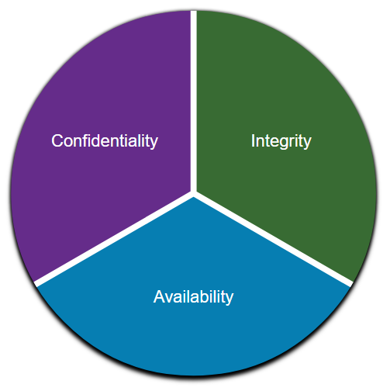
Access Control Communications Security: CIA
Information security deals with protecting information and information systems from unauthorized access, use, disclosure, disruption, modification, or destruction.
CIA Triad
The CIA triad consists of three components of information security:
Confidentiality - Only authorized individuals, entities, or processes can access sensitive information.
Integrity - This refers to the protection of data from unauthorized alteration.
Availability - Authorized users must have uninterrupted access to the network resources and data that they require.
Notes:
19 – Access Control
19.1 – Access Control Concepts
19.1.1 – Communications Security: CIA

Slide 12
Access Control Zero Trust Security
Zero trust is a comprehensive approach to securing all access across networks, applications, and environments.
This approach helps secure access from users, end-user devices, APIs, IoT, microservices, containers, and more.
The principle of a zero trust approach is "never trust always verify".
A zero trust security framework helps to prevent unauthorized access, contain breaches, and reduce the risk of an attacker's lateral movement through a network.
In a Zero trust approach, any place at which an access control decision is required should be considered a perimeter.
Notes:
19 – Access Control
19.1 – Access Control Concepts
19.1.2 – Zero Trust Security

Slide 13
Access Control Zero Trust Security (Contd.)
The three pillars of zero trust are workforce, workloads, and workplace.
Zero Trust for the Workforce - This pillar consists of people who access work applications by using their personal or corporate-managed devices. It ensures only the right users and secure devices can access applications, regardless of location.
Zero Trust for Workloads - This pillar is concerned with applications that are running in the cloud, in data centers, and other virtualized environments that interact with one another. It focuses on secure access when an API, a microservice, or a container is accessing a database within an application.
Zero Trust for the Workplace - This pillar focuses on secure access for all devices, including on the internet of things (IoT), that connect to enterprise networks, such as user endpoints, physical and virtual servers, printers, cameras and more.
Notes:
19 – Access Control
19.1 – Access Control Concepts
19.1.2 – Zero Trust Security

Slide 14
Access Control Access Control Models
An organization must implement proper access controls to protect its network resources, information system resources, and information.
A security analyst should understand the different basic access control models to have a better understanding of how attackers can break the access controls.
The following table lists various types of access control models:
Access Control Models | Description
Discretionary access control (DAC) | This is the least restrictive model and allows users to control access to their data as owners of that data. It may use ACLs or other methods to specify which users or groups of users have access to the information.
Mandatory access control (MAC) | This applies the strictest access control and is used in military or mission critical applications. It assigns security level labels to information and enables users with access based on their security level clearance.
Notes:
19 – Access Control
19.1 – Access Control Concepts
19.1.3 – Access Control Models

Slide 15
Access Control Access Control Models (Contd.)
Access Control Models | Description
Role-based access control (RBAC) | Access decisions are based on an individual’s roles and responsibilities within the organization. Different roles are assigned security privileges, and individuals are assigned to the RBAC profile for the role. Also known as a type of non-discretionary access control.
Attribute-based access control (ABAC) | It allows access based on attributes of the object to be accessed, the subject accessing the resource, and environmental factors regarding how the object is to be accessed.
Rule-based access control (RBAC) | Network security staff specify sets of rules or conditions that are associated with access to data or systems. These rules may specify permitted or denied IP addresses, or certain protocols and other conditions. Also known as Rule Based RBAC.
Time-based access control (TAC) | It allows access to network resources based on time and day.
Notes:
19 – Access Control
19.1 – Access Control Concepts
19.1.3 – Access Control Models
19.1.4 – Check Your Understanding - Identify the Access Control Model

Slide 16
19.2 AAA Usage and Operation
Notes:
Source:
19 – Access Control
19.2 – AAA Usage and Operation
In-Session Activities / Explanations:
Time: 15 min
Instructor Notes:
Introduce the topic and discuss the network security policy and AAA protocol.
Ensure the learners have knowledge about AAA operation, AAA authentication and AAA accounting logs.
Key Points: AAA operation, AAA Authentication, AAA Accounting logs

Slide 17
AAA Usage and Operation AAA Operation
A network must be designed to control who is allowed to connect to it and what they are allowed to do when they are connected. These design requirements are identified in the network security policy.
The policy specifies how network administrators, corporate users, remote users, business partners, and clients access network resources.
The network security policy can also mandate the implementation of an accounting system that tracks who logged in and when and what they did while logged in.
The Authentication, Authorization, and Accounting (AAA) protocol provides the necessary framework to enable scalable access security.
Notes:
19 – Access Control
19.2 – AAA Usage and Operation
19.2.1 – AAA Operation

Slide 18
AAA Usage and Operation AAA Operation (Contd.)
The following table lists the three independent security functions provided by the AAA architectural framework:
AAA Component | Description
Authentication | Authentication can be established using username and password combinations, challenge and response questions, token cards, and other methods. AAA authentication provides a centralized way to control access to the network.
Authorization | After the user is authenticated, authorization services determine which resources the user can access and which operations the user is allowed to perform. An example is "User can access host server XYZ using SSH only."
Accounting | Accounting records what the user does, including what is accessed, the amount of time the resource is accessed, and any changes that were made. Accounting keeps track of how network resources are used. An example is "User accessed host server XYZ using SSH for 15 minutes."
Notes:
19 – Access Control
19.2 – AAA Usage and Operation
19.2.1 – AAA Operation

Slide 19
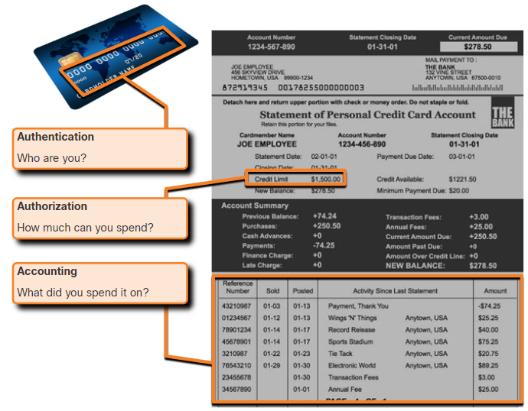
AAA Usage and Operation AAA Operation (Contd.)
This concept is similar to the use of a credit card, as indicated by the figure. The credit card identifies who can use it, how much that user can spend, and keeps account of what items the user spent money on.
Notes:
19 – Access Control
19.2 – AAA Usage and Operation
19.2.1 – AAA Operation

Slide 20
AAA Usage and Operation AAA Authentication
AAA Authentication can be used to authenticate users for administrative access or it can be used to authenticate users for remote network access.
Cisco provides two common methods for implementing AAA Services:
Local AAA Authentication
This method is known as self-contained authentication because it authenticates users against locally stored usernames and passwords.
Local AAA is ideal for small networks.
Notes:
19 – Access Control
19.2 – AAA Usage and Operation
19.2.2 – AAA Authentication

Slide 21

AAA Usage and Operation AAA Authentication (Contd.)
The client establishes a connection with the router.
The AAA router prompts the user for a username and password.
The router authenticated the username and password using the local database and the user is provided access to the network based on information in the local database.
Notes:
19 – Access Control
19.2 – AAA Usage and Operation
19.2.2 – AAA Authentication

Slide 22
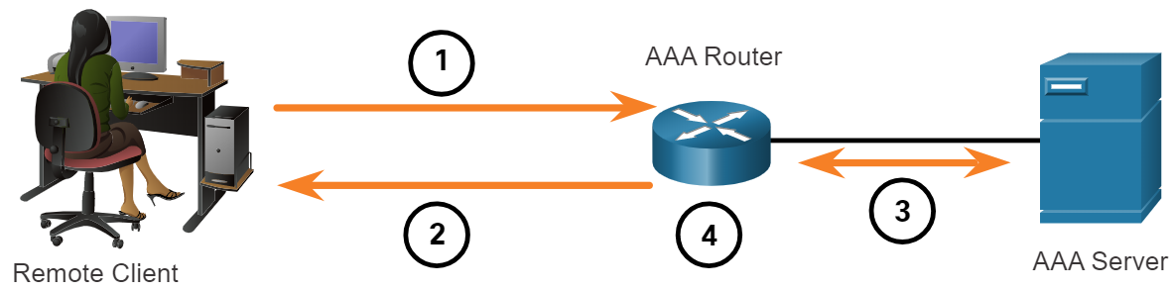
AAA Usage and Operation AAA Authentication (Contd.)
Server-based AAA Authentication
This method authenticates against a central AAA server that contains the usernames and passwords for all users. This is ideal for medium-to-large networks.
The client establishes a connection with the router.
The AAA router prompts the user for a username and password.
The router authenticates the username and password using a AAA server.
The user is provided access to the network based on information in the remote AAA server.
Notes:
19 – Access Control
19.2 – AAA Usage and Operation
19.2.2 – AAA Authentication

Slide 23
AAA Usage and Operation AAA Authentication (Contd.)
Centralized AAA
Centralized AAA is more scalable and manageable than local AAA authentication, and therefore, it is the preferred AAA implementation.
A centralized AAA system may independently maintain databases for authentication, authorization, and accounting.
It can leverage Active Directory or Lightweight Directory Access Protocol (LDAP) for user authentication and group membership, while maintaining its own authorization and accounting databases.
Devices communicate with the centralized AAA server using either the Remote Authentication Dial-In User Service (RADIUS) or Terminal Access Controller Access Control System (TACACS+) protocols.
Notes:
19 – Access Control
19.2 – AAA Usage and Operation
19.2.2 – AAA Authentication

Slide 24
AAA Usage and Operation AAA Authentication (Contd.)
The following table lists the differences between the two protocols:
Functions | TACACS+ | RADIUS
Functionality | It separates authentication, authorization, and accounting functions according to the AAA architecture. This allows modularity of the security server implementation. | It combines authentication and authorization but separates accounting, which allows less flexibility in implementation than TACACS+.
Standard | Mostly Cisco supported | Open/RFC standard
Transport | TCP port 49 | UDP ports 1812 and 1813, or 1645 and 1646
Protocol CHAP | Bidirectional challenge and response as used in Challenge Handshake Authentication Protocol (CHAP) | Unidirectional challenge and response from the RADIUS security server to the RADIUS client
Notes:
19 – Access Control
19.2 – AAA Usage and Operation
19.2.2 – AAA Authentication

Slide 25
AAA Usage and Operation AAA Authentication (Contd.)
Functions | TACACS+ | RADIUS
Confidentiality | Encrypts the entire body of the packet but leaves a standard TACACS+ header. | Encrypts only the password in the access-request packet from the client to the server. The remainder of the packet is unencrypted, leaving the username, authorized services, and accounting unprotected.
Customization | Provides authorization of router commands on a per-user or per-group basis. | Has no option to authorize router commands on a per-user or per-group basis.
Accounting | Limited | Extensive
Notes:
19 – Access Control
19.2 – AAA Usage and Operation
19.2.2 – AAA Authentication

Slide 26
AAA Usage and Operation AAA Accounting Logs
Centralized AAA also enables the use of the Accounting method.
Accounting records from all devices are sent to centralized repositories, which simplifies auditing of user actions.
AAA Accounting collects and reports usage data in AAA logs. These logs are useful for security auditing.
The collected data might include the start and stop connection times, executed commands, number of packets, and number of bytes.
One widely deployed use of accounting is to combine it with AAA authentication. This helps with managing access to internetworking devices by network administrative staff.
Notes:
19 – Access Control
19.2 – AAA Usage and Operation
19.2.3 – AAA Accounting Logs

Slide 27
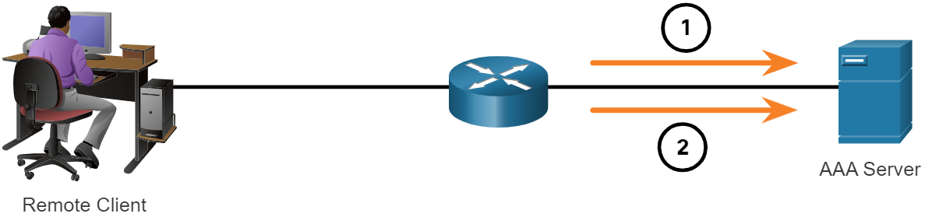
AAA Usage and Operation AAA Accounting Logs (Contd.)
Accounting provides more security than just authentication. The AAA servers keep a detailed log of exactly what the authenticated user does on the device.
This includes all EXEC and configuration commands issued by the user.
When a user has been authenticated, the AAA accounting process generates a start message to begin the accounting process.
When the user finishes, a stop message is recorded and the accounting process ends.
Notes:
19 – Access Control
19.2 – AAA Usage and Operation
19.2.3 – AAA Accounting Logs

Slide 28
AAA Usage and Operation AAA Accounting Logs (Contd.)
The following table describes the types of accounting information that can be collected:
Types of Accounting Information | Description
Network Accounting | It captures information for all Point-to-Point Protocol (PPP) sessions, including packet and byte counts.
Connection Accounting | It captures information about all outbound connections that are made from the AAA client, such as by SSH.
EXEC Accounting | It captures information about user EXEC terminal sessions on the network access server, including username, date, start and stop times, and the access server IP address.
System Accounting | It captures information about all system-level events.
Command Accounting | It captures information about the EXEC shell commands for a specified privilege level ,as well as the date and time each command was executed, and the user who executed it.
Resource Accounting | It captures 'start' and 'stop' record support for connections that have passed user authentication.
Notes:
19 – Access Control
19.2 – AAA Usage and Operation
19.2.3 – AAA Accounting Logs
19.2.4 – Check Your Understanding - Identify the Characteristic of AAA

Slide 29
19.3 Access Control Summary
Notes:
Source:
19 – Access Control
19.3 – Access Control Summary
In-Session Activities / Explanations:
Time: 5 min
Instructor Notes:
Read out the summary points mentioned on the slide.
Discuss the same with the participants.
Ask if they have any questions or doubts.
At the end, ask the students to take the quiz.
Key Points: NA

Slide 30
Access Control Summary What Did I Learn in this Module?
The CIA triad consists of the primary three components of information security: confidentiality, integrity, and availability.
Zero trust is a comprehensive approach to securing all access across networks, applications, and environments.
The principle of zero trust is "never trust, always verify". The pillars of trust are zero trust for workforce, zero trust for workloads, and zero trust for workplace.
In a zero trust approach, any place at which an access control decision is required should be considered a perimeter.
Access control methods include discretionary access control (DAC), mandatory access control (MAC), role-based access control (RBAC), attribute-based control (ABAC), rule-based access (RBAC), and time-based access control (TAC).
A network must be designed to control who is allowed to connect to it and what they are allowed to do when they are connected which is specified in the network security policy.
Notes:
19 – Access Control
19.3 – Access Control Summary
19.3.1 – What Did I Learn in this Module?

Slide 31
Access Control Summary What Did I Learn in this Module? (Contd.)
Authentication, Authorization, and Accounting (AAA) systems provide the necessary framework to enable scalable security.
Cisco provides two common methods of implementing AAA services: Local AAA Authentication and Server-based AAA Authentication.
Centralized AAA is more scalable and manageable than local AAA and is the preferred AAA implementation.
Devices communicate with the centralized AAA server using with the Remote Authentication Dial-In User Service (RADIUS) or Terminal Access Controller Access Control Systems (TACACS+) protocols.
Centralized AAA also enables the use of the accounting method. AAA accounting collects and reports usage data in AAA logs.
Various types of accounting information that can be collected are network accounting, connection accounting, EXEC accounting, system accounting, command accounting, and resource accounting.
Notes:
19 – Access Control
19.3 – Access Control Summary
19.3.1 – What Did I Learn in this Module?
19.3.2 – Quiz – Access Control Quiz

Slide 32
Module 19 New Terms and Commands
Zero Trust Security Discretionary access control (DAC) Mandatory access control (MAC) Attribute-based access control (ABAC) Role-based access control (RBAC) | Rule-based access control (RBAC) Time-based access control (TAC) Remote Authentication Dial-In User Service (RADIUS) Terminal Access Controller Access Control System (TACACS+) | Network Accounting Connection Accounting System Accounting EXEC Accounting Command Accounting Resource Accounting
Notes:
19 – Access Control
New Terms and Commands

