Slide 1
Module 2: Fighters in the War Against Cybercrime
Instructor Materials
CyberOps Associate v1.0
Notes:
Cisco Networking Academy Program
CyberOps Associate v1.0
Module 2: Fighters in the War Against Cybercrime

Slide 2
Instructor Materials – Module 2 Planning Guide
This PowerPoint deck is divided in two parts:
Instructor Planning Guide
Information to help you become familiar with the module
Teaching aids
Instructor Class Presentation
Optional slides that you can use in the classroom
Begins on slide # 8
Note: Remove the Planning Guide from this presentation before sharing with anyone.
For additional help and resources go to the Instructor Home Page and Course Resources for this course. You also can visit the professional development site on www.netacad.com, the official Cisco Networking Academy Facebook page, or Instructor Only FB group.
Notes:
2

Slide 3
What to Expect in this Module
To facilitate learning, the following features within the GUI may be included in this module:
Feature | Description
Check Your Understanding(CYU) | Per topic online quiz to help learners gauge content understanding.
Class Activities | These are found on the Instructor Resources page. Class Activities are designed to facilitate learning, class discussion, and collaboration.
Hands-On Labs | Labs designed for working with physical equipment.
Module Quizzes | Self-assessments that integrate concepts and skills learned throughout the series of topics presented in the module.
Module Summary | Briefly recaps module content.

Slide 4
Check Your Understanding
Check Your Understanding activities are designed to let students quickly determine if they understand the content and can proceed, or if they need to review.
Check Your Understanding activities do not affect student grades.
There are no separate slides for these activities in the PPT. They are listed in the notes area of the slide that appears before these activities.
Notes:
4

Slide 5
Module 2: Activities
What activities are associated with this module?
Page # | Activity Type | Activity Name | Optional?
2.0.3 | Class Activity | Identify Running Processes | Recommended
2.1.9 | Check Your Understanding | Identify the SOC Terminology | Recommended
2.2.5 | Lab | Becoming a Defender | Recommended
Notes:
5

Slide 6
Module 2: Best Practices
Prior to teaching Module 2, the instructor should:
Review the activities and assessments for this module.
Try to include as many questions as possible to keep students engaged during classroom presentation.
Topic 2.1
Ask the learners if they know how organizations protect themselves against security threats.
Encourage the learners to visit the Cisco’s Managed Security Services link to know more about the services.
Mention that this course offers preparation for a certification suitable for the position of Tier 1 Alert Analyst, also known as Cybersecurity Analyst or CyberOps Associate.
Divide the students into groups and ask them to debate on the point “Security cannot be so strong that it interferes with the needs of employees or business functions”.
Notes:
6

Slide 7
Module 2: Best Practices
Topic 2.2
Ask the learners if they know of any of the certifications related to cybersecurity.
Encourage the learners to visit some of the job site aggregators discussed during the class.
Notes:
7

Slide 8
Module 2: Fighters in the War Against Cybercrime
CyberOps Associate v1.0
Notes:
Cisco Networking Academy Program
CyberOps Associate v1.0
Module 2: Fighters in the War Against Cybercrime
In-Session Activities / Explanations:
Time: 5 mins
Instructor Notes:
Welcome the audience in a warm and cordial manner. Ensure that everyone is set up with the required resources.
Introduce yourself briefly and invite participants to introduce self with name, dept. and role, if deemed all right.
Introduce the topic and encourage learners to come up with a list of expectations from the session.
Encourage them to share their expectations by mentioning the possibility that they may be taking this course as they may be considering a career in CyberOps security.
Ask the learners:
What technologies do they need to be aware of?
What types of jobs are available?
Where can they find those jobs?
After setting the expectations, read out the topic Objectives and briefly describe each.
Key Points: NA

Slide 9
Module Objectives
Module Title: Fighters in the War Against Cybercrime
Module Objective: Explain how to prepare for a career in cybersecurity operations.
Topic Title | Topic Objective
The Modern Security Operations Centre | Explain the mission of the Security Operations Center (SOC).
Becoming a Defender | Describe resources available to prepare for a career in cybersecurity operations.
Notes:
9
CyberOps Associate v1.0
2 – Fighters in the War Against Cybercrime
2.0 – Introduction
2.0.2 – What Will I Learn in this Module?
2.0.3 – Class Activity – Identify Running Processes

Slide 10
2.1 The Modern Security Operations Center
Notes:
Source:
2 – Fighters in the War Against Cybercrime
2.1 – The Modern Security Operations Center
In-Session Activities / Explanations:
Time: 15 mins
Instructor Notes:
This topic describes the working and the components of a Modern Security Operations Center (SOC).
Take the learners through the elements of an SOC and define the purpose that an SOC resolves.
Explain the concepts of SIEM and SOAR
Define the key performance indicators (KPI) that can be devised to measure different aspects of SOC performance.
Ensure that they complete the “Check Your Understanding – Identify the SOC Terminology” in section 2.1.9.
Key Points: SOC, SIEM, SOAR, SOC Terminology

Slide 11
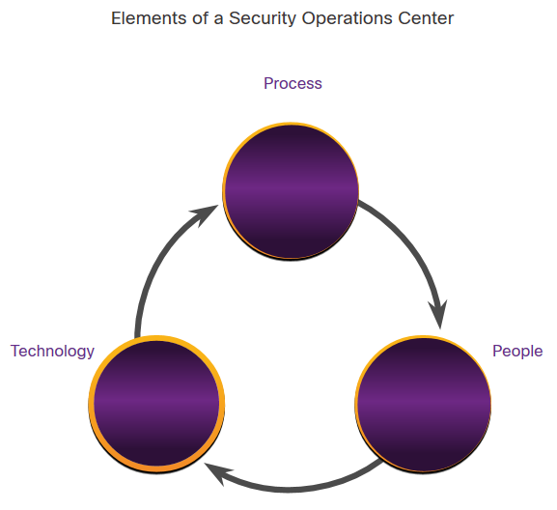
Fighters in the War Against Cybercrime Elements of a SOC
To use a formalized, structured, and disciplined approach for defending against cyber threats, organizations typically use the services of professionals from a Security Operations Center (SOC).
SOCs provide a broad range of services, from monitoring and management, to comprehensive threat solutions and customized hosted security.
SOCs can be wholly in-house, owned and operated by a business, or elements of a SOC can be contracted out to security vendors, such as Cisco’s Managed Security Services.
Notes:
2 – Fighters in the War Against Cybercrime
2.1 – The Modern Security Operations Center
2.1.1 – Elements of a SOC

Slide 12
Fighters in the War Against Cybercrime People in the SOC
SOCs assign job roles by tiers, according to the expertise and responsibilities required for each.
Tiers | Responsibilities
Tier 1 Alert Analyst | Monitor incoming alerts, verify that a true incident has occurred, and forward tickets to Tier 2, if necessary.
Tier 2 Incident Responder | Responsible for deep investigation of incidents and advise remediation or action to be taken.
Tier 3 Threat Hunter | Experts in network, endpoint, threat intelligence, malware reverse engineering and tracing the processes of the malware to determine its impact and how it can be removed. They are also deeply involved in hunting for potential threats and implementing threat detection tools. Threat hunters search for cyber threats that are present in the network but have not yet been detected.
SOC Manager | Manages all the resources of the SOC and serves as the point of contact for the larger organization or customer.
Notes:
2 – Fighters in the War Against Cybercrime
2.1 – The Modern Security Operations Center
2.1.2 – People in the SOC

Slide 13
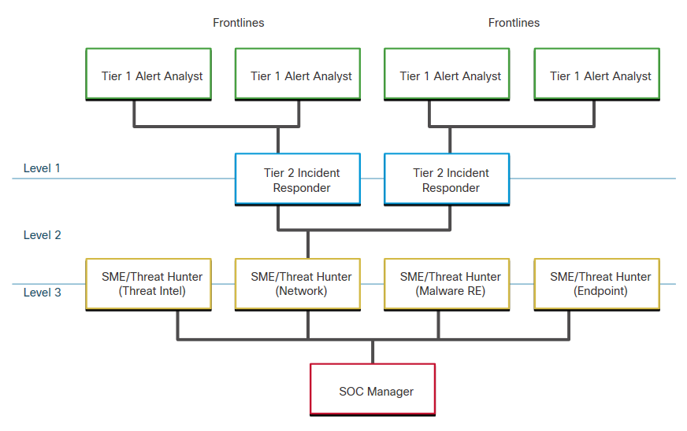
Fighters in the War Against Cybercrime People in the SOC (Contd.)
First tier jobs are more entry level, while third tier jobs require extensive expertise.
The figure, which is originally from the SANS Institute, graphically represents how these roles interact with each other.
Notes:
2 – Fighters in the War Against Cybercrime
2.1 – The Modern Security Operations Center
2.1.2 – People in the SOC

Slide 14
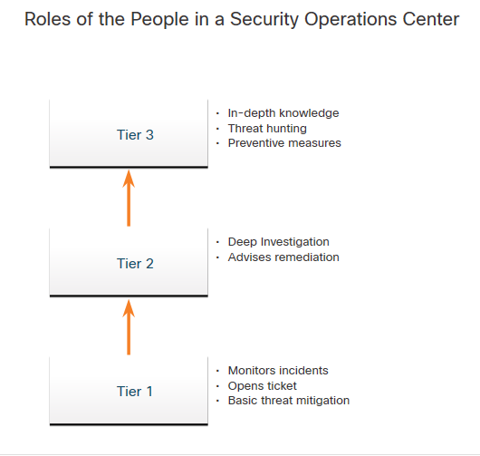
Fighters in the War Against Cybercrime Process in the SOC
A Cybersecurity Analyst is required to monitor security alert queues and investigate the assigned alerts. A ticketing system is used to assign these alerts to the analyst’s queue.
The software that generates the alerts can trigger false alarms. The analyst, therefore, needs to verify that an assigned alert represents a true security incident.
When this verification is established, the incident can be forwarded to investigators or other security personnel to be acted upon. Otherwise, the alert is dismissed as a false alarm.
If a ticket cannot be resolved, the Cybersecurity Analyst forwards the ticket to a Tier 2 Incident Responder for deeper investigation and remediation.
If the Incident Responder cannot resolve the ticket, it is forwarded it to a Tier 3 personnel.
Notes:
2 – Fighters in the War Against Cybercrime
2.1 – The Modern Security Operations Center
2.1.3 – Process in the SOC

Slide 15
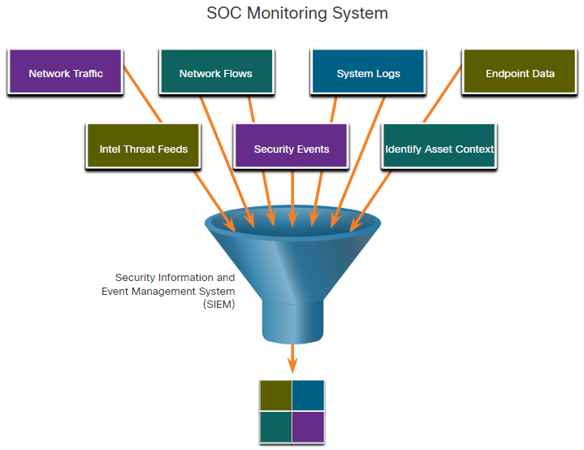
Fighters in the War Against Cybercrime Technologies in the SOC: SIEM
An SOC needs a Security Information and Event Management (SIEM) system to understand the data that firewalls, network appliances, intrusion detection systems, and other devices generate.
SIEM systems collect and filter data, and detect, classify, analyze and investigate threats. They may also manage resources to implement preventive measures and address future threats.
Notes:
2 – Fighters in the War Against Cybercrime
2.1 – The Modern Security Operations Center
2.1.4 – Technologies in the SOC: SIEM

Slide 16
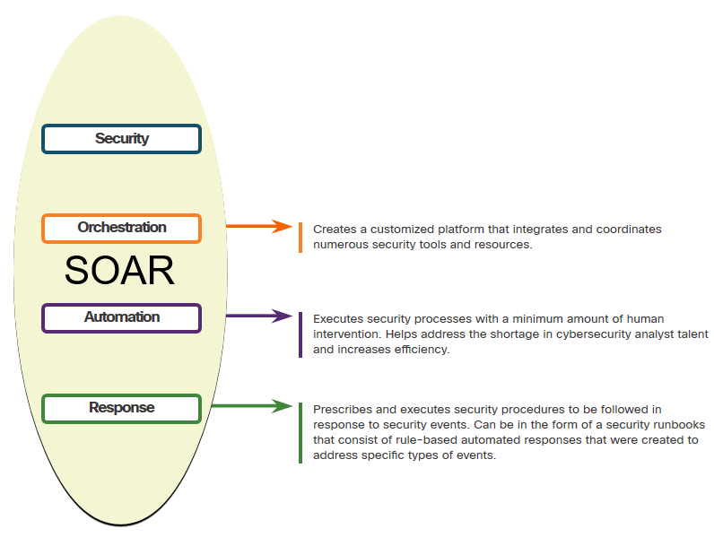
Fighters in the War Against Cybercrime Technologies in the SOC: SOAR
SIEM and Security Orchestration, Automation and Response (SOAR) are often paired together as they have capabilities that complement each other.
Large security operations (SecOps) teams use both technologies to optimize their SOC.
SOAR platforms are similar to SIEMs as they aggregate, correlate, and analyze alerts. In addition, SOAR technology integrate threat intelligence and automate incident investigation and response workflows based on playbooks developed by the security team.
Notes:
2 – Fighters in the War Against Cybercrime
2.1 – The Modern Security Operations Center
2.1.5 – Technologies in the SOC: SOAR

Slide 17
Fighters in the War Against Cybercrime Technologies in the SOC: SOAR (Contd.)
SOAR security platforms:
Gather alarm data from each component of the system.
Provide tools that enable cases to be researched, assessed, and investigated.
Emphasize integration as a means of automating complex incident response workflows that enable more rapid response and adaptive defense strategies.
Include pre-defined playbooks that enable automatic response to specific threats. Playbooks can be initiated automatically based on predefined rules or may be triggered by security personnel.
Notes:
2 – Fighters in the War Against Cybercrime
2.1 – The Modern Security Operations Center
2.1.5 – Technologies in the SOC: SOAR

Slide 18
Fighters in the War Against Cybercrime SOC Metrics
Whether internal to an organization or providing services to multiple organizations, it is important to understand how well the SOC is functioning, so that improvements can be made to the people, processes, and technologies that comprise the SOC.
Many metrics or Key Performance Indicators (KPI) can be devised to measure different aspects of SOC performance. However, five metrics are commonly used as SOC metrics by SOC managers.
Metrics | Definition
Dwell Time | The length of time that threat actors have access to a network before they are detected, and their access is stopped
Mean Time to Detect (MTTD) | The average time that it takes for the SOC personnel to identify valid security incidents have occurred in the network
Mean Time to Respond (MTTR) | The average time it takes to stop and remediate a security incident
Mean Time to Contain (MTTC) | The time required to stop the incident from causing further damage to systems or data
Time to Control | The time required to stop the spread of malware in the network
Notes:
2 – Fighters in the War Against Cybercrime
2.1 – The Modern Security Operations Center
2.1.6 – SOC Metrics

Slide 19
Fighters in the War Against Cybercrime Enterprise and Managed Security
For medium and large networks, the organization will benefit from implementing an enterprise-level SOC, which is a complete in-house solution.
Larger organizations may outsource at least a part of the SOC operations to a security solutions provider.
Cisco offers a wide range of incident response, preparedness, and management capabilities including:
Cisco Smart Net Total Care Service for Rapid Problem Resolution
Cisco Product Security Incident Response Team (PSIRT)
Cisco Computer Security Incident Response Team (CSIRT)
Cisco Managed Services
Cisco Tactical Operations (TacOps)
Cisco’s Safety and Physical Security Program
Notes:
2 – Fighters in the War Against Cybercrime
2.1 – The Modern Security Operations Center
2.1.7 – Enterprise and Managed Security

Slide 20
Fighters in the War Against Cybercrime Security vs. Availability
Security personnel understand that for the organization to accomplish its priorities, network availability must be preserved.
Each business or industry has a limited tolerance for network downtime. That tolerance is usually based upon a comparison of the cost of the downtime in relation to the cost of ensuring against downtime.
Security cannot be so strong that it interferes with the needs of employees or business functions. It is always a tradeoff between strong security and permitting efficient business functioning.
Notes:
2 – Fighters in the War Against Cybercrime
2.1 – The Modern Security Operations Center
2.1.8 – Security vs. Availability
2.1.9 – Check Your Understanding – Identify the SOC Terminology

Slide 21
2.2 Becoming a Defender
Notes:
Source:
2 – Fighters in the War Against Cybercrime
2.2 – Becoming a Defender
In-Session Activities / Explanations:
Time: 5 mins
Instructor Notes:
Explain to the learners, the certifications offered by Cisco and help them choose one as per their requirement.
Guide them with the opportunities for further studies in Cybersecurity and explain them the ways to gain experience in this field.
Key Points: Becoming a defender, Certifications

Slide 22

Becoming a Defender Certifications
A variety of cybersecurity certifications that are relevant to careers in SOCs are available:
Cisco Certified CyberOps Associate
CompTIA Cybersecurity Analyst Certification
(ISC)² Information Security Certifications
Global Information Assurance Certification (GIAC)
Search for “cybersecurity certifications” on the Internet to know more about other vendor and vendor-neutral certifications.
Notes:
2 – Fighters in the War Against Cybercrime
2.1 – Becoming a Defender
2.2.1 – Certifications

Slide 23

Becoming a Defender Further Education
Degrees: When considering a career in the cybersecurity field, one should seriously consider pursuing a technical degree or bachelor’s degree in computer science, electrical engineering, information technology, or information security.
Python Programming: Computer programming is an essential skill for anyone who wishes to pursue a career in cybersecurity. If you have never learned how to program, then Python might be the first language to learn.
Linux Skills: Linux is widely used in SOCs and other networking and security environments. Linux skills are a valuable addition to your skillset as you work to develop a career in cybersecurity.
Notes:
2 – Fighters in the War Against Cybercrime
2.1 – Becoming a Defender
2.2.2 – Further Education

Slide 24

Becoming a Defender Sources of Career Information
A variety of websites and mobile applications advertise information technology jobs. Each site targets a variety of job applicants and provides different tools for candidates to research their ideal job position.
Many sites are job site aggregators that gather listings from other job boards and company career sites and display them in a single location.
Indeed.com
CareerBuilder.com
USAJobs.gov
Glassdoor
LinkedIn
Notes:
2 – Fighters in the War Against Cybercrime
2.1 – Becoming a Defender
2.2.3 – Sources of Career Information

Slide 25

Becoming a Defender Getting Experience
Internships: Internships are an excellent method for entering the cybersecurity field. Sometimes, internships turn into an offer of full time employment. However, even a temporary internship allows you the opportunity to gain experience in the inner workings of a cybersecurity organization
Scholarships and Awards: To help close the security skills gap, organizations like Cisco and INFOSEC have introduced scholarship and awards programs.
Temporary Agencies: Many organizations use temporary agencies to fill job openings for the first 90 days. If the employee is a good match, the organization may convert the employee to a full-time, permanent position.
Your First Job: If you have no experience in the cybersecurity field, working for a call center or support desk may be your first step into gaining the experience you need to move ahead in your career.
Notes:
2 – Fighters in the War Against Cybercrime
2.1 – Becoming a Defender
2.2.4 – Getting Experience

Slide 26
Becoming a Defender Lab – Becoming a Defender
In this lab, you will research and analyze what it takes to become a network defender.
Notes:
2 – Fighters in the War Against Cybercrime
2.1 – Becoming a Defender
2.2.5 – Lab – Becoming a Defender

Slide 27
2.3 Fighters in the War Against Cybercrime Summary
Notes:
Source:
2 – Fighters in the War Against Cybercrime
2.3 – Fighters in the War Against Cybercrime Summary
In-Session Activities / Explanations:
Time: 5 mins
Instructor Notes:
Summarize the module and check if they have any doubts.
Ask them to complete the module quiz present in section 2.3.2.
Key Points: NA

Slide 28
Fighters in the War Against Cybercrime Summary What Did I Learn in this Module?
Major elements of the SOC include people, processes, and technologies.
The job roles include a Tier 1 Alert Analyst, a Tier 2 Incident Responder, a Tier 3 Threat hunter, and an SOC Manager.
A Tier 1 Analyst monitors incidents, open tickets, and performs basic threat mitigation.
SEIM systems are used for collecting and filtering data, detecting and classifying threats, and analyzing and investigating threats.
SOAR integrates threat intelligence and automates incident investigation and response workflows based on playbooks developed by the security team.
KPIs are devised to measure different aspects of SOC performance. Common metrics include Dwell Time, Meant Time to Detect (MTTD), Mean Time to Respond (MTTR), Mean Time to Contain (MTTC), and Time to Control.
Notes:
2 – Fighters in the War Against Cybercrime
2.3 – Fighters in the War Against Cybercrime Summary
2.3.1 – What Did I Learn in this Module?

Slide 29
Fighters in the War Against Cybercrime Summary What Did I Learn in this Module? (Contd.)
There must be a balance between security and availability of the networks. Security cannot be so strong that it interferes with employees or business functions.
A variety of cybersecurity certifications that are relevant to careers in SOCs are available from different organizations.
Notes:
2 – Fighters in the War Against Cybercrime
2.3 – Fighters in the War Against Cybercrime Summary
2.3.1 – What Did I Learn in this Module?
2.3.2 – Module 2: Fighters in the War Against Cybercrime Quiz

Slide 30
Module 2 New Terms and Commands
Security Operations Center (SOC) Cybersecurity Analyst CyberOps Associate Tier 1 Alert Analyst Tier 2 Incident Responder Tier 3 Threat Hunter SOC Manager | Security Information and Event Management (SIEM) system Security Orchestration, Automation and Response (SOAR) Key Performance Indicators (KPI) | Dwell Time Mean Time to Detect (MTTD) Mean Time to Detect (MTTD) Mean Time to Contain (MTTC) Time to Control Job site aggregators Temporary agencies
Notes:
2 – Fighters in the War Against Cybercrime
New Terms and Commands

