Slide 1
Module 20: Threat Intelligence
Instructor Materials
CyberOps Associate v1.0
Notes:
Cisco Networking Academy Program
CyberOps Associates v1.0
Module 20: Threat Intelligence

Slide 2
Instructor Materials – Module 20 Planning Guide
This PowerPoint deck is divided in two parts:
Instructor Planning Guide
Information to help you become familiar with the module
Teaching aids
Instructor Class Presentation
Optional slides that you can use in the classroom
Begins on slide # 7
Note: Remove the Planning Guide from this presentation before sharing with anyone.
For additional help and resources go to the Instructor Home Page and Course Resources for this course. You also can visit the professional development site on www.netacad.com, the official Cisco Networking Academy Facebook page, or Instructor Only FB group.
Notes:
2

Slide 3
What to Expect in this Module
To facilitate learning, the following features within the GUI may be included in this module:
Feature | Description
Check Your Understanding(CYU) | Per topic online quiz to help learners gauge content understanding.
Module Quiz | Self-assessments that integrate concepts and skills learned throughout the series of topics presented in the module.
Module Summary | Briefly recaps module content.

Slide 4
Check Your Understanding
Check Your Understanding activities are designed to let students quickly determine if they understand the content and can proceed, or if they need to review.
Check Your Understanding activities do not affect student grades.
There are no separate slides for these activities in the PPT. They are listed in the notes area of the slide that appears before these activities.
Notes:
4

Slide 5
Module 20: Activities
What activities are associated with this module?
Page # | Activity Type | Activity Name | Optional?
20.2.7 | Check Your Understanding | Identify the Threat Intelligence Information Source | Recommended
Notes:
5

Slide 6
Module 20: Best Practices
Prior to teaching Module 20, the instructor should:
Review the activities and assessments for this module.
Try to include as many questions as possible to keep students engaged during classroom presentation.
Topic 20.1
Ask the class:
How can security professionals effectively protect a network?
Are you aware of any Network security organizations?
Topic 20.2
Discuss the different Threat Intelligence Services and their functions.
Notes:
6

Slide 7
Module 20: Threat Intelligence
CyberOps Associate v1.0
Notes:
Cisco Networking Academy Program
CyberOps Associates v1.0
Module 20: Threat Intelligence
In-Session Activities / Explanations:
Time: 5min
Instructor Notes:
Welcome the audience in a warm and cordial manner. Ensure that everyone is set up with the required resources.
Introduce yourself briefly and invite participants to introduce self with name, dept. and role, if deemed all right.
Introduce the topic and encourage learners to come up with a list of expectations from the session. Collate topics on the white board or Desktop while using learner’s inputs to interpret them in words.
Read out the Objectives and briefly describe each.
Key Points: NA

Slide 8
Module Objectives
Module Title: Threat Intelligence
Module Objective: Use various intelligence sources to locate current security threats.
Topic Title | Topic Objective
Information Sources | Describe information sources used to communicate emerging network security threats.
Threat Intelligence Services | Describe various threat intelligence services.
Notes:
8
CyberOps Associates v1.0
20 – Threat Intelligence
20.0 – Introduction
20.0.2– What Will I Learn in this Module?

Slide 9
20.1 Information Sources
Notes:
Source:
20 – Threat Intelligence
20.1 – Information Sources
In-Session Activities / Explanations:
Time: 7 min
Instructor Notes:
Discuss Network Intelligence Communities
Display Cisco Cybersecurity Reports
Explain to the students how they can podcasts in Cisco Talos to view information regarding cybersecurity and mitigation techniques.
Key Points: Network Security Organizations, Cybersecurity Reports, Blogs and Podcasts

Slide 10
Threat Intelligence Network Intelligence Communities
To effectively protect a network, the security professionals must stay informed about the threats and vulnerabilities.
There are many security organizations which provide network intelligence, resources, workshops, and conferences to help security professionals.
To remain effective, a network security professional must:
Keep abreast of the latest threats – Includes subscribing to real-time feeds regarding threats, routinely perusing security-related websites, following security blogs and podcasts, and more.
Continue to upgrade skills – Includes attending security-related training, workshops, and conferences.
Note: Network security has a very steep learning curve and requires a commitment to continuous professional development.
Notes:
20 – Threat Intelligence
20.1 – Information Sources
20.1.1 – Network Intelligence Communities

Slide 11
Threat Intelligence Network Intelligence Communities (Contd.)
The table lists the important network security organization.
Organization | Description
SysAdmin, Audit, Network, Security (SANS) | SANS Institute resources are largely free upon request and include: The Internet Storm Center - the popular internet early warning system NewsBites - The weekly digest of news articles about computer security. @RISK - The weekly digest of newly discovered attack vectors, vulnerabilities with active exploits, and explanations of how recent attacks worked. Flash security alerts Reading Room - More than 1,200 award-winning, original research papers. SANS also develops security courses.
Mitre | The Mitre Corporation maintains a list of Common Vulnerabilities and Exposures (CVE) used by prominent security organizations.
Notes:
20 – Threat Intelligence
20.1 – Information Sources
20.1.1 – Network Intelligence Communities

Slide 12
Information Sources Network Intelligence Communities (Contd.)
Organization | Description
Forum of Incident Response and Security Teams (FIRST) | It is a security organization that brings together a variety of computer security incident response teams from government, commercial, and educational organizations to foster cooperation and coordination in information sharing, incident prevention and rapid reaction.
SecurityNewsWire | A security news portal that aggregates the latest breaking news pertaining to alerts, exploits, and vulnerabilities.
International Information Systems Security Certification Consortium (ISC)² | Provides vendor neutral education products and career services to more than 75,000+ industry professionals in more than 135 countries.
Center for Internet Security (CIS) | It is a focal point for cyber threat prevention, protection, response, and recovery for state, local, tribal, and territorial (SLTT) governments through the Multi-State Information Sharing and Analysis Center (MS-ISAC). The MS-ISAC offers 24x7 cyber threat warnings and advisories, vulnerability identification, and mitigation and incident response.
Notes:
20 – Threat Intelligence
20.1 – Information Sources
20.1.1 – Network Intelligence Communities

Slide 13
Threat Intelligence Cisco Cybersecurity Reports
Resources to help security professionals stay abreast of the latest threats are the Cisco Annual Cybersecurity Report and the Mid-Year Cybersecurity Report.
These reports provide an update on the state of security preparedness, expert analysis of top vulnerabilities, factors behind the explosion of attacks using adware, spam, and so on.
Cybersecurity analysts should subscribe and read these reports to learn how threat actors are targeting their networks, and what action can be taken to mitigate these attacks.
Notes:
20 – Threat Intelligence
20.1 – Information Sources
20.1.2 – Cisco Cybersecurity Reports

Slide 14
Threat Intelligence Security Blogs and Podcasts
Blogs and podcasts also provide advice, research, and recommended mitigation techniques.
Cisco provides blogs on security-related topics from a number of industry experts and from the Cisco Talos Group.
Cisco Talos offers a series of over 80 podcasts that can be played from the internet or downloaded to your device of choice.
Notes:
20 – Threat Intelligence
20.1 – Information Sources
20.1.3 – Security Blogs and Podcasts

Slide 15
20.2 Threat Intelligence Services
Notes:
Source:
20 – Threat Intelligence
20.2 – Threat Intelligence Services
In-Session Activities / Explanations:
Time: 10 min
Instructor Notes:
Divide the class into groups of four and ask each group to create small presentations. Assign one of the following topics to each group:
Cisco Talos
FireEye and it’s security intelligence resources
Department of Homeland Security (DHS) Automated Indicator Sharing (AIS) service
MITRE Corporation and Common Vulnerabilities and Exposures (CVE).
List the threat intelligence communication standards and discuss with the class.
Ensure they complete the ‘Check Your Understanding – Identify the Threat Intelligence Information Source’ in section 20.2.7.
Key Points: Cisco Talos, FireEye, AIS, CVE Database, Threat Intelligence Communication Standards and Threat Intelligence Platforms

Slide 16
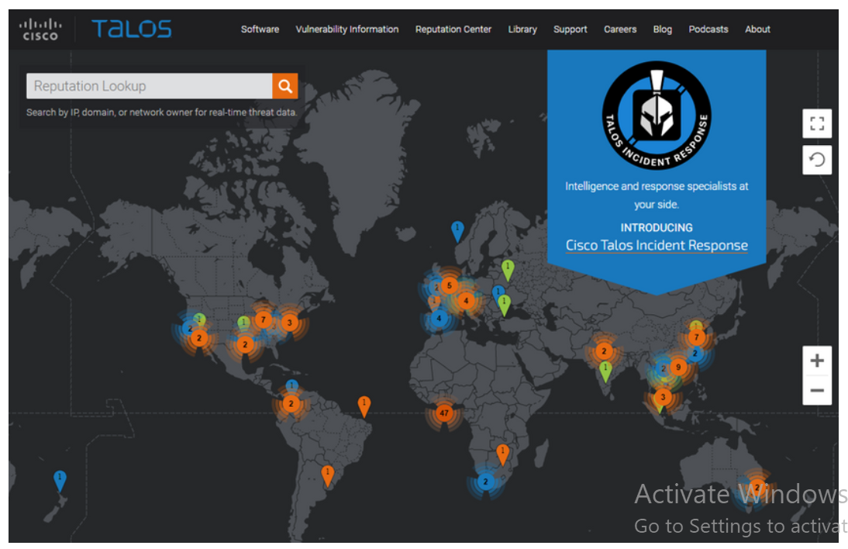
Threat Intelligence Services Cisco Talos
Talos is one of the largest commercial threat intelligence teams in the world, and is comprised of world-class researchers, analysts and engineers.
The goal is to help protect enterprise users, data, and infrastructure from active adversaries.
The team collects information about active, existing, and emerging threats, and then provides comprehensive protection against these attacks and malware to its subscribers.
Cisco Security products can use Talos threat intelligence in real time to provide fast and effective security solutions.
Cisco Talos also provides free software, services, resources, data and maintains the security incident detection rule sets for the Snort.org, ClamAV, and SpamCop network security tools.
Notes:
20 – Threat Intelligence
20.2 – Threat Intelligence Services
20.2.1 – Cisco Talos

Slide 17
Threat Intelligence Services FireEye
FireEye is another security company that offers services to help enterprises secure their networks.
It uses a three-pronged approach combining security intelligence, security expertise, and technology.
It offers SIEM and SOAR with the Helix Security Platform, which uses behavioral analysis and advanced threat detection and is supported by the FireEye Mandiant worldwide threat intelligence network.
Notes:
20 – Threat Intelligence
20.2 – Threat Intelligence Services
20.2.2 – FireEye

Slide 18
Threat Intelligence Services FireEye (Contd.)
FireEye Security System:
The FireEye Security System blocks attacks across web and email threat vectors, and latent malware that resides on file shares.
It can block advanced malware that easily bypasses traditional signature-based defenses and compromises the majority of enterprise networks.
It addresses all stages of an attack lifecycle with a signature-less engine utilizing stateful attack analysis to detect zero-day threats.
Notes:
20 – Threat Intelligence
20.2 – Threat Intelligence Services
20.2.2 – FireEye

Slide 19
Threat Intelligence Services Automated Indicator Sharing
The Automated Indicator Sharing (AIS) is a free service offered by the U.S Department of Homeland Security(DHS).
AIS enables the real-time exchange of cyber threat indicators between the U.S. Federal Government and the private sector.
AIS creates an ecosystem when a threat is recognized. Later, it is immediately shared with the community to help them protect their networks from that particular threat.
Notes:
20 – Threat Intelligence
20.2 – Threat Intelligence Services
20.2.3 – Automated Indicator Sharing

Slide 20
Threat Intelligence Services Common Vulnerabilities and Exposures (CVE) Database
The United States government sponsored the MITRE Corporation to create and maintain a catalog of known security threats called Common Vulnerabilities and Exposures (CVE).
The CVE serves as a dictionary of CVE Identifiers for publicly known cybersecurity vulnerabilities.
The MITRE Corporation defines unique CVE Identifiers for publicly known information-security vulnerabilities to make it easier to share data.
Notes:
20 – Threat Intelligence
20.2 – Threat Intelligence Services
20.2.4 – Common Vulnerabilities and Exposures (CVE) Database

Slide 21
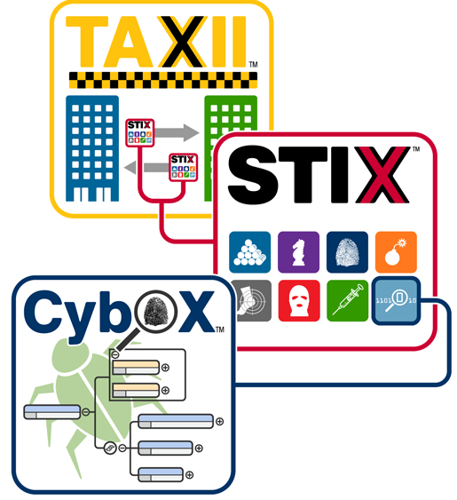
Threat Intelligence Services Threat Intelligence Communication Standards
Three common threat intelligence sharing standards include the following:
Structured Threat Information Expression (STIX) - This is a set of specifications for exchanging cyber threat information between organizations.
Trusted Automated Exchange of Indicator Information (TAXII) – This is the specification for an application layer protocol that allows the communication of CTI over HTTPS. TAXII is designed to support STIX.
CybOX - This is a set of standardized schema for specifying, capturing, characterizing, and communicating events and properties of network operations that supports many cybersecurity functions.
Notes:
20 – Threat Intelligence
20.2 – Threat Intelligence Services
20.2.5 – Threat Intelligence Communication Standards

Slide 22
Threat Intelligence Services Threat Intelligence Communication Standards (Contd.)
The Malware Information Sharing Platform (MISP) is an open source platform for sharing IOCs for newly discovered threats.
MISP is supported by the European Union and is used by over 6,000 organizations globally.
MISP enables automated sharing of IOCs between people and machines by using STIX and other export formats.
Notes:
20 – Threat Intelligence
20.2 – Threat Intelligence Services
20.2.5 – Threat Intelligence Communication Standards

Slide 23
Threat Intelligence Services Threat Intelligence Platforms
A Threat Intelligence Platform (TIP) centralizes the collection of threat data from numerous data sources and formats.
Types of threat Intelligence data:
Indicators of Compromise (IOC)
Tools Techniques and Procedures (TTP)
Reputation information about internet destinations or domains
Organizations can contribute to threat intelligence by sharing their intrusion data over the internet, typically through automation.
Honeypots are simulated networks or servers that are designed to attract attackers. The attack-related information gathered from honeypots can be shared with threat intelligence platform subscribers.
Notes:
20 – Threat Intelligence
20.2 – Threat Intelligence Services
20.2.6 – Threat Intelligence Platforms
20.2.7 Check Your Understanding – Identify the Threat Intelligence Information Source

Slide 24
20.3 Threat Intelligence Summary
Notes:
Source:
20 – Threat Intelligence
20.3 – Threat Intelligence Summary
In-Session Activities / Explanations:
Time: 5 min
Instructor Notes:
Summarise the main points of the module and take the learners through the new terms that they have learned in this module.
Ask them to complete the module quiz present in section 20.3.2.
Key Points: NA

Slide 25
Threat Intelligence Summary What Did I Learn in this Module?
Many organizations such as SANS, Mitre, FIRST, SecurityNewsWire, (ISC)2, and CIS provide network intelligence.
The network security professionals must keep abreast of the latest threats and continue to upgrade skills.
Threat intelligence services allow the exchange of threat information such as vulnerabilities, Indicators of Compromise (IOC), and mitigation techniques.
Cisco Talos is one of the largest commercial threat intelligence teams in the world.
FireEye is another security company that offers services to help enterprises secure their networks. It uses a three-pronged approach combining security intelligence, security expertise and technology.
Notes:
20 – Threat Intelligence
20.3 – Threat Intelligence Summary
20.3.1 – What Did I Learn in this Module?

Slide 26
Threat Intelligence Summary What Did I Learn in this Module? (Contd.)
The U.S Department of Homeland Security (DHS) offers a free service called Automated Indicator Sharing (AIS).
AIS enables real-time exchange of cyber threat indicators between the U.S. Federal Government and the private sector.
The United States government sponsored the MITRE Corporation to create and maintain a catalog of known security threats called Common Vulnerabilities and Exposure (CVE).
Three common threat intelligence sharing standards include Structured Threat Information Expression (STIX), Trusted Automated Exchange of Indicator Information (TAXII), and CybOX.
Notes:
20 – Threat Intelligence
20.3 – Threat Intelligence Summary
20.3.1 – What Did I Learn in this Module?
20.3.2 – Threat Intelligence Quiz

Slide 27
Module 20 New Terms and Commands
SysAdmin, Audit, Network, Security (SANS) Mitre Forum of Incident Response and Security Teams (FIRST) SecurityNewsWire International Information Systems Security Certification Consortium (ISC)² Center for Internet Security (CIS) | Cisco Talos FireEye Automated Indicator Sharing (AIS) Common Vulnerabilities and Exposures (CVE) Structured Threat Information Expression (STIX) Trusted Automated Exchange of Indicator Information (TAXII) | CybOX Malware Information Sharing Platform (MISP) Threat intelligence platforms (TIP) Indicators of compromise (IOC) Tools Techniques and Procedures (TTP)
Notes:
20 – Threat Intelligence
New Terms and Commands

