Slide 1
Module 21: Cryptography
Instructor Materials
CyberOps Associate v1.0
Notes:
Cisco Networking Academy Program
CyberOps Associate v1.0
Module 21: Cryptography

Slide 2
Instructor Materials – Module 21 Planning Guide
This PowerPoint deck is divided in two parts:
Instructor Planning Guide
Information to help you become familiar with the module
Teaching aids
Instructor Class Presentation
Optional slides that you can use in the classroom
Begins on slide # 9
Note: Remove the Planning Guide from this presentation before sharing with anyone.
For additional help and resources go to the Instructor Home Page and Course Resources for this course. You also can visit the professional development site on www.netacad.com, the official Cisco Networking Academy Facebook page, or Instructor Only FB group.
Notes:
2

Slide 3
What to Expect in this Module
To facilitate learning, the following features within the GUI may be included in this module:
Feature | Description
Videos | Expose learners to new skills and concepts.
Check Your Understanding(CYU) | Per topic online quiz to help learners gauge content understanding.
Hands-On Labs | Labs designed for working with physical equipment.
Class Activities | These are found on the Instructor Resources page. Class Activities are designed to facilitate learning, class discussion, and collaboration.
Module Quizzes | Self-assessments that integrate concepts and skills learned throughout the series of topics presented in the module.
Module Summary | Briefly recaps module content.

Slide 4
Check Your Understanding
Check Your Understanding activities are designed to let students quickly determine if they understand the content and can proceed, or if they need to review.
Check Your Understanding activities do not affect student grades.
There are no separate slides for these activities in the PPT. They are listed in the notes area of the slide that appears before these activities.
Notes:
4

Slide 5
Module 21: Activities
What activities are associated with this module?
Page # | Activity Type | Activity Name | Optional?
21.0.2 | Class Activity | Creating Codes | Recommended
21.1.6 | Lab | Hashing Things Out | Recommended
21.2.8 | Video | Cryptography | Recommended
21.2.9 | Check Your Understanding | Classify the Encryption Algorithms | Recommended
21.2.10 | Lab | Encrypting and Decrypting Data Using OpenSSL | Recommended
21.2.11 | Lab | Encrypting and Decrypting Data Using a Hacker Tool | Recommended
21.2.12 | Lab | Examining Telnet and SSH in Wireshark | Recommended
21.4.7 | Lab | Certificate Authority Stores | Recommended
Notes:
5

Slide 6
Module 21: Best Practices
Prior to teaching Module 21, the instructor should:
Review the activities and assessments for this module.
Try to include as many questions as possible to keep students engaged during classroom presentation.
Topic 21.1
Ask the class to name the elements of secure communications and then describe them.
Explain the cryptographic hash functions and its operations.
Discuss the MD5 and SHA hash functions with the class.
Discuss how to add origin authentication and integrity assurance.
Notes:
6

Slide 7
Module 21: Best Practices (Contd.)
Topic 21.2
Ask the class to share their understanding of data confidentiality.
Reinforce the differences between symmetric and asymmetric encryption.
Describe how asymmetric encryption is used to provide confidentiality, authentication and integrity.
Define Diffie-Hellman to the class.
Topic 21.3
Ask the student if they have come across a digital signature.
Reinforce the properties of a digital signature.
Describe the use of digital signatures for code signing and digital certificates.
Notes:
7

Slide 8
Module 21: Best Practices (Contd.)
Topic 21.4
Explain the Public Key Management to the class with the help of an example.
Describe the Public Key Infrastructure (PKI) to the class.
Reinforce the PKI Authorities System and the PKI Trust System.
Describe the interoperability between a PKI and its supporting services.
Brief the class of Certificate Enrollment, Authentication, and Revocation.
Topic 21.5
Ask the participants to list out some of the PKI applications.
Explain the PKI-related issues and ways to solve them.
Describe the challenges of network monitoring and the measures taken by the security analyst to solve these issues.
Notes:
8

Slide 9
Module 21: Cryptography
CyberOps Associate v1.0
Notes:
Cisco Networking Academy Program
CyberOps Associate v1.0
Module 21: Cryptography
In-Session Activities / Explanations:
Time: 5 min
Instructor Notes:
Welcome the audience in a warm and cordial manner. Ensure that everyone is set up with the required resources.
Introduce the topic and encourage learners to come up with a list of expectations from the session. Collate topics on the white board or Desktop while using learner’s inputs to interpret them in words.
To build the context of the module, ask the audience to share their understanding of cryptography and discuss its role in digital data communications.
Read out the Objectives and briefly describe each.
Help the learners to perform the class activity at section 21.0.3.
Key Points: NA

Slide 10
Module Objectives
Module Title: Public Key Cryptography
Module Objective: Explain how the public key infrastructure (PKI) supports network security.
.
Topic Title | Topic Objective
Integrity and Authenticity | Explain the role of cryptography in ensuring the integrity and authenticity of data.
Confidentiality | Explain how cryptographic approaches enhance data confidentiality.
Public Key Cryptography | Explain public key cryptography.
Authorities and the PKI Trust System | Explain how the public key infrastructure functions.
Applications and Impacts of Cryptography | Explain how the use of cryptography affects cybersecurity operations.
Notes:
10
CyberOps Associate v1.0
21 – Cryptography
21.0 – Introduction
21.0.2 – What Will I Learn in this Module?
21.0.3 – Class Activity - Creating Codes

Slide 11
21.1 Integrity and Authenticity
Notes:
Source:
21 – Cryptography
21.1 – Integrity and Authenticity
In-Session Activities / Explanations:
Time: 20 min
Instructor Notes:
Introduce the topic and discuss integrity and authenticity with the learners.
Explain the elements of secure communications.
Ensure the learners have knowledge of cryptographic hash functions and its operations.
Discuss the MD5 and SHA hash functions.
Brief the learners of origin authentication.
By the end of the topic, encourage the learners to perform the Hands-on lab.
Key Points: Hash, MD5, SHA.

Slide 12
Cryptography Securing Communications
Organizations must provide support to secure the data internally as well as externally.
The four elements of securing communications are:
Data Integrity - Guarantees that the message was not altered.
Origin Authentication - Guarantees that the message is not a forgery and it actually comes from whom it states.
Data Confidentiality - Guarantees that only authorized users can read the message.
Data Non-Repudiation - Guarantees that the sender cannot repudiate, or refute, the validity of a message sent.
Notes:
21 – Cryptography
21.1 – Integrity and Authenticity
21.1.1 – Securing Communications

Slide 13
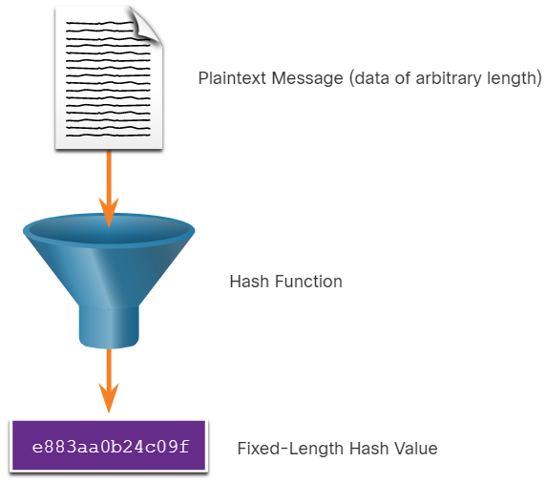
Cryptography Cryptographic Hash Functions
Hashes are used to verify and ensure data integrity.
Hashing is based on a one-way mathematical function that is relatively easy to compute, but significantly harder to reverse.
A hash function takes a variable block of binary data, called the message, and produces a fixed-length, condensed representation, called the hash.
The resulting hash is also sometimes called the message digest, digest, or digital fingerprint.
With hash functions, it is computationally infeasible for two different sets of data to come up with the same hash output.
Every time the data is changed or altered, the hash value also changes.
Notes:
21 – Cryptography
21.1 – Integrity and Authenticity
21.1.2 – Cryptographic Hash Functions

Slide 14
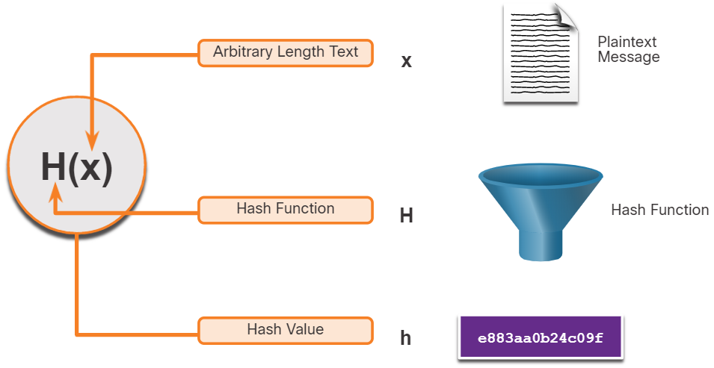
Cryptography Cryptographic Hash Operation
Mathematically, the equation h= H(x) is used to explain how a hash algorithm operates.
As shown in the figure, a hash function H takes an input x and returns a fixed-size string hash value h.
A cryptographic hash function should have the following properties:
The input can be any length.
The output has a fixed length.
H(x) is relatively easy to compute for given x.
H(x) is one way and not reversible.
H(x) is collision free, meaning that two different input values will result in different hash values.
Notes:
21 – Cryptography
21.1 – Integrity and Authenticity
21.1.3 – Cryptographic Hash Operation

Slide 15
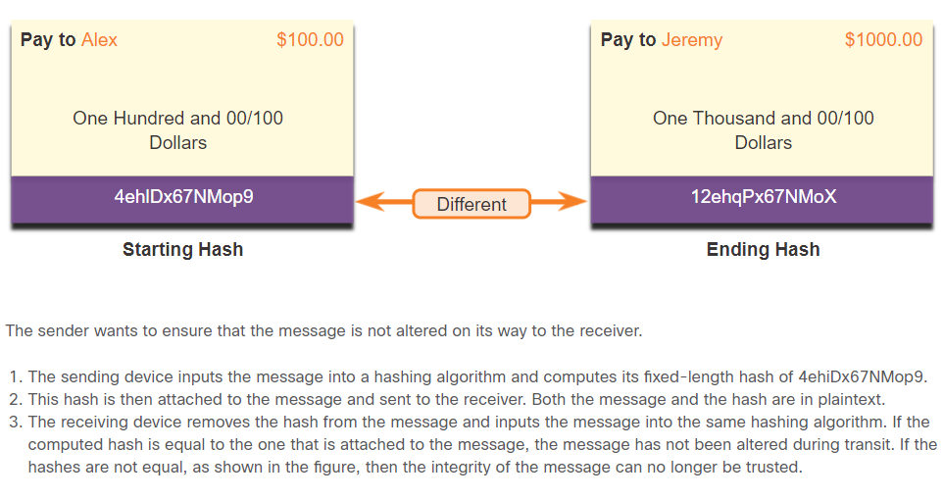
Cryptography MD5 and SHA
Hash functions are used to ensure the integrity of a message either accidentally or intentionally.
In the figure, the sender is sending a $100 money transfer to Alex. The sender wants to ensure that the message is not altered on its way to the receiver.
There are four well-known hash functions:
MD5 with 128-bit digest - A one-way function that produces a 128-bit hashed message. MD5 is a legacy algorithm.
SHA-1 - Very similar to the MD5 hash functions. SHA-1 creates a 160-bit hashed message and is slightly slower than MD5.
SHA-2 - If you are using SHA-2, then SHA-256, SHA-384, and SHA-512 algorithms should be used.
SHA-3 - Next-generation algorithms and should be used whenever possible.
Notes:
21 – Cryptography
21.1 – Integrity and Authenticity
21.1.4 – MD5 and SHA

Slide 16
Cryptography MD5 and SHA (Contd.)
While hashing can be used to detect accidental changes, it cannot be used to guard against deliberate changes that are made by a threat actor.
There is no unique identifying information from the sender in the hashing procedure.
This means that anyone can compute a hash for any data, as long as they have the correct hash function.
Therefore, hashing is vulnerable to man-in-the-middle attacks and does not provide security to transmitted data. To provide integrity and origin authentication, something more is required.
Note: Hashing algorithms only protect against accidental changes and does not protect the data from changes deliberately made by a threat actor.
Notes:
21 – Cryptography
21.1 – Integrity and Authenticity
21.1.4 – MD5 and SHA

Slide 17
Cryptography Origin Authentication
To add origin authentication and integrity assurance, use a keyed-hash message authentication code (HMAC).
HMAC uses an additional secret key as input to the hash function.
Note: Other Message Authentication Code (MAC) methods are also used. However, HMAC is used in many systems including SSL, IPsec, and SSH.
Notes:
21 – Cryptography
21.1 – Integrity and Authenticity
21.1.5 – Origin Authentication

Slide 18
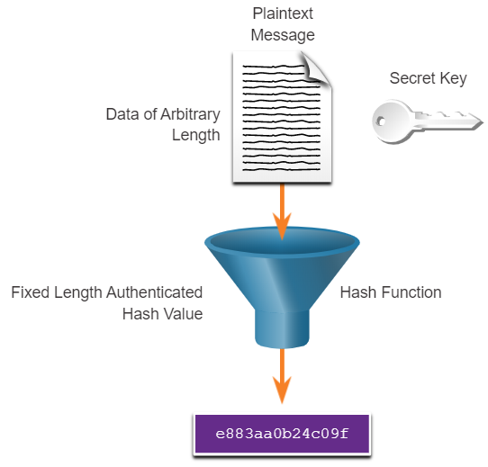
Cryptography Origin Authentication (Contd.)
HMAC Hashing Algorithm
An HMAC is calculated using any cryptographic algorithm that combines a cryptographic hash function with a secret key.
Only the sender and the receiver know the secret key, and the output of the hash function depends on the input data and the secret key.
Only parties who have access to that secret key can compute the digest of an HMAC function.
If two parties share a secret key and use HMAC functions for authentication, a properly constructed HMAC digest of a message that a party has received indicates that the other party was the originator of the message.
Notes:
21 – Cryptography
21.1 – Integrity and Authenticity
21.1.5 – Origin Authentication

Slide 19
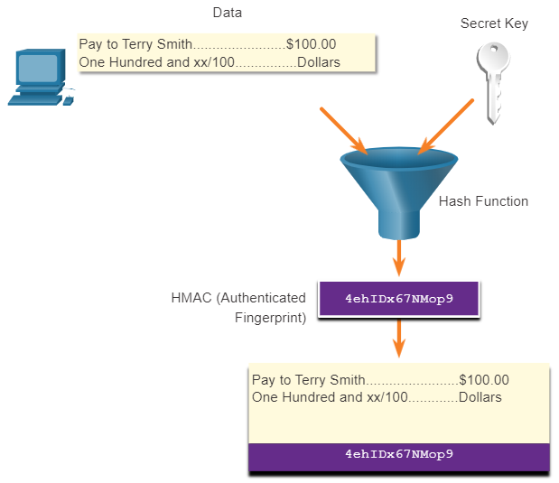
Cryptography Origin Authentication (Contd.)
Creating the HMAC Value
As shown in the figure, the sending device inputs data into the hashing algorithm and calculates the fixed-length HMAC digest.
This authenticated digest is then attached to the message and sent to the receiver.
Notes:
21 – Cryptography
21.1 – Integrity and Authenticity
21.1.5 – Origin Authentication

Slide 20
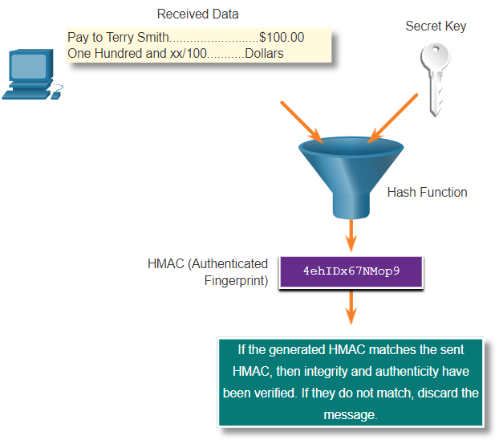
Cryptography Origin Authentication (Contd.)
Verifying the HMAC Value
In the figure, the receiving device removes the digest from the message and uses the plaintext message with its secret key as input into the same hashing function.
If the digest that is calculated by the receiving device is equal to the digest that was sent, the message has not been altered.
Additionally, the origin of the message is authenticated because only the sender possesses a copy of the shared secret key. The HMAC function has ensured the authenticity of the message.
Notes:
21 – Cryptography
21.1 – Integrity and Authenticity
21.1.5 – Origin Authentication

Slide 21
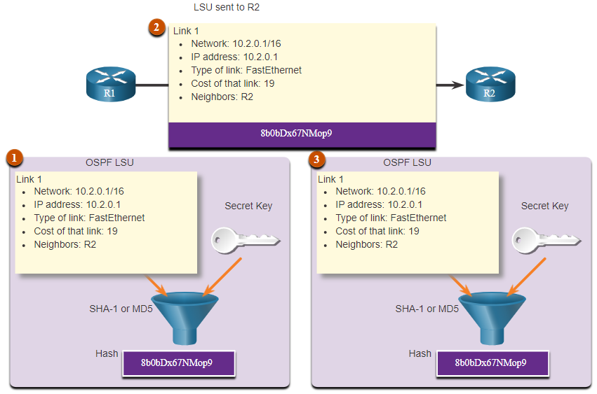
Cryptography Origin Authentication (Contd.)
Cisco Router HMAC Example
In the figure, HMACs are used by Cisco routers that are configured to use Open Shortest Path First (OSPF) routing authentication.
R1 is sending a link state update (LSU) regarding a route to network 10.2.0.0/16:
R1 calculates the hash value using the LSU message and the secret key.
The resulting hash value is sent with the LSU to R2.
R2 calculates the hash value using the LSU and its secret key. R2 accepts the update if the hash values match. If they do not match, R2 discards the update.
Notes:
21 – Cryptography
21.1 – Integrity and Authenticity
21.1.5 – Origin Authentication

Slide 22
Cryptography Lab – Hashing Things Out
In this lab, you will complete the following objectives:
Creating Hashes with OpenSSL
Verifying Hashes
Notes:
21 – Cryptography
21.1 – Integrity and Authenticity
21.1.6 – Lab – Hashing Things Out

Slide 23
21.2 Confidentiality
Notes:
Source:
21 – Cryptography
21.2 – Confidentiality
In-Session Activities / Explanations:
Time: 45 min
Instructor Notes:
Give a brief introduction of the topic and discuss confidentiality with the learners.
Explain the symmetric and asymmetric encryption.
Describe how asymmetric encryption is used to provide confidentiality, authentication and integrity.
Ensure the learners have knowledge of Diffie-Hellman algorithm.
By the end of the topic, encourage the learners to perform the activity and Hands-on labs.
Key Points: Symmetric Encryption, Asymmetric Encryption, Diffie-Hellman

Slide 24
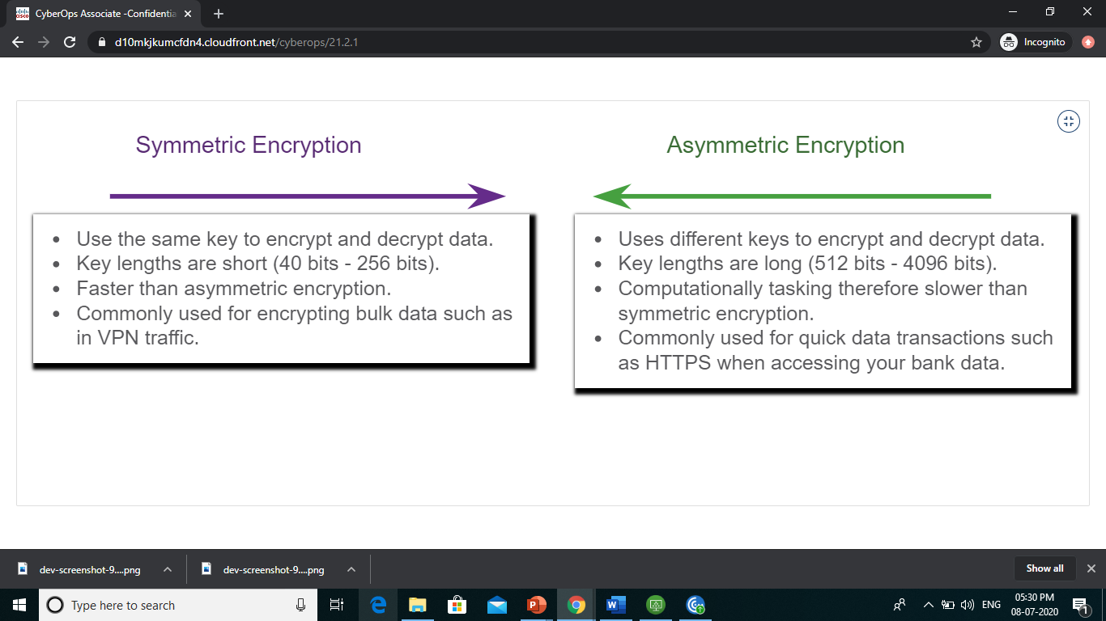
Confidentiality Data Confidentiality
There are two classes of encryption used to provide data confidentiality; asymmetric and symmetric. These two classes differ in how they use keys.
Symmetric encryption algorithms such as Data Encryption Standard (DES), 3DES, and Advanced Encryption Standard (AES) are based on the premise that each communicating party knows the pre-shared key.
Data confidentiality can also be ensured using asymmetric algorithms, including Rivest, Shamir, and Adleman (RSA) and the public key infrastructure (PKI).
The figure highlights some differences between symmetric and asymmetric encryption.
Notes:
21 – Cryptography
21.2 – Confidentiality
21.2.1 – Data Confidentiality

Slide 25
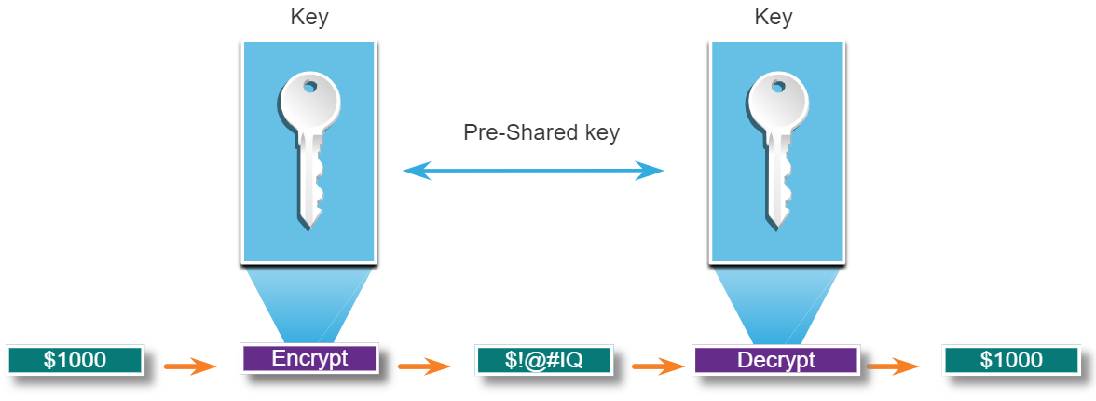
Confidentiality Symmetric Encryption
Symmetric algorithms use the same pre-shared key (secret key) to encrypt and decrypt data.
Symmetric encryption algorithms are commonly used with VPN traffic because they use less CPU resources than asymmetric encryption algorithms.
When using these algorithms, the longer the key, the longer it will take for someone to discover the key.
Most encryption keys are between 112 and 256 bits. Use a longer key for more secure communications.
Symmetric encryption algorithms are sometimes classified as a block cipher or a stream cipher.
Notes:
21 – Cryptography
21.2 – Confidentiality
21.2.2 – Symmetric Encryption

Slide 26
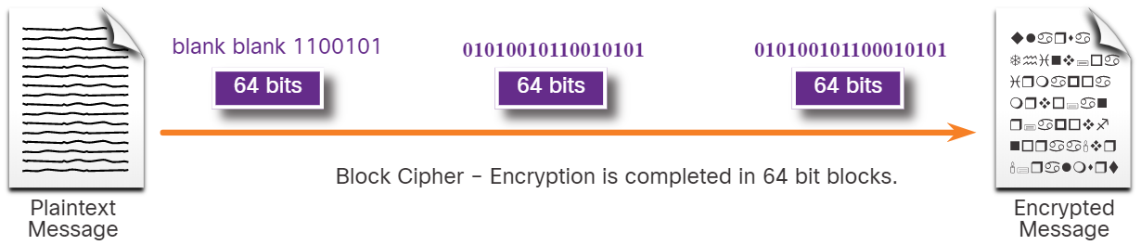
Confidentiality Symmetric Encryption (Contd.)
Block Ciphers
Block ciphers transform a fixed-length block of plaintext into a common block of ciphertext of 64 or 128 bits.
Common block ciphers include DES with a 64-bit block size and AES with a 128-bit block size.
Notes:
21 – Cryptography
21.2 – Confidentiality
21.2.2 – Symmetric Encryption

Slide 27
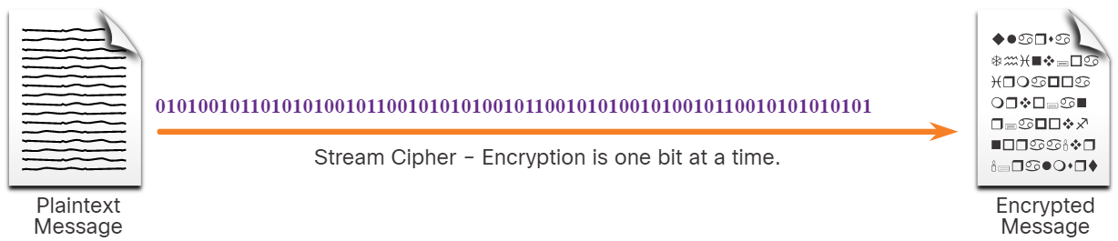
Confidentiality Symmetric Encryption (Contd.)
Stream Ciphers
Stream ciphers encrypt plaintext one byte or one bit at a time.
Stream ciphers are basically a block cipher with a block size of one byte or bit.
Stream ciphers are typically faster than block ciphers because data is continuously encrypted.
Examples include RC4 and A5 which is used to encrypt GSM cell phone communications.
Notes:
21 – Cryptography
21.2 – Confidentiality
21.2.2 – Symmetric Encryption

Slide 28
Confidentiality Symmetric Encryption (Contd.)
Well-known symmetric encryption algorithms are described in the table.
Symmetric Encryption Algorithms | Description
Data Encryption Standard (DES) | This is a legacy algorithm. It uses a short key length that makes it insecure.
3DES (Triple DES) | This is the replacement for DES and repeats the DES algorithm three times. It should be avoided as it is scheduled to be retired in 2023. If implemented, use very short key lifetimes.
Advanced Encryption Standard (AES) | It offers combinations of 128-, 192-, or 256-bit keys to encrypt 128, 192, or 256 bit-long data blocks.
Software-Optimized Encryption Algorithm (SEAL) | It is a stream cipher that uses a 160-bit encryption key and has a lower impact on the CPU compared to other software-based algorithms.
Rivest ciphers (RC) series algorithms | RC4 is a stream cipher that was used to secure web traffic. It has been found to have multiple vulnerabilities which have made it insecure. RC4 should not be used.
Notes:
21 – Cryptography
21.2 – Confidentiality
21.2.2 – Symmetric Encryption

Slide 29
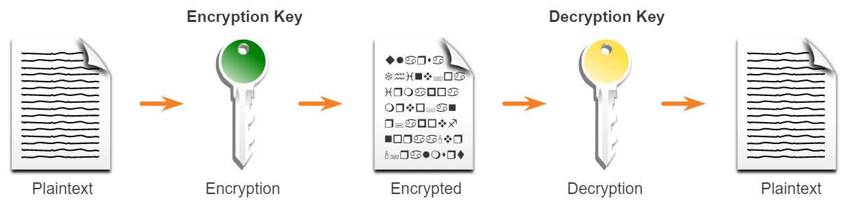
Confidentiality Asymmetric Encryption
Asymmetric algorithms, also called public-key algorithms, are designed in a way that the encryption and the decryption keys are different.
Asymmetric algorithms use a public key and a private key. Both keys are capable of the encryption process, but the complementary paired key is required for decryption.
The process is also reversible. Data that is encrypted with the public key requires the private key to decrypt.
Asymmetric algorithms achieve confidentiality and authenticity by using this process.
Asymmetric encryption can use key lengths between 512 to 4,096 bits.
Asymmetric algorithms are substantially slower than symmetric algorithms.
Notes:
21 – Cryptography
21.2 – Confidentiality
21.2.3 – Asymmetric Encryption

Slide 30
Confidentiality Asymmetric Encryption (Contd.)
Common examples of asymmetric encryption algorithms are described in the table.
Asymmetric Encryption Algorithms | Key Length | Description
Diffie-Hellman (DH) | 512, 1024, 2048, 3072, 4096 | This algorithm allows two parties to agree on a key that they can use to encrypt messages they want to send to each other. The security depends on the assumption that it is easy to raise a number to a certain power, but difficult to compute which power was used, given the number and the outcome.
Digital Signature Standard (DSS) and Digital Signature Algorithm (DSA) | 512 – 1024 | It specifies DSA as the algorithm for digital signatures. DSA is a public key algorithm based on the ElGamal signature scheme. Signature creation speed is similar to RSA, but is 10 to 40 times slower for verification.
Elliptic curve techniques | 224 or higher | Elliptic curve cryptography can be used to adapt many cryptographic algorithms, such as Diffie-Hellman or ElGamal. The main advantage of elliptic curve cryptography is that the keys can be much smaller.
Notes:
21 – Cryptography
21.2 – Confidentiality
21.2.3 – Asymmetric Encryption

Slide 31
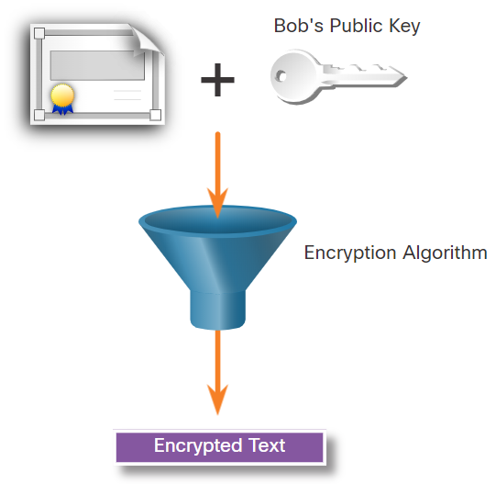
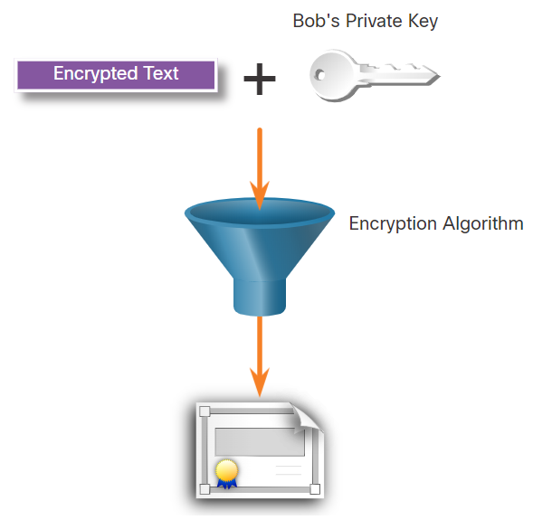
Confidentiality Asymmetric Encryption - Confidentiality
Asymmetric algorithms are used to provide confidentiality without pre-sharing a password.
The confidentiality objective of asymmetric algorithms is initiated when the encryption process is started with the public key.
The process can be summarized using the formula: Public Key (Encrypt) + Private Key (Decrypt) = Confidentiality
When the public key is used to encrypt data, the private key must be used to decrypt data.
Only one host has the private key; therefore, confidentiality is achieved.
Example: Data exchange between Bob and Alice
Alice acquires and uses Bob’s public key to encrypt a message and then send it to Bob.
Bob decrypts the message with the private key and as he is the only one with the private key, confidentiality is achieved.
Notes:
21 – Cryptography
21.2 – Confidentiality
21.2.4 – Asymmetric Encryption - Confidentiality

Slide 32
Confidentiality Asymmetric Encryption - Authentication
The authentication objective of asymmetric algorithms is initiated with the private key encryption process.
The process can be summarized using the formula: Private Key (Encrypt) + Public Key (Decrypt) = Authentication
When the private key is used to encrypt the data, the corresponding public key must be used to decrypt the data.
Because only one host has the private key, only that host could have encrypted the message, providing authentication of the sender.
When a host successfully decrypts a message using a public key, it is trusted that the private key encrypted the message, which verifies who the sender is. This is a form of authentication.
Notes:
21 – Cryptography
21.2 – Confidentiality
21.2.5 – Asymmetric Encryption - Authentication

Slide 33
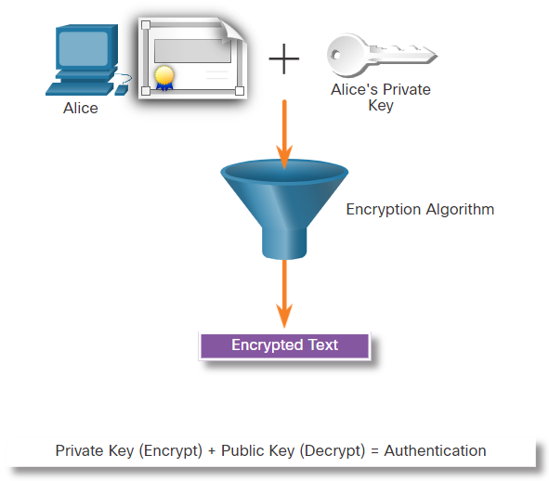
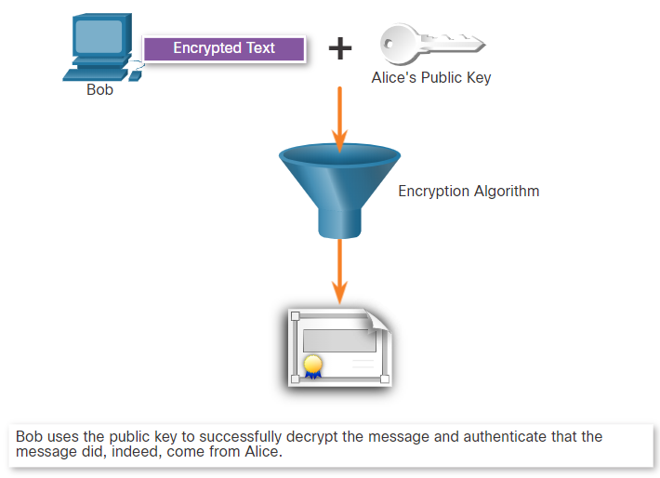
Confidentiality Asymmetric Encryption - Authentication (Contd.)
Let's see how the private and public keys can be used to provide authentication to the data exchange between Bob and Alice.
Alice uses her private key
Alice encrypts a message using her private key and sends it to Bob.
Bob decrypts using the public key
After Bob obtains Alice’s public key, he uses it to decrypt the message and to authenticate that the message has been received from Alice.
Notes:
21 – Cryptography
21.2 – Confidentiality
21.2.5 – Asymmetric Encryption - Authentication

Slide 34
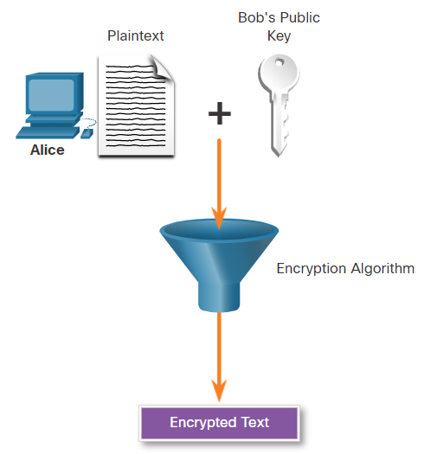
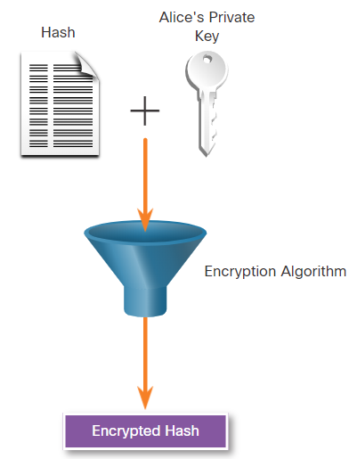
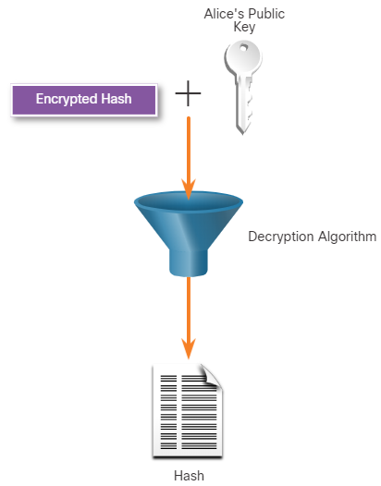
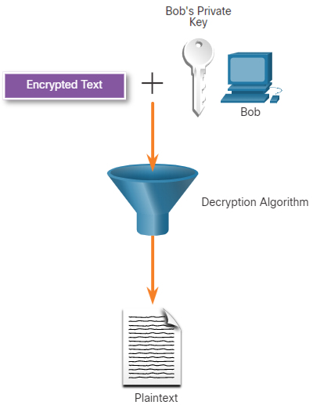
Confidentiality Asymmetric Encryption - Integrity
Combining the two asymmetric encryption processes provides message confidentiality, authentication, and integrity. In this example, a message will be ciphered using Bob’s public key and a ciphered hash will be encrypted using Alice’s private key.
Alice uses Bob’s Public Key
Alice encrypts a hash using her private key
Bob uses Alice’s public key to decrypt the hash
Bob uses his private key to decrypt the message
Notes:
21 – Cryptography
21.2 – Confidentiality
21.2.6 – Asymmetric Encryption - Integrity

Slide 35
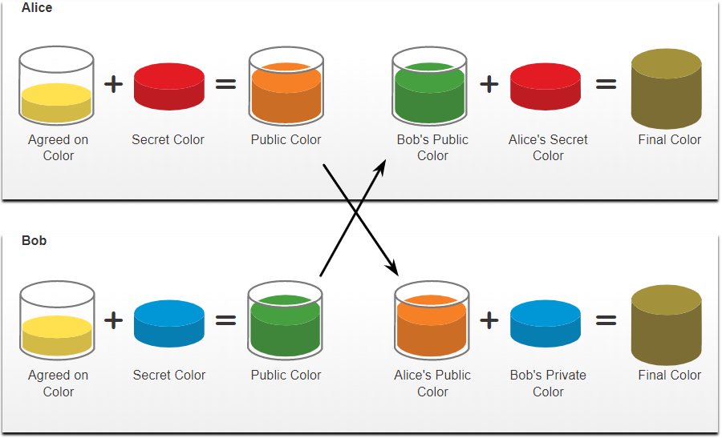
Confidentiality Diffie-Hellman
Diffie-Hellman (DH) is an asymmetric mathematical algorithm that allows two computers to generate an identical shared secret without having communicated before.
The new shared key is never actually exchanged between the sender and receiver.
The key can be used by an encryption algorithm to encrypt traffic between the two systems as both parties know it.
Following are two examples of instances when DH is commonly used:
Data is exchanged using an IPsec VPN
SSH data is exchanged
The security of DH is based on the fact that it uses very large numbers in its calculations.
DH operation
Notes:
21 – Cryptography
21.2 – Confidentiality
21.2.7 – Diffie-Hellman

Slide 36
Confidentiality Diffie-Hellman (Contd.)
Diffie-Hellman uses different DH groups to determine the strength of the key that is used in the key agreement process. The higher group numbers are more secure, but require additional time to compute the key.
The following identifies the DH groups supported by Cisco IOS Software and their associated prime number value:
DH Group 1: 768 bits
DH Group 2: 1024 bits
DH Group 5: 1536 bits
DH Group 14: 2048 bits
DH Group 15: 3072 bits
DH Group 16: 4096 bits
Note: A DH key agreement can also be based on elliptic curve cryptography. DH groups 19, 20, and 24, are supported by Cisco IOS Software.
Notes:
21 – Cryptography
21.2 – Confidentiality
21.2.7 – Diffie-Hellman

Slide 37
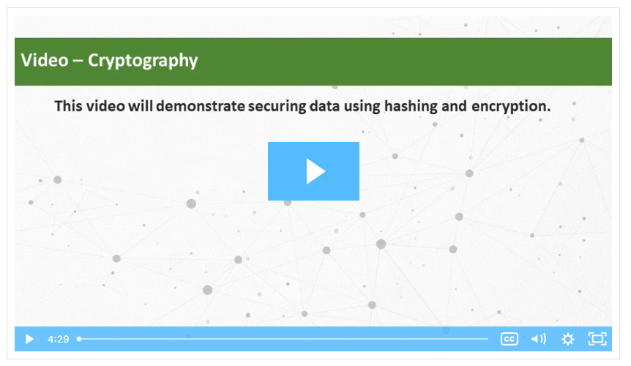
Confidentiality Video - Cryptography
Watch the video to learn more about Cryptography.
Notes:
21 – Cryptography
21.2 – Confidentiality
21.2.8 – Video – Cryptography
21.2.9 – Check Your Understanding - Classify the Encryption Algorithms

Slide 38
Confidentiality Lab - Encrypting and Decrypting Data Using OpenSSL
In this lab, you will complete the following objectives:
Encrypting Messages with OpenSSL
Decrypting Messages with OpenSSL
Notes:
21 – Cryptography
21.2 – Confidentiality
21.2.10 – Lab - Encrypting and Decrypting Data Using OpenSSL

Slide 39
Confidentiality Lab - Encrypting and Decrypting Data Using a Hacker Tool
In this lab, you will complete the following objectives:
Setup Scenario
Create and Encrypt Files
Recover Encrypted Zip File Passwords
Notes:
21 – Cryptography
21.2 – Confidentiality
21.2.11 – Lab - Encrypting and Decrypting Data Using a Hacker Tool

Slide 40
Confidentiality Lab - Examining Telnet and SSH in Wireshark
In this lab, you will complete the following objectives:
Examine a Telnet Session with Wireshark
Examine an SSH Session with Wireshark
Notes:
21 – Cryptography
21.2 – Confidentiality
21.2.12 – Lab - Examining Telnet and SSH in Wireshark

Slide 41
21.3 Public Key Cryptography
Notes:
Source:
21 – Cryptography
21.3 – Public Key Cryptography
In-Session Activities / Explanations:
Time: 10 min
Instructor Notes:
Introduce the topic and explain the properties of digital signatures.
Describe the use of digital signatures for code signing and digital certificates.
Key Points: Code signing, Digital Signature, Digital Certificate

Slide 42
Public Key Cryptography Using Digital Signatures
Digital signatures are a mathematical technique used to provide authenticity, integrity, and nonrepudiation.
Digital signatures use asymmetric cryptography.
Digital signatures are commonly used in the following two situations:
Code signing - Code signing is used to verify the integrity of executable files downloaded from a vendor website. It also uses signed digital certificates to authenticate and verify the identity of the site that is the source of the files.
Digital certificates - These are used to authenticate the identity of a system with a vendor website and establish an encrypted connection to exchange confidential data.
The Digital Signature Standard (DSS) algorithms used for generating and verifying digital signatures are:
Digital Signature Algorithm (DSA)
Rivest-Shamir Adelman Algorithm (RSA)
Elliptic Curve Digital Signature Algorithm (ECDSA)
Notes:
21 – Cryptography
21.3 – Public Key Cryptography
21.3.1 – Using Digital Signatures

Slide 43
Public Key Cryptography Digital Signatures for Code Signing
Digital signatures are commonly used to provide assurance of the authenticity and integrity of software code.
Executable files are wrapped in a digitally signed envelope, which allows the end user to verify the signature before installing the software.
Digitally signing code provides several assurances about the code:
The code is authentic and is actually sourced by the publisher.
The code has not been modified since it left the software publisher.
The publisher undeniably published the code. This provides nonrepudiation of the act of publishing.
The purpose of digitally signed software is to ensure that the software has not been tampered with, and that it originated from the trusted source as claimed.
Notes:
21 – Cryptography
21.3 – Public Key Cryptography
21.3.2 – Digital Signatures for Code Signing

Slide 44
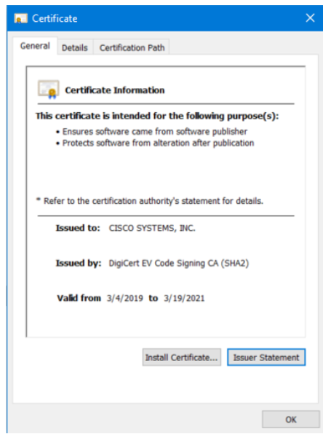
Public Key Cryptography Digital Signatures for Code Signing (Contd.)
The properties of a file that has a digitally signed certificate are as follows:
Properties | Description
File Properties | This executable file was downloaded from the internet and it contains a software tool from Cisco Systems.
Digital Signatures | This tab reveals that the file is from a trusted organization, Cisco Systems Inc.
Digital Signatures Details | This window reveals that the file was signed by Cisco Systems, Inc mentioning the given year, month and time.
Certificate Information | The General tab provides information such as who the certificate was issued to, and who issued the certificate. It also displays the period for which the certificate is valid.
Certificate Path | In this tab, you can see the file was signed by Cisco Systems, as verified to DigiCert.
Notes:
21 – Cryptography
21.3 – Public Key Cryptography
21.3.2 – Digital Signatures for Code Signing

Slide 45
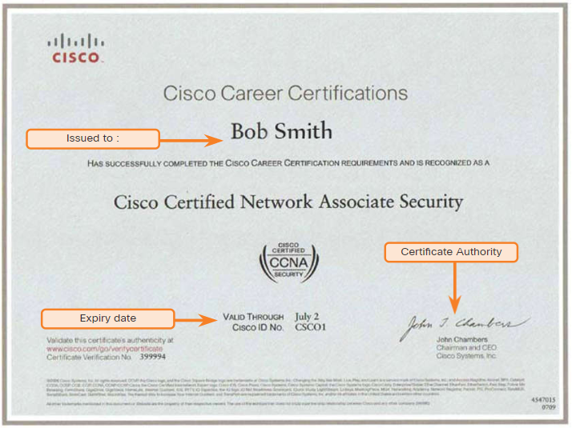
Public Key Cryptography Digital Signatures for Digital Certificates
A digital certificate enables users, hosts, and organizations to securely exchange information over the Internet.
It is used to authenticate and verify that a user who is sending a message is who they claim to be.
Digital certificates can also be used to provide confidentiality for the receiver with the means to encrypt a reply.
Digital certificates are similar to physical certificates.
Digital certificate independently verifies an identity.
In other words, a certificate verifies an identity, a signature verifies information coming from an identity.
Notes:
21 – Cryptography
21.3 – Public Key Cryptography
21.3.3 – Digital Signatures For Digital Certificates

Slide 46
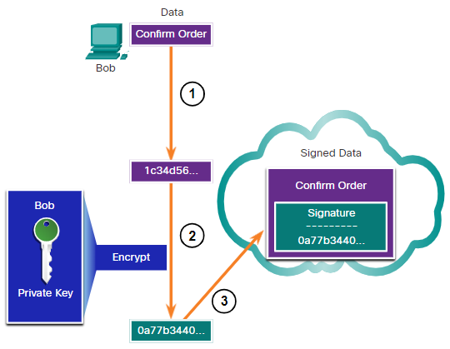
Public Key Cryptography Digital Signatures for Digital Certificates (Contd.)
This scenario will help you understand how a digital signature is used.
Bob is confirming an order with Alice, which she is ordering from Bob’s website.
Bob confirms the order and his computer creates a hash of the confirmation.
The computer encrypts the hash with Bob's private key.
The encrypted hash, which is the digital signature, is added to the document.
The order confirmation is then sent to Alice over the internet.
Notes:
21 – Cryptography
21.3 – Public Key Cryptography
21.3.3 – Digital Signatures For Digital Certificates

Slide 47
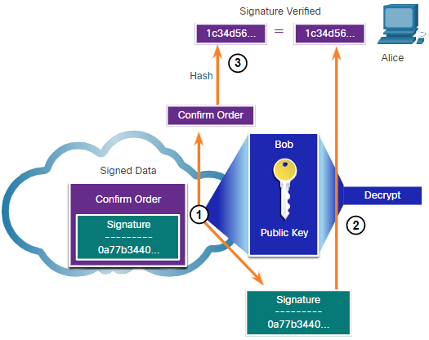
Public Key Cryptography Digital Signatures for Digital Certificates (Contd.)
When Alice receives the digital signature, the following process occurs:
Alice's receiver accepts the order confirmation with the digital signature and obtains Bob's public key.
Alice's computer then decrypts the signature using Bob's public key which reveals the assumed hash value of the sending device.
Alice's computer creates a hash of the received document, without its signature, and compares this hash to the decrypted hash.
If the hashes match, the document is authentic. This means the confirmation was sent by Bob and has not changed since signed.
Notes:
21 – Cryptography
21.3 – Public Key Cryptography
21.3.3 – Digital Signatures For Digital Certificates

Slide 48
21.4 Authorities and the PKI Trust System
Notes:
Source:
21 – Cryptography
21.4 – Authorities and the PKI Trust System
In-Session Activities / Explanations:
Time: 15 min
Instructor Notes:
Introduce the topic and discuss the Public Key Management.
Explain the Public Key Infrastructure (PKI).
Ensure the learners have knowledge of the PKI Authorities System and the PKI Trust System.
Describe the interoperability of different PKI vendors.
Brief the learners of Certificate Enrollment, Authentication, and Revocation.
By the end of the topic, help the learners to perform the Hands-on Lab.
Key Points: Public Key Management, Public Key Infrastructure (PKI), PKI Authorities System, PKI Trust System, Certificate Enrollment, Certificate Authentication, Certificate Revocation

Slide 49
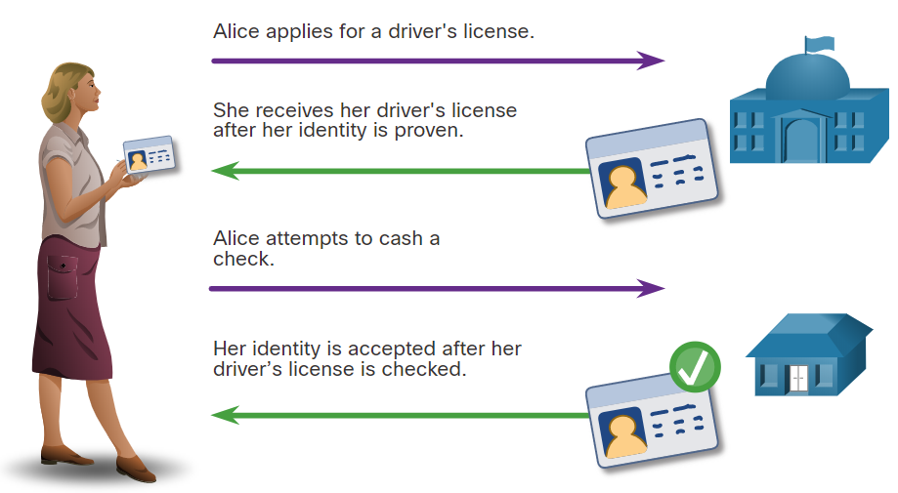
Authorities and the PKI Trust System Public Key Management
When establishing an asymmetric connection between two hosts, the hosts will exchange their public key information.
Trusted third parties on the Internet validate the authenticity of these public keys using digital certificates. The third-party issues credentials that are difficult to forge.
From that point forward, all individuals who trust the third party simply accept the credentials that the third-party issues.
The Public Key Infrastructure (PKI) consists of specifications, systems, and tools that are used to create, manage, distribute, use, store, and revoke digital certificates.
Illustrates how a driver’s license is analogous to a digital certificate
The Certificate Authority (CA) creates digital certificates by tying a public key to a confirmed identify, such as a website or individual.
Notes:
21 – Cryptography
21.4 – Authorities and the PKI Trust System
21.4.1 – Public Key Management

Slide 50
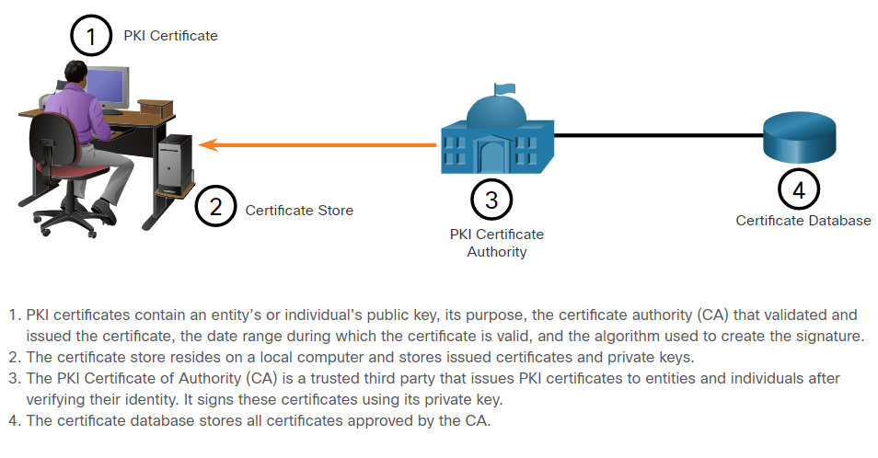
Authorities and the PKI Trust System The Public Key Infrastructure
PKI is needed to support large-scale distribution and identification of public encryption keys.
The PKI framework facilitates a highly scalable trust relationship.
It consists of the hardware, software, people, policies, and procedures needed to create, manage, store, distribute, and revoke digital certificates.
The figure shows the main elements of the PKI.
Notes:
21 – Cryptography
21.4 – Authorities and the PKI Trust System
21.4.2 – The Public Key Infrastructure

Slide 51
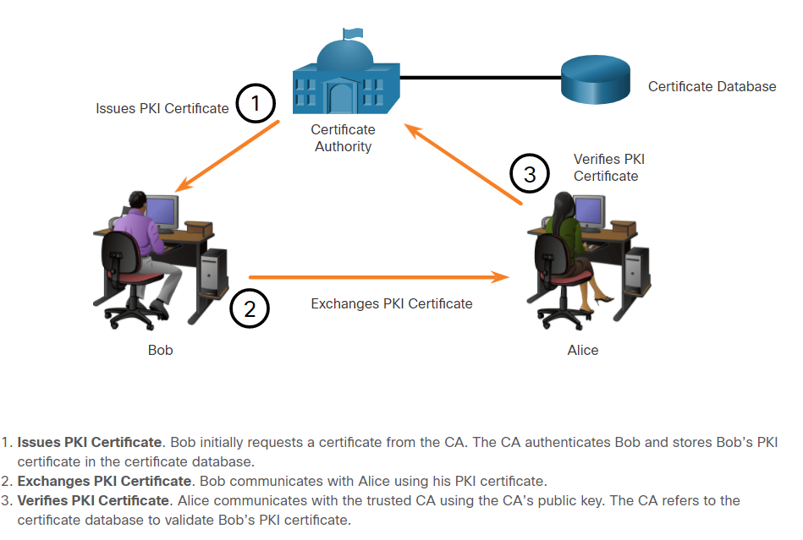
Authorities and the PKI Trust System The Public Key Infrastructure (Contd.)
The below figure shows how the elements of the PKI interoperate:
Note: Not all PKI certificates are directly received from a CA. A Registration Authority (RA) is a subordinate CA and is certified by a root CA to issue certificates for specific uses.
Notes:
21 – Cryptography
21.4 – Authorities and the PKI Trust System
21.4.2 – The Public Key Infrastructure

Slide 52
Authorities and the PKI Trust System The PKI Authorities System
Many vendors provide CA servers as a managed service or as an end-user product.
Organizations may also implement private PKIs using Microsoft Server or Open SSL.
CAs issue certificates based on classes which determine how trusted a certificate is.
The class number is determined by how rigorous the procedure was that verified the identity of the holder when the certificate was issued.
The higher the class number, the more trusted the certificate.
Some CA public keys are preloaded, such as those listed in web browsers.
Class | Description
0 | Used for testing in situations in which no checks have been performed.
1 | Used by individuals who require verification of email.
2 | Used by organizations for which proof of identity is required.
3 | Used for servers and software signing.
4 | Used for online business transactions between companies.
5 | Used for private organizations or government security.
Note: An enterprise can also implement PKI for internal use. PKI can be used to authenticate employees who are accessing the network. In this case, the enterprise is its own CA.
Notes:
21 – Cryptography
21.4 – Authorities and the PKI Trust System
21.4.3 – The PKI Authorities System

Slide 53
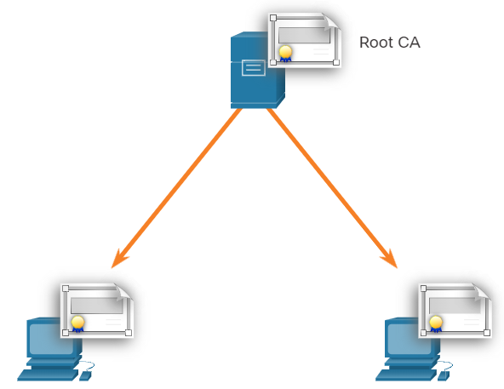
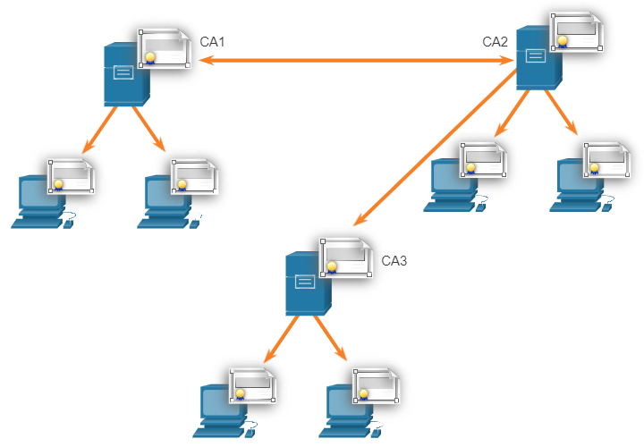
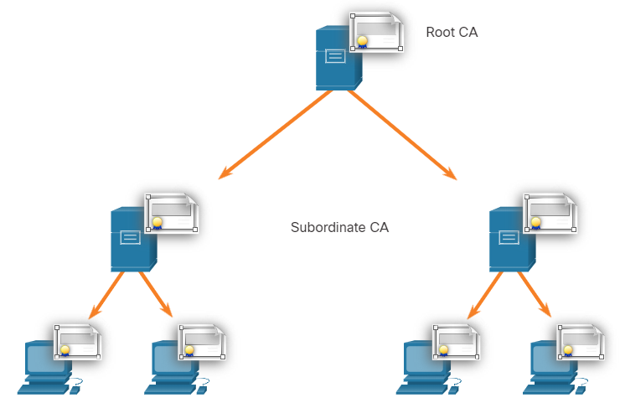
Authorities and the PKI Trust System The PKI Trust System
PKIs can form different topologies of trust which are as follows:
Single-Root PKI Topology: The simplest is the single-root PKI topology. The root CA issues all the certificates to the end users within the same organization. On larger networks, PKI CAs may be linked using two basic architectures:
Cross-certified CA topologies: A peer-to-peer model in which individual CAs establish trust relationships with other CAs by cross-certifying CA certificates.
Hierarchical CA topologies: The root CA (highest level CA), can issue certificates to end users and to a subordinate CA.
Single-Root PKI Topology
Cross-certified CA Topologies
Hierarchical CA Topologies
Notes:
21 – Cryptography
21.4 – Authorities and the PKI Trust System
21.4.4 – The PKI Trust System

Slide 54
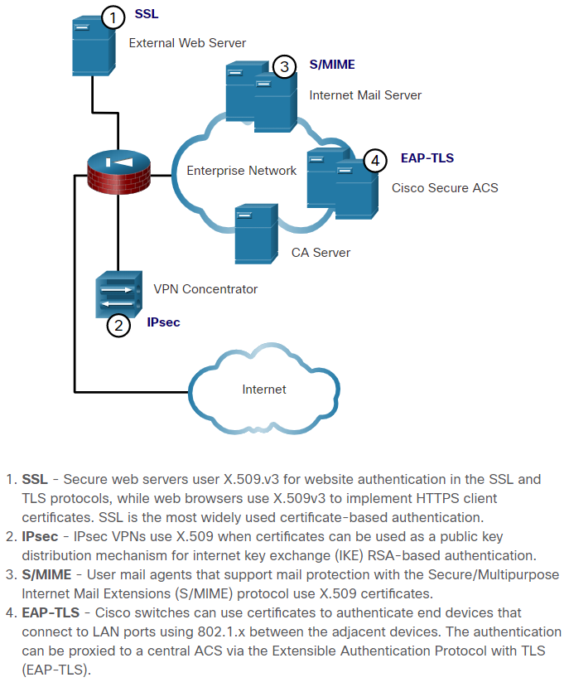
Authorities and the PKI Trust System Interoperability of Different PKI Vendors
Interoperability between a PKI and its supporting services is a concern because many CA vendors have proposed and implemented proprietary solutions.
To address this interoperability concern, the IETF published the Internet X.509 Public Key Infrastructure Certificate Policy and Certification Practices Framework (RFC 2527).
The X.509 version 3 (X.509 v3) standard defines the format of a digital certificate.
Note: LDAP and X.500 are protocols that are used to query a directory service, such as Microsoft Active Directory, to verify a username and password.
X.509v3 Applications
Notes:
21 – Cryptography
21.4 – Authorities and the PKI Trust System
21.4.5 – Interoperability of Different PKI Vendors

Slide 55
Authorities and the PKI Trust System Certificate Enrollment, Authentication and Revocation
All systems that leverage the PKI must have the CA’s public key, which is called the self-signed certificate.
The CA public key verifies all the certificates issued by the CA and is vital for the proper operation of the PKI.
The certificate enrollment process is used by a host system to enroll with a PKI. To do so, CA certificates are retrieved in-band over a network, and the authentication is done out-of-band (OOB) using the telephone.
The system enrolling with the PKI contacts a CA to request and obtain a digital identity certificate for itself and to get the CA’s self-signed certificate.
The final stage verifies that the CA certificate was authentic and is performed using an out-of-band method such as the POTS to obtain the fingerprint of the valid CA identity certificate.
A digital certificate can be revoked if key is compromised or if it is no longer needed.
Note: Only a root CA can issue a self-signed certificate that is recognized or verified by other CAs within the PKI.
Notes:
21 – Cryptography
21.4 – Authorities and the PKI Trust System
21.4.6 – Certificate Enrollment, Authentication, and Revocation

Slide 56
Authorities and the PKI Trust System Lab – Certificate Authority Stores
In this lab, you will complete the following objectives:
Certificates Trusted by Your Browser
Checking for Man-In-Middle
Notes:
21 – Cryptography
21.4 – Authorities and the PKI Trust System
21.4.7 – Lab – Certificate Authority Stores

Slide 57
21.5 Applications and Impacts of Cryptography
Notes:
Source:
21 – Cryptography
21.5 – Applications and Impacts of Cryptography
In-Session Activities / Explanations:
Time: 10 min
Instructor Notes:
Introduce the topic and discuss the PKI applications.
Explain the encrypted network transactions.
By the end of the topic, ensure the learners know of encrypted network monitoring.
Key Points: PKI applications, validity date range, signature validation error, encryption, security monitoring

Slide 58
Applications and Impacts of Cryptography PKI Applications
The following provides a short list of common uses of PKIs:
SSL/TLS certificate-based peer authentication
Secure network traffic using IPsec VPNs
HTTPS Web traffic
Control access to the network using 802.1x authentication
Secure email using the S/MIME protocol
Secure instant messaging
Approve and authorize applications with Code Signing
Protect user data with the Encryption File System (EFS)
Implement two-factor authentication with smart cards
Securing USB storage devices
Notes:
21 – Cryptography
21.5 – Applications and Impacts of Cryptography
21.5.1 – PKI Applications

Slide 59
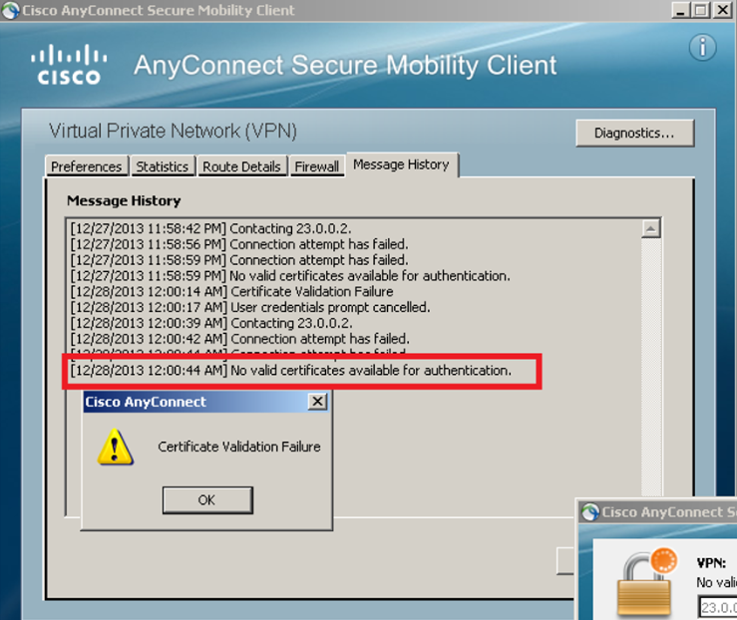
Applications and Impacts of Cryptography Encrypted Network Transactions
Threat actors can use SSL/TLS to introduce regulatory compliance violations, viruses, malware, data loss, and intrusion attempts in a network.
Other SSL/TLS-related issues may be associated with validating the certificate of a web server. When this occurs, the web browsers will display a security warning. PKI-related issues associated with security warnings include:
Validity date range - The X.509v3 certificates specify “not before” and “not after” dates. If the current date is outside the range, the web browser displays a message.
Signature validation error - If a browser cannot validate the signature on the certificate, there is no assurance that the public key in the certificate is authentic.
Notes:
21 – Cryptography
21.5 – Applications and Impacts of Cryptography
21.5.2 – Encrypted Network Transactions

Slide 60
Applications and Impacts of Cryptography Encryption and Security Monitoring
Network monitoring becomes more challenging when packets are encrypted.
As HTTPS introduces end-to-end encrypted HTTP traffic (via TLS/SSL), it is not as easy to peek into user traffic.
Security analysts must know how to circumvent and solve these issues. Here is a list of some of the things that a security analyst could do:
Configure rules to distinguish between SSL and non-SSL traffic, HTTPS and non-HTTPS SSL traffic.
Enhance security through server certificate validation using CRLs and OCSP.
Implement antimalware protection and URL filtering of HTTPS content.
Deploy a Cisco SSL Appliance to decrypt SSL traffic and send it to intrusion prevention system (IPS) appliances to identify risks normally hidden by SSL.
Notes:
21 – Cryptography
21.5 – Applications and Impacts of Cryptography
21.5.3 – Encryption and Security Monitoring

Slide 61
Applications and Impacts of Cryptography Encryption and Security Monitoring (Contd.)
Cryptography is dynamic and always changing. A security analyst must maintain a good understanding of cryptographic algorithms and operations to be able to investigate cryptography-related security incidents.
There are two main ways in which cryptography impacts security investigations.
First, attacks can be directed to specifically target the encryption algorithms themselves.
After the algorithm has been cracked and the attacker has obtained the keys, any encrypted data that has been captured can be decrypted by the attacker and read, thus exposing private data.
Secondly, the security investigation is also affected because data can be hidden in plain sight by encrypting it.
Notes:
21 – Cryptography
21.5 – Applications and Impacts of Cryptography
21.5.3 – Encryption and Security Monitoring

Slide 62
21.6 Public Key Cryptography Summary
Notes:
Source:
21 – Cryptography
21.6 – Public Key Cryptography Summary
In-Session Activities / Explanations:
Time: 5 min
Instructor Notes:
Read out the summary points mentioned on the slide.
Discuss the same with the participants.
Ask if they have any questions or doubts.
Help them finish the module quiz.
Key Points: NA

Slide 63
Public Key Cryptography Summary What Did I Learn in this Module?
The four elements of secure communications: data integrity, origin authentication, data confidentiality, and data non-repudiation.
A hash function takes a variable block of binary data, called the message, and produces a fixed-length, condensed representation, called the hash.
There are two classes of encryption that are used to provide data confidentiality: asymmetric and symmetric.
Symmetric encryption algorithms, such as DES, 3 DES, and AES are based on the premise that each communicating party knows the pre-shared key.
Asymmetric algorithms (public key algorithms) are designed so that the key that is used for encryption is different from the key used for encryption.
Data confidentiality can also be ensured using asymmetric algorithms, including Rivest, Shamir, and Aldeman (RSA) and PKI. The process is summarized using this formula: Public key (Encrypt) + Private Key (Decrypt) = Confidentiality.
Notes:
21 – Cryptography
21.6 – Public Key Cryptography Summary
21.6.1 – What Did I Learn in this Module?

Slide 64
Public Key Cryptography Summary What Did I Learn in this Module? (Contd.)
The authentication objective of an asymmetric algorithm is initiated when the encryption process is started with the private key. The process can be summarized with this formula: Private Key (Encrypt) + Public Key (Decrypt) = Authentication.
Diffie-Hellman (DH) is an asymmetric mathematical equation algorithm that allows two computers to generate an identical shared secret key without having communicate before.
Digital signatures are a mathematical technique used to provide three basic security services: authenticity, integrity, and non-repudiation. Digital signatures are commonly used in code signing and digital certificates.
The Public Key Infrastructure (PKI) consists of specifications, systems, and tools that are used to create, manage, distribute, use, store, and revoke digital certificates.
There are many common uses of PKIs including a few listed here: SSL/TLS certificate-based peer authentication, HTTPS Web traffic, secure instant message, and securing USB storage devices.
A security analyst must be able to recognize and solve potential problems related to permitting PHI-related solutions on the enterprise network.
Notes:
21 – Cryptography
21.6 – Public Key Cryptography Summary
21.6.1 – What Did I Learn in this Module?
21.6.2 – Public Key Cryptography Quiz

Slide 65
Module 21 New Terms and Commands
Hash-based Message Authentication Code (HMAC) Data Encryption Standard (DES) Certificate Authority (CA) Certificate Revocation List (CRL) Online Certificate Status Protocol (OCSP) | Diffie-Hellman Advanced Encryption Standard (AES) Rivest, Shamir, and Adleman (RSA) Elliptic Curve Digital Signature Algorithm (ECDSA) Public Key Infrastructure (PKI) | Software-Optimized Encryption Algorithm (SEAL) Internet Key Exchange (IKE) Pretty Good Privacy (PGP) Secure Socket Layer (SSL) EIGamal Digital Signature Algorithm (DSA)
Notes:
21 – Cryptography
New Terms and Commands

