Slide 1
Module 22: Endpoint Protection
Instructor Materials
CyberOps Associate v1.0
Notes:
Cisco Networking Academy Program
CyberOps Associate v1.0
Module 22: Endpoint Protection

Slide 2
Instructor Materials – Module 22 Planning Guide
This PowerPoint deck is divided in two parts:
Instructor Planning Guide
Information to help you become familiar with the module
Teaching aids
Instructor Class Presentation
Optional slides that you can use in the classroom
Begins on slide # 8
Note: Remove the Planning Guide from this presentation before sharing with anyone.
For additional help and resources go to the Instructor Home Page and Course Resources for this course. You also can visit the professional development site on www.netacad.com, the official Cisco Networking Academy Facebook page, or Instructor Only FB group.
Notes:
2

Slide 3
What to Expect in this Module
To facilitate learning, the following features within the GUI may be included in this module:
Feature | Description
Videos | Expose learners to new skills and concepts.
Check Your Understanding(CYU) | Per topic online quiz to help learners gauge content understanding.
Module Quizzes | Self-assessments that integrate concepts and skills learned throughout the series of topics presented in the module.
Module Summary | Briefly recaps module content.

Slide 4
Check Your Understanding
Check Your Understanding activities are designed to let students quickly determine if they understand the content and can proceed, or if they need to review.
Check Your Understanding activities do not affect student grades.
There are no separate slides for these activities in the PPT. They are listed in the notes area of the slide that appears before these activities.
Notes:
4

Slide 5
Module 22: Activities
What activities are associated with this module?
Page # | Activity Type | Activity Name | Optional?
22.1.5 | Check Your Understanding (CYU) | Identify Antimalware Terms and Concepts | Recommended
22.2.5 | Check your Understanding (CYU) | Identify the Host-Based Intrusion Protection Terminology | Recommended
22.3.4 | Video | Using a Sandbox to Launch Malware | Recommended
Notes:
5

Slide 6
Module 22: Best Practices
Prior to teaching Module 22, the instructor should:
Review the activities and assessments for this module.
Try to include as many questions as possible to keep students engaged during classroom presentation.
Topic 22.1
Describe the three different approaches to detecting viruses.
Explain the devices and techniques used to provide endpoint protection.
Familiarize the learners with Cisco Advanced Malware Protection (AMP).
Notes:
6

Slide 7
Module 22: Best Practices (Contd.)
Topic 22.2
Explain host-based firewall with examples.
Describe the Host-based Intrusion Detection System (HIDS) architecture.
Ask the class to search the internet for OSSEC to learn more.
Topic 22.3
Emphasize how the attack surface is expanding due to cloud-based technologies, mobility, and the Internet of Things (IoT).
Explain the sandboxing technique and the different sandbox tools.
Demonstrate a video on using sandbox environment to launch and analyze a malware attack.
Notes:
7

Slide 8
Module 22: Endpoint Protection
CyberOps Associate v1.0
Notes:
Cisco Networking Academy Program
CyberOps Associate v1.0
Module 22: Endpoint Protection
In-Session Activities / Explanations:
Time: 5 mins
Instructor Notes:
Welcome the audience in a warm and cordial manner. Ensure that everyone is set up with the required resources.
Introduce the topic and encourage learners to come up with a list of expectations from the session. Collate topics on the white board or Desktop while using learner’s inputs to interpret them in words.
Read out the Objectives and briefly describe each.
Key Points: NA

Slide 9
Module Objectives
Module Title: Endpoint Protection
Module Objective: Explain how a malware analysis website generates a malware analysis report.
Topic | Topic Objective
Antimalware Protection | Explain methods of mitigating malware
Host-based Intrusion Prevention | Explain host-based IPS/IDS log entries
Application Security | Explain how a sandbox is used to analyze malware
Notes:
9
CyberOps Associate v1.0
22 – Endpoint Protection
22.0 – Introduction
22.0.2 – What Will I Learn in this Module?

Slide 10
22.1 Antimalware Protection
Notes:
Source:
22 – Endpoint Protection
22.1 – Antimalware Protection
In-Session Activities / Explanations:
Time: 10 mins
Instructor Notes:
Discuss the endpoint threats and how to secure them.
Discuss the host-based and network-based malware protections.
Encourage the learners to complete the CYU on the ‘Identify the Antimalware Terms and Concepts.’
Key Points: Endpoints, Antimalware

Slide 11
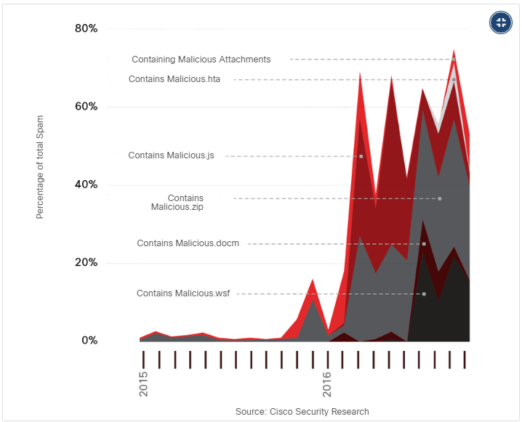
Endpoint Protection Endpoint Threats
Endpoints can be defined as hosts on the network that can access or be accessed by other hosts on the network.
Each endpoint is potentially a way for malicious software to gain access to a network.
Devices that remotely access networks through VPNs are also endpoints that could inject malware into the VPN network from the public network.
Several common types of malware have been found to significantly change features in less than 24 hours in order to evade detection.
Malicious Spam Percentage
Notes:
22 – Endpoint Protection
22.1 – Antimalware Protection
22.1.1 – Endpoint Threats

Slide 12
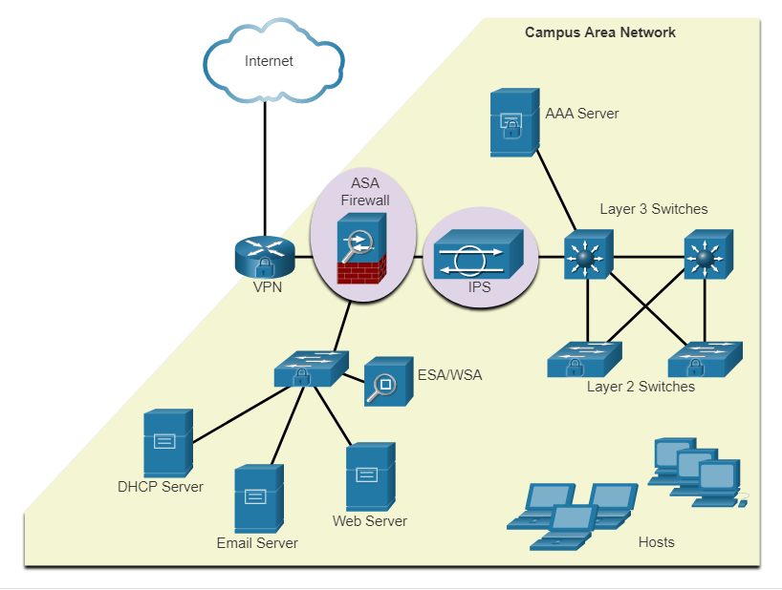
Endpoint Protection Endpoint Security
As many attacks originate from inside the network, securing an internal LAN is nearly as important as securing the outside network perimeter.
After an internal host is infiltrated, it can become a starting point for an attacker to gain access to critical system devices, such as servers and sensitive information.
There are two internal LAN elements to secure:
Endpoints - Hosts are susceptible to malware-related attacks.
Network infrastructure - LAN infrastructure devices interconnect endpoints
Notes:
22 – Endpoint Protection
22.1 – Antimalware Protection
22.1.2 – Endpoint Security

Slide 13
Endpoint Protection Host-Based Malware Protection
Host-based antimalware/antivirus software and host-based firewalls are used to protect mobile devices using VPN.
Antivirus/Antimalware Software
It is a software that is installed on a host to detect and mitigate viruses and malware. For example, Windows Defender Virus & Threat Protection, Cisco AMP for Endpoints, Norton Security, McAfee, Trend Micro, and others.
Antimalware programs may detect viruses using three different approaches:
Signature-based: Recognizes various characteristics of known malware files
Heuristics-based: Recognizes general features shared by various types of malware
Behavior-based: Employs analysis of suspicious behavior
Host-based antivirus protection, also known as agent-based, runs on every protected machine.
Notes:
22 – Endpoint Protection
22.1 – Antimalware Protection
22.1.3 – Host-Based Malware Protection

Slide 14
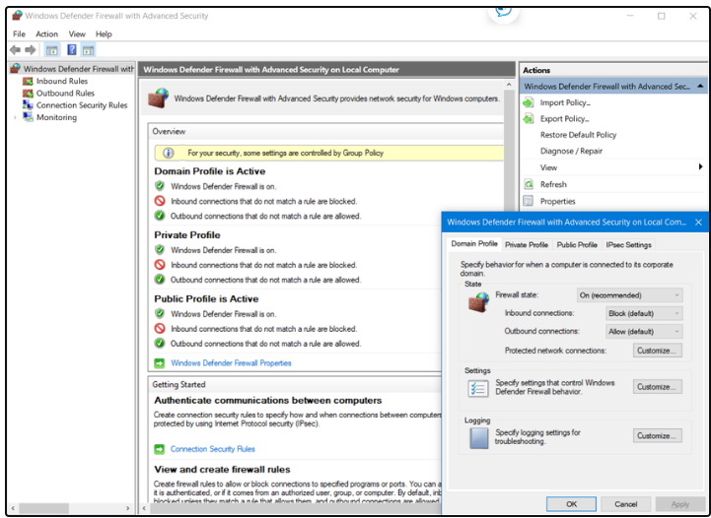
Endpoint Protection Host-Based Malware Protection (Contd.)
Host-based Firewall
This software is installed on a host.
It restricts incoming and outgoing connections to connections initiated by that host only.
Some firewall software can prevent a host from becoming infected and stop infected hosts from spreading malware to other hosts. This function is included in some operating systems.
For example, Windows includes Windows Defender Firewall with Advanced Security.
Notes:
22 – Endpoint Protection
22.1 – Antimalware Protection
22.1.3 – Host-Based Malware Protection

Slide 15
Endpoint Protection Host-Based Malware Protection (Contd.)
Host-based Security Suites
It is recommended to install a host-based suite of security products on home and business networks to provide a layered defense that will protect against most common threats.
These include antivirus, anti-phishing, safe browsing, Host-based intrusion prevention system, and firewall capabilities.
Host-based security products also provide telemetry function.
Most host-based security software includes robust logging functionality that is essential to cyber security operations.
The independent testing laboratory AV-TEST provides high-quality reviews of host-based protections, as well as information about many other security products.
Notes:
22 – Endpoint Protection
22.1 – Antimalware Protection
22.1.3 – Host-Based Malware Protection

Slide 16
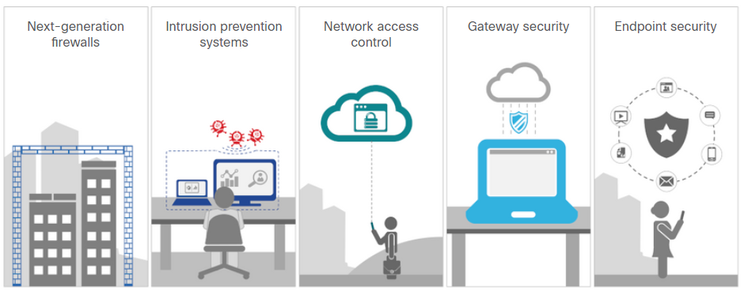
Endpoint Protection Network-Based Malware Protection
Network-based malware prevention devices are capable of sharing information among themselves to make better informed decisions.
Protecting endpoints in a borderless network can be accomplished using network-based, as well as host-based techniques.
Advanced Malware Protection Everywhere
Notes:
22 – Endpoint Protection
22.1 – Antimalware Protection
22.1.4 – Network-Based Malware Protection

Slide 17
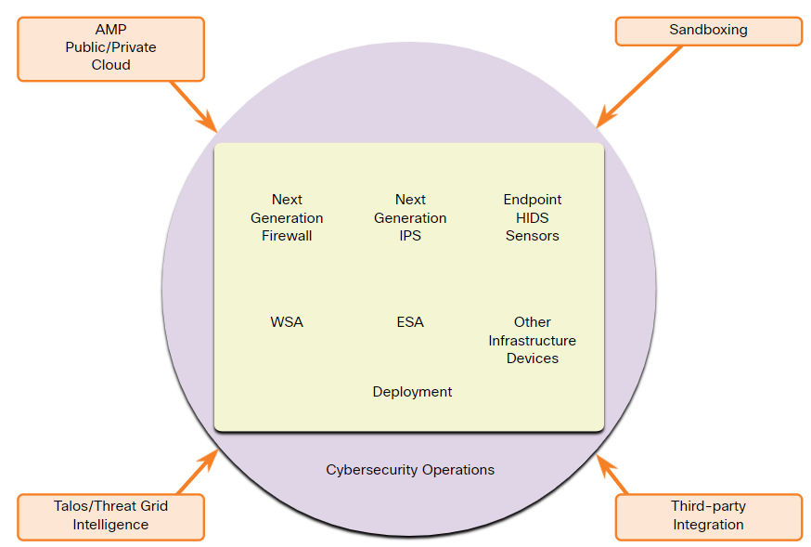
Endpoint Protection Network-Based Malware Protection (Contd.)
Some examples of devices and techniques that implement host protections at the network level:
Advanced Malware Protection (AMP) - Provides endpoint protection from viruses and malware.
Email Security Appliance (ESA) - Provides filtering of SPAM and potentially malicious emails before they reach the endpoint.
Web Security Appliance (WSA) - Provides filtering of websites and blacklisting
Network Admission Control (NAC) - Permits only authorized and compliant systems to connect to the network.
Notes:
22 – Endpoint Protection
22.1 – Antimalware Protection
22.1.4 – Network-Based Malware Protection
22.1.5 – Check Your Understanding - Identify Antimalware Terms and Concepts

Slide 18
22.2 Host-Based Intrusion Protection
Notes:
Source:
22 – Endpoint Protection
22.2 – Host-Based Intrusion Protection
In-Session Activities / Explanations:
Time: 10 mins
Instructor Notes:
Explain the host-based firewalls.
Provide an overview of HIDS
Discuss HIDS operation
Explain HIDS products
Encourage the learners to complete the CYU on Identify the Host-Based Intrusion Protection Terminology.
Key Points: Host-based Firewalls, HIDS, OSSEC

Slide 19
Host-Based Intrusion Protection Host-Based Firewalls
Host-based personal firewalls are standalone software programs that control traffic entering or leaving a computer.
Host-based firewall applications can also be configured to issue alerts to users if suspicious behavior is detected.
Some examples of host-based firewalls:
Windows Defender Firewall – First included with Windows XP, Windows Firewall (now Windows Defender Firewall) uses a profile-based approach to firewall functionality.
iptables – This is an application that allows Linux system administrators to configure network access rules that are part of the Linux kernel Netfilter modules.
nftables – The successor to iptables, nftables is a Linux firewall application that uses a simple virtual machine in the Linux kernel.
TCP Wrappers – This is a rule-based access control and logging system for Linux.
Notes:
22 – Endpoint Protection
22.2 – Host-Based Intrusion Protection
22.2.1 – Host-Based Firewalls

Slide 20
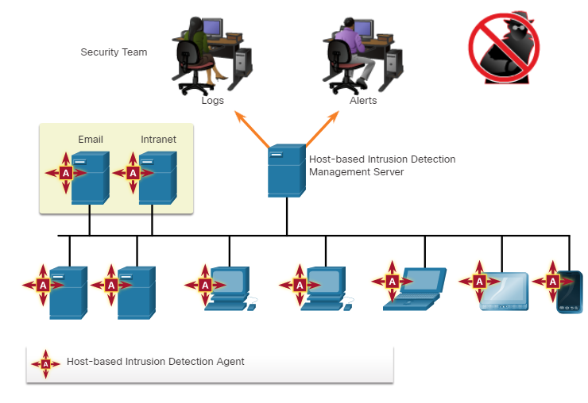
Host-Based Intrusion Protection Host-Based Intrusion Detection
A Host-based Intrusion Detection System (HIDS) is designed to protect hosts against known and unknown malware.
A HIDS can perform detailed monitoring and reporting on the system configuration and application activity.
HIDS is a comprehensive security application that combines the functionalities of antimalware applications with firewall functionality.
As HIDS must run directly on the host, it is considered as an agent-based system.
Host-based Intrusion Detection Architecture
Notes:
22 – Endpoint Protection
22.2 – Host-Based Intrusion Protection
22.2.2 – Host-Based Intrusion Detection

Slide 21
Host-Based Intrusion Protection HIDS Operation
A HIDS can prevent intrusion because it uses signatures to detect known malware and prevent it from infecting a system.
Some malware families exhibit polymorphism.
An additional set of strategies are used to detect the possibility of successful intrusions by malware that evades signature detection:
Anomaly based - Host system behavior is compared to a learned baseline model of normal behavior. If an intrusion is detected, the HIDS can log details of the intrusion, send alerts to security management systems, and take action to prevent the attack.
Policy based - Normal system behavior is described by rules, or the violation of rules, that are predefined. Violation of these policies will result in action by the HIDS, such as shut down of software processes.
Notes:
22 – Endpoint Protection
22.2 – Host-Based Intrusion Protection
22.2.3 – HIDS Operation

Slide 22
Host-Based Intrusion Protection HIDS Products
Most of the HIDS utilize software on the host and some sort of centralized security management functionality that allows integration with network security monitoring services and threat intelligence.
Some examples are Cisco AMP, AlienVault USM, Tripwire, and Open Source HIDS SECurity (OSSEC).
OSSEC uses a central manager server and agents that are installed on individual hosts.
The OSSEC server, or Manager, can also receive and analyze alerts from a variety of network devices and firewalls over syslog.
OSSEC monitors system logs on hosts and also conducts file integrity checking.
Notes:
22 – Endpoint Protection
22.2 – Host-Based Intrusion Protection
22.2.4 – HIDS Products
22.2.5 – Check your Understanding - Identify the Host-Based Intrusion Protection Terminology

Slide 23
22.3 Application Security
Notes:
Source:
22 – Endpoint Protection
22.3 – Application Security
In-Session Activities / Explanations:
Time: 10 mins
Instructor Notes:
Briefly explain attack surface.
Reinforce the difference between blacklisting and whitelisting.
Encourage the learners to gather information on ‘The Spamhaus Project’ and present it in the class.
Describe system-based sandboxing
Key Points: Attack Surface, Blacklisting, Whitelisting, System-based Sandboxing

Slide 24
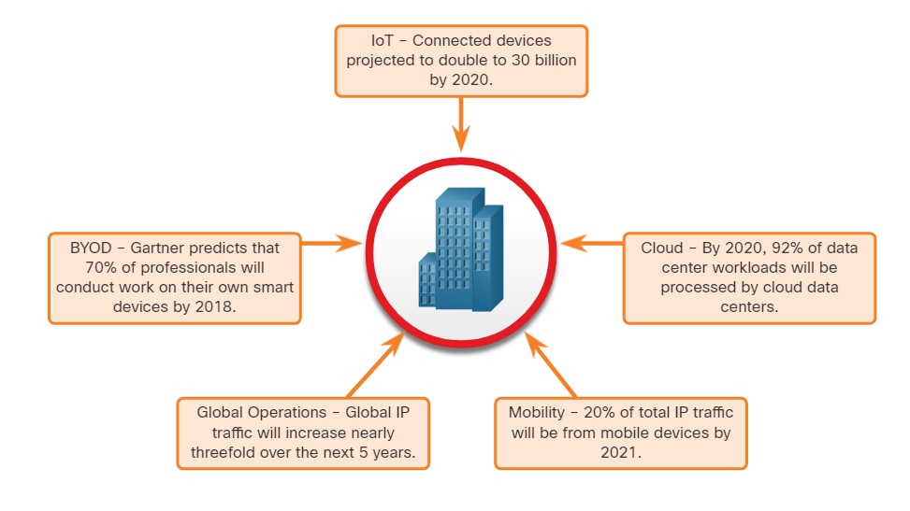
Application Security Attack Surface
An attack surface is the total sum of the vulnerabilities in a given system that is accessible to an attacker.
It can consist of open ports on servers or hosts, software running on internet-facing servers, wireless network protocols, and users.
Components of the Attack Surface:
Network Attack Surface: Exploits vulnerabilities in networks.
Software Attack Surface: Delivered through exploitation of vulnerabilities in web, cloud, or host-based software applications.
Human Attack Surface: Exploits weaknesses in user behavior.
An Expanding Attack Surface
Notes:
22 – Endpoint Protection
22.3 – Application Security
22.3.1 – Attack Surface

Slide 25
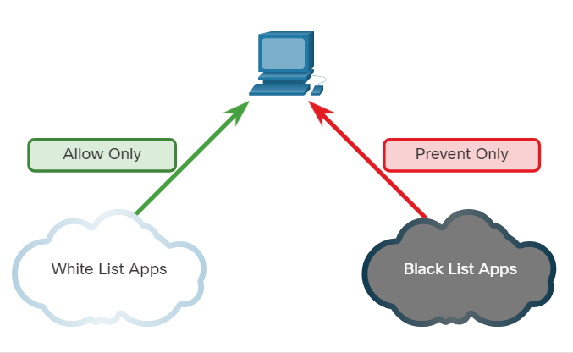
Application Security Application Blacklisting and Whitelisting
Limiting access to potential threats by creating lists of prohibited applications is known as blacklisting.
Application blacklists can dictate which user applications are not permitted to run on a computer.
Whitelists specify which programs are allowed to run.
In this way, known vulnerable applications can be prevented from creating vulnerabilities on network hosts.
Application Blacklisting and Whitelisting
Notes:
22 – Endpoint Protection
22.3 – Application Security
22.3.2 – Application Blacklisting and Whitelisting

Slide 26
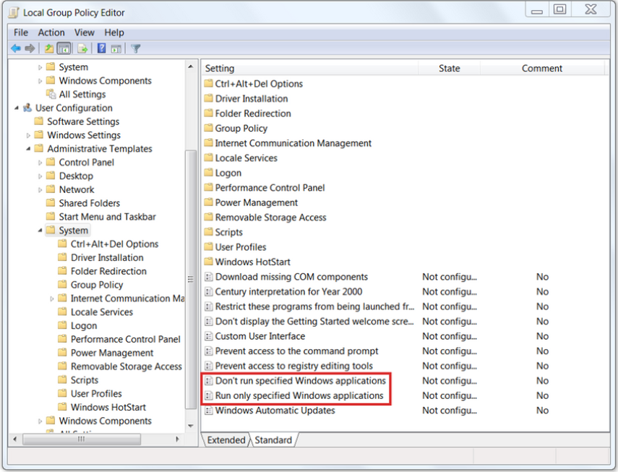
Application Security Application Blacklisting and Whitelisting (Contd.)
Websites can also be whitelisted and blacklisted.
These blacklists can be manually created, or they can be obtained from various security services.
Blacklists can be continuously updated by security services and distributed to firewalls and other security systems that use them.
Cisco’s Firepower security management system is an example of a system that can access the Cisco Talos security intelligence service to obtain blacklists.
Notes:
22 – Endpoint Protection
22.3 – Application Security
22.3.2 – Application Blacklisting and Whitelisting

Slide 27
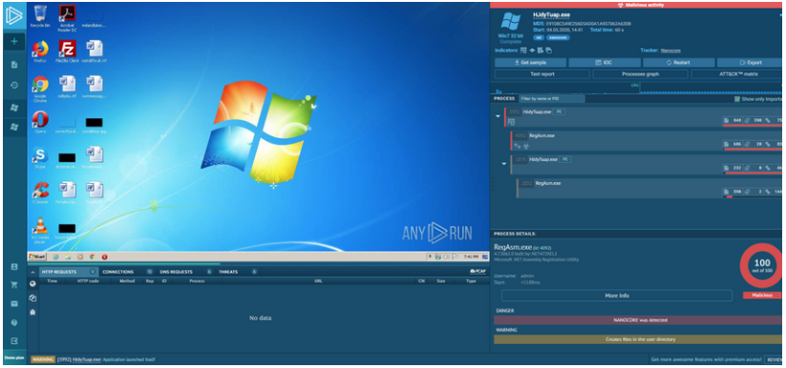
Application Security System-Based Sandboxing
Sandboxing is a technique that allows suspicious files to be executed and analyzed in a safe environment.
Cuckoo Sandbox is a popular free malware analysis system sandbox. It can be run locally and have malware samples submitted to it for analysis.
ANY.RUN is an online tool that offers the ability to upload a malware sample for analysis like any online sandbox.
Notes:
22 – Endpoint Protection
22.3 – Application Security
22.3.3 – System-Based Sandboxing

Slide 28
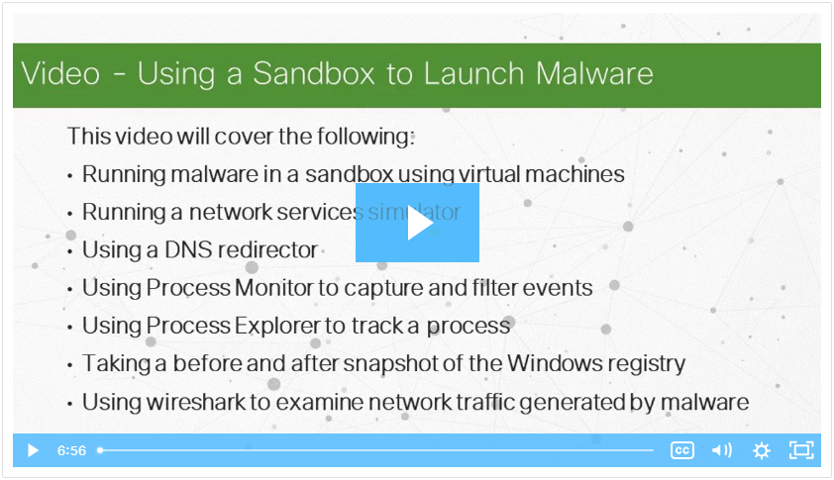
Application Security Video - Using a Sandbox to Launch Malware
Play the video to view a demonstration of using sandbox environment to launch and analyze a malware attack.
Notes:
22 – Endpoint Protection
22.3 – Application Security
22.3.4 – Video - Using a Sandbox to Launch Malware

Slide 29
22.4 Endpoint Protection Summary
Notes:
Source:
22 – Endpoint Protection
22.4 – Endpoint Protection Summary
In-Session Activities / Explanations:
Time: 5 mins
Instructor Notes:
Read out the summary points mentioned on the slide.
Discuss the same with the participants.
Ask if they have any questions or doubts.
Ensure that the learners complete the module quiz.
Key Points: NA

Slide 30
Endpoint Protection Summary What Did I Learn in this Module?
Endpoints are defined as hosts on the network that can access or be accessed by other hosts on the network.
There are two internal LAN elements to secure: Endpoints and Network Infrastructure.
Antivirus/Antimalware Software is installed on a host to detect and mitigate viruses and malware.
Host-based firewalls may use a set of predefined policies, or profiles, to control packets entering and leaving a computer.
Some examples of host-based firewalls include Windows Defender Firewall, iptables, nftables, and TCP Wrappers.
HIDS protects hosts against known and unknown malware.
An attack surface is the total sum of the vulnerabilities in a given system that is accessible to an attacker.
Application blacklists dictate which user applications are not permitted to run on a computer and whitelists specify which programs are allowed to run.
Notes:
22 – Endpoint Protection
22.4 – Endpoint Protection Summary
22.4.1 – What Did I Learn in this Module?
22.4.2 – Endpoint Protection Quiz

Slide 31
Module 22 New Terms and Commands
Antivirus/Antimalware Endpoint | Host-based firewall Sandboxing | Host-based Intrusion Detection System (HIDS) Attack Surface
Notes:
22 – Endpoint Protection
New Terms and Commands

