Slide 1
Module 23: Endpoint Vulnerability Assessment
Instructor Materials
CyberOps Associate v1.0
Notes:
Cisco Networking Academy Program
CyberOps Associate v1.0
Module 23 – Endpoint Vulnerability Assessment

Slide 2
Instructor Materials – Module 23 Planning Guide
This PowerPoint deck is divided in two parts:
Instructor Planning Guide
Information to help you become familiar with the module
Teaching aids
Instructor Class Presentation
Optional slides that you can use in the classroom
Begins on slide # 9
Note: Remove the Planning Guide from this presentation before sharing with anyone.
For additional help and resources go to the Instructor Home Page and Course Resources for this course. You also can visit the professional development site on www.netacad.com, the official Cisco Networking Academy Facebook page, or Instructor Only FB group.
Notes:
2

Slide 3
What to Expect in this Module
To facilitate learning, the following features within the GUI may be included in this module:
Feature | Description
Check Your Understanding (CYU) | Per topic online quiz to help learners gauge content understanding.
Module Quizzes | Self-assessments that integrate concepts and skills learned throughout the series of topics presented in the module.
Module Summary | Briefly recaps module content.

Slide 4
Check Your Understanding
Check Your Understanding activities are designed to let students quickly determine if they understand the content and can proceed, or if they need to review.
Check Your Understanding activities do not affect student grades.
There are no separate slides for these activities in the PPT. They are listed in the notes area of the slide that appears before these activities.
Notes:
4

Slide 5
Module 23: Activities
What activities are associated with this module?
Page # | Activity Type | Activity Name | Optional?
23.1.5 | Check Your Understanding | Identify the Elements of Network Profiling | Recommended
23.2.7 | Check Your Understanding | Identify CVSS Metrics | Recommended
23.3.2 | Check Your Understanding | Identify the Risk Response | Recommended
23.3.9 | Check Your Understanding | Identify Device Management Activities | Recommended
23.4.4 | Check Your Understanding | Identify the Stages in the NIST Cybersecurity Framework | Recommended
Notes:
5

Slide 6
Module 23: Best Practices
Prior to teaching Module 23, the instructor should:
Review the activities and assessments for this module.
Try to include as many questions as possible to keep students engaged during classroom presentation.
Topic 23.1
Differentiate between network and server profiling with examples.
List the different examples of the activities involved in network vulnerability testing.
Notes:
6

Slide 7
Module 23: Best Practices (Contd.)
Topic 23.2
Describe the Common Vulnerability Scoring System (CVSS).
Ask the learners to search the internet for Mitre for more information on CVE.
Familiarize the learners with CVE and NVD vulnerabilities resources.
Topic 23.3
Divide the class into different groups and assign topics to each group- Risk Management, Asset management, Mobile device management, Patch management, Enterprise Patch Management and Configuration Management. Tell them to present and provide your inputs.
Ask the learners to refer to NIST Special Publication 800-30 to get an insight of risk assessment
Inform the learners to refer to NIST Special Publication 800-128 on configuration management for more information.
Notes:
7

Slide 8
Module 23: Best Practices (Contd.)
Topic 23.4
Describe the organizational capability model.
Explain the relationship between ISO-27001 and the Plan, Do, Check and Act cycle.
Ensure that the learners complete the ‘Check Your Understanding - Identify the Stages in the NIST Cybersecurity Framework’ in section 23.4.4.
Notes:
8

Slide 9
Module 23: Endpoint Vulnerability Assessment
CyberOps Associate v1.0
Notes:
Cisco Networking Academy Program
CyberOps Associate v1.0
Module 23 – Endpoint Vulnerability Assessment
In-Session Activities / Explanations:
Time: 2 mins
Instructor Notes:
Welcome the audience in a warm and cordial manner. Ensure that everyone is set up with the required resources.
Introduce the topic and encourage learners to come up with a list of expectations from the session. Collate topics on the white board or Desktop while using learner’s inputs to interpret them in words.
Read out the Objectives and briefly describe each.
Key Points: NA

Slide 10
Module Objectives
Module Title: Endpoint Vulnerability Assessment
Module Objective: Explain how endpoint vulnerabilities are assessed and managed.
Content
Topic Title | Topic Objective
Network and Server Profiling | Explain the value of network and server profiling.
Common Vulnerability Scoring System (CVSS) | Explain how CVSS reports are used to describe security vulnerabilities.
Secure Device Management | Explain how secure device management techniques are used to protect data and assets.
Information Security Management Systems | Explain how information security management systems are used to protect assets.
Notes:
10
Cisco Networking Academy Program
CyberOps Associate v1.0
Module 23 – Endpoint Vulnerability Assessment
23.0 – Introduction
23.0.2 - What ill I Learn in this Module?

Slide 11
23.1 Network and Server Profiling
Notes:
Source:
23 – Endpoint Vulnerability Assessment
23.1 – Network and Server Profiling
In-Session Activities / Explanations:
Time: 10 mins
Instructor Notes:
Explain the importance of network and server profiling
Emphasize on the different activities and tools in vulnerability testing
Discuss tools that can be used to describe normal network traffic characteristics.
Walk the learners through Network Anomaly Detection.
Key Points: Network Profiling, Server Profiling, Anomaly detection, Network Vulnerability Assessment.

Slide 12
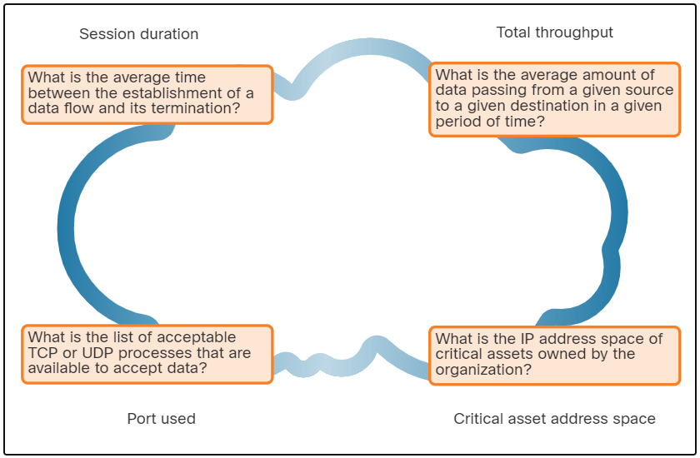
Network and Server Profiling Network Profiling
Network and device profiling provides statistical baseline information that can serve as a reference point for normal network and device performance.
Elements of network profile:
Session duration
Total throughput
Critical asset address space
Typical traffic type
Elements of a Network Profile
Notes:
23 – Endpoint Vulnerability Assessment
23.1 – Network and Server Profiling
23.1.1 – Network Profiling

Slide 13
Network and Server Profiling Server Profiling
A server profile is a security baseline for a given server.
Server profiling is used to establish the accepted operating state of servers.
The server profile elements are as follows:
Listening ports
Logged in users and accounts
Service accounts
Software environment
Notes:
23 – Endpoint Vulnerability Assessment
23.1 – Network and Server Profiling
23.1.2 – Server Profiling

Slide 14
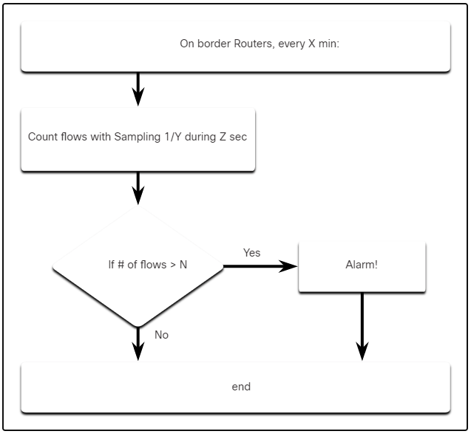
Network and Server Profiling Network Anomaly Detection
Network behavior is described by a large amount of diverse data such as the features of packet flow, features of the packets themselves, and telemetry from multiple sources.
Big Data analytics techniques can be used to analyze this data and detect variations from the baseline.
Anomaly detection can identify infected hosts on the network that are scanning for other vulnerable hosts.
The figure illustrates a simplified version of an algorithm designed to detect an unusual condition at the border routers of an enterprise.
Notes:
23 – Endpoint Vulnerability Assessment
23.1 – Network and Server Profiling .
23.1.3 – Network Anomaly Detection

Slide 15
Network and Server Profiling Network Vulnerability Testing
Network Vulnerability Testing includes Risk Analysis, Vulnerability Assessment and Penetration Testing.
The table lists examples of activities and tools that are used in vulnerability testing:
Activity | Description | Tools
Risk analysis | Individuals conduct comprehensive analysis of impacts of attacks on core company assets and functioning | Internal or external consultants, risk management frameworks
Vulnerability Assessment | Patch management, host scans, port scanning, other vulnerability scans and services | OpenVas, Microsoft Baseline Analyzer, Nessus, Qualys, Nmap
Penetration Testing | Use of hacking techniques and tools to penetrate network defenses and identify depth of potential penetration | Metasploit, CORE Impact, ethical hackers
Notes:
23 – Endpoint Vulnerability Assessment
23.1 – Network and Server Profiling .
23.1.4 – Network Vulnerability Testing
23.1.5 – Check Your Understanding - Identify the Elements of Network Profiling

Slide 16
23.2 Common Vulnerability Scoring System (CVSS)
Notes:
Source:
23 – Endpoint Vulnerability Assessment
23.2 – Network and Server Profiling
In-Session Activities / Explanations:
Time: 10 mins
Instructor Notes:
Provide an overview of CVSS.
Discuss the CVSS process
Review the CVSS reports
Explain the CVSS metric groups
Key Points: CVSS, key terms, CVSS base metric group, CVSS Process, CVSS Reports,

Slide 17
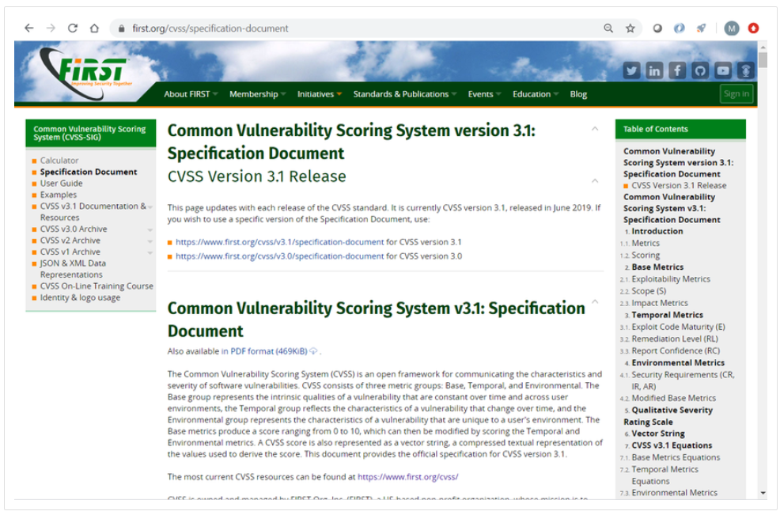
Common Vulnerability Scoring System (CVSS)
CVSS Overview
The Common Vulnerability Scoring System (CVSS) is a risk assessment tool designed to convey the common attributes and severity of vulnerabilities in computer hardware and software systems.
CVSS provides standardized vulnerability scores.
It provides an open provides an open framework with metrics to all users.
CVSS helps prioritize risk.
The Forum of Incident Response and Security Teams (FIRST) has been designated as the custodian of the CVSS to promote its adoption globally.
Notes:
23 – Endpoint Vulnerability Assessment
23.2 – Common Vulnerability Scoring System (CVSS)
23.2.1 – CVSS Overview

Slide 18
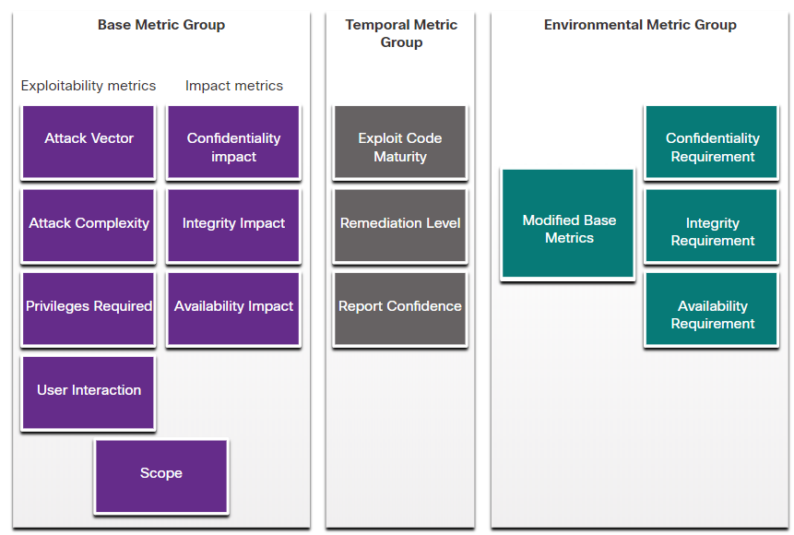
Common Vulnerability Scoring System (CVSS)
CVSS Metric Groups
The CVSS uses three groups of metrics to assess vulnerability.
Base Metric Group: Represents the characteristics of a vulnerability that are constant over time and across contexts.
Temporal Metric Group: Measures the characteristics of a vulnerability that may change over time, but not across user environments.
Environmental Metric Group: Measures the aspects of a vulnerability that are rooted in a specific organization’s environment.
Notes:
23 – Endpoint Vulnerability Assessment
23.2 – Common Vulnerability Scoring System (CVSS)
23.2.2 – CVSS Metric Groups

Slide 19
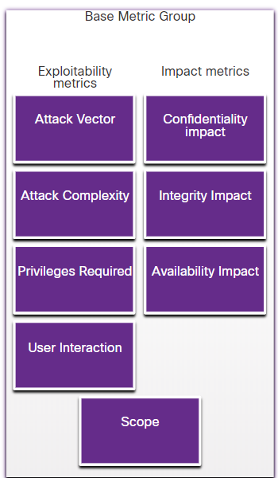
Common Vulnerability Scoring System (CVSS)
CVSS Base Metric Group
Base Metric Group Exploitability metrics include the following criteria:
Attack vector
Attack complexity
Privileges required
User interaction
Scope
Base Metric Group Impact metrics components include the following criteria:
Confidentiality Impact
Integrity Impact
Availability Impact
Notes:
23 – Endpoint Vulnerability Assessment
23.2 – Common Vulnerability Scoring System (CVSS)
23.2.3 – CVSS Base Metric Group

Slide 20
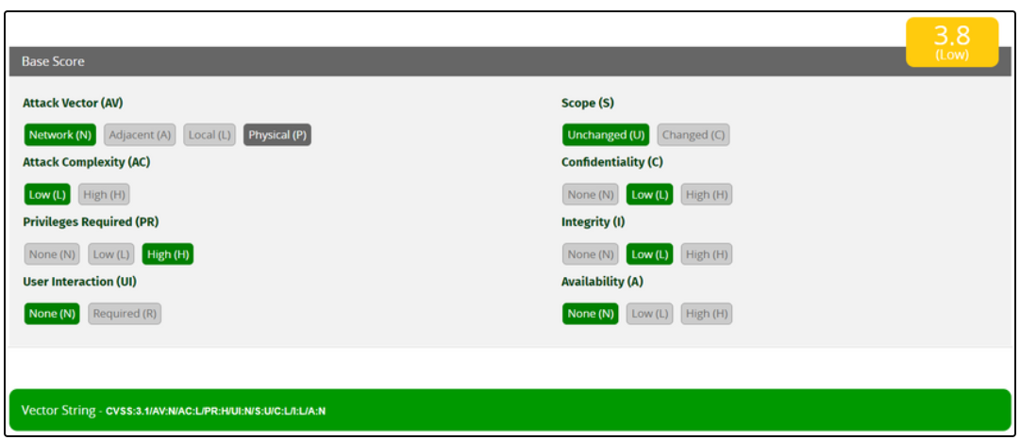
Common Vulnerability Scoring System (CVSS)
The CVSS Process
The CVSS process uses a tool called the CVSS v3.1 Calculator.
The calculator is like a questionnaire in which the choices are made that describe the vulnerability for each metric group.
Later, a score is generated and numeric severity rating is displayed.
Notes:
23 – Endpoint Vulnerability Assessment
23.2 – Common Vulnerability Scoring System (CVSS)
23.2.4 – The CVSS Process

Slide 21
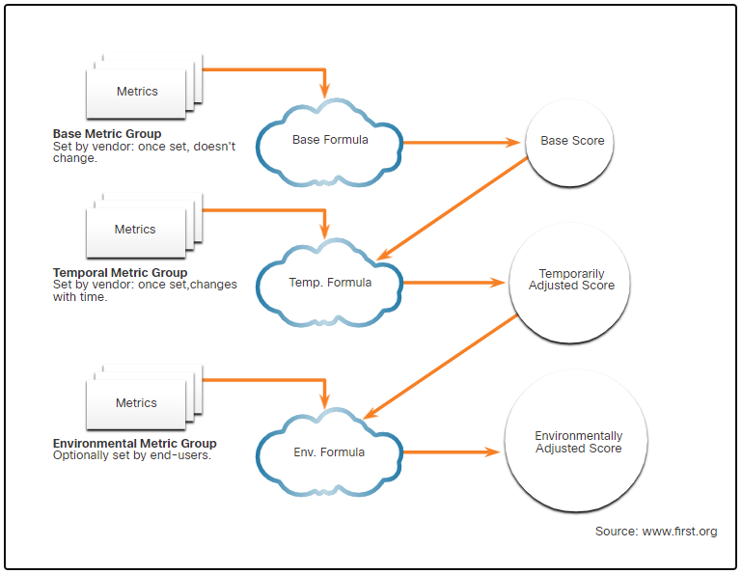
Common Vulnerability Scoring System (CVSS)
The CVSS Process (Contd.)
After the Base Metric group is completed, the Temporal and Environmental metric values modify the Base Metric results to provide an overall score.
Notes:
23 – Endpoint Vulnerability Assessment
23.2 – Common Vulnerability Scoring System (CVSS)
23.2.4 – The CVSS Process

Slide 22
Common Vulnerability Scoring System (CVSS)
CVSS Reports
The higher the severity rating, the greater the potential impact of an exploit and the greater the urgency in addressing the vulnerability.
Any vulnerability that exceeds 3.9 should be addressed.
The ranges of scores and the corresponding qualitative meaning is shown in the table:
Rating | CVSS Score
None | 0
Low | 0.1 – 3.9
Medium | 4.0 – 6.9
High | 7.0 – 8.9
Critical | 9.0 – 10.0
Notes:
23 – Endpoint Vulnerability Assessment
23.2 – Common Vulnerability Scoring System (CVSS)
23.2.5 – CVSS Reports

Slide 23
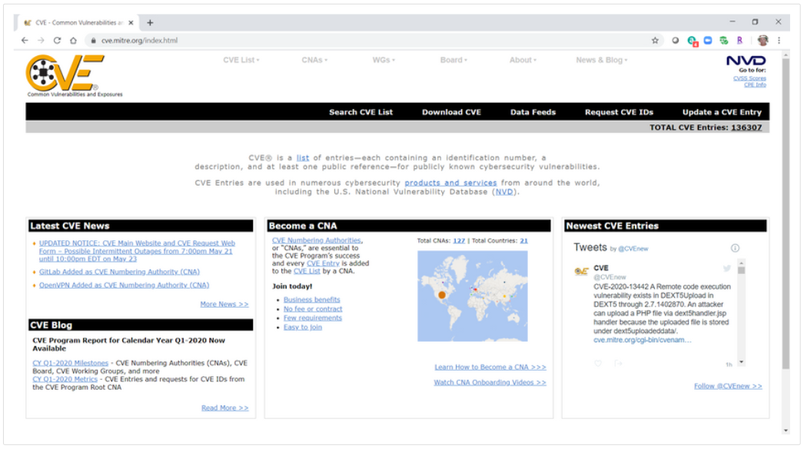
Common Vulnerability Scoring System (CVSS)
Other Vulnerability Information Sources
Common Vulnerabilities and Exposures (CVE):
CVE identifier provides a standard way to research a reference to vulnerabilities.
Threat intelligence services use CVE identifiers, and they appear in various security system logs.
The CVE Details website provides a linkage between CVSS scores and CVE information.
Notes:
23 – Endpoint Vulnerability Assessment
23.2 – Common Vulnerability Scoring System (CVSS)
23.2.6 – Other Vulnerability Information Sources
23.2.7 – Check Your Understanding - Identify CVSS Metrics

Slide 24
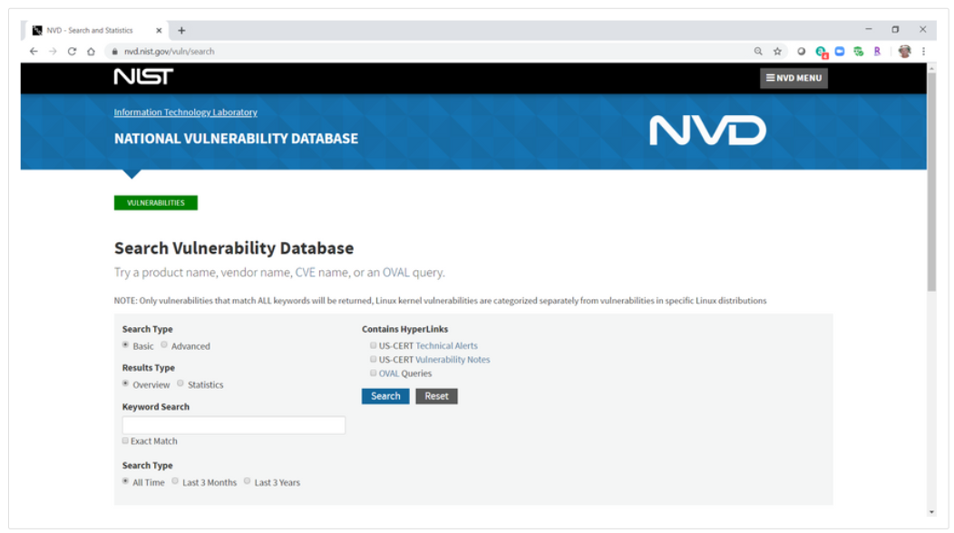
Common Vulnerability Scoring System (CVSS)
Other Vulnerability Information Sources (Contd.)
National Vulnerability Database (NVD):
This utilizes CVE identifiers and supplies additional information on vulnerabilities such as CVSS threat scores, technical details, affected entities, and resources for further investigation.
The database was created and is maintained by the U.S. government National Institute of Standards and Technology (NIST) agency.
Notes:
23 – Endpoint Vulnerability Assessment
23.2 – Common Vulnerability Scoring System (CVSS)
23.2.6 – Other Vulnerability Information Sources
23.2.7 - Check Your Understanding - Identify CVSS Metrics

Slide 25
23.3 Secure Device Management
Notes:
Source:
23 – Endpoint Vulnerability Assessment
23.3 – Secure Device Management
In-Session Activities / Explanations:
Time: 12 mins
Instructor Notes:
Provide an overview of security device management.
Explain the Risk management lifecycle.
List the steps in Vulnerability management lifecycle.
Provide a brief on asset management.
Discuss Mobile Device management
Define Configuration management
Explain Enterprise Patch Management
Walk the learners through the Patch management techniques
Encourage the learners to complete the ‘Check Your Understanding - Identify the Risk Response’ in section 23.3.2.
Key Points: Risk Management, Vulnerability Management, Asset Management, Mobile Device Management, Configuration and Patch Management

Slide 26
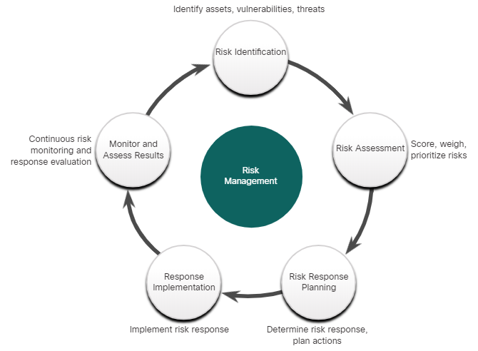
Secure Device Management
Risk Management
Risk management involves the selection and specification of security controls for an organization.
A mandatory activity in risk assessment is to identify threats and vulnerabilities.
Ways to respond to identified risks:
Risk avoidance - Stop performing the activities that create risk.
Risk reduction - Take measures to reduce vulnerability.
Risk sharing - Shift some risk to other parties.
Risk retention - Accept the risk and its consequences.
Notes:
23 – Endpoint Vulnerability Assessment
23.3 – Secure Device Management
23.3.1 – Risk Management
23.3.2 – Check Your Understanding - Identify the Risk Response

Slide 27
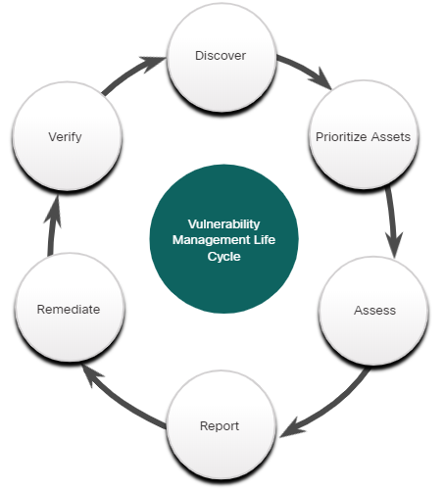
Secure Device Management
Vulnerability Management
Vulnerability management is a security practice designed to proactively prevent the exploitation of IT vulnerabilities.
The steps in the Vulnerability Management Life Cycle:
Discover - Develop a network baseline. Identify security vulnerabilities on a regular automated schedule.
Prioritize Assets - Categorize assets into groups or business units, and assign a business value based on their criticality to business operations.
Assess - Determine a baseline risk profile to eliminate risks based on asset criticality, vulnerability, threats, and asset classification.
Notes:
23 – Endpoint Vulnerability Assessment
23.3 – Secure Device Management
23.3.3 – Vulnerability Management

Slide 28
Secure Device Management
Vulnerability Management (Contd.)
Report - Measure the level of business risk associated with your assets according to your security policies. Document a security plan, monitor suspicious activity, and describe known vulnerabilities.
Remediate - Prioritize according to business risk and address vulnerabilities in order of risk.
Verify - Verify that threats have been eliminated through follow-up audits.
Notes:
23 – Endpoint Vulnerability Assessment
23.3 – Secure Device Management
23.3.3 – Vulnerability Management

Slide 29
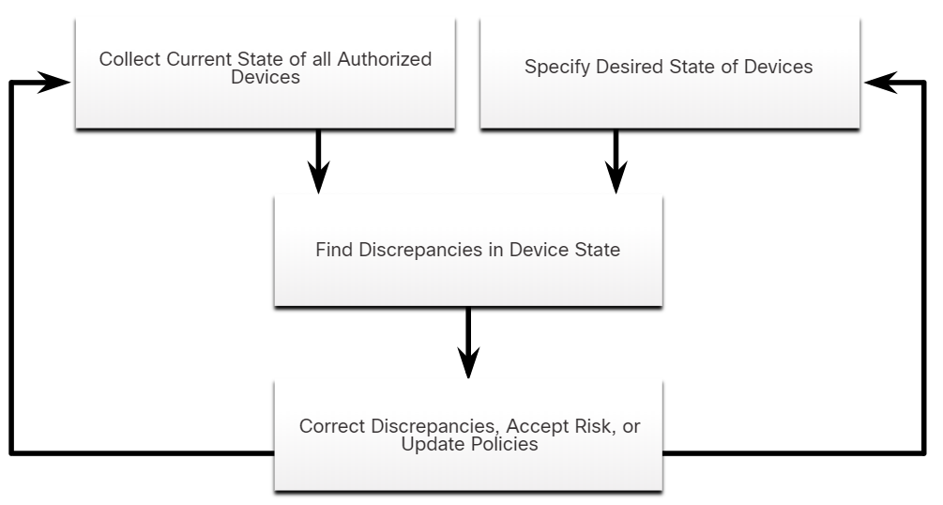
Secure Device Management
Asset Management
Asset management involves the implementation of systems that track the location and configuration of networked devices and software across an enterprise.
Tools and Techniques for Asset management:
Automated discovery and inventory of the actual state of devices
Articulation of the desired state for those devices using policies, plans, and procedures in the organization’s information security plan
Identification of non-compliant authorized assets
Remediation or acceptance of device state, possible iteration of desired state definition
Repeat the process at regular or ongoing intervals
Notes:
23 – Endpoint Vulnerability Assessment
23.3 – Secure Device Management
23.3.4 – Asset Management

Slide 30
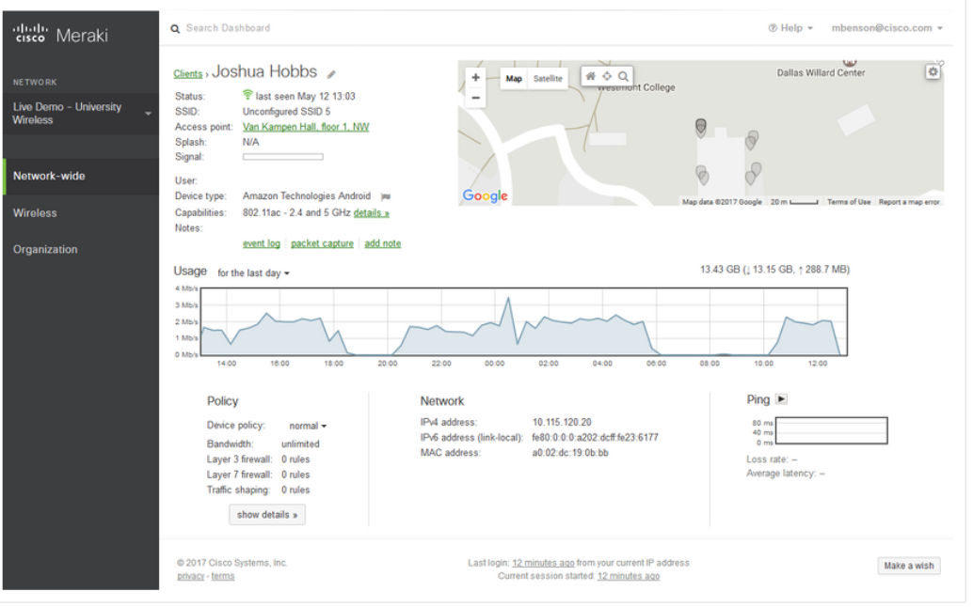
Secure Device Management
Mobile Device Management
Mobile devices cannot be physically controlled on the premises of an organization.
MDM systems, such as Cisco Meraki Systems Manager, allows the security personnel to configure, monitor and update a very diverse set of mobile clients from the cloud.
Notes:
23 – Endpoint Vulnerability Assessment
23.3 – Secure Device Management
23.3.5 – Mobile Device Management

Slide 31
Secure Device Management
Configuration Management
Configuration Management: As defined by NIST, configuration management:
Comprises a collection of activities focused on establishing and maintaining the integrity of products and systems, through control of the processes for initializing, changing, and monitoring the configurations of those products and systems.
Configuration tools : Puppet, Chef, Ansible, and SaltStack
Notes:
23 – Endpoint Vulnerability Assessment
23.3 – Secure Device Management
23.3.6 – Configuration Management

Slide 32
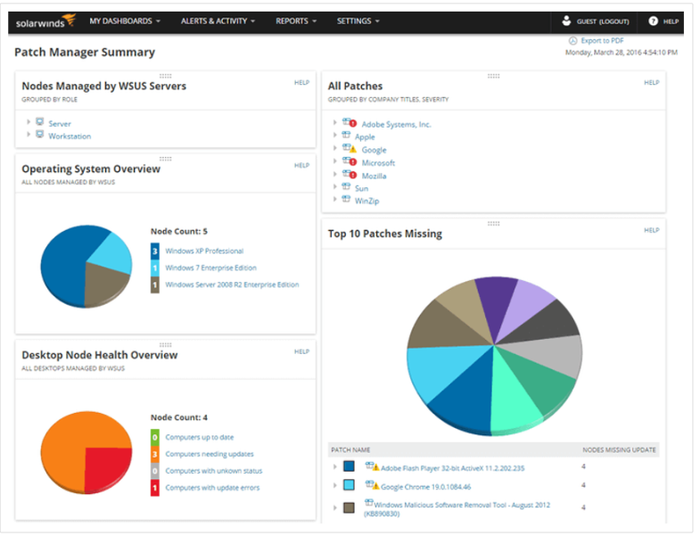
Secure Device Management
Enterprise Patch Management
Patch management involves all aspects of software patching, including identifying required patches, acquiring, distributing, installing, and verifying.
Patch management is required by some compliance regulations such as Sarbanes Oxley (SOX) and the Health Insurance Portability and Accountability Act (HIPAA).
Notes:
23 – Endpoint Vulnerability Assessment
23.3 – Secure Device Management
23.3.7 – Enterprise Patch Management

Slide 33
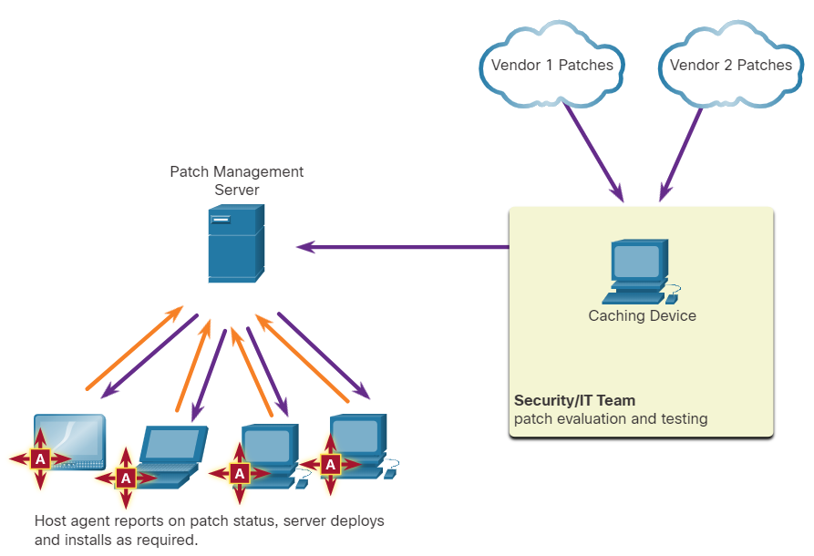
Secure Device Management Patch Management Techniques
Agent-based:
This requires a software agent to be running on each host to be patched.
The agent reports whether vulnerable software is installed on the host.
The agent communicates with the patch management server and determines if patches exist that require installation, and installs the patches.
Agent-based approaches are the preferred means of patching mobile devices.
Notes:
23 – Endpoint Vulnerability Assessment
23.3 – Secure Device Management
23.3.8 - Patch Management Techniques

Slide 34
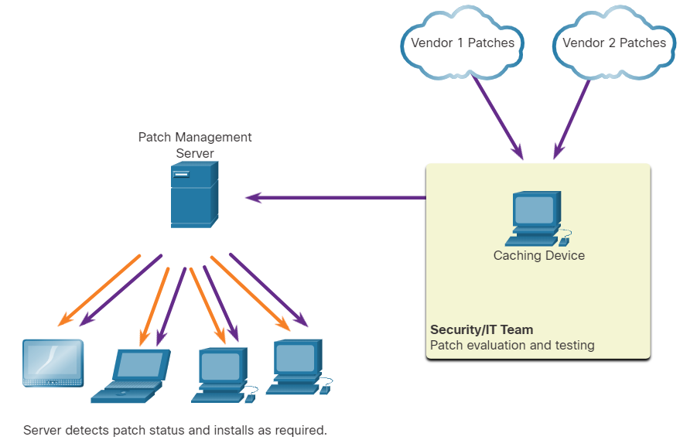
Secure Device Management Patch Management Techniques
Agentless Scanning:
Patch management servers scan the network for devices that require patching.
The server determines which patches are required and installs those patches on the clients.
Only devices that are on scanned network segments can be patched, which can be a problem for mobile devices.
Notes:
23 – Endpoint Vulnerability Assessment
23.3 – Secure Device Management
23.3.8 - Patch Management Techniques

Slide 35
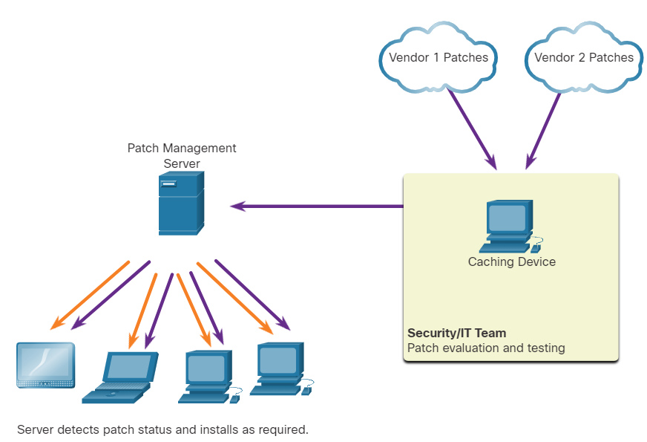
Secure Device Management Patch Management Techniques
Passive Network Monitoring:
Devices requiring patching are identified through the monitoring of traffic on the network.
This approach is only effective for software that includes version information in its network traffic.
Notes:
23 – Endpoint Vulnerability Assessment
23.3 – Secure Device Management
23.3.8 - Patch Management Techniques
23.3.9 - Check Your Understanding - Identify Device Management Activities

Slide 36
23.4 Information Security Management Systems
Notes:
23 – Endpoint Vulnerability Assessment
23.4 - Information Security Management Systems
In-Session Activities / Explanations:
Time: 10 mins
Instructor Notes:
Introduce the topic and discuss ISMS.
Walk the learners through the different ISO standards
Describe the NIST Cybersecurity framework along with its core functions.
Key Points: Information Security Management System (ISMS), ISO-27001, NIST Cybersecurity Framework

Slide 37
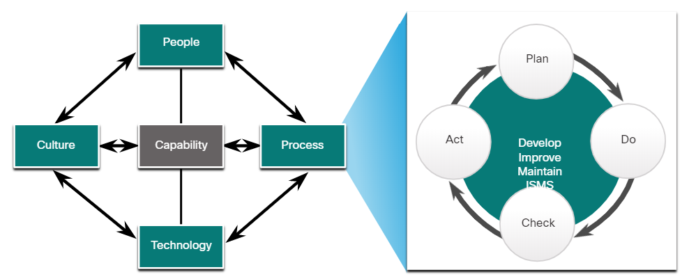
Information Security Management Systems Security Management Systems
An Information Security Management System (ISMS) consists of a management framework to identify, analyze, and address information security risks.
ISMSs provide conceptual models that guide organizations in planning, implementing, governing, and evaluating information security programs.
It incorporates the “plan-do-check-act” framework, known as the Deming cycle.
ISM is seen as an elaboration on People-Process-Technology-Culture model of organizational capability
A General Model for Organizational Capability
Notes:
23 – Endpoint Vulnerability Assessment
23.4 - Information Security Management Systems
23.4.1 – Security Management Systems

Slide 38
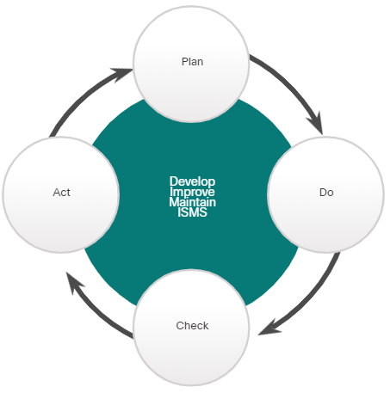
Information Security Management Systems ISO-27001
ISO/IEC 27000 family of standards – internationally accepted standards that facilitate business conducted between countries. The ISO 27001 - global, industry-wide specification for an ISMS.
Plan | Do | Check | Act
Understand business objectives Define activities scope Access and manage support Assess and define risk Perform asset management and vulnerability assessment | Create and implement risk management plan Establish and enforce risk management policies and procedures Train personnel, allocate resources | Monitor exécution Compile reports Support external certification audit | Continually audit processes Continually improve processes Take corrective action Take preventive action
Notes:
23 – Endpoint Vulnerability Assessment
23.4 - Information Security Management Systems
23.4.2 – ISO 27001

Slide 39
Information Security Management Systems NIST Cybersecurity Framework
NIST Cybersecurity Framework – is a set of standards designed to integrate existing standards, guidelines, and practices to help better manage and reduce cybersecurity risk.
The below table describes the core functions in NIST Cybersecurity Framework:
Core Function | Description
IDENTIFY | Develop an organizational understanding to manage cybersecurity risk to systems, assets, data, and capabilities.
PROTECT | Develop and implement the appropriate safeguards to ensure delivery of critical infrastructure services.
DETECT | Develop and implement the appropriate activities to identify the occurrence of a cybersecurity event.
RESPOND | Develop and implement the appropriate activities to act on a detected cybersecurity event.
RECOVER | Develop and implement the appropriate activities to maintain plans for resilience and to restore any capabilities or services that were impaired due to a cybersecurity event.
Notes:
23 – Endpoint Vulnerability Assessment
23.4 - Information Security Management Systems
23.4.3 – NIST Cybersecurity Framework
23.4.4 – Check Your Understanding - Identify the Stages in the NIST Cybersecurity Framework

Slide 40
23.5 Endpoint Vulnerability Assessment Summary
Notes:
Source:
23 – Endpoint Vulnerability Assessment
23.5 – Endpoint Vulnerability Assessment Summary
In-Session Activities / Explanations:
Time: 5 mins
Instructor Notes:
Read out the summary points mentioned on the slide.
Discuss the same with the participants.
Ask if they have any questions or doubts.
Ensure that the learners complete the module quiz.
Key Points: NA

Slide 41
Endpoint Vulnerability Assessment Endpoint Vulnerability Assessment Summary
Network and device profiling provides statistical baseline information that can serve as a reference point for normal network and device performance.
Network security can be evaluated using a variety of tools and services.
Vulnerability assessment uses software to scan Internet-facing servers and internal networks for various types of vulnerabilities.
The Common Vulnerability Scoring System (CVSS) is a vendor-neutral, industry standard, open framework for rating the risks of a given vulnerability by using a variety of metrics to calculate a composite score.
Vulnerabilities are rated according to the attack vector, attack complexity, privileges required, user interaction, and scope.
Risk management involves the selection and specification of security controls for an organization.
Notes:
23 – Endpoint Vulnerability Assessment
23.5 – Endpoint Vulnerability Assessment Summary
23.5.1 - What Did I Learn in this Module?

Slide 42
Endpoint Vulnerability Assessment Endpoint Vulnerability Assessment Summary (Contd.)
Vulnerability management is a security practice that is designed to proactively prevent the exploitation of IT vulnerabilities that exist within an organization.
Organizations can use an Information Security Management System (ISMS) to identify, analyze, and address information security risks.
Standards for managing cybersecurity risk are available from ISO and NIST.
NIST has also developed the Cybersecurity Framework, which is similar to the ISO/IEC 27000 standards.
Notes:
23 – Endpoint Vulnerability Assessment
23.5 – Endpoint Vulnerability Assessment Summary
23.5.1 - What Did I Learn in this Module?
23.5.2 – Endpoint Vulnerability Quiz

Slide 43
Module 23 New Terms and Commands
Network Profiling Cisco Identity Services Engine (ISE) Server Profiling Network Anomaly Detection Network Behavior Analysis (NBA) Rule–based anomaly detection Network Vulnerability Testing Common Vulnerability Scoring System (CVSS) | Forum of Incident Response and Security Teams (FIRST) Base Metric Group Temporal Metric Group Environmental Metric Group CVSS v3.1 Calculator Common Vulnerabilities and Exposures (CVE) National Vulnerability Database (NVD) | Mobile Device Management (MDM) Patch Management Agent-based Patch Management Agentless Scanning Passive Network Monitoring Information Security Management System (ISMS) Deming Cycle
Notes:
23 – Endpoint Vulnerability Assessment
New Terms and Commands

