Slide 1
Module 25: Network Security Data
Instructor Materials
CyberOps Associate v1.0
Notes:
Cisco Networking Academy Program
CyberOps Associate v1.0
Module 25: Network Security Data

Slide 2
Instructor Materials – Module 25 Planning Guide
This PowerPoint deck is divided in two parts:
Instructor Planning Guide
Information to help you become familiar with the module
Teaching aids
Instructor Class Presentation
Optional slides that you can use in the classroom
Begins on slide # 9
Note: Remove the Planning Guide from this presentation before sharing with anyone.
For additional help and resources go to the Instructor Home Page and Course Resources for this course. You also can visit the professional development site on www.netacad.com, the official Cisco Networking Academy Facebook page, or Instructor Only FB group.
Notes:
2

Slide 3
What to Expect in this Module?
To facilitate learning, the following features within the GUI may be included in this module:
Feature | Description
Check Your Understanding(CYU) | Per topic online quiz to help learners gauge content understanding.
PT Activity | Simulation and modeling activities designed to explore, acquire, reinforce, and expand skills.
Module Quizzes | Self-assessments that integrate concepts and skills learned throughout the series of topics presented in the module.
Module Summary | Briefly recaps module content.

Slide 4
Check Your Understanding
Check Your Understanding activities are designed to let students quickly determine if they understand the content and can proceed, or if they need to review.
Check Your Understanding activities do not affect student grades.
There are no separate slides for these activities in the PPT. They are listed in the notes area of the slide that appears before these activities.
Notes:
4

Slide 5
Module 25: Activities
What activities are associated with this module?
Page # | Activity Type | Activity Name | Optional?
25.1.5 | Check Your Understanding | Identify Types of Network Monitoring Data | Recommended
25.2.5 | Check Your Understanding | Identify Windows Event Security Levels | Recommended
25.3.8 | Check Your Understanding | Identify the Security Technology from the Data Description | Recommended
25.3.9 | Check Your Understanding | Identify the NextGen Firewall Event Types | Recommended
25.3.10 | Packet Tracer | Explore a NetFlow Implementation | Recommended
25.3.11 | Packet Tracer | Logging From Multiple Sources | Recommended
Notes:
5

Slide 6
Module 25: Best Practices
Prior to teaching Module 25, the instructor should:
Review the activities and assessments for this module.
Try to include as many questions as possible to keep students engaged during classroom presentation.
Topic 25.1
Ask the class to share their understanding on the types of security data.
Explain the alert data and how alerts are generated by Snort.
Discuss session data and transaction data with the class.
Describe the full packet captures and statistical data to the class.
Notes:
6

Slide 7
Module 25: Best Practices (Contd.)
Topic 25.2
Explain host logs and its different event types to the class.
Ask the class what do they know of Syslog and its packet format.
Explain how server logs are important in security monitoring.
Describe SIEM and its various functions.
Show the Splunk Threat Dashboard to the class and explain its main components to them.
Notes:
7

Slide 8
Module 25: Best Practices (Contd.)
Topic 25.3
Explain the uses of tcpdump command line to the class.
Discuss NetFlow with the help of some examples.
Describe the Cisco Application Visibility and Control (AVC) system.
Ask the class to share their understanding of content filter logs and proxy logs and then discuss the logs with them.
Explain the importance of Next-Generation Firewalls to the class.
Notes:
8

Slide 9
Module 25: Network Security Data
CyberOps Associate v1.0
Notes:
Cisco Networking Academy Program
CyberOps Associate v1.0
Module 25: Network Security Data
In-Session Activities / Explanations:
Time: 5 min
Instructor Notes:
Welcome the audience in a warm and cordial manner. Ensure that everyone is set up with the required resources.
Introduce the topic and encourage learners to come up with a list of expectations from the session. Collate topics on the white board or Desktop while using learner’s inputs to interpret them in words.
Interact with the audience to see how network security data is collected, processed, and used to make network security decisions.
Read out the Objectives and briefly describe each.
Key Points: NA

Slide 10
Module Objectives
Module Title: Network Security Data
Module Objective: Explain the types of network security data used in security monitoring.
Topic Title | Topic Objective
Types of Security Data | Describe the types of data used in security monitoring.
End Device Logs | Describe the elements of an end device log file.
Network Logs | Describe the elements of a network device log file.
Notes:
10
CyberOps Associate v1.0
25 – Network Security Data
25.0 – Introduction
25.0.2 – What Will I Learn in this Module?

Slide 11
25.1 Types of Security Data
Notes:
Source:
25 – Network Security Data
25.1 – Types of Security Data
In-Session Activities / Explanations:
Time: 10 min
Instructor Notes:
Introduce the topic and discuss the types of security data.
Explain the alert data, session data and transaction data.
Describe the full packet captures.
Ensure the learners have knowledge of statistical data.
By the end of the topic, ensure that the learners complete the "Check Your Understanding - Identify Types of Network Monitoring Data" at section 25.1.5.
Key Points: Alert Data, Snorts, Session Data, Transaction Data, Full Packet Captures, Statistical data.

Slide 12
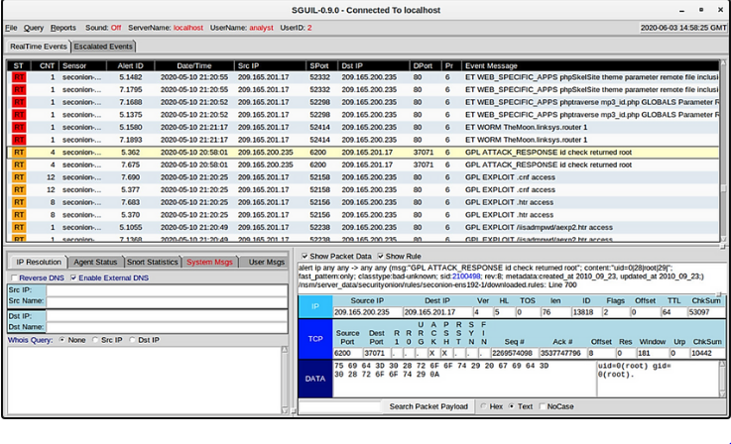
Network Security Data
Alert Data
Alert data consists of messages generated by intrusion prevention systems (IPSs) or intrusion detection systems (IDSs) in response to traffic that violates a rule or matches the signature of a known exploit.
A network IDS (NIDS), such as Snort, comes configured with rules for known exploits.
Alerts are generated by Snort and are made readable and searchable by the Sguil and Squert applications, which are part of the Security Onion suite of NSM tools.
Sguil Console Showing Test Alert from Snort IDS
Notes:
25 – Network Security Data
25.1 – Types of Security Data
25.1.1 – Alert Data

Slide 13
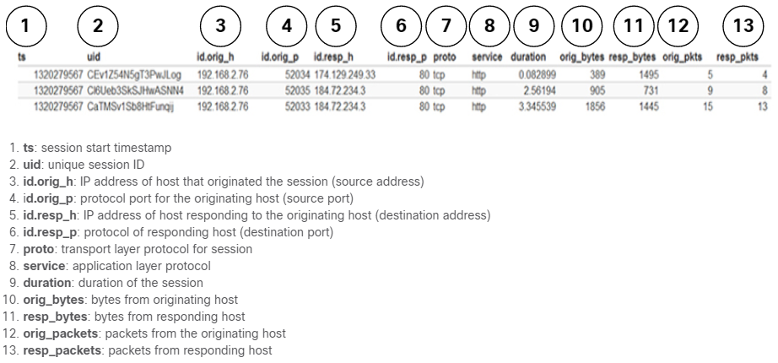
Network Security Data
Session and Transaction Data
Session data is a record of a conversation between two network endpoints.
It includes the five tuples of source and destination IP addresses, source and destination port numbers, and the IP code for the protocol in use.
Data about the session includes a session ID, the amount of data transferred by source and destination and information related to the duration of the session.
The figure shows a partial output for three HTTP sessions from a Zeek connection log.
Notes:
25 – Network Security Data
25.1 – Types of Security Data
25.1.2 – Session and Transaction Data

Slide 14
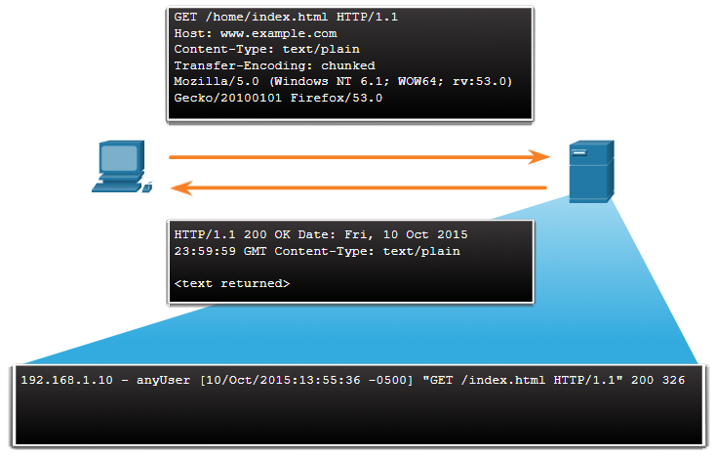
Network Security Data
Session and Transaction Data (Contd.)
Transaction data consists of the messages that are exchanged during network sessions.
These transactions can be viewed in packet capture transcripts.
The transactions that represent the requests and replies would be logged in an access log on a server or by a NIDS like Zeek.
A session might include the downloading of content from a webserver, as shown in the figure.
Notes:
25 – Network Security Data
25.1 – Types of Security Data
25.1.2 – Session and Transaction Data

Slide 15
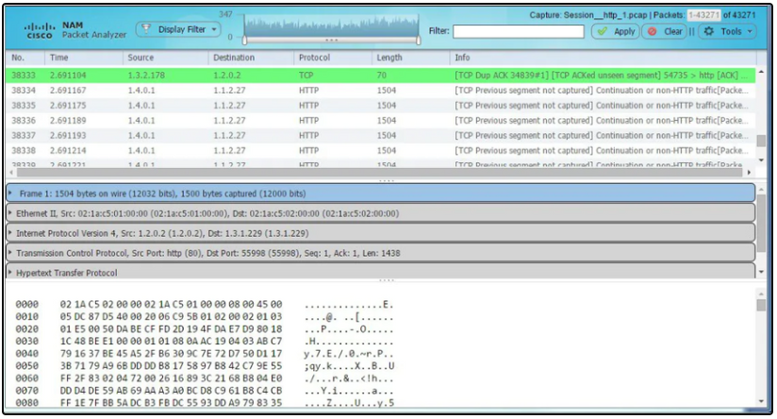
Network Security Data
Full Packet Captures
Full packet captures are the most detailed network data that is generally collected.
It contains the actual content of the conversations such as text of email messages, the HTML in web pages, and the files that enter or leave the network.
Extracted content can be recovered from full packet captures and analyzed for malware or user behavior that violates business and security policies.
The figure here shows the interface for the Network Analysis Monitor component of Cisco Prime Infrastructure system, which can display full packet captures.
Notes:
25 – Network Security Data
25.1 – Types of Security Data
25.1.3 – Full Packet Captures

Slide 16
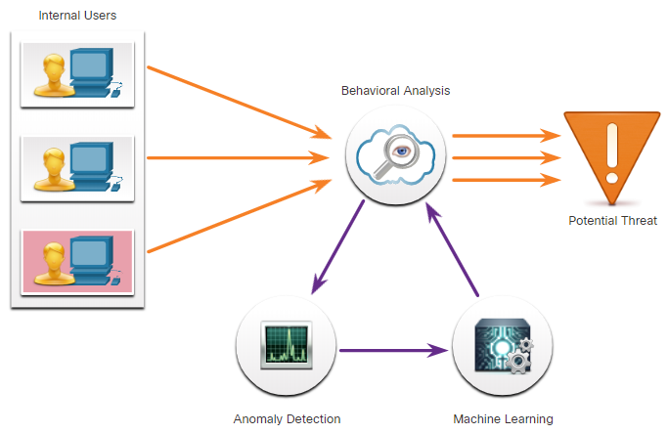
Network Security Data
Statistical Data
Statistical data is about network traffic which is created through the analysis of other forms of network data.
Statistics can be used to characterize normal amounts of variation in network traffic patterns in order to identify network conditions that are significantly outside of those ranges.
An example of an NSM tool that utilizes statistical analysis is Cisco Cognitive Threat Analytics.
It is able to find malicious activity that has bypassed security controls or entered the network through unmonitored channels (including removable media) and is operating inside an organization’s environment.
The figure shows an architecture for Cisco Cognitive Threat Analytics.
Notes:
25 – Network Security Data
25.1 – Types of Security Data
25.1.4 – Statistical Data
25.1.5 – Check Your Understanding - Identify Types of Network Monitoring Data

Slide 17
25.2 End Device Logs
Notes:
Source:
25 – Network Security Data
25.2 – End Device Logs
In-Session Activities / Explanations:
Time: 15 min
Instructor Notes:
Give a brief introduction to the topic and discuss end device logs.
Explain host logs and its different event types.
Describe Syslog and Syslog packet format.
Explain how server logs are important in security monitoring.
Explain SIEM and its functions along with the Splunk Threat Dashboard.
Ensure that the learners complete the "Check Your Understanding - Identify Windows Event Security Levels" at section 25.2.5.
Key Points: HIDS, Host Logs, Syslog, Server log, SIEM, Splunk Threat Dashboard.

Slide 18
End Device Logs
Host Logs
Host-based intrusion detection systems (HIDS) run on individual hosts.
Many host-based protections submit logs to a centralized log management servers which can be searched from a central location using NSM tools.
Microsoft Windows host logs are visible locally through Event Viewer. Event Viewer keeps four types of logs:
Application logs – These contain events logged by various applications.
System logs – These include events regarding the operation of drivers, processes, and hardware.
Setup logs – These record information about the installation of software, including Windows updates.
Security logs – These record events related to security, such as logon attempts and operations related to file or object management and access.
Command-line logs – Attackers who have gained access to a system, and some types of malware, execute commands from the command-line interface (CLI) rather than a GUI. Logging command line execution will provide visibility into this type of incident.
Notes:
25 – Network Security Data
25.2 – End Device Logs
25.2.1 – Host Logs

Slide 19
End Device Logs
Host Logs (Contd.)
The table explains the meaning of the five Windows host log event types.
Event Type | Description
Error | It is an event that indicates a significant problem such as loss of data or functionality. For example, if a service fails to load during startup, an error event is logged.
Warning | It is an event that is not necessarily significant but may indicate a possible future problem. For example, when disk space is low, a warning event is logged. If an application recovers from an event without loss of functionality or data, it can classify the event as a warning event.
Information | It describes the successful operation of an application, driver, or service. For example, when a network driver loads successfully, it may be appropriate to log an information event. Note that it is generally inappropriate for a desktop application to log an event each time it starts.
Success Audit | It is an event that records an audited security access attempt that is successful. For example, a user’s successful attempt to log on to the system is a success audit event.
Failure Audit | It is an event that records an audited security access attempt that fails. For example, if a user tries to access a network drive and fails, the attempt is logged as a failure audit event.
Notes:
25 – Network Security Data
25.2 – End Device Logs
25.2.1 – Host Logs

Slide 20
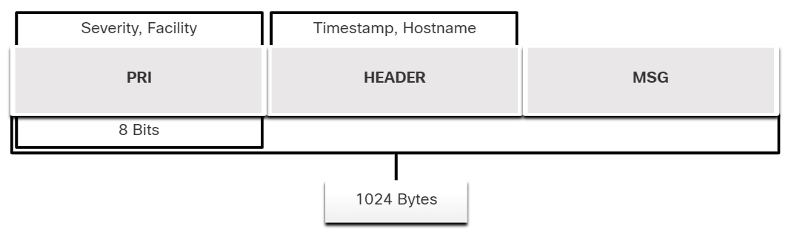
End Device Logs
Syslog
Syslog incudes specifications for message formats, a client-server application structure, and network protocol. It is a client/server protocol.
Many different types of network devices can be configured to use the syslog standard to log events to centralized syslog servers.
The full format of a Syslog message has three distinct parts: PRI (priority), HEADER, MSG (message text).
The PRI consists of two elements, the Facility and Severity of the message, which are both integer values.
The Facility consists of sources that generated the message, such as the system, process, or application.
The Severity is a value from 0-7 that defines the severity of the message.
Notes:
25 – Network Security Data
25.2 – End Device Logs
25.2.2 – Syslog

Slide 21
End Device Logs
Syslog (Contd.)
Facility
Facility codes between 15 and 23 (local0-local7) are not assigned a keyword or name.
They can be assigned to different meanings depending on the use context. Also, various operating systems have been found to utilize both facilities 9 and 15 for clock messages.
Severity
Value | Severity
0 | Emergency: system is unusable
1 | Alert: action must be taken immediately
2 | Critical: critical conditions that should be corrected immediately and indicates failure in a system
3 | Error: a failure that is not urgent, should be resolved within a given time
4 | Warning: an error does not presently exist; but, an error will occur in the future if the condition is not addressed
5 | Notice: an event that is not an error, but that is considered unusual. Does not require immediate action.
6 | Informational: messages issued regarding normal operation
7 | Debug: messages of interest to developers
Notes:
25 – Network Security Data
25.2 – End Device Logs
25.2.2 – Syslog

Slide 22
End Device Logs
Syslog (Contd.)
Priority
The Priority (PRI) value is calculated by multiplying the Facility value by 8, and then adding it to the Severity value, as shown below
Priority = (Facility * 8) + Severity
The Priority value is the first value in a packet and occurs between angled brackets <>.
Notes:
25 – Network Security Data
25.2 – End Device Logs
25.2.2 – Syslog

Slide 23

End Device Logs
Server Logs
Server logs are an essential source of data for network security monitoring.
DNS proxy server logs which document all the DNS queries and responses that occur on the network are especially important.
Two important log files are Apache webserver access logs and Microsoft Internet Information Server (IIS) access logs.
Apache Access Log
IIS Access Log
Notes:
25 – Network Security Data
25.2 – End Device Logs
25.2.3 – Server Logs

Slide 24
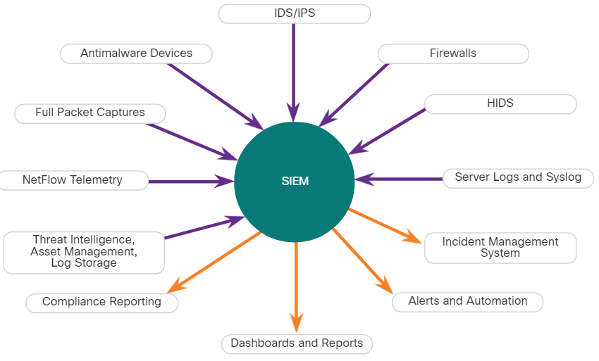
End Device Logs
SIEM and Log Collection
Security Information and Event Management (SIEM) technology is used in many organizations to provide real-time reporting and long-term analysis of security events, as shown in the figure.
SIEM Inputs and Outputs
Notes:
25 – Network Security Data
25.2 – End Device Logs
25.2.4 – SIEM and Log Collection

Slide 25
End Device Logs
SIEM and Log Collection (Contd.)
SIEM combines the essential functions of SEM and SIM tools to provide a view of the enterprise network using the following functions:
Log collection – Event records from sources throughout the organization provide important forensic information and help to address compliance reporting requirements.
Normalization – This maps log messages from different systems into a common data model, enabling the organization to connect and analyze related events, even if they are initially logged in different source formats.
Correlation – This links logs and events from disparate systems or applications, speeding detection of and reaction to security threats.
Aggregation – This reduces the volume of event data by consolidating duplicate event records.
Reporting – This presents the correlated, aggregated event data in real-time monitoring and long-term summaries, including graphical interactive dashboards.
Compliance – This is reporting to satisfy the requirements of various compliance regulations.
Notes:
25 – Network Security Data
25.2 – End Device Logs
25.2.4 – SIEM and Log Collection

Slide 26
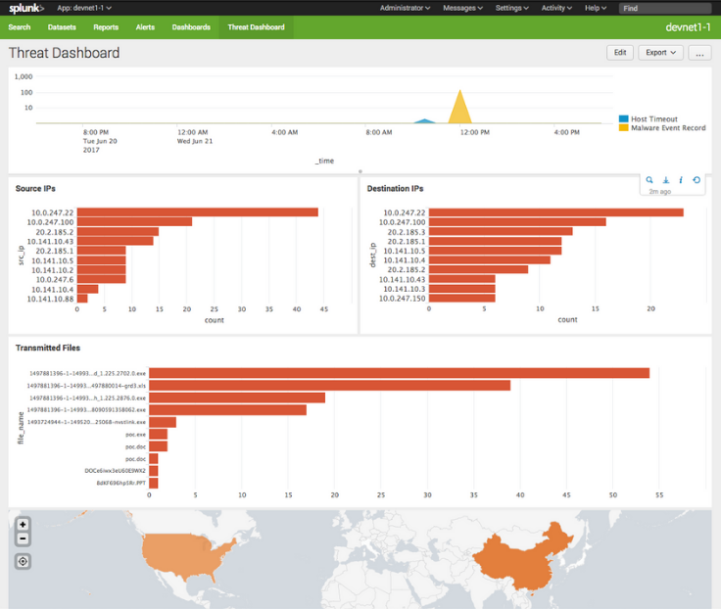
End Device Logs
SIEM and Log Collection (Contd.)
Splunk Threat Dashboard
A popular SIEM is Splunk, which is made by a Cisco partner.
The figure shows a Splunk Threat Dashboard. Splunk is widely used in SOCs.
Because of the lack of cybersecurity professionals to monitor and analyze the large volume of security data, it is important that tools from multiple vendors can be integrated into a single platform.
Integrated security platforms go beyond SIEM and SOAR to unify multiple security technologies into a unified team.
Notes:
25 – Network Security Data
25.2 – End Device Logs
25.2.4 – SIEM and Log Collection
25.2.5 - Check Your Understanding - Identify Windows Event Security Levels

Slide 27
25.3 Network Logs
Notes:
Source:
25 – Network Security Data
25.3 – Network Logs
In-Session Activities / Explanations:
Time: 30 min
Instructor Notes:
Give a brief introduction to the topic and discuss the network logs.
Explain the tcpdump command line and NetFlow.
Describe the Cisco Application Visibility and Control (AVC) system.
Ensure the learners know of content filter logs.
Explain logging from Cisco devices.
Ensure the learners have understanding of proxy logs.
Explain how important is Next-Generation Firewalls for network security.
By the end of the topic, encourage the learners to complete the given activities in this topic.
Key Points: tcpdump , NetFlow , AVC, Content Filter Logs, Cisco Umbrella, Proxy Log, Next- Generations firewalls

Slide 28
Network Logs
Tcpdump
The tcpdump command line tool is a very popular packet analyzer.
It can display packet captures in real time or write packet captures to a file.
It captures detailed packet protocol and content data.
Wireshark is a GUI built on tcpdump functionality.
The structure of tcpdump captures varies depending on the protocol captured and the fields requested.
Notes:
25 – Network Security Data
25.3 – Network Logs 25.3.1 - Tcpdump

Slide 29
Network Logs
NetFlow
NetFlow is a protocol that was developed by Cisco as a tool for network troubleshooting and session-based accounting.
NetFlow provides an important set of services for IP applications, including network traffic accounting, usage-based network billing, network planning, security, Denial-of-Service monitoring capabilities, and network monitoring.
It also provides information about network users and applications, peak usage times, and traffic routing.
It records information about the packet flow including metadata. Cisco developed NetFlow and then allowed it to be used as a basis for an IETF standard called IPFIX.
NetFlow information can be viewed with tools such as the nfdump.
nfdump provides a command line utility for viewing NetFlow data from the nfcapd capture daemon, or collector.
Notes:
25 – Network Security Data
25.3 – Network Logs 25.3.2 - NetFlow

Slide 30
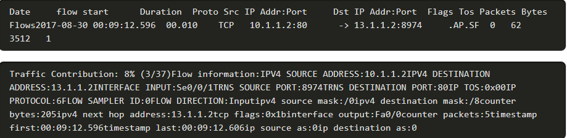
Network Logs
NetFlow (Contd.)
An example of a basic NetFlow flow record, in two different formats, is shown in the figure.
A large number of attributes for a flow are available. The IANA registry of IPFIX entities lists several hundred, with the first 128 being the most common.
NetFlow is a useful tool in the analysis of network security incidents. It can be used to construct a timeline of compromise, understand individual host behavior, or to track the movement of an attacker or exploit from host to host within a network.
Notes:
25 – Network Security Data
25.3 – Network Logs 25.3.2 - NetFlow

Slide 31
Network Logs
Application Visibility and Control
The Cisco Application Visibility and Control (AVC) system combines multiple technologies to recognize, analyze, and control over 1000 applications.
These include voice and video, email, file sharing, gaming, peer-to-peer (P2P), and cloud-based applications.
AVC uses Cisco next-generation network-based application recognition version 2 (NBAR2), also known as Next-Generation NBAR, to discover and classify the applications in use on the network.
The NBAR2 application recognition engine supports over 1000 network applications.
Notes:
25 – Network Security Data
25.3 – Network Logs 25.3.3 - Application Visibility and Control

Slide 32
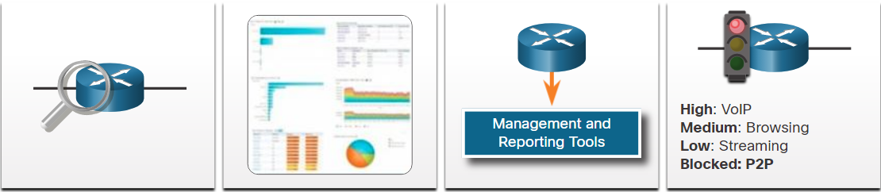
Network Logs
Application Visibility and Control (Contd.)
Application Recognition
Identify applications using L3 to L7 data.
1000+ applications
Cloud services
Cisco WebEx
YouTube
Skype
P2P
NBAR2
Metrics Collection
Collect metrics for export to management tool
Bandwidth usage
Response time
Latency
Packet loss
Jitter
P2P
Netflow9 Flexible Netflow IPFIX
Management and Reporting
Provision the network, collect data, and report on applications performance
Report generation
Policy Management
Cisco Prime Other 3rd Party Software
Control
Control application use to maximize network performance
Application prioritizarion
Application bandwidth enforcement
QoS
Notes:
25 – Network Security Data
25.3 – Network Logs 25.3.3 - Application Visibility and Control

Slide 33
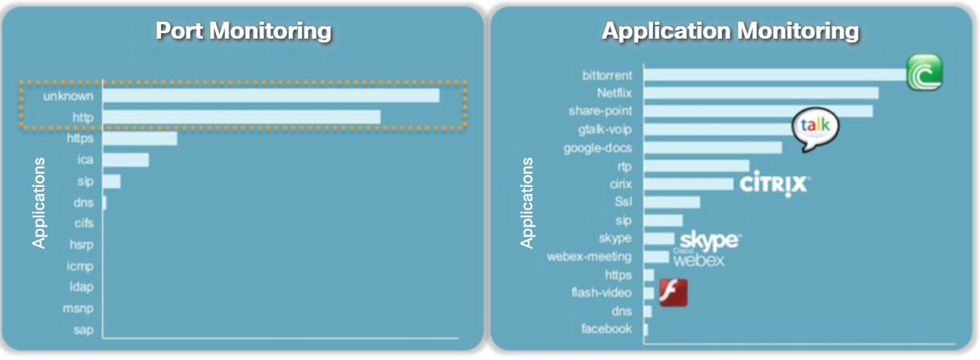
Network Logs
Application Visibility and Control (Contd.)
Port Monitoring vs. Application Monitoring
A management and reporting system analyzes and presents the application analysis data into dashboard reports for use by network monitoring personnel. Application usage can also be controlled through quality of service classification and policies based on the AVC information.
Notes:
25 – Network Security Data
25.3 – Network Logs 25.3.3 - Application Visibility and Control

Slide 34
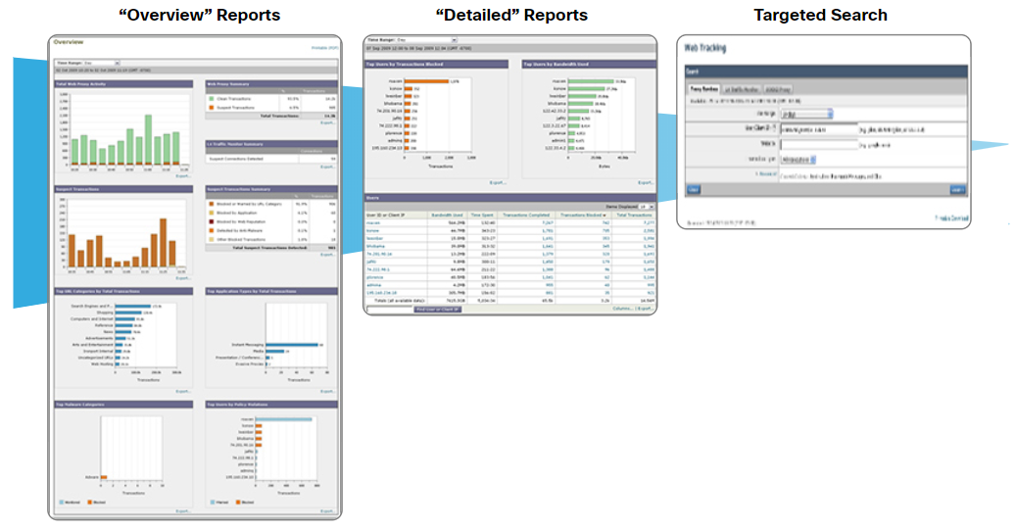
Network Logs
Content Filter Logs
Devices that provide content filtering, such as the Cisco Email Security Appliance (ESA) and the Cisco Web Security Appliance (WSA), provide a wide range of functionalities for security monitoring.
The figure shows the dashboards from Cisco content filtering devices. By clicking components of the Overview reports, more relevant details are displayed. Target searches provide the focused information.
Notes:
25 – Network Security Data
25.3 – Network Logs 25.3.4 - Content Filter Logs

Slide 35
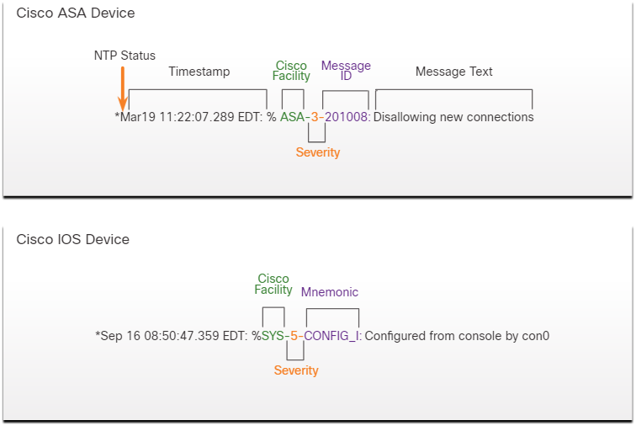
Network Logs
Logging from Cisco Devices
Cisco security devices can be configured to submit events and alerts to security management platforms using SNMP or syslog.
The figure shows a syslog message generated by a Cisco ASA device and a syslog message generated by a Cisco IOS device.
There are two meanings used for the term facility in Cisco syslog messages.
The first is the standard set of Facility values that were established by the syslog standards.
The other Facility value is assigned by Cisco and occurs in the MSG part of the syslog message.
Notes:
25 – Network Security Data
25.3 – Network Logs 25.3.5 - Logging from Cisco Devices

Slide 36
Network Logs
Proxy Logs
Proxy servers, such as those used for web and DNS requests, contain valuable logs that are a primary source of data for network security monitoring.
The proxy server requests the resources and returns them to the client and generates logs of all requests and responses.
These logs can then be analyzed to determine which hosts are making the requests, whether the destinations are safe or potentially malicious, and to also gain insights into the kind of resources that have been downloaded.
Web proxies provide data that helps determine whether responses from the web were generated in response to legitimate requests or have been manipulated to appear to be responses but are in fact exploits.
It is also possible to use web proxies to inspect outgoing traffic as means of data loss prevention (DLP).
DLP involves scanning outgoing traffic to detect whether the data that is leaving the web contains sensitive, confidential, or secret information.
Notes:
25 – Network Security Data
25.3 – Network Logs 25.3.6 - Proxy Logs

Slide 37
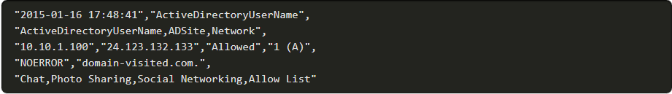
Network Logs
Proxy Logs (Contd.)
Cisco Umbrella
Cisco Umbrella, formerly OpenDNS, offers a hosted DNS service that extends the capability of DNS to include security enhancements.
Cisco Umbrella applies many more resources to managing DNS than most organizations can afford. Cisco Umbrella functions in part as a DNS super proxy in this regard.
The Cisco Umbrella suite of security products apply real-time threat intelligence to managing DNS access and the security of DNS records.
An example of a DNS proxy log appears below.
Notes:
25 – Network Security Data
25.3 – Network Logs 25.3.6 - Proxy Logs

Slide 38
Network Logs
Next-Generation Firewalls
Next-Generation or NextGen Firewall devices extend network security beyond IP addresses and Layer 4 port numbers to the application layer and beyond.
NexGen Firewalls are advanced devices that provided much more functionality than previous generations of network security devices.
One functionality is reporting dashboards with interactive features that allow quick point-and-click reports on very specific information without the need for SIEM or other event correlators.
NextGen Firewall devices (NGFW) use Firepower Services to consolidate multiple security layers into a single platform.
Firepower services include application visibility and control, Firepower Next-Generation IPS (NGIPS), reputation and category-based URL filtering, and Advanced Malware Protection (AMP).
Notes:
25 – Network Security Data
25.3 – Network Logs 25.3.7 - Next-Generation Firewalls

Slide 39
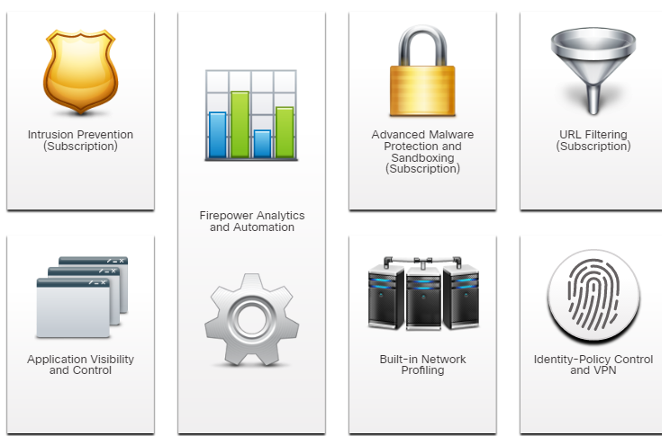
Network Logs
Next-Generation Firewalls (Contd.)
Common NGFW events include:
Connection Event
Intrusion Event
Host or Endpoint Event
Network Discovery Event
Netflow Event
Services Provided by NGFW
Notes:
25 – Network Security Data
25.3 – Network Logs 25.3.7 - Next-Generation Firewalls
25.3.8 - Check Your Understanding - Identify the Security Technology from the Data Description
25.3.9 - Check Your Understanding - Identify the NextGen Firewall Event Types

Slide 40
Network Logs
Packet Tracer - Explore a NetFlow Implementation
In this Packet Tracer activity, you will do the following:
Explore an implementation of NetFlow.
Notes:
25 – Network Security Data
25.3 – Network Logs 25.3.10 - Packet Tracer - Explore a NetFlow Implementation

Slide 41
Network Logs
Packet Tracer - Logging from Multiple Sources
In this Packet Tracer activity, you will do the following:
Use Packet Tracer to compare network data generated by multiple sources including syslog, AAA, and NetFlow.
Notes:
25 – Network Security Data
25.3 – Network Logs 25.3.11 - Packet Tracer - Logging from Multiple Sources

Slide 42
25.4 Network Security Data Summary
Notes:
Source:
25 – Network Security Data
25.4 - Network Security Data Summary
In-Session Activities / Explanations:
Time: 5 min
Instructor Notes:
Read out the summary points mentioned on the slide.
Discuss the same with the participants.
Ask if they have any questions or doubts.
Encourage the learners to complete the module quiz present in section 25.4.2.
Key Points: NA

Slide 43
Network Security Data Summary What Did I Learn in this Module?
Alert data consists of messages that are generated by intrusion prevention systems (IPSs) or intrusion detection systems (IDSs) in response to traffic that violates a rule or matches the signature of a known exploit.
Within the Security Onion suite of NSM tools, alerts are generated by Snort and are made readable and searchable by the Sguil, Squert, and Kibana applications.
Session data will include identifying information such as the five tuples of source and destination IP addresses, source and destination port numbers, and the IP code for the protocol in use.
Data about the session typically includes a session ID, the amount of data transferred by source and destination, and information related to the duration of the session.
Full packet captures contain the actual contents of data conversations, such as the text of email messages, the HTML in webpages, and the files that enter or leave the network.
Statistical data is created through the analysis of various forms of network data.
Notes:
25 – Network Security Data
25.4 - Network Security Data Summary
25.4.1 - What Did I Learn in this Module?

Slide 44
Network Security Data Summary What Did I Learn in this Module? (Contd.)
Host-based intrusion detection systems (HIDS) run on individual hosts.
Syslog incudes specifications for message formats, a client-server application structure, and network protocol.
Server logs are an essential source of data for network security monitoring.
DNS proxy server logs document all the DNS queries and responses that occur on the network.
DNS proxy logs are useful for identifying hosts that may have visited dangerous websites and for identifying DNS data exfiltration and connections to malware command-and-control servers.
SIEM combines the essential functions of security event management (SEM) and security information management (SIM) tools to provide a comprehensive view of the enterprise network using log collection, normalization, correlation, aggregation, reporting, and compliance.
Notes:
25 – Network Security Data
25.4 - Network Security Data Summary
25.4.1 - What Did I Learn in this Module?

Slide 45
Network Security Data Summary What Did I Learn in this Module? (Contd.)
The tcpdump command line tool is a very popular packet analyzer. It can display packet captures in real time or write packet captures to a file.
NetFlow provides valuable information about network users and applications, peak usage times, and traffic routing.
Cisco Application Visibility and Control uses Cisco next-generation network-based application recognition version 2 (NBAR2), also known as Next-Generation NBAR.
Devices such as the Cisco Email Security Appliance (ESA) and the Cisco Web Security Appliance (WSA), provide a wide range of functionalities for security monitoring by utilizing content filtering.
Proxy servers are devices that act as intermediaries for network clients.
NextGen Firewall devices extend network security beyond IP addresses and Layer 4 port numbers to the application layer and beyond.
Notes:
25 – Network Security Data
25.4 - Network Security Data Summary
25.4.1 - What Did I Learn in this Module?
25.4.2 - Module 25: Network Security Data Quiz

Slide 46
Module 25 New Terms and Commands
Intrusion Prevention Systems (IPSs) Intrusion Detection Systems (IDSs) Host-based Intrusion Detection Systems (HIDS) Local Security Authority Subsystem Service (LSASS) Internet Information Server (IIS) Security Information and Event Management (SIEM) Application Visibility and Control (AVC) | Network-Based Application Recognition version 2 (NBAR2) Email Security Appliance (ESA) Web Security Appliance (WSA) Data Loss Prevention (DLP) NextGen Firewall devices (NGFW) Next-Generation IPS (NGIPS) Advanced Malware Protection (AMP)
Notes:
26 - Evaluating Alerts
New Terms and Commands

