Slide 1
Module 26: Evaluating Alerts
Instructor Materials
CyberOps Associate v1.0
Notes:
Cisco Networking Academy Program
CyberOps Associate v1.0
Module 26: Evaluating Alerts

Slide 2
Instructor Materials – Module 26 Planning Guide
This PowerPoint deck is divided in two parts:
Instructor Planning Guide
Information to help you become familiar with the module
Teaching aids
Instructor Class Presentation
Optional slides that you can use in the classroom
Begins on slide # 8
Note: Please remove the Planning Guide from this presentation before sharing with anyone.
For additional help and resources, go to the Instructor Home Page and Course Resources for this course. You also can visit the professional development site on www.netacad.com, the official Cisco Networking Academy Facebook page, or Instructor Only FB group.
Notes:
2

Slide 3
What to Expect in this Module
To facilitate learning, the following features within the GUI may be included in this module:
Feature | Description
Hands-On Labs | Labs designed for working with physical equipment.
Check Your Understanding (CYU) | Per topic online quiz to help learners gauge content understanding.
Module Quizzes | Self-assessments that integrate concepts and skills learned throughout the series of topics presented in the module.
Module Summary | Briefly recaps module content.

Slide 4
Check Your Understanding
Check Your Understanding activities are designed to let students quickly determine if they understand the content and can proceed, or if they need to review.
Check Your Understanding activities do not affect student grades.
There are no separate slides for these activities in the PPT. They are listed in the notes area of the slide that appears before these activities.
Notes:
4

Slide 5
Module 26: Activities
What activities are associated with this module?
Page # | Activity Type | Activity Name | Optional?
26.1.7 | Lab | Snort and Firewall Rules | Recommended
26.2.4 | Check Your Understanding | Identify Deterministic and Probabilistic Scenarios | Recommended
26.2.5 | Check Your Understanding | Identify the Alert Classification | Recommended
Notes:
5

Slide 6
Module 26: Best Practices
Prior to teaching Module 26, the instructor should:
Review the activities and assessments for this module.
Try to include as many questions as possible to keep students engaged during classroom presentation.
Topic 26.1
Ask the class what do they know of Security Onion and then discuss the various components of Security Onion.
Ask the participants to share their understanding of the Security Onion analysis tools.
Describe the five-tuple information included in alerts.
Explain the alert generation and the fields involved in events of alert generation.
Explain the Snort rule structure and its components.
Notes:
6

Slide 7
Module 26: Best Practices (Contd.)
Topic 26.2
Discuss the need for alert evaluation with the class.
Explain how alerts can be evaluated and classified.
Define the deterministic analysis and probabilistic analysis.
Notes:
7

Slide 8
Module 26: Evaluating Alerts
CyberOps Associate v1.0
Notes:
Cisco Networking Academy Program
CyberOps Associate v1.0
Module 26: Evaluating Alerts
In-Session Activities / Explanations:
Time: 5 min
Instructor Notes:
Welcome the audience in a warm and cordial manner. Ensure that everyone is set up with the required resources.
Introduce the topic and encourage learners to come up with a list of expectations from the session. Collate topics on the white board or Desktop while using learner’s inputs to interpret them in words.
Interact with the audience to provide an overview on alerts, common workflows associated with alerts, and standard methods for evaluating and classifying alerts.
Read out the Objectives and briefly describe each.
Key Points: NA

Slide 9
Module Objectives
Module Title: Evaluating Alerts
Module Objective: Explain the process of evaluating alerts
Topic Title | Topic Objective
Source of Alerts | Identify the structure of alerts.
Overview of Alert Evaluation | Explain how alerts are classified.
Notes:
9
CyberOps Associate v1.0
26 – Evaluating Alerts
26.0 – Introduction
26.0.2 – What Will I Learn in this Module?

Slide 10
26.1 Sources of Alerts
Notes:
Source:
26 – Evaluating Alerts
26.1 – Sources of Alerts
In-Session Activities / Explanations:
Time: 20 min
Instructor Notes:
Introduce the topic and discuss the sources of alerts.
Explain Security Onion and the various components of Security Onion Architecture.
Ensure the learners have knowledge of Security Onion analysis tools.
Discuss the five-tuple information in alerts.
Explain the alert generation and the various fields involved in alert generation.
Explain Snort rule structure along with components and rule options.
By the end of the topic, encourage the learners to perform the Hands-on Lab - Snort and Firewall Rules.
Key Points: Security Onion, Security Onion Architecture , Analysis tools, Alerts.

Slide 11
Evaluating Alerts
Security Onion
Security Onion is an open-source suite of Network Security Monitoring (NSM) tools that run on an Ubuntu Linux distribution.
Security Onion tools provides three core functions for the cybersecurity analyst such as full packet capture and data types, network-based and host-based intrusion detection systems, and alert analyst tools.
Security Onion can be installed as a standalone installation or as a sensor and server platform.
Some components of Security Onion are owned and maintained by corporations, such as Cisco and Riverbend Technologies, but are made available as open source.
Notes:
26 – Evaluating Alerts
26.1 – Sources of Alerts
26.1.1 – Security Onion

Slide 12
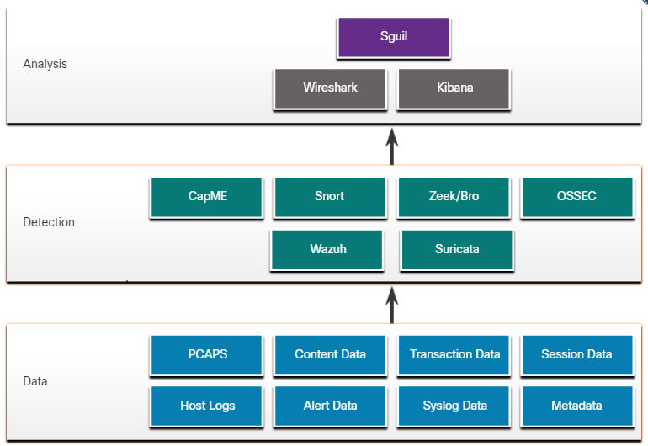
Evaluating Alerts
Detection Tools for Collecting Alert Data
Security Onion contains many components. It is an integrated environment which is designed to simplify the deployment of a comprehensive NSM solution.
The figure illustrates the way in which components of the Security Onion work together.
A Security Onion Architecture
Notes:
26 – Evaluating Alerts
26.1 – Sources of Alerts
26.1.2 – Detection Tools for Collecting Alert Data

Slide 13
Evaluating Alerts
Detection Tools for Collecting Alert Data (Contd.)
The following table lists the detection tools of the Security Onion:
Components | Description
CapME | This is a web application that allows viewing of pcap transcripts rendered with the tcpflow or Zeek tools.
Snort | This is a Network Intrusion Detection System (NIDS). It is an important source of alert data that is indexed in the Sguil analysis tool.
Zeek | Formerly known as Bro. This is a NIDS that uses more of a behavior-based approach to intrusion detection.
OSSEC | This is a host-based intrusion detection system (HIDS) that is integrated into Security Onion.
Wazuh | It is a full-featured solution that provides a broad spectrum of endpoint protection mechanisms including host logfile analysis, file integrity monitoring, vulnerability detection, configuration assessment, and incident response.
Suricata | This is a NIDS that uses a signature-based approach. It can also be used for inline intrusion prevention.
Notes:
26 – Evaluating Alerts
26.1 – Sources of Alerts
26.1.2 – Detection Tools for Collecting Alert Data

Slide 14
Evaluating Alerts
Analysis Tools
Security Onion integrates these various types of data and Intrusion Detection System (IDS) logs into a single platform through the following tools:
Sguil: This provides a high-level console for investigating security alerts from a wide variety of sources. Sguil serves as a starting point in the investigation of security alerts. Many data sources are available by pivoting directly from Sguil to other tools.
Kibana: It is an interactive dashboard interface to Elasticsearch data. It allows querying of NSM data and provides flexible visualizations of that data. It is possible to pivot from Sguil directly into Kibana to see contextualized displays.
Wireshark: It is a packet capture application that is integrated into the Security Onion suit. It can be opened directly from other tools and display full packet captures relevant to an analysis.
Zeek: This is a network traffic analyzer that serves as a security monitor. It inspects all traffic on a network segment and enables in-depth analysis of that data. Pivoting from Sguil into Zeek provides access to very accurate transaction logs, file content, and customized output.
Notes:
26 – Evaluating Alerts
26.1 – Sources of Alerts
26.1.3 – Analysis Tools

Slide 15
Evaluating Alerts
Alert Generation
Security alerts are notification messages that are generated by NSM tools, systems, and security devices. Alerts can come in many forms depending on the source.
In Security Onion, Sguil provides a console that integrates alerts from multiple sources into a timestamped queue.
A cybersecurity analyst works through the security queue investigating, classifying, escalating, or retiring alerts.
Alerts will generally include five-tuples information, as well as timestamps and information identifying which device or system generated the alert.
SrcIP - the source IP address for the event.
SPort - the source (local) Layer 4 port for the event.
DstIP - the destination IP for the event.
DPort - the destination Layer 4 port for the event.
Pr - the IP protocol number for the event.
Notes:
26 – Evaluating Alerts
26.1 – Sources of Alerts
26.1.4 – Alert Generation

Slide 16
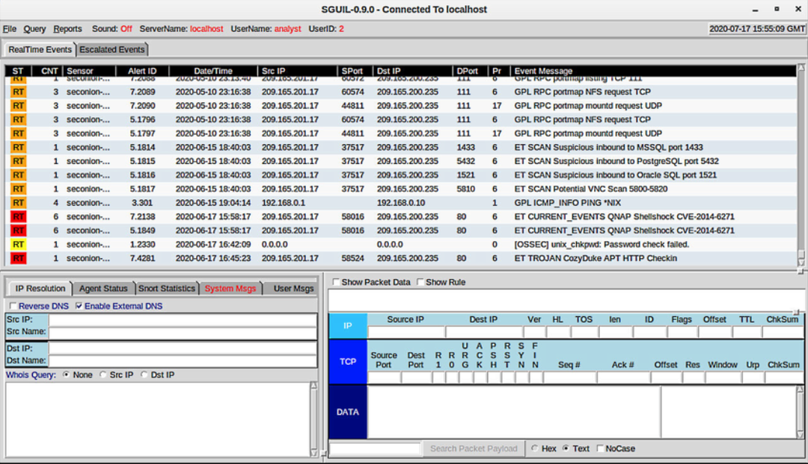
Evaluating Alerts
Alert Generation (Contd.)
The figure shows the Sguil application window with the queue of alerts that are waiting to be investigated in the top portion of the interface. The fields available for the real-time events are as follows:
ST - This is the status of the event. The event is color-coded by priority based on the category of the alert. There are four priority levels: very low, low, medium, and high and the colors range from light yellow to red as the priority increases.
CNT - This is the count for the number of times this event has been detected for the same source and destination IP address. The system has determined that this set of events is correlated.
Sensor - This is the agent reporting the event. The available sensors and their identifying numbers can be found in the Agent Status tab of the pane which appears below the events window on the left.
Sguil Window
Notes:
26 – Evaluating Alerts
26.1 – Sources of Alerts
26.1.4 – Alert Generation

Slide 17
Evaluating Alerts
Alert Generation (Contd.)
Alert ID - This two-part number represents the sensor that has reported the problem and the event number for that sensor.
Date/Time - This is the timestamp for the event. In the case of correlated events, it is the timestamp for the first event.
Event Message - This is the identifying text for the event. his is configured in the rule that triggered the alert. The associated rule can be viewed in the right-hand pane, just above the packet data. To display the rule, the Show Rule checkbox must be selected.
Sguil Window
Notes:
26 – Evaluating Alerts
26.1 – Sources of Alerts
26.1.4 – Alert Generation

Slide 18
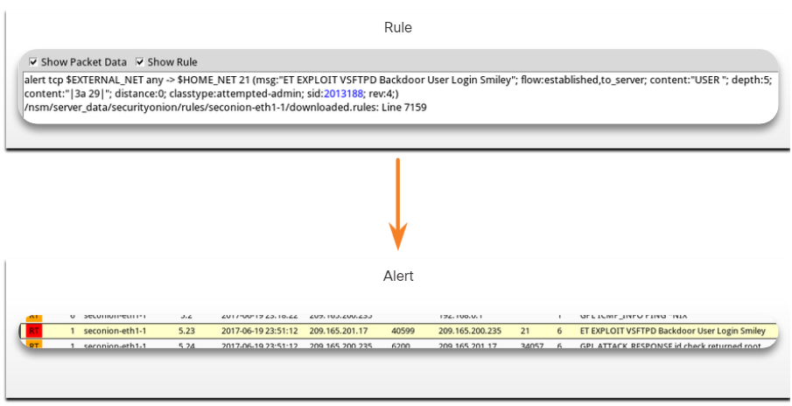
Evaluating Alerts
Rules and Alerts
Alerts can come from a number of sources:
NIDS - Snort, Zeek, and Suricata
HIDS - OSSEC, Wazuh
Asset management and monitoring - Passive Asset Detection System (PADS)
HTTP, DNS, and TCP transactions - Recorded by Zeek and pcaps
Syslog messages - Multiple sources
The information found in the alerts that are displayed in Sguil will differ in message format because they come from different sources.
The Sguil alert in the figure was triggered by a rule that was configured in Snort.
Notes:
26 – Evaluating Alerts
26.1 – Sources of Alerts
26.1.5 – Rules and Alerts

Slide 19
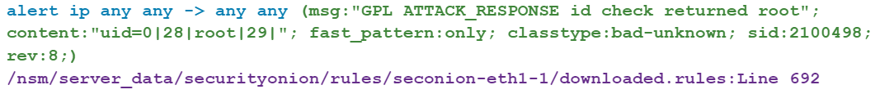
Evaluating Alerts
Snort Rule Structure
Snort rules consist of two sections, as shown in the figure: the rule header and the rule options. Rule Location is sometimes added by Sguil.
Component | Example (shortened…) | Explanation
rule header | alert ip any any -> any any | Contains the action to be taken, source and destination addresses and port, and the direction of traffic flow
rule options | (msg:”GPL ATTACK_RESPONSE ID CHECK RETURNED ROOT”;…) | Includes the message to be displayed, details of packet content, alert type, source ID, and additional details, such as a reference for the rule or vulnerability
rule location | /nsm/server_data/securityonion/rules/… | Added by Sguil to indicate the location of the rule in the Security Onion file structure and in the specified rule file
Notes:
26 – Evaluating Alerts
26.1 – Sources of Alerts
26.1.6 – Snort Rule Structure

Slide 20
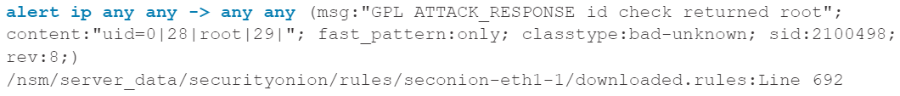
Evaluating Alerts
Snort Rule Structure (Contd.)
The Rule Header
The rule header contains the action, protocol, addressing, and port information, as shown in the figure. The structure of the header portion is consistent between Snort alert rule. Snort can be configured to use variables to represent internal and external IP addresses.
Component | Explanation
alert | the action to be taken is to issue an alert, other actions are log and pass
ip | the protocol
any any | the specified source is any IP address and any Layer 4 port
-> | the direction of flow is from the source to the destination
any any | the specified destination is any IP address and any Layer 4 port
Notes:
26 – Evaluating Alerts
26.1 – Sources of Alerts
26.1.6 – Snort Rule Structure

Slide 21
Evaluating Alerts
Snort Rule Structure (Contd.)
The Rule Options
The structure of the options section of the rule is variable. It is the portion of the rule that is enclosed in parenthesis, as shown in the figure. It contains the text message that identifies the alert. It also contains metadata about the alert, such as a URL.
Snort rule messages may include the source of the rule. Three common sources for Snort rules are:
GPL - Older Snort rules that were created by Sourcefire and distributed under a GPLv2. The GPL ruleset is not Cisco Talos certified. The GPL ruleset is can be downloaded from the Snort website, and it is included in Security Onion.
ET - Snort rules from Emerging Threats which is a collection point for Snort rules from multiple sources. The ET ruleset contains rules from multiple categories. A set of ET rules is included with Security Onion. Emerging Threats is a division of Proofpoint, Inc.
VRT - These rules are immediately available to subscribers and are released to registered users 30 days after they were created, with some limitations. They are now created and maintained by Cisco Talos.
Notes:
26 – Evaluating Alerts
26.1 – Sources of Alerts
26.1.6 – Snort Rule Structure

Slide 22
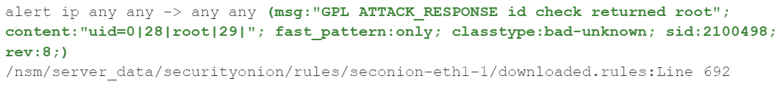
Evaluating Alerts
Snort Rule Structure (Contd.)
Component | Explanation
msg: | Text that describes the alert.
content: | Refers to content of the packet. In this case, an alert will be sent if the literal text “uid=0(root)” appears anywhere in the packet data. Values specifying the location of the text can be provided.
reference: | This is not shown in the figure. It is often a link to a URL that provides more information on the rule. In this case, the sid is hyperlinked to the source of the rule on the internet.
classtype: | A category for the attack. Snort includes a set of default categories that have one of four priority values.
sid: | A unique numeric identifier for the rule.
rev: | The revision of the rule that is represented by the sid.
Notes:
26 – Evaluating Alerts
26.1 – Sources of Alerts
26.1.6 – Snort Rule Structure

Slide 23
Evaluating Alerts
Lab - Snort and Firewall Rules
In this lab, you will complete the following objectives:
Perform live monitoring of IDS and events.
Configure your own customized firewall rule to stop internal hosts from contacting a malware-hosting server.
Craft a malicious packet and launch it against an internal target.
Create a customized IDS rule to detect the customized attack and issue an alert based on it.
Notes:
26 – Evaluating Alerts
26.1 – Sources of Alerts
26.1.7 – Lab - Snort and Firewall Rules

Slide 24
26.2 Overview of Alert Evaluation
Notes:
Source:
26 – Evaluating Alerts
26.2 – Overview of Alert Evaluation
In-Session Activities / Explanations:
Time: 10 min
Instructor Notes:
Give a brief introduction to the topic and discuss the need for alert evaluation.
Explain how alerts can be evaluated and classified.
Explain the deterministic analysis and probabilistic analysis.
By the end of the topic, encourage the learners to perform the given activities.
Key Points: Alert Evaluation, Deterministic Analysis, Probabilistic Analysis

Slide 25
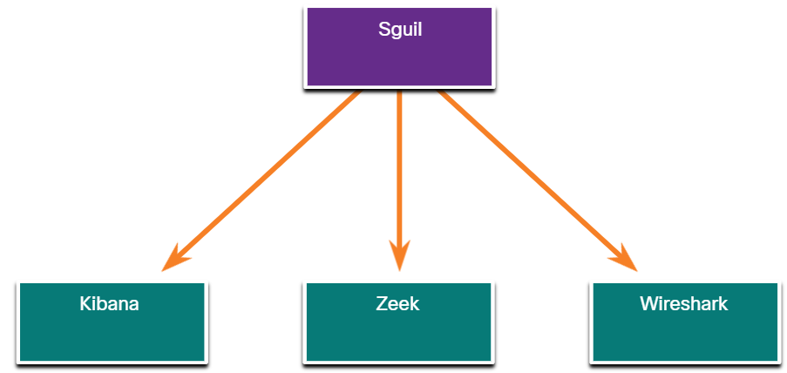
Overview of Alert Evaluation The Need for Alert Evaluation
The threat landscape is constantly changing as new vulnerabilities and threats are discovered. As user and organizational needs change, so also does the attack surface.
Threat actors have learned how to quickly vary features of their exploits in order to evade detection.
It is better to have alerts that are sometimes generated by innocent traffic, than it is to have rules that miss malicious traffic.
It is necessary to have skilled cybersecurity analysts investigate alerts to determine if an exploit has actually occurred.
Tier 1 cybersecurity analysts will work through queues of alerts in a tool like Sguil, pivoting to tools like Zeek, Wireshark, and Kibana to verify that an alert represents an actual exploit.
Primary Tools for the Tier 1 Cybersecurity Analyst
Notes:
26 – Evaluating Alerts
26.2 – Overview of Alert Evaluation 26.2.1 – The Need for Alert Evaluation

Slide 26
Overview of Alert Evaluation Evaluating Alerts
Security incidents are classified using a scheme borrowed from medical diagnostics. This classification scheme is used to guide actions and to evaluate diagnostic procedures. The concern is that either diagnosis can be accurate, or true, or inaccurate, or false.
In network security analysis, the cybersecurity analyst is presented with an alert. The cybersecurity analyst needs to determine if this diagnosis is true.
Alerts can be classified as follows:
True Positive: The alert has been verified to be an actual security incident.
False Positive: The alert does not indicate an actual security incident. Benign activity that results in a false positive is sometimes referred to as a benign trigger.
An alternative situation is that an alert was not generated. The absence of an alert can be classified as:
True Negative: No security incident has occurred. The activity is benign.
False Negative: An undetected incident has occurred.
Notes:
26 – Evaluating Alerts
26.2 – Overview of Alert Evaluation 26.2.2 – Evaluating Alerts

Slide 27
Overview of Alert Evaluation Evaluating Alerts (Contd.)
When an alert is issued, it will receive one of four possible classifications:
True positives are the desired type of alert. They mean that the rules that generate alerts have worked correctly.
False positives are not desirable. Although they do not indicate that an undetected exploit has occurred, they are costly because cybersecurity analysts must investigate false alarms.
True negatives are desirable. They indicate that benign normal traffic is correctly ignored, and erroneous alerts are not being issued.
False negatives are dangerous. They indicate that exploits are not being detected by the security systems that are in place.
 | True | False
Positive (Alert exists) | Incident occurred | No incident occurred
Negative (No alert exists) | No incident occurred | Incident occurred
Note: “True” events are desirable. “False” events are undesirable and potentially dangerous.
Notes:
26 – Evaluating Alerts
26.2 – Overview of Alert Evaluation 26.2.2 – Evaluating Alerts

Slide 28
Overview of Alert Evaluation Evaluating Alerts (Contd.)
Benign events are those that should not trigger alerts. Excess benign events indicate that some rules or other detectors need to be improved or eliminated.
When true positives are suspected, a cybersecurity analyst is required to escalate the alert to a higher level for investigation. The investigator will move forward with the investigation in order to confirm the incident and identify any potential damage that may have been caused.
A cybersecurity analyst may also be responsible for informing security personnel that false positives are occurring to the extent that the cybersecurity analyst’s time is seriously impacted.
False negatives may be discovered well after an exploit has occurred. This can happen through retrospective security analysis (RSA). RSA can occur when newly obtained rules or other threat intelligence is applied to archived network security data.
For this reason, it is important to monitor threat intelligence to learn of new vulnerabilities and exploits and to evaluate the likelihood that the network was vulnerable to them at some time in the past.
Notes:
26 – Evaluating Alerts
26.2 – Overview of Alert Evaluation 26.2.2 – Evaluating Alerts

Slide 29
Overview of Alert Evaluation Deterministic Analysis and Probabilistic Analysis
Deterministic analysis evaluates risk based on what is known about a vulnerability. This type of risk analysis can only describe the worst case.
Probabilistic analysis estimates the potential success of an exploit by estimating the likelihood that if one step in an exploit has successfully been completed that the next step will also be successful.
In a deterministic analysis, all of the information to accomplish an exploit is assumed to be known.
In probabilistic analysis, it is assumed that the port numbers that will be used can only be predicted with some degree of confidence.
The two approaches are summarized below.
Deterministic Analysis - For an exploit to be successful, all prior steps in the exploit must also be successful. The cybersecurity analyst knows the steps for a successful exploit.
Probabilistic Analysis - Statistical techniques are used to determine the probability that a successful exploit will occur based on the likelihood that each step in the exploit will succeed.
Notes:
26 – Evaluating Alerts
26.2 – Overview of Alert Evaluation 26.2.3 – Deterministic Analysis and Probabilistic Analysis
26.2.4 – Check Your Understanding - Identify Deterministic and Probabilistic Scenarios
26.2.5 – Check Your Understanding - Identify the Alert Classification

Slide 30
26.3 Evaluating Alerts Summary
Notes:
Source:
26 – Evaluating Alerts
26.3 – Evaluating Alerts Summary
In-Session Activities / Explanations:
Time: 5 min
Instructor Notes:
Read out the summary points mentioned on the slide.
Discuss the same with the participants.
Ask if they have any questions or doubts.
At the end, encourage the learners to take the quiz at section 26.3.2.
Key Points: NA

Slide 31
Evaluating Alerts Summary What Did I Learn in this Module?
Security Onion is an open-source suite of Network Security Monitoring (NSM) tools that run on an Ubuntu Linux distribution.
Security Onion tools provide three core functions for the cybersecurity analyst: full packet capture and data types, network-based and host-based intrusion detection systems, and alert analyst tools.
Security Onion integrates the data and IDS logs into a single platform through the following tools:
Sguil - serves as a starting point in the investigation of security alerts.
Kibana - It is an interactive dashboard interface to Elasticsearch data.
The Wireshark packet capture application is integrated into the Security Onion suite.
Zeek is a network traffic analyzer that serves as a security monitor.
Notes:
26 – Evaluating Alerts
26.3 – Evaluating Alerts Summary
26.3.1 – What Did I Learn in this Module?

Slide 32
Evaluating Alerts Summary What Did I Learn in this Module? (Contd.)
Snort is a Network Intrusion Detection System (NIDS). It is an important source of the alert data that is indexed in the Sguil analysis tool.
Alerts can be classified as True Positive (The alert has been verified to be an actual security incident) or False Positive (The alert does not indicate an actual security incident).
An alternative situation is that an alert was not generated. The absence of an alert can be classified as: True Negative (No security incident has occurred. The activity is benign.) and False Negative (An undetected incident has occurred).
Deterministic analysis evaluates risk based on what is known about a vulnerability.
Probabilistic analysis estimates the potential success of an exploit by estimating the likelihood that if one step in an exploit has successfully been completed that the next step will also be successful.
Notes:
26 – Evaluating Alerts
26.3 – Evaluating Alerts Summary
26.3.1 – What Did I Learn in this Module?

Slide 33
Module 26 New Terms and Commands
Security Onion Network Security Monitoring (NSM) CapME Snort Zeek OSSEC Wazuh Suricata | Passive Asset Detection System (PADS) Retrospective Security Analysis (RSA) Deterministic Analysis Probabilistic Analysis Sguil Kibana Wireshark Zeek
Notes:
26 - Evaluating Alerts
New Terms and Commands

