Slide 1
Module 27: Working with Network Security Data
Instructor Materials
CyberOps Associate v1.0
Notes:
Cisco Networking Academy Program
CyberOps Associate v1.0
Module 27 – Working with network Security Data

Slide 2
Instructor Materials – Module 27 Planning Guide
This PowerPoint deck is divided in two parts:
Instructor Planning Guide
Information to help you become familiar with the module
Teaching aids
Instructor Class Presentation
Optional slides that you can use in the classroom
Begins on slide # 8
Note: Remove the Planning Guide from this presentation before sharing with anyone.
For additional help and resources go to the Instructor Home Page and Course Resources for this course. You also can visit the professional development site on www.netacad.com, the official Cisco Networking Academy Facebook page, or Instructor Only FB group.
Notes:
2

Slide 3
What to Expect in this Module
To facilitate learning, the following features within the GUI may be included in this module:
Feature | Description
Hands-On Labs | Labs designed for working with physical equipment.
Videos | Expose learners to new skills and concepts.
Module Quizzes | Self-assessments that integrate concepts and skills learned throughout the series of topics presented in the module.
Module Summary | Briefly recaps module content.

Slide 4
Check Your Understanding
Check Your Understanding activities are designed to let students quickly determine if they understand the content and can proceed, or if they need to review.
Check Your Understanding activities do not affect student grades.
There are no separate slides for these activities in the PPT. They are listed in the notes area of the slide that appears before these activities.
Notes:
4

Slide 5
Module 27: Activities
What activities are associated with this module?
Page # | Activity Type | Activity Name | Optional?
27.1.5 | Lab | Convert Data into a Universal Format | Recommended
27.2.9 | Lab | Regular Expression Tutorial | Recommended
27.2.10 | Lab | Extract an Executable from a PCAP | Recommended
27.2.11 | Video | Interpret HTTP and DNS Data to Isolate Threat Actor | Recommended
27.2.12 | Lab | Interpret HTTP and DNS Data to Isolate Threat Actor | Recommended
27.2.13 | Video | Isolate Compromised Host Using 5-Tuple | Recommended
27.2.14 | Lab | Isolate Compromised Host Using 5-Tuple | Recommended
27.2.15 | Lab | Investigate a Malware Exploit | Recommended
27.2.16 | Lab | Investigating an Attack on a Windows Host | Recommended
Notes:
5

Slide 6
Module 27: Best Practices
Prior to teaching Module 27, the instructor should:
Review the activities and assessments for this module.
Try to include as many questions as possible to keep students engaged during classroom presentation.
Topic 27.1
Provide an overview of the Security Onion tools.
Ask the learners to visit https://github.com/Security-Onion-Solutions/security-onion/wiki/IntroductionToSecurityOnion to learn more about Security Onion tools like ELK, Squil, HIDS and so on.
Ask the class what do they understand by data archiving ? What is its importance?
Notes:
6

Slide 7
Module 27: Best Practices (Contd.)
Topic 27.2
Briefly explain Squil.
Ask the class to visit the site: https://docs.securityonion.net/en/latest/sguil.html to learn more on Squil.
Demonstrate a video of ‘Interpret HTTP and DNS Data to Isolate Threat Actor’ to the class.
Demonstrate a video of ‘Isolate Compromised Host Using 5-Tuple’ to the class.
Topic 27.3
Demonstrate to the students the Kibana interface and explain the customization of dashboards.
Notes:
7

Slide 8
Module 27: Working with Network Security Data
CyberOps Associate v1.0
Notes:
Cisco Networking Academy Program
CyberOps Associate v1.0
Module 27 – Working with Network Security Data
In-Session Activities / Explanations:
Time: 5 mins
Instructor Notes:
Welcome the audience in a warm and cordial manner. Ensure that everyone is set up with the required resources.
Introduce the topic and encourage learners to come up with a list of expectations from the session. Collate topics on the white board or Desktop while using learner’s inputs to interpret them in words.
Provide an overview of the module including the different topics that will be covered.
Read out the Objectives and briefly describe each.
Key Points: NA

Slide 9
Module Objectives
Module Title : Working with Network Security Data
Module Objective: Interpret data to determine the source of an alert.
Topic Title | Topic Objective
A Common Data Platform | Explain how data is prepared for use in a Network Security Monitoring (NSM) system.
Investigating Network Data | Use Security Onion tools to investigate network security events.
Enhancing the Work of the CyberSecurity Analyst | Describe network monitoring tools that enhance workflow management.
Notes:
9
Module 27 – Working with Network Security Data
27.0 – Introduction
27.0.2 - What Will I Learn in this Module?

Slide 10
27.1 A Common Data Platform
Notes:
Source:
27 – Working with Network Security Data
27.1 – A Common Data Platform
In-Session Activities / Explanations:
Time: 15 mins
Instructor Notes:
Explain the core components of ELK.
Explain the process of network data reduction.
Define data normalization.
At the end of the topic, enquire how the learners have performed in the lab session in section 27.1.5.
Key Points: ELK, Data Reduction, Data Normalization, Data Archiving

Slide 11
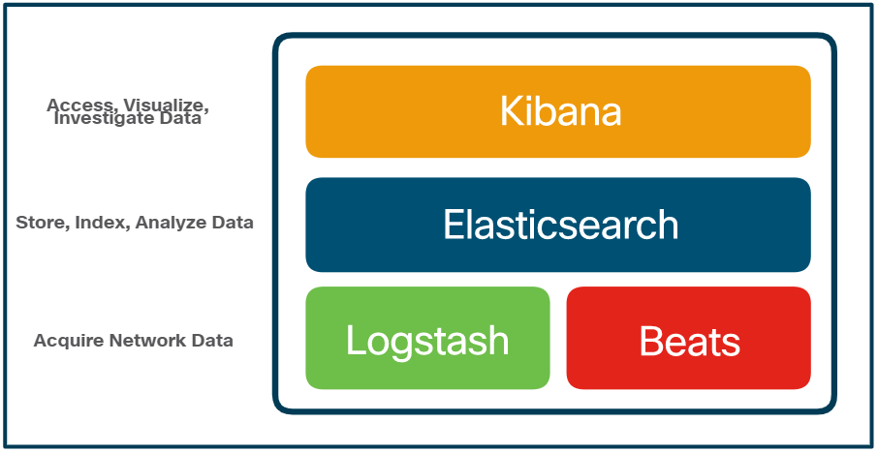
A Common Data Platform ELK
Security Onion includes Elastic Stack that consists of Elasticsearch, Logstash, and Kibana (ELK).
Core Components of ELK:
Elasticsearch: An open-core platform for searching and analyzing an organization’s data in near real time.
Logstash: Enables collection and normalization of network data into data indexes that can be efficiently searched by Elasticsearch.
Kibana: Provides a graphical interface to data that is compiled by Elasticsearch.
Beats: Series of software plugins that send different types of data to the Elasticsearch data stores.
Notes:
27 – Working with Network Security Data
27.1 – A Common Data Platform
27.1.1 - ELK

Slide 12
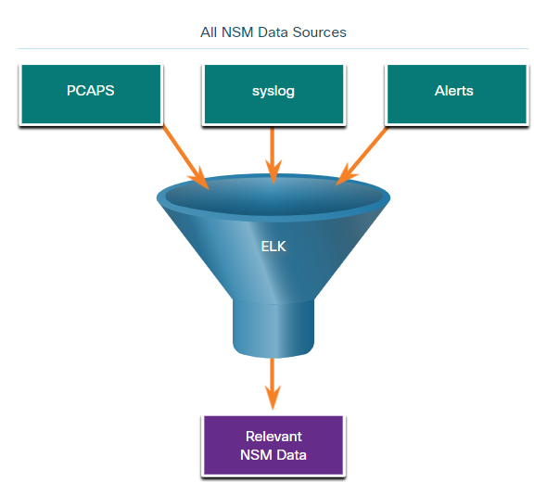
A Common Data Platform Data Reduction
To reduce data, it is essential to identify the network data that should be gathered and stored to reduce the burden on systems.
By limiting the volume of data, tools like Elasticsearch will be far more useful.
Notes:
27 – Working with Network Security Data
27.1 – A Common Data Platform
27.1.2 – Data Reduction

Slide 13
A Common Data Platform Data Normalization
Data normalization is the process of combining data from a number of sources into a common format.
A common schema will specify the names and formats for the required data fields.
For example, IPv6 addresses, MAC addresses, and date and time can be represented in varying formats:
IPv6 Address Formats | Mac Formats | Date Formats
2001:db8:acad:1111:2222::33 | A7:03:DB:7C:91:AA | Monday, July 24, 2017 7:39:35pm
2001:DB8:ACAD:1111:2222::33 | A7-03-DB-7C-91-AA | Mon, 24 Jul 2017 19:39:35 +0000
2001:DB8:ACAD:1111:2222:0:0:33 | A70.3DB.7C9.1AA | 2017-07-24T19:39:35+00:00
Data normalization is also required to simplify searching for correlated events.
Notes:
27 – Working with Network Security Data
27.1 – A Common Data Platform
27.1.3 – Data Normalization

Slide 14
A Common Data Platform Data Archiving
Retaining Network Security Monitoring (NSM) data indefinitely is not feasible due to storage and access issues.
The retention period for certain types of network security information may be specified by compliance frameworks.
Sguil alert data is retained for 30 days by default. This value is set in the securityonion.conf file.
Security Onion data can always be archived to external storage by a data archive system, depending on the needs and capabilities of the organization.
Note: The storage locations for the different types of Security Onion data will vary based on the Security Onion implementation.
Notes:
27 – Working with Network Security Data
27.1 – A Common Data Platform
27.1.4 – Data Archiving

Slide 15
A Common Data Platform Lab - Convert Data into a Universal Format
In this lab, you will complete the following objectives:
Part 1: Use command line tools to manually normalize log entries.
Part 2: The timestamp field must be normalized.
Part 3: The IPv6 field requires normalization.
Notes:
27 – Endpoint Vulnerability Assessment
27.1 – A Common Data Platform
27.1.5 – Lab - Convert Data into a Universal Format

Slide 16
27.2 Investigating Network Data
Notes:
Source:
27 – Working with Network Security Data
27.2 – Investigating Network Data
In-Session Activities / Explanations:
Time: 40 mins
Instructor Notes:
Introduce the topic with a real life scenario describing the investigation of network data and the tracking of alerts.
Explain how alerts are verified in Squil
Discuss the construction of Sguil queries .
Explain the interaction of an applications with an operating system (OS)
Describe how to investigate the API calls.
Describe how cybersecurity analysts can investigate files
At the end of the topic, enquire how learners have performed in the lab sessions.
Key Points: Sguil, Squil queries, , API calls

Slide 17
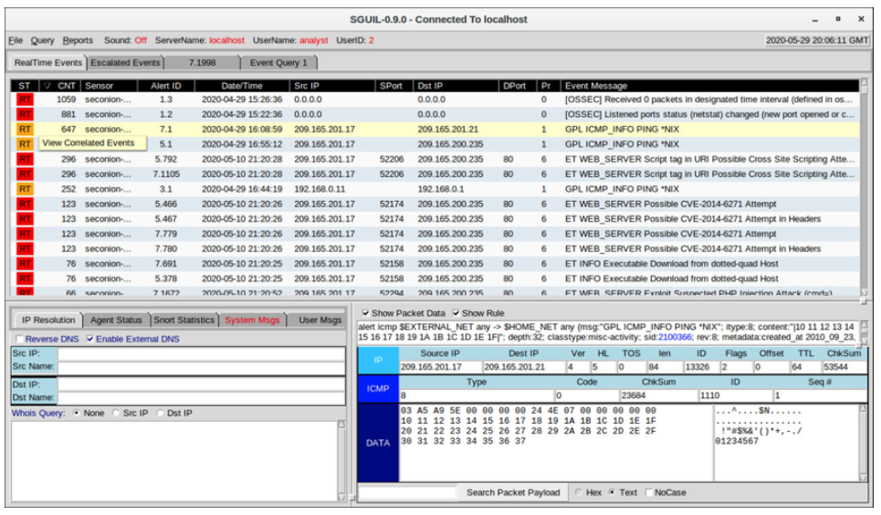
Investigating Network Data Working in Sguil
In Security Onion, the first place that a cybersecurity analyst will go to verify alerts is Sguil.
Sguil automatically correlates similar alerts into a single line and provides a way to view correlated events represented by that line.
To understand what is happening in the network, it may be useful to sort the CNT column to display the alerts with the highest frequency.
Sguil Alerts Sorted on CNT
Notes:
27 – Working with Network Security Data
27.2 – Investigating Network Data
27.2.1- Working in Sguil

Slide 18
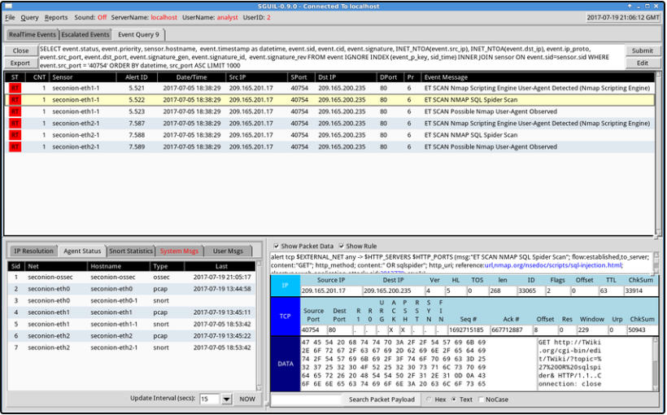
Investigating Network Data Sguil Queries
Queries can be constructed in Sguil using the Query Builder. It simplifies constructing queries to a certain degree.
Cybersecurity analyst must know the field names and some issues with field values to effectively build queries in Sguil.
For example, Sguil stores IP addresses in an integer representation.
Notes:
27 – Working with Network Security Data
27.2 – Investigating Network Data
27.2.2 – Sguil Queries

Slide 19
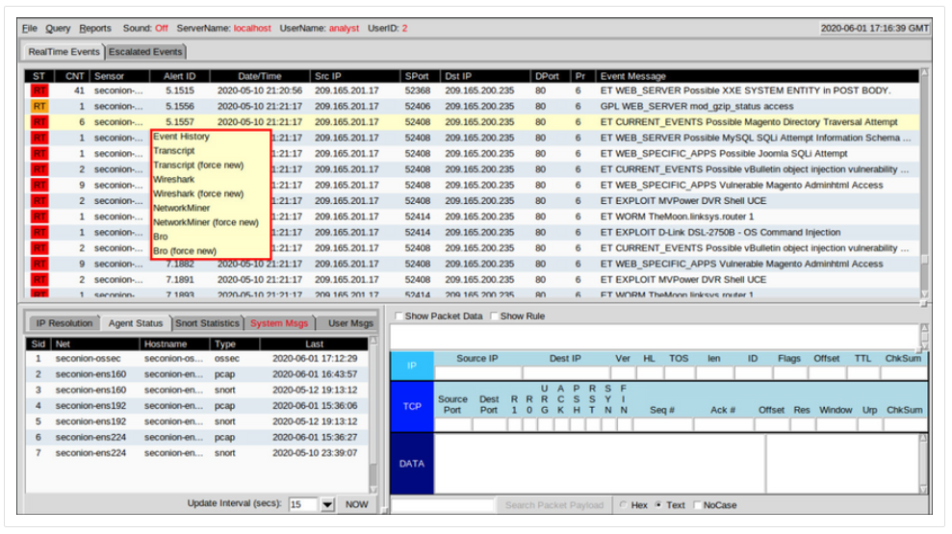
Investigating Network Data Pivoting from Sguil
Sguil provides the ability for the cybersecurity analyst to pivot to other information sources and tools.
Log files are available in Elasticsearch.
Relevant packet captures can be displayed in Wireshark.
Sguil can provide pivots to Passive Real-time Asset Detection System (PRADS) and Security Analyst Network Connection Profiler (SANCP) information.
Note: The Sguil interface refers to PADS instead of PRADS.
Notes:
27 – Working with Network Security Data
27.2 – Investigating Network Data
27.2.3 – Pivoting from Sguil

Slide 20
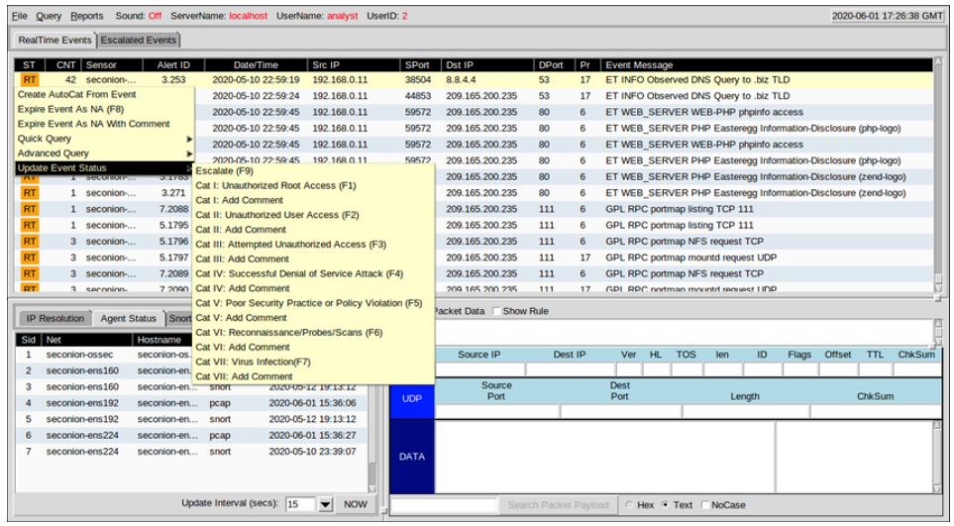
Investigating Network Data Event Handling in Sguil
Sguil is a console that enables a cybersecurity analyst to investigate, verify, and classify security alerts.
Three tasks can be completed in Squil to manage alerts:
Alerts that have been found to be false positives can be expired.
An event can be escalated by pressing the F9 key.
An event can be categorized.
Sguil includes seven pre-built categories that can be assigned by using a menu or by pressing the corresponding function key.
Notes:
27 – Working with Network Security Data
27.2 – Investigating Network Data
27.2.4 – Event Handling in Sguil

Slide 21
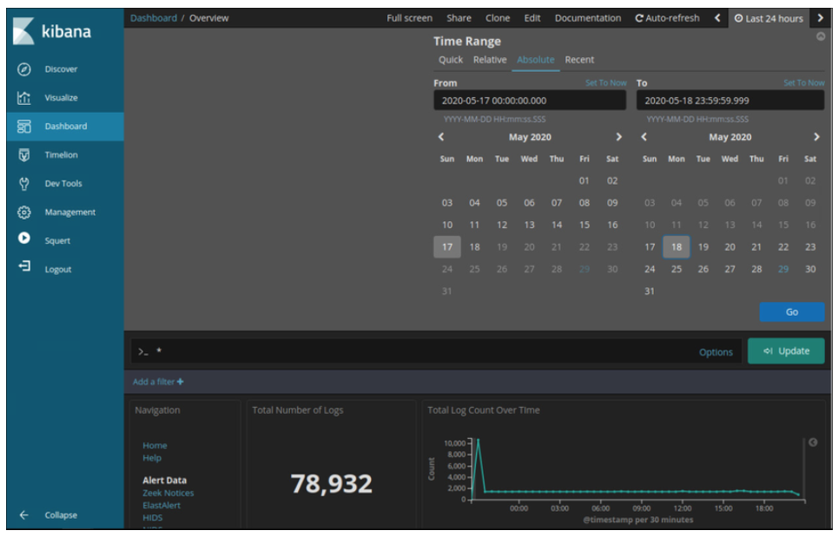
Investigating Network Data Working in ELK
Logstash and Beats are used for data ingestion in the Elastic Stack.
Kibana, which is the visual interface into the logs, is configured to show the last 24 hours by default.
Logs are ingested into Elasticsearch into separate indices or databases based on a configured range of time.
The best way to monitor the data in Elasticsearch is to build customized visual dashboards.
Notes:
27 – Working with Network Security Data
27.2 – Investigating Network Data
27.2.5 – Working in ELK

Slide 22
Investigating Network Data Queries in ELK
Elasticsearch is built on Apache Lucene, an open-source search engine software library featuring full text indexing and searching capabilities.
Using Lucene software libraries, Elasticsearch has its own query language based on JSON called Query Domain Specific Language (DSL).
Along with JSON, Elasticsearch queries make use of elements such as Boolean operators, Fields, Ranges, Wildcards, Regex, Fuzzy Search, and Text Search.
Elasticsearch was designed to interface with users using web-based clients that follow the HTTP REST framework.
Methods used for executing the queries are URI, cURL, JSON and Dev Tools.
Note: Advanced Elasticsearch queries are beyond the scope of this course. In the labs, you will be provided with the complex query statements, if necessary.
Notes:
27 – Working with Network Security Data
27.2 – Investigating Network Data
27.2.6 – Queries in ELK

Slide 23
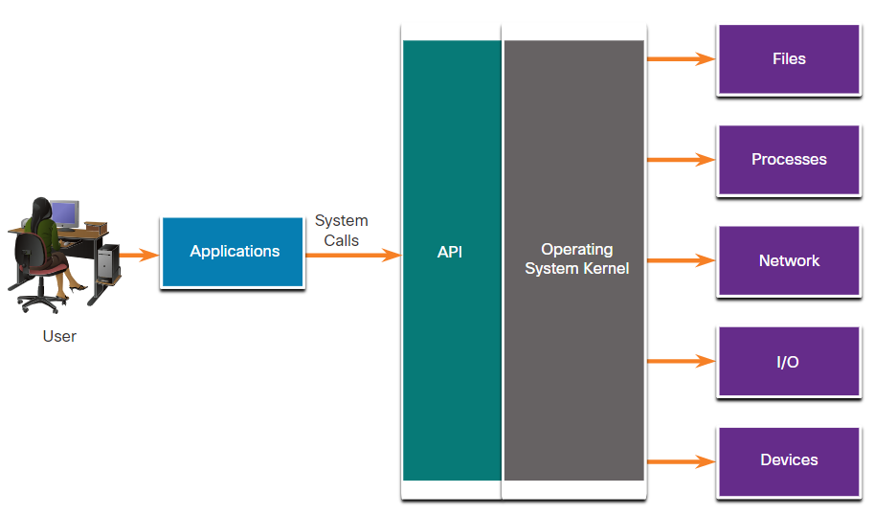
Investigating Network Data Investigating Process or API Calls
Applications interact with an Operating System (OS) through system calls to the OS Application Programming Interface (API).
If malware can fool an OS kernel into allowing it to make system calls, many exploits are possible.
OSSEC rules detect changes in host-based parameters.
OSSEC rules will trigger an alert in Sguil.
Pivoting to Kibana on the host IP address allows you to choose the type of alert based on the program that created it.
Filtering for OSSEC indices results in a view of the OSSEC events that occurred on the host, including indicators that malware may have interacted with the OS kernel
Notes:
27 – Working with Network Security Data
27.2 – Investigating Network Data
27.2.7 - Investigating Process or API Calls

Slide 24
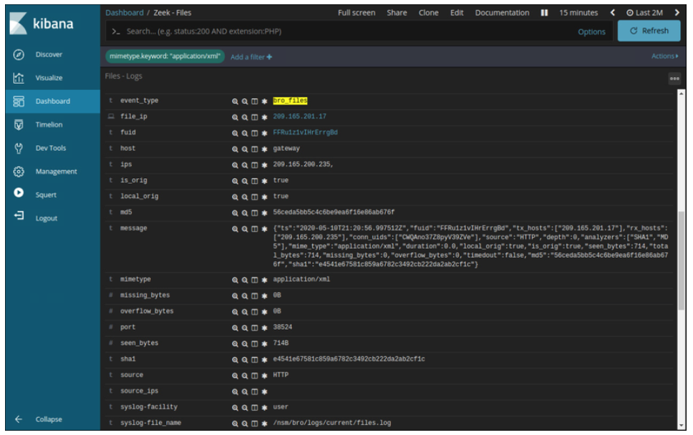
Investigating Network Data Investigating File Details
In Sguil, if the cybersecurity analyst is suspicious of a file, the hash value can be submitted to an online site to determine if the file is a known malware.
In Kibana, Zeek Hunting can be used to display information regarding the files that have entered the network.
Note that in Kibana, the event type is shown as bro_files, even though the new name for Bro is Zeek.
Notes:
27 – Working with Network Security Data
27.2 – Investigating Network Data
27.2.8 – Investigating File Details

Slide 25
Investigating Network Data Lab - Regular Expression Tutorial
In this lab, you will complete the following objectives:
Use an online tutorial to explore regular expressions.
Describe the information that matches given regular expressions.
Notes:
27 – Working with Network Security Data
27.2 – Investigating Network Data
27.2.9 – Lab - Regular Expression Tutorial

Slide 26
Investigating Network Data Lab - Extract an Executable from a PCAP
Looking at logs is very important, but it is also important to understand how network transactions happen at the packet level.
In this lab, you will complete the following objective:
Analyze the traffic in a previously captured pcap file and extract an executable file from the traffic.
Notes:
27 – Working with Network Security Data
27.2 – Investigating Network Data
27.2.10 – Lab - Extract an Executable from a PCAP

Slide 27
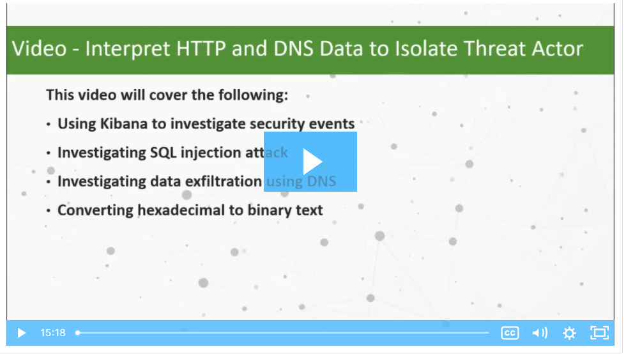
Investigating Network Data Video - Interpret HTTP and DNS Data to Isolate Threat Actor
Watch the video to view a walkthrough of the Security Onion Interpret HTTP and DNS Data to Isolate Threat Actor lab.
Notes:
27 – Working with Network Security Data
27.2 – Investigating Network Data
27.2.11 – Video - Interpret HTTP and DNS Data to Isolate Threat Actor

Slide 28
Investigating Network Data Lab - Interpret HTTP and DNS Data to Isolate Threat Actor
In this lab, you will complete the following objective:
Investigate SQL injection and DNS exfiltration exploits using Security Onion tools.
Notes:
27 – Working with Network Security Data
27.2 – Investigating Network Data
27.2.12 – Lab - Interpret HTTP and DNS Data to Isolate Threat Actor

Slide 29
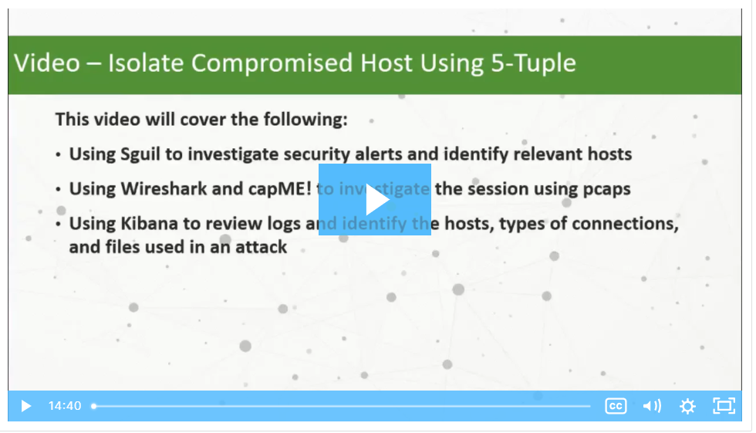
Investigating Network Data Video - Isolate Compromised Host Using 5-Tuple
Watch the video to view a walkthrough of the Security Onion Isolate Compromised Host Using 5-Tuple lab.
Notes:
27 – Working with Network Security Data
27.2 – Investigating Network Data
27.2.13 – Video - Isolate Compromised Host Using 5-Tuple

Slide 30
Investigating Network Data Lab - Isolate Compromised Host Using 5-Tuple
In this lab, you will complete the following objective:
Use Security Onion tools to investigate an exploit.
Notes:
27 – Working with Network Security Data
27.2 – Investigating Network Data
27.2.14 – Lab - Isolate Compromised Host Using 5-Tuple

Slide 31
Investigating Network Data Lab - Investigate a Malware Exploit
In this lab, you will complete the following objective:
Use Security Onion to investigate a more complex malware exploit the uses an exploit kit to infect hosts.
Notes:
27 – Working with Network Security Data
27.2 – Investigating Network Data
27.2.15 - Lab - Investigate a Malware Exploit

Slide 32
Investigating Network Data Lab - Investigating an Attack on a Windows Host
In this lab, you will complete the following objectives:
Investigate an attack on a Windows host.
Use Sguil, Kibana, and Wireshark in Security Onion to investigate the attack.
Examine exploit artifacts.
Notes:
27 – Working with Network Security Data
27.2 – Investigating Network Data
27.2.16 - Lab - Investigating an Attack on a Windows Host

Slide 33
27.3 Enhancing the Work of the Cybersecurity Analyst
Notes:
Source:
27 – Working with Network Security Data
27.3 – Enhancing the Work of the Cybersecurity Analyst
In-Session Activities / Explanations:
Time: 5 mins
Instructor Notes:
Discuss Dashboards
Explain the Kibana interface
Describe workflow management
Key Points: Dashboards, Kibana, workflow management

Slide 34
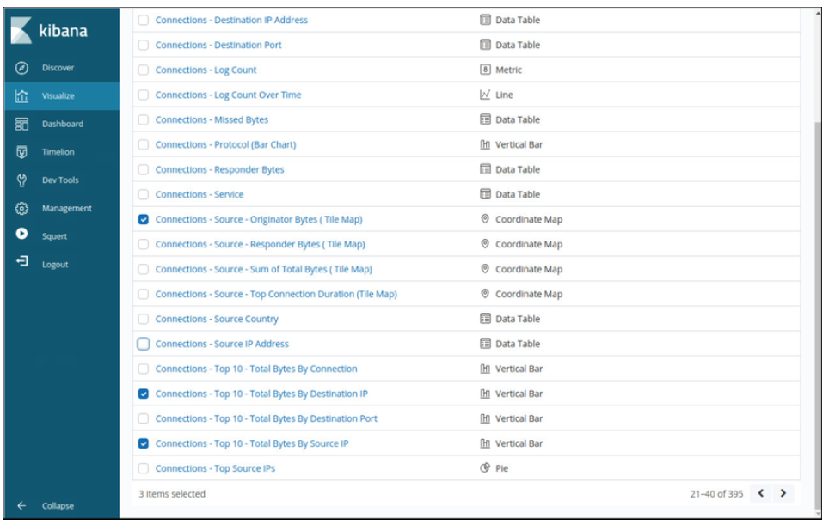
Enhancing the Work of the Cybersecurity Analyst Dashboards and Visualizations
Dashboards provide a combination of data and visualizations which allows cybersecurity analysts to focus on specific details and information.
Dashboards are usually interactive.
Kibana includes the capability of designing custom dashboards.
In addition, tools such as Squert in Security Onion provide a visual interface to NSM data.
Notes:
27 – Working with Network Security Data
27.3 – Enhancing the Work of the Cybersecurity Analyst
27.3.1 – Dashboards and Visualizations

Slide 35
Enhancing the Work of the Cybersecurity Analyst Workflow Management
Workflows are the sequence of processes and procedures through which work tasks are completed.
Managing the SOC workflows:
Enhances the efficiency of the cyberoperations team
Increases the accountability of the staff
Ensures that all potential alerts are treated properly
Sguil provides a basic workflow management but not a good choice for large operations. There are third party systems available that can be customized.
Automated queries add efficiency to the cyberoperations workflow. These queries automatically search for complex security incidents that may evade other tools.
Notes:
27 – Working with Network Security Data
27.3 – Enhancing the Work of the Cybersecurity Analyst
27.3.2 – Workflow Management

Slide 36
27.4 Working with Network Security Data Summary
Notes:
Source:
27 – Working with Network Security Data
27.4 – Working with Network Security Data Summary
In-Session Activities / Explanations:
Time: 5 mins
Instructor Notes:
Summarize all the topics of this module.
Ask the learners if they have any doubts.
Ensure that the learners complete the module quiz
Key Points: NA

Slide 37
Working with Network Security Data
What Did I Learn in this Module?
A network security monitoring platform such as ELK or Elastic Stack must unite the data for analysis.
ELK consists of Elasticsearch, Logstash, and Kibana with components, Beats, ElastAlert, and Curator.
Network data must be reduced so that only relevant data is processed by the NSM system.
Network data must also be normalized to convert the same types of data to consistent formats.
Sguil provides a console that enables a cybersecurity analyst to investigate, verify, and classify security alerts.
Kibana visualizations provide insights into NSM data by representing large amounts of data formats that are easier to interpret.
Workflow management adds efficiency to the work of the SOC team.
Notes:
27 – Working with Network Security Data
27.4 – Working with Network Security Data Summary
27.4.1 – What Did I Learn in this Module?
27.4.2 – Module 27: Working with Network Security Data Quiz

Slide 38
Module 27 New Terms and Commands
Elasticsearch, Logstash, and Kibana (ELK). Security Onion Squil Network Security Monitoring (NSM) | Passive Real-time Asset Detection System (PRADS) Security Analyst Network Connection Profiler (SANCP) Squert
Notes:
27 – Working with Network Security Data
New Terms and Commands

