Slide 1
Module 28: Digital Forensics and Incident Analysis and Response
Instructor Materials
CyberOps Associate v1.0
Notes:
Cisco Networking Academy Program
CyberOps Associate v1.0
Module 28: Digital Forensics and Incident Analysis and Response

Slide 2
Instructor Materials – Module 28 Planning Guide
This PowerPoint deck is divided in two parts:
Instructor Planning Guide
Information to help you become familiar with the module
Teaching aids
Instructor Class Presentation
Optional slides that you can use in the classroom
Begins on slide # 8
Note: Remove the Planning Guide from this presentation before sharing with anyone.
For additional help and resources go to the Instructor Home Page and Course Resources for this course. You also can visit the professional development site on www.netacad.com, the official Cisco Networking Academy Facebook page, or Instructor Only FB group.
Notes:
2

Slide 3
What to Expect in this Module
To facilitate learning, the following features within the GUI may be included in this module:
Feature | Description
Check Your Understanding (CYU) | Per topic online quiz to help learners gauge content understanding.
Hands-On Labs | Labs designed for working with physical equipment.
Module Quizzes | Self-assessments that integrate concepts and skills learned throughout the series of topics presented in the module.
Module Summary | Briefly recaps module content.

Slide 4
Check Your Understanding
Check Your Understanding activities are designed to let students quickly determine if they understand the content and can proceed, or if they need to review.
Check Your Understanding activities do not affect student grades.
There are no separate slides for these activities in the PPT. They are listed in the notes area of the slide that appears before these activities.
Notes:
4

Slide 5
Module 28: Activities
What activities are associated with this module?
Page # | Activity Type | Activity Name | Optional?
28.1.3 | Check Your Understanding | Identify the Steps in the Digital Forensics Process | Recommended
28.1.5 | Check Your Understanding | Identify the Type of Evidence | Recommended
28.2.9 | Check Your Understanding | Identify the Kill Chain Step | Recommended
28.3.4 | Check Your Understanding | Identify the Diamond Model Features | Recommended
28.4.2 | Check Your Understanding | Identify the Incident Response Plan Elements | Recommended
28.4.11 | Check Your Understanding | Identify the Incident Handling Term | Recommended
28.4.12 | Lab | Incident Handling | Recommended
Notes:
5

Slide 6
Module 28: Best Practices
Prior to teaching Module 28, the instructor should:
Review the activities and assessments for this module.
Try to include as many questions as possible to keep students engaged during classroom presentation.
Topic 28.1
Explain the digital forensic process with a real life example.
Define types of evidences. Later, provide examples to the learners and ask them to identify.
Describe an example of most volatile to least volatile evidence collection order.
Notes:
6

Slide 7
Module 28: Best Practices (Contd.)
Topic 28.2
Discuss the steps in Cyber Kill Chain by writing each step on the whiteboard so as to give the learners an entire overview of Cyber Kill Chain.
Topic 28.3
Brief the students on the Diamond model and explain pivoting with the help of an example.
Differentiate between Diamond Model and Cyber Kill Chain process.
Topic 28.4
Introduce the NIST Computer Security Incident Handling Guide to the learners.
Discuss the domain levels of Cybersecurity Maturity Model Certification (CMMC).
Use a flowchart to explain each phase of the NIST Response Lifecycle.
Notes:
7

Slide 8
Module 28: Digital Forensics and Incident Analysis and Response
CyberOps Associate v1.0
Notes:
Cisco Networking Academy Program
CyberOps Associate v1.0
Module 28: Digital Forensics and Incident Analysis and Response
In-Session Activities / Explanations:
Time: 5 min
Instructor Notes:
Welcome the audience in a warm and cordial manner. Ensure that everyone is set up with the required resources.
Introduce the topic and encourage learners to come up with a list of expectations from the session. Collate topics on the white board or Desktop while using learner’s inputs to interpret them in words.
Read out the Objectives and briefly describe each.
Key Points: NA

Slide 9
Module Objectives
Module Title: Digital Forensics and Incident Analysis and Response
Module Objective: Explain how the CyberOps Associate responds to cyber security incidents.
Topic Title | Topic Objective
Evidence Handling and Attack Attribution | Explain the role of digital forensics processes
The Cyber Kill Chain | Identify the steps in the Cyber Kill Chain
The Diamond Model of Intrusion Analysis | Classify an intrusion event using the Diamond Model
Incident Response | Apply the NIST 800-61r2 incident handling procedures to a given incident scenario
Notes:
9
CyberOps Associate v1.0
28 – Digital Forensics and Incident Analysis and Response
28.0 – Introduction
28.0.2– What Will I Learn in this Module?

Slide 10
28.1 Evidence Handling and Attack Attribution
Notes:
Source:
28 – Digital Forensics and Incident Analysis and Response
28.1 – Evidence Handling and Attack Attribution
In-Session Activities / Explanations:
Time: 15 min
Instructor Notes:
Briefly explain Digital Forensics
Describe Digital Forensics process
List the types of evidence
Define chain of custody
Explain the MITRE ATT&CK framework
Walk the learners through attack attribution
Ensure that the learners complete the ‘Check Your Understanding - Identify the Steps in the Digital Forensics Process’ in section 28.1.3.
Key Points: Digital Forensic process, Evidence handling, Chain of Custody, Attack Attribution, MITRE ATT&CK framework

Slide 11
Digital Forensics and Incident Analysis and Response
Digital Forensics
Digital Forensics is the recovery and investigation of information found on digital devices as it relates to criminal activity.
Indicators of compromise are the evidence that a cybersecurity incident has occurred.
For example, under the US HIPAA regulations, if data breach has occurred involving patient information, then notification of the breach must be made to the affected individuals.
Digital forensic investigation must be used to determine the affected individuals and also to certify the number of affected individuals so that appropriate notification can be made in compliance with HIPAA regulations.
At times, Cybersecurity analysts may find themselves in direct contact with digital forensic evidence that details the conduct of members of the organization.
Analysts must know the requirements regarding the preservation and handling of such evidence.
Notes:
28 – Digital Forensics and Incident Analysis and Response
28.1 – Evidence Handling and Attack Attribution
28.1.1 – Digital Forensics

Slide 12
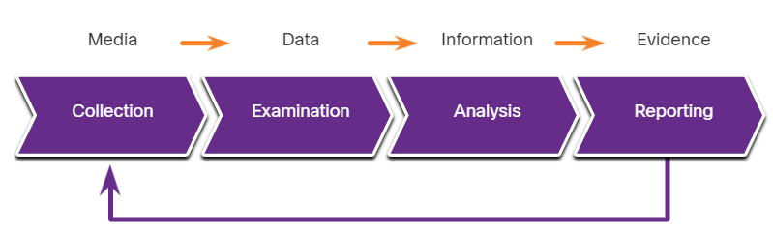
Digital Forensics and Incident Analysis and Response
The Digital Forensics Process
NIST describes the four phases of the digital evidence forensic process:
Collection - Identification of potential sources of forensic data and acquisition, handling, and storage of that data
Examination - Assessing and extracting relevant information from the collected data
Analysis - Drawing conclusions from the data and correlation of data from multiple sources
Reporting - Preparing and presenting information that resulted from the analysis phase.
Notes:
28 – Digital Forensics and Incident Analysis and Response
28.1 – Evidence Handling and Attack Attribution
28.1.2 – The Digital Forensics Process
28.1.3 – Check Your Understanding - Identify the Steps in the Digital Forensics Process

Slide 13
Digital Forensics and Incident Analysis and Response
Types of Evidence
In legal proceedings, evidence is broadly classified as following:
Direct Evidence - The evidence that was indisputably in the possession of the accused, or is eyewitness evidence from someone who directly observed criminal behavior.
Indirect evidence - This evidence establishes a hypothesis in combination with other facts. It is also known as circumstantial evidence.
Best evidence – This evidence could be storage devices used by an accused, or archives of files that can be proven to be unaltered.
Corroborating evidence - This evidence supports an assertion that is developed from best evidence.
Notes:
28 – Digital Forensics and Incident Analysis and Response
28.1 – Evidence Handling and Attack Attribution
28.1.4 – Types of Evidence
28.1.5 – Check Your Understanding - Identify the Type of Evidence

Slide 14
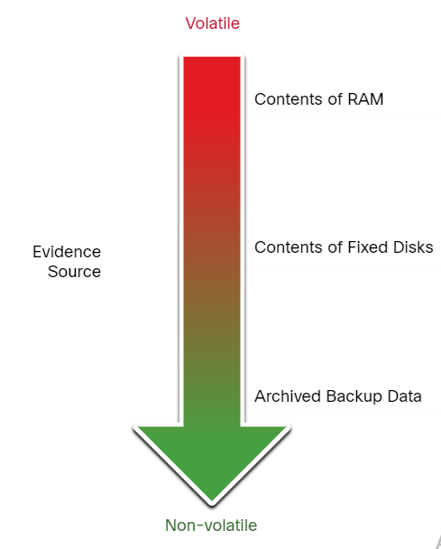
Digital Forensics and Incident Analysis and Response
Evidence Collection Order
IETF RFC 3227 describes an order for the collection of digital evidence based on the volatility of the data.
Data stored in RAM is the most volatile and it will be lost when the device is turned off.
The collection of digital evidence should begin with the most volatile evidence and proceed to the least volatile.
Details of the systems from which the evidence was collected, including who has access to those systems and at what level of permissions should be recorded.
Notes:
28 – Digital Forensics and Incident Analysis and Response
28.1 – Evidence Handling and Attack Attribution
28.1.6 – Evidence Collection Order

Slide 15
Digital Forensics and Incident Analysis and Response
Chain of Custody
Chain of custody involves the collection, handling, and secure storage of evidence.
Detailed records should be kept of the following:
Who discovered and collected the evidence?
All details regarding the handling of evidence including times, places, and personnel involved.
Who has primary responsibility for the evidence, when responsibility was assigned, and when custody changed?
Who has physical access to the evidence while it was stored? Access should be restricted to only the most essential personnel.
Notes:
28 – Digital Forensics and Incident Analysis and Response
28.1 – Evidence Handling and Attack Attribution
28.1.7 – Chain of Custody

Slide 16
Digital Forensics and Incident Analysis and Response
Data Integrity and Preservation
Time stamping of files should be preserved. Hence, the original evidence should be copied, and analysis should only be conducted on copies of the original.
The timestamps may be part of the evidence, opening files from the original media should be avoided.
Archive and protect the original disk to keep it in its original, untampered with, condition.
Special tools should be used to preserve forensic evidence before the device is shut down and evidence is lost.
Users should not disconnect, unplug, or turn off infected machines unless explicitly told to do so by security personnel.
Following these processes will ensure that any evidence of malpractice will be preserved, and any indicators of compromise can be identified.
Notes:
28 – Digital Forensics and Incident Analysis and Response
28.1 – Evidence Handling and Attack Attribution
28.1.8 – Data Integrity and Preservation

Slide 17
Digital Forensics and Incident Analysis and Response
Attack Attribution
Threat Attribution refers to the act of determining the individual, organization, or nation responsible for a successful intrusion or attack incident.
Identifying responsible threat actors should occur through the principled and systematic investigation of the evidence.
In an evidence-based investigation, the incident response team correlates Tactics, Techniques, and Procedures (TTP) that were used in the incident with other known exploits.
Some aspects of a threat that can aid in attribution are the location of originating hosts or domains, features of the code used in malware and the tools, and other techniques.
For internal threats, asset management plays a major role. Uncovering the devices from which an attack was launched can lead directly to the threat actor.
IP addresses, MAC addresses, and DHCP logs can help track the addresses used in the attack back to a specific device.
Notes:
28 – Digital Forensics and Incident Analysis and Response
28.1 – Evidence Handling and Attack Attribution
28.1.9 – Attack Attribution

Slide 18
Digital Forensics and Incident Analysis and Response
The MITRE ATT&CK Framework
The MITRE Adversarial Tactics, Techniques & Common Knowledge (ATT&CK) Framework enables the ability to detect attacker’s Tactics, Techniques, and Procedures (TTP) as a part of threat defense and attack attribution.
Tactics consist of the technical goals that an attacker must accomplish to execute an attack.
Techniques are the means by which the tactics are accomplished.
Procedures are the specific actions taken by threat actors in the techniques that have been identified.
The MITRE ATT&CK Framework is a global knowledge base of threat actor behavior.
The framework is designed to enable automated information sharing by defining data structures for exchanging information between its community of users and MITRE.
Note: Do an internet search on MITRE ATT&CK to learn more about the tool.
Notes:
28 – Digital Forensics and Incident Analysis and Response
28.1 – Evidence Handling and Attack Attribution
28.1.10 – The MITRE ATT&CK Framework

Slide 19
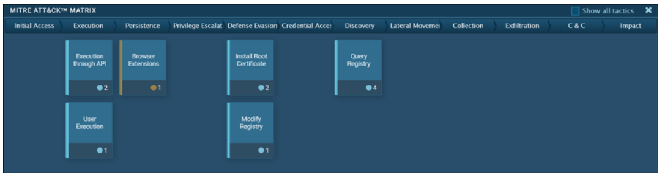
Digital Forensics and Incident Analysis and Response
The MITRE ATT&CK Framework (Contd.)
The figure shows an analysis of a ransomware exploit from the ANY.RUN online sandbox. The columns show the enterprise attack matrix tactics, with the techniques that are used by the malware.
MITRE ATT&CK Matrix for a Ransomware Exploit
Notes:
28 – Digital Forensics and Incident Analysis and Response
28.1 – Evidence Handling and Attack Attribution
28.1.10 – The MITRE ATT&CK Framework

Slide 20
28.2 The Cyber Kill Chain
Notes:
Source:
28 – Digital Forensics and Incident Analysis and Response
28.2 – The Cyber Kill Chain
In-Session Activities / Explanations:
Time: 10 min
Instructor Notes:
Brief the learners on the Cyber Kill Chain process
Define the steps in Cyber Kill Chain
Explain the adversary tactics and SOC defenses used during each step
Key Points: Reconnaissance, Weaponization, Delivery, Exploitation, Installation, Command and Control, Action on Objectives

Slide 21
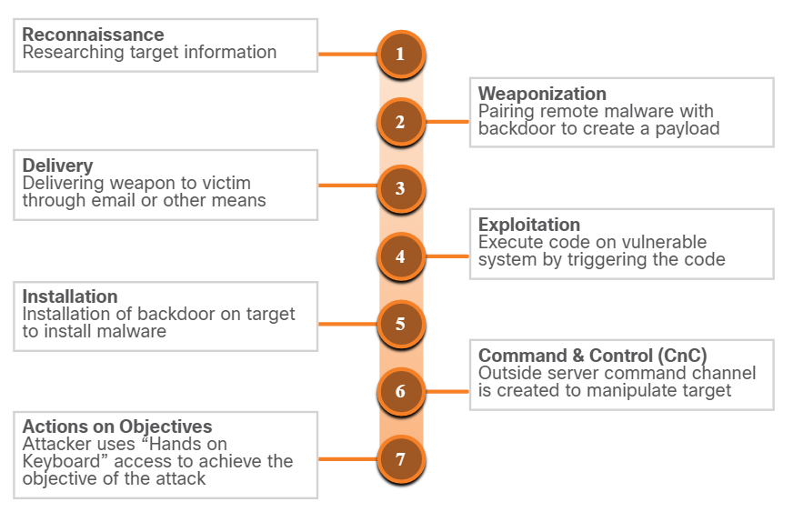
The Cyber Kill Chain
Steps of the Cyber Kill Chain
The Cyber Kill Chain was developed by Lockheed Martin to identify and prevent cyber intrusions.
When responding to a security incident, the objective is to detect and stop the attack at the earliest in the kill chain progression to avoid further damage.
If the attacker is stopped at any stage, the kill chain is broken and the defender successfully thwarted the threat actor’s intrusion.
Steps of Cyber Kill Chain
Note: Threat actor refers to the party instigating the attack. However, Lockheed Martin uses the term “adversary” in Cyber Kill Chain. Therefore, the terms adversary and threat actor are used interchangeably in this topic.
Notes:
28 – Digital Forensics and Incident Analysis and Response
28.2 – The Cyber Kill Chain
28.2.1 – Steps of the Cyber Kill Chain

Slide 22
The Cyber Kill Chain
Reconnaissance
Reconnaissance is when the threat actor performs research, gathers intelligence, and selects targets.
The threat actor will choose targets that have been neglected or unprotected because they will have a higher likelihood of becoming penetrated and compromised.
The table summarizes the tactics and defenses used during the reconnaissance step.
Adversary Tactics | SOC Defences
Plan and conduct research: Harvest email addresses Identify employees on social media Collect all public relations information (press releases, awards, conference attendees and so on) Discover internet-facing servers Conduct scans of the network to identify IP addresses and open ports | Discover adversary’s intent: Web log alerts and historical searching data Data mine browser analytics Build playbooks for detecting behavior that indicate recon activity Prioritize defense around technologies and people that reconnaissance activity is targeting
Notes:
28 – Digital Forensics and Incident Analysis and Response
28.2 – The Cyber Kill Chain
28.2.2 – Reconnaissance

Slide 23
The Cyber Kill Chain
Weaponization
Weaponization uses the information from reconnaissance to develop a weapon against specific targeted systems or individuals in the organization.
It is often more effective to use a zero-day attack to avoid detection methods.
A zero-day attack uses a weapon that is unknown to defenders and network security systems.
The table summarizes the tactics and defenses used during the weaponization step.
Adversary Tactics | SOC Defence
Prepare and stage the operation: Obtain an automated tool to deliver the malware payload (weaponizer). Select or create a document to present to the victim. Select or create a backdoor and command and control infrastructure. | Detect and collect weaponization artifacts: Ensure that IDS rules and signatures are up to date. Conduct full malware analysis. Build detections for the behavior of known weaponizers. Is malware old, “off the shelf” or new malware that might indicate a tailored attack? Collect files and metadata for future analysis. Determine which weaponizer artifacts are common to which campaigns.
Notes:
28 – Digital Forensics and Incident Analysis and Response
28.2 – The Cyber Kill Chain
28.2.3 – Weaponization

Slide 24
The Cyber Kill Chain
Delivery
During this step, the weapon is transmitted to the target using a delivery vector. If the weapon is not delivered, the attack will be unsuccessful.
The threat actor will use different methods to increase the odds of delivering the payload such as encrypting communications, making the code look legitimate, or obfuscating the code.
Security sensors are so advanced that they can detect the code as malicious unless it is altered to avoid detection.
The table summarizes the tactics and defenses used during the delivery step.
Adversary Tactics | SOC Defence
Launch malware at target: Direct against web servers Indirect delivery through: Malicious email Malware on USB stick Social media interactions Compromised websites | Block delivery of malware: Analyze the infrastructure path used for delivery. Understand targeted servers, people, and data available to attack. Infer intent of the adversary based on targeting. Collect email and web logs for forensic reconstruction.
Notes:
28 – Digital Forensics and Incident Analysis and Response
28.2 – The Cyber Kill Chain
28.2.4 – Delivery

Slide 25
The Cyber Kill Chain
Exploitation
After the weapon has been delivered, the threat actor uses it to break the vulnerability and gain control of the target.
The most common exploit targets are applications, operating system vulnerabilities, and users.
The table summarizes the tactics and defenses used during the exploitation step.
Adversary Tactics | SOC Defence
Exploit a vulnerability to gain access: Use software, hardware, or human vulnerability Acquire or develop the exploit Use an adversary-triggered exploit for server vulnerabilities Use a victim-triggered exploit such as opening an email attachment or malicious web link | Train employees, secure code, and harden devices: Employee security awareness training and periodic email testing Web developer training for securing code Regular vulnerability scanning and penetration testing Endpoint hardening measures Endpoint auditing to forensically determine origin of exploit
Notes:
28 – Digital Forensics and Incident Analysis and Response
28.2 – The Cyber Kill Chain
28.2.5 – Exploitation

Slide 26
The Cyber Kill Chain
Installation
In the Installation step, the threat actor establishes a back door into the system to allow for continued access to the target.
To preserve this backdoor, the remote access should not alert cyber security analysts or users. The access method must survive through antimalware scans and rebooting of the computer to be effective.
The table summarizes the tactics and defenses used during the installation step.
Adversary Tactics | SOC Defence
Install persistent backdoor: Install webshell on web server for persistent access. Create point of persistence by adding services, AutoRun keys, etc. Some adversaries modify the timestamp of the malware to make it appear as part of the operating system. | Detect, log, and analyze installation activity: HIPS to alert or block on common installation paths. Determine if malware requires elevated privileges or user privileges Endpoint auditing to discover abnormal file creations. Determine if malware is known threat or new variant.
Notes:
28 – Digital Forensics and Incident Analysis and Response
28.2 – The Cyber Kill Chain
28.2.6 – Installation

Slide 27
The Cyber Kill Chain
Command and Control
The goal is to establish Command and Control (CnC or C2) with the target system.
Compromised hosts usually beacon out of the network to a controller on the internet.
Threat actors use CnC channels to issue commands to the software that they installed on the target.
The cyber security analyst must be able to detect CnC communications to discover the compromised host.
Adversary Tactics | SOC Defence
Open channel for target manipulation: Open two-way communications channel to CNC infrastructure Most common CNC channels over web, DNS, and email protocols CnC infrastructure may be adversary owned or another victim network itself | Last chance to block operation: Research possible new CnC infrastructures Discover CnC infrastructure though malware analysis Isolate DNS traffic to suspect DNS servers, especially Dynamic DNS Prevent impact by blocking or disabling CnC channel Consolidate the number of internet points of presence Customize rules blocking of CnC protocols on web proxies
The table summarizes the tactics and defenses used during command and control step.
Notes:
28 – Digital Forensics and Incident Analysis and Response
28.2 – The Cyber Kill Chain
28.2.7 – Command and Control

Slide 28
The Cyber Kill Chain
Actions on Objectives
Actions on Objectives is the final step of the Cyber Kill Chain that describes the threat actor achieving their original objective.
At this point, the threat actor is deeply rooted in the systems of the organization, hiding their moves and covering their tracks.
It is extremely difficult to remove the threat actor from the network.
The table summarizes the tactics and defenses used during the actions on objectives step.
Adversary Tactics | SOC Defence
Reap the rewards of successful attack: Collect user credentials Privilege escalation Internal reconnaissance Lateral movement through environment Collect and exfiltrate data Destroy systems Overwrite, modify, or corrupt data | Detect by using forensic evidence: Establish incident response playbook Detect data exfiltration, lateral movement, and unauthorized credential usage Immediate analyst response for all alerts Forensic analysis of endpoints for rapid triage Network packet captures to recreate activity Conduct damage assessment
Notes:
28 – Digital Forensics and Incident Analysis and Response
28.2 – The Cyber Kill Chain
28.2.8 – Actions on Objectives
28.2.9 – Check Your Understanding - Identify the Kill Chain Step

Slide 29
28.3 The Diamond Model of Intrusion Analysis
Notes:
Source:
28 – Digital Forensics and Incident Analysis and Response
28.3 – The Diamond Model of Intrusion Analysis
In-Session Activities / Explanations:
Time: 12 min
Instructor Notes:
Provide an overview of the Diamond model
Illustrate pivoting across Diamond model
Explain how Diamond model and Cyber Kill chain are interlinked
Key Points: Diamond Model, adversary, intrusion

Slide 30
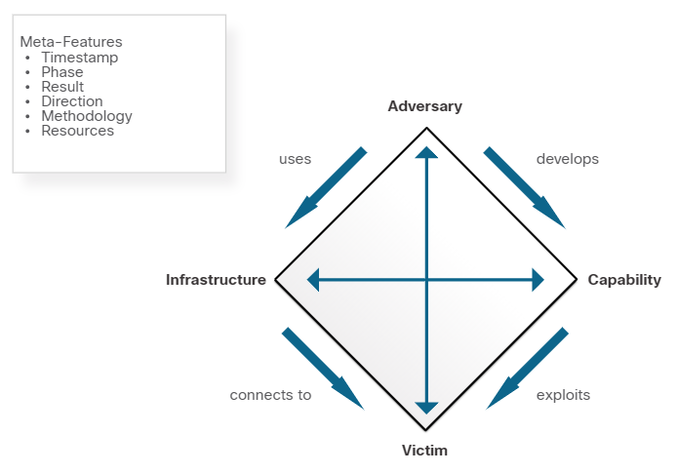
The Diamond Model of Intrusion Analysis
Diamond Model Overview
The Diamond Model of Intrusion Analysis represents a security incident or event.
The four core features of an intrusion event are:
Adversary - Parties responsible for the intrusion.
Capability - Tool or technique used by the adversary to attack the victim.
Infrastructure – Network path(s) used by the adversary to establish and maintain command and control over their capabilities.
Victim – Target of the attack.
Meta-features expand the model slightly to include the important elements: Timestamp, Phase, Result, Direction, Methodology, and Resources
Notes:
28 – Digital Forensics and Incident Analysis and Response
28.3 – The Diamond Model of Intrusion Analysis
28.3.1 – Diamond Model Overview

Slide 31
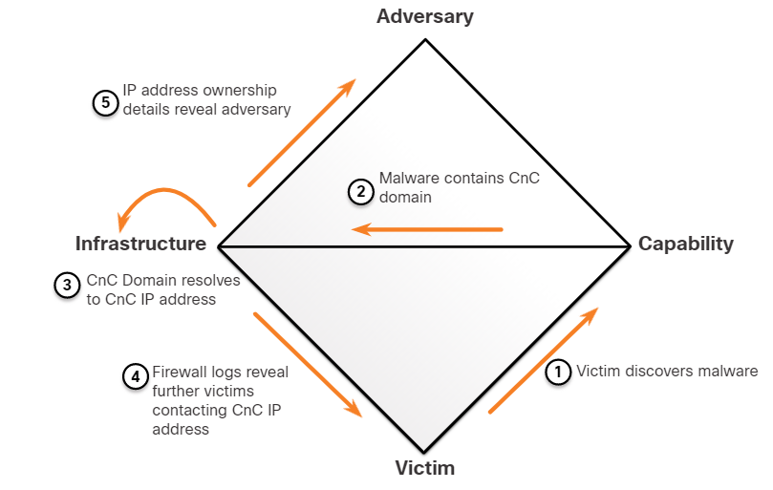
The Diamond Model of Intrusion Analysis
Pivoting Across the Diamond Model
The Diamond Model is ideal for illustrating how the adversary pivots from one event to the next. For example:
An employee reports that his computer is acting abnormally. A host scan by the security technician indicates that the computer is infected with malware.
An analysis of the malware reveals that the malware contains a list of CnC domain names that resolve to a list of IP addresses.
These IP addresses are used to identify the adversary and investigate logs to determine if other victims in the organization are using the CnC channel.
Diamond Model Characterization of an Exploit
Notes:
28 – Digital Forensics and Incident Analysis and Response
28.3 – The Diamond Model of Intrusion Analysis
28.3.2 – Pivoting Across the Diamond Model

Slide 32
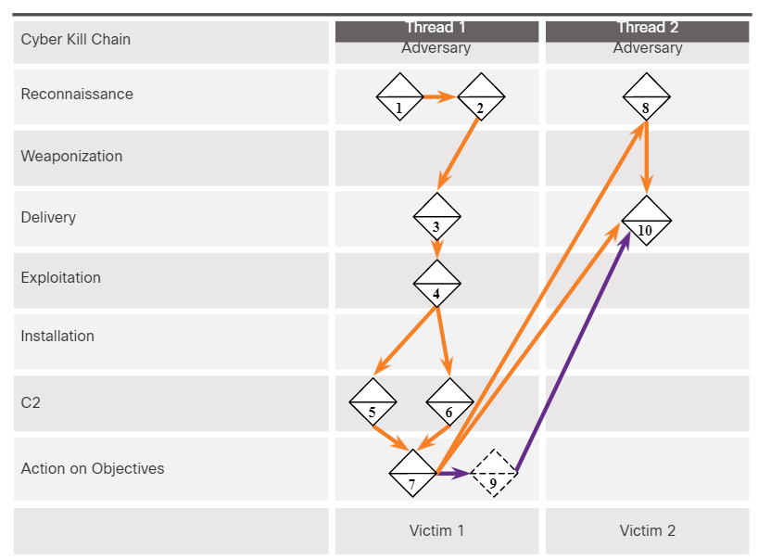
The Diamond Model of Intrusion Analysis
The Diamond Model and the Cyber Kill Chain (Contd.)
Events are threaded together in a chain in which each event must be completed before the next event. This thread of events can be mapped to the Cyber Kill Chain.
The example illustrates the end-to-end process of an adversary as they traverse the Cyber Kill Chain:
Adversary conducts a web search for victim company Gadgets, Inc. receiving as part of the results the domain name gadgets.com.
Adversary search “network administrator gadget.com” and discovers forum postings from users claiming to be network administrators of gadget.com and the profiles reveal their email addresses.
Adversary sends phishing emails with a Trojan horse attached to the network administrators.
Notes:
28 – Digital Forensics and Incident Analysis and Response
28.3 – The Diamond Model of Intrusion Analysis
28.3.3 – The Diamond Model and the Cyber Kill Chain

Slide 33
The Diamond Model of Intrusion Analysis
The Diamond Model and the Cyber Kill Chain (Contd.)
One network administrator (NA1) opens the malicious attachment which executes the enclosed exploit.
NA1’s host registers with a CnC controller by sending an HTTP Post message and receiving an HTTP Response in return.
It is revealed from reverse engineering that the malware has additional backup IP addresses.
Through a CnC HTTP response message sent to NA1’s host, the malware begins to act as a proxy for new TCP connections.
Notes:
28 – Digital Forensics and Incident Analysis and Response
28.3 – The Diamond Model of Intrusion Analysis
28.3.3 – The Diamond Model and the Cyber Kill Chain

Slide 34
The Diamond Model of Intrusion Analysis
The Diamond Model and the Cyber Kill Chain (Contd.)
Through information from the proxy that is running on NA1’s host, Adversary searches the web for “most important research ever” and finds Victim 2, Interesting Research Inc.
Adversary checks NA1’s email contact list for any contacts from Interesting Research Inc. and discovers the contact for the Interesting Research Inc. Chief Research Officer.
Chief Research Officer of Interesting Research Inc. receives a spear-phish email from Gadget Inc.’s NA1’s email address sent from NA1’s host with the same payload as observed in Event 3.
The adversary now has two compromised victims from which additional attacks can be launched.
Notes:
28 – Digital Forensics and Incident Analysis and Response
28.3 – The Diamond Model of Intrusion Analysis
28.3.3 – The Diamond Model and the Cyber Kill Chain
28.3.4 – Check Your Understanding - Identify the Diamond Model Features

Slide 35
28.4 Incident Response
Notes:
Source:
28 – Digital Forensics and Incident Analysis and Response
28.4 – Incident Response
In-Session Activities / Explanations:
Time: 20 min
Instructor Notes:
Explain incident response
List the plan, policy and procedure elements
Discuss the type of stakeholders involved in handling a security incident
Describe the phases involved in the NIST Incident Response Lifecycle.
Ensure that the learners complete the ‘Check Your Understanding - Identify the Incident Response Plan Elements’ in section 28.4.2.
Key Points: Incident Response, NIST Incident Response Life Cycle, Incident Data Collection and Retention

Slide 36
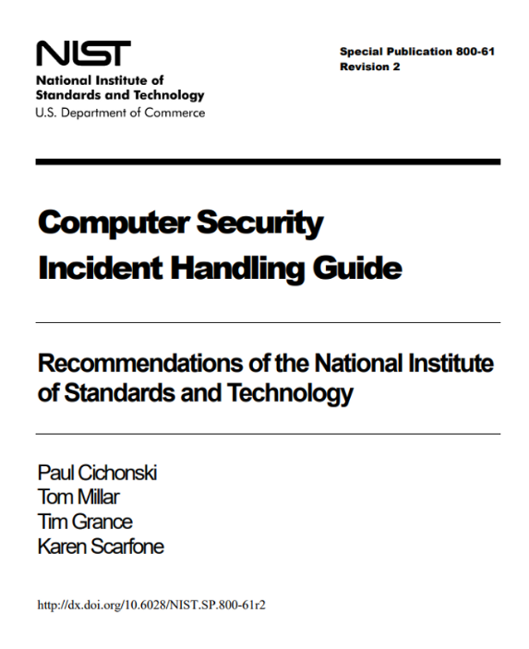
Incident Response
Establishing an Incident Response Capability
Incident response aims to limit the impact of the attack, assess the damage caused, and implement recovery procedures.
Incident Response involves the methods, policies, and procedures that are used by an organization to respond to a cyber attack.
Note: Although this chapter summarizes the content in the NIST 800-61r2 standard, you should be familiar with the entire publication as it covers four major exam topics for the Understanding Cisco Cybersecurity Operations Fundamentals exam.
Notes:
28 – Digital Forensics and Incident Analysis and Response
28.4 – Incident Response
28.4.1 – Establishing an Incident Response Capability

Slide 37
Incident Response
Establishing an Incident Response Capability (Contd.)
The below table summarizes the policy, plan and procedure elements in an incident response:
Policy Elements | Plan Elements | Procedure Elements
Statement of management commitment Purpose and objectives of the policy Scope of the policy Definition of computer security incidents and related terms Organizational structure and definition of roles, responsibilities, and levels of authority Prioritization of severity ratings of incidents Performance measures Reporting and contact forms | Mission Strategies and goals Senior management approval Organizational approach to incident response How the incident response team will communicate with the rest of the organization and with other organizations Metrics for measuring the incident response capacity How the program fits into overall organization | Technical processes Using techniques Filling out forms Following checklists
Notes:
28 – Digital Forensics and Incident Analysis and Response
28.4 – Incident Response
28.4.1 – Establishing an Incident Response Capability
28.4.2 – Check Your Understanding - Identify the Incident Response Plan Elements

Slide 38
Incident Response
Incident Response Stakeholders
The stakeholders involved in handing a security incident are as follows:
Management
Information Assurance
IT Support
Legal Department
Public Affairs and Media Relations
Human Resources
Business Continuity Planners
Physical Security and Facilities Management
Notes:
28 – Digital Forensics and Incident Analysis and Response
28.4 – Incident Response
28.4.3 – Incident Response Stakeholders

Slide 39
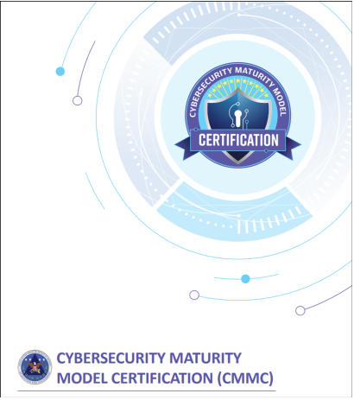
Incident Response
Incident Response Stakeholders (Contd.)
The Cybersecurity Maturity Model Certification (CMMC)
The CMMC certifies organizations by level. For most domains, there are five levels, however for incident response, there are only four:
Level 2 - Establish an incident response plan that follows the NIST process.
Level 3 - Document and report incidents to stakeholders identified in the incident response plan.
Level 4 - Use knowledge of attacker TTP to refine incident response planning and execution.
Level 5 - Utilize accepted and systematic computer forensic data gathering techniques.
Notes:
28 – Digital Forensics and Incident Analysis and Response
28.4 – Incident Response
28.4.3 – Incident Response Stakeholders

Slide 40
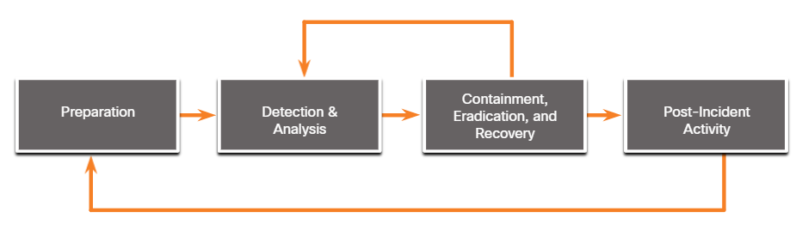
Incident Response
NIST Incident Response Life Cycle
NIST defines four steps in the incident response process life cycle:
Preparation - The members of the CSIRT are trained in how to respond to an incident.
Detection and Analysis – CSIRT quickly identifies, analyzes, and validates an incident.
Containment, Eradication, and Recovery – CSIRT implements procedures to contain the threat, eradicate the impact on organizational assets, and use backups to restore data and software.
Post-Incident Activities – CSIRT documents how the incident was handled, recommends changes for future response, and specifies how to avoid a reoccurrence.
Notes:
28 – Digital Forensics and Incident Analysis and Response
28.4 – Incident Response
28.4.4 – NIST Incident Response Life Cycle

Slide 41
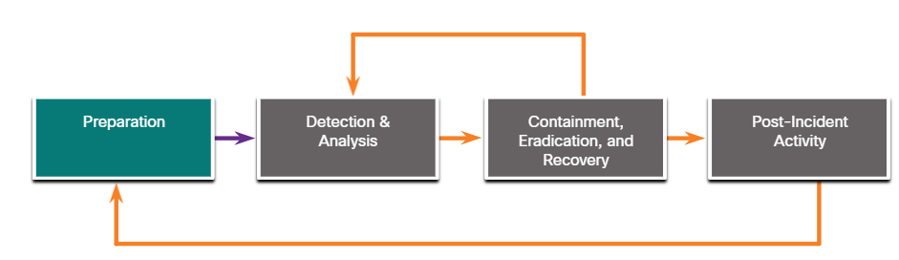
Incident Response
Preparation
The preparation phase is when the CSIRT is created and trained. The tools and assets that will be needed by the team to investigate incidents are acquired and deployed.
The examples of actions in the preparation phase are as follows:
Facilities to host the response team and the SOC are created.
Risk assessments are used to implement controls that will limit the number of incidents.
User security awareness training materials are developed.
Necessary hardware and software for incident analysis and mitigation is acquired.
Notes:
28 – Digital Forensics and Incident Analysis and Response
28.4 – Incident Response
28.4.5 – Preparation

Slide 42
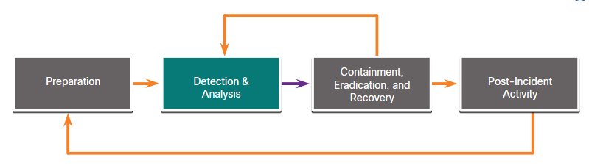
Incident Response
Detection and Analysis
Different types of incidents will require different responses.
Attack Vectors: Web, Email, Loss or Theft, Impersonation, Attrition and Media.
Detection: Automated detection - Antivirus software, IDS, manual detection - user reports.
Analysis: Use Network and System Profiling to determine the validity of security incidents.
Scoping: Provide information on the containment of the incident and deeper analysis of the effects of the incident.
Incident Notification: Notify appropriate stakeholders and outside parties, once the incident is analyzed and prioritized,
Notes:
28 – Digital Forensics and Incident Analysis and Response
28.4 – Incident Response
28.4.6 – Detection and Analysis

Slide 43
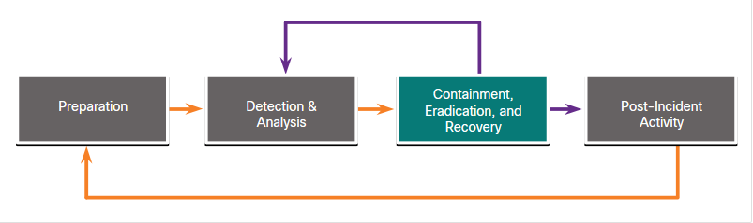
Incident Response
Containment, Eradication, and Recovery
After determining the validity of the incident through detection and analysis, it must be contained.
Containment Strategy: For every type of incident, a containment strategy should be created and enforced depending on some conditions.
Evidence: During an incident, evidence must be gathered to resolve it. It is required for subsequent investigation by authorities.
Attacker Identification: Identifying attackers will minimize the impact on critical business assets and services.
Eradication, recovery, and remediation: to eradicate, identify all hosts that need remediation; to recover hosts, use clean and recent backups, or rebuild them with installation media.
Notes:
28 – Digital Forensics and Incident Analysis and Response
28.4 – Incident Response
28.4.7 – Containment, Eradication, and Recovery

Slide 44
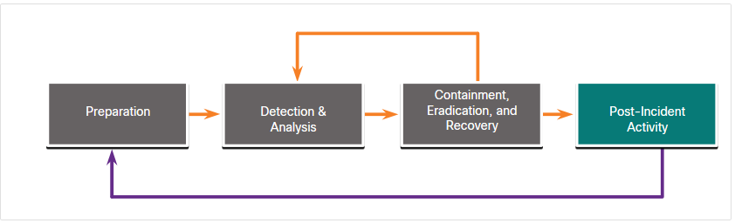
Incident Response
Post-Incident Activities
It is important to periodically meet with all the parties involved to discuss the events that took place and the actions of all of the individuals while handling the incident.
Lessons-based hardening:
The organization should hold a “lessons learned” meeting to:
Review the effectiveness of the incident handling process.
Identify necessary hardening needed for existing security controls and practices.
Notes:
28 – Digital Forensics and Incident Analysis and Response
28.4 – Incident Response
28.4.8 – Post-Incident Activities

Slide 45
Incident Response
Incident Data Collection and Retention
The below table summarizes the incident data collection and retention:
Incident Data Collection | Retention
The collected data after the lessons-learned meeting can be used to: Determine the incident cost for budgeting Determine the effectiveness of the CSIRT Identify possible security weaknesses throughout the system The time of each incident provides an insight into the total amount of labor used and the total time of each phase of the incident response process. Only collect data that can be used to define and refine the incident handling process. Perform an objective assessment of each Incident. | Some of the determining factors for evidence retention: Prosecution - When an attacker will be prosecuted because of a security incident, the evidence should be retained until after all legal actions have been completed. Data Type - An organization may specify that specific types of data should be kept for a specific period of time. Cost - If there is a lot of hardware and storage media that needs to be stored for a long time, it can become costly.
Notes:
28 – Digital Forensics and Incident Analysis and Response
28.4 – Incident Response
28.4.9 – Incident Data Collection and Retention

Slide 46
Incident Response
Reporting Requirements and Information Sharing
Governmental regulations should be consulted by the legal team to determine the organization’s responsibility for reporting the incident.
Management needs to determine what additional communication is necessary with other stakeholders, such as customers, vendors, partners and so on.
NIST recommends that an organization coordinate with organizations to share details for the incident. The critical recommendations from NIST for sharing information are as follows:
Plan incident coordination with external parties before incidents occur.
Consult with the legal department before initiating any coordination efforts.
Perform incident information sharing throughout the incident response life cycle.
Attempt to automate as much of the information sharing process as possible.
Balance the benefits of information sharing with the drawbacks of sharing sensitive information.
Notes:
28 – Digital Forensics and Incident Analysis and Response
28.4 – Incident Response
28.4.10 – Reporting Requirements and Information Sharing
28.4.11 – Check Your Understanding - Identify the Incident Handling Term

Slide 47
Incident Response
Lab - Incident Handling
In this lab, you will apply your knowledge of security incident handling procedures to formulate questions about given incident scenarios.
Notes:
28 – Digital Forensics and Incident Analysis and Response
28.4 – Incident Response
28.4.10 – Lab - Incident Handling

Slide 48
28.5 Digital Forensics and Incident Analysis and Response Summary
Notes:
Source:
28 – Digital Forensics and Incident Analysis and Response
28.5 – Digital Forensics and Incident Analysis and Response Summary
In-Session Activities / Explanations:
Time: 5 mins
Instructor Notes:
Read out the summary points mentioned on the slide.
Discuss the same with the participants.
Ask if they have any questions or doubts.
Ensure that the learners complete the module quiz.
Key Points: NA

Slide 49
Digital Forensics and Incident Analysis and Response Summary What Did I Learn in this Module?
Digital forensics is the recovery and investigation of information found on digital devices as it relates to criminal activity.
Indicators of compromise are the evidence that a cyber security incident has occurred.
The forensic process includes four steps: collection, examination, analysis, and reporting.
In legal proceedings, evidence is broadly classified as direct, indirect, best evidence and corroborating evidence.
Threat attribution refers to the act of determining the individual, organization, or nation responsible for a successful intrusion or attack incident.
In an evidence-based investigation, the incident response team correlates Tactics, Techniques, and Procedures (TTP) that were used in the incident with other known exploits.
Notes:
28 – Digital Forensics and Incident Analysis and Response
28.5 – Digital Forensics and Incident Analysis and Response Summary
28.5.1– What Did I Learn in this Module?

Slide 50
Digital Forensics and Incident Analysis and Response Summary What Did I Learn in this Module?
The MITRE Adversarial Tactics, Techniques & Common Knowledge (ATT&CK) Framework enables the ability to detect attacker tactics, techniques, and procedures (TTP) as part of threat defense and attack attribution.
The Cyber Kill Chain was developed to identify and prevent cyber intrusions.
The steps in the Cyber Kill Chain are reconnaissance, weaponization, delivery, exploitation, installation, command and control, and actions on objectives.
The Diamond Model of Intrusion Analysis represents a security incident or event.
The four core features of an intrusion event are adversary, capability, infrastructure and victim.
Incident Response involves the methods, policies, and procedures that are used by an organization to respond to a cyber attack.
Notes:
28 – Digital Forensics and Incident Analysis and Response
28.5 – Digital Forensics and Incident Analysis and Response Summary
28.5.1– What Did I Learn in this Module?

Slide 51
Module 28 New Terms and Commands
Digital Forensic Corroborating evidence Best evidence Chain of Custody Threat Attribution Tactics, Techniques and Procedures (TTP) MITRE Adversarial Tactics, Techniques & Common Knowledge (ATT&CK) | Cyber Kill Chain Adversary Diamond Model of Intrusion Analysis Incident Response Capability Computer Security Incident Handling Guide Computer Security Incident Response Capability (CSIRC) | Incident Response policy Incident Response Plan Standard Operating Procedures(SOD) Cyber security Maturity Model Certification(CMMC) Containment Eradication Precursor Lessons-based hardening
Notes:
28 – Digital Forensics and Incident Analysis and Response
New Terms and Commands

