Slide 1
Module 5:Network Protocols
Instructor Materials
CyberOps Associates v1.0
Notes:
Cisco Networking Academy Program
CyberOps Associates v1.0
Module 5: Network Protocols

Slide 2
Instructor Materials – Module 5 Planning Guide
This PowerPoint deck is divided in two parts:
Instructor Planning Guide
Information to help you become familiar with the module
Teaching aids
Instructor Class Presentation
Optional slides that you can use in the classroom
Begins on slide # 8
Note: Please remove the Planning Guide from this presentation before sharing with anyone.
For additional help and resources go to the Instructor Home Page and Course Resources for this course. You also can visit the professional development site on www.netacad.com, the official Cisco Networking Academy Facebook page, or Instructor Only FB group.
Notes:
2

Slide 3
What to Expect in this Module
To facilitate learning, the following features within the GUI may be included in this module:
Feature | Description
Animations | Expose learners to new skills and concepts.
Check Your Understanding(CYU) | Per topic online quiz to help learners gauge content understanding.
Hands-On Labs | Labs designed for working with physical equipment.
Module Quizzes | Self-assessments that integrate concepts and skills learned throughout the series of topics presented in the module.
Module Summary | Briefly recaps module content.

Slide 4
Check Your Understanding
Check Your Understanding activities are designed to let students quickly determine if they understand the content and can proceed, or if they need to review.
Check Your Understanding activities do not affect student grades.
There are no separate slides for these activities in the PPT. They are listed in the notes area of the slide that appears before these activities.
Notes:
4

Slide 5
Module 5: Activities
What activities are associated with this module?
Page # | Activity Type | Activity Name | Optional?
5.1.5 | Lab | Tracing a Route | Recommended
5.3.7 | Lab | Introduction to Wireshark | Recommended
5.3.8 | Check Your Understanding | Data Encapsulation | Recommended
Notes:
5

Slide 6
Module 5: Best Practices
Prior to teaching Module 5, the instructor should:
Review the activities and assessments for this module.
Try to include as many questions as possible to keep students engaged during classroom presentation.
Topic 5.1
Ask the participants to share their understanding of the networks and their ranges.
Ask the class what do they know about client-server communications.
Ask the class to share any general example of network communication session.
Show an example of a network to the class and let them trace the path and share their understanding.
Notes:
6

Slide 7
Module 5: Best Practices (Contd.)
Topic 5.2
Ask the learners what do they know about network protocols.
Form an interactive session with the class by giving real time examples on message formatting and encapsulation and ask some related questions in the session.
Brief the methods of communication and then ask the learners to explain.
Question the participants about their knowledge on OSI reference model and TCP/IP protocol model.
Topic 5.3
Explain the class about segmentation and multiplexing and then ask them to find the basic difference.
Briefly explain sequencing and then ask the learners about the importance of sequencing in segmenting messages.
Explain encapsulation and de-encapsulation to the class.
Notes:
7

Slide 8
Module 5:Network Protocols
CyberOps Associates v1.0
Notes:
Cisco Networking Academy Program
CyberOps Associates v1.0
Module 5: Network Protocols
In-Session Activities / Explanations:
Time: 5 min
Instructor Notes:
Welcome the audience in a warm and cordial manner. Ensure that everyone is set up with the required resources.
Introduce yourself briefly and invite participants to introduce themselves with name, dept. and role, if deemed all right.
To build the context of the module, ask the audience what they know about network protocols and their purpose.
Introduce the topic and encourage learners to come up with a list of expectations from the session. Collate topics on the white board or Desktop while using learner’s inputs to interpret them in words.
Read out the Objectives and briefly describe each.
Key Points: NA

Slide 9
Module Objectives
Module Title: Network Protocols
Module Objective: Explain how protocols enable network operations.
Topic Title | Topic Objective
Network Communications Process | Explain the basic operation of data networked communications.
Communications Protocols | Explain how protocols enable network operations.
Data Encapsulation | Explain how data encapsulation allows data to be transported across the network.
Notes:
9
CyberOps Associates v1.0
5 - Network Protocols
5.0 - Introduction
5.0.2 – What Will I Learn in this Module?

Slide 10
5.1 Network Communications Process
Notes:
Source:
5 – Network Protocols
5.1 – Network Communications Process
In-Session Activities / Explanations:
Time: 12 mins
Instructor Notes:
Introduce the topic and discuss the networks and their ranges.
Help the learners get familiar with client-server communications.
By the end of the topic, ensure the learners also have an understanding of route tracing.
Key Points: SOHO, peer-to-peer, client-sever, tracing the route

Slide 11
Network Protocols
Networks of Many Sizes
Networks vary in size. They range from simple networks consisting of two computers, to networks connecting millions of devices.
Businesses and large organizations use networks to provide consolidation, storage, and access to information on network servers. Networks provide email, instant messaging, and collaboration among employees. Many organizations use their network’s connection to the internet to provide products and services to customers.
Peer-to-peer network: In small businesses and homes, many computers function as both the servers and clients on the network. This type of network is called a peer-to-peer network.
Notes:
5 - Network Protocols
5.1 – Network Communications Process
5.1.1 – Networks of Many Sizes

Slide 12
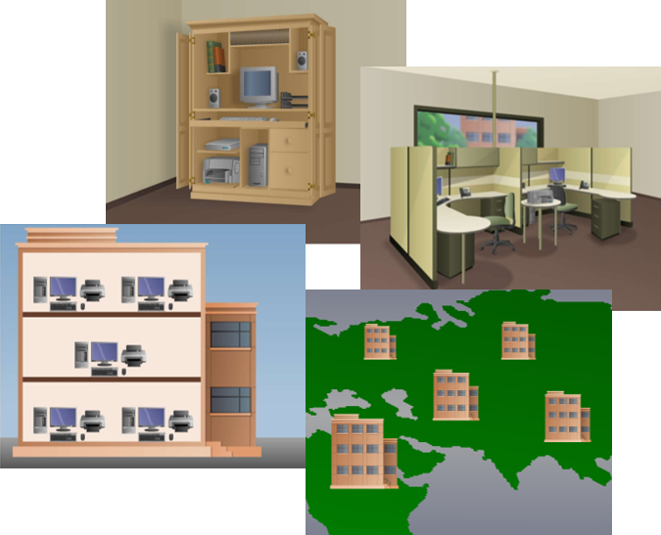
Network Protocols
Networks of Many Sizes (Contd.)
Small Home networks: Small home networks connect a few computers to each other and to the internet.
Small Office and Home Office (SOHO) networks: The SOHO network allows a home office or a remote office to connect to a corporate network, or access centralized, shared resources.
Medium to Large networks: These are used by corporations and schools and can have many locations with hundreds or thousands of interconnected hosts.
World Wide networks: The internet is a network of networks that connects hundreds of millions of computers world-wide.
Notes:
5 - Network Protocols
5.1 – Network Communications Process
5.1.1 – Networks of Many Sizes

Slide 13
Network Protocols
Client-Server Communications
All computers that are connected to a network and that participate directly in network communication are classified as hosts. Hosts are also called end devices, endpoints, or nodes.
Servers are simply computers with specialized software that enables servers to provide information to other end devices on the network.
A server can be single-purpose, providing only one service, such as web pages or it can be multipurpose, providing a variety of services such as web pages, email, and file transfers.
Client computers have software installed that enables them to request and display the information obtained from the server. A single computer can run multiple types of client software.
Notes:
5 - Network Protocols
5.1 – Network Communications Process
5.1.2 – Client-Server Communications

Slide 14
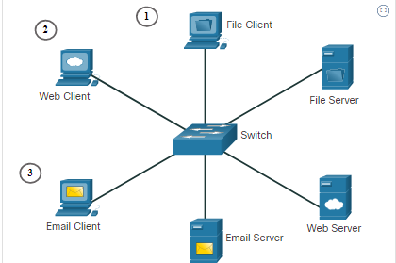
Network Protocols
Client-Server Communications (Contd.)
The File Server stores corporate and user files in a central location. The client devices access these files with client software such as Windows Explorer.
The Web Server runs web server software and clients use their browser software, such as Windows Internet Explorer, to access web pages on the server.
The Email Server runs email server software and clients use their mail client software, such as Microsoft Outlook, to access email on the server.
Notes:
5 - Network Protocols
5.1 – Network Communications Process
5.1.2 – Client-Server Communications

Slide 15

Network Protocols
Typical Sessions
A typical network user normally uses some type of computing device to establish many connections with network servers. Those servers could be located in the same room or around the world.
Let us see some examples.
At School
Students are encouraged to use devices such as laptops and tablets to access learning resources.
Terry, connects to the school’s wi-fi network and searches for the required resources using a search engine.
Her search is submitted wirelessly from her device to the school’s network. The search data is addressed so that it can find its way back to Terry.
The search string of binary data is encoded into radio waves and is converted into electrical signals that travel on the school’s wired network to reach the school’s Internet Service Provider’s (ISP) network.
A combination of technologies take Terry’s search to the search engine website, where the request is processed by the Search Engine’s servers.
The results are then encoded and addressed to her school and eventually to Terry’s device.
Notes:
5 - Network Protocols
5.1 – Network Communications Process
5.1.3 – Typical Sessions

Slide 16

Network Protocols
Typical Sessions (Contd.)
While Gaming
Michelle uses a gaming console to play games against other players. Her network connects to an ISP using a router and a cable modem that allow her home network to connect to a cable TV network belonging to Michelle’s ISP.
The cable wires for Michelle’s neighborhood all connect to a central point on a telephone pole and then connect to a fiber-optic network that connects many neighborhoods served by Michelle’s ISP.
When Michelle connects her gaming console to a company that hosts a popular online game, her actions in her game become data that is sent to the gamer network. Information that identifies Michelle, the game she is playing, and Michelle’s network location are added to the game data. The pieces of data that represent Michelle’s game play are sent at high speed to the game provider’s network.
The results are returned to Michelle in the form of graphics and sounds.
Notes:
5 - Network Protocols
5.1 – Network Communications Process
5.1.3 – Typical Sessions

Slide 17

Network Protocols
Typical Sessions (Contd.)
In Medical Consultations
Dr. Ismael Awad frequently needs to consult with other specialists on patient cases. His hospital has taken subscription to a special service called Cloud that allows medical data including patient x-rays to be stored at a central location that accessible over the internet.
When a patient has an X-ray taken, the image is digitized as data. The hospital uses network services that encrypt the image data and patient information. This encrypted data cannot be intercepted and read as it travels across the internet to the cloud service provider’s data centers. The data is addressed so that it can be routed to the cloud provider’s data center to reach the correct services that provide storage and retrieval of high-resolution digital images.
All of this interaction is digital and takes place using networked services that are provided by the medical cloud service.
Notes:
5 - Network Protocols
5.1 – Network Communications Process
5.1.3 – Typical Sessions

Slide 18
Network Protocols
Tracing the Path
Cybersecurity analysts need to have a deep understanding of how networks operate. They must be able to determine the origin of traffic and its destination.
Traffic from a computer to an internet server can take many paths.
Notes:
5 - Network Protocols
5.1 – Network Communications Process
5.1.4 – Tracing the Path

Slide 19
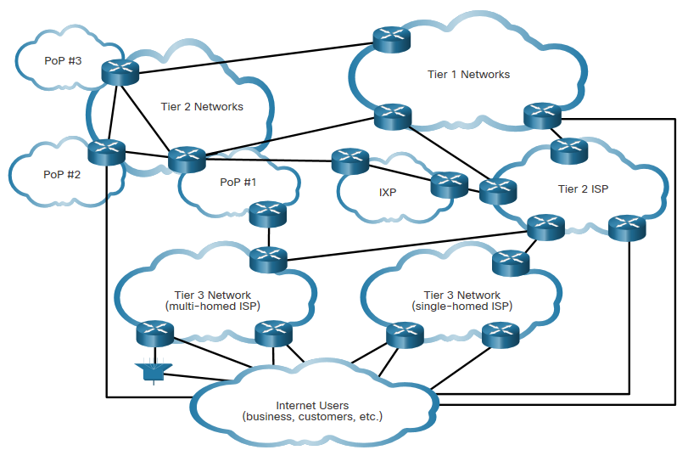
Network Protocols
Tracing the Path (Contd.)
A combination of copper and fiber-optic cables that go over land and under the ocean carry data traffic. These connections connect telecommunications facilities and ISPs distributed throughout the world.
Global Tier 1 and Tier 2 ISPs connect portions of the internet together, usually through an Internet Exchange Point (IXP).
Larger networks connect to Tier 2 networks through a Point of Presence (PoP), which is usually a location in the building where physical connections to the ISP are made. The Tier 3 ISPs connect homes and businesses to the internet.
Notes:
5 - Network Protocols
5.1 – Network Communications Process
5.1.4 – Tracing the Path

Slide 20
Network Protocols
Lab - Tracing a Route
In this lab, you will use two route tracing utilities to examine the internet pathway to destination networks. The objective will be to:
Verify connectivity to a website
Use the traceroute utility on the Linux command line
Use a web-based traceroute tool
Notes:
5 - Network Protocols
5.1 – Network Communications Process
5.1.5 – Lab - Tracing a Route

Slide 21
5.2 Communications Protocols
Notes:
Source:
5 – Network Protocols
5.2 – Communications Protocols
In-Session Activities / Explanations:
Time: 25 mins
Instructor Notes:
Give an introduction to the topic and discuss the protocol and its functions.
Briefly explain TCP/IP Protocol Suite.
Ensure the learners know about encapsulation.
Talk over message formatting, size and timing.
Describe the three methods of communications.
Take the learners through OSI reference model and TCP/IP protocol model.
Key Points: OSI reference model, TCP/IP protocol, Encapsulation, Message formatting, Unicast, Multicast, Broadcast

Slide 22
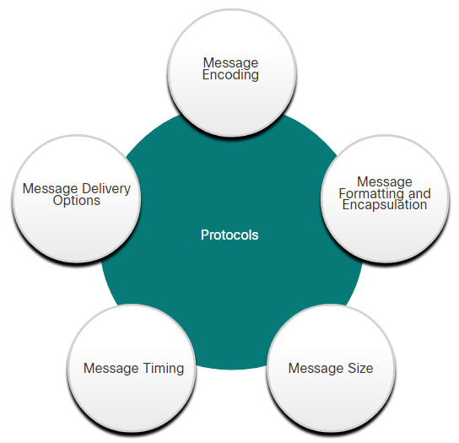
Communications Protocols
What are Protocols?
Simply having a connection between end devices is not enough to enable communication. For communication to occur, devices must know “how” to communicate.
Communication is governed by rules called protocols.
These protocols are specific to the type of communication method occurring.
Network protocols specify many features of network communication.
Notes:
5 - Network Protocols
5.2 – Communications Protocols
5.2.1 – What are Protocols?

Slide 23
Communications Protocols
Network Protocols
Network protocols provide the means for computers to communicate on networks.
Network protocols dictate the message encoding, formatting, encapsulation, size, timing, and delivery options.
Networking protocols define a common format and set of rules for exchanging messages between devices.
Some common networking protocols are Hypertext Transfer Protocol (HTTP), Transmission Control Protocol (TCP), and Internet Protocol (IP).
Note: IP in this course refers to both the IPv4 and IPv6 protocols. IPv6 is the most recent version of IP and will eventually replace the more common IPv4.
Notes:
5 - Network Protocols
5.2 – Communications Protocols
5.2.2 – Network Protocols

Slide 24
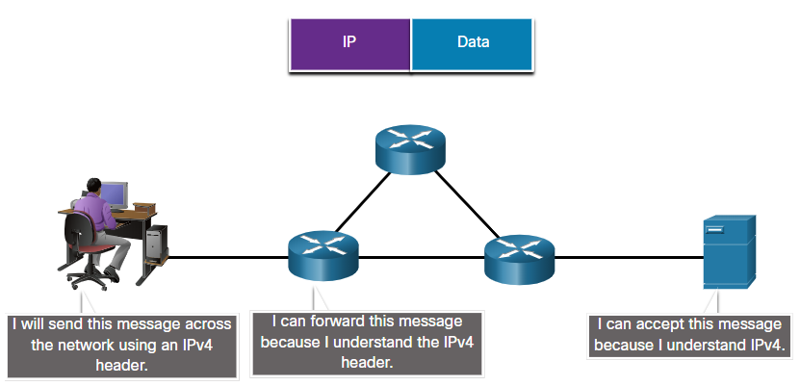
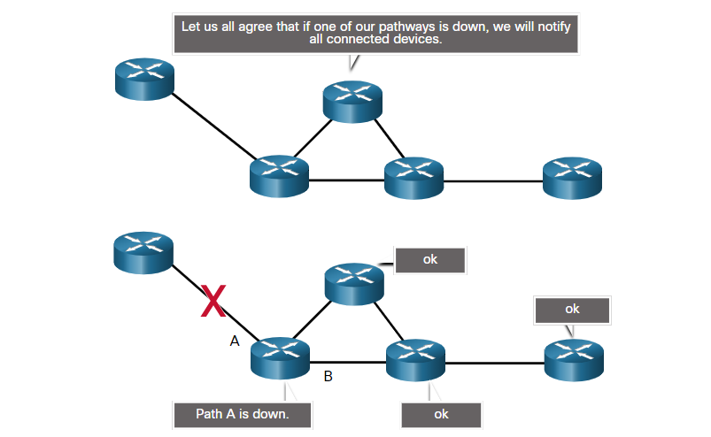
Communications Protocols
Network Protocols (Contd.)
Message Structure specifies how the message is formatted or structured.
Path Sharing specifies the process by which networking devices share information about pathways with other networks.
Notes:
5 - Network Protocols
5.2 – Communications Protocols
5.2.2 – Network Protocols

Slide 25
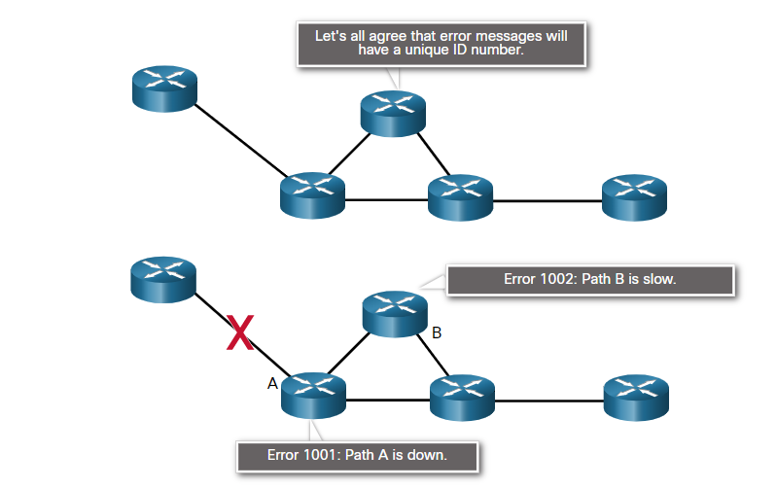
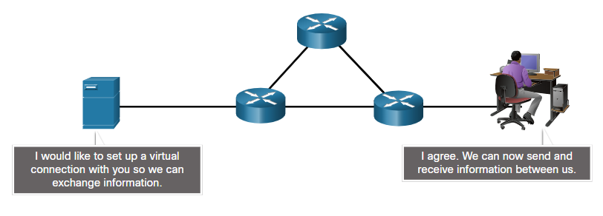
Communications Protocols
Network Protocols (Contd.)
Information Sharing specifies how and when error and system messages are passed between devices.
Session Management manages the setup and termination of data transfer sessions.
Notes:
5 - Network Protocols
5.2 – Communications Protocols
5.2.2 – Network Protocols

Slide 26
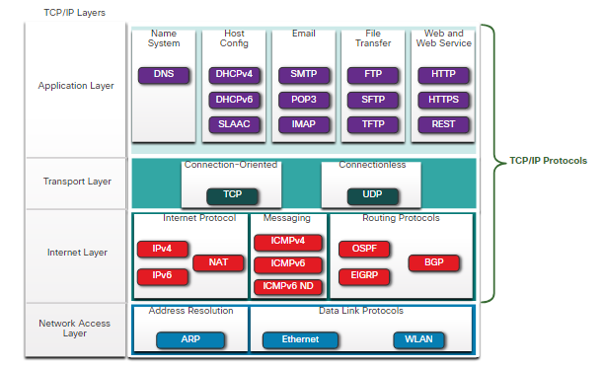
Communications Protocols
The TCP/IP Protocol Suite
TCP/IP is the protocol suite used by the internet and the networks of today.
TCP/IP has two important aspects for vendors and manufacturers:
Open standard protocol suite - This means it is freely available to the public and can be used by any vendor on their hardware or in their software.
Standards-based protocol suite - This means it has been endorsed by the networking industry and approved by a standards organization.
Notes:
5 - Network Protocols
5.2 – Communications Protocols
5.2.3 – The TCP/IP Protocol Suite

Slide 27
Communications Protocols
The TCP/IP Protocol Suite (Contd.)
Lets have a look at the brief description of protocols at each layer.
Application Layer
Name System - DNS (Domain Name System): Translates domain names into IP addresses.
Host Config
Protocol | Description
DHCPv4 (Dynamic Host Configuration Protocol for IPv4) | Dynamically assigns IPv4 addressing information to DHCPv4 clients at start-up and allows the addresses to be re-used when no longer needed.
DHCPv6 (Dynamic Host Configuration Protocol for IPv6) | It is similar to DHCPv4. Dynamically assigns IPv6 addressing information to DHCPv6 clients at start-up.
SLAAC (Stateless Address Autoconfiguration) | A method that allows a device to obtain its IPv6 addressing information without using a DHCPv6 server.
Notes:
5 - Network Protocols
5.2 – Communications Protocols
5.2.3 – The TCP/IP Protocol Suite

Slide 28
Communications Protocols
The TCP/IP Protocol Suite (Contd.)
Email
Protocol | Description
SMTP (Simple Mail Transfer Protocol) | Enables clients to send email to a mail server and enables servers to send email to other servers.
POP3 (Post Office Protocol version 3) | Enables clients to retrieve email from a mail server and download the email to the client's local mail application.
IMAP (Internet Message Access Protocol) | Enables clients to access email stored on a mail server as well as maintaining email on the server.
File Transfer
Protocol | Description
FTP (File Transfer Protocol) | Sets the rules that enable a user on one host to access and transfer files to and from another host over a network.
SFTP (SSH File Transfer Protocol) | Used to establish a secure file transfer session in which the file transfer is encrypted.
TFTP (Trivial File Transfer Protocol) | A simple and connectionless protocol with best-effort, unrecognized file delivery.
Notes:
5 - Network Protocols
5.2 – Communications Protocols
5.2.3 – The TCP/IP Protocol Suite

Slide 29
Communications Protocols
The TCP/IP Protocol Suite (Contd.)
Web and Web Service
Protocol | Description
HTTP (Hypertext Transfer Protocol) | A set of rules for exchanging text, graphic images, sound, video, and other multimedia files on the World Wide Web.
HTTPS (HTTP Secure) | A secure form of HTTP that encrypts the data that is exchanged over the World Wide Web.
REST (Representational State Transfer) | A web service that uses application programming interfaces (APIs) and HTTP requests to create web applications
Notes:
5 - Network Protocols
5.2 – Communications Protocols
5.2.3 – The TCP/IP Protocol Suite

Slide 30
Communications Protocols
The TCP/IP Protocol Suite (Contd.)
Transport Layer
Connection-Oriented - TCP (Transmission Control Protocol): Enables reliable communication between processes running on separate hosts and provides reliable transmissions that confirm successful delivery.
Connectionless - UDP (User Datagram Protocol): Enables a process running on one host to send packets to a process running on another host.
Notes:
5 - Network Protocols
5.2 – Communications Protocols
5.2.3 – The TCP/IP Protocol Suite

Slide 31
Communications Protocols
The TCP/IP Protocol Suite (Contd.)
Internet Layer
Internet Protocol
Protocol | Description
IPv4 (Internet Protocol version 4) | Receives message segments from the transport layer, packages messages into packets, and addresses packets for end-to-end delivery over a network. IPv4 uses a 32-bit address.
IPv6 (IP version 6) | Similar to IPv4 but uses a 128-bit address.
NAT (Network Address Translation) | Translates IPv4 addresses from a private network into globally unique public IPv4 addresses.
Notes:
5 - Network Protocols
5.2 – Communications Protocols
5.2.3 – The TCP/IP Protocol Suite

Slide 32
Communications Protocols
The TCP/IP Protocol Suite (Contd.)
Messaging
Protocol | Description
ICMPv4 (Internet Control Message Protocol for IPv4) | Provides feedback from a destination host to a source host about errors in packet delivery.
ICMPv6 (ICMP for IPv6) | Similar functionality to ICMPv4 but is used for IPv6 packets.
ICMPv6 ND (ICMPv6 Neighbor Discovery) | Includes four protocol messages that are used for address resolution and duplicate address detection.
Routing Protocols
Protocol | Description
OSPF (Open Shortest Path First) | Link-state routing protocol that uses a hierarchical design based on areas. OSPF is an open standard interior routing protocol.
EIGRP (Enhanced Interior Gateway Routing Protocol) | A Cisco proprietary routing protocol that uses a composite metric based on bandwidth, delay, load and reliability.
BGP (Border Gateway Protocol) | An open standard exterior gateway routing protocol used between Internet Service Providers (ISPs).
Notes:
5 - Network Protocols
5.2 – Communications Protocols
5.2.3 – The TCP/IP Protocol Suite

Slide 33
Communications Protocols
The TCP/IP Protocol Suite (Contd.)
Network Access Layer
Address Resolution - ARP (Address Resolution Protocol): Provides dynamic address mapping between an IPv4 address and a hardware address.
Data Link Protocols -
Ethernet: Defines the rules for wiring and signaling standards of the network access layer.
WLAN (Wireless Local Area Network): Defines the rules for wireless signaling across the 2.4 GHz and 5 GHz radio frequencies.
Notes:
5 - Network Protocols
5.2 – Communications Protocols
5.2.3 – The TCP/IP Protocol Suite

Slide 34
Communications Protocols
Message Formatting and Encapsulation
When a message is sent from source to destination, it must use a specific format or structure.
Message formats depend on the type of message and the channel that is used to deliver the message.
Notes:
5 - Network Protocols
5.2 – Communications Protocols
5.2.4 – Message Formatting and Encapsulation

Slide 35
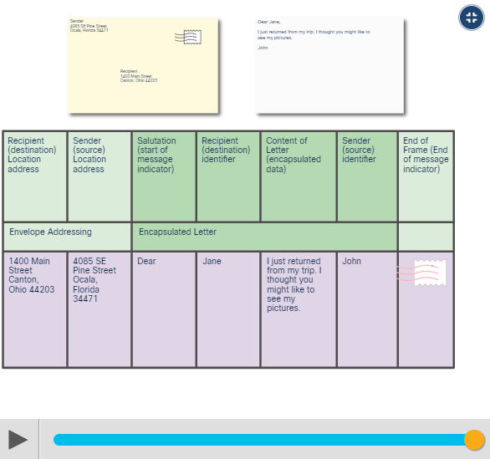
Communications Protocols
Message Formatting and Encapsulation (Contd.)
Analogy:
When sending a letter, correct format is required. An envelope has the address of the sender and receiver, each located at the proper place on the envelope.
The process of placing one message format (the letter) inside another message format (the envelope) is called encapsulation.
De-encapsulation occurs when the process is reversed by the recipient and the letter is removed from the envelope.
Notes:
5 - Network Protocols
5.2 – Communications Protocols
5.2.4 – Message Formatting and Encapsulation

Slide 36
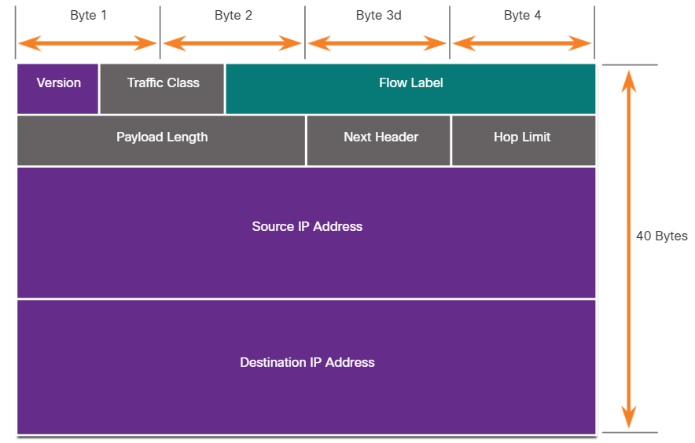
Communications Protocols
Message Formatting and Encapsulation (Contd.)
Network:
Similar to sending a letter, a message that is sent over a computer network follows specific format rules for it to be delivered and processed.
Internet Protocol (IP) is a protocol with a similar function to the envelope example.
IP is responsible for sending a message from the message source to destination over one or more networks.
Notes:
5 - Network Protocols
5.2 – Communications Protocols
5.2.4 – Message Formatting and Encapsulation

Slide 37
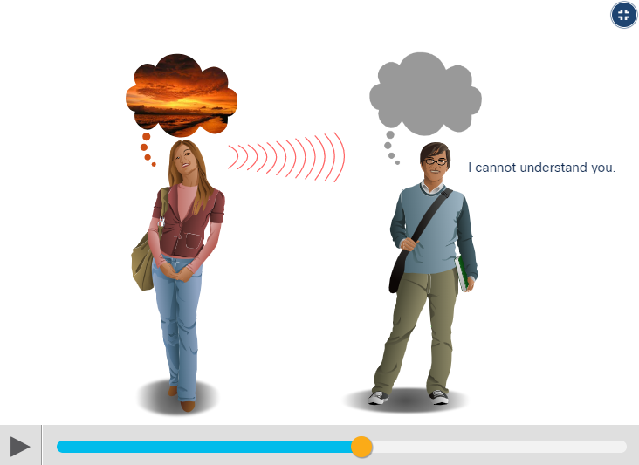
Communications Protocols
Message Size
Another rule of communication is message size.
Analogy:
When people communicate with each other, the messages that they send are usually broken into smaller parts or sentences.
These sentences are limited in size to what the receiving person can process at one time. It also makes it easier for the receiver to read and comprehend.
Notes:
5 - Network Protocols
5.2 – Communications Protocols
5.2.5 – Message Size

Slide 38
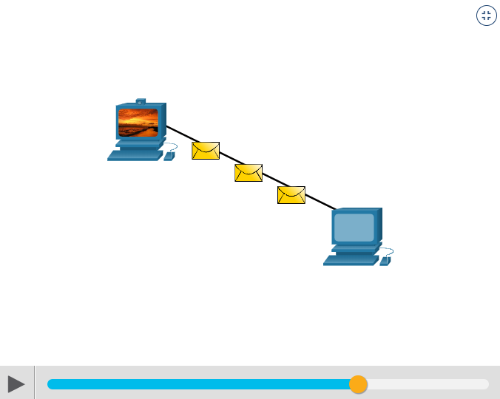
Communications Protocols
Message Size (Contd.)
Network:
Encoding between hosts must be in an appropriate format for the medium.
Messages sent across the network are first converted into bits by the sending host
Each bit is encoded into a pattern of sounds, light waves, or electrical impulses depending on the network media over which the bits are transmitted.
The destination host receives and decodes the signals to interpret the message.
Notes:
5 - Network Protocols
5.2 – Communications Protocols
5.2.5 – Message Size

Slide 39
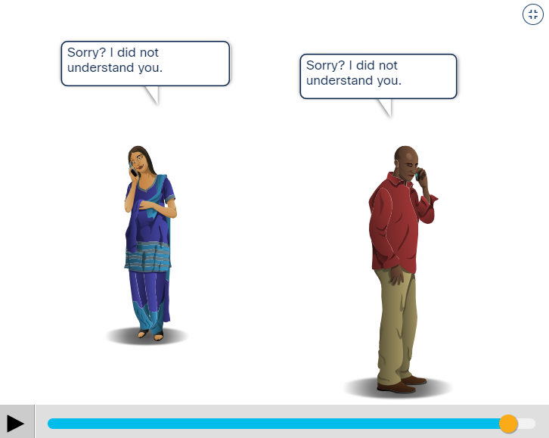
Communications Protocols
Message Timing
Message timing includes the following:
Flow Control - Flow control defines how much information can be sent and the speed at which it can be delivered.
Response Timeout - Hosts on the network use network protocols that specify how long to wait for responses and what action to take if a response timeout occurs.
Access method - This determines when someone can send a message. When a device wants to transmit on a wireless LAN, it is necessary for the WLAN NIC to determine whether the wireless medium is available.
Notes:
5 - Network Protocols
5.2 – Communications Protocols
5.2.6 – Message Timing

Slide 40
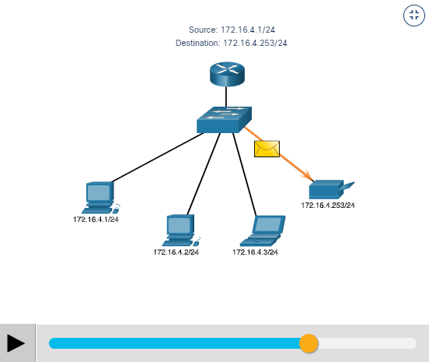
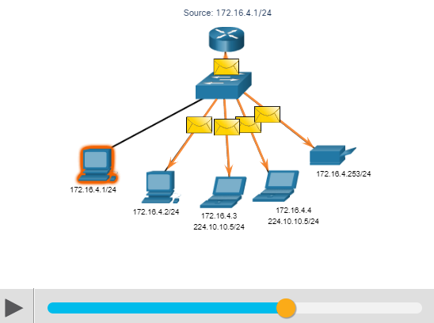
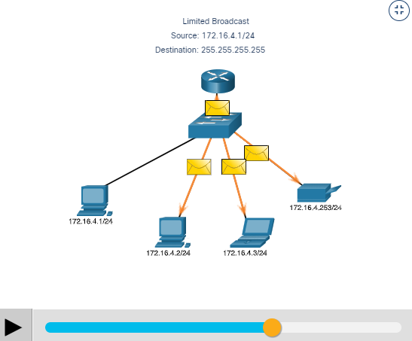
Communications Protocols
Unicast, Multicast, and Broadcast
A message can be delivered in different ways. Hosts on a network various delivery options to communicate. The different methods of communication are called as unicast, multicast, and broadcast.
Unicast: A one-to-one delivery option means there is only a single destination for the message.
Multicast: When a host needs to send messages using a one-to many delivery option.
Broadcast: If all hosts on the network need to receive the message at the same time, a broadcast may be used. Broadcasting represents a one-to-all message delivery option.
Notes:
5 - Network Protocols
5.2 – Communications Protocols
5.2.7 – Unicast, Multicast, and Broadcast

Slide 41
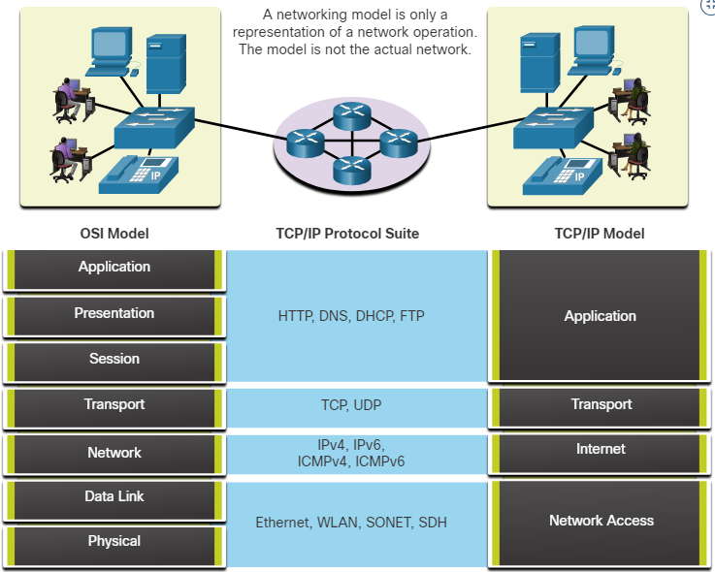
Communications Protocols
The Benefits of Using a Layered Model
A layered model is used to modularize the operations of a network into manageable layers. These are the benefits of using a layered model:
Assisting in protocol design
Fostering competition
Preventing technology or capability changes
Providing a common language
Two layered models that are used to describe network operations are:
Open System Interconnection (OSI) Reference Model
TCP/IP Reference Model
Notes:
5 - Network Protocols
5.2 – Communications Protocols
5.2.8 – The Benefits of Using a Layered Model

Slide 42
Communications Protocols
The OSI Reference Model
The OSI reference model provides list of functions and services that can occur at each layer.
This type of model provides consistency within all types of network protocols and services by describing what must be done at a particular layer, but not prescribing how it should be accomplished.
It also describes the interaction of each layer with the layers directly above and below.
Note that while the TCP/IP model layers are referred only by name but the seven OSI model layers are more often referred by number rather than by name.
Notes:
5 - Network Protocols
5.2 – Communications Protocols
5.2.9 – The OSI Reference Model

Slide 43
Communications Protocols
The OSI Reference Model (Contd.)
OSI Model Layer | Description
7 - Application | Contains protocols used for process-to-process communications
6 - Presentation | Provides representation of the data transferred between application layer services
5 - Session | Provides services to the presentation layer to organize its dialogue and to manage data exchange
4 - Transport | Defines services to segment, transfer, and reassemble the data for individual communications between the end devices
3 - Network | Provides services to exchange the individual pieces of data over the network
2 - Data Link | Describe methods for exchanging data frames between devices over a common media
1 - Physical | Describe the mechanical, electrical, functional, and procedural means to activate, maintain, and de-activate physical connections for a bit transmission between devices
Notes:
5 - Network Protocols
5.2 – Communications Protocols
5.2.9 – The OSI Reference Model

Slide 44
Communications Protocols
The TCP/IP Protocol Model
The TCP/IP protocol model is also referred to as the internet model.
It describes the functions that occur at each layer of protocols within the TCP/IP suite. TCP/IP is also used as a reference model.
TCP/IP Model Layer | Description
4 - Application | Represents data to the user, plus encoding and dialog control
3 - Transport | Supports communication between various devices across diverse networks
2 - Internet | Determines the best path through the network
1 - Network Access | Controls the hardware devices and media that make up the network
Notes:
5 - Network Protocols
5.2 – Communications Protocols
5.2.10 – The TCP/IP Protocol Model

Slide 45
5.3 Data Encapsulation
Notes:
Source:
5 – Network Protocols
5.3 - Data Encapsulation
In-Session Activities / Explanations:
Time: 15 mins
Instructor Notes:
This topic describes data encapsulation
Ensure the learners know about segmentation and multiplexing and their basic difference.
Explain the association of sequencing with segmentation.
By the end of the topic, help the learners to know about encapsulation and de-encapsulation with examples.
Also, mention to the audience that Wireshark will be used in this course to demonstrate network concepts.
Key Points: Segmentation, Multiplexing, Sequencing, Encapsulation, DE-encapsulation, PDU

Slide 46
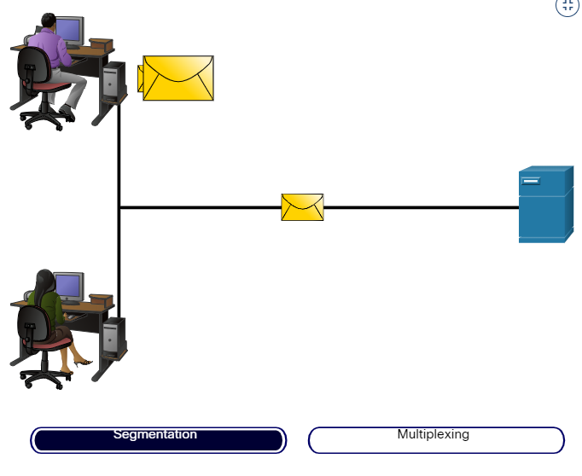
Data Encapsulation Segmenting Messages
If large streams of data is sent across a network, it would result in delays. If any link in the interconnected network failed during the transmission, it will result in lost of complete message.
Segmentation is the process of dividing a stream of data into smaller units for transmissions over the network.
Segmentation is necessary as networks use the TCP/IP protocol to send data in individual IP packets. Each packet is sent separately and the packets containing segments for the same destination can be sent over different paths.
Notes:
5 - Network Protocols
5.3 – Data Encapsulation
5.3.1 – Segmenting Messages

Slide 47
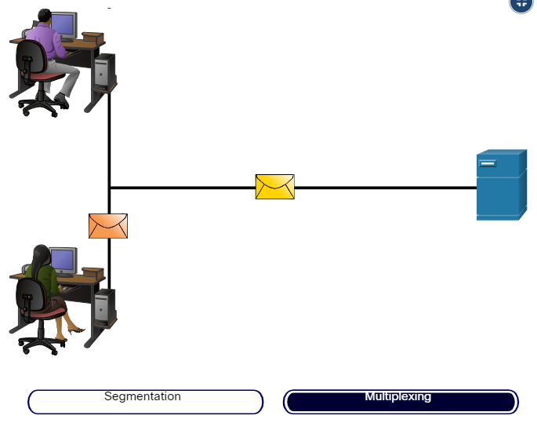
Data Encapsulation Segmenting Messages (Contd.)
Benefits of segmenting messages:
Increases speed - As a large data stream is segmented into packets, more data can be sent over the network without tying up a communications link. This allows many different conversations to be interleaved on the network called multiplexing.
Increases efficiency - If a single segment fails to reach its destination, only that segment needs to be retransmitted instead of resending the entire data stream.
Notes:
5 - Network Protocols
5.3 – Data Encapsulation
5.3.1 – Segmenting Messages

Slide 48
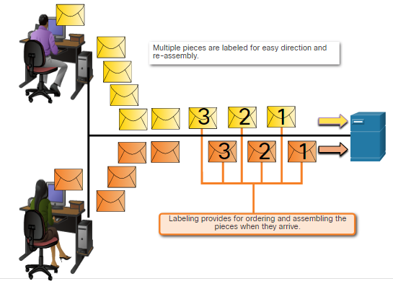
Data Encapsulation Sequencing
While transmitting messages using segmentation and multiplexing, there is a possibility of data to reach the destination in a collapsed order.
Each segment of the message must go through a sequencing process to ensure that it gets to the correct destination and can be reassembled similar to the content of the original message.
TCP is responsible for sequencing the individual segments
Notes:
5 - Network Protocols
5.3 – Data Encapsulation
5.3.2 – Sequencing

Slide 49
Data Encapsulation Protocol Data Units
As application data is passed down the protocol stack on its way to be transmitted across the network media, various protocol information is added at each level. This is known as the encapsulation process.
The form that a piece of data takes at any layer is called a Protocol Data Unit (PDU).
During encapsulation, each succeeding layer encapsulates the PDU that it receives from the layer above in accordance with the protocol being used.
At each stage of the process, a PDU has a different name to reflect its new functions.
Note: Although the UDP PDU is called datagram, IP packets are sometimes also referred to as IP datagrams.
Notes:
5 - Network Protocols
5.3 – Data Encapsulation
5.3.3 – Protocol Data Units

Slide 50
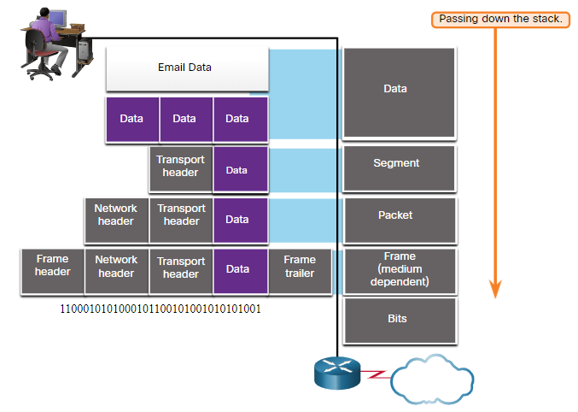
Data Encapsulation Protocol Data Units (Contd.)
The PDUs for each form of data are:
Data - The general term for the PDU used at the application layer
Segment - Transport layer PDU
Packet - Network layer PDU
Frame - Data Link layer PDU
Bits - Physical layer PDU used when physically transmitting data over the medium
Note: If the Transport header is TCP, then it is a segment. If the Transport header is UDP then it is a datagram.
Notes:
5 - Network Protocols
5.3 – Data Encapsulation
5.3.3 – Protocol Data Units

Slide 51
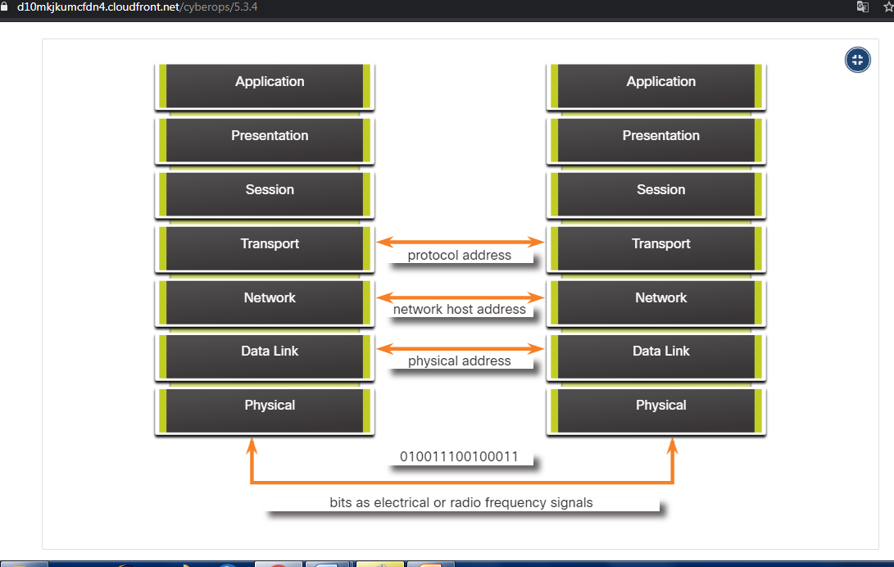
Data Encapsulation Three Addresses
Network protocols require addresses to be used for network communication.
The OSI transport, network, and data link layers use addressing in some form.
The transport layer uses protocol addresses in the form of port numbers to identify network applications.
The network layer specifies addresses that identify the networks that clients and servers are attached to.
Data link layer specifies the devices on the local LAN that should handle data frames.
All three addresses are required for client-server communication.
Notes:
5 - Network Protocols
5.3 – Data Encapsulation
5.3.4 – Three Addresses

Slide 52
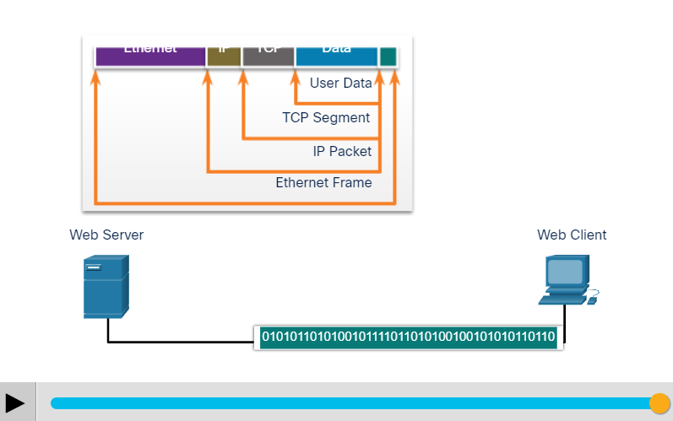
Data Encapsulation Encapsulation Example
When messages are being sent on a network, the encapsulation process works from top to bottom.
At each layer, the upper layer information is considered data within the encapsulated protocol. For example, the TCP segment is considered data within the IP packet.
Notes:
5 - Network Protocols
5.3 – Data Encapsulation
5.3.5 – Encapsulation Example

Slide 53
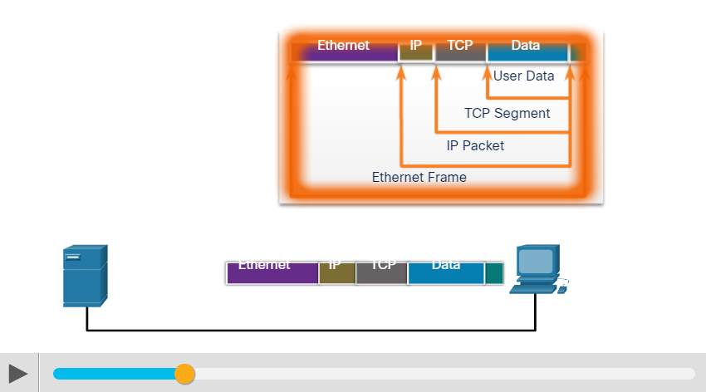
Data Encapsulation De-encapsulation Example
This process is reversed at the receiving host and is known as de-encapsulation.
De-encapsulation is the process used by a receiving device to remove one or more of the protocol headers.
The data is de-encapsulated as it moves up the stack toward the end-user application.
Notes:
5 - Network Protocols
5.3 – Data Encapsulation
5.3.6 – De-encapsulation Example

Slide 54
Data Encapsulation Lab - Introduction to Wireshark
Wireshark is a software protocol analyzer, or "packet sniffer" application, used for network troubleshooting, analysis, software and protocol development, and education.
In this lab, you will use Wireshark to capture and analyze network traffic.
Notes:
5 - Network Protocols
5.3 – Data Encapsulation
5.3.7 – Lab - Introduction to Wireshark
5.3.8 - Check Your Understanding – Data Encapsulation

Slide 55
5.4 Network Protocols Summary
Notes:
Source:
5 – Network Protocols
5.4 – Network Protocols Summary
In-Session Activities / Explanations:
Time: 5 min
Instructor Notes:
Read out the summary points mentioned on the slide.
Discuss the same with the participants.
Ask if they have any questions or doubts.
At the end, ask the students to take the quiz.
Key Points: Network Communications, Communications Protocols, Data Encapsulation

Slide 56
Network Protocols Summary What Did I Learn in this Module?
Networks come in all sizes and can be found in homes, businesses, and other organizations. The internet is the largest network in existence.
Servers are hosts that use specialized software to enable them to respond to requests for different types of data from clients.
Clients are hosts that use software applications such as web browsers, email clients, or file transfer applications to request data from servers.
Larger businesses may connect to Tier 2 ISPs through a Point of Presence (POP).
Tier 3 ISPs connect homes and businesses to the internet
Network protocols specify many features of network communication such as message encoding, message formatting and encapsulation, and delivery options.
Protocols specify how messages are structured and the way that networking devices share information about pathways to other networks.
Notes:
5 – Network protocols
5.4 - Network Protocols Summary
5.4.1 - What Did I Learn in this Module?

Slide 57
Network Protocols Summary What Did I Learn in this Module? (Contd.)
Common protocols at the application layer of the suite are DNS, DHCP, POP3, and HTTPS.
The OSI model has seven layers. The TCP/IP model has four layers.
Data is broken into a series of smaller pieces and sent over the network. This is called segmentation.
Increased speed is gained because many data conversations can happen at the same time on the network. This is called multiplexing.
As data is passed down the protocol stack to be sent, different information is added by each layer. This process is called encapsulation.
The form that data takes at different layer is called a protocol data unit (PDU)
De-encapsulation is the process used by a receiving device to remove one or more of the protocol headers.
Notes:
5 – Network protocols
5.4 – Network Protocols Summary
5.4.1 – What Did I Learn in this Module?
5.4.2 – Module 5: Network Protocols Quiz

Slide 58
Module 5 New Terms and Commands
Small office and home office (SOHO) Peer-to-peer Internet Exchange Point (IXP). Point Of Presence (POP) Bring Your Own Device (BYOD) | Internet service provider (ISP) Transmission control protocol (TCP) User Datagram Protocol (UDP) Open System Interconnection (OSI)
Notes:
5 – Network Protocols
New Terms and Commands

