Slide 1
Module 6:Ethernet and Internet Protocol(IP)
Instructor Materials
CyberOps Associate v1.0
Notes:
Cisco Networking Academy Program
CyberOps Associates v1.0
Module 6:Ethernet and Internet Protocol(IP)

Slide 2
Instructor Materials – Module 6 Planning Guide
This PowerPoint deck is divided in two parts:
Instructor Planning Guide
Information to help you become familiar with the module
Teaching aids
Instructor Class Presentation
Optional slides that you can use in the classroom
Begins on slide # 10
Note: Please remove the Planning Guide from this presentation before sharing with anyone.
For additional help and resources, go to the Instructor Home Page and Course Resources for this course. You also can visit the professional development site on www.netacad.com, the official Cisco Networking Academy Facebook page, or Instructor Only FB group.
Notes:
2

Slide 3
What to Expect in this Module
To facilitate learning, the following features within the GUI may be included in this module:
Feature | Description
Animations | Expose learners to new skills and concepts.
Check Your Understanding(CYU) | Per topic online quiz to help learners gauge content understanding.
Videos | Expose learners to new skills and concepts.
Module Quizzes | Self-assessments that integrate concepts and skills learned throughout the series of topics presented in the module.
Module Summary | Briefly recaps module content.

Slide 4
Check Your Understanding
Check Your Understanding activities are designed to let students quickly determine if they understand the content and can proceed, or if they need to review.
Check Your Understanding activities do not affect student grades.
There are no separate slides for these activities in the PPT. They are listed in the notes area of the slide that appears before these activities.
Notes:
4

Slide 5
Module 6: Activities
What activities are associated with this module?
Page # | Activity Type | Activity Name | Optional?
6.1.4 | Check Your Understanding | Ethernet Frame Fields | Recommended
6.2.1 | Animation | The Network Layer | Recommended
6.2.7 | Check Your Understanding | IP Characteristics | Recommended
6.2.10 | Check Your Understanding | IPv4 Packet | Recommended
6.3.5 | Video | Network, Host, and Broadcast Addresses | Recommended
6.3.7 | Check Your Understanding | IPv4 Address Structure | Recommended
6.5.5 | Check Your Understanding | How a Host Routes | Recommended
6.6.6 | Video | Layer 2 and Layer 3 Addressing | Recommended
6.6.7 | Check Your Understanding | IPv6 Address Representation | Recommended
Notes:
5

Slide 6
Module 6: Best Practices
Prior to teaching Module 6, the instructor should:
Review the activities and assessments for this module.
Try to include as many questions as possible to keep students engaged during classroom presentation.
Topic 6.1
Ask the learners about their understanding on Ethernet.
Discuss the decimal and binary Equivalents of Hexadecimal
Notes:
6

Slide 7
Module 6: Best Practices (Contd.)
Topic 6.2
Discuss the operations of network layer.
Briefly explain IP encapsulation.
Explain connectionless network with the analogy.
Briefly discuss the fields in IPV4 packet header with the help of an example.
Topic 6.3
Explain Prefix Length with an example. Later, ask students to write IP addresses with the required prefix length.
Discuss how the network is determined and the different IP versions used.
Notes:
7

Slide 8
Module 6: Best Practices (Contd.)
Topic 6.4
Define private address.
Describe reserved private address.
Topic 6.5
Discuss the Host forwarding decision.
Ask the learners’ what they understand by default gateway and have a discussion on the same.
Explain Host routing tables.
Notes:
8

Slide 9
Module 6: Best Practices (Contd.)
Topic 6.6
Differentiate between IPV4 and IPv6.
List the addressing rules.
Notes:
9

Slide 10
Module 6:Ethernet and Internet Protocol(IP)
CyberOps Associates v1.0
Notes:
Cisco Networking Academy Program
CyberOps Associates v1.0
Module 6 : Ethernet and Internet Protocol(IP)
In-Session Activities / Explanations:
Time: 5 min
Instructor Notes:
Welcome the audience in a warm and cordial manner. Ensure that everyone is set up with the required resources.
Introduce the topic and encourage learners to come up with a list of expectations from the session. Collate topics on the white board or Desktop while using learner’s inputs to interpret them in words.
Read out the Objectives and briefly describe each.
Key Points: NA

Slide 11
Module Objectives
Module Title: Ethernet and IP Protocol
Module Objective: Explain how the Ethernet and IP protocols support network communication.
Topic Title | Topic Objective
Ethernet | Explain how Ethernet supports network communication.
IPv4 | Explain how the IPv4 protocol supports network communications.
IP Addressing Basics | Explain how IP addresses enable network communication.
Types of IPv4 Addresses | Explain the types of IPv4 addresses that enable network communication.
The Default Gateway | Explain how the default gateway enables network communication.
IPv6 | Explain how the IPv6 protocol supports network communications.
Notes:
11
6 - Ethernet and Internet Protocol(IP)
6.0.2 – What Will I Learn In This Module?

Slide 12
6.1 Ethernet
Notes:
Source
6 – Ethernet and Internet Protocol(IP)
6.1 – Ethernet
In-Session Activities / Explanations:
Time: 7 min
Instructor Notes:
This topic discusses Ethernet Encapsulation , Ethernet Frame fields and MAC address Formats.
Describe Ethernet Encapsulation and its functions in OSI Model.
Discuss Ethernet frame fields and explain each field in detail.
Explain the different representations of MAC address format.
Define the Decimal and Binary Equivalents of Hexadecimal.
Ensure that they complete the “Check Your Understanding - Ethernet Frame Fields” in section 6.1.4.
Key Points: Ethernet, Ethernet Fields, MAC Address format

Slide 13
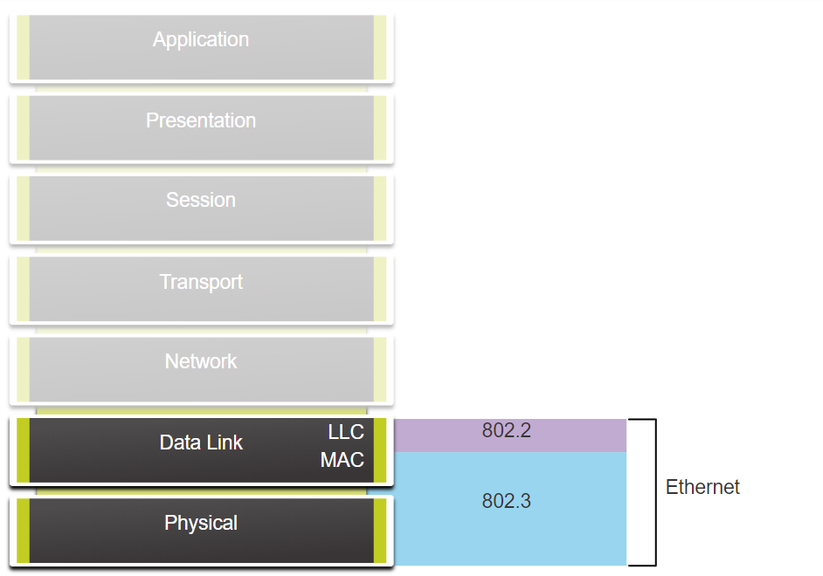
Ethernet and Internet Protocol (IP)
Ethernet Encapsulation
Unlike wireless, Ethernet uses wired communications, including twisted pair, fiber-optic links, and coaxial cables.
Ethernet operates in the data link layer and physical layer.
It is a family of networking technologies defined in the IEEE 802.2 and 802.3 standards.
Ethernet supports data bandwidths from 10 Mbps to 100,000 Mbps (100 Gbps)
As seen in the figure, Ethernet standards define both the Layer 2 protocols and the Layer 1 technologies.
Ethernet and the OSI Model
Notes:
6 - Ethernet and Internet Protocol (IP)
6.1 – Ethernet
6.1.1 – Ethernet Encapsulation

Slide 14
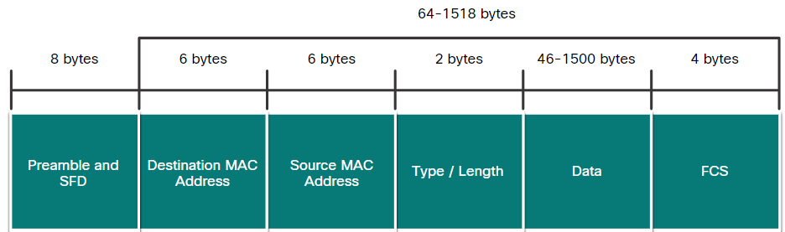
Ethernet and Internet Protocol (IP)
Ethernet Frame Fields
The minimum Ethernet frame size is 64 bytes and the maximum is 1518 bytes. This includes all bytes from the destination MAC address field through the Frame Check Sequence (FCS) field.
Any frame less than 64 bytes in length is considered a “collision fragment” or “runt frame” and is automatically discarded by receiving stations. Frames with more than 1500 bytes of data are considered “jumbo” or “baby giant frames”.
Ethernet Frame Fields
Notes:
6 - Ethernet and Internet Protocol(IP)
6.1 – Ethernet
6.1.2 – Ethernet Frame Fields

Slide 15
Ethernet and Internet Protocol (IP)
Ethernet Frame Fields
The Ethernet fields and their description is as follows:
Field | Description
Preamble and Start Frame Delimiter | Used for synchronization between the sending and receiving devices.
Destination MAC Address | It is the identifier for the intended recipient. This address is used by Layer 2 to assist devices in determining if a frame is addressed to them. The address in the frame is compared to the MAC address in the device.
Source MAC Address | Identifies the originating NIC or interface of the frame.
Type / Length | Identifies the upper layer protocol encapsulated in the Ethernet frame.
Data Field | Contains the encapsulated data from a higher layer, an IPv4 packet.
Frame Check Sequence | Used to detect errors in a frame using Cyclic Redundancy Check (CRC).
Notes:
6 - Ethernet and Internet Protocol(IP)
6.1 – Ethernet
6.1.2 – Ethernet Frame Fields

Slide 16
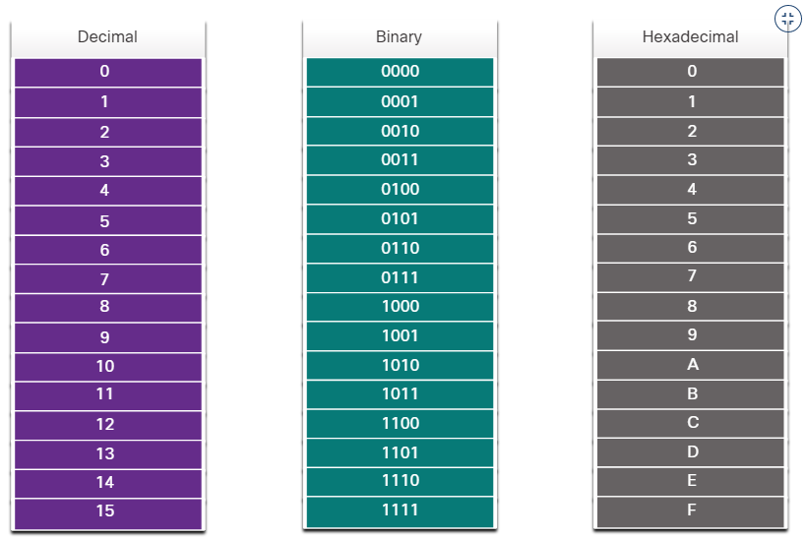
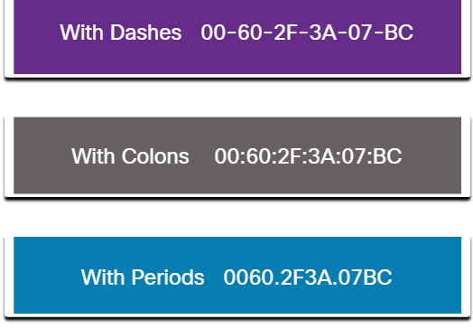
Ethernet and Internet Protocol (IP)
MAC Address Format
An Ethernet MAC address is a 48-bit binary value expressed as 12 hexadecimal digits.
Hexadecimal digits uses numbers 0 to 9 and the letters A to F.
Hexadecimal is commonly used to represent binary data.
All data that travels on the network is encapsulated in Ethernet frames.
Decimal and Binary Equivalents of 0 to F Hexadecimal
Different Representations of MAC Addresses
Notes:
6 - Ethernet and Internet Protocol(IP)
6.1 – Ethernet
6.1.3 – Ethernet Frame Fields
6.1.4 - Check Your Understanding - Ethernet Frame Fields

Slide 17
6.2 IPv4
Notes:
Source
6 – Ethernet and Internet Protocol (IP)
6.2 - IPv4
In-Session Activities / Explanations:
Time: 10 min
Instructor Notes:
Brief the learners on the four basic operations of network layer protocol
Take the learners through IP Encapsulation and define its purpose.
Discuss three basic characteristics of IP.
Explain connectionless network with an example.
Illustrate that IPV4 is media independent.
Explain the fields in IPV4 packet header
Ensure that they complete the “Check Your Understanding – IPV4 packet” in section 6.2.10.
Key Points: Characteristics of IP , Fragmentation , IPV4 packet header fields.

Slide 18
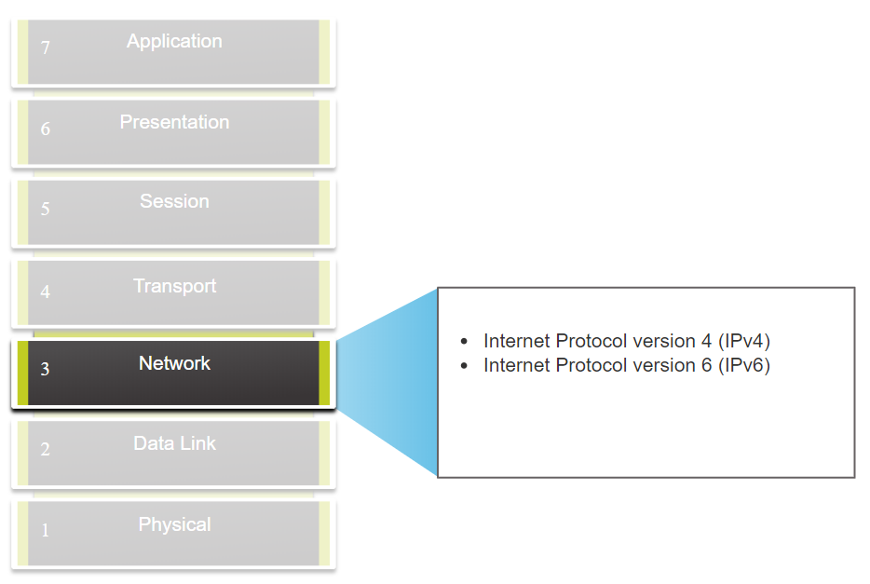
IPv4
The Network Layer
The network layer provides services to allow end devices to exchange data across networks.
IPv4 and IPv6 are the principle network layer communication protocols.
Open Shortest Path First (OSPF) and Internet Control Message Protocol (ICMP) are other network layer protocols.
Basic operations of network layer protocol:
Addressing end devices - Configured with a unique IP address for identification
Encapsulation - Encapsulates the Protocol Data Unit (PDU) from the transport layer into a packet.
Routing - Select the best path and direct packets towards destination host.
De-encapsulation – Performed by the destination host.
Network Layer Protocol
Notes:
6 - Ethernet and Internet Protocol(IP)
6.2 – IPv4
6.2.1 – The Network Layer

Slide 19
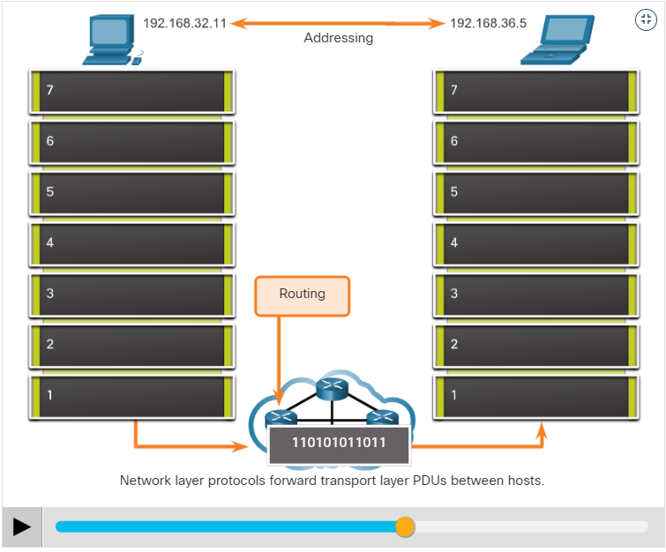
IPv4
The Network Layer (Contd.)
Network layer communication protocols specify the packet structure and processing used to carry the data from one host to another host.
Operating without regard to the data carried in each packet allows the network layer to carry packets for multiple types of communications between multiple hosts.
Click Play in the figure to view an animation that demonstrates the exchange of data.
Notes:
6 - Ethernet and Internet Protocol(IP)
6.2 – IPv4
6.2.1 – The Network Layer

Slide 20
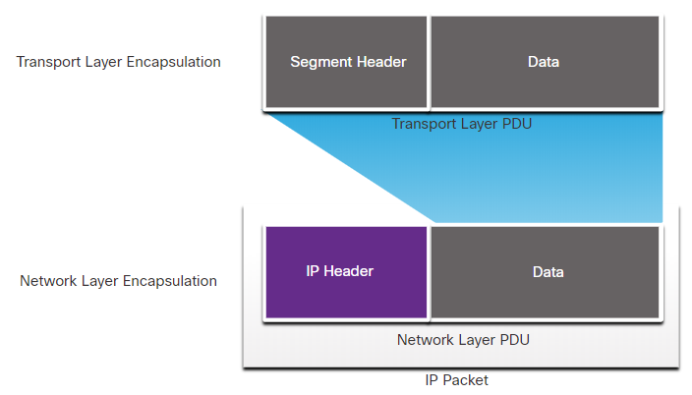
IPv4
IP Encapsulation
IP encapsulates the transport layer segment or other data by adding an IP header.
IP Header is used to deliver the packet to the destination host. It is examined by Layer 3 devices.
The process of encapsulating data layer by layer enables the services at the different layers to develop and scale without affecting the other layers.
IP addressing information remains the same from the time the packet leaves the source host until it arrives at the destination host, except when translated by the device performing Network Address Translation (NAT) for IPv4.
The encapsulated transport layer PDU or other data, remains unchanged during the network layer processes.
Notes:
6 - Ethernet and Internet Protocol(IP)
6.2 – IPv4
6.2.2 – IP Encapsulation

Slide 21
IPv4
Characteristics of IP
IP was designed as a protocol with low overhead.
IP provides the functions that are necessary to deliver a packet from a source to a destination over an interconnected system of networks.
The basic characteristics of IP are as follows:
Connectionless - There is no connection with the destination established before sending data packets.
Best Effort - IP is inherently unreliable because packet delivery is not guaranteed.
Media Independent - Operation is independent of the medium (for example, copper, fiber-optic, or wireless) carrying the data.
Notes:
6 - Ethernet and Internet Protocol(IP)
6.2 – IPv4
6.2.3– Characteristics of IP

Slide 22
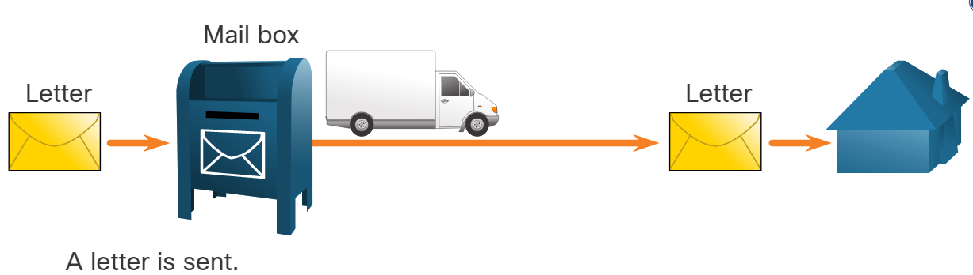
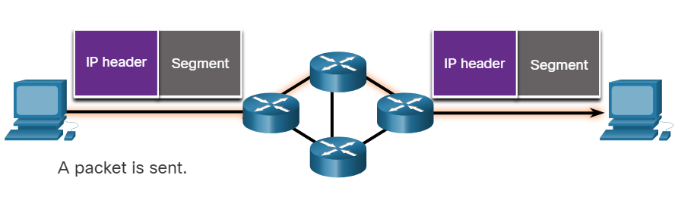
IPv4
Connectionless
Connectionless - Analogy
There is no dedicated end-to-end connection created by IP before data is sent.
Connectionless communication is conceptually similar to sending a letter to someone without notifying the recipient in advance.
Connectionless - Network
IP requires no initial exchange of control information to establish an end-to-end connection before packets are forwarded.
Connectionless - Analogy
Connectionless - Network
Notes:
6 - Ethernet and Internet Protocol(IP)
6.2 – IPv4
6.2.4 – Connectionless

Slide 23
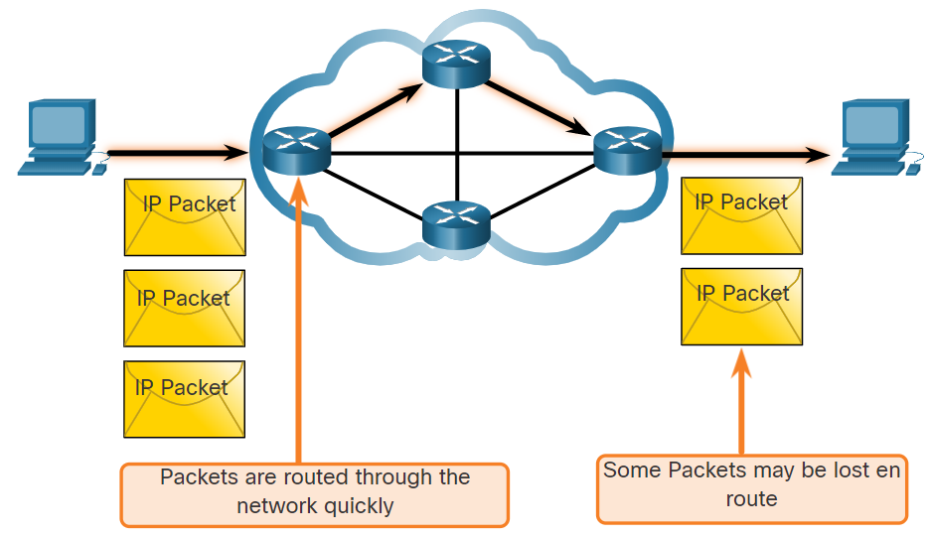
IPv4
Best Effort
As an unreliable network layer protocol, IP protocol does not guarantee that all the sent packets will be received.
Other protocols manage the process of tracking packets and ensuring their delivery.
The figure illustrates the unreliable or best-effort delivery characteristic of the IP protocol.
Notes:
6 - Ethernet and Internet Protocol(IP)
6.2 – IPv4
6.2.5 – Best Effort

Slide 24
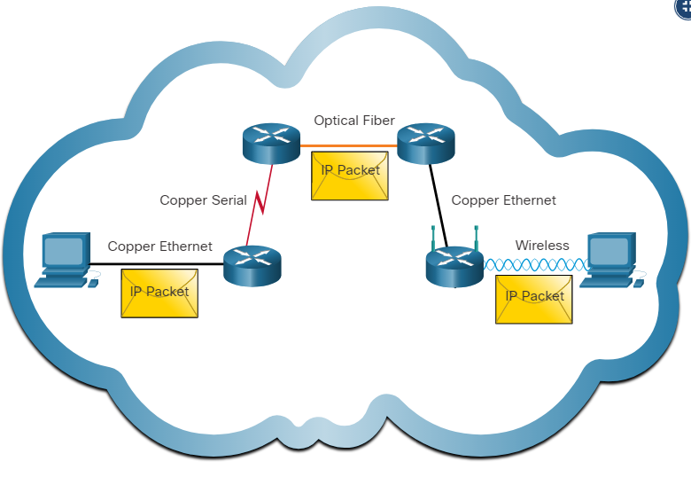
IPv4
Media Independent
IP operates independently of the media that carry the data at lower layers of the protocol stack.
IP packets can be communicated as electronic signals over copper cable, as optical signals over fiber, or wirelessly as radio signals.
The OSI data link layer is responsible for taking an IP packet and preparing it for transmission over the communications medium.
The maximum size of the PDU that each medium can transport is referred to as the Maximum Transmission Unit (MTU).
The data link layer passes the MTU value up to the network layer. Later, the network layer determines the size of the large packets.
Notes:
6 - Ethernet and Internet Protocol (IP)
6.2 – IPv4
6.2.6 – Media Independent
6.2.7 - Check Your Understanding - IP Characteristics

Slide 25
IPv4
IPv4 Packet Header
IPv4 is one of the primary network layer communication protocols.
The IPv4 packet header is used to ensure that this packet is delivered to its next stop on the way to its destination end device.
An IPv4 packet header consists of fields containing important information about the packet.
These fields contain binary numbers which are examined by the Layer 3 process.
Notes:
6 - Ethernet and Internet Protocol(IP)
6.2 – IPv4
6.2.8 - IPv4 Packet Header

Slide 26
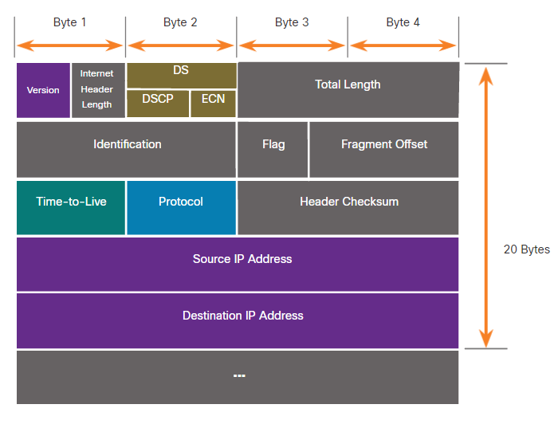
IPv4
IPv4 Packet Header Fields
The significant fields in the IPv4 header include the following:
Version
Differentiated Services or DiffServ (DS)
Header Checksum
Time to Live (TTL)
Protocol
Source IPv4 Address
Destination IPv4 Address
Notes:
6 – Ethernet and Internet Protocol(IP)
6.2 – IPv4
6.2.9 – IPv4 Packet Header Fields
6.2.10 – Check Your Understanding - IPv4 Packet

Slide 27
6.3 IP Addressing Basics
Notes:
Source
6 – Ethernet and Internet Protocol(IP)
6.3 – IP Addressing Basics
In-Session Activities / Explanations:
Time: 10 min
Instructor Notes:
Discuss network and host portions
Explain the concepts of subnet mask and prefix length
Explain the subnetting broadcast domains.
Demonstrate a video to the students to explain Network, Host and Broadcast addresses.
Ensure that they complete the “Check Your Understanding – IPV4 Address structure” in section 6.3.7
Key Points: Network and Host portion , subnet mask , broadcast domains, prefix length

Slide 28
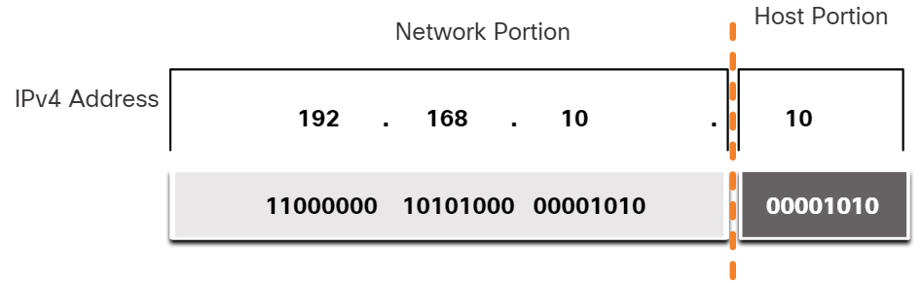
IP Addressing Basics
Network and Host Portions
An IPv4 address is a 32-bit hierarchical address that is made up of a network portion and a host portion.
The bits within the network portion of the address must be identical for all devices that are in the same network.
The bits within the host portion of the address must be unique to identify a specific host within a network.
If two hosts have the same bit-pattern in the specified network portion of the 32-bit stream, then those two hosts will reside in the same network.
Notes:
6 - Ethernet and Internet Protocol(IP)
6.3 – IP Addressing Basics
6.3.1 - Network and Host Portions

Slide 29
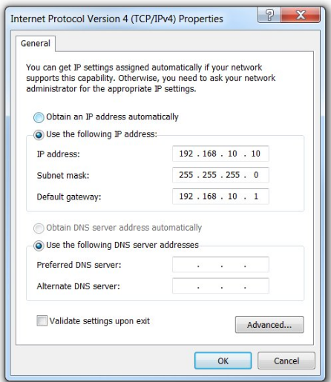
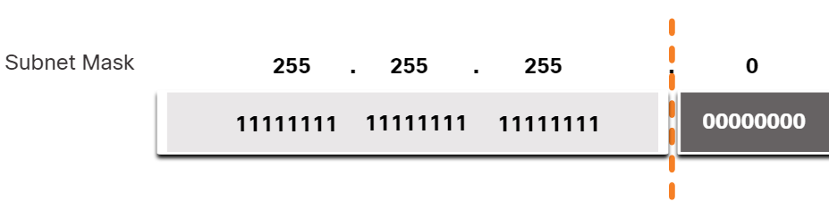
IP Addressing Basics
The Subnet Mask
To assign IPv4 address to a host requires the following:
IPv4 address - Unique IPv4 address of the host.
Subnet mask- Used to identify the network/host portion.
Note: A default gateway IPv4 address is required to reach remote networks and DNS server IPv4 addresses are required to translate domain names to IPv4 addresses.
Subnet Mask
When an IPv4 address is assigned to a device, the subnet mask is used to determine the network address of the device.
Subnet mask is a consecutive sequence of 1 bits followed by a consecutive sequence of 0 bits.
Notes:
6 - Ethernet and Internet Protocol(IP)
6.3 – IP Addressing Basics
6.3.2 - The Subnet Mask

Slide 30
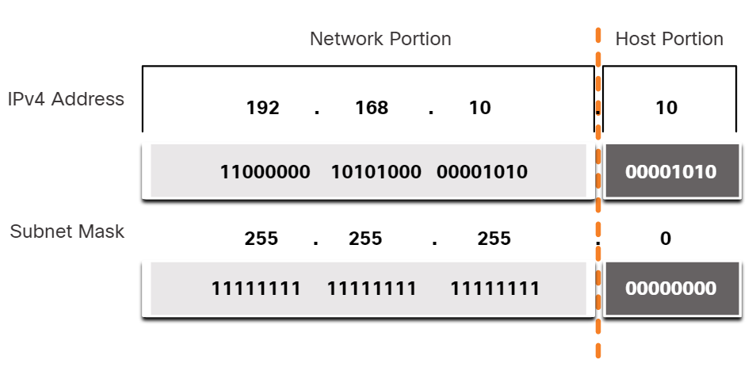
IP Addressing Basics
The Subnet Mask (Contd.)
To identify the network and host portions of an IPv4 address, the subnet mask is compared to the IPv4 address bit for bit, from left to right as shown in the figure.
The subnet mask does not actually contain the network or host portion of an IPv4 address.
The actual process used to identify the network portion and host portion is called ANDing.
Associating an IPv4 Address with its Subnet Mask
Notes:
6 - Ethernet and Internet Protocol(IP)
6.3 – IP Addressing Basics
6.3.2 - The Subnet Mask

Slide 31
IP Addressing Basics
The Prefix Length
The prefix length is the number of bits set to 1 in the subnet mask.
It is written in “slash notation”, which is noted by a forward slash (/) followed by the number of bits set to 1.
When representing an IPv4 address using a prefix length, the IPv4 address is written followed by the prefix length with no spaces.
Note: A network address is also referred to as a prefix or network prefix. Therefore, the prefix length is the number of 1 bits in the subnet mask.
When representing an IPv4 address using a prefix length, the IPv4 address is written followed by the prefix length with no spaces. For example, 192.168.10.10 255.255.255.0 would be written as 192.168.10.10/24.
Notes:
6 - Ethernet and Internet Protocol(IP)
6.3 – IP Addressing Basics
6.3.3 - The Prefix Length

Slide 32
IP Addressing Basics
The Prefix Length (Contd.)
The first column lists the subnet masks that can be used with a host address. The second column displays the converted 32-bit binary address. The last column displays the resulting prefix length.
Subnet Mask | 32-bit Address | Prefix Length
255.0.0.0 | 11111111.00000000.00000000.00000000 | /8
255.255.0.0 | 11111111.11111111.00000000.00000000 | /16
255.255.255.0 | 11111111.11111111.11111111.00000000 | /24
255.255.255.128 | 11111111.11111111.11111111.10000000 | /25
255.255.255.192 | 11111111.11111111.11111111.11000000 | /26
255.255.255.224 | 11111111.11111111.11111111.11100000 | /27
255.255.255.240 | 11111111.11111111.11111111.11110000 | /28
255.255.255.248 | 11111111.11111111.11111111.11111000 | /29
255.255.255.252 | 11111111.11111111.11111111.11111100 | /30
Notes:
6 - Ethernet and Internet Protocol(IP)
6.3 – IP Addressing Basics
6.3.3 - The Prefix Length

Slide 33
IP Addressing Basics
Determining the Network: Logical AND
A logical AND is one of three Boolean operations used in Boolean or digital logic.
The AND operation is used in determining the network address.
Logical AND is the comparison of two bits that produce the results as shown below
1 AND 1 = 1
0 AND 1 = 0
1 AND 0 = 0
0 AND 0 = 0
To identify the network address of an IPv4 host, the IPv4 address is logically ANDed, bit by bit, with the subnet mask.
Note: In digital logic, 1 represents True and 0 represents False. When using an AND operation, both input values must be True (1) for the result to be True (1).
Notes:
6 - Ethernet and Internet Protocol(IP)
6.3 – IP Addressing Basics
6.3.4 - Determining the Network: Logical AND

Slide 34
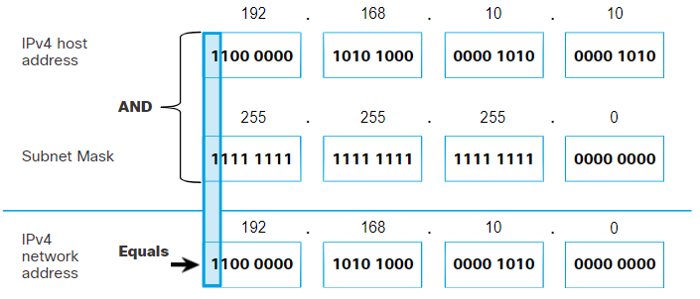
IP Addressing Basics
Determining the Network: Logical AND (Contd.)
To illustrate how AND is used to discover a network address, consider a host with IPv4 address 192.168.10.10 and subnet mask of 255.255.255.0, as shown in the figure:
IPv4 host address (192.168.10.10) - The IPv4 address of the host in dotted decimal and binary formats.
Subnet mask (255.255.255.0) - The subnet mask of the host in dotted decimal and binary formats.
Network address (192.168.10.0) - The logical AND operation between the IPv4 address and subnet mask results in an IPv4 network address shown in dotted decimal and binary formats.
Notes:
6 - Ethernet and Internet Protocol(IP)
6.3 – IP Addressing Basics
6.3.4 - Determining the Network: Logical AND

Slide 35
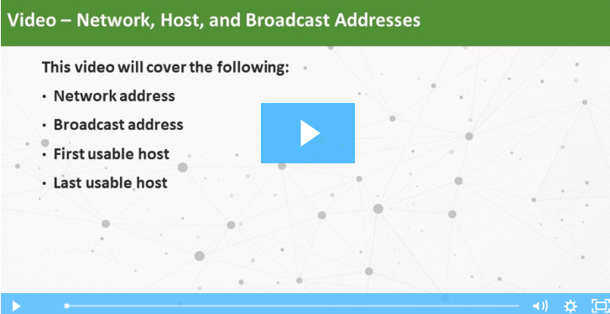
IP Addressing Basics
Video – Network, Host, and Broadcast Addresses
Watch the video to learn about Network, Host and Broadcast addresses.
Notes:
6 - Ethernet and Internet Protocol(IP)
6.3 – IP Addressing Basics
6.3.5 - Video – Network, Host, and Broadcast Addresses

Slide 36
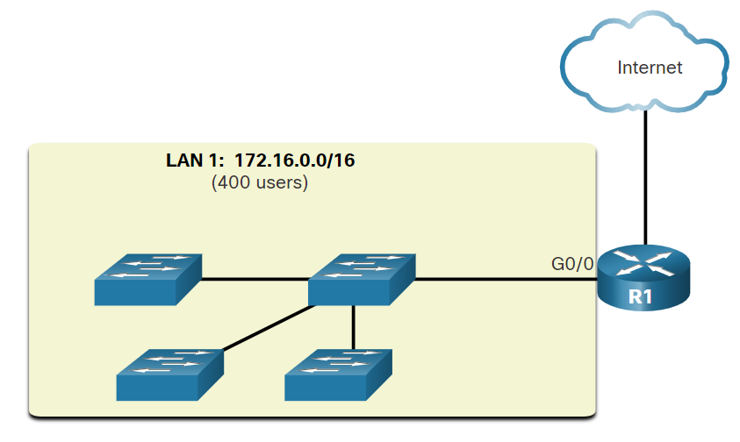
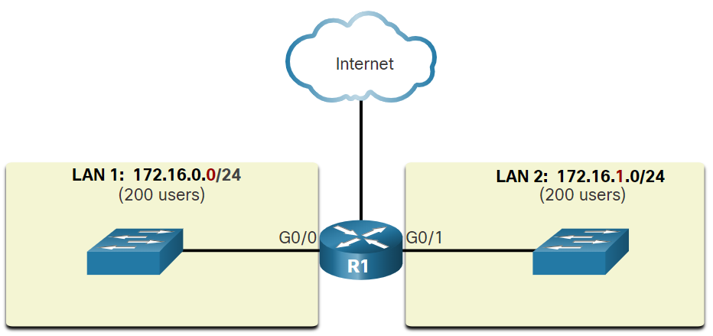
IP Addressing Basics
Subnetting Broadcast Domains
In the figure, LAN 1 connects 400 users that could each generate broadcast traffic, which can slow down network and device operations.
The solution is to reduce the size of the network to create smaller broadcast domains in a process called subnetting. These smaller network spaces are called subnets.
Subnetting reduces the overall network traffic and improves network performance.
A Large Broadcast Domain
Note: The terms subnet and network are often used interchangeably. Most networks are a subnet of some larger address block.
Communication between Networks
Notes:
6 - Ethernet and Internet Protocol(IP)
6.3 – IP Addressing Basics
6.3.6 - Subnetting Broadcast Domains CREATE MBAR

Slide 37
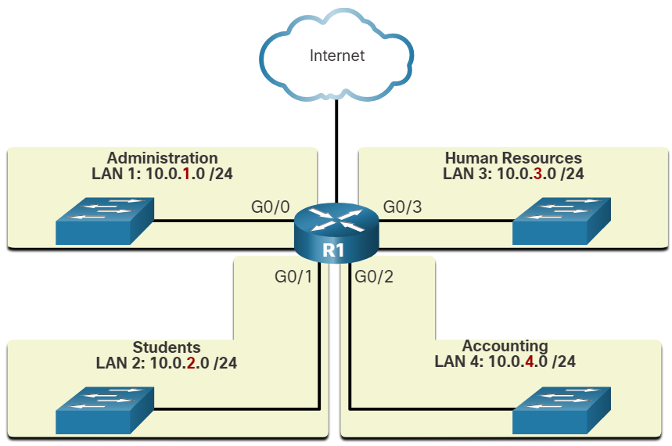
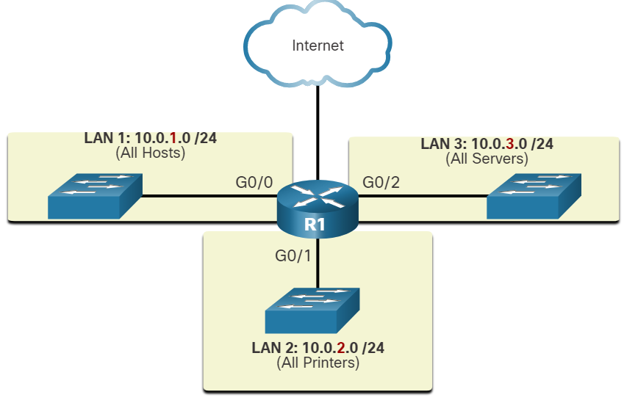
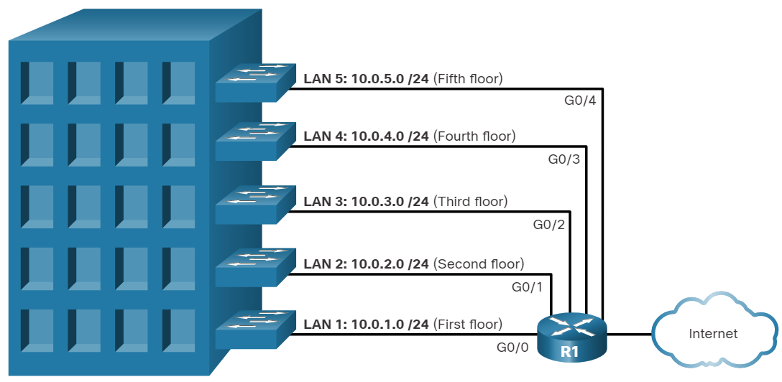
IP Addressing Basics
Subnetting Broadcast Domains (Contd.)
Network administrators can group devices and services into subnets that may be determined by a variety of factors.
Location
By Department
Device Type
Notes:
6 - Ethernet and Internet Protocol(IP)
6.3 – IP Addressing Basics
6.3.6 - Subnetting Broadcast Domains CREATE MBAR
6.3.7 - Check Your Understanding - IPv4 Address Structure

Slide 38
6.4 Types of IPv4 Addresses
Notes:
Source
6 – Ethernet and Internet Protocol(IP)
6.4 – Types of IPv4 Addresses
In-Session Activities / Explanations:
Time: 5 min
Instructor Notes:
Discuss IPV4 address classes with its range.
Explain reserved private addresses
Key Points: Address classes , Reserved private address

Slide 39
Types of IPv4 Addresses
IPv4 Address Classes and Default Subnet Masks
Address Classes
The IPv4 addresses were based on the following classes:
Class A (0.0.0.0/8 to 127.0.0.0/8) – Designed to support extremely large networks with more than 16 million host addresses.
Class B (128.0.0.0 /16 – 191.255.0.0 /16) – Designed to support moderate to large size networks with up to approximately 65,000 host addresses.
Class C (192.0.0.0 /24 – 223.255.255.0 /24) – Designed to support small networks with a maximum of 254 hosts.
Note: There is also a Class D multicast block consisting of 224.0.0.0 to 239.0.0.0 and a Class E experimental address block consisting of 240.0.0.0 – 255.0.0.0.
Notes:
6 - Ethernet and Internet Protocol(IP)
6.4 - Types of IPv4 Addresses
6.4.1 - Pv4 Address Classes and Default Subnet Masks

Slide 40
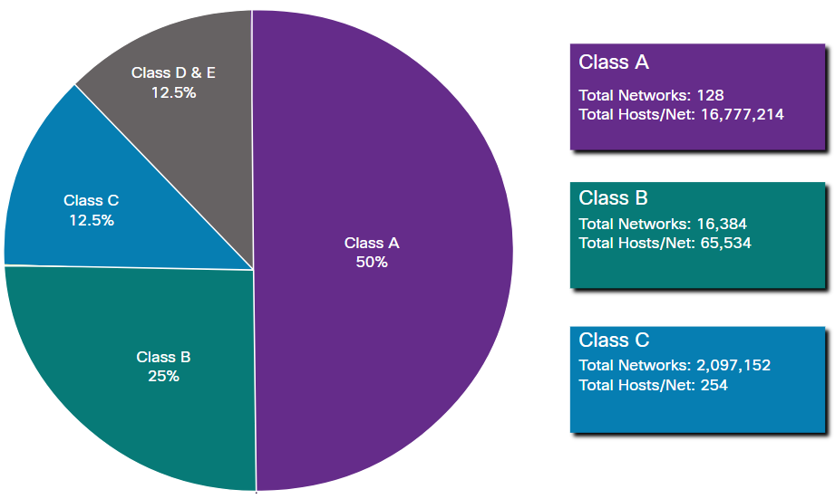
Types of IPv4 Addresses
IPv4 Address Classes and Default Subnet Masks (Contd.)
The classful system allocated :
50% of the available IPv4 addresses to 128 Class A networks
25% of the addresses to Class B
Class C shared the remaining 25% with Class D and E.
Summary of Classful Addressing
Notes:
6 - Ethernet and Internet Protocol(IP)
6.4 - Types of IPv4 Addresses
6.4.1 - IPv4 Address Classes and Default Subnet Masks

Slide 41
Types of IPv4 Addresses
Reserved Private Addresses
Private Addresses:
There are blocks of addresses called private addresses that are used by most organizations to assign IPv4 addresses to internal hosts.
Private IPv4 addresses are not unique and can be used by any internal network.
Private address blocks:
10.0.0.0 /8 or 10.0.0.0 to 10.255.255.255
172.16.0.0 /12 or 172.16.0.0 to 172.31.255.255
192.168.0.0 /16 or 192.168.0.0 to 192.168.255.255
The addresses within these address blocks are not allowed on the internet and must be filtered by internet routers.
Notes:
6 - Ethernet and Internet Protocol(IP)
6.4 - Types of IPv4 Addresses
6.4.2 - Reserved Private Addresses

Slide 42
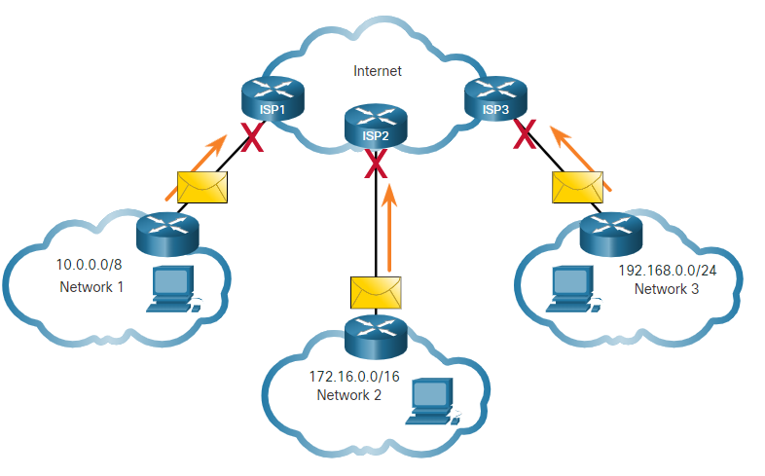
Types of IPv4 Addresses
Reserved Private Addresses (Contd.)
In the figure, users in networks 1, 2, or 3 are sending packets to remote destinations. The ISP routers would see that the source IPv4 addresses in the packets are from private addresses and discard the packets.
Most organizations use private IPv4 addresses for their internal hosts.
Network Address Translation (NAT) is used to translate between private IPv4 and public IPv4 addresses.
Private Addresses Cannot be Routed over the Internet
Notes:
6 - Ethernet and Internet Protocol(IP)
6.4 - Types of IPv4 Addresses
6.4.2 - Reserved Private Addresses

Slide 43
6.5 The Default Gateway
Notes:
Source
6 – Ethernet and Internet Protocol(IP)
6.5 – The Default Gateway
In-Session Activities / Explanations:
Time: 7 min
Instructor Notes:
Discuss host forwarding decision
Explain the concept of default gateway
Explain the use of netstar-r command
Ensure that they complete the “Check Your Understanding – How a Host Routes” in section 6.5.5.
Key Points: host forwading decision , default gateway.

Slide 44
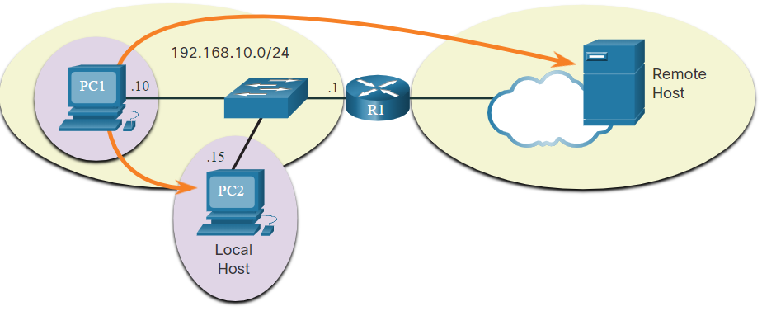
The Default Gateway
Host Forwarding Decision
Another role of the network layer is to direct packets between hosts. A host can send a packet to: Itself, Local host, and Remote host.
The figure illustrates PC1 connecting to a local host on the same network, and to a remote host located on another network.
Whether a packet is destined for a local host or a remote host is determined by the source end device. The method of determination varies by IP version:
In IPv4 - The source device uses its own subnet mask along with its own IPv4 address and the destination IPv4 address to make this determination.
In IPv6 - The local router advertises the local network address to all devices on the network.
Notes:
6 - Ethernet and Internet Protocol(IP)
6.5 - The Default Gateway
6.5.1 - Host Forwarding Decision

Slide 45
The Default Gateway
Default Gateway
The default gateway is the network device that can route traffic to other networks.
On a network, a default gateway is usually a router with these features:
It has a local IP address in the same address range as other hosts on the local network.
It can accept data into the local network and forward data out of the local network.
It routes traffic to other networks.
A default gateway is required to send traffic outside the local network.
Traffic cannot be forwarded outside the local network if there is no default gateway, or the default gateway address is not configured, or the default gateway is down.
Notes:
6 - Ethernet and Internet Protocol(IP)
6.5 - The Default Gateway
6.5.2 - Default Gateway

Slide 46
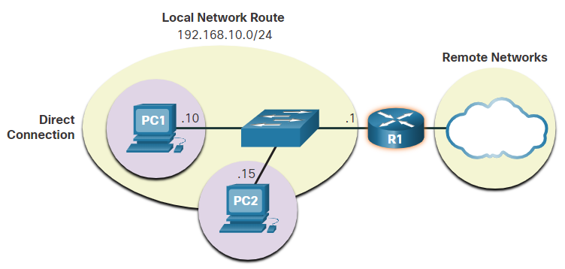
The Default Gateway
A Host Routes to the Default Gateway
In IPv4, the host receives the IPv4 address of the default gateway either dynamically from Dynamic Host Configuration Protocol (DHCP) or configured manually.
In IPv6, the router advertises the default gateway address or the host can be configured manually.
Having a default gateway configured creates a default route in the routing table of the PC.
A default route is the route or pathway your computer will take when it tries to contact a remote network.
PC1 and PC2 are configured with the IPv4 address of 192.168.10.1 as the default gateway
Notes:
6 - Ethernet and Internet Protocol(IP)
6.5 - The Default Gateway
6.5.3 - A Host Routes to the Default Gateway

Slide 47
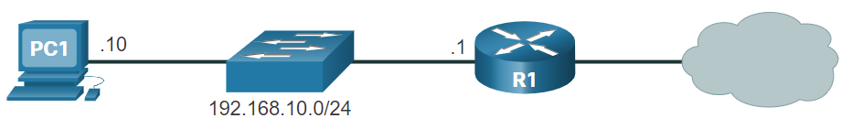
The Default Gateway
Host Routing Tables
On a Windows host, the route print or netstat -r command can be used to display the host routing table. Both commands generate the same output.
The figure displays a sample topology and the output generated by the netstat –r command.
Notes:
6 - Ethernet and Internet Protocol(IP)
6.5 - The Default Gateway
6.5.4 - Host Routing Tables

Slide 48
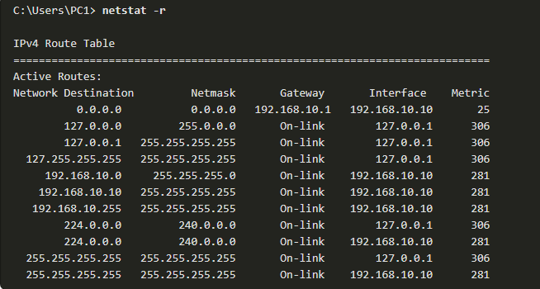
The Default Gateway
Host Routing Tables (Contd.)
Entering the netstat -r command displays three sections related to the current TCP/IP network connections:
Interface List
IPv4 Route Table
IPv6 Route Table
Note: The output only displays the IPv4 route table.
IPv4 Routing Table for PC1
Notes:
6 - Ethernet and Internet Protocol(IP)
6.5 - The Default Gateway
6.5.4 - Host Routing Tables
6.5.5 - Check Your Understanding - How a Host Routes

Slide 49
6.6 IPv6
Notes:
Source
6 – Ethernet and Internet Protocol(IP)
6.6 – IPv6
In-Session Activities / Explanations:
Time: 10 min
Instructor Notes:
Discuss the transition from IPv4 to IPv6.
Describe the IPv6 addressing formats with different examples.
Explain the roles of IPv6.
Define IPv6 prefix length.
Key Points: IPv6, IPv6 addressing formats, Prefix Length

Slide 50
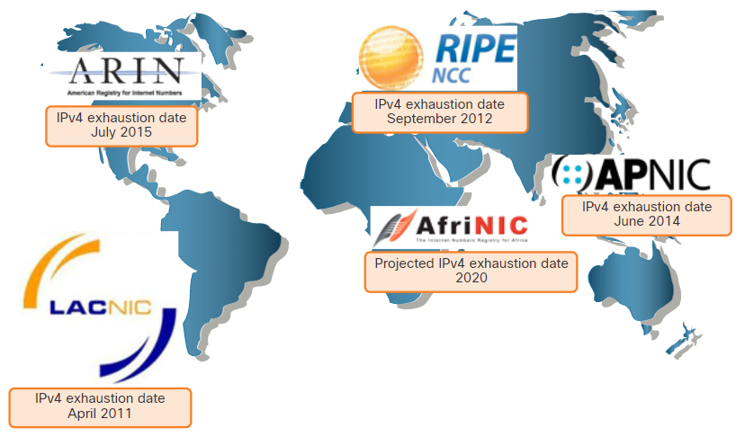
IPv6
Need for IPv6
IPv6 is designed to be the successor to IPv4.
IPv6 has a larger 128-bit address space, providing 340 undecillion possible addresses.
Mobile providers have been leading the way with the transition to IPv6.
Most top ISPs and content providers such as YouTube, Facebook, and Netflix, have also made the transition.
Many companies like Microsoft, Facebook, and LinkedIn are transitioning to IPv6-only internally.
The depletion of IPv4 address space has been the motivating factor for moving to IPv6.
RIR IPv4 Exhaustion Dates
Notes:
6 - Ethernet and Internet Protocol (IP)
6.6 - IPv6
6.6.1 - Need for IPv6

Slide 51
IPv6
Need for IPv6 (Contd.)
Internet of Things
The internet of today is more than email, web pages, and file transfers between computers.
The evolving internet is becoming an Internet of Things (IoT).
Computers, tablets, and smartphones will not be the only devices accessing the internet but there will also be sensor-equipped, internet-ready devices of tomorrow including everything from automobiles and biomedical devices, to household appliances and natural ecosystems.
With an increasing internet population, a limited IPv4 address space, issues with NAT and the IoT, the time has come to begin the transition to IPv6.
Notes:
6 - Ethernet and Internet Protocol (IP)
6.6 - IPv6
6.6.1 - Need for IPv6

Slide 52
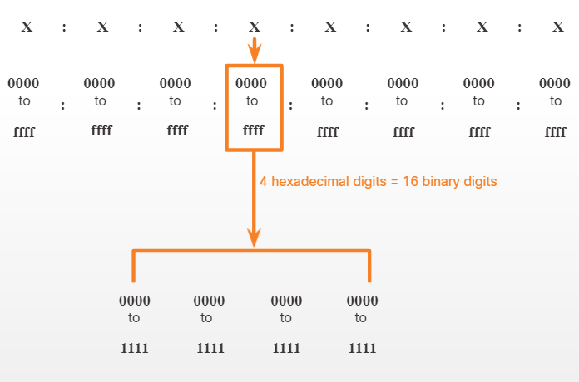
IPv6
IPv6 Addressing Formats
IPv6 addresses are 128 bits in length and written as a string of hexadecimal values.
Every four bits is represented by a single hexadecimal digit for a total of 32 hexadecimal values.
IPv6 addresses are not case-sensitive and can be written in either lowercase or uppercase.
16-bit Segments or Hextets
Notes:
6 - Ethernet and Internet Protocol (IP)
6.6 - IPv6
6.6.2 - IPv6 Addressing Formats

Slide 53
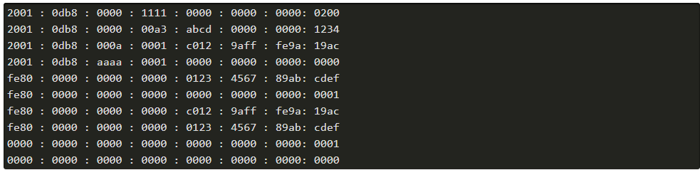
IPv6
IPv6 Addressing Formats (Contd.)
Preferred Format
The preferred format for writing an IPv6 address is x:x:x:x:x:x:x:x, with each “x” consisting of four hexadecimal values.
Each “x” is a single hextet which is 16 bits or four hexadecimal digits.
Examples of IPv6 addresses in the preferred format
Notes:
6 - Ethernet and Internet Protocol (IP)
6.6 - IPv6
6.6.2 - IPv6 Addressing Formats

Slide 54
IPv6
Rule 1 - Omit Leading Zeros
Rule 1: Omit any leading 0s (zeros) in any hextet.
The four examples of ways to omit leading zeros:
01ab can be represented as 1ab
09f0 can be represented as 9f0
0a00 can be represented as a00
00ab can be represented as ab
This rule only applies to leading 0s, NOT to trailing 0s, otherwise the address would be ambiguous. 01ab. For example, refer to the below table.
Type | Format
Preferred | 2001 : 0db8 : 0000 : 1111 : 0000 : 0000 : 0000 : 0200
No leading 0s | 2001 : db8 : 0 : 1111 : 0 : 0 : 0 : 200
Notes:
6 - Ethernet and Internet Protocol(IP)
6.6 - IPv6
6.6.3 - Rule 1 - Omit Leading Zeros

Slide 55
IPv6
Rule 2 - Double Colon
Rule 2: Double colon (::) can replace any single, contiguous string of one or more 16-bit hextets consisting of all zeros.
Example: 2001:db8:cafe:1:0:0:0:1 could be represented as 2001:db8:cafe:1::1.
The double colon (::) is used in place of the three all-0 hextets (0:0:0).
The double colon (::) can only be used once within an address.
When used with the omitting leading 0s technique, the notation of IPv6 address can often be greatly reduced. This is commonly known as the compressed format.
Example of incorrect use of the double colon: 2001:db8::abcd::1234.
Type | Format
Preferred | 2001 : 0db8 : 0000 : 1111 : 0000 : 0000 : 0000 : 0200
Compressed/spaces | 2001 : db8 : 0 : 1111 : : 200
Compressed | 2001:db8:0:1111::200
Notes:
6 - Ethernet and Internet Protocol(IP)
6.6 - IPv6
6.6.4 - Rule 2 - Double Colon

Slide 56
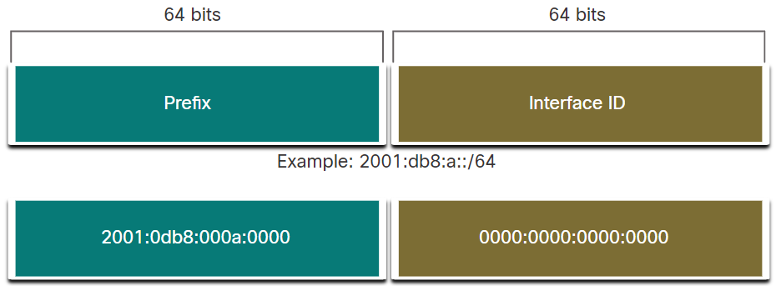
IPv6
IPv6 Prefix Length
The prefix can be identified by a dotted-decimal subnet mask or prefix length (slash notation).
For example, an IPv4 address of 192.168.1.10 with dotted-decimal subnet mask 255.255.255.0 is equivalent to 192.168.1.10/24.
In IPv4 the /24 is called the prefix, whereas in Pv6 it is called the prefix length.
Similar to IPv4, the prefix length is represented in slash notation and is used to indicate the network portion of an IPv6 address. It can range from 0 to128.
It is strongly recommended to use a 64-bit Interface ID for most networks.
Notes:
6 - Ethernet and Internet Protocol(IP)
6.6 - IPv6
6.6.5 - IPv6 Prefix Length

Slide 57
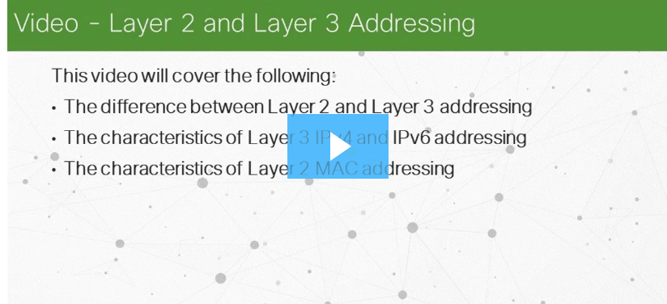
IPv6
Video – Layer 2 and Layer 3 Addressing
Watch the video to learn about Layer 2 and Layer 3 Addressing
Notes:
6 - Ethernet and Internet Protocol(IP)
6.6 - IPv6
6.6.6 - Video – Layer 2 and Layer 3 Addressing
6.6.7 – Check Your Understanding - IPv6 Address Representation

Slide 58
6.7 Ethernet and IP Protocol Summary
Notes:
Source
6 – Ethernet and Internet Protocol (IP)
6.7 – Ethernet and IP Protocol Summary
In-Session Activities / Explanations:
Time: 5 min
Instructor Notes:
Read out the summary points mentioned on the slide.
Discuss the same with the participants.
Ask if they have any questions or doubts.
At the end, ask the students to complete the module quiz.
Key Points: NA

Slide 59
Ethernet and IP Protocol Summary What Did I Learn in this Module?
Ethernet and wireless LANs (WLANs) are the two most popular LAN technologies. It operates at the physical and data link layers of the OSI model and are defined in the IEEE 802.2 and 802.3 standards.
The MAC address can be represented using dashes, colons, or periods between the groups of digits.
IP version 4 (IPv4) and IP version 6 (IPv6) are the principle network layer communication protocols.
Network layer protocols perform four basic operations such as addressing end devices, encapsulation, routing, and de-encapsulation
An IPv4 address is a 32-bit hierarchical address that identifies a network and a host on the network. An IPv6 address is a 128-bit hierarchical address.
The prefix length is the number of bits that are set to 1 in the subnet mask. It is written in “slash notation”, which is noted by a forward slash (/) followed by the number of bits that are set to 1.
Notes:
6 – Ethernet and Internet Protocol(IP)
6.7 – Ethernet and IP Protocol Summary 6.7.1 – What Did I Learn in this Module?

Slide 60
Ethernet and IP Protocol Summary What Did I Learn in this Module?
The process that is used to identify the network portion and host portion is called ANDing.
Class A, Class B, and Class C are the different ranges of IP addresses.
The router that is connected to the local network segment is referred to as the default gateway.
On a Windows host, the route print or netstat -r command can be used to display the host routing table.
There are two rules that help to reduce the number of digits that are needed to represent an IPv6 address.
The prefix length can range from 0 to 128.
Notes:
6 – Ethernet and Internet Protocol(IP)
6.7 – Ethernet and IP Protocol Summary 6.7.1 – What Did I Learn in this Module?
6.7.2 – Module 6: Ethernet and IP Protocol Quiz

Slide 61
Module 6 New Terms and Commands
Open Shortest Path First (OSPF) Internet Control Message Protocol (ICMP) Maximum Transmission Unit (MTU). | Internet Header Length (IHL), Time to Live (TTL)
Notes:
6 – Ethernet and Internet Protocol (IP)
New Terms and Commands

