Slide 1
Module 7: Connectivity Verification
Instructor Materials
CyberOps Associate v1.0
Notes:
Cisco Networking Academy Program
CyberOps Associate v1.0
Module 7: Connectivity Verification

Slide 2
Instructor Materials – Module 7 Planning Guide
This PowerPoint deck is divided in two parts:
Instructor Planning Guide
Information to help you become familiar with the module
Teaching aids
Instructor Class Presentation
Optional slides that you can use in the classroom
Begins on slide # 8
Note: Remove the Planning Guide from this presentation before sharing with anyone.
For additional help and resources go to the Instructor Home Page and Course Resources for this course. You also can visit the professional development site on www.netacad.com, the official Cisco Networking Academy Facebook page, or Instructor Only FB group.
Notes:
2

Slide 3
What to Expect in this Module
To facilitate learning, the following features within the GUI may be included in this module:
Feature | Description
Animations | Expose learners to new skills and concepts.
Videos | Expose learners to new skills and concepts.
PT Activity | Simulation and modeling activities designed to explore, acquire, reinforce, and expand skills.
Module Quizzes | Self-assessments that integrate concepts and skills learned throughout the series of topics presented in the module.
Module Summary | Briefly recaps module content.

Slide 4
Check Your Understanding
Check Your Understanding activities are designed to let students quickly determine if they understand the content and can proceed, or if they need to review.
Check Your Understanding activities do not affect student grades.
There are no separate slides for these activities in the PPT. They are listed in the notes area of the slide that appears before these activities.
Notes:
4

Slide 5
Module 7: Activities
What activities are associated with this module?
Page # | Activity Type | Activity Name | Optional?
7.2.1 | Video | Network Testing and Verification with Windows CLI Commands | Recommended
7.2.8 | Packet Tracer | Verify IPv4 and IPv6 Addressing | Recommended
Notes:
5

Slide 6
Module 7: Best Practices
Prior to teaching Module 7, the instructor should:
Review the activities and assessments for this module.
Try to include as many questions as possible to keep students engaged during classroom presentation.
Topic 7.1
Ask the class what do they know about ICMP protocol and its uses.
Explain the students about ICMPv4 messages.
Discuss with the class about ICMPv6 RS and RA messages.
Notes:
6

Slide 7
Module 7: Best Practices (Contd.)
Topic 7.2
Ask the participants to share their understanding on ping and explain its different uses to them.
Explain the class about traceroute and ask them to find out the basic difference between ping and traceroute.
Notes:
7

Slide 8
Module 7: Connectivity Verification
CyberOps Associate v1.0
Notes:
Cisco Networking Academy Program
CyberOps Associate v1.0
Module 7: Connectivity Verification
In-Session Activities / Explanations:
Time: 5min
Instructor Notes:
Welcome the audience in a warm and cordial manner. Ensure that everyone is set up with the required resources.
Introduce the topic and encourage learners to come up with a list of expectations from the session. Collate topics on the white board or Desktop while using learner’s inputs to interpret them in words.
Interact with the learners to provide an overview of network connectivity verification.
Read out the Objectives and briefly describe each.
Key Points: NA

Slide 9
Module Objectives
Module Title: Connectivity Verification
Module Objective: Use ICMP connectivity verification tools
Topic Title | Topic Objective
ICMP | Explain how ICMP is used to test network connectivity.
Ping and Traceroute Utilities | Use Windows tools, ping, and traceroute to verify network connectivity.
Notes:
9
CyberOps Associate v1.0
7 – Connectivity Verification
7.0 – Introduction
7.0.2 – What Will I Learn in this Module?

Slide 10
7.1 ICMP
Notes:
Source:
7 – Connectivity Verification
7.1 – ICMP
In-Session Activities / Explanations:
Time: 10 min
Instructor Notes:
Introduce the topic and discuss the ICMP protocol and its uses.
Ensure the learners know about ICMPv4 messages.
By the end of the topic, ensure the learners have understanding about ICMPv6 RS and RA Messages.
Key Points: ICMPv4 messages, ICMPv6 RS and RA messages

Slide 11
Connectivity Verification
ICMPv4 Messages
The TCP/IP suite provide messages to be sent in the event of certain errors. These messages are sent using the services of ICMP.
The purpose of these messages is to provide feedback about issues related to the processing of IP packets under certain conditions.
ICMP messages are not required and are often not allowed within a network for security reasons.
ICMP is available for both IPv4 and IPv6. ICMPv4 is the messaging protocol for IPv4. ICMPv6 provides the same services for IPv6 but includes additional functionality.
ICMP messages common to both ICMPv4 and ICMPv6 include host confirmation, destination or service unreachable, time exceeded and route redirection.
Notes:
7 – Connectivity Verification
7.1 – ICMP
7.1.1 – ICMPv4 Messages

Slide 12
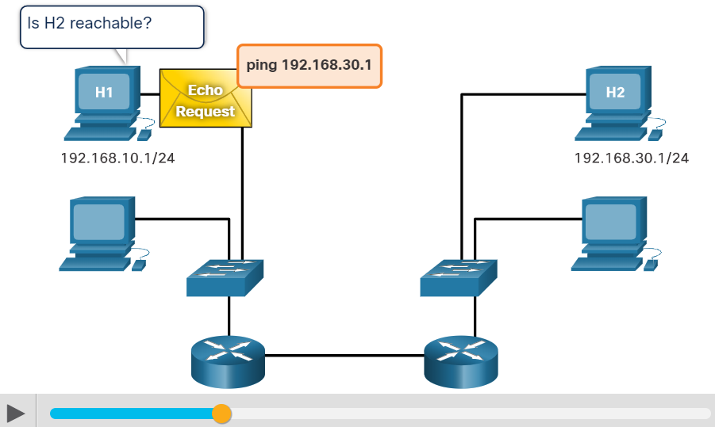
Connectivity Verification ICMPv4 Messages (Contd.)
Host Confirmation
An ICMP Echo Message can be used to determine if a host is operational.
The local host sends an ICMP Echo Request to a host. If the host is available, the destination host responds with an Echo Reply.
This use of the ICMP Echo messages is the basis of the ping utility.
Notes:
7 – Connectivity Verification
7.1 – ICMP
7.1.1 – ICMPv4 Messages

Slide 13
Connectivity Verification ICMPv4 Messages (Contd.)
Destination or Service Unreachable
When a host or gateway receives a packet that it cannot deliver, it can use an ICMP Destination Unreachable message to notify the source that the destination or service is unreachable.
The message will include a code that indicates why the packet could not be delivered. The Destination Unreachable codes for ICMPv4 includes the following:
0 - Net unreachable
1 - Host unreachable
2 - Protocol unreachable
3 - Port unreachable
Note: ICMPv6 has slightly different codes for Destination Unreachable messages.
Notes:
7 – Connectivity Verification
7.1 – ICMP
7.1.1 – ICMPv4 Messages

Slide 14
Connectivity Verification ICMPv4 Messages (Contd.)
Time Exceeded
An ICMPv4 Time Exceeded message is used by a router to indicate that a packet cannot be forwarded because the Time to Live (TTL) field of the packet was decremented to 0.
If a router receives a packet and decrements the TTL field in the IPv4 packet to zero, it discards the packet and sends a Time Exceeded message to the source host.
ICMPv6 also sends a Time Exceeded message if the router cannot forward an IPv6 packet because the packet has expired.
IPv6 does not have a TTL field. It uses the hop limit field to determine if the packet has expired.
Notes:
7 – Connectivity Verification
7.1 – ICMP
7.1.1 – ICMPv4 Messages

Slide 15
Connectivity Verification ICMPv6 RS and RA Messages
ICMPv6 has new features and improved functionality not found in ICMPv4. ICMPv6 messages are encapsulated in IPv6.
It has four new protocols as part of the Neighbor Discovery Protocol (ND or NDP).
Messaging between an IPv6 router and an IPv6 device:
Router Solicitation (RS) message
Router Advertisement (RA) message
Messaging between IPv6 devices:
Neighbor Solicitation (NS) message
Neighbor Advertisement (NA) message
Notes:
7 – Connectivity Verification
7.1 – ICMP
7.1.2 – ICMPv6 RS and RA Messages

Slide 16
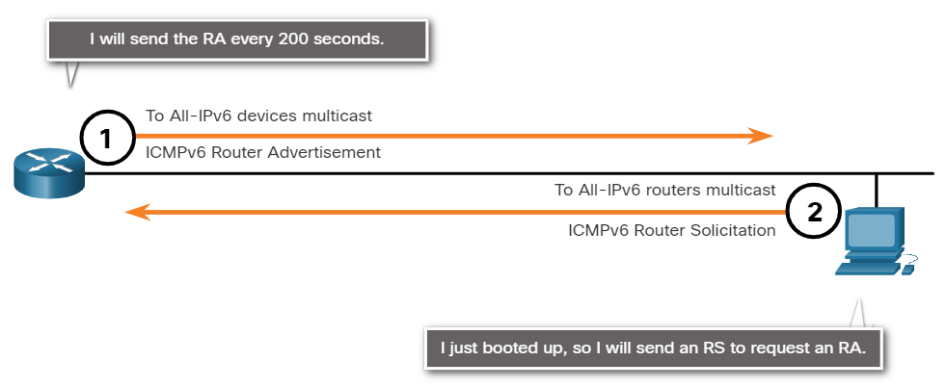
Connectivity Verification ICMPv6 RS and RA Messages (Contd.)
Router Solicitation: Messaging Between an IPv6 Router and an IPv6 Device
RA messages are sent by routers to provide addressing information to hosts using Stateless Address Auto Configuration (SLAAC).
A router will send an RA message periodically or in response to an RS message. A host using SLAAC will set its default gateway to the link-local address of the router that sent the RA.
When a host is configured to obtain its addressing information automatically using SLAAC, the host will send an RS message to the router requesting an RA message.
Notes:
7 – Connectivity Verification
7.1 – ICMP
7.1.2 –ICMPv6 RS and RA Messages

Slide 17
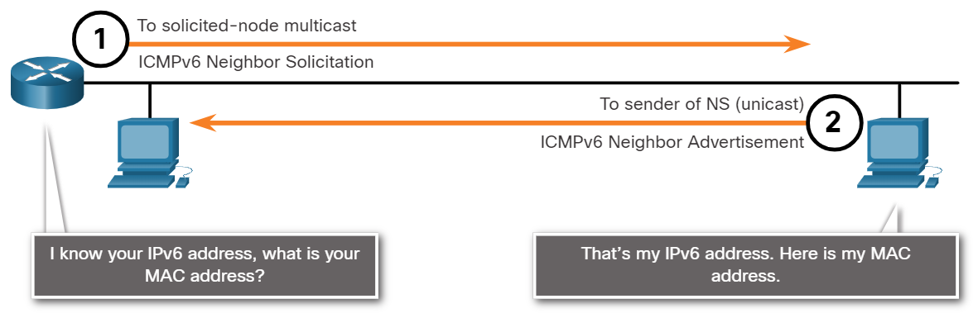
Connectivity Verification ICMPv6 RS and RA Messages (Contd.)
Address Resolution: Messaging Between IPv6 Devices
NA messages are sent when a device knows the IPv6 address of a device but does not know its MAC address. This is equivalent to an ARP Request for IPv4.
NA messages are sent in response to an NS message and match the target IPv6 address in the NS. The NA message includes the device’s Ethernet MAC address. This is equivalent to an ARP Reply in IPv4.
Notes:
7 – Connectivity Verification
7.1 – ICMP
7.1.2 –ICMPv6 RS and RA Messages

Slide 18
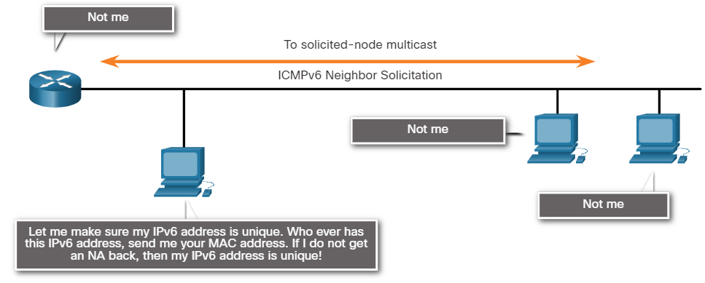
Connectivity Verification ICMPv6 RS and RA Messages (Contd.)
Duplicate Address Detection (DAD)
When a device is assigned a global unicast or link-local unicast address, the DAD is performed on the address to ensure that it is unique.
To check the uniqueness of an address, the device will send an NS message with its own IPv6 address.
If another device on the network has this address, it will respond with an NA message which will notify the sending device that the address is in use. If a corresponding NA message is not returned within a certain period of time, the unicast address is unique and acceptable for use.
Notes:
7 – Connectivity Verification
7.1 – ICMP
7.1.2 –ICMPv6 RS and RA Messages

Slide 19
7.2 Ping and Traceroute Utilities
Notes:
Source:
7 – Connectivity Verification
7.2 – Ping and Traceroute Utilities
In-Session Activities / Explanations:
Time: 18 min
Instructor Notes:
Give a brief introduction of the topic to the learners.
Ensure the learners have knowledge about the ping utility and its different uses.
Explain the learners about traceroute utility.
By the end of the topic, ensure the learners also have an understanding on ICMP packet format.
Also, encourage the learners to perform the packet tracker activity at section 7.2.8.
Key Points: Ping, Traceroute, ICMP Packet Format

Slide 20
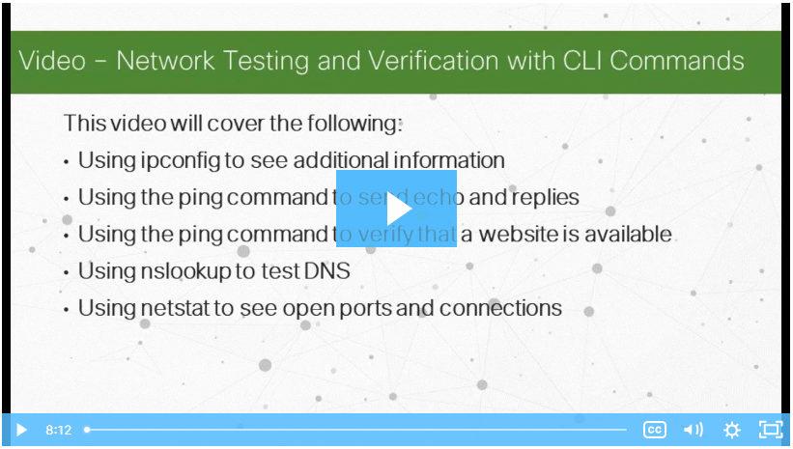
Ping and Traceroute Utilities Video - Network Testing and Verification with Windows CLI Commands
This video will demonstrate the Network Testing and Verification with Windows CLI Commands.
Notes:
7 – Connectivity Verification
7.2 – Ping and Traceroute Utilities
7.2.1 – Video - Network Testing and Verification with Windows CLI Commands

Slide 21
Ping and Traceroute Utilities Ping – Test Connectivity
Ping is an IPv4 and IPv6 testing utility that uses ICMP echo request and echo reply messages to test connectivity between hosts.
To test connectivity to another host on a network, an echo request is sent to the host address using the ping command. If the host at the specified address receives the echo request, it responds with an echo reply.
As each echo reply is received, ping provides feedback on the time between when the request was sent and when the reply was received. This can be a measure of network performance.
Ping has a timeout value for the reply. If a reply is not received within the timeout, ping provides a message indicating that a response was not received.
Notes:
7 – Connectivity Verification
7.2 – Ping and Traceroute Utilities
7.2.2 – Ping - Test Connectivity

Slide 22
Ping and Traceroute Utilities Ping – Test Connectivity (Contd.)
After all the requests are sent, the ping utility provides a summary that includes the success rate and average round-trip time to the destination.
Type of connectivity tests performed with ping include the following:
Pinging the local loopback
Pinging the default gateway
Pinging the remote host
Notes:
7 – Connectivity Verification
7.2 – Ping and Traceroute Utilities
7.2.2 – Ping - Test Connectivity

Slide 23
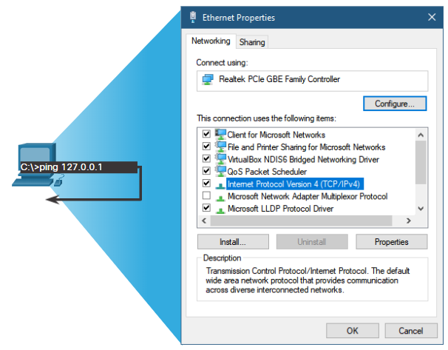
Ping and Traceroute Utilities Ping the Loopback
Ping can be used to test the internal configuration of IPv4 or IPv6 on the local host.
To perform this test, ping the local loopback address of 127.0.0.1 for IPv4 (::1 for IPv6).
A response from 127.0.0.1 for IPv4, or ::1 for IPv6, indicates that IP is properly installed on the host. This response comes from the network layer.
This response tests IP down through the network layer of IP.
An error message indicates that TCP/IP is not operational on the host.
Pinging the local host confirms that TCP/IP is installed and working on the local host.
Pinging 127.0.0.1 causes a device to ping itself.
Notes:
7 – Connectivity Verification
7.2 – Ping and Traceroute Utilities
7.2.3 – Ping the Loopback

Slide 24
Ping and Traceroute Utilities Ping the Default Gateway
The ping can be used to test the ability of a host to communicate on the local network. This is done by pinging the IP address of the default gateway of the host.
A successful ping to the default gateway indicates that the host and the router interface serving as the default gateway are both operational on the local network.
For this test, the default gateway address is mostly used as the router is always operational. If the default gateway address does not respond, a ping can be sent to the IP address of another host on the local network that is operational.
If either the default gateway or another host responds, then the local host can successfully communicate over the local network.
If the default gateway does not respond but another host does, this could indicate a problem with the router interface serving as the default gateway.
One possibility is that the wrong default gateway address been configured on the host or the router interface may be fully operational but have security applied to it.
Notes:
7 – Connectivity Verification
7.2 – Ping and Traceroute Utilities
7.2.4 – Ping the Default Gateway

Slide 25
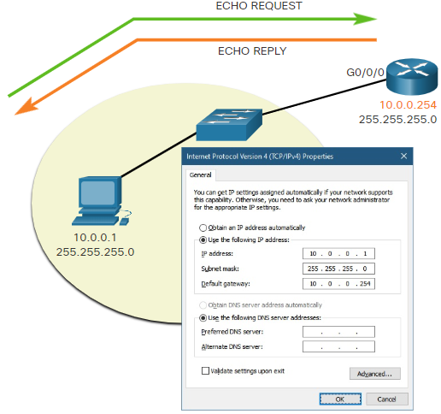
Ping and Traceroute Utilities Ping the Default Gateway (Contd.)
The host pings its default gateway, sending an ICMP echo request. The default gateway sends an echo reply confirming connectivity.
Notes:
7 – Connectivity Verification
7.2 – Ping and Traceroute Utilities
7.2.4 – Ping the Default Gateway

Slide 26
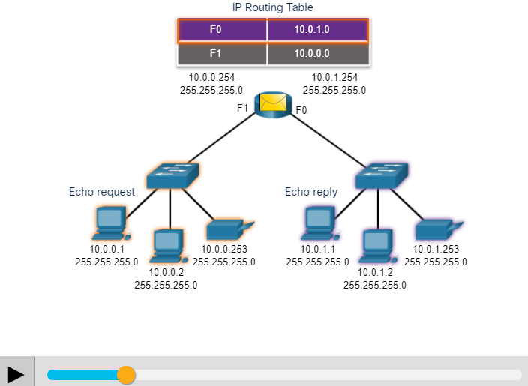
Ping and Traceroute Utilities Ping a Remote Host
Ping can also be used to test the ability of a local host to communicate across an internetwork. The local host can ping an operational IPv4 host of a remote network.
The router uses its IP routing table to forward the packets.
If this ping is successful, the operation of a large piece of the internetwork and the functionality of the remote host can be verified.
A successful ping across the network confirms communication on the local network, the operation of the router as the default gateway, and the operation of all other routers in the path between the local network and the network of the remote host.
Notes:
7 – Connectivity Verification
7.2 – Ping and Traceroute Utilities
7.2.5 – Ping a Remote Host

Slide 27
Ping and Traceroute Utilities Traceroute - Test the Path
Ping is used to test connectivity between two hosts but does not provide information about the details of devices between the hosts.
Traceroute (tracert) is a utility that generates a list of hops that were successfully reached along the path. This list can provide important verification and troubleshooting information.
If the data reaches the destination, then the trace lists the interface of every router in the path between the hosts.
If the data fails at some hop along the way, the address of the last router that responded to the trace can provide an indication of where the problem or security restrictions are found.
Notes:
7 – Connectivity Verification
7.2 – Ping and Traceroute Utilities
7.2.6 – Traceroute - Test the Path

Slide 28
Ping and Traceroute Utilities Traceroute - Test the Path (Contd.)
Round Trip Time (RTT)
The traceroute provides a round-trip time for each hop along the path and indicates if a hop fails to respond.
The round-trip time is the time a packet takes to reach the remote host and for the response from the host to return.
An asterisk (*) is used to indicate a lost or unreplied packet.
This information can be used to locate a problematic router in the path or may indicate that the router is configured not to reply.
If the display shows high response times or data losses from a particular hop, this is an indication that the resources of the router or its connections may be overused.
Notes:
7 – Connectivity Verification
7.2 – Ping and Traceroute Utilities
7.2.6 – Traceroute - Test the Path

Slide 29
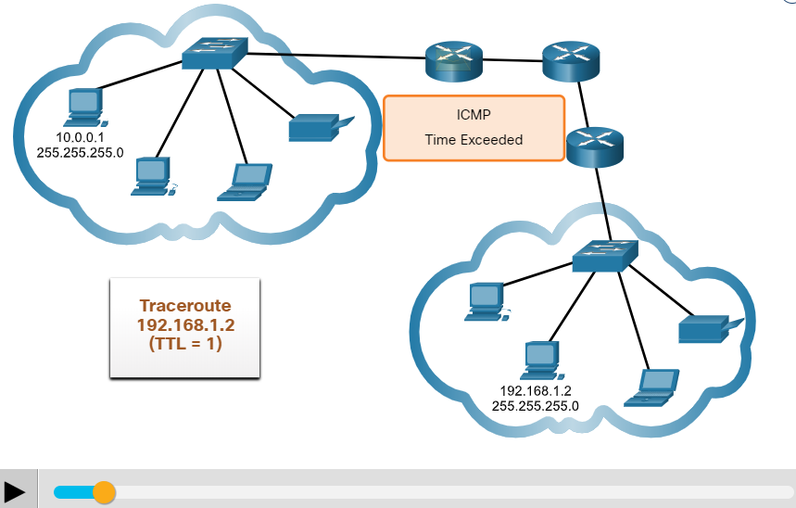
Ping and Traceroute Utilities Traceroute - Test the Path (Contd.)
IPv4 TTL and IPv6 Hop Limit: Traceroute uses the function of the TTL field in IPv4 and the Hop Limit field in IPv6 in the Layer 3 headers, along with the ICMP Time Exceeded message.
The first sequence of messages sent from traceroute have a TTL field value of 1 which causes the TTL to time out the IPv4 packet at the first router. This router then responds with an ICMPv4 Time Exceeded message. Traceroute now has the address of the first hop.
Traceroute then progressively increments the TTL field (2, 3, 4...) for each sequence of messages. This provides the trace with the address of each hop as the packets time out further down the path. The TTL field continues to be increased until the destination is reached.
After the final destination is reached, the host responds with either an ICMP Port Unreachable message or an ICMP Echo Reply message instead of the ICMP Time Exceeded message.
Notes:
7 – Connectivity Verification
7.2 – Ping and Traceroute Utilities
7.2.6 – Traceroute - Test the Path

Slide 30
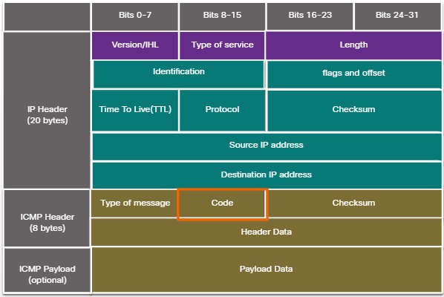
Ping and Traceroute Utilities ICMP Packet Format
ICMP is encapsulated directly into IP packets.
ICMP acts as a data payload within the IP packet. It has a special header data field.
It uses message codes to differentiate between different types of ICMP messages. These are some common message codes:
0 – Echo reply (response to a ping)
3 – Destination Unreachable
5 – Redirect (use another route to the destination)
8 – Echo request (for ping)
11 – Time Exceeded (TTL became 0)
Notes:
7 – Connectivity Verification
7.2 – Ping and Traceroute Utilities
7.2.7 – ICMP Packet Format

Slide 31
Ping and Traceroute Utilities Packet Tracer – Verify IPv4 and IPv6 Addressing
In this Packet Tracer, you will do the following:
Verify IPv4 and IPv6 addressing configuration.
Test connectivity with Ping and Tracert.
Notes:
7 – Connectivity Verification
7.2 – Ping and Traceroute Utilities
7.2.8 – Packet Tracer – Verify IPv4 and IPv6 Addressing

Slide 32
7.3 Connectivity Verification Summary
Notes:
Source:
7 – Connectivity Verification
7.3 – Connectivity Verification Summary
In-Session Activities / Explanations:
Time: 10 min
Instructor Notes:
Read out the summary points mentioned on the slide.
Discuss the same with the participants.
Ask if they have any questions or doubts.
At the end, ask the students to take the quiz.
Key Points: NA

Slide 33
Connectivity Verification Summary
What Did I Learn in this Module?
The TCP/IP suite sends ICMP messages when IP packets encounter forwarding problems.
ICMPv4 is the messaging protocol for IPv4, while ICMPv6 provides these same services for IPv6 and includes additional functionality.
ICMP messages that are common to both ICMPv4 and ICMPv6 include host confirmation, destination or service unreachable, time exceeded, and route redirection.
ICMPv6 includes the additional four ICMPv6 messages for the Neighbor Discovery Protocol (NDP).
These messages are router solicitation (RS) and router advertisements (RA) messages that are sent between IPv6 routers and IPv6 hosts, and neighbor solicitation (NS) and neighbor advertisement (NA) messages that are sent between IPv6 devices.
Notes:
7 – Connectivity Verification
7.3 – Connectivity Verification Summary
7.3.1 – What Did I Learn in this Module?

Slide 34
Connectivity Verification Summary
What Did I Learn in this Module? (Contd.)
Ping is an IPv4 and IPv6 testing utility that uses ICMP echo request and echo reply messages to test connectivity between hosts.
Some of the types of connectivity tests that are performed with ping include pinging the local loopback, pinging the default gateway, and pinging a remote host.
Traceroute (tracert) is a utility that generates a list of the router hops that were successfully reached along a path.
Traceroute makes use of a function of the TTL field in IPv4 and the Hop Limit field in the IPv6 Layer 3 headers, along with the ICMP Time Exceeded message.
ICMP is encapsulated directly into IP packets as the data payload. The ICMP data payload contains special header data fields.
Notes:
7 – Connectivity Verification
7.3 – Connectivity Verification Summary
7.3.1 – What Did I Learn in this Module?
7.3.2 – Module 7: Connectivity Verification Quiz

Slide 35
Module 7 New Terms and Commands
ICMP Echo Message Time to Live (TTL) Neighbor Discovery Protocol (ND or NDP) Router Solicitation (RS) message Router Advertisement (RA) message Stateless Address Auto Configuration (SLAAC) | Duplicate Address Detection (DAD) Ping Traceroute (tracert) Round Trip Time (RTT) Hop Limit
Notes:
7 – Connectivity Verification
New Terms and Commands

