Slide 1
Module 8: Address Resolution Protocol
Instructor Materials
CyberOps Associate v1.0
Notes:
Cisco Networking Academy Program
CyberOps Associates v1.0
Module 8: Address Resolution Protocol

Slide 2
Instructor Materials – Module 8 Planning Guide
This PowerPoint deck is divided in two parts:
Instructor Planning Guide
Information to help you become familiar with the module
Teaching aids
Instructor Class Presentation
Optional slides that you can use in the classroom
Begins on slide # 7
Note: Remove the Planning Guide from this presentation before sharing with anyone.
For additional help and resources go to the Instructor Home Page and Course Resources for this course. You also can visit the professional development site on www.netacad.com, the official Cisco Networking Academy Facebook page, or Instructor Only FB group.
Notes:
2

Slide 3
What to Expect in this Module
To facilitate learning, the following features within the GUI may be included in this module:
Feature | Description
Animations | Expose learners to new skills and concepts.
Videos | Expose learners to new skills and concepts.
Hands-On Labs | Labs designed for working with physical equipment.
Module Quizzes | Self-assessments that integrate concepts and skills learned throughout the series of topics presented in the module.
Module Summary | Briefly recaps module content.

Slide 4
Check Your Understanding
Check Your Understanding activities are designed to let students quickly determine if they understand the content and can proceed, or if they need to review.
Check Your Understanding activities do not affect student grades.
There are no separate slides for these activities in the PPT. They are listed in the notes area of the slide that appears before these activities.
Notes:
4

Slide 5
Module 8: Activities
What activities are associated with this module?
Page # | Activity Type | Activity Name | Optional?
8.2.2 | Animation | ARP Functions | Recommended
8.2.3 | Video | ARP Operation - ARP Request | Recommended
8.2.4 | Video | ARP Operation - ARP Reply | Recommended
8.2.5 | Video | ARP Role in Remote Communication | Recommended
8.2.8 | Lab | Wireshark to Examine Ethernet Frames | Recommended
8.3.2 | Video | ARP Spoofing | Recommended
Notes:
5

Slide 6
Module 8: Best Practices
Prior to teaching Module 8, the instructor should:
Review the activities and assessments for this module.
Try to include as many questions as possible to keep students engaged during classroom presentation.
Topic 8.1
Ask the class if they are familiar with IP addresses. If so, ask them to provide their thoughts on the same and write on a whiteboard and build a mind map.
Define the primary addresses on Ethernet and describe the communication process on a local network
Demonstrate a video to the class on ARP Request and have a discussion on the same.
Demonstrate a video to the class on ARP Reply and have a discussion on the same.
Notes:
6

Slide 7
Module 8: Best Practices
Topic 8.2
Provide a recap on ARP and then introduce the ARP issues.
Demonstrate a video to the class on ARP spoofing and have a discussion on the same.
Explain ARP broadcasts by illustrating its diagram on the whiteboard with its icons.
Notes:
7

Slide 8
Module 8: Address Resolution Protocol
CyberOps Associate v1.0
Notes:
Cisco Networking Academy Program
CyberOps Associates v1.0
Module 8 : Address Resolution Protocol
In-Session Activities / Explanations:
Time: 5 min
Instructor Notes:
Welcome the audience in a warm and cordial manner. Ensure that everyone is set up with the required resources.
Introduce the topic and encourage learners to come up with a list of expectations from the session. Collate topics on the white board or Desktop while using learner’s inputs to interpret them in words.
Before reading the objectives, familiarize the learners with the basics of IP addresses and MAC addresses and their roles in Address Resolution Protocol (ARP).
Read out the Objectives and briefly describe each.
Key Points: NA

Slide 9
Module Objectives
Module Title: Address Resolution Protocol
Module Objective: Analyze address resolution protocol PDUs on a network.
Topic Title | Topic Objective
MAC and IP | Compare the roles of the MAC address and the IP address.
ARP | Analyze ARP by examining Ethernet frames.
ARP Issues | Explain how ARP requests impact network and host performance as well as potential security risks.
Notes:
9
CyberOps Associates v1.0
8 – Address Resolution Protocol
8.0 – Introduction
8.0.2– What Will I Learn in this Module?

Slide 10
8.1 MAC and IP
Notes:
Source:
8 – Address Resolution Protocol
8.1 – MAC and IP
In-Session Activities / Explanations:
Time: 25 min
Instructor Notes:
Describe the process of communication on a local network
Describe the process of communication on a remote network
Key Points: IP Address, MAC Address

Slide 11
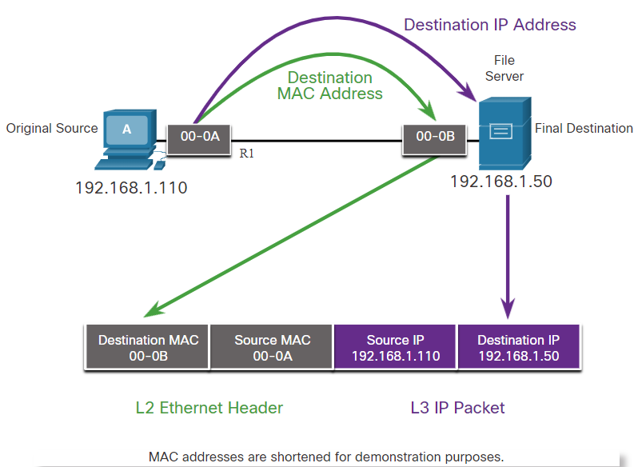
Address Resolution Protocol Destination on Same Network
The two primary addresses assigned to a device on an Ethernet LAN:
Primary Addresses on Ethernet LAN | Description
Physical Address (The Mac Address) | Used for Ethernet NIC to Ethernet NIC communications on the same network. If the destination IP address is on the same network, the destination MAC address will be that of the destination device.
Logical Address (The IP Address) | Used to send the packet from the original source to the final destination. The destination IP address may be on the same IP network as the source or may be on a remote network.
Communicating on a local network
Note: Most applications use Domain Name System (DNS) to determine the IP address when given a domain name such as www.cisco.com.
Notes:
8 – Address Resolution Protocol
8.1 – MAC and IP
8.1.1 – Destination on Same Network

Slide 12
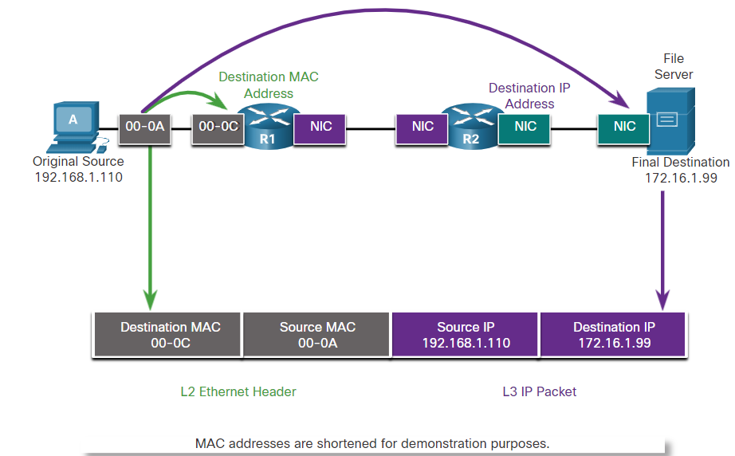
Address Resolution Protocol Destination on Remote Network
When the destination IP address is on a remote network, the destination MAC address will be the address of the host’s default gateway. The process in the figure is as below:
Routers examine the destination IPv4 address.
When the router receives the Ethernet frame, it de-encapsulates the Layer 2 information.
Using the destination IP address, the router determines the next-hop device, and then encapsulates the IP packet in a new data link frame for the outgoing interface.
If the next-hop device is the final destination, the destination MAC address will be that of the device’s Ethernet NIC.
Communicating on a remote network
Notes:
8 – Address Resolution Protocol
8.1 – MAC and IP
8.1.2 – Destination on Remote Network

Slide 13
8.2 ARP
Notes:
Source:
8 – Address Resolution Protocol
8.2 – ARP
In-Session Activities / Explanations:
Time: 15 min
Instructor Notes:
Provide an overview of ARP
Play the animation to view the ARP functions
Explain the ARP operation
Demonstrate a video to the learners to explain the ARP role in remote communication
Explain the process of removing entries from the ARP table
List the commands used to display the ARP tables on different networking devices
Key Points: ARP Operations, ARP Table, ARP Functions

Slide 14
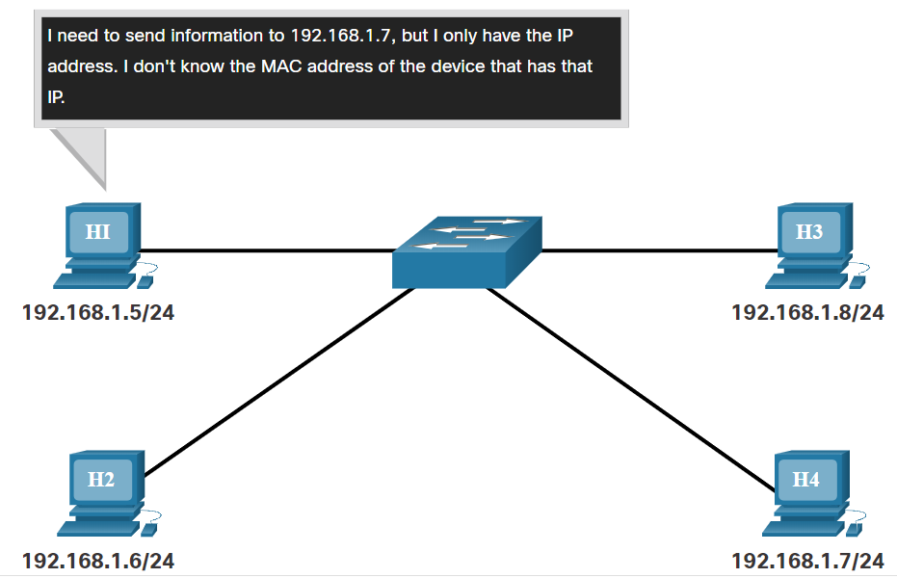
ARP ARP Overview
The figure illustrates a problem while sending a packet to another host on the same local IPv4 network because the IP address is known but the MAC address of the device is unknown.
A device uses Address Resolution Protocol (ARP) to determine the destination MAC address of a local device when it knows its IPv4 address.
ARP provides two basic functions:
Resolving IPv4 addresses to MAC addresses
Maintaining a table of IPv4 to MAC address mappings
Notes:
8 – Address Resolution Protocol
8.2 – ARP
8.2.1 – ARP Overview

Slide 15
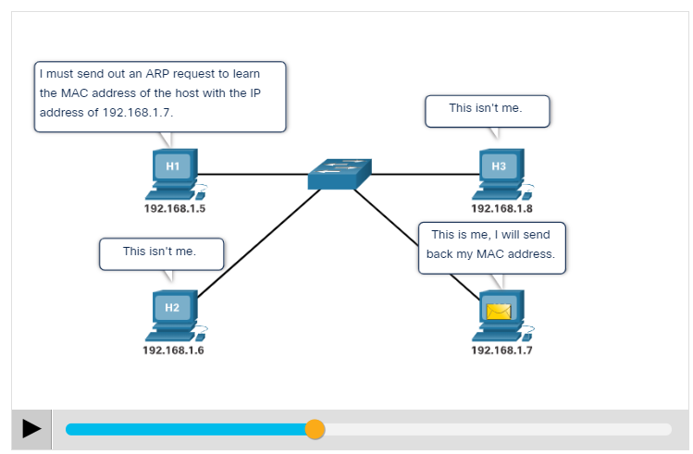
ARP ARP Functions
When a packet is sent to the data link layer to be encapsulated into an Ethernet frame, the device refers to a table called ARP table or ARP cache in its RAM memory to find the MAC address that is mapped to the IPv4 address.
The sending device will search its ARP table for a destination IPv4 address and a corresponding MAC address, if the packet’s destination IPv4 address is on the same network as the source IPv4 address.
If the device locates the IPv4 address, its corresponding MAC address is used as the destination MAC address in the frame.
Click play in the figure to see an animation of the ARP function.
Notes:
8 – Address Resolution Protocol
8.2 – ARP
8.2.2 – ARP Functions

Slide 16
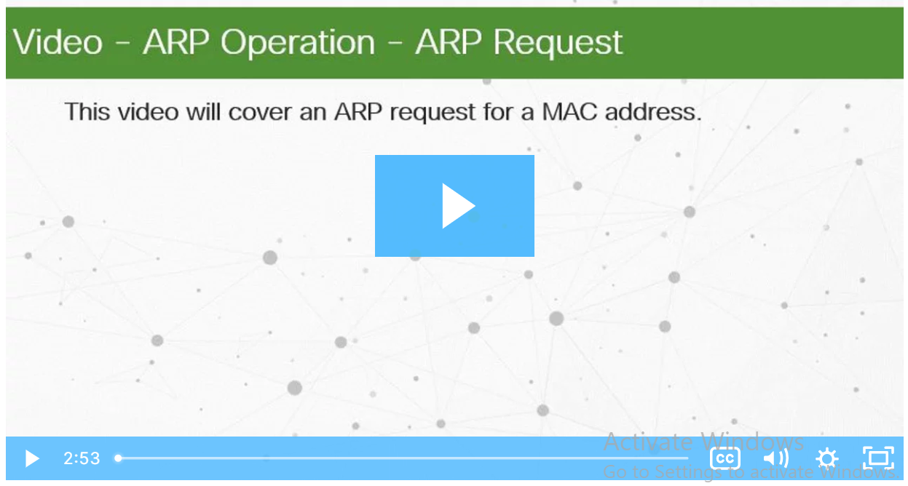
ARP Video - ARP Operation - ARP Request
When a device needs to determine the MAC address mapped to the IPv4 address and no entry is found for the IPv4 address in its ARP table, then an ARP request is sent.
Click Play to view a demonstration of an ARP request for a destination IPv4 address that is on the local network.
Notes:
8 – Address Resolution Protocol
8.2 – ARP
8.2.3 – Video - ARP Operation - ARP Request

Slide 17
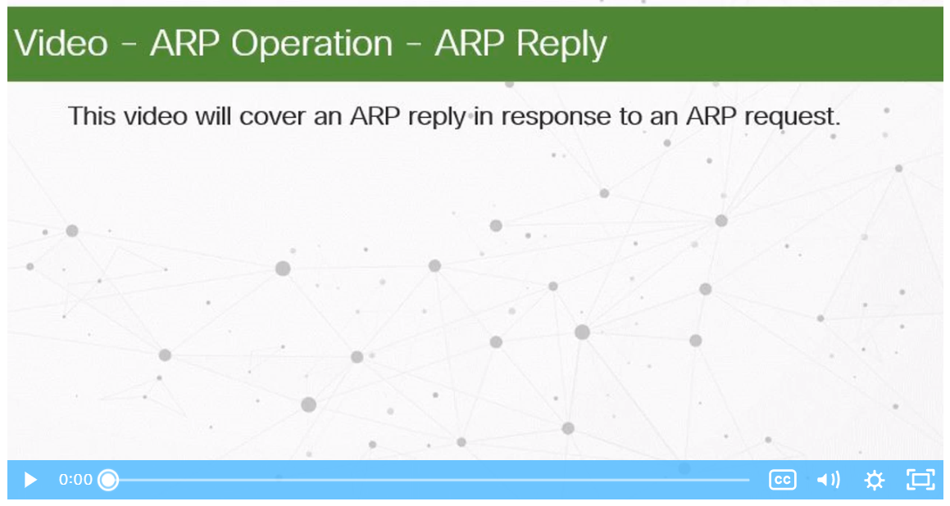
ARP Video - ARP Operation - ARP Reply
Only the device with the target IPv4 address associated with the ARP request will respond with an ARP reply.
Click Play in the figure to view a demonstration of an ARP reply.
Note: IPv6 uses a similar process to ARP for IPv4, known as ICMPv6 Neighbor Discovery (ND). IPv6 uses neighbor solicitation and neighbor advertisement messages, similar to IPv4 ARP requests and ARP replies.
Notes:
8 – Address Resolution Protocol
8.2 – ARP
8.2.4 – Video - ARP Operation - ARP Reply

Slide 18
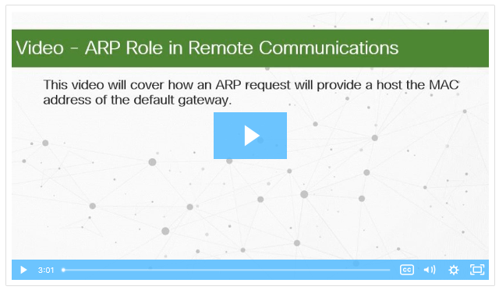
ARP Video - ARP Role in Remote Communication
Click Play to view a demonstration of an ARP request and ARP reply associated with the default gateway.
Notes:
8 – Address Resolution Protocol
8.2 – ARP
8.2.5 – Video - ARP Role in Remote Communication

Slide 19
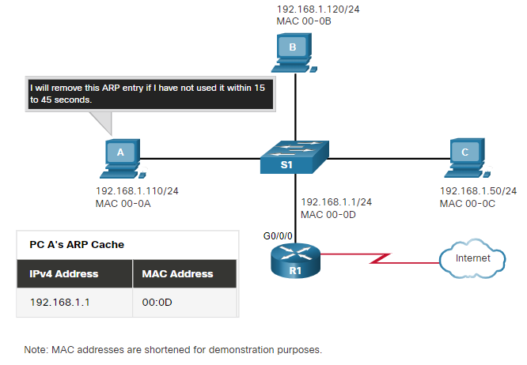
ARP Removing Entries from an ARP Table
For each device, an ARP cache timer removes the ARP entries that have not been used for a specified period of time.
The times differ depending on the operating system of the device.
Commands may also be used to manually remove some or all of the entries in the ARP table.
After an entry has been removed, the process for sending an ARP request and receiving an ARP reply must occur again to enter the map in the ARP table.
Notes:
8 – Address Resolution Protocol
8.2 – ARP
8.2.6 – Removing Entries from an ARP Table

Slide 20
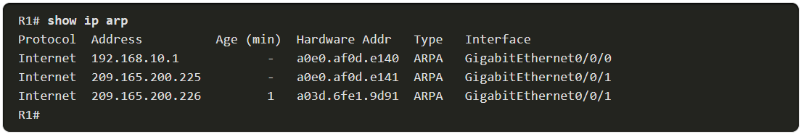
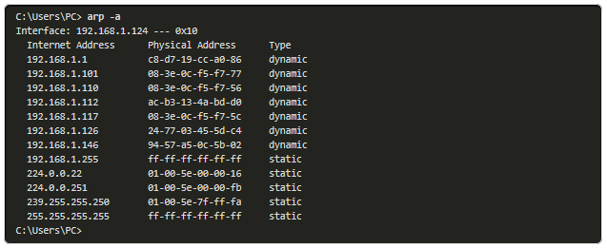
ARP ARP Tables on Networking Devices
On a Cisco router, the show ip arp command is used to display the ARP table.
On a Windows 10 PC, the arp –a command is used to display the ARP table.
Notes:
8 – Address Resolution Protocol
8.2 – ARP
8.2.7 – ARP Tables on Networking Devices

Slide 21
ARP Lab - Wireshark to Examine Ethernet Frames
In this lab, you will do the following:
Use Wireshark to capture and view Ethernet Frames in order to investigate ARP and IP and MAC addressing.
Capture and analyze ICMP frames.
Notes:
8 – Address Resolution Protocol
8.2 – ARP
8.2.8 – Lab - Wireshark to Examine Ethernet Frames

Slide 22
8.3 ARP Issues
Notes:
Source:
8 – Address Resolution Protocol
8.3 – ARP Issues
In-Session Activities / Explanations:
Time: 7 min
Instructor Notes:
Describe ARP broadcasts with an example
Discuss ARP spoofing with an example
Key Points: ARP Broadcasts, ARP Spoofing

Slide 23
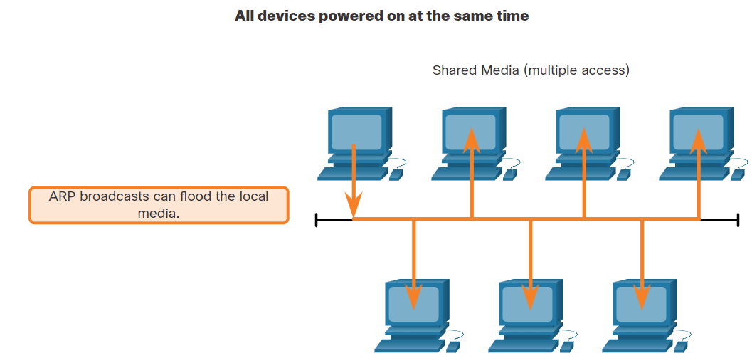
ARP Issues ARP Issues - ARP Broadcasts and ARP Spoofing
ARP Broadcasts
As a broadcast frame, an ARP request is received and processed by every device on the local network.
On a typical business network, these broadcasts would have minimal impact on network performance.
If many devices start accessing network services at the same time, there can be reduction in performance for a short time.
After the devices send out the initial ARP broadcasts and have learned the necessary MAC addresses, any impact on the network will be minimized.
Notes:
8 – Address Resolution Protocol
8.3 – ARP Issues
8.3.1 – ARP Issues - ARP Broadcasts and ARP Spoofing

Slide 24
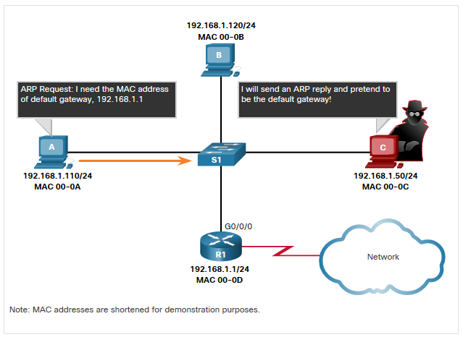
ARP Issues ARP Issues - ARP Broadcasts and ARP Spoofing (Contd.)
ARP Spoofing
The use of ARP can lead to a potential security risk in some cases.
A threat actor uses ARP spoofing to perform an ARP poisoning attack.
It is a technique used by a threat actor to reply to an ARP request for an IPv4 address belonging to another device, such as the default gateway.
The threat actor sends an ARP reply with its own MAC address.The receiver of the ARP reply will add the wrong MAC address to its ARP table and send these packets to the threat actor.
Notes:
8 – Address Resolution Protocol
8.3 – ARP Issues
8.3.1 – ARP Issues - ARP Broadcasts and ARP Spoofing

Slide 25
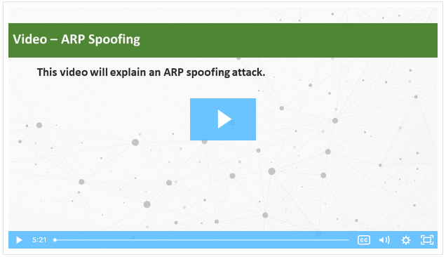
ARP Issues Video - ARP Spoofing
Click Play in the figure to view a video about ARP Spoofing.
Notes:
8 – Address Resolution Protocol
8.3 – ARP Issues
8.3.2 – Video - ARP Spoofing

Slide 26
8.4 Address Resolution Protocol Summary
Notes:
Source:
8 – Address Resolution Protocol
8.4 – Address Resolution Protocol Summary
In-Session Activities / Explanations:
Time: 5 min
Instructor Notes:
Read out the summary points mentioned on the slide.
Discuss the same with the participants.
Ask if they have any questions or doubts.
At the end, ask the students to complete the module quiz.
Key Points: NA

Slide 27
Module Summary and Quiz What Did I Learn in this Module?
IP addresses are used to identify the address of the original source device and the final destination device.
MAC addresses are used to deliver the data link frame with the encapsulated IP packet from one NIC to another NIC on the same network.
ARP is used to map the logical IPv4 address with the Layer 2 MAC address.
ARP provides two basic functions: resolving IPv4 addresses to MAC addresses and maintaining a table of IPv4 to MAC address mappings.
When the destination IPv4 address is on the same network as the source, the ARP process sends the IPv4 address to all hosts on the network so that the host with the matching IPv4 address can reply with the corresponding MAC address
If the packet’s destination IPv4 address is on the same network as the source IPv4 address, the device will search the ARP table for the destination IPv4 address.
Notes:
Source:
8 – Address Resolution Protocol
8.4 – Address Resolution Protocol Summary
8.4.1 – What Did I Learn in this Module?

Slide 28
Module Summary and Quiz What Did I Learn in this Module? (Contd.)
If there is no entry for the IPv4 address in its ARP table, the sending device sends out an ARP request to determine the destination MAC address.
Only the device with the target IPv4 address associated with the ARP request will respond with an ARP reply.
In IPv6, ICMPv6 Neighbor Discovery (ND) is used.
As a broadcast frame, an ARP request is received and processed by every device on the local network.
A threat actor can use ARP spoofing to perform an ARP poisoning attack by replying to an ARP request for an IPv4 address belonging to another device, such as the default gateway.
Notes:
Source:
8 – Address Resolution Protocol
8.4 – Address Resolution Protocol Summary
8.4.1 – What Did I Learn in this Module?
8.4.2 – Module 8: Address Resolution Protocol Quiz

Slide 29
Module 8 New Terms and Commands
IP Address MAC Address Address Resolution Protocol (ARP) Dynamic ARP Inspection (DAI) | ARP Table ARP Broadcast ARP Spoofing Neighbor Discovery (ND)
Notes:
Module 8 – Address Resolution Protocol
New Terms and Commands

