Slide 1
Rough Draft PPT

Slide 2
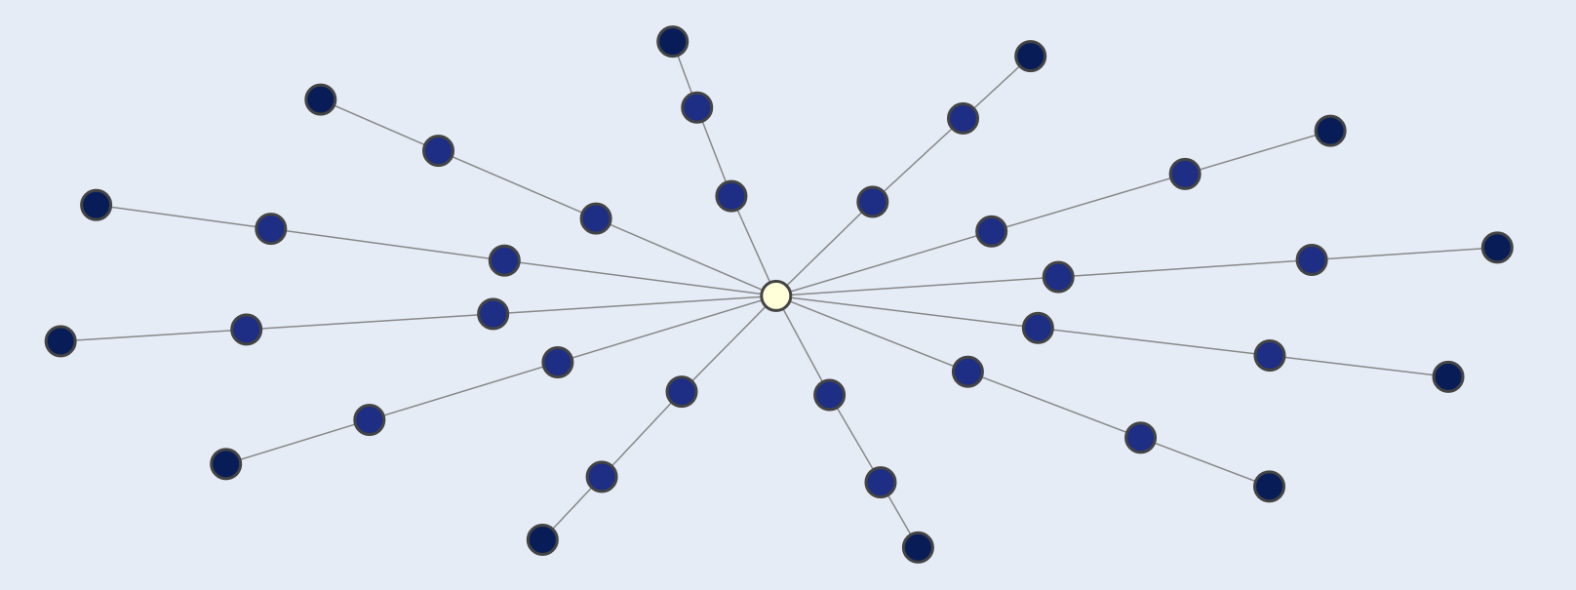
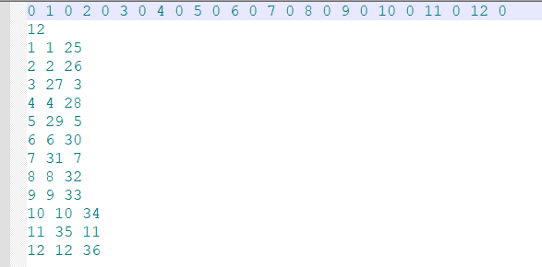
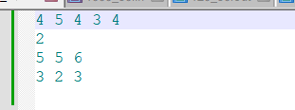
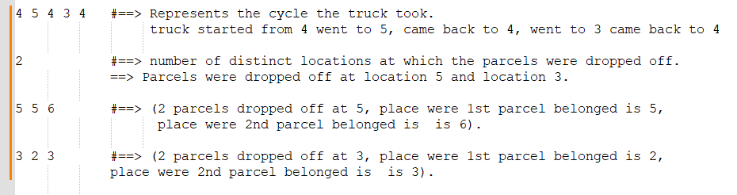
ILP Graph Type 1
120_50_v2.in

Slide 3
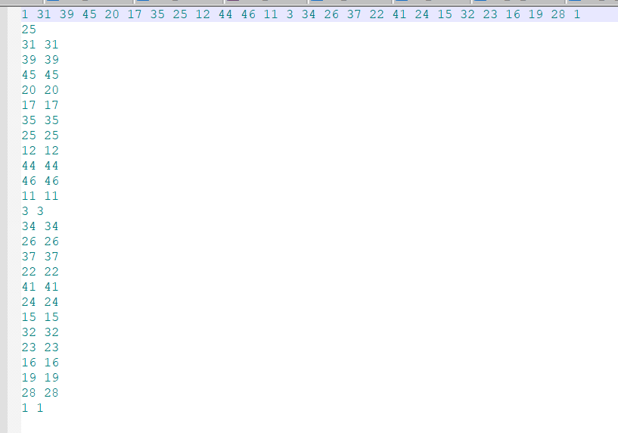
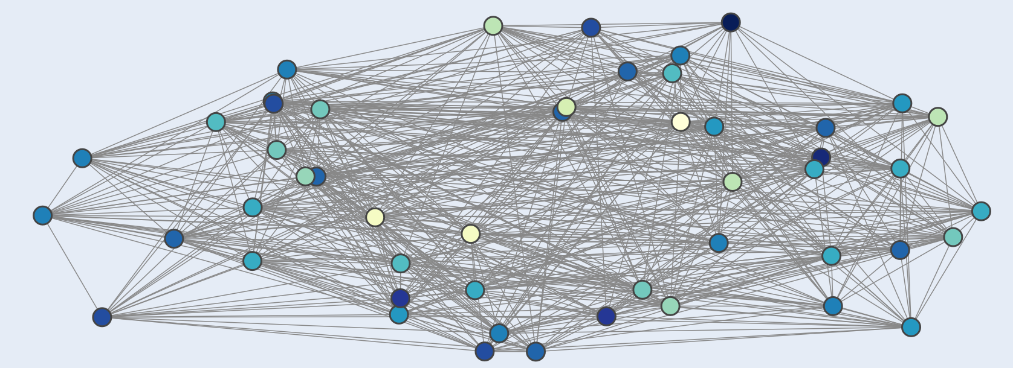
ILP Graph Type 2
1_50.in

Slide 4
Objective function (should I mention??)
2/3rd of driving cost + walking cost
1. Process input file to get the information in it
2. Create a graph from adjacency matrix (network x) and convert drop-off locations to indices
4. Compute Articulation Map
5. Semi-tree Algorithm
9. Generate total expenditure
8. Validate output
7. Fine-tune ILP solution (Heuristic)
6. Invoke Integer Linear programming (ILP) solver
Notes:
Location to indices : This step maps the given list of homes/hubs and the starting truck location to their respective indices in the graph. This conversion is necessary for processing and solving the problem using graph algorithms.
1. Convert input file to adjacency matrix:
Extract the total number of locations from the first element of input_data and convert it to an integer.
Extract the total number of houses from the second element of input_data and convert it to an integer.
Store the list of locations provided in the third element of input_data.
Store the list of houses provided in the fourth element of input_data.
Extract the starting location from the fifth element of input_data and convert it to an integer.
Process the remaining rows in input_data to create an adjacency matrix. For each row, replace 'x' with itself or convert other entries to float.
Finally, the function returns the extracted values: number_of_locations, number_of_houses, list_of_locations, list_of_houses, starting_location, and adjacency_matrix. Adjacency matrix have the information about which nodes will have direct edges between them.
2. Create a graph from adjacency matrix (network x)
This step transforms the input problem into a graph representation.
Modeling the problem as a graph allows us to leverage graph algorithms and techniques,
making it easier to find an optimal or near-optimal solution.
3. Convert location to indices: The line stas = set([list_of_locations.index(h) for h in list_of_homes]) converts the list of home names
(list_of_homes) into a set of indices. It does this by iterating through each home name (h) in the list_of_homes and finding
its index in the list_of_locations. This set of indices, called stas, represents the target locations
(homes) in the graph. This conversion is necessary for processing and solving the problem using graph algorithms.
Semitree algorithm: The idea here was to leverage the articulation points and biconnected components to decompose the graph into smaller subproblems.
Initialize lists to store the subproblem solutions (locations and drop-offs).
2. Loop through the biconnected components and corresponding subgraphs related to the current articulation point (sloc). 2a. Identify the target locations in the current subgraph. 2b. Handle cases where there are no or only one or two target locations in the subgraph. 2c. If there are more target locations, proceed to further decompose the problem: 2e. Create a biconnected graph for the current component. 2f. Identify the target locations within the biconnected graph. 2g. Initialize dictionaries and sets for mapping fake target locations to original ones and storing recursive results. 2h. Iterate through the articulation points in the current subgraph, converting them into target locations or making recursive treesolve calls if necessary. 2i. Run the TSP solver (optitsp) on the biconnected graph and the identified target locations. 3. Stitch the solutions together by combining the results of the TSP solvers and the recursive treesolve calls. 4. Reconstruct the final solution by merging the subproblem solutions (locations and drop-offs) into a single list and dictionary, respectively. 5. Convert the drop-off sets to lists and return the final solution (list of locations and dictionary of drop-offs).

Slide 5
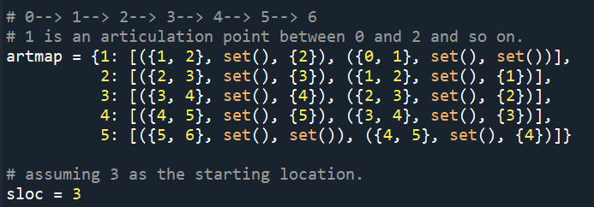
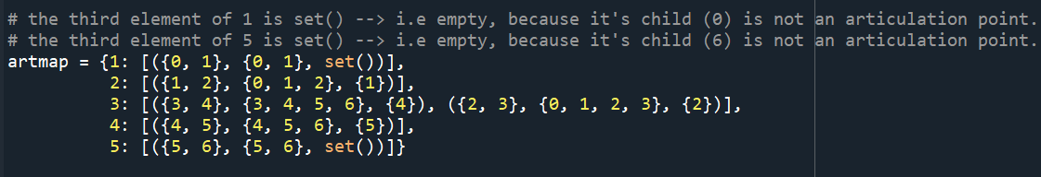
Articulation Maps
Find biconnected components
Identify articulation points
Initialize articulation map and include starting location
Use BFS to remove parent-child relationship between articulation points
DFS over articulation map to construct subgraphs associated with articulation points
Notes:
In the given algorithm, point 5 refers to removing parent-child relationships between articulation points in the articulation map. This step is necessary to ensure that the algorithm does not revisit the same subproblems multiple times, which could lead to inefficiency and redundant work.
In the initial articulation map example , we can see that each articulation point has a tuple with information about its neighboring biconnected components, subgraphs, and other articulation points connected to it. This representation maintains parent-child relationships between articulation points, which means that an articulation point (parent) will have information about its connected articulation point (child).
The BFS approach is used to remove these parent-child relationships to ensure that we only visit each articulation point once when generating subgraphs, avoiding redundant work.
After applying the BFS approach and DFS, the final articulation map represents an updated version of the initial articulation map where parent-child relationships are removed. This final map will be used by the algorithm to efficiently construct subgraphs associated with each articulation point without revisiting the same subproblems.
DFS: 1. Iterate through the tuples associated with the given starting location in the articulation map. 2. Update the subgraph with nodes from the biconnected component. 3. Recursively call the 'generateSubgraphsDFS' method for each child articulation point in the tuple. 4. Update the subgraph with nodes from the subgraphs of the child articulation points.
In the final articulation map, you can observe that the third element (the set of child articulation points) is empty for articulation points 1 and 5 because their children (0 and 6) are not articulation points. This indicates that the parent-child relationships have been removed as intended, ensuring that the algorithm will not revisit the same subproblems multiple times.
Subgraph: A subgraph associated with each articulation point is a smaller graph that is part of the original graph, containing the articulation point and the vertices and edges of the biconnected components connected to that articulation point. has been made to efficiently decompose the problem into smaller subproblems by leveraging biconnected components and articulation points in the graph. Decomposing the problem into smaller subproblems using biconnected components and articulation points in the graph has several advantages:
Computational efficiency: The TSP is an NP-hard problem, meaning that its time complexity grows exponentially with the number of nodes. By breaking down the problem into smaller subproblems, the overall computation time can be significantly reduced.
Optimal substructure: Biconnected components and articulation points help identify smaller subproblems with optimal substructure. By solving these subproblems optimally, we can construct a close-to-optimal solution for the original problem. This can lead to better performance compared to traversing the entire graph directly.
Divide and conquer: Decomposing the problem allows us to apply a divide-and-conquer strategy. This helps to manage complexity, making the problem easier to understand, debug, and optimize.

Slide 6
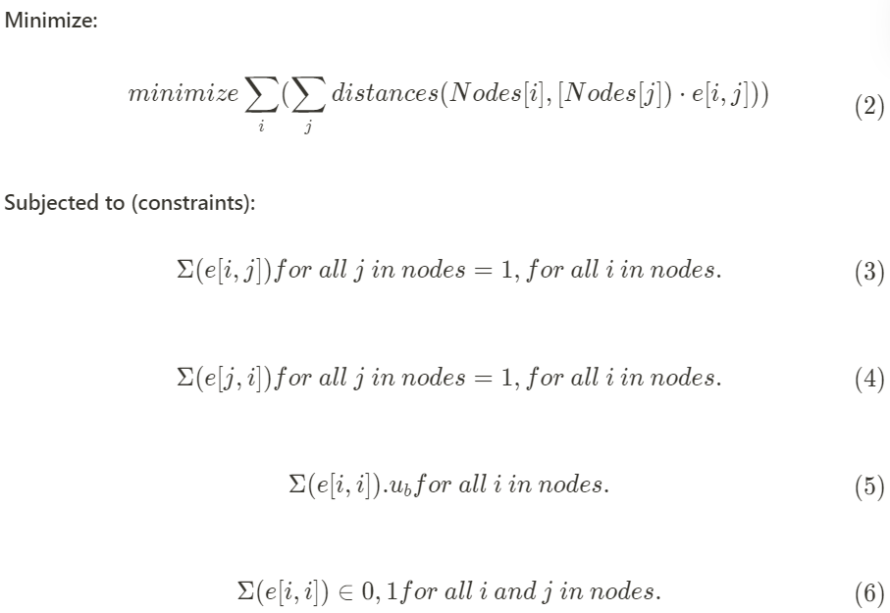
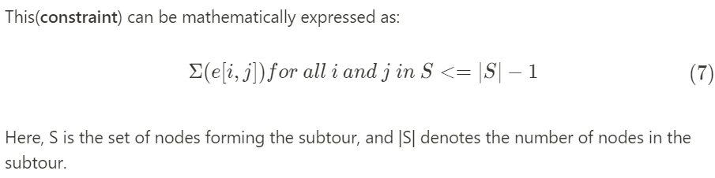
Integer Linear Programming
Decision Variables
Objective function
Degree-2 Constraints
No-self loop constraint
Subtour elimination (Lazy constraint)

Slide 7
Validate output
Following is validated:
Check if the number of dropoffs in the output matches the stated number of dropoffs.
Invalid dropoff locations.
Dropoff locations not in the car path.
Multiple dropoffs with the same location.
Dropoff with no students getting off.
Invalid target locations.
Targets that get off at multiple dropoffs.
Notes:
has been made to efficiently decompose the problem into smaller subproblems by leveraging biconnected components and articulation points in the graph. Decomposing the problem into smaller subproblems using biconnected components and articulation points in the graph has several advantages:
Computational efficiency: The TSP is an NP-hard problem, meaning that its time complexity grows exponentially with the number of nodes. By breaking down the problem into smaller subproblems, the overall computation time can be significantly reduced.
Optimal substructure: Biconnected components and articulation points help identify smaller subproblems with optimal substructure. By solving these subproblems optimally, we can construct a close-to-optimal solution for the original problem. This can lead to better performance compared to traversing the entire graph directly.
Divide and conquer: Decomposing the problem allows us to apply a divide-and-conquer strategy. This helps to manage complexity, making the problem easier to understand, debug, and optimize.
Subgraph: A subgraph associated with each articulation point is a smaller graph that is part of the original graph, containing the articulation point and the vertices and edges of the biconnected components connected to that articulation point.

Slide 8
Appendix

Slide 9
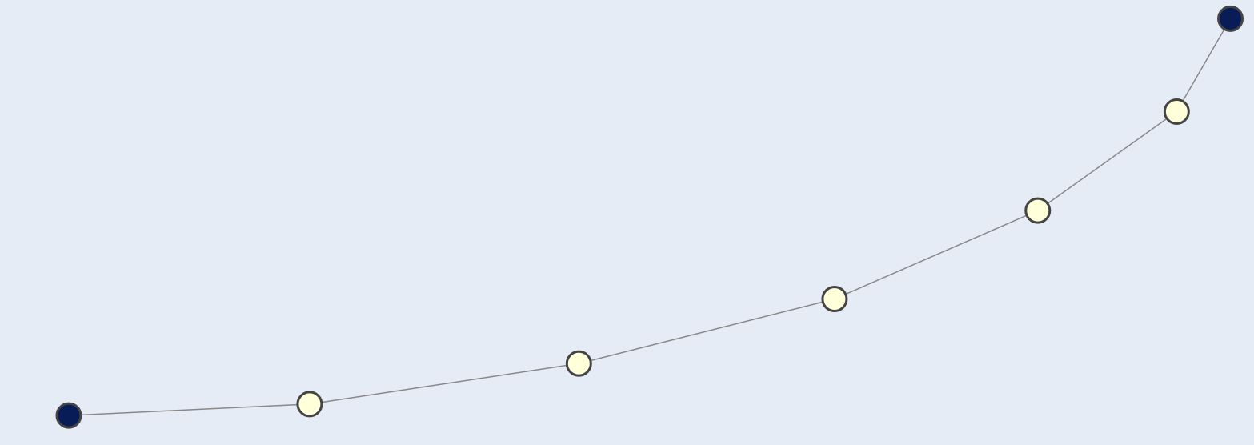
ILP Graph Type 1
120_50_v2.in
1000_50.in

Slide 10
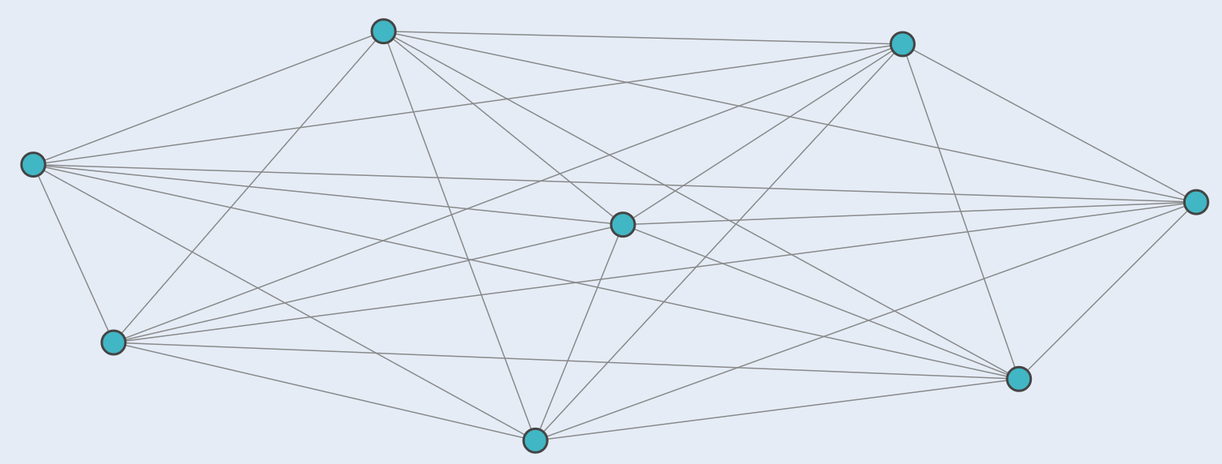
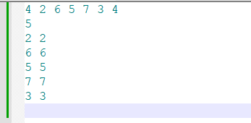
ILP Graph Type 2
1004_50_All_Connected.in
1_50.in

