Slide 1
Final Project Report Minimizing Energy Expended by a Parcel Delivery Truck
Christopher Hadler : hadler.c@northeastern.edu
Clara Wells : wells.cl@northeastern.edu
Shruti Saravanan : saravanan.s@northeastern.edu
Luv Verma : verma.lu@northeastern.edu

Slide 2
Content
Problem Introduction
Solutions Explored (ILP based TSP Solution, Christofide’s algorithm)
Output Discussion

Slide 3
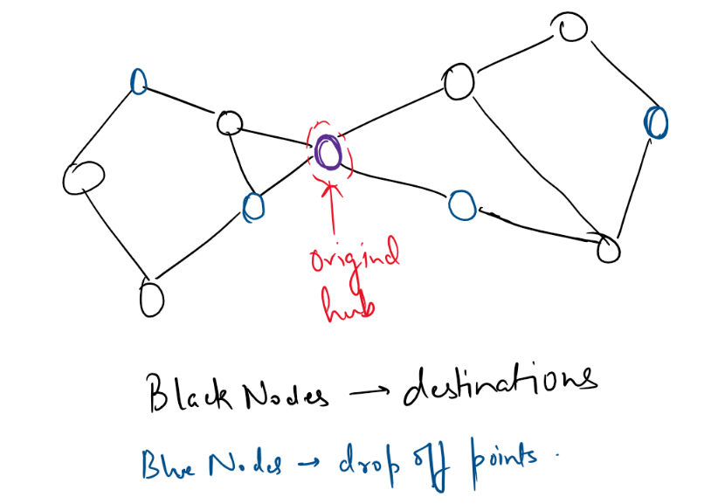
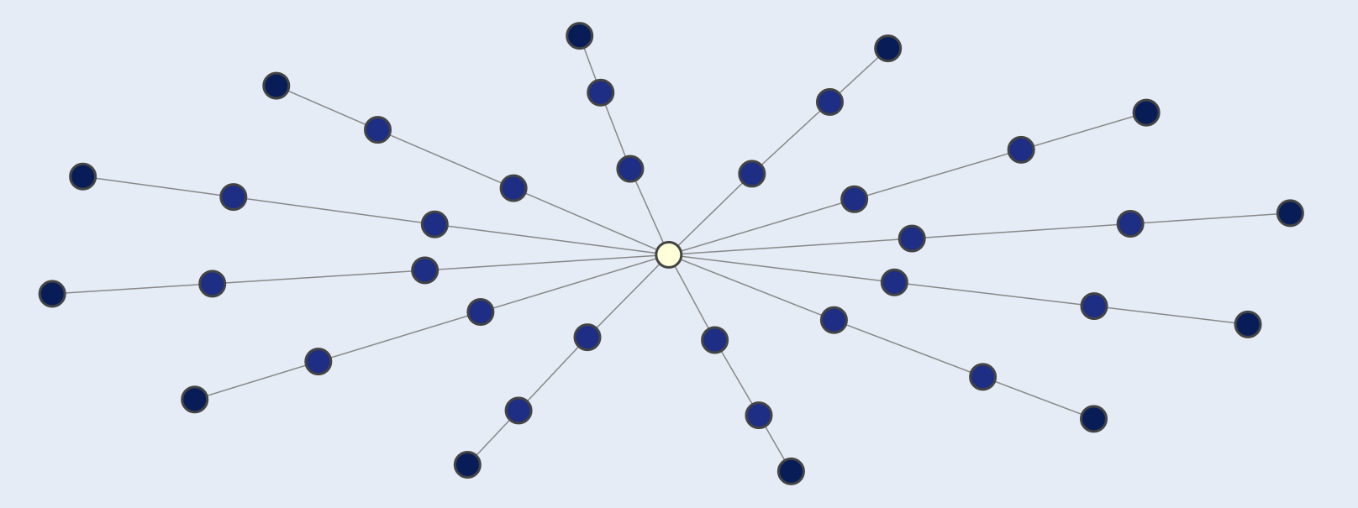
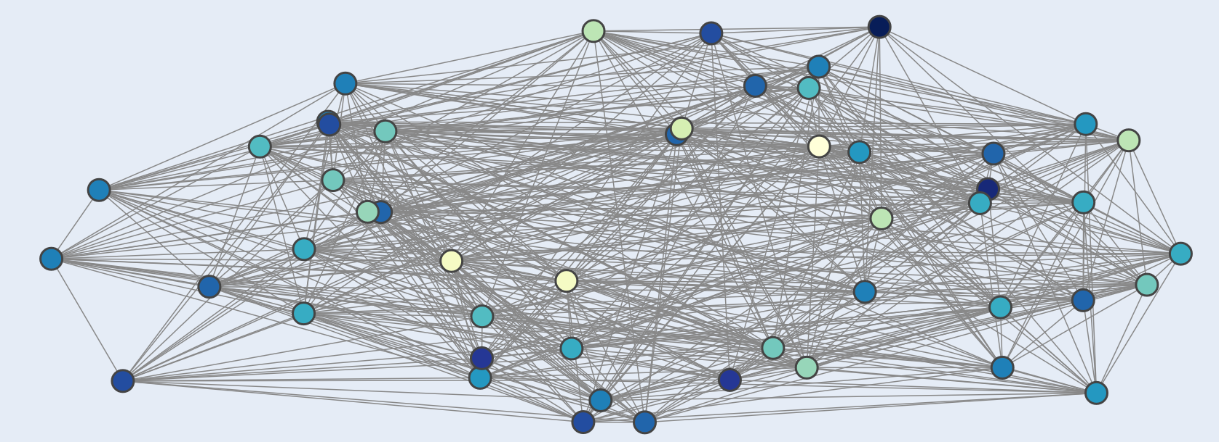
Problem Introduction
Parcel delivery by the delivery truck. Delivery as to be done at either local hubs/houses. Drop-off points are in blue below.
Destinations are the black node. Since, in the problem below, number of destinations are higher than the number of drop-off points, these drop-off points will have multiple parcels dropped off.
Problem: Total energy minimization (energy of the truck as well as the owner taking its parcel). Say energy consumed by truck is 2/3 units on the road length of 1 unit, however road lengths can be less than 21K Kms. Energy consumed by local owner taking the parcel from drop-off points(can be local hubs) is 1 unit (constant, not changing).
Indirectly, it can be formulated as a TSP problem, where we can plan the drop-offs in such a way that it is possible to minimize the sum of distances between the nodes travelled/included included in the tour.
Notes:
Objective function: 2/3rd of driving cost + walking cost

Slide 4
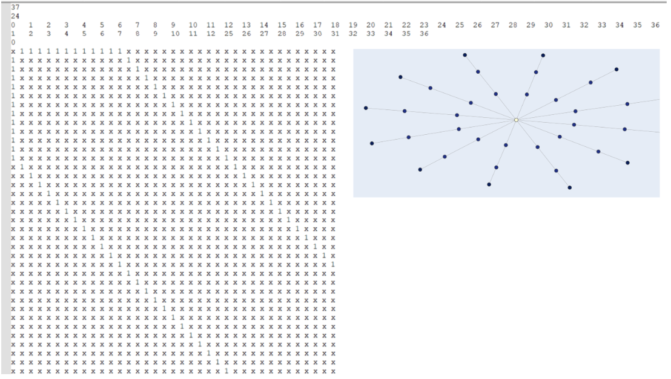
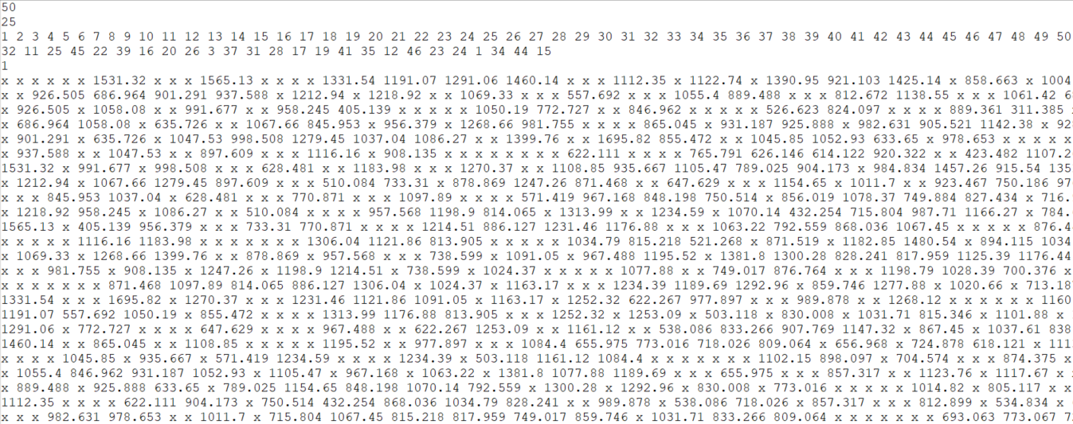
Input Format (specifically for/from TSP Solver)
Input Format:
Line 1: No. of locations (where parcel has to reach)
Line 2: No. of drop-off locations (home/local hub)
Line 3: Location/names
Line 4: Home/local hub/names (will be the subset of Line 3)
Line 5: Main hub (starting/ending point)
Remaining Lines: adjacency matrix representation of graph. Location I refers to the location name at index i. no road between two location is marked as ‘x’. If there is a direct route between two locations, that is marked as the length of the road. (For example in example shown all routes are marked as length of 1).

Slide 5
Overview of TSP Approach
Manipulating Data
Creating Subgraphs
Solving subgraphs and connecting them back
1. Process input file to get the information in it
2. Create a graph from adjacency matrix (network x) and convert drop-off locations to indices
3. Compute Articulation Map
4. Tree based subdivision algorithm
Check for certain conditions
TSP Solver employed along with Heuristics
7. Validate output
6. Fine-tune ILP solution (Heuristic)
5. Invoke Integer Linear programming (ILP) solver
Notes:
Location to indices : This step maps the given list of homes/hubs and the starting truck location to their respective indices in the graph. This conversion is necessary for processing and solving the problem using graph algorithms.
1. Convert input file to adjacency matrix:
Extract the total number of locations from the first element of input_data and convert it to an integer.
Extract the total number of houses from the second element of input_data and convert it to an integer.
Store the list of locations provided in the third element of input_data.
Store the list of houses provided in the fourth element of input_data.
Extract the starting location from the fifth element of input_data and convert it to an integer.
Process the remaining rows in input_data to create an adjacency matrix. For each row, replace 'x' with itself or convert other entries to float.
Finally, the function returns the extracted values: number_of_locations, number_of_houses, list_of_locations, list_of_houses, starting_location, and adjacency_matrix. Adjacency matrix have the information about which nodes will have direct edges between them.
2. Create a graph from adjacency matrix (network x)
This step transforms the input problem into a graph representation.
Modeling the problem as a graph allows us to leverage graph algorithms and techniques,
making it easier to find an optimal or near-optimal solution.
3. Convert location to indices: The line stas = set([list_of_locations.index(h) for h in list_of_homes]) converts the list of home names
(list_of_homes) into a set of indices. It does this by iterating through each home name (h) in the list_of_homes and finding
its index in the list_of_locations. This set of indices, called stas, represents the target locations
(homes) in the graph. This conversion is necessary for processing and solving the problem using graph algorithms.
Semitree algorithm: The idea here was to leverage the articulation points and biconnected components to decompose the graph into smaller subproblems.
Initialize lists to store the subproblem solutions (locations and drop-offs).
2. Loop through the biconnected components and corresponding subgraphs related to the current articulation point (sloc). 2a. Identify the target locations in the current subgraph. 2b. Handle cases where there are no or only one or two target locations in the subgraph. 2c. If there are more target locations, proceed to further decompose the problem: 2e. Create a biconnected graph for the current component. 2f. Identify the target locations within the biconnected graph. 2g. Initialize dictionaries and sets for mapping fake target locations to original ones and storing recursive results. 2h. Iterate through the articulation points in the current subgraph, converting them into target locations or making recursive treesolve calls if necessary. 2i. Run the TSP solver (optitsp) on the biconnected graph and the identified target locations. 3. Stitch the solutions together by combining the results of the TSP solvers and the recursive treesolve calls. 4. Reconstruct the final solution by merging the subproblem solutions (locations and drop-offs) into a single list and dictionary, respectively. 5. Convert the drop-off sets to lists and return the final solution (list of locations and dictionary of drop-offs).

Slide 6
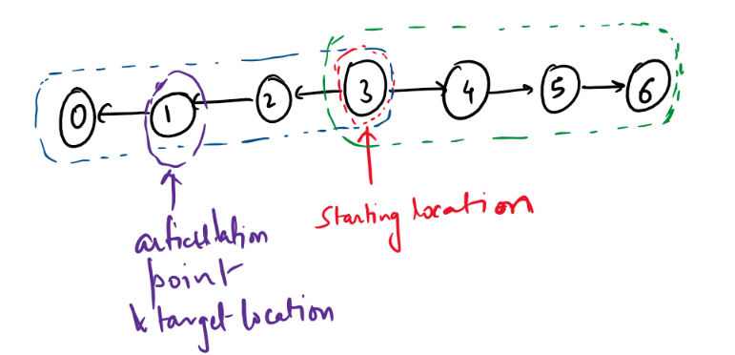
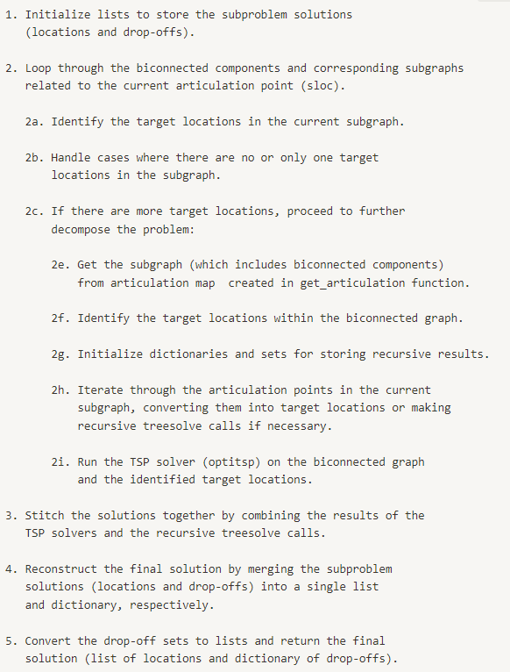
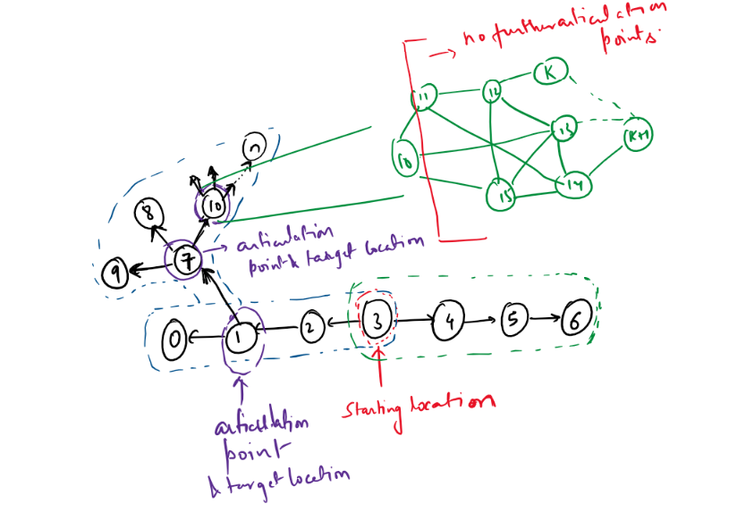
Tree based subdivision algorithm
Taken from the report
Notes:
Stitching happens during backtracking. So the biconnected components that are visited last, their cycles get into the solutions first. We will append the articulation points. And then move to another biconnected component cycles.
The stitching process assembles the individual cycles formed by solving the TSP within each subgraph and combines them with the results of recursive treesolve calls to create a single solution for the entire graph.
When the TSP is solved within each biconnected component, it forms a cycle (a closed tour) of locations. However, for the overall problem, we need a single path that connects all the required locations and drop-off points.
The stitching process addresses this by connecting the cycles and any additional recursive treesolve results from articulation points, effectively transforming the individual cycles into a single path.

Slide 7
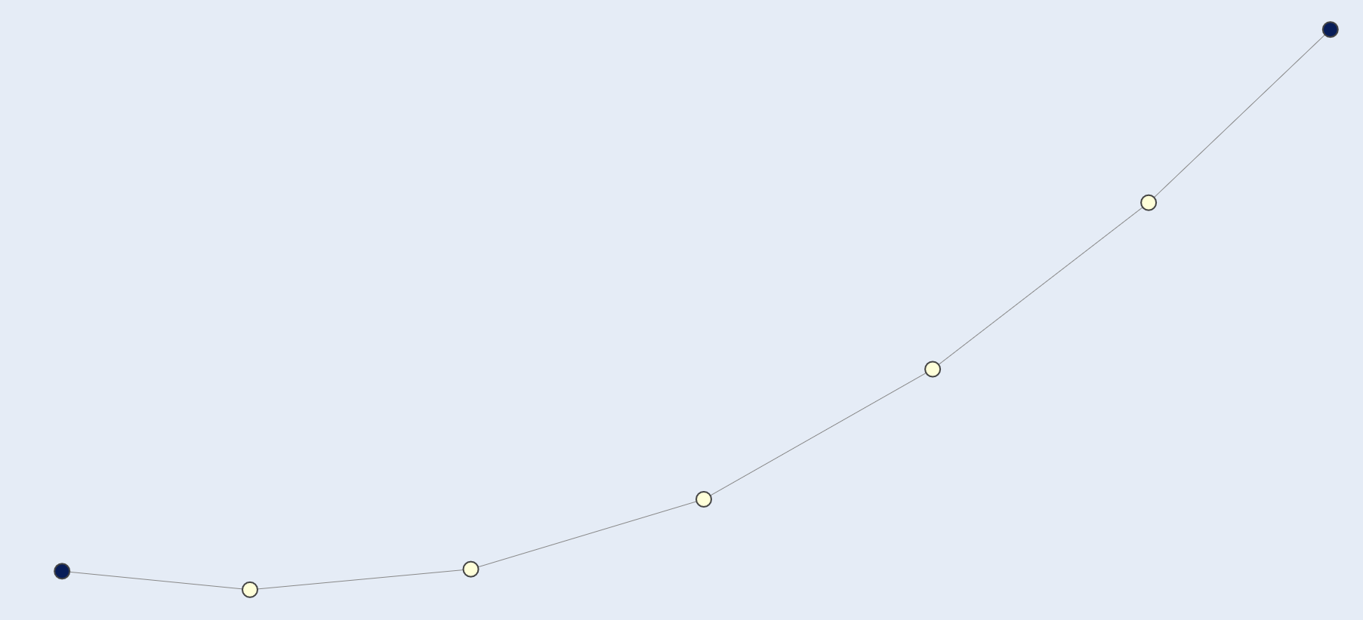

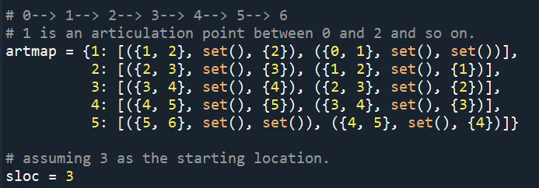
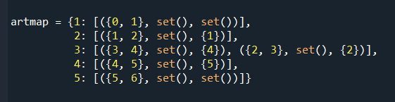
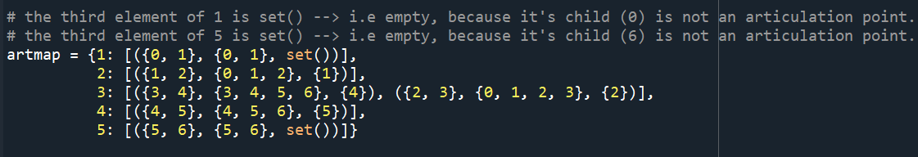
Generation of Articulation maps and Subgraphs
Find biconnected components
Identify articulation points
Initialize articulation map and include starting location
Advantages:
Computational efficiency
Optimal Substructure
Divide and Conquer
Use BFS to remove parent-child relationship between articulation points
DFS over articulation map to construct subgraphs associated with articulation points
Notes:
This has been done to efficiently decompose the problem into smaller subproblems by leveraging biconnected components and articulation points in the graph. Decomposing the problem into smaller subproblems using biconnected components and articulation points in the graph has several advantages:
Computational efficiency: The TSP is an NP-hard problem, meaning that its time complexity grows exponentially with the number of nodes. By breaking down the problem into smaller subproblems, the overall computation time can be significantly reduced.
Optimal substructure: Biconnected components and articulation points help identify smaller subproblems with optimal substructure. By solving these subproblems optimally, we can construct a close-to-optimal solution for the original problem. This can lead to better performance compared to traversing the entire graph directly.
Divide and conquer: Decomposing the problem allows us to apply a divide-and-conquer strategy. This helps to manage complexity, making the problem easier to understand, debug, and optimize.
Key is an articulation point.
Values : list of tuples.
Each tuple has 3 elements.
Biconnected component. 2. subgraph associated with that node. 3. set of other articulation points that are a part of biconnected components, excluding current articulation point.
In the given algorithm, point 5 refers to removing parent-child relationships between articulation points in the articulation map. This step is necessary to ensure that the algorithm does not revisit the same subproblems multiple times, which could lead to inefficiency and redundant work.
In the initial articulation map example , we can see that each articulation point has a tuple with information about its neighboring biconnected components, subgraphs, and other articulation points connected to it. This representation maintains parent-child relationships between articulation points, which means that an articulation point (parent) will have information about its connected articulation point (child).
The BFS approach is used to remove these parent-child relationships to ensure that we only visit each articulation point once when generating subgraphs, avoiding redundant work.
After applying the BFS approach
DFS is applied: DFS is used in the generateSubgraphsDFS method because the goal is to efficiently construct the complete subgraphs associated with each articulation point. DFS is suitable for this task because it explores the graph as deep as possible along a branch before backtracking. This approach allows the algorithm to fully explore and build the subgraphs by following the connections between nodes in the graph. Additionally, DFS uses a recursive approach, which makes it easy to implement and manage when exploring the graph's structure.
In the final articulation map, you can observe that the third element (the set of child articulation points) is empty for articulation points 1 and 5 because their children (0 and 6) are not articulation points. This indicates that the parent-child relationships have been removed as intended, ensuring that the algorithm will not revisit the same subproblems multiple times.
This has been done to efficiently decompose the problem into smaller subproblems by leveraging biconnected components and articulation points in the graph. Decomposing the problem into smaller subproblems using biconnected components and articulation points in the graph has several advantages:
Computational efficiency: The TSP is an NP-hard problem, meaning that its time complexity grows exponentially with the number of nodes. By breaking down the problem into smaller subproblems, the overall computation time can be significantly reduced.
Optimal substructure: Biconnected components and articulation points help identify smaller subproblems with optimal substructure. By solving these subproblems optimally, we can construct a close-to-optimal solution for the original problem. This can lead to better performance compared to traversing the entire graph directly.
Divide and conquer: Decomposing the problem allows us to apply a divide-and-conquer strategy. This helps to manage complexity, making the problem easier to understand, debug, and optimize.
DFS: 1. Iterate through the tuples associated with the given starting location in the articulation map. 2. Update the subgraph with nodes from the biconnected component. 3. Recursively call the 'generateSubgraphsDFS' method for each child articulation point in the tuple. 4. Update the subgraph with nodes from the subgraphs of the child articulation points.
Subgraph: A subgraph associated with each articulation point is a smaller graph that is part of the original graph, containing the articulation point and the vertices and edges of the biconnected components connected to that articulation point. This has been done to efficiently decompose the problem into smaller subproblems by leveraging biconnected components and articulation points in the graph. Decomposing the problem into smaller subproblems using biconnected components and articulation points in the graph has several advantages:
Computational efficiency: The TSP is an NP-hard problem, meaning that its time complexity grows exponentially with the number of nodes. By breaking down the problem into smaller subproblems, the overall computation time can be significantly reduced.
Optimal substructure: Biconnected components and articulation points help identify smaller subproblems with optimal substructure. By solving these subproblems optimally, we can construct a close-to-optimal solution for the original problem. This can lead to better performance compared to traversing the entire graph directly.
Divide and conquer: Decomposing the problem allows us to apply a divide-and-conquer strategy. This helps to manage complexity, making the problem easier to understand, debug, and optimize.

Slide 8
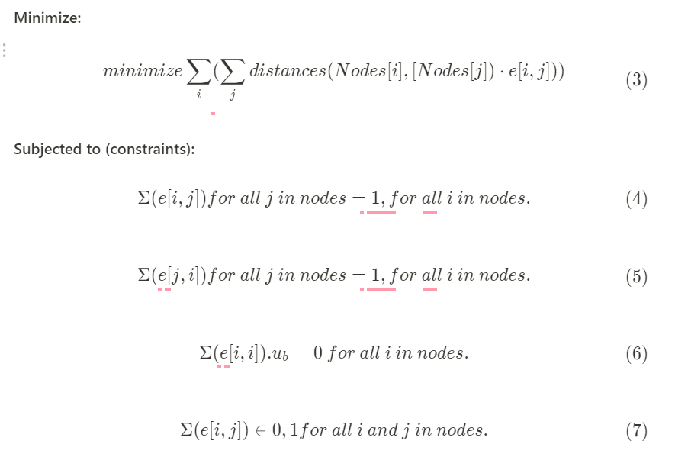

Integer Linear Programming
Decision Variables
Objective function
Degree-2 Constraints
No-self loop constraint
Subtour elimination (Lazy constraint)
Fine-Tuning (Heuristic)
Notes:
Decision Variables:
Decision variables are represented as a binary matrix ‘e’ with dimensions |nodes| x |nodes|. where |nodes| is the number of nodes in the problem. Each element e[i, j] of this matrix corresponds to an edge connecting node i to node j.
If $e[i,j]$ = 1, it means the edge from node i to node j is included in the tour. The salesman will travel directly from node i to node j.
If $e[i,j]$ = 0, it means the edge from node i to node j is not included in the tour. The salesman will not travel directly from node i to node j.
Objective function:
The aim is to minimize the total distance of the tour. To achieve this, we need to find the optimal combination of edges (direct connections between nodes) that form a tour with the shortest possible distance.
The double summation above calculates the total distance of the tour by summing the distances of all included edges. The outer summation goes over all nodes i, and the inner summation goes over all nodes j.
Degree-2 Constraints:
Each node must have exactly two incident edges (one incoming and one outgoing). This is necessary to form a valid tour:
Constraint 1: outgoing edges constraint (one outgoing edge for each node) Equation 4:
This constraint ensures that for each node i, there is exactly one edge from node i to another node j. The summation goes over all nodes j, and the constraint enforces that the sum of the decision variables e[i,j] for a given node i must be equal to 1. This means that there is exactly one outgoing edge from each node in the tour.
Constraint 2: incoming edges constraint (one incoming edge for each node): Equation 5:
This constraint ensures that for each node i, there is exactly one edge coming into node i from another node j. The summation goes over all nodes j, and the constraint enforces that the sum of the decision variables e[j,i] for a given node i must be equal to 1. This means that there is exactly one incoming edge to each node in the tour.
No Self-Loop Constraints: Equation 6:
This ensures that the salesman cannot travel from a city directly back to the same city. The no self-loop constraint is implemented by setting the upper bound (ub) of the diagonal elements $e[i,i]$ in the binary decision matrix $e$ to 0, for all i in nodes.
Equation 7 constraint:
The constraint e[i, j] ∈ {0, 1} for all i and j in nodes refers to the fact that each decision variable e[i, j] in the binary matrix can only take one of two possible values: 0 or 1 (If e[i, j] = 1, it means that the edge between node i and node j is included in the final tour )
Equation 8:
This constraint ensures that the total number of edges in the subgraph formed by the nodes in the subtour S is less than or equal to the number of nodes in the subtour minus 1. This effectively breaks the subtour by forcing at least one node to connect to a node outside the subtour, preventing the formation of subtours in the final solution.
Fine-Tuning Heuristic: basically based on a certain radius (median value taken from all the energy consumptions, that is taking place from a certain node), all the nodes within this median distance is explored for the
Better drop-off let us-say, if two drop-off are such that changing there positions/order leads to the reduction in the local travel cost. (objective function is considered). In Future, We could explore better heuristic designs.. (hard clustering and soft clustering are few of the ideas).

Slide 9
Validate output
Following is validated:
Check if the number of dropoffs in the output matches the stated number of dropoffs.
Invalid dropoff locations.
Dropoff locations not in the car path.
Multiple dropoffs with the same location.
Dropoff with no students getting off.
Invalid target locations.
Targets that get off at multiple dropoffs.
Notes:
has been made to efficiently decompose the problem into smaller subproblems by leveraging biconnected components and articulation points in the graph. Decomposing the problem into smaller subproblems using biconnected components and articulation points in the graph has several advantages:
Computational efficiency: The TSP is an NP-hard problem, meaning that its time complexity grows exponentially with the number of nodes. By breaking down the problem into smaller subproblems, the overall computation time can be significantly reduced.
Optimal substructure: Biconnected components and articulation points help identify smaller subproblems with optimal substructure. By solving these subproblems optimally, we can construct a close-to-optimal solution for the original problem. This can lead to better performance compared to traversing the entire graph directly.
Divide and conquer: Decomposing the problem allows us to apply a divide-and-conquer strategy. This helps to manage complexity, making the problem easier to understand, debug, and optimize.
Subgraph: A subgraph associated with each articulation point is a smaller graph that is part of the original graph, containing the articulation point and the vertices and edges of the biconnected components connected to that articulation point.

Slide 10
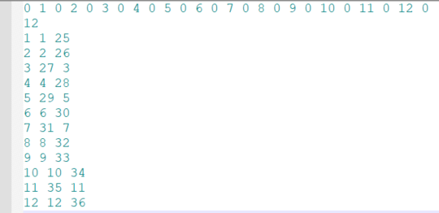
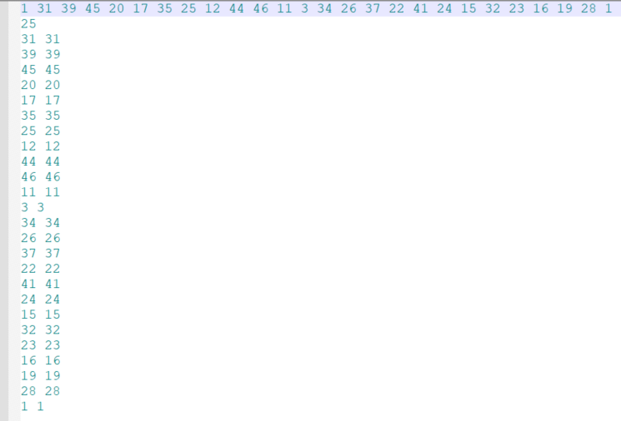
Output Discussion
Output Format:
Line 1: Represent the cycle (of locations) the truck took to drop-off parcels
Line 2: Number of distinct locations at which parcels were dropped off
Next Lines:
1st column: Location/name where the parcel/(s) were dropped.
Remaining columns: Location/name/(s) of the parcels which were dropped off at a particular location

Slide 11
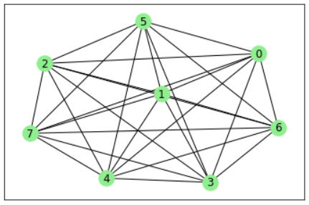
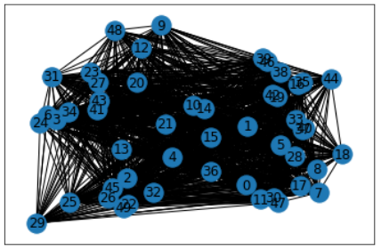
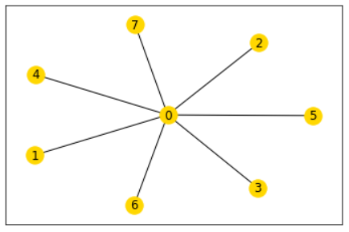
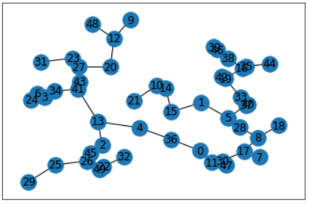
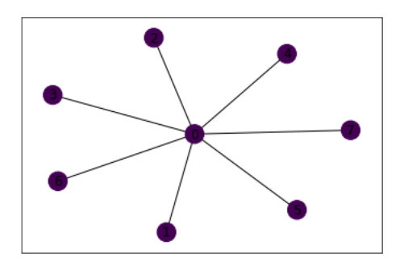
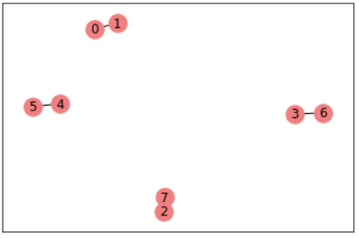
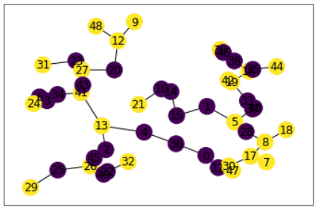
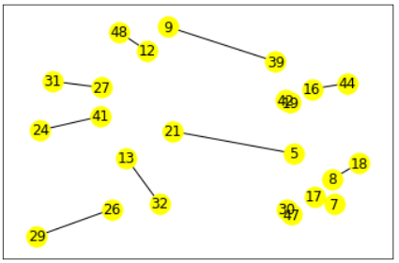
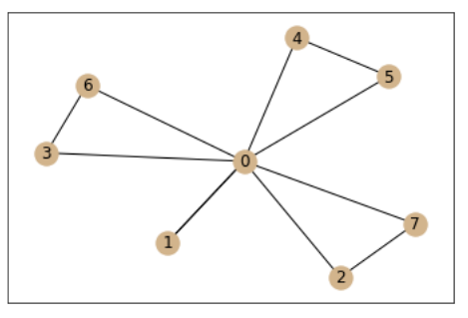
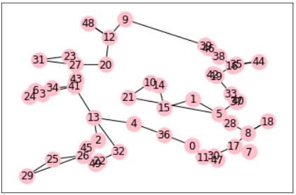
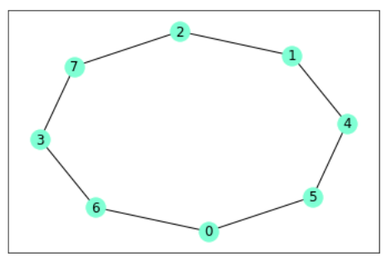
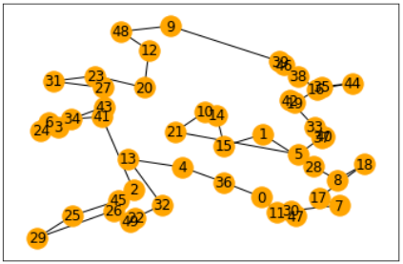
The Christofides Algorithm Steps
Small
dataset
Medium
dataset
Find min spanning tree MST of graph G
2. Make set S of odd-degree nodes in MST
3. Find min-cost perfect matching PM from S
4. Create a multigraph MG from PM to MST
5. Find an Eulerian cycle of MG
6. Remove repeated vertices from MG
Advantages:
Computational efficiency
1.5 approximation
Notes:
This has been done to efficiently decompose the problem into smaller subproblems by leveraging biconnected components and articulation points in the graph. Decomposing the problem into smaller subproblems using biconnected components and articulation points in the graph has several advantages:
Computational efficiency: The TSP is an NP-hard problem, meaning that its time complexity grows exponentially with the number of nodes. By breaking down the problem into smaller subproblems, the overall computation time can be significantly reduced.
Optimal substructure: Biconnected components and articulation points help identify smaller subproblems with optimal substructure. By solving these subproblems optimally, we can construct a close-to-optimal solution for the original problem. This can lead to better performance compared to traversing the entire graph directly.
Divide and conquer: Decomposing the problem allows us to apply a divide-and-conquer strategy. This helps to manage complexity, making the problem easier to understand, debug, and optimize.
Key is an articulation point.
Values : list of tuples.
Each tuple has 3 elements.
Biconnected component. 2. subgraph associated with that node. 3. set of other articulation points that are a part of biconnected components, excluding current articulation point.
In the given algorithm, point 5 refers to removing parent-child relationships between articulation points in the articulation map. This step is necessary to ensure that the algorithm does not revisit the same subproblems multiple times, which could lead to inefficiency and redundant work.
In the initial articulation map example , we can see that each articulation point has a tuple with information about its neighboring biconnected components, subgraphs, and other articulation points connected to it. This representation maintains parent-child relationships between articulation points, which means that an articulation point (parent) will have information about its connected articulation point (child).
The BFS approach is used to remove these parent-child relationships to ensure that we only visit each articulation point once when generating subgraphs, avoiding redundant work.
After applying the BFS approach
DFS is applied: DFS is used in the generateSubgraphsDFS method because the goal is to efficiently construct the complete subgraphs associated with each articulation point. DFS is suitable for this task because it explores the graph as deep as possible along a branch before backtracking. This approach allows the algorithm to fully explore and build the subgraphs by following the connections between nodes in the graph. Additionally, DFS uses a recursive approach, which makes it easy to implement and manage when exploring the graph's structure.
In the final articulation map, you can observe that the third element (the set of child articulation points) is empty for articulation points 1 and 5 because their children (0 and 6) are not articulation points. This indicates that the parent-child relationships have been removed as intended, ensuring that the algorithm will not revisit the same subproblems multiple times.
This has been done to efficiently decompose the problem into smaller subproblems by leveraging biconnected components and articulation points in the graph. Decomposing the problem into smaller subproblems using biconnected components and articulation points in the graph has several advantages:
Computational efficiency: The TSP is an NP-hard problem, meaning that its time complexity grows exponentially with the number of nodes. By breaking down the problem into smaller subproblems, the overall computation time can be significantly reduced.
Optimal substructure: Biconnected components and articulation points help identify smaller subproblems with optimal substructure. By solving these subproblems optimally, we can construct a close-to-optimal solution for the original problem. This can lead to better performance compared to traversing the entire graph directly.
Divide and conquer: Decomposing the problem allows us to apply a divide-and-conquer strategy. This helps to manage complexity, making the problem easier to understand, debug, and optimize.
DFS: 1. Iterate through the tuples associated with the given starting location in the articulation map. 2. Update the subgraph with nodes from the biconnected component. 3. Recursively call the 'generateSubgraphsDFS' method for each child articulation point in the tuple. 4. Update the subgraph with nodes from the subgraphs of the child articulation points.
Subgraph: A subgraph associated with each articulation point is a smaller graph that is part of the original graph, containing the articulation point and the vertices and edges of the biconnected components connected to that articulation point. This has been done to efficiently decompose the problem into smaller subproblems by leveraging biconnected components and articulation points in the graph. Decomposing the problem into smaller subproblems using biconnected components and articulation points in the graph has several advantages:
Computational efficiency: The TSP is an NP-hard problem, meaning that its time complexity grows exponentially with the number of nodes. By breaking down the problem into smaller subproblems, the overall computation time can be significantly reduced.
Optimal substructure: Biconnected components and articulation points help identify smaller subproblems with optimal substructure. By solving these subproblems optimally, we can construct a close-to-optimal solution for the original problem. This can lead to better performance compared to traversing the entire graph directly.
Divide and conquer: Decomposing the problem allows us to apply a divide-and-conquer strategy. This helps to manage complexity, making the problem easier to understand, debug, and optimize.

Slide 12
Conclusion
Minimization of overall energy expenditure was formulated as a TSP problem, where we minimized the sum of distances between the nodes travelled/included in the tour.
Several optimizations where done, such as looking out for articulation points, getting biconnected components, breaking parent-child relationships in biconnected components.
The problem was posed as a minimization problem (minimization the sum of distances between the nodes). Equations were formulated and Gurobi optimizer was used.
A fine-tuning heuristic was developed to minimize the total energy expenditure in the TSP cycles in subgraphs.
Solutions within subgraphs were stitched, finally to get to the overall solution.
Showed that solution worked on two extreme cases (minimal to maximal articulation points).
A network of 100 locations with 50 drop-off points was tested and was run successfully.
Christofide’s algorithm was also explored. With a small number of nodes, it suggested a path the same length as the optimal path. With 20+ nodes, it was <= 1.5 times optimal.

Slide 13
Thank You

Slide 14
Appendix

Slide 15
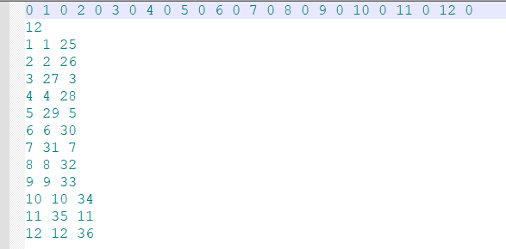
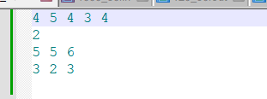
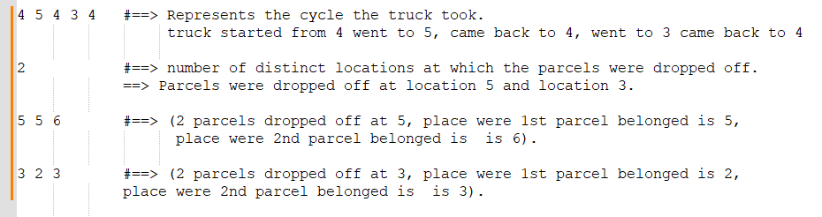
ILP Graph Type 1
120_50_v2.in

Slide 16
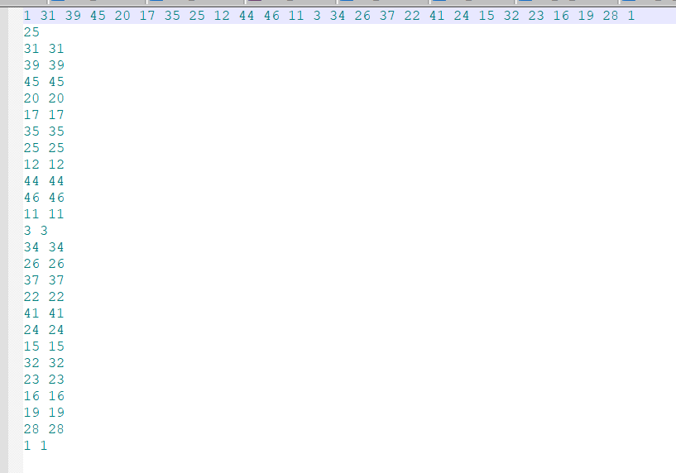
ILP Graph Type 2
Location/
Location/
1_50.in

Slide 17
Overview of TSP Approach
Manipulating Data
Creating Subgraphs
Solving subgraphs and connecting them back
1. Process input file to get the information in it
2. Create a graph from adjacency matrix (network x) and convert drop-off locations to indices
3. Compute Articulation Map
4. Tree based subdivision algorithm
Check for certain conditions
TSP Solver employed along with Heuristics
8. Generate total expenditure
7. Validate output
6. Fine-tune ILP solution (Heuristic)
5. Invoke Integer Linear programming (ILP) solver
Notes:
Location to indices : This step maps the given list of homes/hubs and the starting truck location to their respective indices in the graph. This conversion is necessary for processing and solving the problem using graph algorithms.
1. Convert input file to adjacency matrix:
Extract the total number of locations from the first element of input_data and convert it to an integer.
Extract the total number of houses from the second element of input_data and convert it to an integer.
Store the list of locations provided in the third element of input_data.
Store the list of houses provided in the fourth element of input_data.
Extract the starting location from the fifth element of input_data and convert it to an integer.
Process the remaining rows in input_data to create an adjacency matrix. For each row, replace 'x' with itself or convert other entries to float.
Finally, the function returns the extracted values: number_of_locations, number_of_houses, list_of_locations, list_of_houses, starting_location, and adjacency_matrix. Adjacency matrix have the information about which nodes will have direct edges between them.
2. Create a graph from adjacency matrix (network x)
This step transforms the input problem into a graph representation.
Modeling the problem as a graph allows us to leverage graph algorithms and techniques,
making it easier to find an optimal or near-optimal solution.
3. Convert location to indices: The line stas = set([list_of_locations.index(h) for h in list_of_homes]) converts the list of home names
(list_of_homes) into a set of indices. It does this by iterating through each home name (h) in the list_of_homes and finding
its index in the list_of_locations. This set of indices, called stas, represents the target locations
(homes) in the graph. This conversion is necessary for processing and solving the problem using graph algorithms.
Semitree algorithm: The idea here was to leverage the articulation points and biconnected components to decompose the graph into smaller subproblems.
Initialize lists to store the subproblem solutions (locations and drop-offs).
2. Loop through the biconnected components and corresponding subgraphs related to the current articulation point (sloc). 2a. Identify the target locations in the current subgraph. 2b. Handle cases where there are no or only one or two target locations in the subgraph. 2c. If there are more target locations, proceed to further decompose the problem: 2e. Create a biconnected graph for the current component. 2f. Identify the target locations within the biconnected graph. 2g. Initialize dictionaries and sets for mapping fake target locations to original ones and storing recursive results. 2h. Iterate through the articulation points in the current subgraph, converting them into target locations or making recursive treesolve calls if necessary. 2i. Run the TSP solver (optitsp) on the biconnected graph and the identified target locations. 3. Stitch the solutions together by combining the results of the TSP solvers and the recursive treesolve calls. 4. Reconstruct the final solution by merging the subproblem solutions (locations and drop-offs) into a single list and dictionary, respectively. 5. Convert the drop-off sets to lists and return the final solution (list of locations and dictionary of drop-offs).

Slide 18
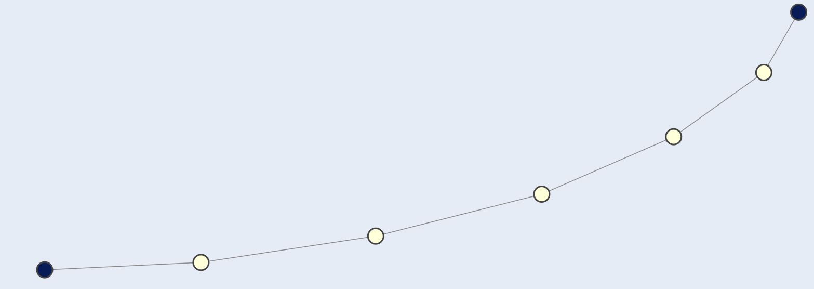
ILP Graph Type 1
120_50_v2.in
1000_50.in

Slide 19
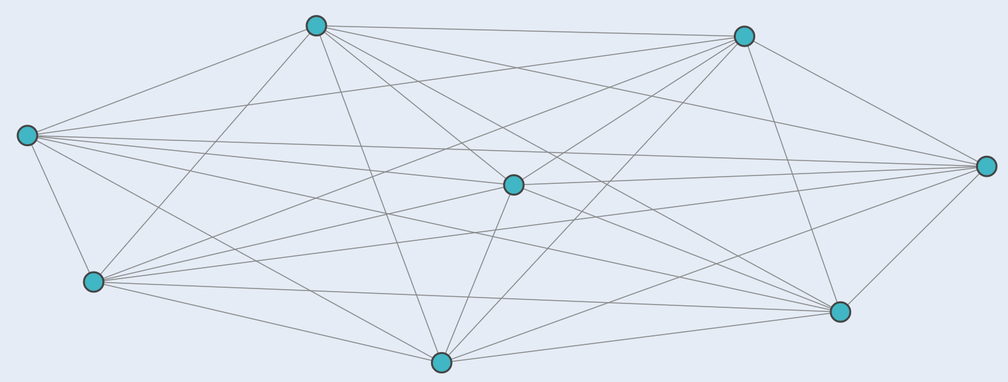
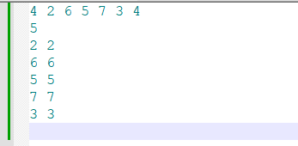
ILP Graph Type 2
1004_50_All_Connected.in
1_50.in

