Slide 1



Borcelle Company
Impact of COVID-19 on ABC Company’s Parcel Delivery Business.
By Group 2

Slide 2

Agenda
Executive Summary
First Impact of COVID-19 on Customer Volumes
Key Events in the COVID-19 Timeline Impacting Change
Impact of COVID-19 in Peak season of 2020
Impact of COVID-19 on Customer Groups
Customer Group Growth Distribution During COVID Period
New Customer Percentage and 2019 Loss During COVID
Covid Impact on Revenue by Customer Group
Covid Impact on Parcel Volumes by Customer Group

Slide 3

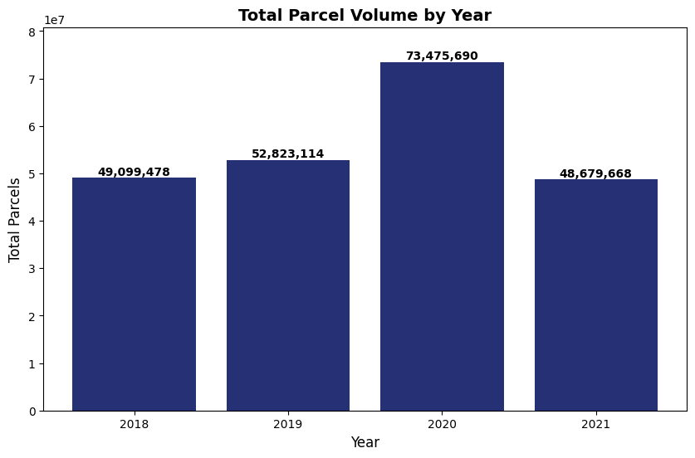
Executive Summary
Business Impacts
Recommendations
Revenue growth in 2020 driven by volume surge.
Operational challenges due to unprecedented demand.
COVID-19 amplified disparities across customer groups.
Scale for demand peaks.
Re-engage lost customers.
Focus on growth segments.
To provide a comprehensive analysis of the COVID-19 pandemic's impact on ABC Company's customer base, highlighting revenue trends, customer dynamics, and sector performance to guide strategic decision-making.
High-Growth Customers in 2020
50.52%
Total parcel volumes increased in 2020 (73.4M) vs. 2019 (52.8M)
39.1%
Total Revenue in 2020
$1,402.19M
Growth Distribution for Enterprise
50%

Slide 4
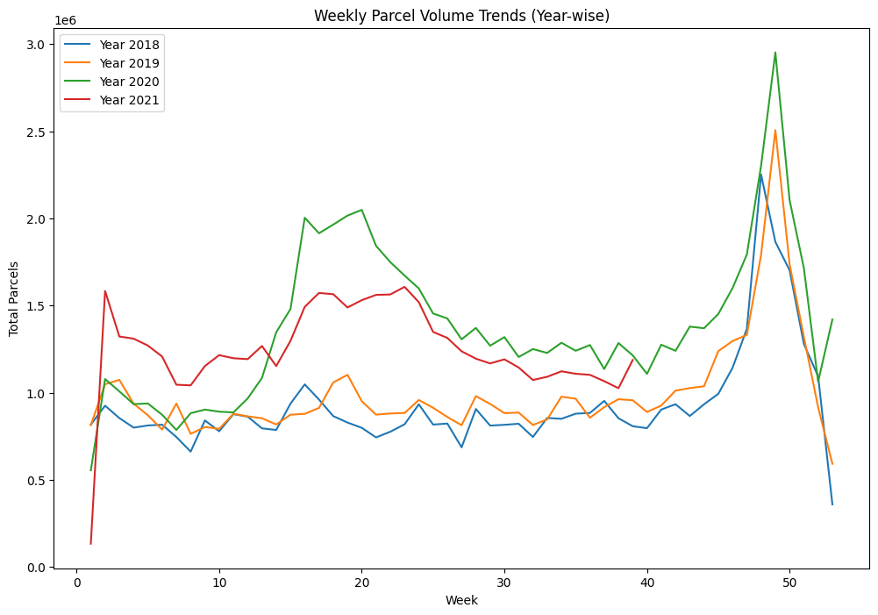
First Impact of COVID-19 on Customer Volumes
Initial Impact: Around week 12 (March 2020), we see the first notable increase in parcel volumes, which aligns with the onset of lockdowns and social distancing measures.
Peak Growth: Following this initial spike, there’s a substantial rise around week 20, indicating a continued shift towards online shopping.

Slide 5
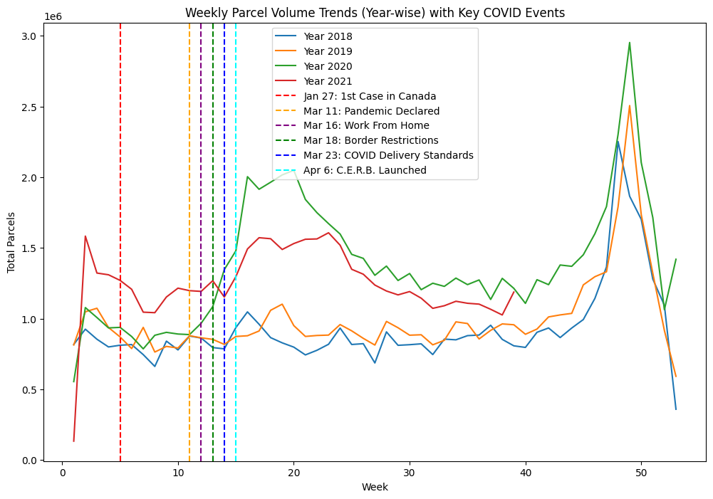
Key Events in the COVID-19 Timeline Impacting Change
March 11, 2020:
Event: WHO declares COVID-19 a pandemic.
Impact: Surge in parcel volumes due to panic buying and rise in e-commerce.
March 16, 2020:
Event: Federal public servants urged to work from home.
Impact: Increased demand for home deliveries of work-related and personal items.
March 18, 2020:
Event: Canada-U.S. border restrictions imposed.
Impact: Shift in demand towards domestic parcel deliveries.
April 6, 2020:
Event: Canada Emergency Response Benefit (C.E.R.B.) launched.
Impact: Stabilized consumer spending, sustaining the rise in parcel volumes.

Slide 6
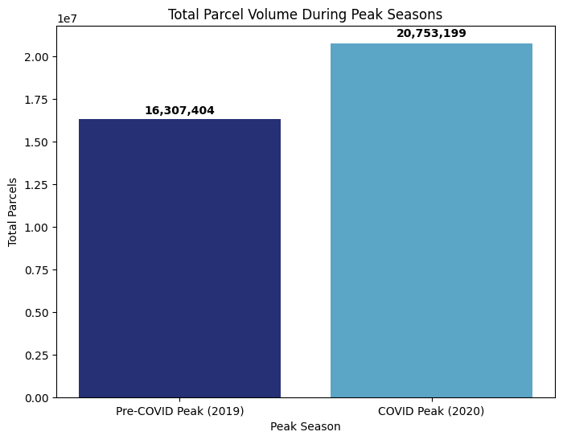
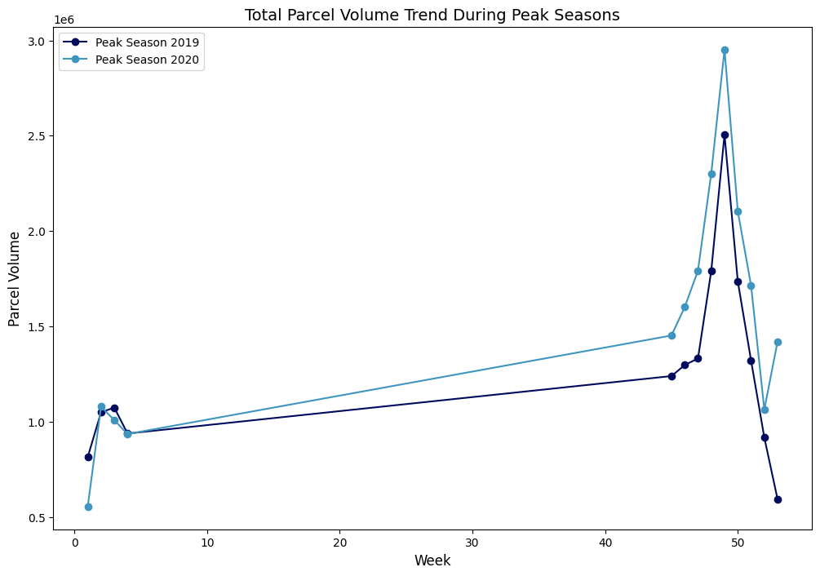
Impact of COVID-19 in Peak season of 2020
Pre-peak weeks (40–47): In 2020, there's a steady increase in parcel volume, whereas 2019 shows a more stable trend.
Peak period: Both years see a sharp rise in parcel volumes.
Post-peak: Volumes drop steeply in both years, but 2020 remains slightly higher than 2019.
27.23%
2019 Peak Season: 16.31 million parcels.
increase in parcel volume at 2020 peak season
2020 Peak Season: 20.75 million parcels.
6

Slide 7
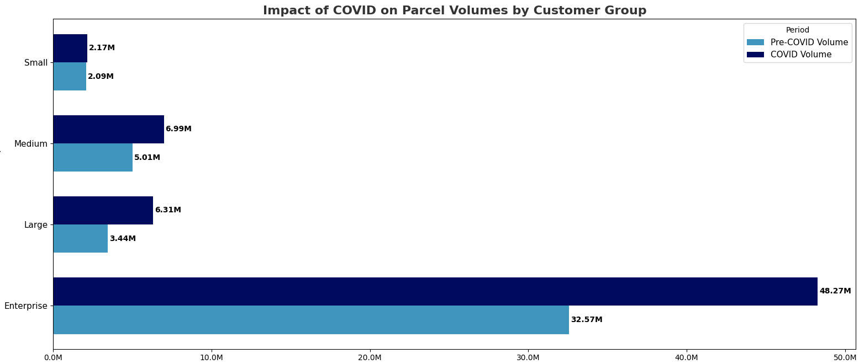
Impact of COVID-19 on Customer Groups
Enterprise group: Significant growth in parcel volumes, from 7M (Pre-COVID) to 48.3M (COVID).
Large group: Increased volume, from 3.44M (Pre-COVID) to 6.31M (COVID).
Medium group: Moderate growth, from 5.01M (Pre-COVID) to 6.99M (COVID).
Small group: Moderate increase, from 2.09M (Pre-COVID) to 2.17M (COVID).
7

Slide 8
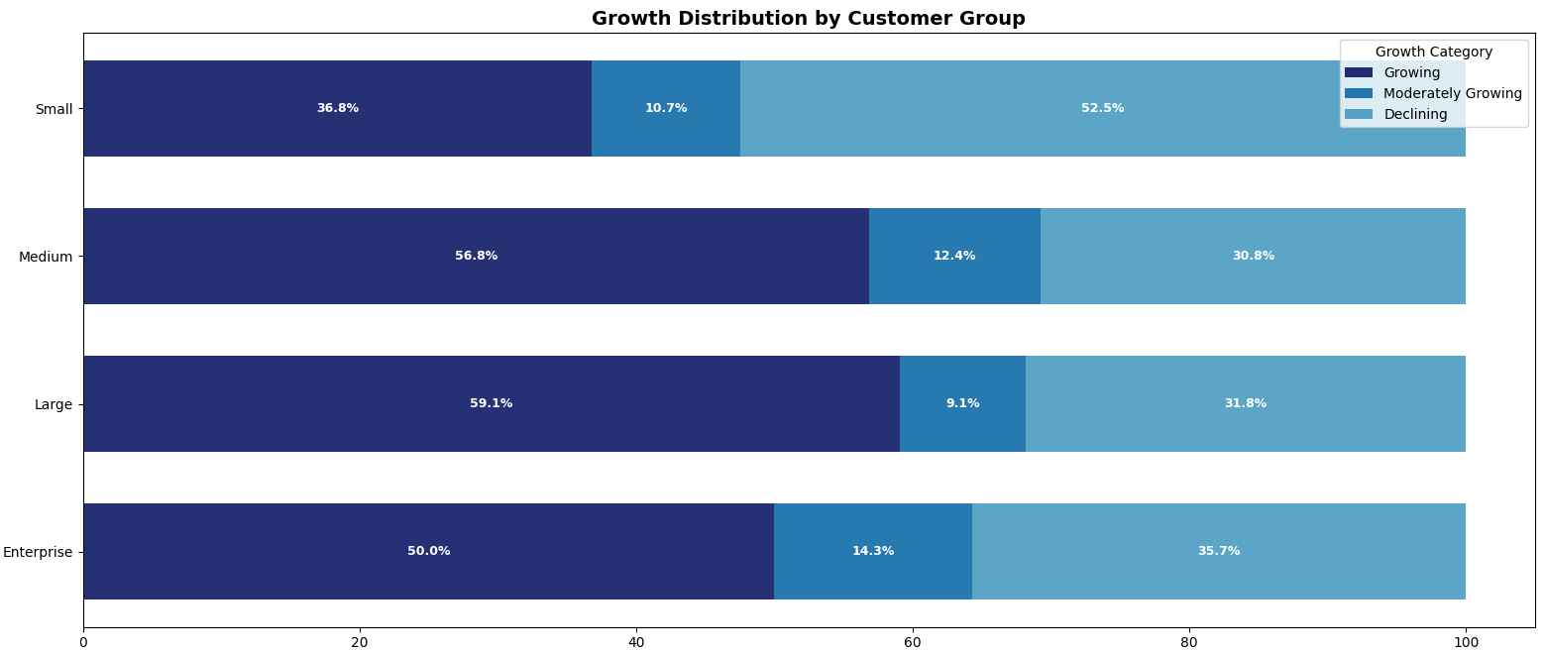
Customer Group Growth Distribution During COVID Period
Large Group: 59.1% are growing, leading all customer groups with strong growth momentum.
Enterprise Group: Balanced performance, with 50% growth despite some decline (35.7%).
Medium Group: Consistent growth with 56.8% growing customers.
Small Group: Promising growth with 36.8%, though challenges remain with 52.5% declining.
.
8

Slide 9
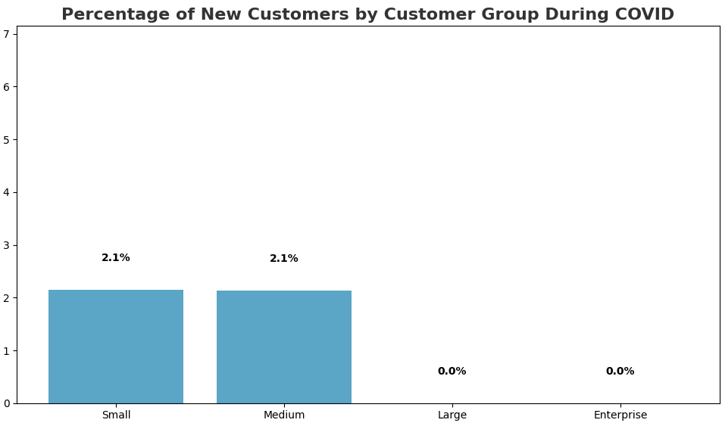
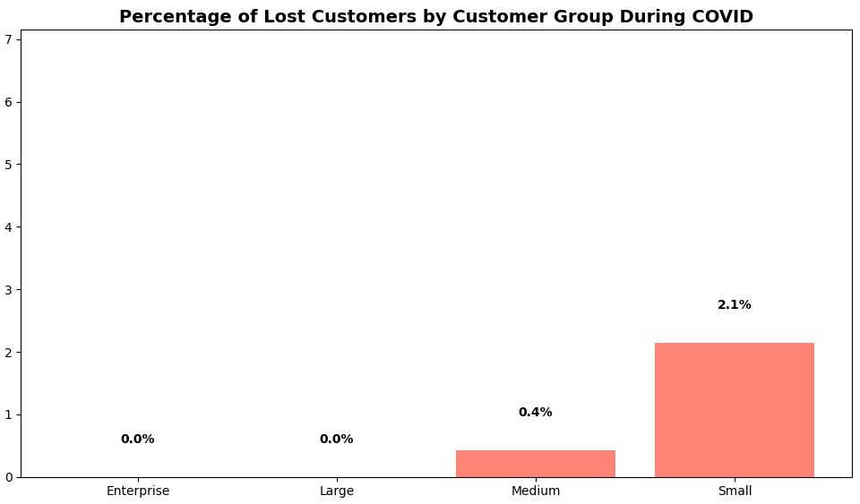
New Customer Percentage and 2019 Loss During COVID
Both the Small and Medium customer groups were able to attract new customers during the pandemic, highlighting their agility and responsiveness to market changes.
The Large and Enterprise customer groups did not gain new customers, indicating that they may have focused more on retaining existing customers and stabilizing their operations rather than seeking new ones.
Larger businesses (Enterprise and Large groups) demonstrated strong customer retention during the pandemic, with no lost customers.
Smaller businesses were more affected, with a higher percentage of lost customers, indicating a need for targeted support to help them navigate challenges and maintain customer relationships.

Slide 10
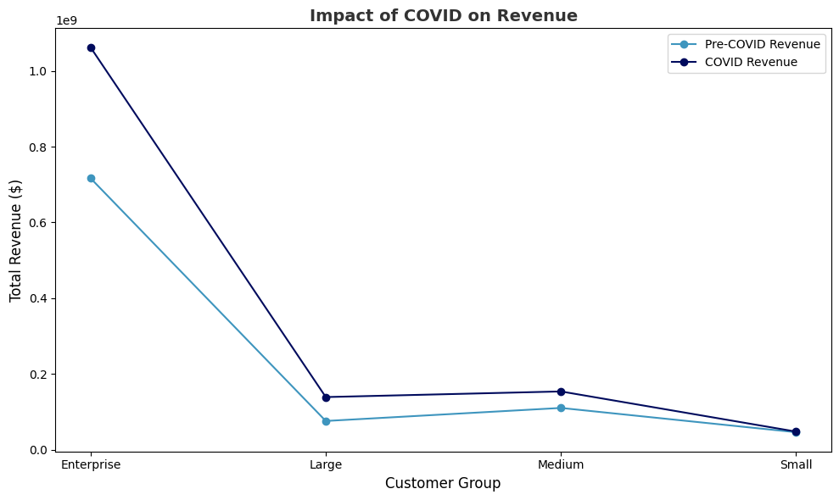
Covid Impact on Revenue by Customer Group
Small & Medium Groups: Attracted 2.1% new customers, showing agility.
Large & Enterprise Groups: No new customers, focused on retaining existing ones.
Overall Insight: Smaller businesses were more successful in acquiring new customers during the pandemic.
10

Slide 11
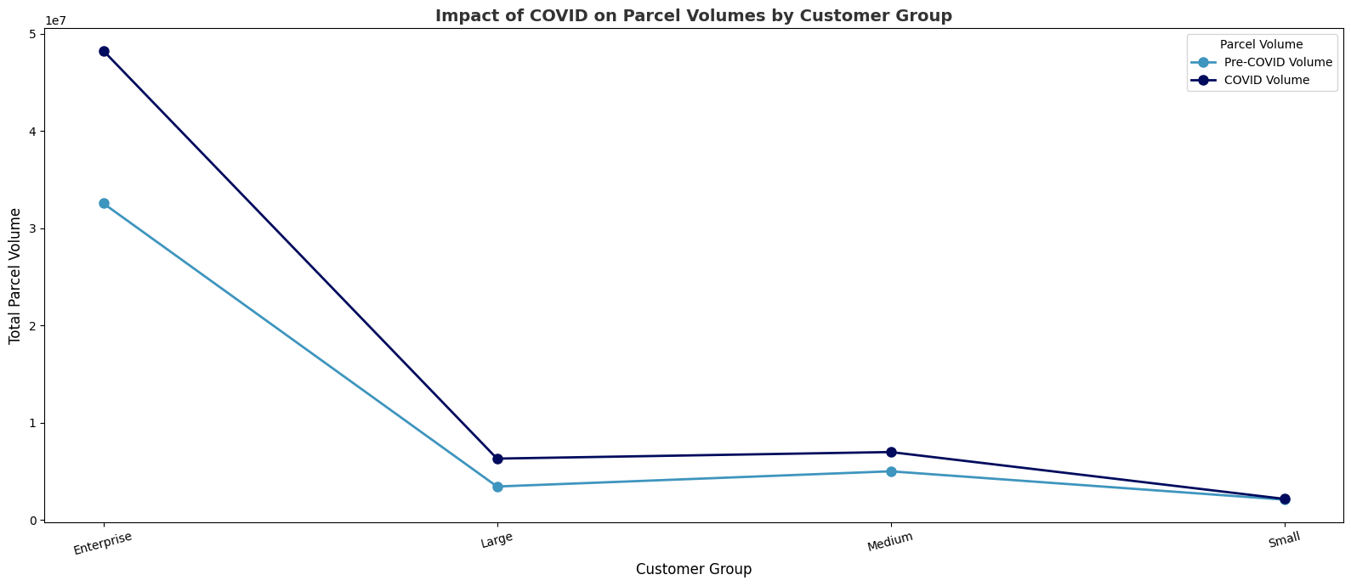
Covid Impact on Parcel Volumes by Customer Group
Enterprise: Volume increased from 49.12M to 43.54M during COVID, indicating strong business growth.
Large: Volume remained stable at around 5.67M, showing resilience.
Medium: Volume increased from 6.28M to 7.93M, reflecting moderate adaptability.
Small: Volume decreased slightly from 1.92M to 2.94M, facing some challenges but remaining stable.

Slide 12

Reference
Reference
https://www.flaticon.com/free-icon/logistics_4394250
https://www.oreilly.com/library/view/storytelling-with-data/9781119002253/

Slide 13
Thank You!

