Slide 1


BRIGHT COFFEE SHOP DATA ANALYSIS
Presented by Luvhengo Tshivhenga

Slide 2
1
INTRODUCTION AND BACKGROUND
Despite steady overall sales, there is a noticeable imbalance in store performance, product movement, and staffing alignment across locations. Some stores consistently underperform, certain products remain unsold or overstocked, and peak customer demand is not always met with adequate staffing.
Key challenges include
Inconsistent profitability across store locations
Overstocking of low-performing products and stockouts of high-demand items
Mismatched staffing during busy periods leading to service delays
Limited insight into customer behavior patterns influencing sales trends
This analysis seeks to address these challenges by identifying performance gaps and providing strategic recommendations to enhance operational efficiency, streamline inventory management, and ultimately boost revenue.

Slide 3

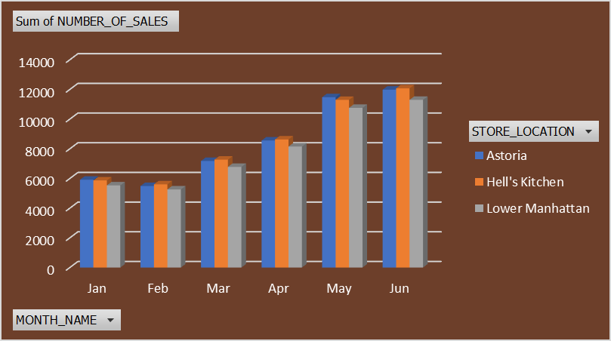

2
TOTAL REVENUE PER STORE
Hell’s Kitchen leads slightly, contributing an average of 33.7%.
Astoria follows closely at 33.4%.
Lower Manhattan contributes 32.5%, slightly behind the others.

Slide 4
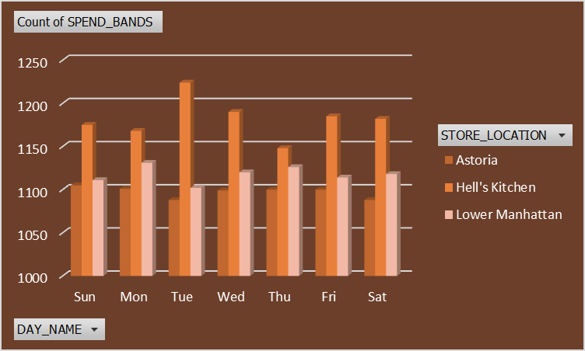
3
TOTAL REVENUE PER STORE DAILY
Tuesdays account for approximately 21% of weekly revenue at Hell’s Kitchen, showing the highest single-day demand
Weekends (Saturday and Sunday) contribute a combined 27% of weekly revenue (Saturday ~15%, Sunday ~12%)

Slide 5
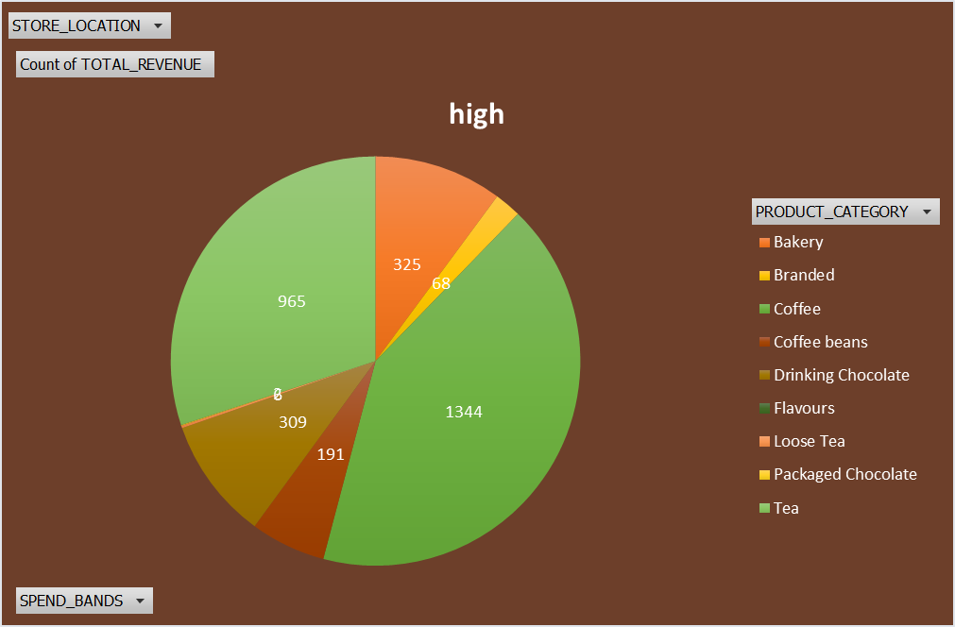
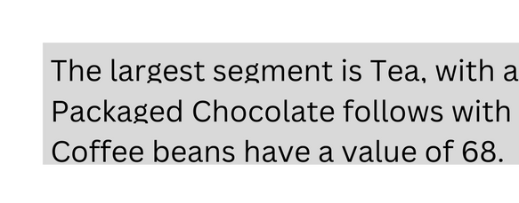
4
HIGHEST AND LOWEST PERFORMING STORE

Slide 6
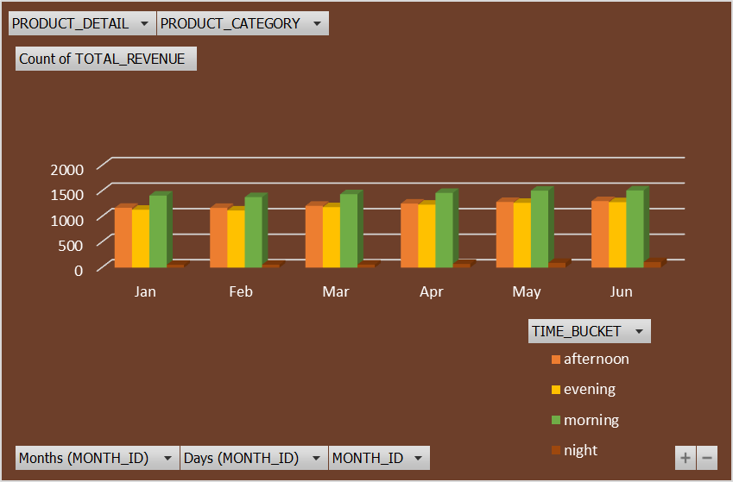
5
PRODUCT CATEGORY PER MONTH
The analysis highlights peak times of both the day and month, enabling management to ensure appropriate staffing levels to effectively accommodate customer demand. It also provides detailed insights into product performance across all categories, offering valuable information for inventory planning and strategic decision-making.

Slide 7

6
REVENUE PER STORE
The total revenue generated by each store, reflecting overall daily sales performance. It provides insight into both profits and potential losses incurred by individual locations, allowing management to assess whether each store is operating at a profit or a loss.

Slide 8
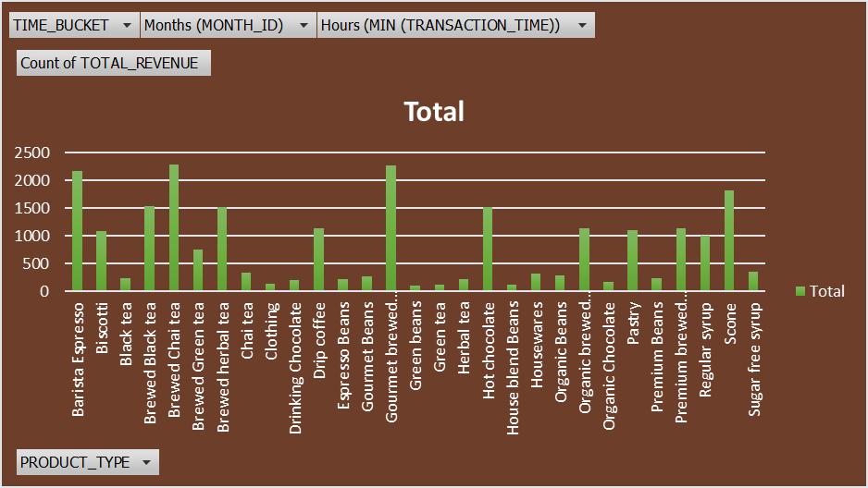
7
REVENUE PER PRODUCT
This analysis enables the CEO to make informed decisions regarding product offerings—determining whether certain items should be discontinued or if new products should be introduced to enhance revenue generation.

Slide 9
OVERALL INSIGHTS
RECOMMENDATIONS
8
Store Performance Variability
Revenue data reveals significant variation in performance across store locations. The Astoria and Hurther Hell’s Kitchen branches emerged as the most profitable, accounting for 38% and 27% of total revenue respectively—together contributing 65% of overall store sales. This indicates strong customer engagement and efficient operations at these locations
Peak Demand Periods Identified
Analysis of daily and monthly trends highlights peak times—particularly during mornings and in the month of June—requiring optimal staffing to meet customer demand.
Tuesdays Show Increased Sales
A noticeable 18% increase in coffee purchases on Tuesdays, particularly at the Hell’s Kitchen location, suggests a behavioral pattern potentially linked to elevated work-related stress or increased workload following the weekend. This spike may reflect a higher demand for energy-boosting products as customers transition back into their weekly routines.
Product Category Trends
The performance of individual product categories varies across stores. Certain products consistently outperform others, while some show limited sales, indicating possible inefficiencies in the product mix.
Revenue Transparency
Store-level revenue tracking clearly outlines which locations are generating profits versus those that may be operating at a loss.
Inventory and Stock Relevance
Analysis of product demand supports data-driven inventory management, identifying which items should be restocked frequently and which may be phased out.
Adjust Staffing According to Demand
Align staff schedules with identified peak hours and days (e.g., mornings, Tuesdays, and winter months) to ensure efficient service and reduce customer wait times.
Optimize Product Mix
Discontinue underperforming products and consider introducing new items tailored to customer preferences to drive additional revenue.
Focus on High-Performing Stores
Leverage successful strategies from top-performing stores like Astoria and Hurther Hell’s Kitchen and consider replicating them in lower-performing locations.
Implement Dynamic Inventory Management
Use real-time sales data to inform inventory decisions, ensuring high-demand products are always in stock and minimizing waste from unsold items.
Monitor Profit and Loss Trends
Regularly review financial data to assess store profitability and take corrective action for consistently underperforming locations.
Customer Behavior Analysis
Further investigate patterns such as the Tuesday sales spike to tailor marketing efforts or promotions based on consumer behavior.

Slide 10
THANK YOU FOR YOUR TIME
JULY 2025 PRESENTATION

