Slide 1
Supervised By:
K. Santosh Jhansi(Cse)
Done BY:
K . Lavanya Sai Kumar(18331A0568)
Varsha()
Usha Avanti()
Ganesh()

Slide 2
Abstract

Slide 3
High level design

Slide 4
Database design

Slide 5
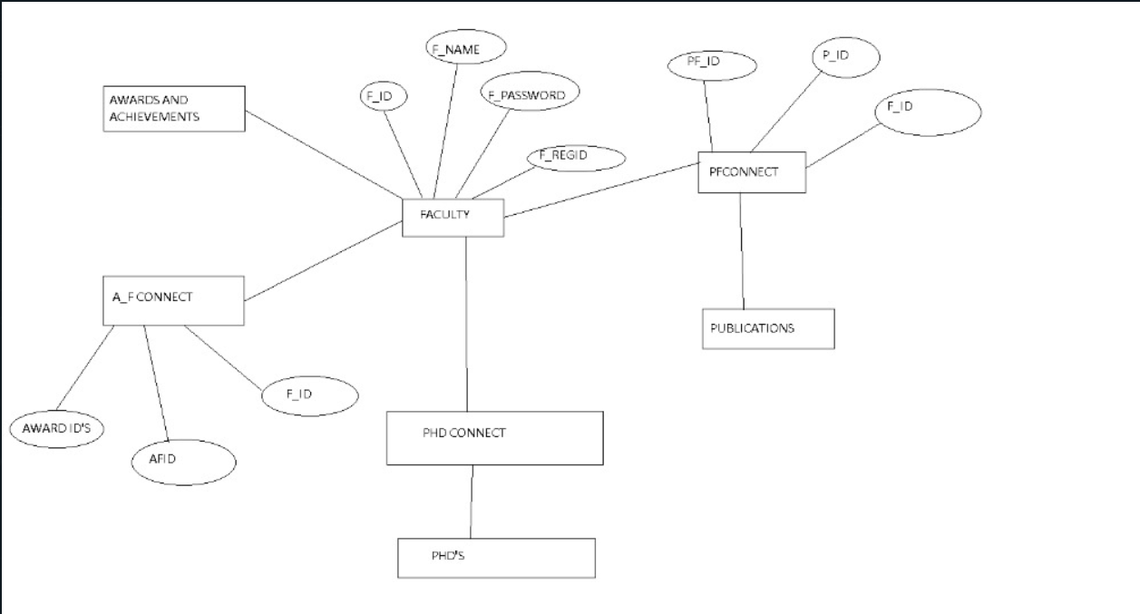
Entity Relationship (ER) Diagram

Slide 6
Business Logic

Slide 7

Thankyou

