Slide 1


SMART INDIA HACKATHON 2026
CAPTAIN
Privacy-first browser actions. On-device control.
Problem Statement ID — 26171
Problem Statement Title
On-device Visual Perception for
Light-weight Browser Agents
Theme — Smart Automation
PS Category — Software
Team ID — 171818
Team Name — Byte Hogs
ISRO | Department of Space
Notes:
Sources checked 29 September 2026. CAPTAIN local source: C:/Users/Admin/Downloads/projects/captain2.0/captain/README.md; public README: https://github.com/luvtankha/captain/blob/main/README.md. Official problem statement: https://www.sih.gov.in/sih2026PS (26171). Local prototype, not SIH certification. Official metadata: PS 26171, On-device Visual Perception for Light-weight Browser Agents; ISRO / Department of Space; Smart Automation; Software. Registered details supplied by user: Byte Hogs, Team ID 171818.

Slide 2

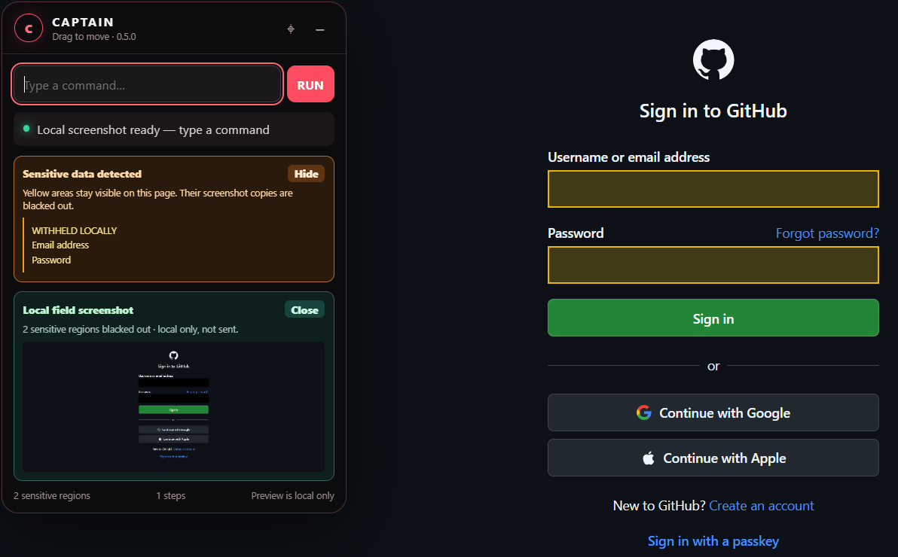
IDEA TITLE: CAPTAIN
Byte Hogs
Separate task context from private values
Actual GitHub login: yellow fields + local masked copy
Proposed solution
Hold E for 4 seconds; scan automatically
Type a command; navigate in a normal tab
Detect fields; show withheld categories
Problem fit
Mask sensitive regions before planning
Keep public page context useful
Innovation / differentiation
Visible privacy proof + consent checkpoint
Fresh capture + validated actions
Email / password / name / Aadhaar / PAN / date of birth / address
CAPTAIN
Notes:
Sources checked 29 September 2026. CAPTAIN local source: C:/Users/Admin/Downloads/projects/captain2.0/captain/README.md; public README: https://github.com/luvtankha/captain/blob/main/README.md. Official problem statement: https://www.sih.gov.in/sih2026PS (26171). Local prototype, not SIH certification. Product evidence: captain/runtime/local-fields-github.png and local-fields-github.json, timestamp 2026-09-29T15:13:03.957Z. Actual GitHub login, two marked regions and two black screenshot masks. Crop only; no composited or invented product UI. Local field PNG is local-only, not the outgoing proof-bound image. Detection examples describe scope, not perfect recall across all websites.

Slide 3





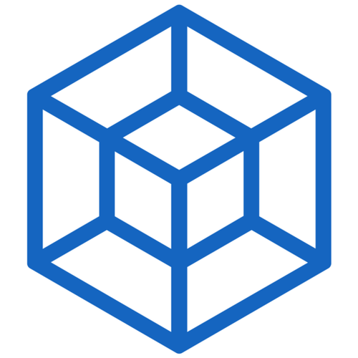
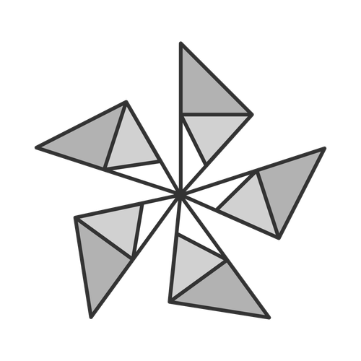


TECHNICAL APPROACH
Byte Hogs
Privacy boundary before planning
LOCAL PRIVACY BOUNDARY
Local companion
Local browser
Raw captures and detected private values stay in the extension
Sanitized context
1 Navigate
2 Perceive
3 Protect
4 Plan
5 Execute
Hold E for 4 s
Type destination
Open normal tab
DOM structure
Local OCR / vision
Sensitive-field scan
Withheld list + preview
Consent + fresh proof
Sanitize fields / image
Rules by default
Optional Ollama
Safe action plan
Validate action
Verify outcome
Await command
Optional remote VLM
Sanitized context only
Configured adapter
JavaScript / MV3
Chrome + Edge
Tesseract.js
Local OCR
ONNX / WASM
Local PII + vision
Node.js 22+
Extension APIs
Fail-closed: mask uncertain regions or omit image. Protected input requires human direction.
CAPTAIN
Notes:
Sources checked 29 September 2026. CAPTAIN local source: C:/Users/Admin/Downloads/projects/captain2.0/captain/README.md; public README: https://github.com/luvtankha/captain/blob/main/README.md. Official problem statement: https://www.sih.gov.in/sih2026PS (26171). Local prototype, not SIH certification. Architecture evidence: extension/content-script.js, service-worker.js, vision-worker.js; server/index.mjs, planner.mjs, outbound-contract.mjs, result-verifier.mjs. Typed commands only. Hold E for four seconds outside editable controls. Consent-sensitive workflow rescans before planning. On-device DOM/OCR/ONNX checks. Local-only field PNG differs from optional proof-bound outgoing JPEG. Unverifiable image omitted. Local deterministic planning is the default. Optional Ollama adapter runs on loopback. The configured remote VLM adapter receives sanitized context only, not raw captures. Planned actions return to the extension for local validation and execution. Local models include Gravitee BERT-small PII and UltraFace; optional UI detector grounding remains partial. Tesseract https://github.com/naptha/tesseract.js ; ONNX https://onnxruntime.ai/docs/get-started/with-javascript/web.html ; Chrome https://developer.chrome.com/docs/extensions/develop/migrate/what-is-mv3 ; Node https://nodejs.org/docs/latest/api/ . Official logos: https://raw.githubusercontent.com/naptha/tesseract.js/master/docs/images/tesseract.png ; https://onnxruntime.ai/images/logos/onnxruntime/ORT_icon_for_light_bg.png ; https://nodejs.org/static/logos/nodejsHex.svg . Third-party logos identify technologies, not endorsements.

Slide 4
FEASIBILITY AND VIABILITY
Byte Hogs
Working prototype; measured claims only
567 / 567
GitHub: 2 fields
Windows + Chrome / Edge
Regression tests passed
Login + password blacked out
Normal tabs · local Node companion
Local log · 29 Sep 2026
Public screenshot content retained
Deterministic tasks: no API key
Risk → mitigation
Page changes after capture
Rescan; bind proof to fresh document
Uncertain visual privacy
Omit image; never send unverified capture
Credentials / CAPTCHA / gated entry
Block protected input; request human direction
Partial: general visual grounding. Future validation: PII accuracy, CPU / RAM / latency, wider sites, Firefox.
CAPTAIN
Notes:
Sources checked 29 September 2026. CAPTAIN local source: C:/Users/Admin/Downloads/projects/captain2.0/captain/README.md; public README: https://github.com/luvtankha/captain/blob/main/README.md. Official problem statement: https://www.sih.gov.in/sih2026PS (26171). Local prototype, not SIH certification. Test evidence: captain/runtime/local-fields-tests.log — 567 tests, 567 pass, 0 fail, 0 skip, 20988.6878ms. This is an existing local 29 Sep 2026 run, not a new run performed for this deck, not a PII benchmark and not universal website coverage. GitHub local-fields-github.json verifies login/password black pixels and retained public pixel. Broad performance, Firefox runtime and independent deployment remain unverified. No 100% privacy claim.

Slide 5

IMPACT AND BENEFITS
Byte Hogs
Potential value for ISRO research-portal workflows
Scientist workflow
CAPTAIN mechanism
Practical benefit
Repeated public-portal visits
Typed destination
Validated navigation
Repeatable access
to research portals
Account / identity fields
Local detection + masks
Withheld categories
Less private context
exposed to planning
Credential-gated workflows
Consent checkpoint
Protected-input stop
Scientist retains
access decisions
Target context: ISSDC / PRADAN mission archives and MOSDAC data services
Potential use only. No verified ISRO deployment or portal integration.
Scope: webpage interaction, not satellite-data analysis or mission-system control.
CAPTAIN
Notes:
Sources checked 29 September 2026. CAPTAIN local source: C:/Users/Admin/Downloads/projects/captain2.0/captain/README.md; public README: https://github.com/luvtankha/captain/blob/main/README.md. Official problem statement: https://www.sih.gov.in/sih2026PS (26171). Local prototype, not SIH certification. ISRO relevance: https://www.issdc.gov.in/ identifies its mission-payload archive and PRADAN access. https://www.mosdac.gov.in/ describes meteorological and oceanographic satellite-data services. These sources establish the research-portal context only, not a CAPTAIN deployment, integration or site-specific validation. Benefits are potential application of implemented controls, not measured productivity gains. No credential autofill, mission-system control or satellite-data analysis claimed. Official evaluation weights from https://www.sih.gov.in/sih2026PS, PS26171: Visual context25%, PII recall/precision20%, redaction precision20%, client resource utilization20%, end-to-end task latency15%. These are evaluation weights, NOT CAPTAIN scores. Benefits are design intent and demonstrated controls, not measured financial/environmental savings. Icons: Lucide https://lucide.dev/license ; icon source https://github.com/lucide-icons/lucide/tree/main/icons . Copyright (c) 2026 Lucide Icons and Contributors. Permission to use, copy, modify, and/or distribute this software for any purpose with or without fee is hereby granted, provided that the above copyright notice and this permission notice appear in all copies. THE SOFTWARE IS PROVIDED AS IS AND THE AUTHOR DISCLAIMS ALL WARRANTIES WITH REGARD TO THIS SOFTWARE INCLUDING ALL IMPLIED WARRANTIES OF MERCHANTABILITY AND FITNESS. IN NO EVENT SHALL THE AUTHOR BE LIABLE FOR ANY SPECIAL, DIRECT, INDIRECT, OR CONSEQUENTIAL DAMAGES OR ANY DAMAGES WHATSOEVER RESULTING FROM LOSS OF USE, DATA OR PROFITS, WHETHER IN AN ACTION OF CONTRACT, NEGLIGENCE OR OTHER TORTIOUS ACTION, ARISING OUT OF OR IN CONNECTION WITH THE USE OR PERFORMANCE OF THIS SOFTWARE.

Slide 6
RESEARCH AND REFERENCES
Byte Hogs
Source code, evidence and research
1 CAPTAIN repository
4 Browser extension source
Complete implementation
On-device browser-agent implementation
2 CAPTAIN README
5 Privacy / regression tests
Architecture, workflow and setup
Privacy and regression checks
3 Raw README
6 Official SIH problem statement
Direct machine-readable project reference
Requirements for SIH 26171
Research / runtime references
UI-TARS paper
Tesseract.js OCR
ONNX Runtime Web
Chrome Manifest V3
GUI-agent research
Reads text from images
Runs local AI models
Extension architecture
ISSDC / PRADAN
MOSDAC
Node.js
TrueSight reference
ISRO mission-data access
Weather and ocean data
Local companion runtime
Privacy research only
CAPTAIN demo: youtube.com/watch?v=KYISYCh2GKU
CAPTAIN workflow video
CAPTAIN
Notes:
Sources checked 29 September 2026. CAPTAIN local source: C:/Users/Admin/Downloads/projects/captain2.0/captain/README.md; public README: https://github.com/luvtankha/captain/blob/main/README.md. Official problem statement: https://www.sih.gov.in/sih2026PS (26171). Local prototype, not SIH certification. 1 CAPTAIN repository — https://github.com/luvtankha/captain
2 CAPTAIN README — https://github.com/luvtankha/captain/blob/main/README.md
3 Raw README — https://raw.githubusercontent.com/luvtankha/captain/main/README.md
4 Browser extension source — https://github.com/luvtankha/captain/tree/main/extension
5 Privacy / regression tests — https://github.com/luvtankha/captain/tree/main/tests
6 Official SIH problem statement — https://sih.gov.in/sih2026PS
Research: UI-TARS https://arxiv.org/abs/2501.12326 (research reference, not CAPTAIN deployed planner); Tesseract.js https://github.com/naptha/tesseract.js ; ONNX Runtime Web https://onnxruntime.ai/docs/get-started/with-javascript/web.html ; Chrome MV3 https://developer.chrome.com/docs/extensions/develop/migrate/what-is-mv3 .
Design reference: RE-DACT.pdf provided by user; TrueSight https://github.com/berserk-23115/TrueSight is a research/design reference, not CAPTAIN active production classifier. User-supplied CAPTAIN demo: https://www.youtube.com/watch?v=KYISYCh2GKU . Research portal context: https://www.issdc.gov.in/ and https://www.mosdac.gov.in/ .

