Slide 1

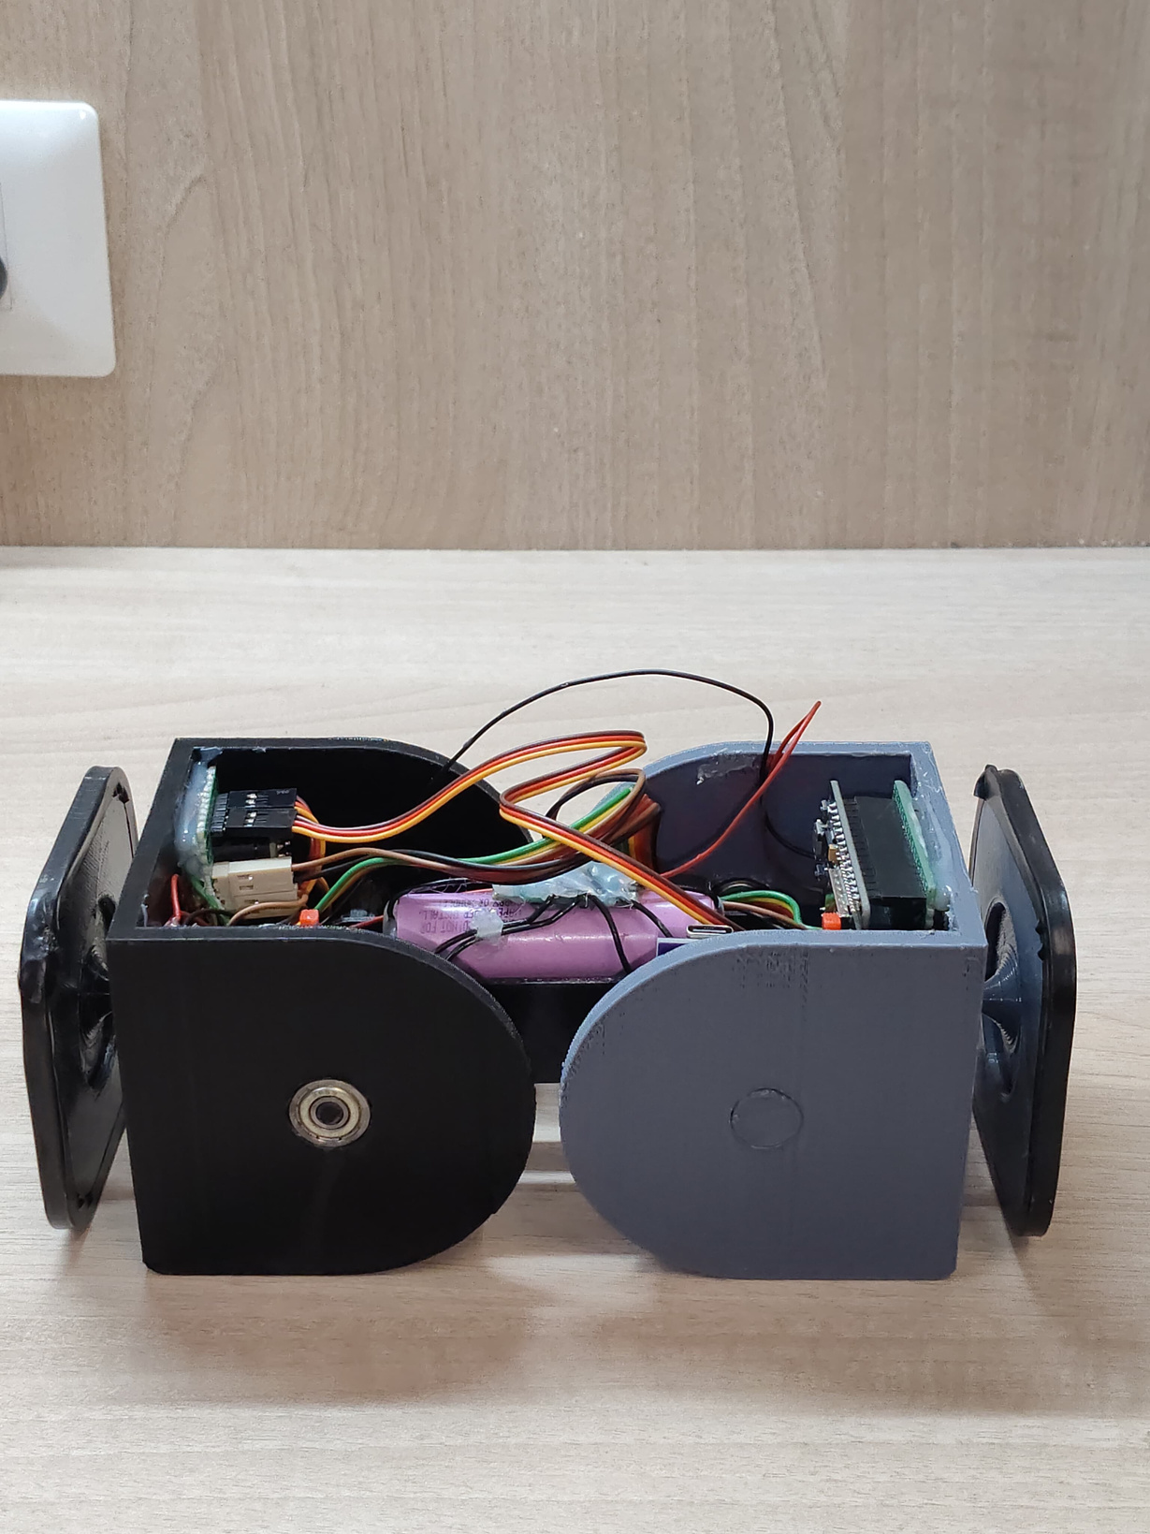
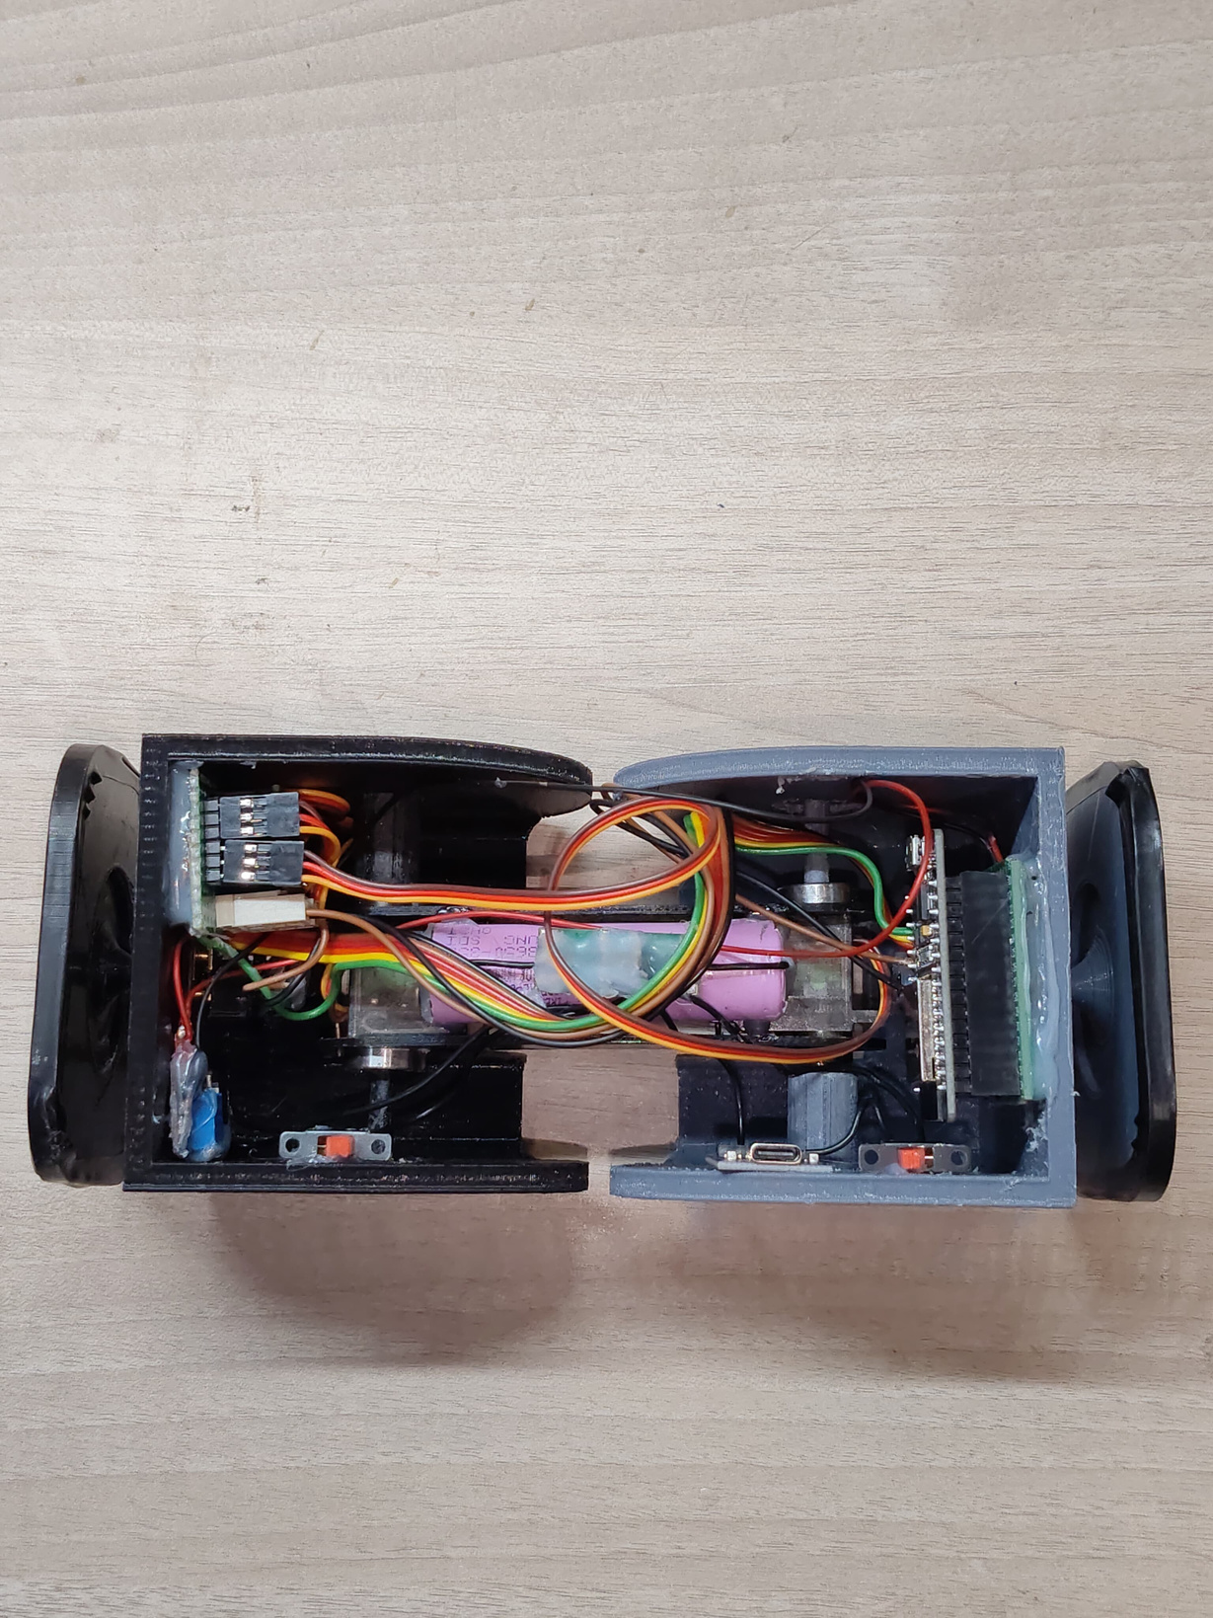
Reconfigurable Robot

Slide 2
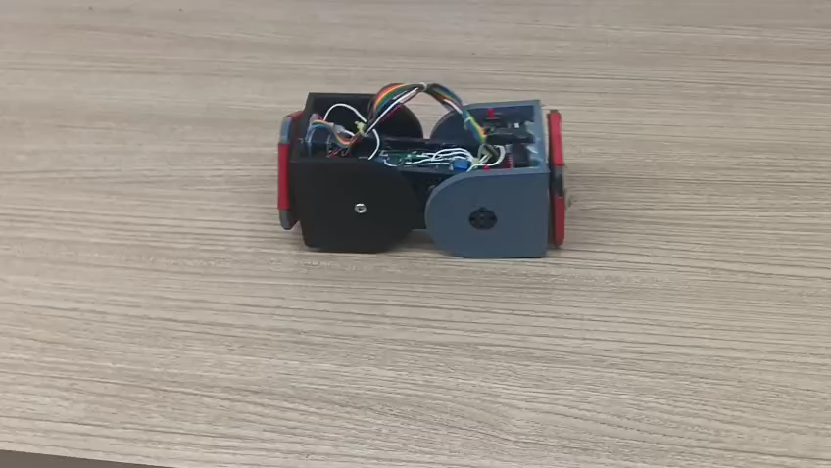
Notes:
© Copyright PresentationGO.com – Free Templates & Infographics for PowerPoint and Google Slides

Slide 3
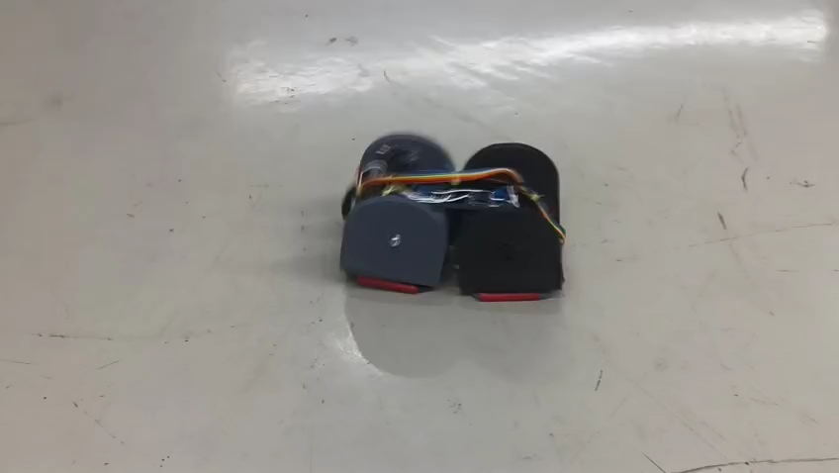

Slide 4
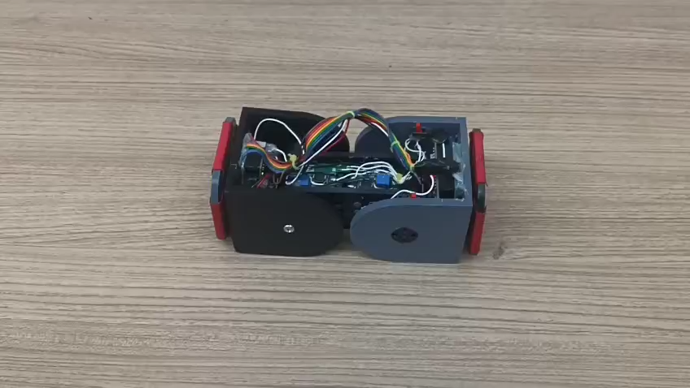

Slide 5
