Slide 1
1216 SmallGroupMeeting

Slide 2
Last week
1.network introduction
2.Algorithm designed
Notes:
歷年來的sketch都是注重在單一的switch，而這篇則是注重在所有switch的合作，不需要每一個switch都去紀錄，而只要某幾個switch去紀錄就好。
有點像是分散式，合作式的sketch

Slide 3
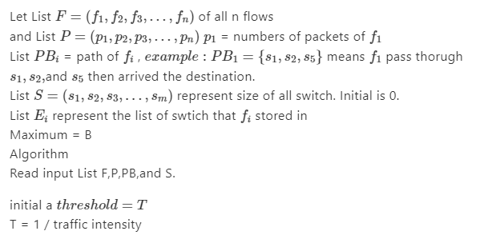
Algorithm

Slide 4
Algorithm
One by one
Smallest Fit or Varied First Fit

Slide 5
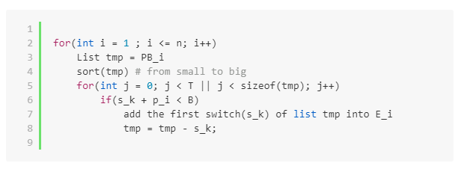
Sort need to be stable.

Slide 6
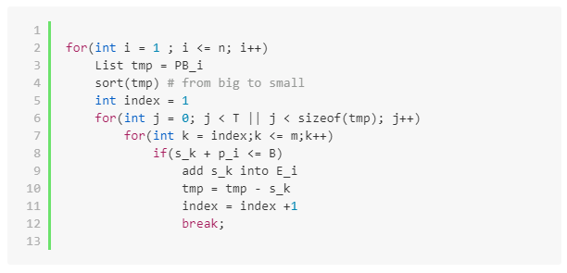
Best Fit

Slide 7
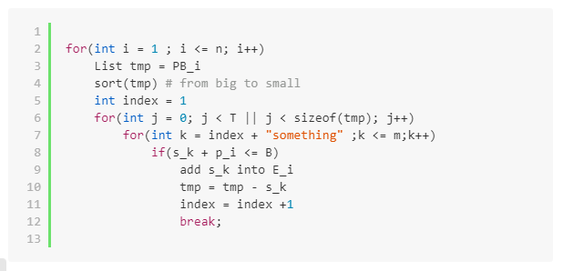
Consider Error detected
Something: sizeof(PB) / T

Slide 8
Problem
1. Configuration of T , Something.
2. Another way to solve error detected.

