Slide 1
20220106
Wade

Slide 2
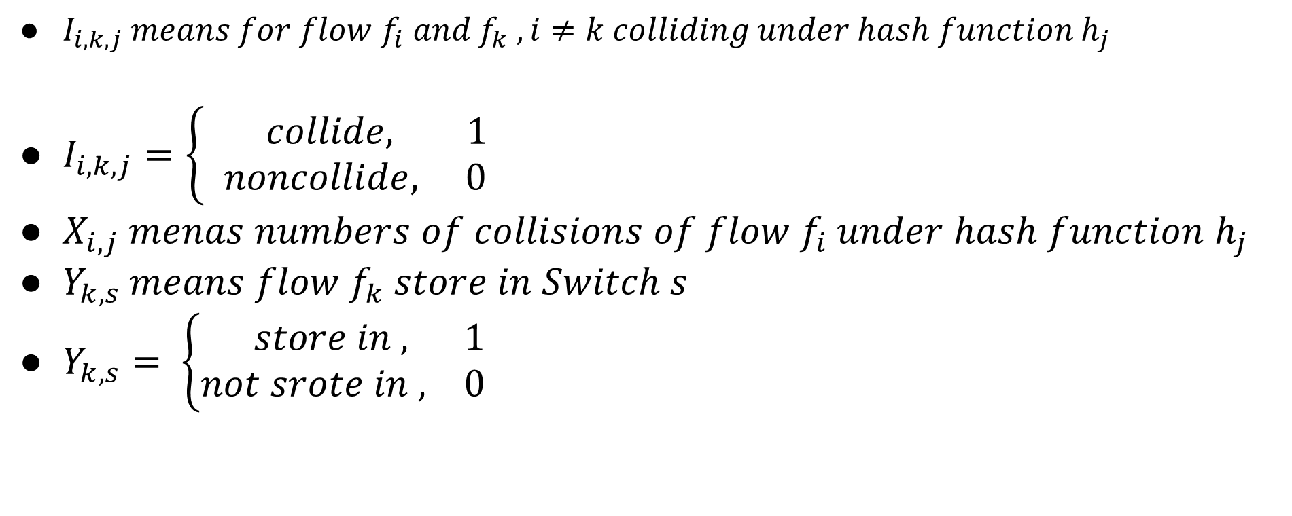
Algo (Latex Ver.)
$I_{i,k,j} means for flow f_{i} and f_{k} ,i≠k colliding under hash function h_{j}$
$I_{i,k,j}=\left\{\begin{aligned} collide, 1 \\ &noncollide, 0\end{aligned}\right.$
$X_{i,j} menas numbers of collisions of flow f_{i} under hash function h_{j}$
$Y_{k,s} means flow f_{k} store in Switch s$
$Y_{k,s}= \left\{\begin{aligned} store in , 1 \\ &not srote in , 0\end{aligned}\right.$

Slide 3

$E\left[I_{i,k,j}\right]=P\left[h_{j}\left(i\right)=h_{j}\left(k\right)\right]≤\frac{1}{range(h_{j})}≤\frac{1}{w}≤\frac{e}{ε}$
$X_{i,j} = \sum_{k=1}^{n}{I_{i,k,j}⋅a_{k}⋅Y_{k,s}}$
$E\left[X_{i,j}\right]= \sum_{k=1}^{n}{E\left[I_{i,k,j}\right]⋅a_{k}⋅Y_{k,s}}$

Slide 4

Problem statement
$X_{i} ∀ h_{j} E\left[X_{i,j}\right]≥m_{i}$
$∀ i m_{i}≤biggest$
$minimize biggest$

Slide 5
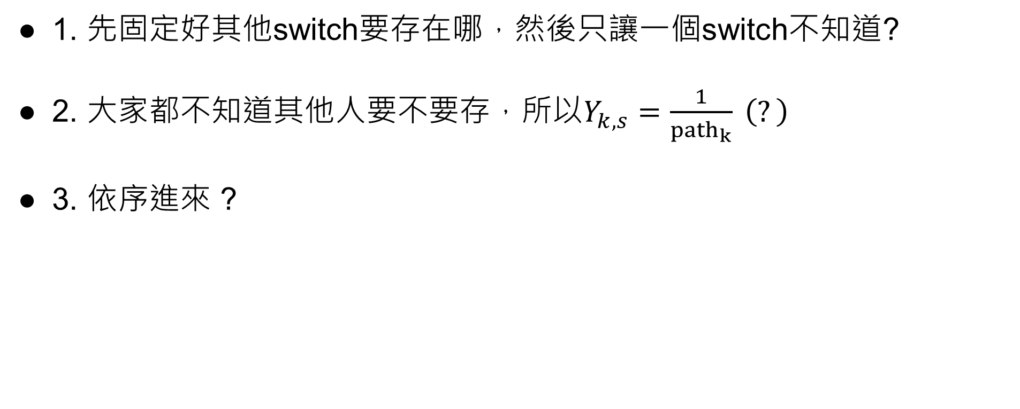
Code
1. 先固定好其他switch要存在哪，然後只讓一個switch不知道?
2. 大家都不知道其他人要不要存，所以$Y_{k,s}=\frac{1}{{path}_{k}} \left(?\right)$
3. 依序進來 ?

