Slide 1
0329

Slide 2
Last week
More general
This week
Test three way

Slide 3
Background Setting
Switch : 6
Flow : 431
Biggest size of flow : 3203
Smallest size of flow : 1

Slide 4
First Way
Add all flow to all sketch
5/3 | 5/6 | 5/9 | 6/9
4498 | 2032 | 1057 | 1028
4721 | 2733 | 1046 | 1098
5759 | 1856 | 960 | 1127
4436 | 1919 | 983 | 1058
4662 | 2243 | 982 | 1023
5160 | 1747 | 1014 | 989
5054 | 2464 | 1089 | 1090
5052 | 2386 | 892 | 1094
4933 | 2121 | 1264 | 1210
4777 | 1759 | 1189 | 1008
4905.2 | 2126 | 1047.6 | 1072.5

Slide 5
Second Way
Add flow at smallest ARE sketch
Only store in one sketch
5/3 | 5/6 | 5/9 | 6/9
1158 | 448 | 150 | 243
717 | 309 | 208 | 99
2362 | 422 | 122 | 332
914 | 456 | 98 | 116
732 | 355 | 201 | 123
822 | 407 | 138 | 148
774 | 466 | 229 | 106
1581 | 425 | 182 | 223
754 | 276 | 297.7142 | 166
1226 | 424 | 297 | 185
1104 | 398.8 | 192.2714 | 174.1

Slide 6
Third Way
Use Algo
5/3 | 5/6 | 5/9 | 6/9
488 | 186 | 87 | 89
509 | 207 | 90 | 78
545 | 192 | 75 | 76
487 | 205 | 93 | 73
477 | 207 | 85 | 71
494 | 196 | 90 | 91
526 | 212 | 81 | 80
516 | 199 | 97 | 93
508 | 205 | 91 | 84
489 | 167 | 85 | 83
503.9 | 197.6 | 87.4 | 81.8

Slide 7
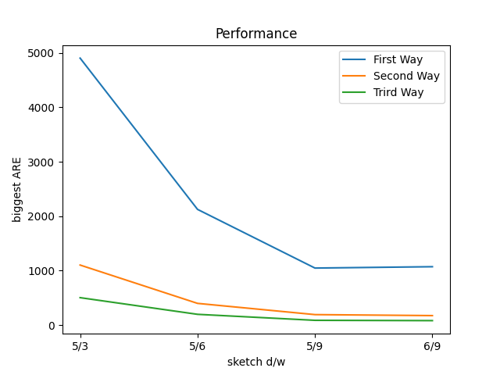
Summarize

