Slide 1

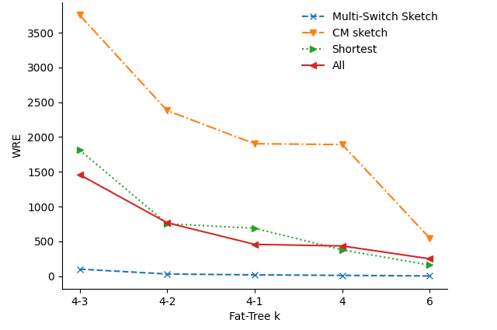
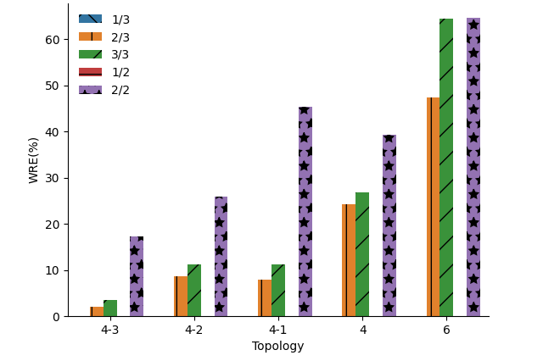
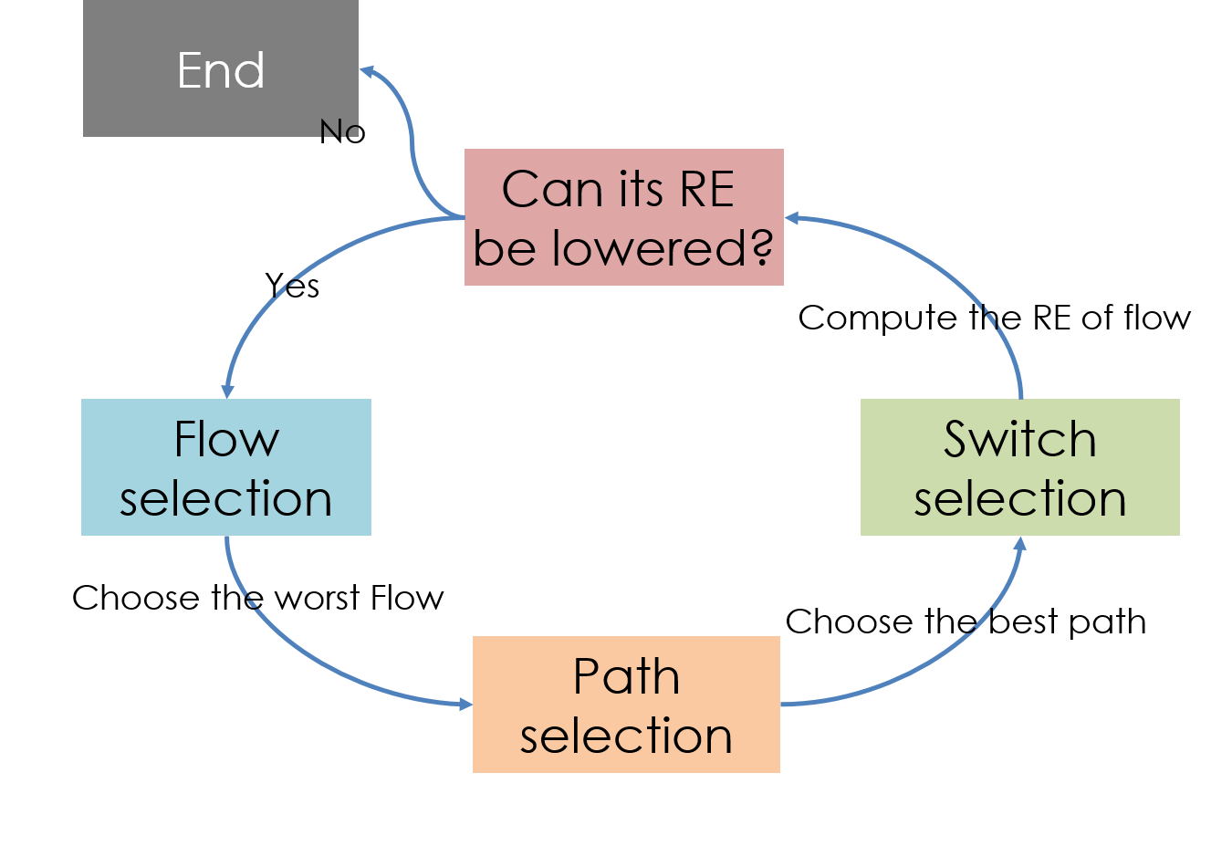
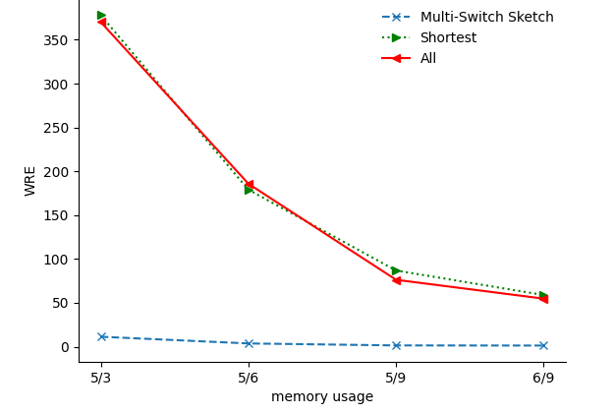
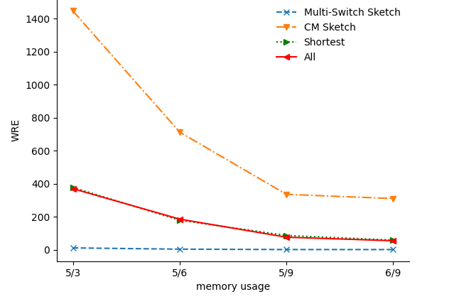
Multi-Switch Cooperative Sketch-based Monitoring
National Yang Ming Chiao Tung University, Hsinchu, Taiwan, R.O.C. Institute of Network Engineering
Wei-Te Lu,and Kate Ching-Ju Lin
Abstract
Our design is to use every switch in the network, creating a decentralized network measurement system. As each switch responds to different traffic, the overhead of each switch and the processing time of packets can be improved.
We believe that our design can enable network managers to manage the network faster and more accurately and increase user satisfaction.
Design
Flow selection: We select the flow from the set one by one. Start, choose the flow that not belongs to any switch and follow the step.3 and step.4. And keep the top k error of flow by a hash table. After each flow has been distributed to at least one switch, choose the worst flow by the top- k hash table and do the same until the flow can not get better.
Path selection: We select the path by the k-top algorithm, and adjust the parameters to find the path that joint consider the routing path overhead and accuracy.
Switch selection: As a traditional sketch, the switch will return the sketch to the controller periodically. And controller can use the sketch to accomplish the measurement task. Since we already have suitable existing data, we can use the sketch to determine which is the best switch for the flow by hash the flow to each sketch and choosing the lowest error of the sketch.
Evaluation
Conclusion
Multi-Switch Sketch:
Alleviate the degrees of collisions by cooperative monitoring
Improve the WRE of all flows
Jointly consider routing to enhance offloading opportunities
Outperform baseline schemes in different scenarios

