Slide 1
Proposal
Wade Lu

Slide 2
Outline
Background
Motivation
Problem statement

Slide 3
Background

Slide 4
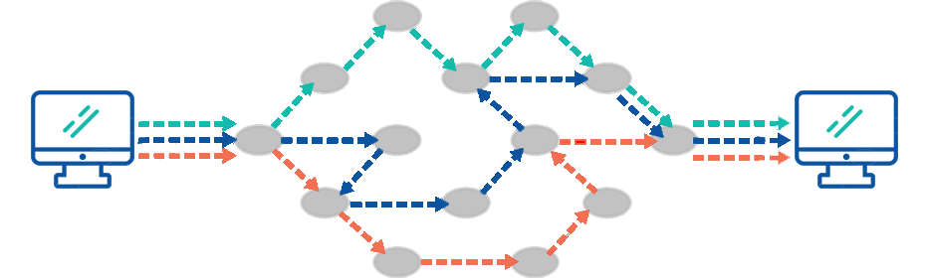
Network Traffic Measurement
Partial/Sampling Only sample packets or flows, or collect detailed statistics based on a preconfigured list of conditionals.
Probing Measures the states of devices or links by sending probing packets, and only these probes are measured.
In-band Carry information in every packet header.
Sketch-based Collects the information of every packet in a compact data structure, namely sketch, on network devices.
Notes:
網路的發展日新月異，網路的規模也在不斷的越擴越大
人類對於網路的依賴也越來越深，因此在這種情況下
對網路去進行管理是不可缺少的，而想要進行網路的管理任務，
如traffic engineering, anomaly detection, load balancing, and resource provisioning來說 網路測量的能力就變得極為重要。
現行有四種對網路去進行測量的方法
* Partial/Sampling : 只會測量所有flow中的一部份，或是進行採樣，所以最後得到的準確性不太確定是不是可信的。
* Probing : 透過發射探測封包去測量機器，並且只會去測量這些探測封包。
* In-band : 雖然可以測量得很好，但他overhead太大，會隨著網路規模而逐漸變大。
* Sketch-based : 他無法收集到重大的網路資訊，如掉包或是jitters。且大多數的sketch沒辦法實作在p4上面。

Slide 5
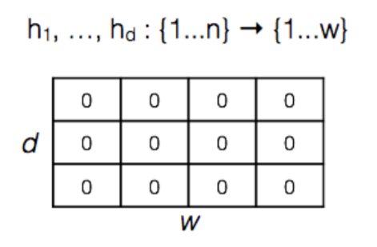
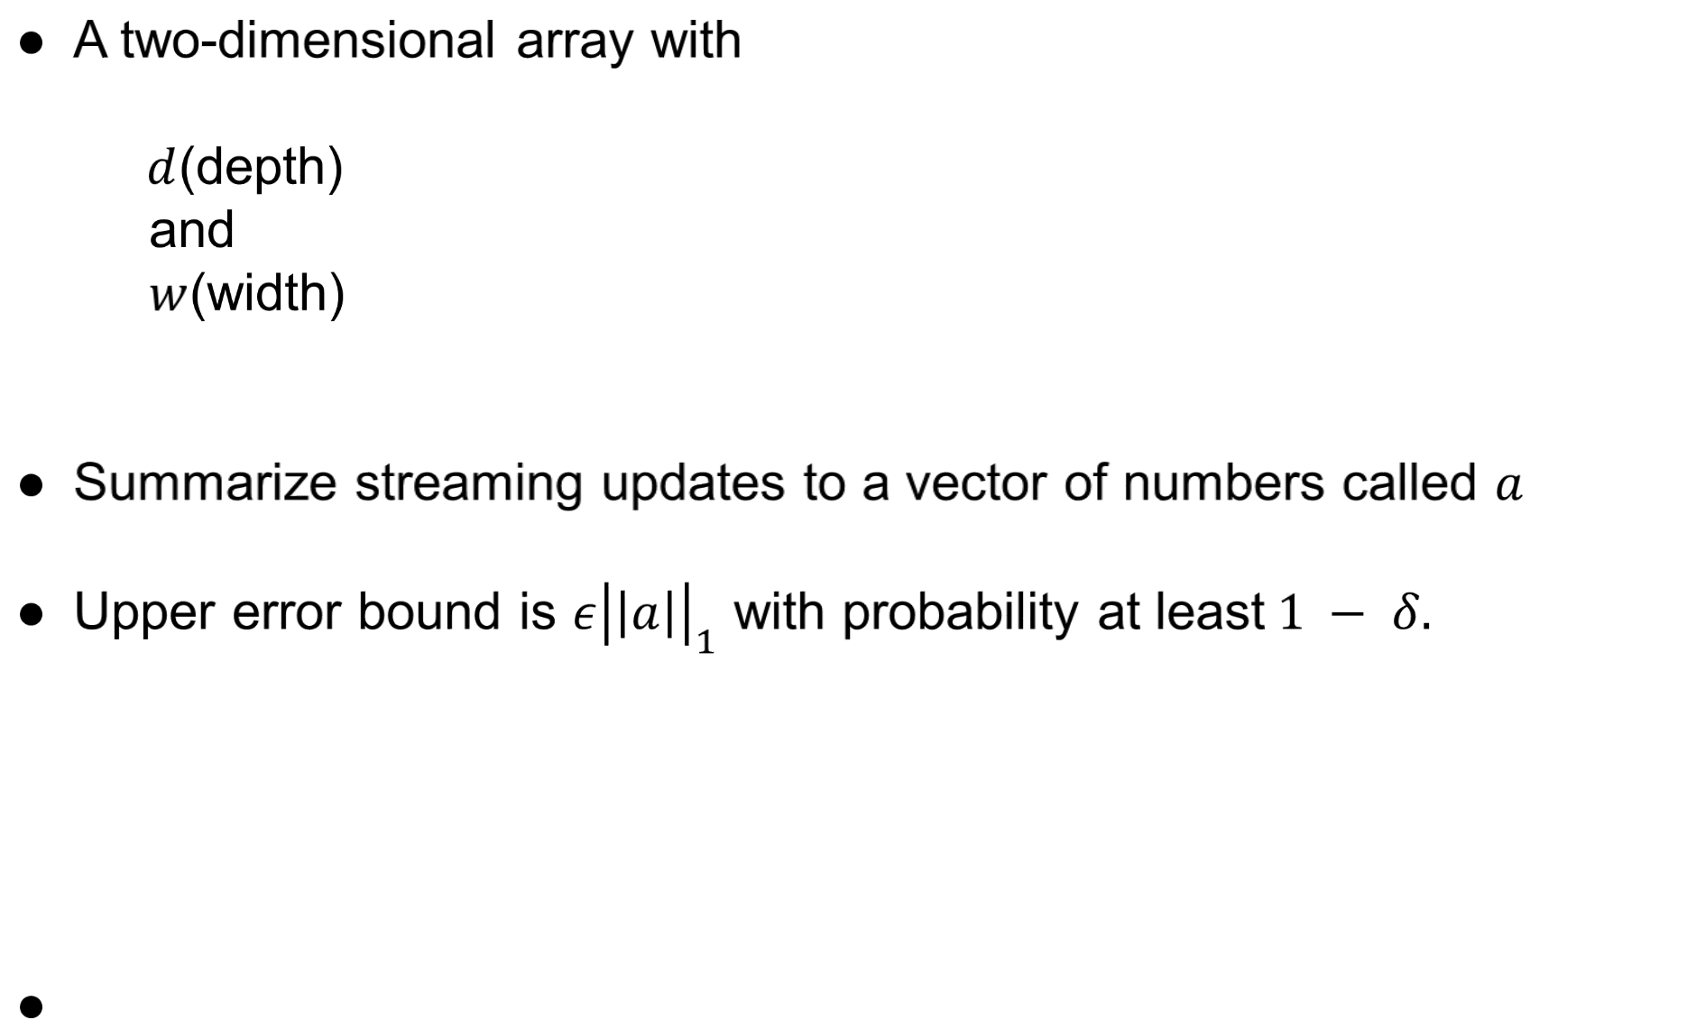


CM-Sketch
A two-dimensional array with
$d$(depth)
and
$w$(width)
Summarize streaming updates to a vector of numbers called $a$
Upper error bound is $ε{\left|\left|a\right|\right|}_{1}$ with probability at least$1 − δ.$
$$d= \left\lceil \lg\left(\frac{1}{δ}\right)\right\rceil$$
$$w= \left\lceil \frac{e}{ε}\right\rceil$$
5

Slide 6


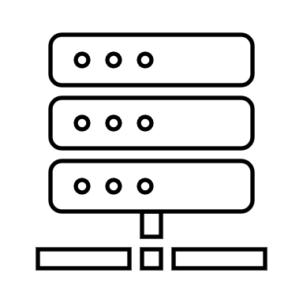





Distributed Sketch

Slide 7
Motivation
Notes:
歷年來的sketch都是注重在單一的switch，而這篇則是注重在所有switch的合作，不需要每一個switch都去紀錄，而只要某幾個switch去紀錄就好。
有點像是分散式，合作式的sketch
重點是 當今天每一個switch都去計每一個flow，這樣只會導致每一個switch都擠一堆flow
然後error反而會上升
但今天要我們可以selective去決定說哪一個switch 要存哪一些flow 讓flow不要全部擠在一起
這樣反而可以使error下降，而且我們只要保證他的誤差有在我們的控制內，就可以不用全部人都記
附帶還會讓hash function次數使用下降，進而提升網路狀況

Slide 8
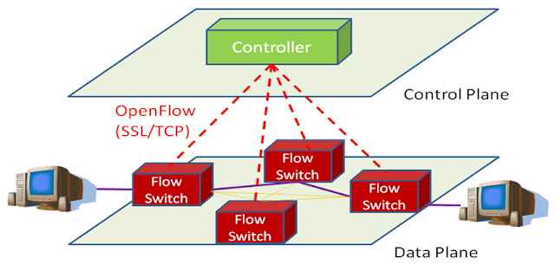
Traditional method
Notes:
歷年來的sketch都是注重在單一的switch，而這篇則是注重在所有switch的合作，不需要每一個switch都去紀錄，而只要某幾個switch去紀錄就好。
有點像是分散式，合作式的sketch 重點是 當今天每一個switch都去計每一個flow，這樣只會導致每一個switch都擠一堆flow
然後error反而會上升
但今天要我們可以selective去決定說哪一個switch 要存哪一些flow 讓flow不要全部擠在一起
這樣反而可以使error下降，而且我們只要保證他的誤差有在我們的控制內，就可以不用全部人都記
附帶還會讓hash function次數使用下降，進而提升網路狀況

Slide 9








Collision
F1
0 | 0 | 0 | 0 | 0 | 0
0 | 0 | 1 | 0 | 0 | 0
0 | 0 | 2 | 0 | 0 | 0
F2
Notes:
重點是 當今天每一個switch都去計每一個flow，這樣只會導致每一個switch都擠一堆flow
然後error反而會上升
但今天要我們可以selective去決定說哪一個switch 要存哪一些flow 讓flow不要全部擠在一起
這樣反而可以使error下降，而且我們只要保證他的誤差有在我們的控制內，就可以不用全部人都記
附帶還會讓hash function次數使用下降，進而提升網路狀況

Slide 10
F1
F1
0 | 0 | 2 | 0 | 0 | 0
0 | 0 | 2 | 0 | 0 | 0
S1
S3
F2
F2
F1
F1
0 | 0 | 2 | 0 | 0 | 0
0 | 0 | 2 | 0 | 0 | 0
S2
F2
S4
F2

Slide 11

F1
0 | 0 | 1 | 0 | 0 | 0
0 | 0 | 0 | 0 | 0 | 0
S1
0 | 0 | 1 | 0 | 0 | 0
0 | 0 | 0 | 0 | 0 | 0
S2
F2

Slide 12
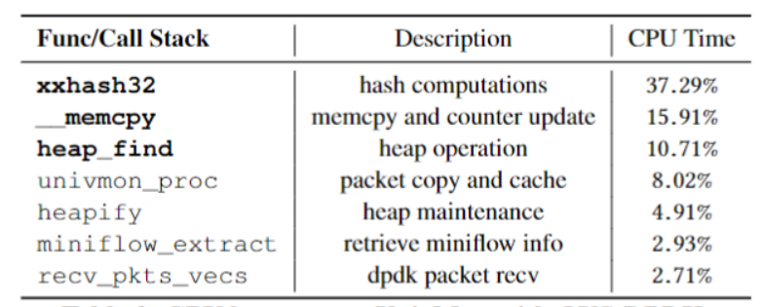


Shortcoming of sketch
Hash calls
Counter update
Error bound

Slide 13




How to deal with hash?
Strawman
- Sample packets
- Reduce numbers of hashes function
未知的作者 的 此相片 已透過 CC BY-ND 授權

Slide 14


Slide 15
Question
1.How to decide the allocation of flow?
2.Dose it really work like what I thought?
3.Can it do the same task like traditional sketch?

Slide 16
Problem statement
Notes:
先寫 ARE 後面再推導
ARE 用 例如說 w d 先寫一個簡單版的 後面再慢慢推出來

Slide 17
Question
1.How to decide the allocation of flow?
2.Dose it really work like what I thought?
3.Can it do the same task like traditional sketch?

Slide 18
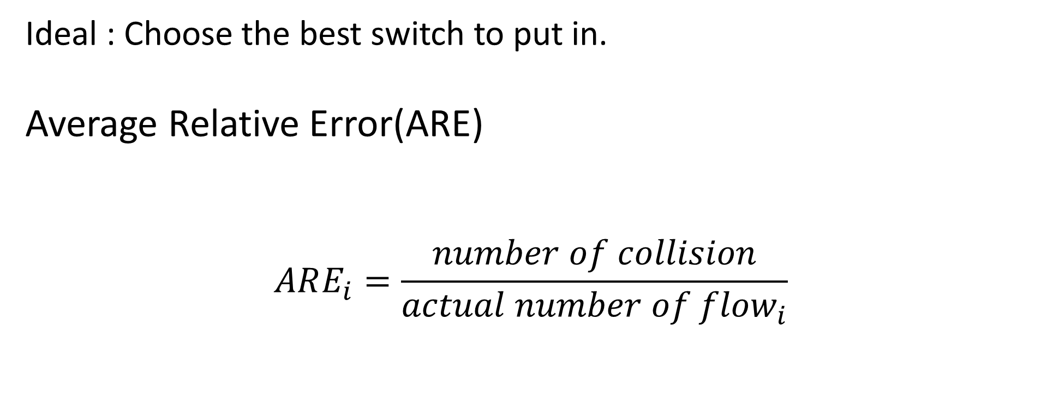
How to decide the allocation of flow?
Ideal : Choose the best switch to put in.
Average Relative Error(ARE)
$$ARE_{i}=\frac{number of collision}{actual number of flow_{i}}$$

Slide 19
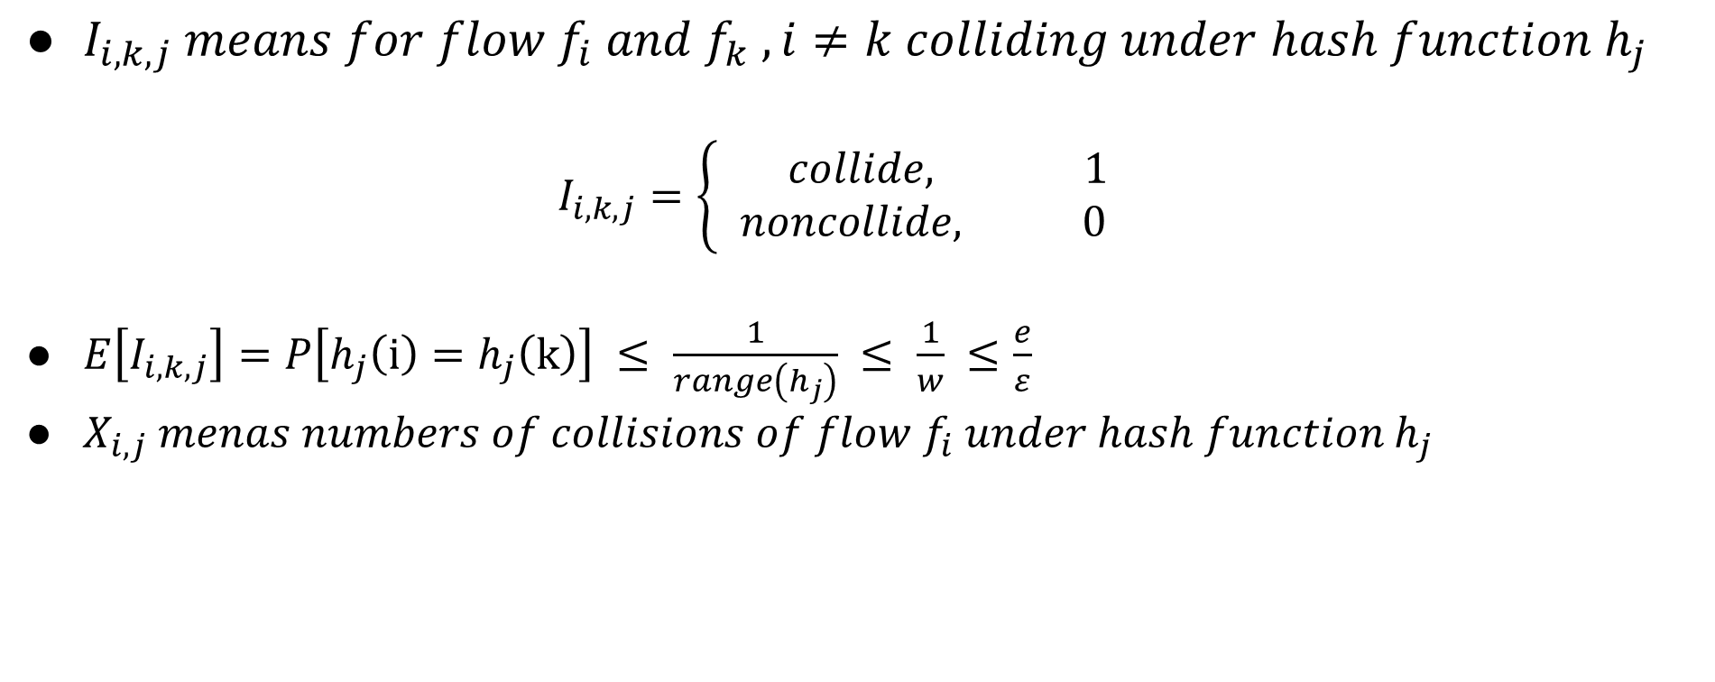
Number of collision
$I_{i,k,j} means for flow f_{i} and f_{k} ,i≠k colliding under hash function h_{j}$ $I_{i,k,j}=\left\{\begin{aligned} collide, 1 \\ &noncollide, 0\end{aligned}\right.$
$E\left[I_{i,k,j}\right]=P\left[h_{j}\left(i\right)=h_{j}\left(k\right)\right] ≤ \frac{1}{range\left(h_{j}\right)} ≤ \frac{1}{w} ≤\frac{e}{ε}$
$X_{i,j} menas numbers of collisions of flow f_{i} under hash function h_{j}$

Slide 20
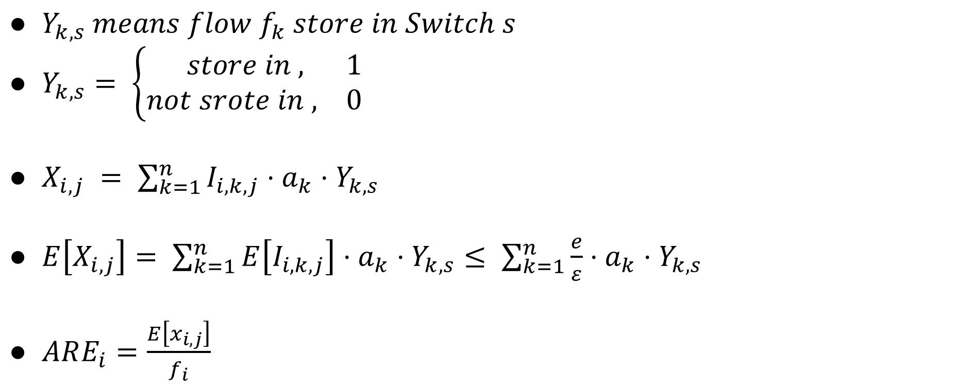
Number of collision
$Y_{k,s} means flow f_{k} store in Switch s$
$Y_{k,s}= \left\{\begin{aligned} store in , 1 \\ &not srote in , 0\end{aligned}\right.$
$X_{i,j} = \sum_{k=1}^{n}{I_{i,k,j}⋅a_{k}⋅Y_{k,s}}$
$E\left[X_{i,j}\right]= \sum_{k=1}^{n}{E\left[I_{i,k,j}\right]⋅a_{k}⋅Y_{k,s}}≤ \sum_{k=1}^{n}{\frac{e}{ε}⋅a_{k}⋅Y_{k,s}}$
$ARE_{i}=\frac{E\left[x_{i,j}\right]}{f_{i}}$

Slide 21
Problem Statement
Input
A set of switch and a set of flow
Task
Determine the location of flow
Objective
Minimize the biggest ARE

Slide 22
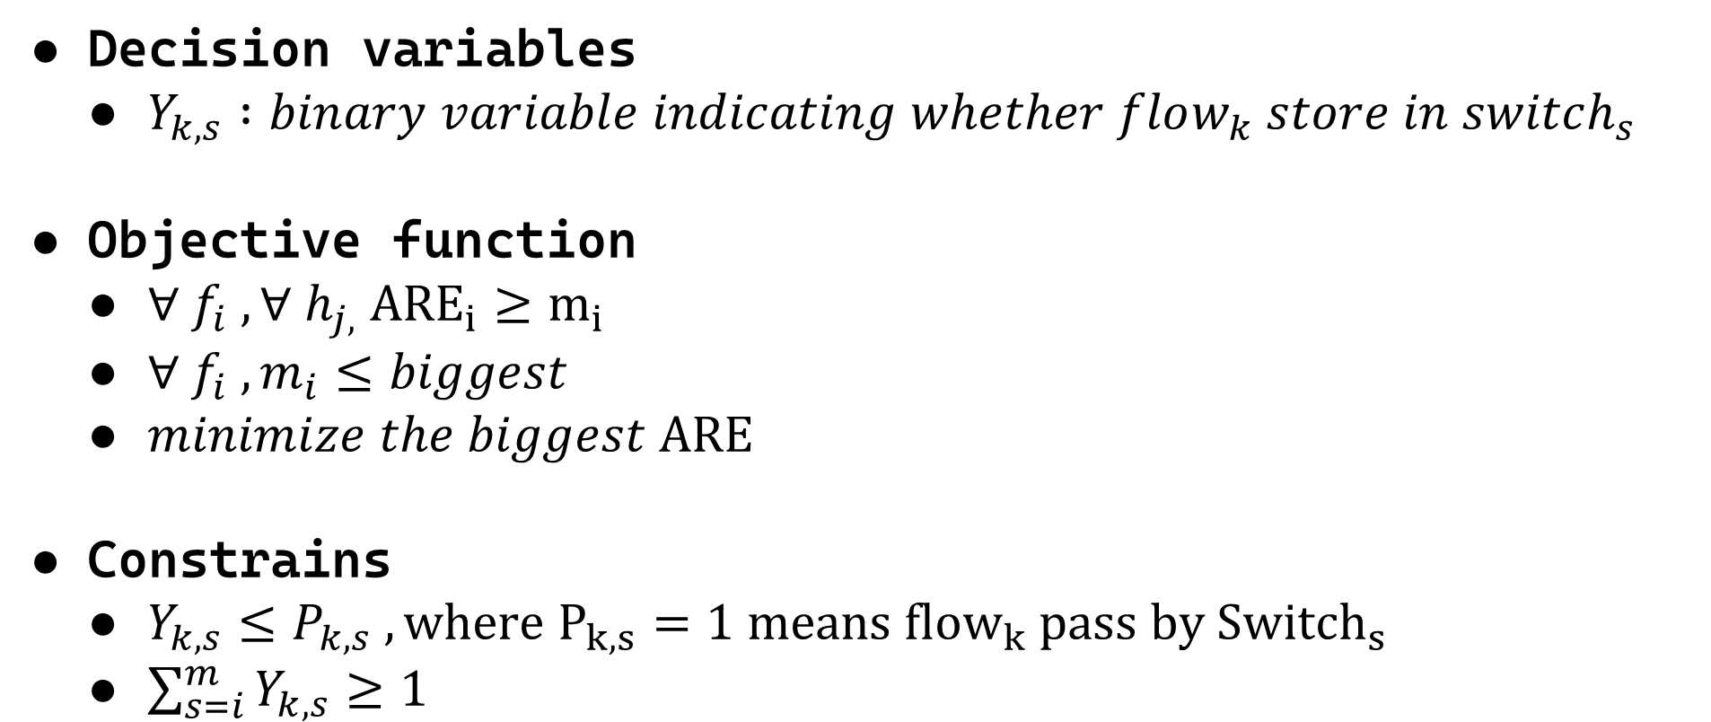
Problem Statement
Decision variables
$Y_{k,s} :binary variable indicating whether flow_{k} store in switch_{s}$
Objective function
$∀ f_{i} ,∀ h_{j,} {ARE}_{i}≥m_{i}$
$∀ f_{i} , m_{i}≤biggest$
$minimize the biggest ARE$
Constrains
$Y_{k,s}≤P_{k,s} ,where P_{k,s}=1 means {flow}_{k} pass by {Switch}_{s}$
$\sum_{s=i}^{m}{Y_{k,s}≥1}$

Slide 23
ARE
F1
0 | 0 | 0 | 0 | 0 | 0
0 | 0 | 1 | 0 | 0 | 0
0 | 0 | 2 | 0 | 0 | 0
F2

Slide 24

ARE
$$ARE_{i}=\frac{number of collision}{actual number of flow_{i}}$$

Slide 25

Cooperate
$ARE_{i}=\frac{minimum E\left[X_{i,j}\right]}{f_{i}} j∈D$
 | 1
 |  | 3
 | 4
 |  | 3
 |  |  | 3
 | 2
 |  |  |  | 3
 |  | 2
2

Slide 26
Question
1.How to decide the allocation of flow?
2.Dose it really work like what I thought?
3.Can it do the same task like traditional sketch?

Slide 27
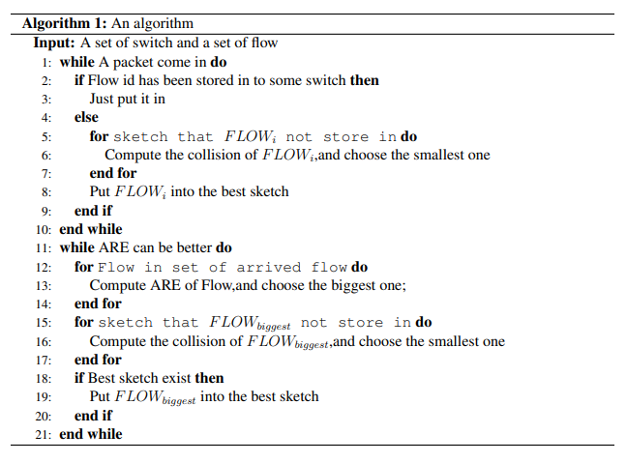
Algorithm
For first store
For multiple store
Notes:
找出最差的flow每一個switch都嘗試放放看，挑放了之後改善最好的進去放，要是每一個switch放都沒辦法變好，就結束這個演算法。

Slide 28
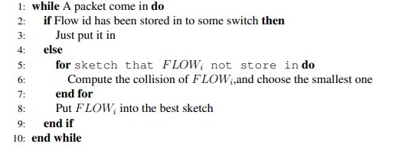
First Store

Slide 29




A1
S1
S2
B1
S3
S4
C1
S5
S6

Slide 30
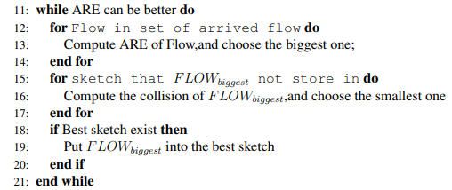
Multiple Store

Slide 31
Background Setting
B1
6 sketchs with 1 row 2 column
Numbers of packets A:120
B:6
C:11
A1
C1
A2
S1
S2
C2
A3
C3
S3
S4
A4
C4
S5
S6

Slide 32
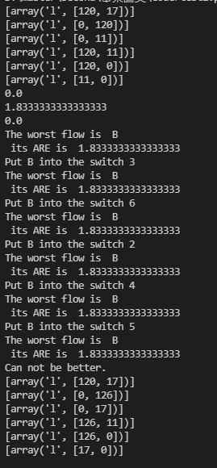
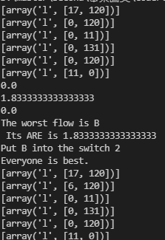
Result
Run good
Collision

Slide 33

Test 2
10 Switch with Fat tree topology
Src
Dst

Slide 34
Background Setting
First way: CM-Sketch
Second way : Choose the best one and put in(First Store)
Third way : Choose the best one and put in + Choose the worst flow and do the Multiple Store

Slide 35
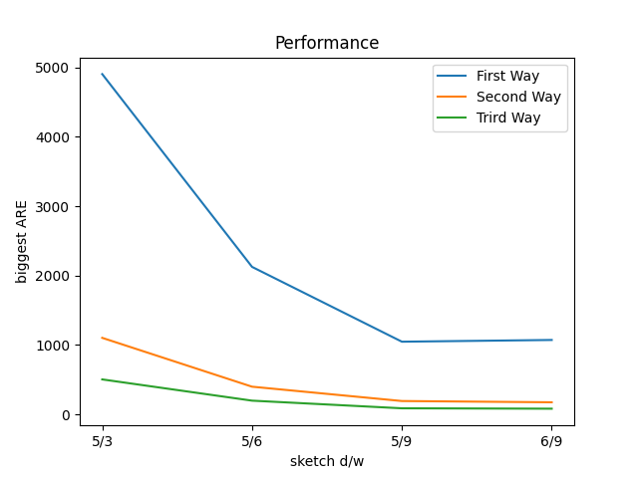
Memory Usage
Sketch w = 3, d = 5 w = 6, d = 5 w = 9, d = 5 w = 6, d = 5

Slide 36
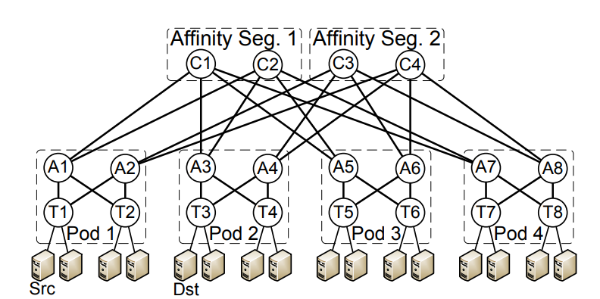
Test 3
Topology

Slide 37
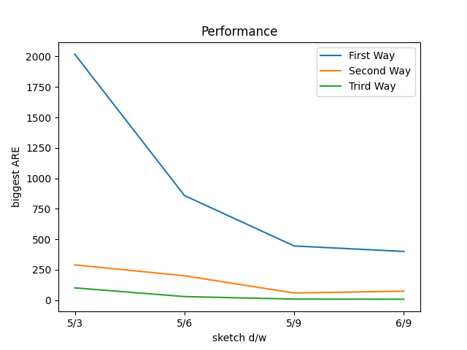
Traffic : CAIDA 2019 with random src and dst
Sketch w = 3, d = 5 w = 6, d = 5 w = 9, d = 5 w = 6, d = 5

Slide 38
Question
1.How to decide the allocation of flow?
2.Dose it really work like what I thought?
3.Can it do the same task like traditional sketch?

Slide 39
Next
Routing Algorithm
Consider packet loss

Slide 40
Accurate
Fast
Network Performance Anomalies(NPA) location
Squeeze theorem

Slide 41
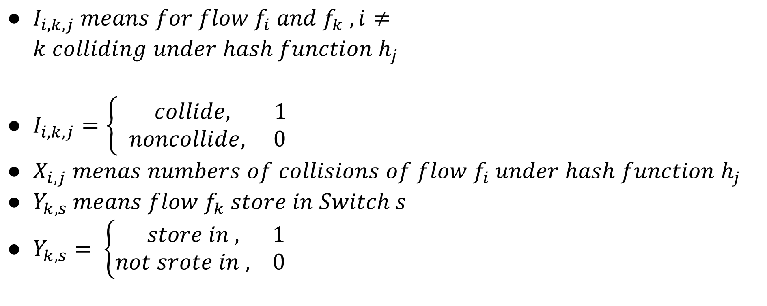
$I_{i,k,j} means for flow f_{i} and f_{k} ,i≠k colliding under hash function h_{j}$
$I_{i,k,j}=\left\{\begin{aligned} collide, 1 \\ &noncollide, 0\end{aligned}\right.$
$X_{i,j} menas numbers of collisions of flow f_{i} under hash function h_{j}$
$Y_{k,s} means flow f_{k} store in Switch s$
$Y_{k,s}= \left\{\begin{aligned} store in , 1 \\ &not srote in , 0\end{aligned}\right.$

Slide 42

$E\left[I_{i,k,j}\right]=P\left[h_{j}\left(i\right)=h_{j}\left(k\right)\right]≤\frac{1}{range(h_{j})}≤\frac{1}{w}≤\frac{e}{ε}$
$X_{i,j} = \sum_{k=1}^{n}{I_{i,k,j}⋅a_{k}⋅Y_{k,s}}$
$E\left[X_{i,j}\right]= \sum_{k=1}^{n}{E\left[I_{i,k,j}\right]⋅a_{k}⋅Y_{k,s}}≤ \sum_{k=1}^{n}{\frac{e}{ε}⋅a_{k}⋅Y_{k,s}}$
$ARE_{i}=\frac{E\left[x_{i,j}\right]}{f_{i}}$

Slide 43
Constrain
1. Size of Switch
2. Flow can store in the switch when it transmit go through it

Slide 44

$∀ f_{i} ,∀ h_{j,} {ARE}_{i}≥m_{i}$
$∀ f_{i} , m_{i}≤biggest$
$minimize the biggest ARE$

Slide 45
Idea

Slide 46
Teamwork
F1
F2
F2
F2
Src
S2
S4
F1
F1
S1
S3
Dst
Notes:
如何分配 (依據line rate來決定間的數量
Switch如何分辨flow

Slide 47

未知的作者 的 此相片 已透過 CC BY-NC 授權

