Slide 1
SoilDyn: soil interaction in OpenFAST
Loose coupling SoilDyn + SubDyn + ElastoDyn in OpenFAST
Implementation complete, testing ongoing
SoilDyn
6x6 Stiffness matrix
REDWIN DLL: Models 1, 2, 3 - Tested extensively with Model 2
Testing with Phase II model ongoing
Release in next few weeks for general use/testing

Slide 2
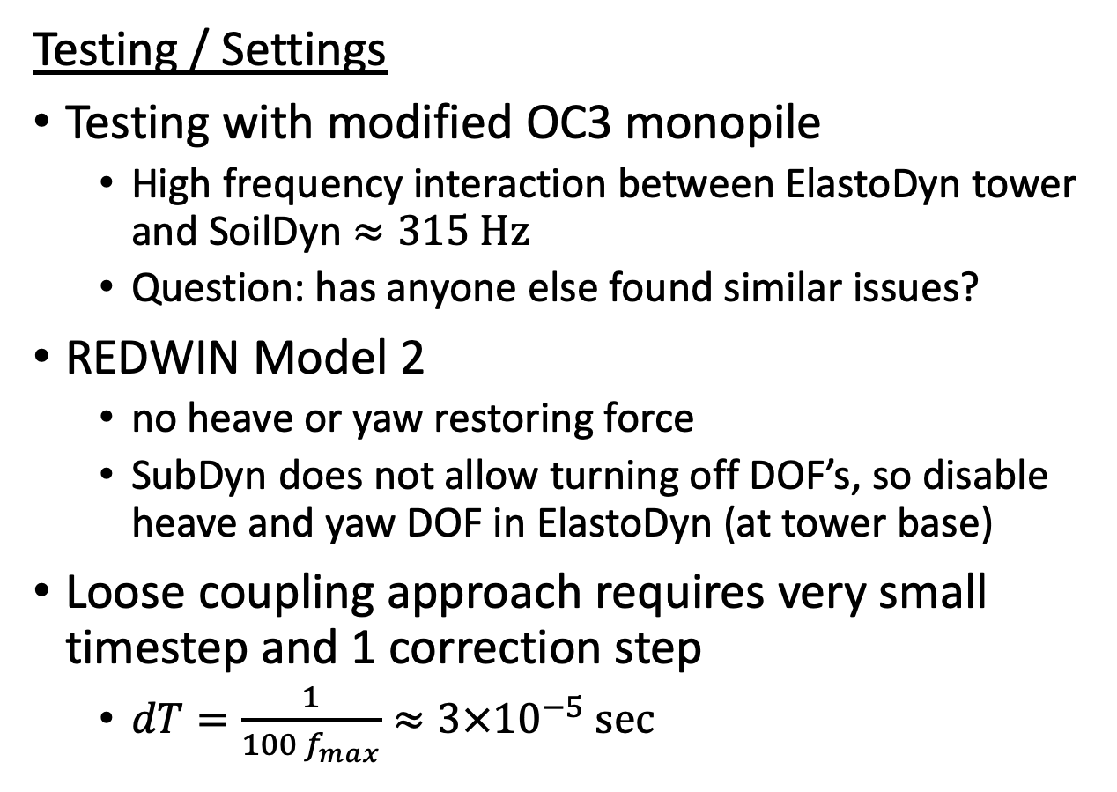
SoilDyn: soil interaction in OpenFAST
Testing / Settings
Testing with modified OC3 monopile
High frequency interaction between ElastoDyn tower and SoilDyn $≈315 \text{Hz}$
Question: has anyone else found similar issues?
REDWIN Model 2
no heave or yaw restoring force
SubDyn does not allow turning off DOF’s, so disable heave and yaw DOF in ElastoDyn (at tower base)
Loose coupling approach requires very small timestep and 1 correction step
$dT=\frac{1}{100 f_{max}}≈3×{10}^{−5} \text{sec}$

Slide 3
SoilDyn: soil interaction in OpenFAST
Tips
Loose coupling solver interaction is non-trivial
During development, 6x6 stiffness for faster debugging
REDWIN DLL
Properties and Calibration curve files must be in working directory
DLL will abort the program on errors without returning

