Slide 1
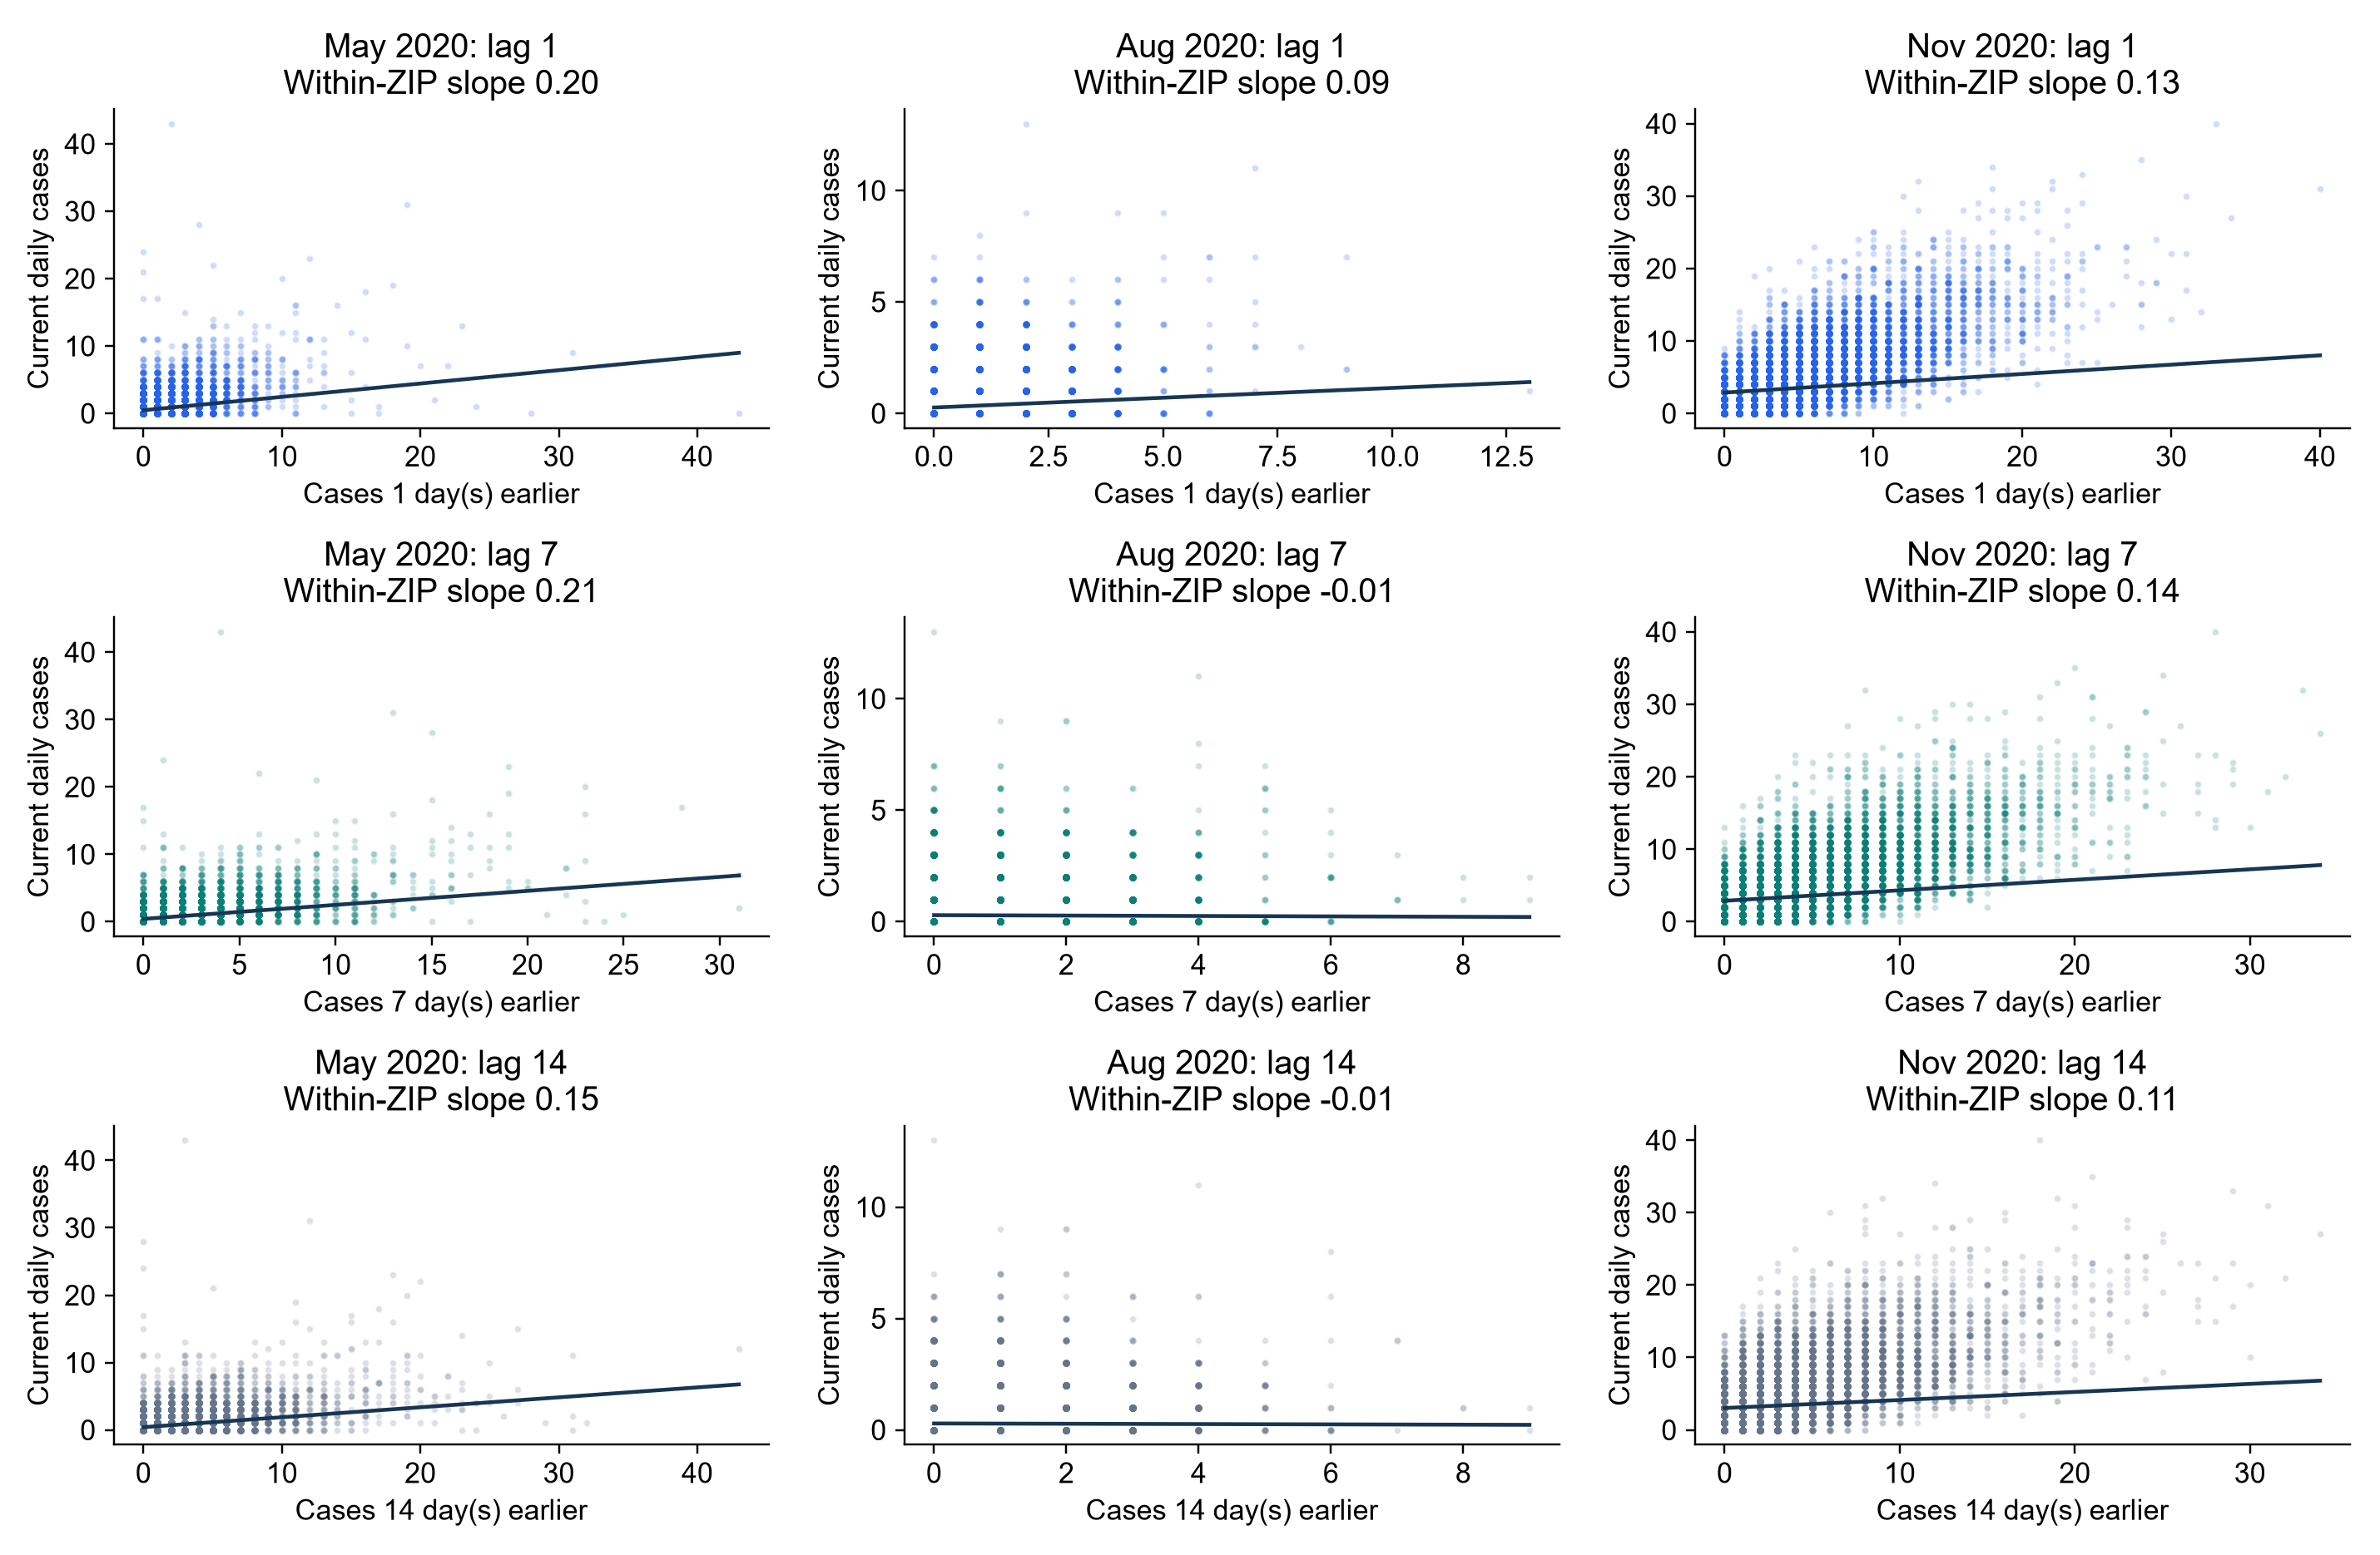
Does Case Persistence Change Over Time?
Monthly relationships between current cases and earlier cases within each ZIP
KEY FINDING
August shows weaker lag relationships. Monthly uncertainty remains wide.
NOTEBOOK 39: MAY, AUG AND NOV 2020
1
Notes:
SUGGESTED NARRATION
Our feature analysis showed that local history matters most. We then asked whether its relationship with current cases changes over time. Each point is one ZIP on one day. The three rows use cases one, seven and fourteen days earlier. The columns show May, August and November 2020. We estimate slopes after accounting for each ZIP’s average level within that month. August shows weaker relationships, especially at lag seven. May and November show positive lag-seven and lag-fourteen relationships. Lag fourteen slopes are about 0.15 in May, near zero in August and 0.11 in November. These are descriptive associations. Monthly uncertainty is wide, so we do not claim the differences between months are statistically established. The next page checks whether different lag inputs actually improve predictions.
ANALYSIS AND SOURCES
Expanded monthly_lag_relationships.csv includes lag14: May .147580 CI[.061874,.235273], August -.006833 CI[-.025394,.047488], November .110937 CI[.031663,.236444]. Bootstrap2000 draws, same fixed seed; added combinations change subsequent draws slightly. Lag1/7 point estimates unchanged. Original Notebook39 information follows for reference. May lag1 .198089 CI[-.020698,.288849],lag7 .207786[.057192,.316171];Auglag1 .087828[-.024504,.095107],lag7-.009029[-.043360,.030888];Novlag1 .128432[-.019841,.196659],lag7.144960[.042279,.262517]. 585ZIPs,May/Aug18135observations each,Nov17550. Within-ZIP demeaning separately each month. Scatter shows raw counts;line uses within-ZIP slope and grand-mean intercept, not pooled OLS. Axes differ across months. 2000 circular7daywhole-date-cross-section bootstrap,pointwise95percentinterval,recenter eachdraw. Few monthlyblocks,no formal between-month tests. NotGMM and no causalclaim.
Scope: only2020development/validation results. No2021–2023scores. Retrospective recorded-onset counts, missing-onset records excluded, historical availability unverified. Same585ZIPs and sameforecasttargets across models. Forecasts clippedat0. Original34candidates plus model-specific ZIPidentity. Exploratory previously inspected developmentdata.

