Slide 1
2021 Evaluation Design
The same forecasting rules carried forward from the 2020 development period
585
362
211,770
NJ ZIPs
Forecast origins
Three-day paths
60-day rolling training Weekly refits Daily forecasts for Days 1–3
34 candidate features, including commuting pressure
2021 temporal evaluation
Previously inspected data. No 2022–2023 results in this comparison.
NOTEBOOK 32 Retrospective temporal evaluation, 2021 only
1
Notes:
SUGGESTED NARRATION
We carried the existing model settings into 2021. Each model uses a rolling sixty-day history and refits every seven days. Every day it predicts the next three daily case counts. We compare the same585ZIPs and362forecast origins. This is a later-time evaluation, but we do not describe2021as an untouched test because some data were inspected previously.
SOURCE AND DEFINITIONS
Notebook 32. Source folder: Weikun/later_time_evaluation_outputs/evaluation_2021_20261101/. Tables: focus_period_scorecard.csv, focus_horizon_metrics.csv, focus_MAE_exploratory_HAC_tests.csv. Same 585 ZIPs, same actual targets, 60-day rolling training and weekly refits. All 34 candidate features including pressure, plus model-specific ZIP encoding. Origin dates Jan 1–Dec 28, targets through Dec 31. Prior inspection means this is not an untouched holdout. Retrospective recorded onset counts assume historical availability. Missing onset records excluded. Frozen plan: frozen_plan.json. Training labels mature before each fit. Scheduled refits can use past observed2021labels, never future targets. Warning event definition and thresholds remain from Notebook27 and2020calibration.

Slide 2
Full-Year Prediction Performance
Three-day trajectory errors across the same ZIPs and forecast origins
Trajectory MAE, cases
RMSE, cases
KEY FINDINGS
Random Forest has the lowest MAE, 1.5% below Dynamic Panel.
NOTEBOOK 32 Retrospective temporal evaluation, 2021 only
2
Notes:
SUGGESTED NARRATION
Random Forest has the lowest overall trajectory MAE at1.090cases, compared with1.107for Dynamic Panel, a1.5percent descriptive reduction. XGBoost is0.8percent lower than the benchmark. Random Forest and Dynamic Panel have almost identical RMSE around1.90. The absolute gains are small.
SOURCE AND DEFINITIONS
Notebook 32. Source folder: Weikun/later_time_evaluation_outputs/evaluation_2021_20261101/. Tables: focus_period_scorecard.csv, focus_horizon_metrics.csv, focus_MAE_exploratory_HAC_tests.csv. Same 585 ZIPs, same actual targets, 60-day rolling training and weekly refits. All 34 candidate features including pressure, plus model-specific ZIP encoding. Origin dates Jan 1–Dec 28, targets through Dec 31. Prior inspection means this is not an untouched holdout. Retrospective recorded onset counts assume historical availability. Missing onset records excluded. Trajectory MAE averages three absolute horizon errors for each ZIP-origin path, then averages all211770paths. RMSE uses all horizon errors. Values are point estimates, not confidence intervals. Rankings are descriptive.

Slide 3
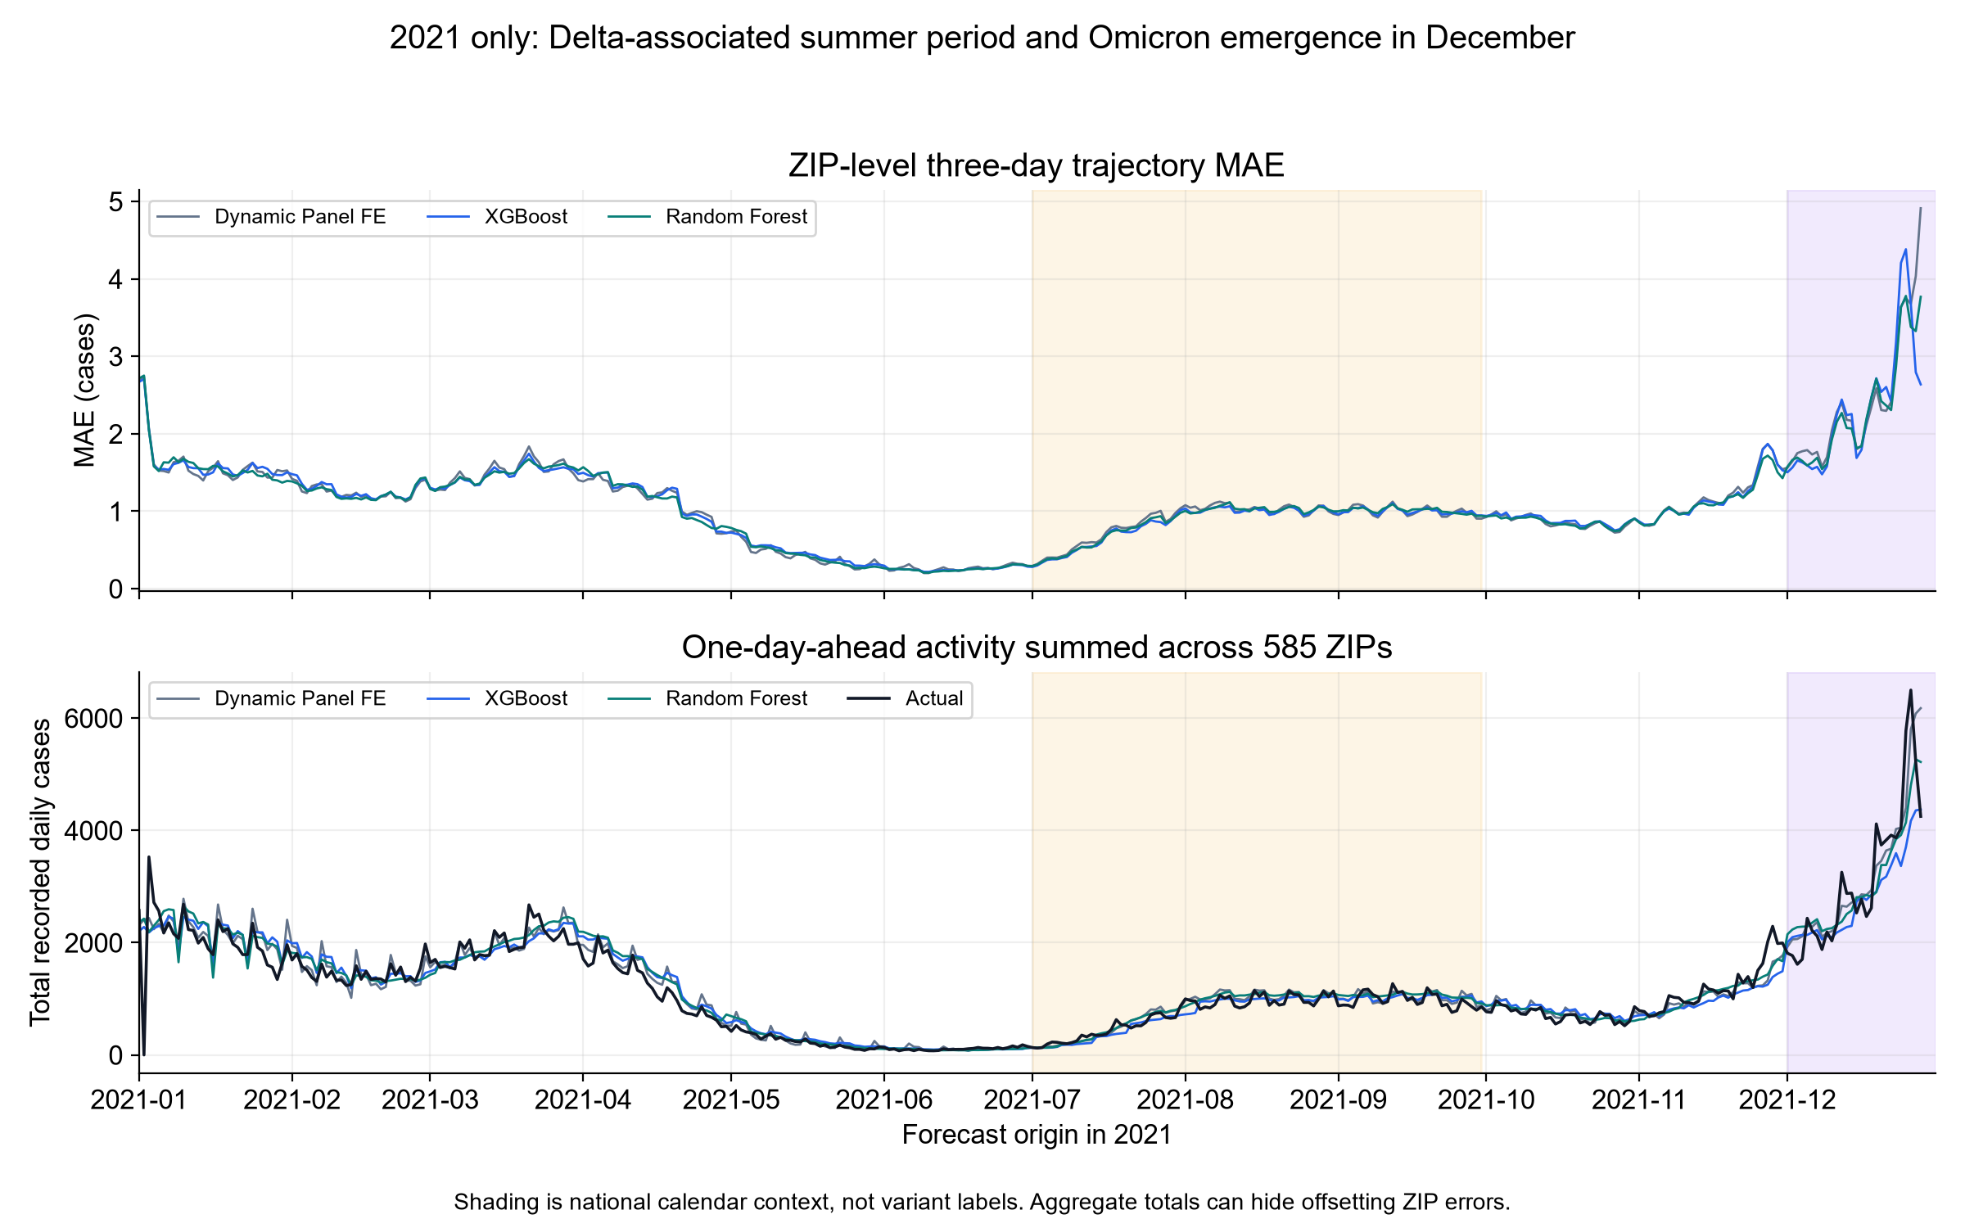
Performance Changes Through 2021
Daily ZIP-level errors alongside total observed and predicted activity
KEY FINDINGS
Errors rise sharply
in December
All models follow the
broad activity pattern.
Aggregate curves can
hide ZIP-level errors.
NOTEBOOK 32 Retrospective temporal evaluation, 2021 only
3
Notes:
SUGGESTED NARRATION
The models capture the broad aggregate pattern, but all have larger absolute ZIP-level errors during the December surge. Aggregate totals can look accurate even when errors cancel across ZIPs, so we retain the ZIP-level trajectory MAE as the main count measure.
SOURCE AND DEFINITIONS
Notebook 32. Source folder: Weikun/later_time_evaluation_outputs/evaluation_2021_20261101/. Tables: focus_period_scorecard.csv, focus_horizon_metrics.csv, focus_MAE_exploratory_HAC_tests.csv. Same 585 ZIPs, same actual targets, 60-day rolling training and weekly refits. All 34 candidate features including pressure, plus model-specific ZIP encoding. Origin dates Jan 1–Dec 28, targets through Dec 31. Prior inspection means this is not an untouched holdout. Retrospective recorded onset counts assume historical availability. Missing onset records excluded. Original Python figure01_2021_errors_and_activity.png. Top averages errors over ZIP paths. Bottom sums one-day-ahead predictions and actuals. Forecast origin on x-axis. Larger absolute errors also reflect higher case volume. Shading gives national calendar context, not NJ variant labels. CDC https://www.cdc.gov/mmwr/volumes/71/wr/mm7106a4.htm. December includes mixed Delta/Omicron circulation and excludes January2022peak.

Slide 4
Delta and Omicron Contexts
Trajectory MAE in cases. Model rankings differ across two periods within 2021
Delta context: July–September
Omicron emergence: December
XGBoost: lowest MAE, 2.8% below benchmark
Random Forest: lowest MAE, 4.6% below benchmark
NOTEBOOK 32 Retrospective temporal evaluation, 2021 only
4
Notes:
SUGGESTED NARRATION
XGBoost has the lowest MAE in the Delta-associated summer context. Random Forest has the lowest MAE during December. We therefore do not see one model leading in every period. December errors are much larger, alongside much higher case activity.
SOURCE AND DEFINITIONS
Notebook 32. Source folder: Weikun/later_time_evaluation_outputs/evaluation_2021_20261101/. Tables: focus_period_scorecard.csv, focus_horizon_metrics.csv, focus_MAE_exploratory_HAC_tests.csv. Same 585 ZIPs, same actual targets, 60-day rolling training and weekly refits. All 34 candidate features including pressure, plus model-specific ZIP encoding. Origin dates Jan 1–Dec 28, targets through Dec 31. Prior inspection means this is not an untouched holdout. Retrospective recorded onset counts assume historical availability. Missing onset records excluded. Delta origins Jul1–Sep27,89days, all targets bySep30. December origins Dec1–28,28days, all targets byDec31. Mean actual counts1.365vs5.392cases perZIP-target. Calendar context from CDC https://www.cdc.gov/mmwr/volumes/71/wr/mm7106a4.htm. These are not variant-confirmed infections or causal variant effects.

Slide 5
2021 Outbreak Warning Performance
DP = Dynamic Panel, XGB = XGBoost, RF = Random Forest. Original warning rule.
Average Precision (AP)
Event detection rate
Correct warnings / all warnings
KEY FINDINGS
XGBoost issues more reliable warnings, but misses more events.
NOTEBOOK 32 Retrospective temporal evaluation, 2021 only
5
Notes:
SUGGESTED NARRATION
Random Forest has the highest AP, around0.544. Dynamic Panel and Random Forest detect about80percent of eligible events. XGBoost detects76.4percent, but82.8percent of its issued warnings are correct, the highest precision. This shows the trade-off between finding more events and issuing fewer false warnings.
SOURCE AND DEFINITIONS
Notebook 32. Source folder: Weikun/later_time_evaluation_outputs/evaluation_2021_20261101/. Tables: focus_period_scorecard.csv, focus_horizon_metrics.csv, focus_MAE_exploratory_HAC_tests.csv. Same 585 ZIPs, same actual targets, 60-day rolling training and weekly refits. All 34 candidate features including pressure, plus model-specific ZIP encoding. Origin dates Jan 1–Dec 28, targets through Dec 31. Prior inspection means this is not an untouched holdout. Retrospective recorded onset counts assume historical availability. Missing onset records excluded. 2752eligible2021events. DP2217detected/3028warnings; XGB2102/2539; RF2214/2863. AP is origin-level average_precision_score, not accuracy or warning precision. Positive eligible-origin share4.514percent. Warning event: trailingMA3 exceeds28earlier MA3mean+2sampleSD, latest3days total>=5, two consecutive qualifying days confirm onsecond. Reset7nonqualifyingdays. Thresholdstrict>0 allmodels from2020calibration,7daywarningcooldown,one-to-oneeventmatchingwithin1–3days. Event recall and warning precision use different denominators.

Slide 6
Warning Trade-Offs Across Epidemic Periods
The same warning rule, with different case activity and event prevalence
Event detection: Delta context
Event detection: December
Warning precision
Delta: 76.2% / 82.5% / 76.4%
December: 58.6% / 84.5% / 77.3%
NOTEBOOK 32 Retrospective temporal evaluation, 2021 only
6
Notes:
SUGGESTED NARRATION
Across both periods, XGBoost has the highest warning precision and lower event recall. The precision gap is particularly large in December. Dynamic Panel detects84percent of events but only58.6percent of its warnings match events. XGBoost detects81.3percent and achieves84.5percent warning precision. Model choice therefore depends on the cost of missed events and false warnings.
SOURCE AND DEFINITIONS
Notebook 32. Source folder: Weikun/later_time_evaluation_outputs/evaluation_2021_20261101/. Tables: focus_period_scorecard.csv, focus_horizon_metrics.csv, focus_MAE_exploratory_HAC_tests.csv. Same 585 ZIPs, same actual targets, 60-day rolling training and weekly refits. All 34 candidate features including pressure, plus model-specific ZIP encoding. Origin dates Jan 1–Dec 28, targets through Dec 31. Prior inspection means this is not an untouched holdout. Retrospective recorded onset counts assume historical availability. Missing onset records excluded. Values ordered DynamicPanel/XGBoost/RandomForest. Delta791eligibleevents, detection617/577/623, warnings810/699/815. December475eligibleevents, detection399/386/398, warnings681/457/515. Retain original continuous2021cooldown, do not reset at period boundaries. Include events with an eligible origin in the period1–3days beforeconfirmation. AP not plottedhere.

Slide 7
What the Evidence Supports
Small average gains and substantial differences in warning behavior
Delta context
December
XGBoost improves MAE by 0.025 cases
Random Forest has the lowest point MAE
Exploratory adjusted p = 0.0019
versus Dynamic Panel
Uncertainty intervals include zero
for both comparisons with the benchmark
No single model leads across every period and metric.
Continue reporting trajectory accuracy together with warning recall and precision.
NOTEBOOK 32 Retrospective temporal evaluation, 2021 only
7
Notes:
SUGGESTED NARRATION
The Delta-period MAE gain for XGBoost is supported by our exploratory comparison. The adjustedpvalue is0.0019. December has only28forecast origins and the intervals includezero, so the point ranking does not establish a clear winner. Our main conclusion is that overall count accuracy and warning performance answer different questions.
SOURCE AND DEFINITIONS
Notebook 32. Source folder: Weikun/later_time_evaluation_outputs/evaluation_2021_20261101/. Tables: focus_period_scorecard.csv, focus_horizon_metrics.csv, focus_MAE_exploratory_HAC_tests.csv. Same 585 ZIPs, same actual targets, 60-day rolling training and weekly refits. All 34 candidate features including pressure, plus model-specific ZIP encoding. Origin dates Jan 1–Dec 28, targets through Dec 31. Prior inspection means this is not an untouched holdout. Retrospective recorded onset counts assume historical availability. Missing onset records excluded. Paired errors averaged across585ZIPs byforecast date. HAC7lags, Holm adjustment over6plannedfocuscontrasts. Delta DP−XGB=.0252046576,95percent7daydate-blockbootstrapCI .012617to.040323,rawp.0003825,Holmp.0019124. December DP−XGB=.0901436,CI−.159803to.129681,Holmp.841293; DP−RF=.1095384,CI−.020569to.157396,Holmp.341889.2000pairedcommondateblockresamples,14day sensitivity available. Intervals describe error differences conditional on fitted predictions, not prediction intervals for daily cases. Exploratory previously inspected2021data.

