Slide 1
Our Outbreak Definition
A rule-defined case-surge event for each NJ ZIP
01
Current activity
Trailing 3-day mean exceeds historical mean + 2 SD
02
Minimum size
At least 5 recorded cases across the latest 3 days
03
Confirmation
Two consecutive qualifying days; event starts on Day 2
Baseline: 28 earlier 3-day means, excluding the latest 3 positions.
Event resets after 7 consecutive nonqualifying days.
NOTEBOOK 27 Exploratory retrospective analysis
1
Notes:
SUGGESTED NARRATION
We define a case-surge event separately for each ZIP. Its three-day mean must exceed its historical mean plus two standard deviations, with at least five cases over three days. We confirm the event on the second consecutive qualifying day. This is a research definition rather than an official outbreak label.
SOURCE AND DEFINITIONS
Source: Notebook27, Weikun/outbreak_task_outputs/case_surge_v1_20261101/. Exact definitions: task_definition.json; assessment results: warning_metrics.csv. Existing models, no refit. Same585ZIPs. Research-defined case-surge events, not independently adjudicated outbreaks. Retrospective onset availability assumed; missing-onset records excluded. For day t, MA3=(C[t]+C[t-1]+C[t-2])/3. Baseline is MA3[t-30] through MA3[t-3],28values, sampleSD ddof1. Strict MA3 exceedance and sum>=5. Onset=confirmation day, never backdated. Active state ends on seventh consecutive nonqualifying day. No recurrent confirmation while active. Thresholds are prespecified v1 research choices, not CDC standards. Full2020 catalog:1838events in496of585ZIPs; these full-year counts differ from scored assessment events.

Slide 2
Warning Evaluation Design
Same event labels and forecast origins for all three models
Calibration
Assessment
Apr 30–Aug 28, 2020
Sep 1–Dec 28, 2020
All future targets end by Aug 31.
Predict new confirmations within 1–3 days.
Choose warning thresholds here.
585 ZIPs; 1,131 eligible events.
One warning matches one event. Seven-day cooldown limits repeat alerts.
Risk scores come from existing three-day predictions. No model retraining.
NOTEBOOK 27 Exploratory retrospective analysis
2
Notes:
SUGGESTED NARRATION
We calibrated warning thresholds using April through August and assessed them in September through December. All calibration targets end before September. The models forecast whether a new event confirmation will occur within the next three days, while the ZIP is currently outside an event. The assessment contains1,131eligible events.
SOURCE AND DEFINITIONS
Source: Notebook27, Weikun/outbreak_task_outputs/case_surge_v1_20261101/. Exact definitions: task_definition.json; assessment results: warning_metrics.csv. Existing models, no refit. Same585ZIPs. Research-defined case-surge events, not independently adjudicated outbreaks. Retrospective onset availability assumed; missing-onset records excluded. Risk=max over confirmation days t+1..t+3 of minimum of two consecutive qualification margins. Each margin incorporates normalized threshold exceedance and minimum5case gate. Normalizer=max(baselineSD,1). Forecasts clipped at0, no refit. Eligible origin inactive with baseline available. Warning score>threshold. Grid0,.25,.5,1,2,3,5,10,infinity; smallest nonnegative value achieving <=1false warning/30at-riskZIP-days in calibration. All3select0; budget is loose and not evidence of optimization. OriginsAug29–31 omitted. One-to-one event matching with earliest warning1..3days before confirmation; issue cooldown7days. Assessment event denominator includes only events with eligible scored origins. Prior inspection makes this exploratory, not an untouched test.

Slide 3

Precision–Recall Performance
Average Precision (AP) summarizes ranking across warning thresholds
KEY FINDINGS
AP: 0.520 / 0.542 / 0.540
Dynamic Panel / XGBoost / Random Forest
Positive share: 5.94%
AP is a ranking summary, not percentage accuracy.
NOTEBOOK 27 Exploratory retrospective analysis
3
Notes:
SUGGESTED NARRATION
Precision asks how many warnings are correct, while recall asks how many positives we find. Average Precision summarizes this trade-off across thresholds. XGBoost and Random Forest have similar AP, around0.54. The positive origin share is5.94percent, which gives context. We have not established that their small AP difference is statistically significant.
SOURCE AND DEFINITIONS
Source: Notebook27, Weikun/outbreak_task_outputs/case_surge_v1_20261101/. Exact definitions: task_definition.json; assessment results: warning_metrics.csv. Existing models, no refit. Same585ZIPs. Research-defined case-surge events, not independently adjudicated outbreaks. Retrospective onset availability assumed; missing-onset records excluded. average_precision_score, step-integrated PR summary, not trapezoidal PRarea. AP DP.5200263937,XGB.5420565706,RF.5400816447. PRunit=eligibleZIP-origin, label confirmation within next3days. Positive3299/55541=.05939756. Event-level precision/recall on nextslide use collapsed matched warnings and event denominators and need not equal a point on origin-level PRcurve. Risk is a score, not a calibrated probability. Read warning_metrics.csv assessment rows and risk_scores files.

Slide 4
Detection, Lead Time and Warning Precision
Same three models, with lead time measured before event confirmation
Event recall by lead time
Correct warnings / all warnings
3.8%
2.4%
1.1%
16.4%
7.8%
13.5%
58.4%
64.1%
63.4%
Total: 78.6% / 72.9% / 79.3%
XGBoost has the highest precision
Recall: all 1,131 eligible events. Precision: issued warnings. Most detections have a 1-day lead.
NOTEBOOK 27 Exploratory retrospective analysis
4
Notes:
SUGGESTED NARRATION
The left bars stack the shares detected exactly one, two and three days before confirmation. Their total is each model’s event recall. Random Forest detects79.3percent of all eligible events. The right chart uses issued warnings as its denominator, with XGBoost highest at83.7percent. Most detections occur only one day before confirmation.
SOURCE AND DEFINITIONS
Source: Notebook27, Weikun/outbreak_task_outputs/case_surge_v1_20261101/. Exact definitions: task_definition.json; assessment results: warning_metrics.csv. Existing models, no refit. Same585ZIPs. Research-defined case-surge events, not independently adjudicated outbreaks. Retrospective onset availability assumed; missing-onset records excluded. Sources: Notebook27 warning_metrics.csv assessment and Notebook28 lead_time_breakdown.csv. DP exact lead counts661/185/43, XGB725/88/12, RF717/153/27. Every left segment divides by1131eligibleevents; right precision denominators1309/986/1170warnings. Events matched once using earliest warning in1..3days under7day cooldown. Confirmation is second qualifying day, so lead1often already has first abnormal day observed. Left and right denominators differ, and no formal superiority significance claim is made.

Slide 5
Warning Lead Time
Time before the rule-defined event confirmation
Mean lead time among detected events
KEY FINDINGS
Median: 1 day for all
Most successful warnings are close to confirmation.
First abnormal day may already be observed
Lead time does not establish warning before all abnormal activity.
NOTEBOOK 27 Exploratory retrospective analysis
5
Notes:
SUGGESTED NARRATION
Median lead time is one day for all three models. Mean lead times range from1.14to1.30days among detected events. Because our event requires two consecutive abnormal days, an alert one day before confirmation may already use the first abnormal day. These results do not demonstrate warning before the biological start of an outbreak.
SOURCE AND DEFINITIONS
Source: Notebook27, Weikun/outbreak_task_outputs/case_surge_v1_20261101/. Exact definitions: task_definition.json; assessment results: warning_metrics.csv. Existing models, no refit. Same585ZIPs. Research-defined case-surge events, not independently adjudicated outbreaks. Retrospective onset availability assumed; missing-onset records excluded. Lead=confirmationdate−firstmatchedwarningorigin,1..3days only. MeansDP1.30484,XGB1.13576,RF1.23077; mediansall1. Conditional on detected events; missed events excluded from this mean and reported on previousslide. One can have lower recall yet longer lead on a different detected subset, so means alone should not rank models. Next: review event/falsewarning examples and sensitivity of event definitions, then freeze for later-year retrospective evaluation. No2021–2023results included.

Slide 6
Does the Outbreak Definition Change Results?
Sensitivity analysis: 3-, 5- and 7-day means | Sep–Dec 2020
Dynamic Panel
XGBoost
Random Forest
Average Precision (AP)
Event detection rate
Warning precision
XGBoost: highest warning precision in all three settings (~84%).
Higher precision alone does not determine the final model.
Different definitions = different events. Forecast horizon stays 3 days.
NOTEBOOK 29 Exploratory retrospective analysis
6
Notes:
SUGGESTED NARRATION
We compared three outbreak definitions using the existing forecasts. XGBoost has the highest warning precision under all three definitions, at about84percent. However, five-day event recall is79.8percent for XGBoost versus82.6percent for Random Forest. We therefore consider missed events and warning lead time as well as precision. Higher AP under longer smoothing does not establish a better model because the event labels themselves change.
SOURCE AND DEFINITIONS
Source: Notebook27, Weikun/outbreak_task_outputs/case_surge_v1_20261101/. Exact definitions: task_definition.json; assessment results: warning_metrics.csv. Existing models, no refit. Same585ZIPs. Research-defined case-surge events, not independently adjudicated outbreaks. Retrospective onset availability assumed; missing-onset records excluded. Notebook29: outbreak_smoothing_outputs/smoothing_3_5_7_20261101/assessment_comparison.csv. All585ZIPs, Sep1–Dec28 origins2020; future3days unchanged. Three-day definition remains primary;5/7day definitions are sensitivity analyses. Eligible events1131/1082/992 under3/5/7. Warning thresholds selected on earlier calibration only, all0. Minimum size remains last3day sum>=5;2consecutive qualifying days and7day reset unchanged. Historical baseline uses28earlier means of the same smoothing window with gap equal to that window, so baseline changes as well. Longer smoothing incorporates more known history. No retraining, no2021–2023assessment, no significance claim for ranking. Median lead time remains1day for all models/settings.

Slide 7
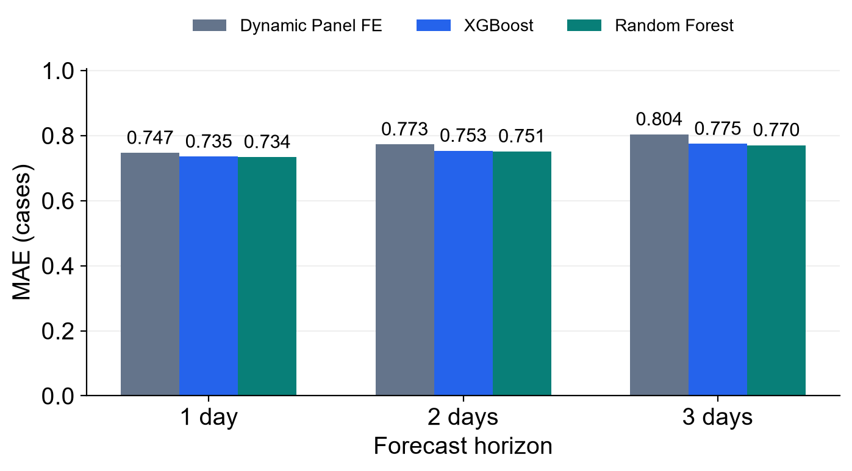
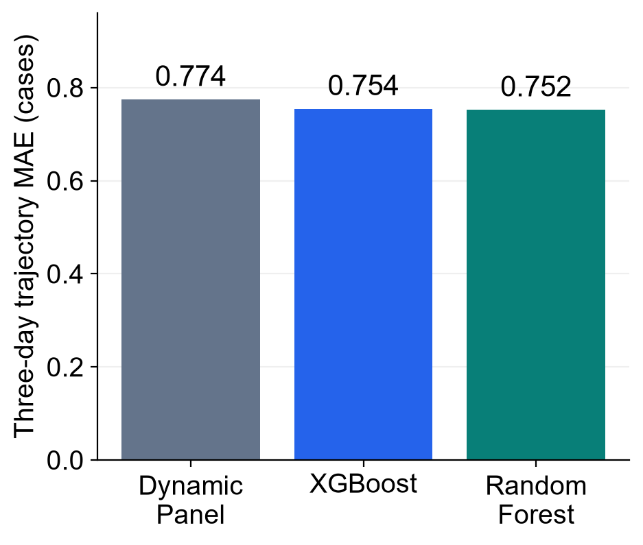
Overall Prediction Performance
585 ZIPs, Apr 30–Dec 28, 2020. Same targets, 60-day training, weekly refits.
Daily case MAE by horizon
Three-day trajectory MAE
KEY FINDINGS
Trajectory MAE: RF improves 2.9%, XGBoost 2.6% versus Dynamic Panel.
RMSE favors Dynamic Panel: 1.418 versus 1.431 (XGB) and 1.436 (RF).
MODEL COMPARISON Exploratory retrospective analysis
7
Notes:
SUGGESTED NARRATION
We compare the same585ZIPs and the same243forecast origins, from April30 through December28 in2020. Random Forest has the lowest mean absolute error at every horizon. Its overall three-day trajectory MAE is0.752, compared with0.774for Dynamic Panel, a2.9percent improvement. XGBoost improves MAE by2.6percent. However, Dynamic Panel has the lowest RMSE, which gives greater weight to larger errors. There is therefore no single winner across both measures.
SOURCE AND DEFINITIONS
Source: Notebook27, Weikun/outbreak_task_outputs/case_surge_v1_20261101/. Exact definitions: task_definition.json; assessment results: warning_metrics.csv. Existing models, no refit. Same585ZIPs. Research-defined case-surge events, not independently adjudicated outbreaks. Retrospective onset availability assumed; missing-onset records excluded. Source: model_prediction_comparison_outputs/comparison_20261101/metrics_by_horizon.csv, overall_trajectory_metrics.csv and summary.json. Same ZIP, origin, horizon and actual arrays checked exactly across all3NPZfiles. Prediction=max(raw_predictions,0), no refit. Every ZIP-origin-horizon has equal weight. MAE perhorizon DP.74650089/.77279649/.80355147; XGB.73510660/.75328445/.77450609; RF.73384026/.75145335/.77036261. Trajectory MAE first averages3absolute horizon errors perZIP-origin then allZIP-origins. Overall DP.77428295,XGB.75429904,RF.75188541. RMSE DP1.41839625,XGB1.43124458,RF1.43576637 computed from all errors, not mean ofhorizon RMSEs. All34candidatefeatures including pressure, model-specific ZIP encoding. Score window is2020development/rollingvalidation, not independent finaltest. No confidence intervals or significance assertions on thisslide. Lower MAE does not establish better warning performance.

Slide 8
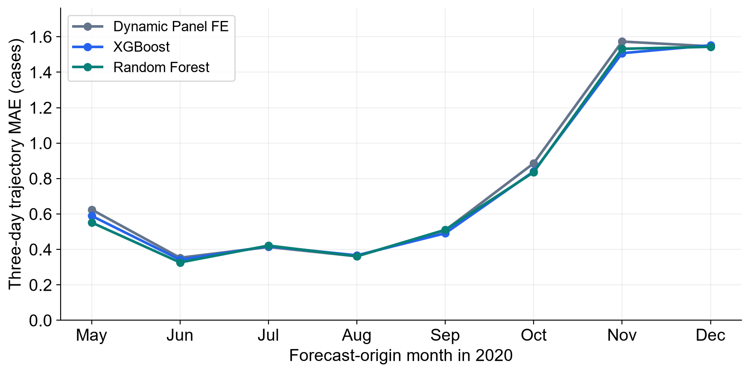
Is the Improvement Consistent Over Time?
Monthly trajectory MAE across all 585 ZIPs, May–December 2020
KEY FINDINGS
Months with lower MAE
than Dynamic Panel
XGBoost: 5 of 8
Random Forest: 6 of 8
No model leads every month.
August RF and benchmark
are nearly tied.
All models have larger absolute errors in November and December.
MODEL COMPARISON Exploratory retrospective analysis
8
Notes:
SUGGESTED NARRATION
The small overall gains are not uniform over time. XGBoost has lower monthly trajectory MAE than Dynamic Panel in five of eight months. Random Forest is lower in six, but its August difference is effectively a tie, about0.000012cases. Dynamic Panel performs best in July. All models have much higher absolute errors in November and December, when case activity is higher. This motivates reporting performance across time alongside a single overall score.
SOURCE AND DEFINITIONS
Source: Notebook27, Weikun/outbreak_task_outputs/case_surge_v1_20261101/. Exact definitions: task_definition.json; assessment results: warning_metrics.csv. Existing models, no refit. Same585ZIPs. Research-defined case-surge events, not independently adjudicated outbreaks. Retrospective onset availability assumed; missing-onset records excluded. Source: model_prediction_comparison_outputs/comparison_20261101/monthly_trajectory_metrics.csv. Month defined by forecast-origin date, all3targets retained; a late-month path can include nextmonth targets within2020. May-Dec eightcalendarbuckets; April30only excluded from monthly plot/count but retained in overall scores. December origins endDec28 so no2021targets. Everymodel uses the same585ZIPs on the sameorigins permonth. Strict descriptive win counts RF6/8,XGB5/8, no significance test and no minimum practical-difference threshold. RF August .36139577 vsDP.36140819 is near-tie; December gain also small. Monthly MAE also depends on case activity and count distribution, so larger late-year errors alone do not prove intrinsic model deterioration. These are exploratory2020development results. Later-year performance is not on thisslide. No per-ZIP cherry-picking and no model retraining for these charts.

