Slide 1
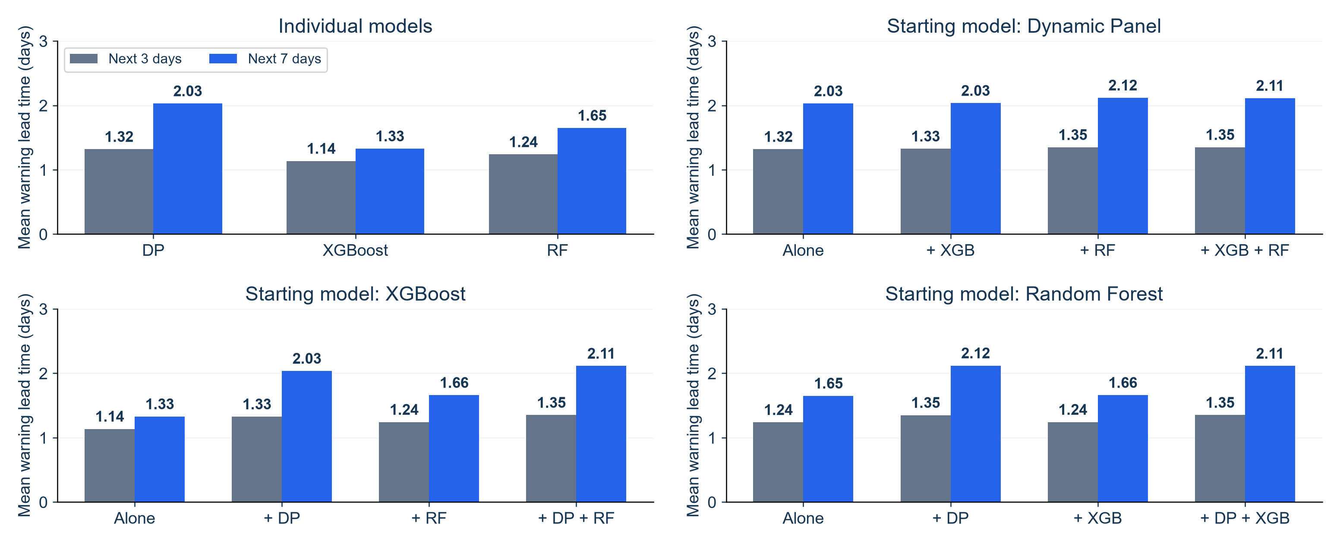
Do Combined Models Give Earlier Warnings?
Mean warning lead time for the same combinations, comparing 3-day and 7-day horizons
KEY FINDING
Seven-day DP + RF averages 2.12 days. Every system still has a 1-day median.
NOTEBOOK 38: SEP 1–DEC 24, 2020 EXPLORATORY VALIDATION
1
Notes:
SUGGESTED NARRATION
This page compares warning lead time for the same combinations as the detection and precision charts. Each chart shows the mean for three-day and seven-day warning horizons. We use the same585ZIPs andSeptember1 toDecember24 daily forecast dates. Seven-day warnings have longer mean lead times, particularly when Dynamic Panel is included. DP plus Random Forest has the longest seven-day mean, at2.12days. Adding all three gives2.11days, so it does not improve on that pair. However, every individual and combined system still has a median of one day. These means include only successfully detected events. Different systems detect different events, and a longer matching window allows longer lead times. We must read these results with detection and false warnings before choosing a system. Event start remains the second consecutive abnormal day under our rule, so a one-day warning may already use the first abnormal day.
ANALYSIS AND SOURCES
Notebook38 combined_warning_metrics_3_vs_7.csv. [{"rule":"DP","horizon_days":3,"eligible_events":1039,"detected_events":820,"warning_episodes":1229,"false_warning_episodes":409,"event_detection_rate":0.7892204042,"warning_precision":0.6672091131,"mean_lead_days":1.3195121951,"median_lead_days":1,"false_warnings_per_30_at_risk_zip_days":0.2296462661,"at_risk_zip_days":53430},{"rule":"XGBoost","horizon_days":3,"eligible_events":1039,"detected_events":761,"warning_episodes":918,"false_warning_episodes":157,"event_detection_rate":0.7324350337,"warning_precision":0.8289760349,"mean_lead_days":1.135348226,"median_lead_days":1,"false_warnings_per_30_at_risk_zip_days":0.0881527232,"at_risk_zip_days":53430},{"rule":"RF","horizon_days":3,"eligible_events":1039,"detected_events":831,"warning_episodes":1097,"false_warning_episodes":266,"event_detection_rate":0.7998075072,"warning_precision":0.7575205105,"mean_lead_days":1.238267148,"median_lead_days":1,"false_warnings_per_30_at_risk_zip_days":0.1493542953,"at_risk_zip_days":53430},{"rule":"DP + XGBoost","horizon_days":3,"eligible_events":1039,"detected_events":826,"warning_episodes":1241,"false_warning_episodes":415,"event_detection_rate":0.7949951877,"warning_precision":0.6655922643,"mean_lead_days":1.3256658596,"median_lead_days":1,"false_warnings_per_30_at_risk_zip_days":0.23301516,"at_risk_zip_days":53430},{"rule":"DP + RF","horizon_days":3,"eligible_events":1039,"detected_events":840,"warning_episodes":1294,"false_warning_episodes":454,"event_detection_rate":0.8084696824,"warning_precision":0.6491499227,"mean_lead_days":1.3488095238,"median_lead_days":1,"false_warnings_per_30_at_risk_zip_days":0.2549129702,"at_risk_zip_days":53430},{"rule":"XGBoost + RF","horizon_days":3,"eligible_events":1039,"detected_events":833,"warning_episodes":1107,"false_warning_episodes":274,"event_detection_rate":0.801732435,"warning_precision":0.7524841915,"mean_lead_days":1.2412965186,"median_lead_days":1,"false_warnings_per_30_at_risk_zip_days":0.1538461538,"at_risk_zip_days":53430},{"rule":"All three","horizon_days":3,"eligible_events":1039,"detected_events":840,"warning_episodes":1295,"false_warning_episodes":455,"event_detection_rate":0.8084696824,"warning_precision":0.6486486486,"mean_lead_days":1.35,"median_lead_days":1,"false_warnings_per_30_at_risk_zip_days":0.2554744526,"at_risk_zip_days":53430},{"rule":"DP","horizon_days":7,"eligible_events":1125,"detected_events":918,"warning_episodes":1614,"false_warning_episodes":696,"event_detection_rate":0.816,"warning_precision":0.5687732342,"mean_lead_days":2.0283224401,"median_lead_days":1,"false_warnings_per_30_at_risk_zip_days":0.3907916901,"at_risk_zip_days":53430},{"rule":"XGBoost","horizon_days":7,"eligible_events":1125,"detected_events":793,"warning_episodes":927,"false_warning_episodes":134,"event_detection_rate":0.7048888889,"warning_precision":0.8554476807,"mean_lead_days":1.3278688525,"median_lead_days":1,"false_warnings_per_30_at_risk_zip_days":0.07523863,"at_risk_zip_days":53430},{"rule":"RF","horizon_days":7,"eligible_events":1125,"detected_events":889,"warning_episodes":1158,"false_warning_episodes":269,"event_detection_rate":0.7902222222,"warning_precision":0.7677029361,"mean_lead_days":1.6490438695,"median_lead_days":1,"false_warnings_per_30_at_risk_zip_days":0.1510387423,"at_risk_zip_days":53430},{"rule":"DP + XGBoost","horizon_days":7,"eligible_events":1125,"detected_events":925,"warning_episodes":1632,"false_warning_episodes":707,"event_detection_rate":0.8222222222,"warning_precision":0.5667892157,"mean_lead_days":2.0345945946,"median_lead_days":1,"false_warnings_per_30_at_risk_zip_days":0.3969679955,"at_risk_zip_days":53430},{"rule":"DP + RF","horizon_days":7,"eligible_events":1125,"detected_events":949,"warning_episodes":1711,"false_warning_episodes":762,"event_detection_rate":0.8435555556,"warning_precision":0.5546464056,"mean_lead_days":2.1180189673,"median_lead_days":1,"false_warnings_per_30_at_risk_zip_days":0.4278495227,"at_risk_zip_days":53430},{"rule":"XGBoost + RF","horizon_days":7,"eligible_events":1125,"detected_events":893,"warning_episodes":1170,"false_warning_episodes":277,"event_detection_rate":0.7937777778,"warning_precision":0.7632478632,"mean_lead_days":1.6595744681,"median_lead_days":1,"false_warnings_per_30_at_risk_zip_days":0.1555306008,"at_risk_zip_days":53430},{"rule":"All three","horizon_days":7,"eligible_events":1125,"detected_events":949,"warning_episodes":1715,"false_warning_episodes":766,"event_detection_rate":0.8435555556,"warning_precision":0.5533527697,"mean_lead_days":2.1127502634,"median_lead_days":1,"false_warnings_per_30_at_risk_zip_days":0.430095452,"at_risk_zip_days":53430}] Same585ZIPs,115dailyforecastdatesSep1–Dec24. Three-daynativeeligibleevents1039,seven-day1125. Model-specificthresholds retained fromNotebook37,all0. OR signals on sameZIPdate before shared7dayissuecooldown;recomputeone-to-oneearliesteventmatchingwithin1..Hdays. No refit. Meanleadcalculatedonlydetected events. Same-detected-eventleadcomparison.csv providespairedtiming:DP+RF840commondetected,3daymean1.349vs7day1.817,difference.468day;allthree840,1.350vs1.814,difference.464day. Whole7daydetectedsubsetmeans2.118and2.113are notpairedimprovements. These3dayvaluesdifferfrompreviousSep1–Dec28figuresbecauseweusematchedshorterdateperiod. Allmedians1. No significance claim or real-timeavailabilityverification.
Scope: only2020development/validation results. No2021–2023scores. Retrospective recorded-onset counts, missing-onset records excluded, historical availability unverified. Same585ZIPs and sameforecasttargets across models. Forecasts clippedat0. Original34candidates plus model-specific ZIPidentity. Exploratory previously inspected developmentdata.

