Slide 1
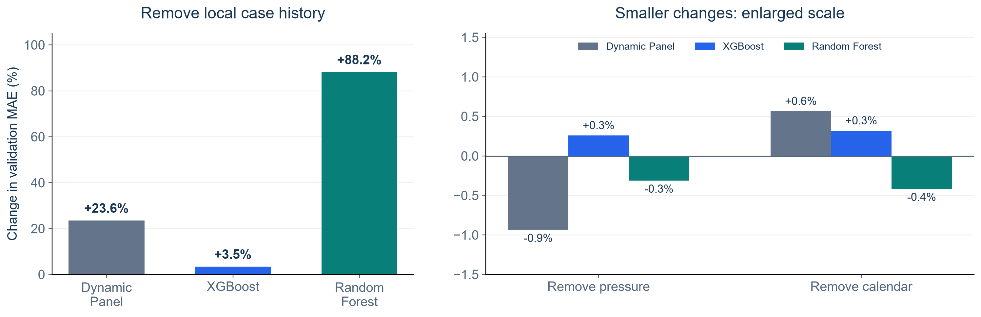
Which Features Help Our Forecasts?
Remove one feature group, refit, then compare validation MAE
Positive = removing the group increases error. Panels use different scales.
KEY FINDING
Local case history helps most. Pressure and calendar show small, uncertain gains.
NOTEBOOK 33: APR 30–DEC 28, 2020 VALIDATION
1
Notes:
SUGGESTED NARRATION
We removed one feature group at a time and retrained each model, using the same ZIPs and forecast dates. Removing local history raised MAE by about 24 percent for Dynamic Panel, 3.5 percent for XGBoost and 88 percent for Random Forest. Removing pressure or calendar changed MAE by less than one percent. Their uncertainty intervals include zero. Local history gives the clearest predictive value. This does not show that commuting is unrelated to disease spread. It measures the extra value of our features in these models. We evaluate case count errors across the three-day path here, rather than direction or outbreak warnings.
ANALYSIS AND SOURCES
Source: Notebook33 group_ablation_summary.csv and RESULTS.md. Change=(DROP_MAE/FULL_MAE-1)*100. Same585ZIPs,243dates,142155paths,60daywindow,weeklyrefits,h1–3. Local-history deltas23.553383/3.459554/88.202006percent;pressure-.933342/.258157/-.311237;calendar.565338/.318900/-.415206. Pointwise95percent14daydate-blockbootstrap CIs for all pressure/calendar effects cross0. Primary Holm HAC7 local p .0000497/.0000000714/.000603;HAC28 sensitivity .0572/.00373/.1682. Do not claim all local effects remain statistically significant under sensitivity. Main full-feature models unchanged. Removal retains pressure and ZIP identity.
Scope: only2020development/validation results. No2021–2023scores. Retrospective recorded-onset counts, missing-onset records excluded, historical availability unverified. Same585ZIPs and sameforecasttargets across models. Forecasts clippedat0. Original34candidates plus model-specific ZIPidentity. Exploratory previously inspected developmentdata.

Slide 2
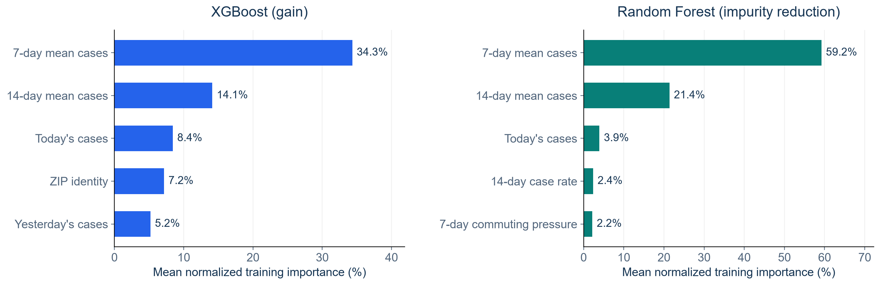
Which Inputs Do the Tree Models Use Most?
Top five inputs by average training importance across weekly fits
Compare ranks within each model. Importance values use different definitions.
KEY FINDING
Both models rely most on 7-day and 14-day average case counts.
NOTEBOOK 33: APR 30–DEC 28, 2020 VALIDATION
2
Notes:
SUGGESTED NARRATION
We also looked at the five highest-ranked inputs in each tree model. The seven-day and fourteen-day average case counts rank first and second in both models. Today’s count ranks third in both models. ZIP identity appears in XGBoost’s top five, while seven-day pressure appears in Random Forest’s top five. These rankings describe what the models use in training. XGBoost measures gain and Random Forest measures impurity reduction, so we read the rankings separately. Correlated features can share importance. A high rank alone does not prove that a feature improves future predictions or causes disease spread. The previous removal experiment provides the predictive comparison.
ANALYSIS AND SOURCES
Source: Notebook33 training_importance_summary.csv. Top5 by model-specific mean normalized importance acrossfits/horizons. XGB gain and RF impurity reduction use different definitions. Correlations and split opportunities affect ranking. ZIPidentity additional to34engineeredinputs. All full features retained. No new fits or feature selection in this deck.
Scope: only2020development/validation results. No2021–2023scores. Retrospective recorded-onset counts, missing-onset records excluded, historical availability unverified. Same585ZIPs and sameforecasttargets across models. Forecasts clippedat0. Original34candidates plus model-specific ZIPidentity. Exploratory previously inspected developmentdata.

