Slide 1
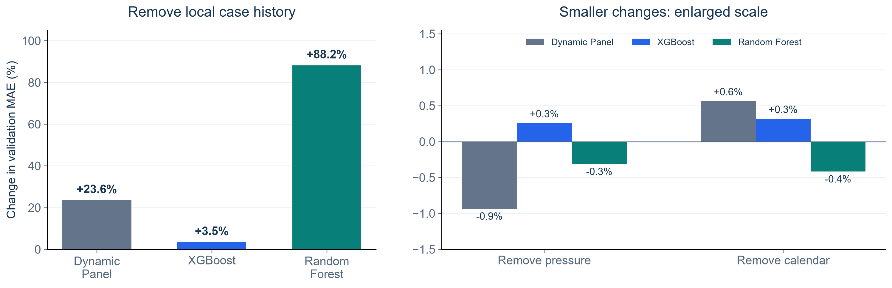
Which Features Help Our Forecasts?
Remove one feature group, refit, then compare validation MAE
Positive = removing the group increases error. Panels use different scales.
KEY FINDING
Local case history helps most. Pressure and calendar show small, uncertain gains.
NOTEBOOK 33: APR 30–DEC 28, 2020 VALIDATION
1
Notes:
SUGGESTED NARRATION
We removed one feature group at a time and retrained each model, using the same ZIPs and forecast dates. Removing local history raised MAE by about 24 percent for Dynamic Panel, 3.5 percent for XGBoost and 88 percent for Random Forest. Removing pressure or calendar changed MAE by less than one percent. Their uncertainty intervals include zero. Local history gives the clearest predictive value. This does not show that commuting is unrelated to disease spread. It measures the extra value of our features in these models. We evaluate case count errors across the three-day path here, rather than direction or outbreak warnings.
ANALYSIS AND SOURCES
Source: Notebook33 group_ablation_summary.csv and RESULTS.md. Change=(DROP_MAE/FULL_MAE-1)*100. Same585ZIPs,243dates,142155paths,60daywindow,weeklyrefits,h1–3. Local-history deltas23.553383/3.459554/88.202006percent;pressure-.933342/.258157/-.311237;calendar.565338/.318900/-.415206. Pointwise95percent14daydate-blockbootstrap CIs for all pressure/calendar effects cross0. Primary Holm HAC7 local p .0000497/.0000000714/.000603;HAC28 sensitivity .0572/.00373/.1682. Do not claim all local effects remain statistically significant under sensitivity. Main full-feature models unchanged. Removal retains pressure and ZIP identity.
Scope: only2020development/validation results. No2021–2023scores. Retrospective recorded-onset counts, missing-onset records excluded, historical availability unverified. Same585ZIPs and sameforecasttargets across models. Forecasts clippedat0. Original34candidates plus model-specific ZIPidentity. Exploratory previously inspected developmentdata.

Slide 2
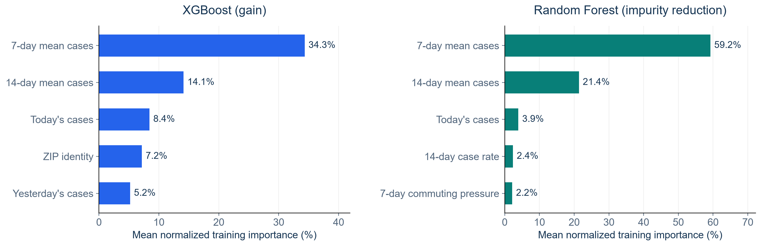
Which Inputs Do the Tree Models Use Most?
Top five inputs by average training importance across weekly fits
Compare ranks within each model. Importance values use different definitions.
KEY FINDING
Both models rely most on 7-day and 14-day average case counts.
NOTEBOOK 33: APR 30–DEC 28, 2020 VALIDATION
2
Notes:
SUGGESTED NARRATION
We also looked at the five highest-ranked inputs in each tree model. The seven-day and fourteen-day average case counts rank first and second in both models. Today’s count ranks third in both models. ZIP identity appears in XGBoost’s top five, while seven-day pressure appears in Random Forest’s top five. These rankings describe what the models use in training. XGBoost measures gain and Random Forest measures impurity reduction, so we read the rankings separately. Correlated features can share importance. A high rank alone does not prove that a feature improves future predictions or causes disease spread. The previous removal experiment provides the predictive comparison.
ANALYSIS AND SOURCES
Source: Notebook33 training_importance_summary.csv. Top5 by model-specific mean normalized importance acrossfits/horizons. XGB gain and RF impurity reduction use different definitions. Correlations and split opportunities affect ranking. ZIPidentity additional to34engineeredinputs. All full features retained. No new fits or feature selection in this deck.
Scope: only2020development/validation results. No2021–2023scores. Retrospective recorded-onset counts, missing-onset records excluded, historical availability unverified. Same585ZIPs and sameforecasttargets across models. Forecasts clippedat0. Original34candidates plus model-specific ZIPidentity. Exploratory previously inspected developmentdata.

Slide 3
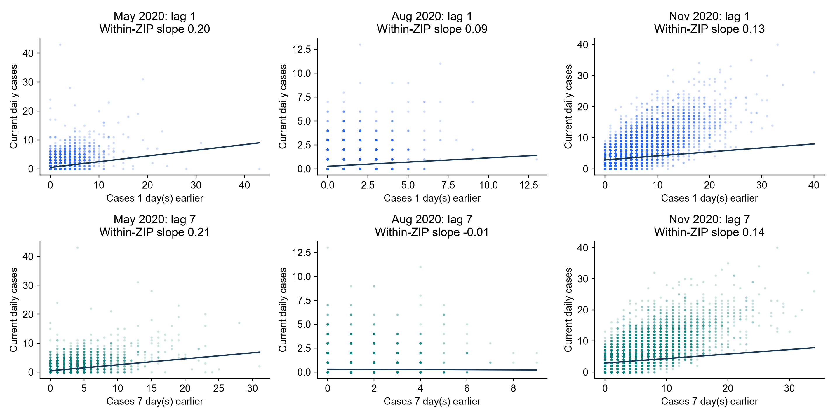
Does Case Persistence Change Over Time?
Monthly relationships between current cases and earlier cases within each ZIP
KEY FINDING
August shows weaker lag relationships. Monthly uncertainty remains wide.
NOTEBOOK 39: MAY, AUG AND NOV 2020
3
Notes:
SUGGESTED NARRATION
Our feature analysis showed that local history matters most. We then asked whether its relationship with current cases changes over time. Each point is one ZIP on one day. The upper row uses yesterday’s count and the lower row uses the count seven days earlier. We estimate slopes after accounting for each ZIP’s average level within that month. August shows weaker relationships, especially at lag seven. May and November show positive lag-seven relationships. These are descriptive associations. Monthly uncertainty is wide, so we do not claim the differences between months are statistically established. The next page checks whether different lag inputs actually improve predictions.
ANALYSIS AND SOURCES
Notebook39 monthly_lag_relationships.csv. May lag1 .198089 CI[-.020698,.288849],lag7 .207786[.057192,.316171];Auglag1 .087828[-.024504,.095107],lag7-.009029[-.043360,.030888];Novlag1 .128432[-.019841,.196659],lag7.144960[.042279,.262517]. 585ZIPs,May/Aug18135observations each,Nov17550. Within-ZIP demeaning separately each month. Scatter shows raw counts;line uses within-ZIP slope and grand-mean intercept, not pooled OLS. Axes differ across months. 2000 circular7daywhole-date-cross-section bootstrap,pointwise95percentinterval,recenter eachdraw. Few monthlyblocks,no formal between-month tests. NotGMM and no causalclaim.
Scope: only2020development/validation results. No2021–2023scores. Retrospective recorded-onset counts, missing-onset records excluded, historical availability unverified. Same585ZIPs and sameforecasttargets across models. Forecasts clippedat0. Original34candidates plus model-specific ZIPidentity. Exploratory previously inspected developmentdata.

Slide 4
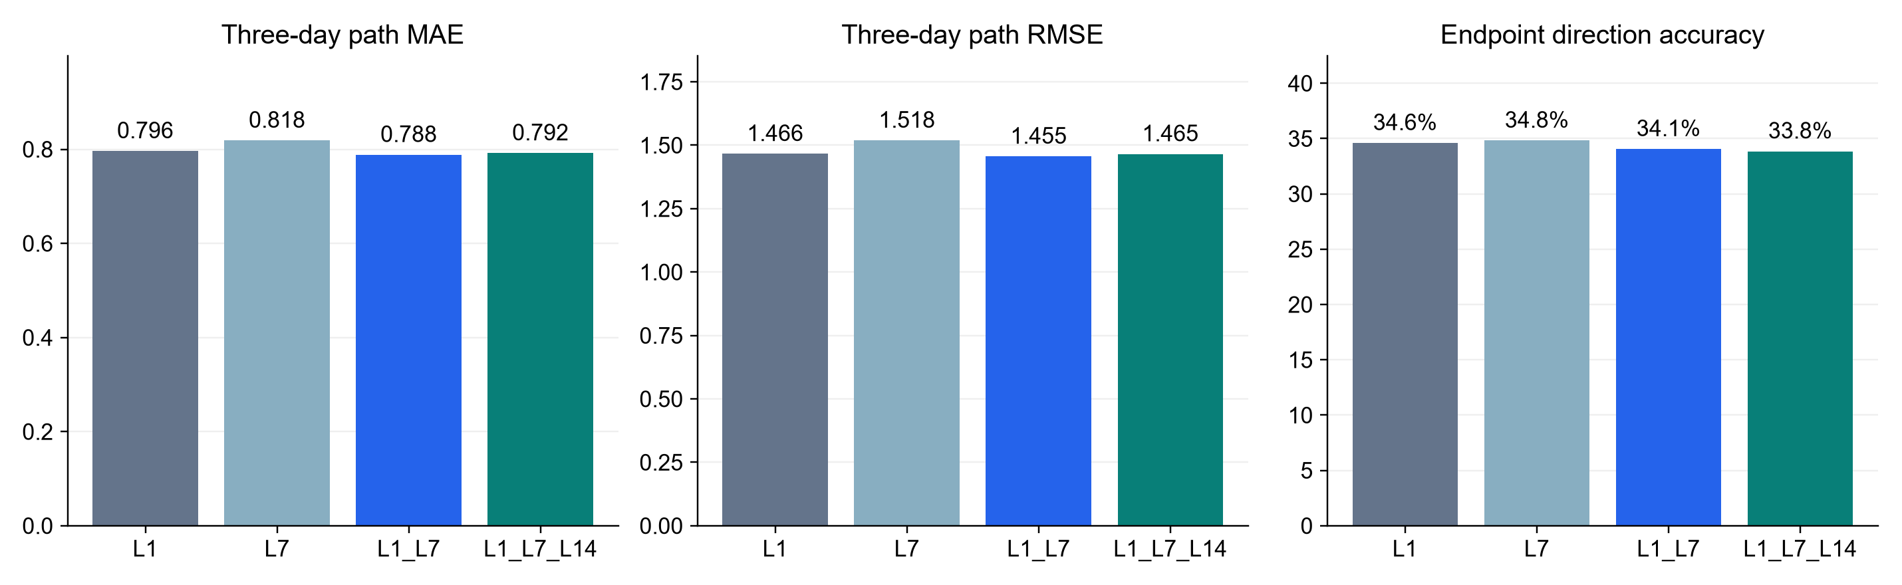
Do Different Lags Improve Three-Day Forecasts?
Controlled Dynamic Panel FE comparison with the same regions and forecast dates
All variants retain today’s cases, pressure, calendar inputs and ZIP fixed effects.
KEY FINDING
Lag 1 + 7 lowers MAE by 1.0% versus Lag 1. Direction accuracy does not improve.
NOTEBOOK 39: APR 30–DEC 28, 2020 VALIDATION
4
Notes:
SUGGESTED NARRATION
We tested four lag configurations using the same rolling training and validation rules. Every variant keeps today’s count, pressure, calendar inputs and ZIP fixed effects. We leave out other local derived features so they cannot indirectly supply the lag information we are comparing. Lag one plus lag seven has the lowest MAE and RMSE among these four configurations. Its MAE is about one percent lower than lag one alone. The paired improvement interval is positive. The adjusted p-value is about .00042 with a seven-day dependence allowance and .046 with a twenty-eight-day allowance. Adding lag fourteen does not improve the point scores further. Direction accuracy remains around34percent and does not improve with the best count configuration. Better count prediction therefore does not automatically mean better direction prediction. These are diagnostic variants. We keep the original full models unchanged.
ANALYSIS AND SOURCES
Notebook39 validation_metrics.csv and paired_comparisons.csv. L1 MAE.79604864 RMSE1.46574 direction.345996;L7 .8184867/1.51824/.348197;L1L7 .7880965/1.45525/.340586;L1L7L14 .7916366/1.46496/.338462. MAE gain .00795212,about.99895percent,14daybootstrap4000 pointwise95CI[.00330935,.013758]. Holm3contrastsHAC7p.000423016,HAC28p.0459201. No test of L14 increment versus L1L7,so no significance claim for that difference. L7vsL1 worse delta-.0224381,Holm7 .000000875864/Holm28 .00328148. L1L7L14vsL1 CIcross0,p.22578/.409075. 420newFEfits,35weeklyfitdatesx3horizonsx4variants. Same585ZIPs,243dates142155paths,60calendar days,14warmup,45/44/43trainingpairs perZIP. Labels matured<=fitdate,forecastdates>fitdate except general same-day acceptable not usedhere. Exclude rollingmeans/std,localrates,acceleration/jerk,sparsehistory fromallvariants. Exactendpointflat,alwaysflatreference56.8percent exceeds all configurations. Never infer7daywarningfromlag7input. NoGMMtests.
Scope: only2020development/validation results. No2021–2023scores. Retrospective recorded-onset counts, missing-onset records excluded, historical availability unverified. Same585ZIPs and sameforecasttargets across models. Forecasts clippedat0. Original34candidates plus model-specific ZIPidentity. Exploratory previously inspected developmentdata.

