Slide 1
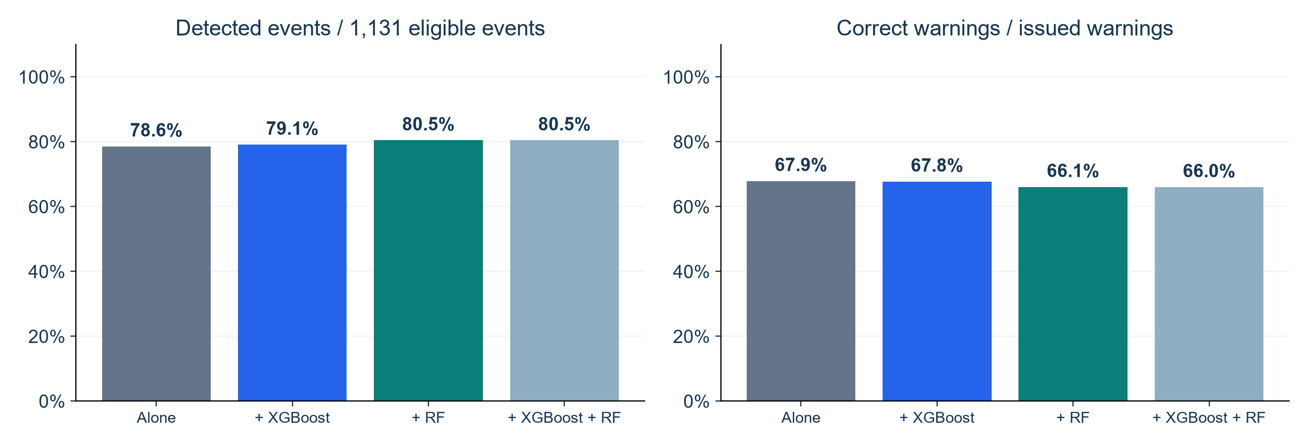
Dynamic Panel as the Starting Model
Keep the starting model and add other warning signals
KEY FINDINGS
Adding RF raises detection by 1.9 points, while precision falls by 1.8 points.
Adding both detects no more events than adding RF alone.
WARNING VALIDATION: SEP–DEC 2020
1
Notes:
SUGGESTED NARRATION
We start with Dynamic Panel FE. We keep its warning signal and add one other model or both. Any included model can trigger an alert. The left chart shows event detection and the right shows warning precision. Adding RF raises detection by 1.9 points, while precision falls by 1.8 points. Adding both detects no more events than adding RF alone. The added models help detect more events, but warning precision falls. Changes are percentage points, not relative percentages.
ANALYSIS AND SOURCES
Notebook36 incremental_value_by_starting_model.csv. [{"starting_model":"Dynamic Panel FE","added_models":"None","event_detection_pct":78.60300618921309,"correct_warning_pct":67.9144385026738,"detection_change_pp":0,"precision_change_pp":0,"detected_events":889,"false_warnings":420,"extra_events":0,"extra_false_warnings":0},{"starting_model":"Dynamic Panel FE","added_models":"XGBoost","event_detection_pct":79.13351016799292,"correct_warning_pct":67.75170325510976,"detection_change_pp":0.5305039787798393,"precision_change_pp":-0.1627352475640386,"detected_events":895,"false_warnings":426,"extra_events":6,"extra_false_warnings":6},{"starting_model":"Dynamic Panel FE","added_models":"Random Forest","event_detection_pct":80.45977011494253,"correct_warning_pct":66.08569353667393,"detection_change_pp":1.8567639257294437,"precision_change_pp":-1.8287449659998731,"detected_events":910,"false_warnings":467,"extra_events":21,"extra_false_warnings":47},{"starting_model":"Dynamic Panel FE","added_models":"XGBoost + Random Forest","event_detection_pct":80.45977011494253,"correct_warning_pct":66.0377358490566,"detection_change_pp":1.8567639257294437,"precision_change_pp":-1.8767026536172016,"detected_events":910,"false_warnings":468,"extra_events":21,"extra_false_warnings":48}] Same585ZIPs and1131eligibleevents. Original thresholds retained. OR on same ZIP-date before shared seven-day cooldown and one-to-one event matching within next1–3days. Net detected-event differences may include gained and lost events. No retraining or formal significance test. Three-model OR from verified Notebook34.
Scope: only2020development/validation results. No2021–2023scores. Retrospective recorded-onset counts, missing-onset records excluded, historical availability unverified. Same585ZIPs and sameforecasttargets across models. Forecasts clippedat0. Original34candidates plus model-specific ZIPidentity. Exploratory previously inspected developmentdata.

Slide 2
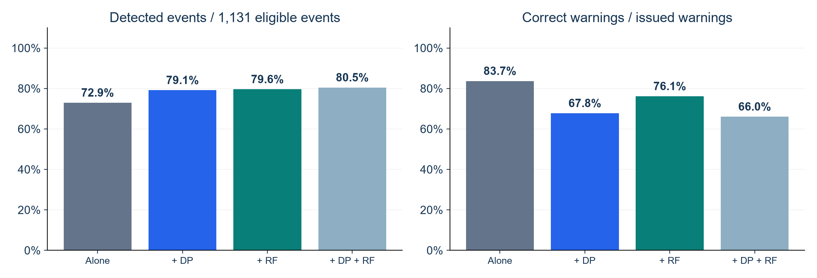
XGBoost as the Starting Model
Keep the starting model and add other warning signals
KEY FINDINGS
Adding RF raises detection by 6.6 points, while precision falls by 7.5 points.
Adding both gains 85 events but adds 307 false warnings.
WARNING VALIDATION: SEP–DEC 2020
2
Notes:
SUGGESTED NARRATION
We start with XGBoost. We keep its warning signal and add one other model or both. Any included model can trigger an alert. The left chart shows event detection and the right shows warning precision. Adding RF raises detection by 6.6 points, while precision falls by 7.5 points. Adding both gains 85 events but adds 307 false warnings. The added models help detect more events, but warning precision falls. Changes are percentage points, not relative percentages.
ANALYSIS AND SOURCES
Notebook36 incremental_value_by_starting_model.csv. [{"starting_model":"XGBoost","added_models":"None","event_detection_pct":72.94429708222812,"correct_warning_pct":83.67139959432049,"detection_change_pp":0,"precision_change_pp":0,"detected_events":825,"false_warnings":161,"extra_events":0,"extra_false_warnings":0},{"starting_model":"XGBoost","added_models":"Dynamic Panel FE","event_detection_pct":79.13351016799292,"correct_warning_pct":67.75170325510976,"detection_change_pp":6.189213085764811,"precision_change_pp":-15.91969633921072,"detected_events":895,"false_warnings":426,"extra_events":70,"extra_false_warnings":265},{"starting_model":"XGBoost","added_models":"Random Forest","event_detection_pct":79.57559681697613,"correct_warning_pct":76.14213197969542,"detection_change_pp":6.6312997347480085,"precision_change_pp":-7.5292676146250574,"detected_events":900,"false_warnings":282,"extra_events":75,"extra_false_warnings":121},{"starting_model":"XGBoost","added_models":"Dynamic Panel FE + Random Forest","event_detection_pct":80.45977011494253,"correct_warning_pct":66.0377358490566,"detection_change_pp":7.515473032714414,"precision_change_pp":-17.633663745263885,"detected_events":910,"false_warnings":468,"extra_events":85,"extra_false_warnings":307}] Same585ZIPs and1131eligibleevents. Original thresholds retained. OR on same ZIP-date before shared seven-day cooldown and one-to-one event matching within next1–3days. Net detected-event differences may include gained and lost events. No retraining or formal significance test. Three-model OR from verified Notebook34.
Scope: only2020development/validation results. No2021–2023scores. Retrospective recorded-onset counts, missing-onset records excluded, historical availability unverified. Same585ZIPs and sameforecasttargets across models. Forecasts clippedat0. Original34candidates plus model-specific ZIPidentity. Exploratory previously inspected developmentdata.

Slide 3
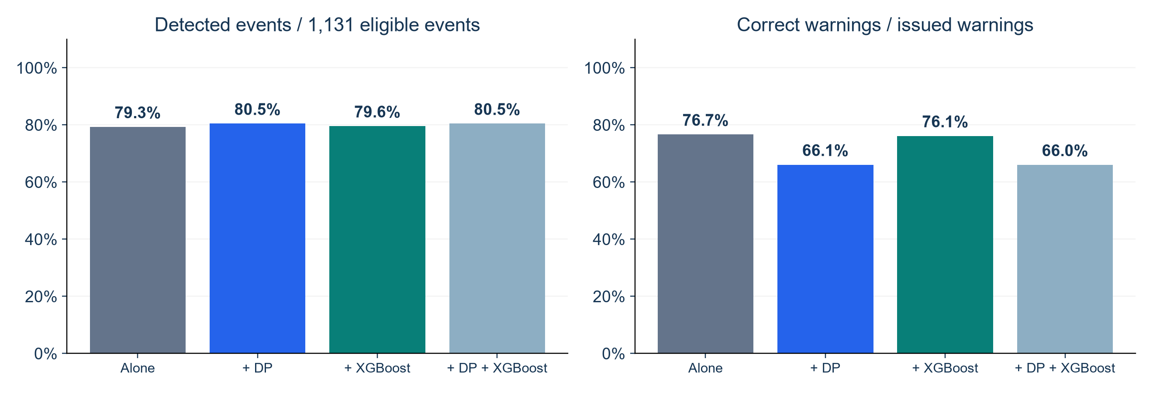
Random Forest as the Starting Model
Keep the starting model and add other warning signals
KEY FINDINGS
Adding XGBoost gains 3 events and adds 9 false warnings.
Adding DP gains 13 events but adds 194 false warnings.
WARNING VALIDATION: SEP–DEC 2020
3
Notes:
SUGGESTED NARRATION
We start with Random Forest. We keep its warning signal and add one other model or both. Any included model can trigger an alert. The left chart shows event detection and the right shows warning precision. Adding XGBoost gains 3 events and adds 9 false warnings. Adding DP gains 13 events but adds 194 false warnings. The added models help detect more events, but warning precision falls. Changes are percentage points, not relative percentages.
ANALYSIS AND SOURCES
Notebook36 incremental_value_by_starting_model.csv. [{"starting_model":"Random Forest","added_models":"None","event_detection_pct":79.3103448275862,"correct_warning_pct":76.66666666666667,"detection_change_pp":0,"precision_change_pp":0,"detected_events":897,"false_warnings":273,"extra_events":0,"extra_false_warnings":0},{"starting_model":"Random Forest","added_models":"Dynamic Panel FE","event_detection_pct":80.45977011494253,"correct_warning_pct":66.08569353667393,"detection_change_pp":1.1494252873563204,"precision_change_pp":-10.580973129992744,"detected_events":910,"false_warnings":467,"extra_events":13,"extra_false_warnings":194},{"starting_model":"Random Forest","added_models":"XGBoost","event_detection_pct":79.57559681697613,"correct_warning_pct":76.14213197969542,"detection_change_pp":0.2652519893899141,"precision_change_pp":-0.5245346869712453,"detected_events":900,"false_warnings":282,"extra_events":3,"extra_false_warnings":9},{"starting_model":"Random Forest","added_models":"Dynamic Panel FE + XGBoost","event_detection_pct":80.45977011494253,"correct_warning_pct":66.0377358490566,"detection_change_pp":1.1494252873563204,"precision_change_pp":-10.628930817610073,"detected_events":910,"false_warnings":468,"extra_events":13,"extra_false_warnings":195}] Same585ZIPs and1131eligibleevents. Original thresholds retained. OR on same ZIP-date before shared seven-day cooldown and one-to-one event matching within next1–3days. Net detected-event differences may include gained and lost events. No retraining or formal significance test. Three-model OR from verified Notebook34.
Scope: only2020development/validation results. No2021–2023scores. Retrospective recorded-onset counts, missing-onset records excluded, historical availability unverified. Same585ZIPs and sameforecasttargets across models. Forecasts clippedat0. Original34candidates plus model-specific ZIPidentity. Exploratory previously inspected developmentdata.

Slide 4
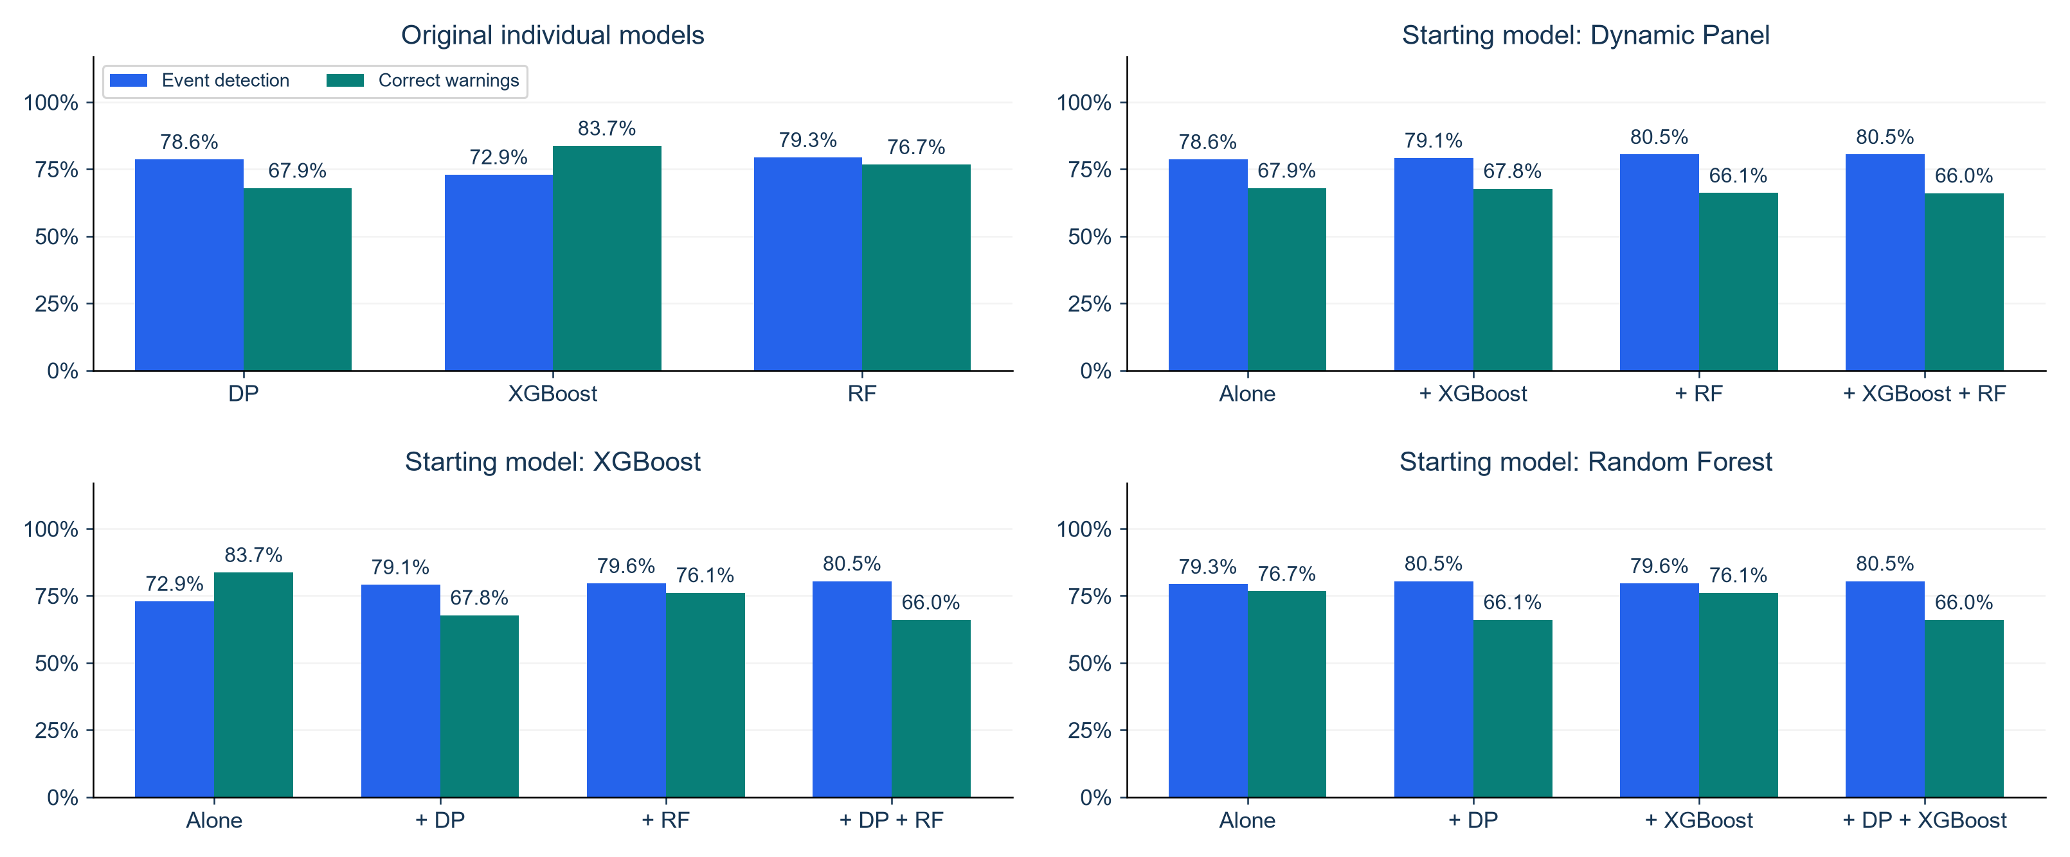
Individual Models and Added Warning Signals
Same 585 ZIPs and 1,131 events. Any included model can trigger an alert.
KEY FINDING
Adding models catches more events, but lowers warning precision.
WARNING VALIDATION: SEP–DEC 2020
4
Notes:
SUGGESTED NARRATION
The top-left chart repeats our original individual-model comparison. The other charts start from each model separately and add one model or both. Blue bars show event detection and green bars show the proportion of warnings that are correct. All charts use the same percentage scale. Adding models detects more events, but warning precision falls. The improvement is small when starting from DP or Random Forest. Starting from XGBoost gives a larger detection gain, but also a larger loss in warning precision. We find no clear overall improvement under this OR rule.
ANALYSIS AND SOURCES
Notebook36 incremental_value_by_starting_model.csv. All values from same585ZIPs,1131eligible events andSep1–Dec28 2020 forecastdates. OR on sameZIP-date followed by shared7-daycooldown and one-to-one event matching. Originalcalibrationthresholds. No significanceclaim, later-year evaluation or modelretraining. Each pair appears under both member starting points intentionally; same combined system, different reference. Correctwarnings=matchedwarnings/issuedwarnings. Eventdetection=matchedevents/1131.
Scope: only2020development/validation results. No2021–2023scores. Retrospective recorded-onset counts, missing-onset records excluded, historical availability unverified. Same585ZIPs and sameforecasttargets across models. Forecasts clippedat0. Original34candidates plus model-specific ZIPidentity. Exploratory previously inspected developmentdata.

