Slide 1
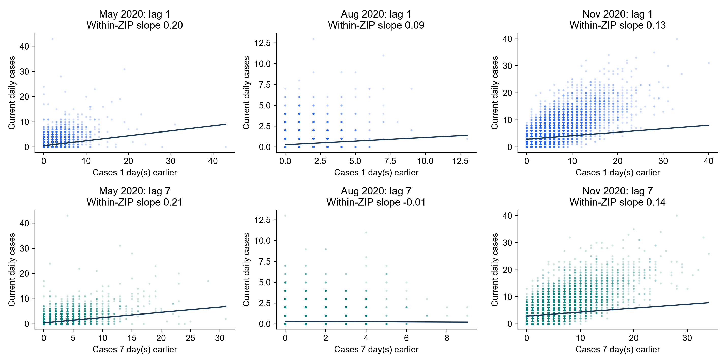
Does Case Persistence Change Over Time?
Monthly relationships between current cases and earlier cases within each ZIP
KEY FINDING
August shows weaker lag relationships. Monthly uncertainty remains wide.
NOTEBOOK 39: MAY, AUG AND NOV 2020
1
Notes:
SUGGESTED NARRATION
Our feature analysis showed that local history matters most. We then asked whether its relationship with current cases changes over time. Each point is one ZIP on one day. The upper row uses yesterday’s count and the lower row uses the count seven days earlier. We estimate slopes after accounting for each ZIP’s average level within that month. August shows weaker relationships, especially at lag seven. May and November show positive lag-seven relationships. These are descriptive associations. Monthly uncertainty is wide, so we do not claim the differences between months are statistically established. The next page checks whether different lag inputs actually improve predictions.
ANALYSIS AND SOURCES
Notebook39 monthly_lag_relationships.csv. May lag1 .198089 CI[-.020698,.288849],lag7 .207786[.057192,.316171];Auglag1 .087828[-.024504,.095107],lag7-.009029[-.043360,.030888];Novlag1 .128432[-.019841,.196659],lag7.144960[.042279,.262517]. 585ZIPs,May/Aug18135observations each,Nov17550. Within-ZIP demeaning separately each month. Scatter shows raw counts;line uses within-ZIP slope and grand-mean intercept, not pooled OLS. Axes differ across months. 2000 circular7daywhole-date-cross-section bootstrap,pointwise95percentinterval,recenter eachdraw. Few monthlyblocks,no formal between-month tests. NotGMM and no causalclaim.
Scope: only2020development/validation results. No2021–2023scores. Retrospective recorded-onset counts, missing-onset records excluded, historical availability unverified. Same585ZIPs and sameforecasttargets across models. Forecasts clippedat0. Original34candidates plus model-specific ZIPidentity. Exploratory previously inspected developmentdata.

Slide 2
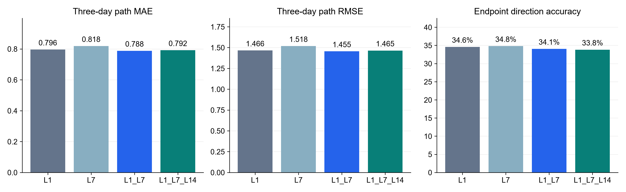
Do Different Lags Improve Three-Day Forecasts?
Controlled Dynamic Panel FE comparison with the same regions and forecast dates
All variants retain today’s cases, pressure, calendar inputs and ZIP fixed effects.
Lag 1 + 7: MAE gain 0.008 cases. 95% CI: 0.003–0.014. Adjusted p: 0.00042 / 0.046*
KEY FINDING
Lag 1 + 7 lowers MAE by 1.0% versus Lag 1. Direction accuracy does not improve.
2020 VALIDATION. *HAC7 / HAC28 SENSITIVITY. MAIN FULL MODELS UNCHANGED
2
Notes:
SUGGESTED NARRATION
We tested four lag configurations using the same rolling training and validation rules. Every variant keeps today’s count, pressure, calendar inputs and ZIP fixed effects. We leave out other local derived features so they cannot indirectly supply the lag information we are comparing. Lag one plus lag seven has the lowest MAE and RMSE among these four configurations. Its MAE is about one percent lower than lag one alone. The paired improvement interval is positive. The adjusted p-value is about .00042 with a seven-day dependence allowance and .046 with a twenty-eight-day allowance. Adding lag fourteen does not improve the point scores further. Direction accuracy remains around34percent and does not improve with the best count configuration. Better count prediction therefore does not automatically mean better direction prediction. These are diagnostic variants. We keep the original full models unchanged.
ANALYSIS AND SOURCES
Notebook39 validation_metrics.csv and paired_comparisons.csv. L1 MAE.79604864 RMSE1.46574 direction.345996;L7 .8184867/1.51824/.348197;L1L7 .7880965/1.45525/.340586;L1L7L14 .7916366/1.46496/.338462. MAE gain .00795212,about.99895percent,14daybootstrap4000 pointwise95CI[.00330935,.013758]. Holm3contrastsHAC7p.000423016,HAC28p.0459201. No test of L14 increment versus L1L7,so no significance claim for that difference. L7vsL1 worse delta-.0224381,Holm7 .000000875864/Holm28 .00328148. L1L7L14vsL1 CIcross0,p.22578/.409075. 420newFEfits,35weeklyfitdatesx3horizonsx4variants. Same585ZIPs,243dates142155paths,60calendar days,14warmup,45/44/43trainingpairs perZIP. Labels matured<=fitdate,forecastdates>fitdate except general same-day acceptable not usedhere. Exclude rollingmeans/std,localrates,acceleration/jerk,sparsehistory fromallvariants. Exactendpointflat,alwaysflatreference56.8percent exceeds all configurations. Never infer7daywarningfromlag7input. NoGMMtests.
Scope: only2020development/validation results. No2021–2023scores. Retrospective recorded-onset counts, missing-onset records excluded, historical availability unverified. Same585ZIPs and sameforecasttargets across models. Forecasts clippedat0. Original34candidates plus model-specific ZIPidentity. Exploratory previously inspected developmentdata.

