Slide 1
Do the Three Models Complement Each Other?
Same predictions, new analysis of agreement and disagreement
585
3
1,131
NJ ZIPs
Full-feature models
Eligible local events
Trajectory overlap
Which actual rises and declines does each model identify?
Warning combinations
What changes when 1, 2 or all 3 models must agree?
KEY FINDING: Similar average scores can hide different successes and misses.
NOTEBOOK 34 — EXPLORATORY 2020 VALIDATION
1
Notes:
SUGGESTED NARRATION
Our mentor asked whether the models make the same mistakes. We use their existing predictions to check which paths and events each model catches. We then compare three simple warning rules: at least one model, at least two models, or all three models must issue an alert. We do not retrain the models for this analysis.
ANALYSIS AND SOURCES
Notebook 34. Direction overlap: Apr30–Dec28 2020, 585 ZIPs ×243 daily forecast dates. Warning assessment: Sep1–Dec28 2020, 1131 eligible rule-defined local events. Same 34 candidate inputs plus ZIP identity. Existing calibration thresholds retained. No 2021–2023 outcomes.
Scope: only2020development/validation results. No2021–2023scores. Retrospective recorded-onset counts, missing-onset records excluded, historical availability unverified. Same585ZIPs and sameforecasttargets across models. Forecasts clippedat0. Original34candidates plus model-specific ZIPidentity. Exploratory previously inspected developmentdata.

Slide 2
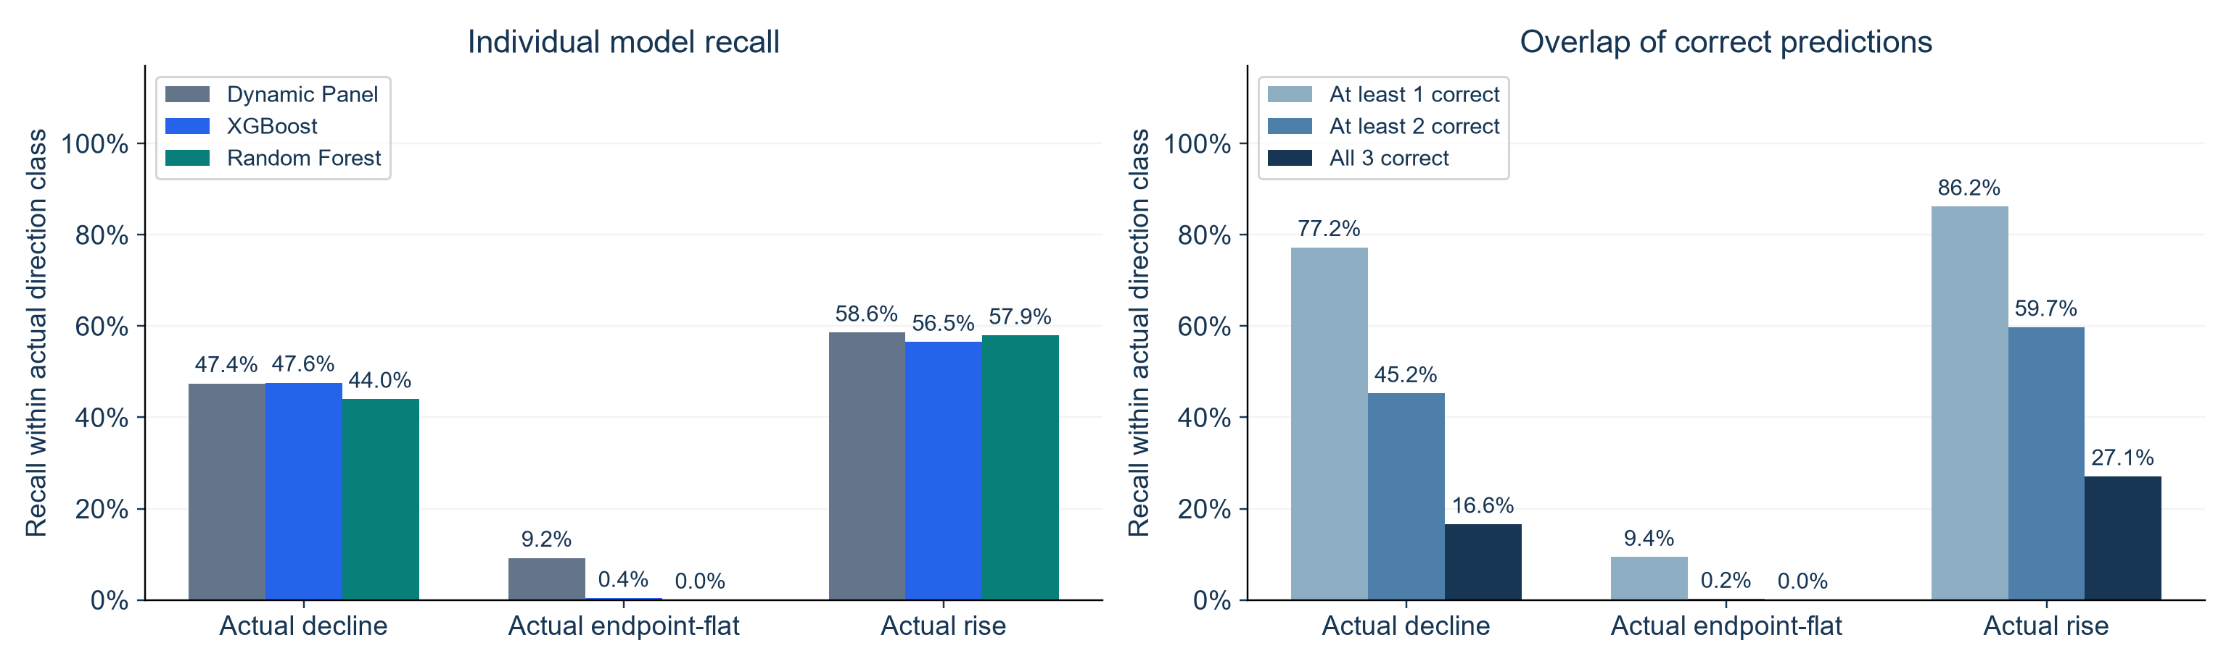
Model Agreement Across All Direction Classes
Individual recall and overlap within each actual direction class
KEY FINDINGS
At least one is correct on 77.2% of declines and 86.2% of rises.
Flat paths remain difficult: 9.4% have at least one correct model.
DIRECTION ANALYSIS: APR 30–DEC 28, 2020
2
Notes:
SUGGESTED NARRATION
The left chart shows recall for each individual model. The right chart shows how their correct predictions overlap, using the same actual paths. At least one model is correct on77.2percent of declines and86.2percent of rises. At least two are correct on45.2and59.7percent. All three are correct on16.6and27.1percent. For actual flat paths, at least one model is correct on9.4percent, at least two on0.2percent, and all three on0percent. Flat means the Day1 and Day3 counts are exactly equal. So the models capture different changes, and requiring more models to be correct reduces coverage. These groups overlap and should not be added together. They describe recall within actual direction classes, not overall accuracy or warning precision. We still need false-positive results to evaluate a voting rule.
ANALYSIS AND SOURCES
direction_overlap_by_actual_class.csv. Actual decline n30267,rise31174. Individual DP/XGB/RF decline .474345/.475964/.440116;rise .585552/.564862/.579361. Atleast1/2/3 decline .772425/.452209/.165791;rise .861808/.597357/.270610. Same y-axis name as earlier presentation: Recall within actual direction class. Both panels show identical0–100percent tick scales. Nested coverage categories, not disjoint counts. Atleast-one retrospective coverage does not identify which model is right in advance and is not a combined overall accuracy. Flat paths included: individual DP9.184percent,XGB0.378percent,RF0percent. Atleast1 9.379percent,atleast2 .183percent,all3zero. Exact flat means Day1 equals Day3. No predictions or evaluation definitions changed.
Scope: only2020development/validation results. No2021–2023scores. Retrospective recorded-onset counts, missing-onset records excluded, historical availability unverified. Same585ZIPs and sameforecasttargets across models. Forecasts clippedat0. Original34candidates plus model-specific ZIPidentity. Exploratory previously inspected developmentdata.

Slide 3
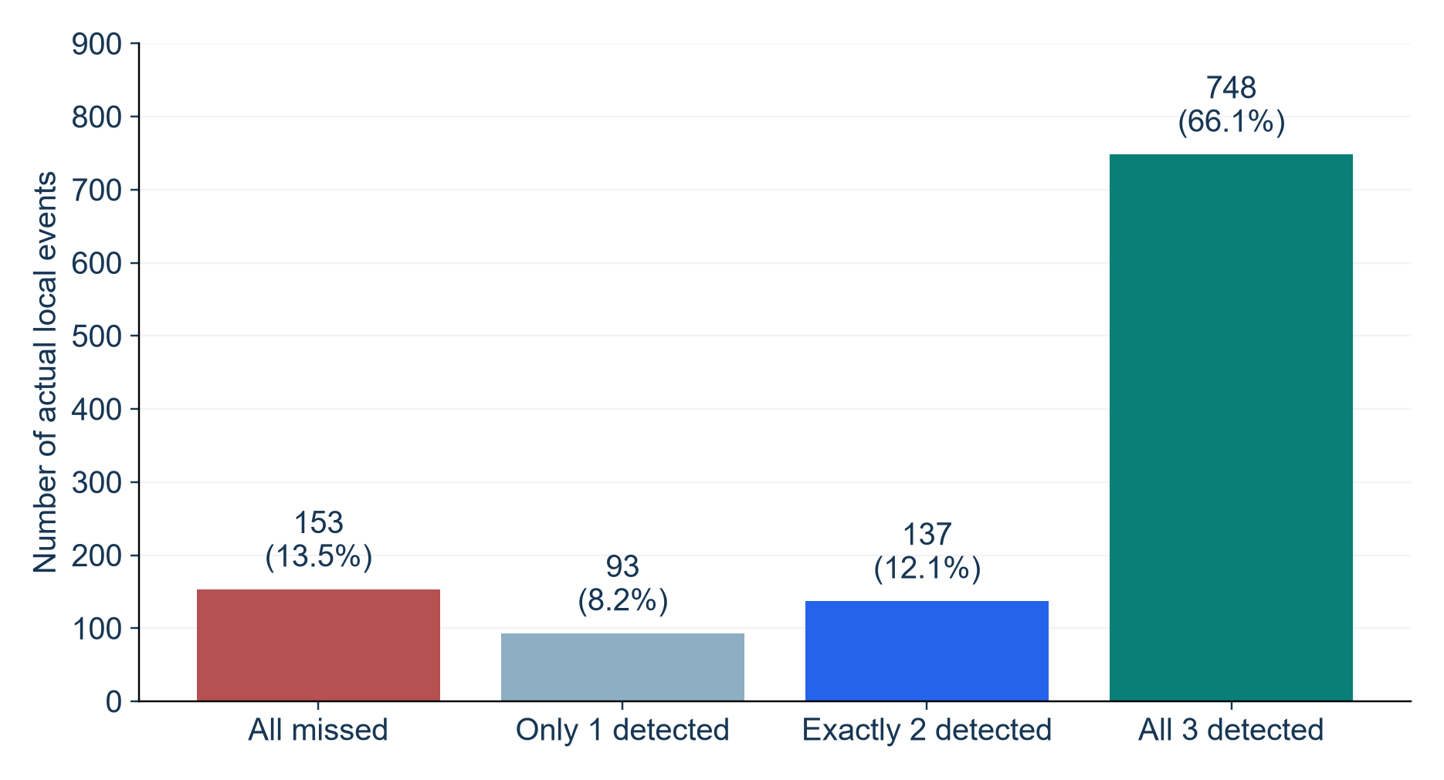
Some Events Need Information from Different Models
How many original warning systems detected each of the 1,131 events?
KEY FINDINGS
93 events: only one model
These events show the value of keeping different models.
153 events: all missed
Combining the current signals still leaves shared gaps.
WARNING ASSESSMENT: SEP–DEC 2020
3
Notes:
SUGGESTED NARRATION
Of the 1,131 events, all three individual models detect 748. Two detect 137, and only one detects 93. All three miss 153. The events caught by just one model provide direct evidence of complementarity. But the common misses show that combining the current models cannot solve every problem. This chart compares the original individual systems; the next slides recompute a combined warning system.
ANALYSIS AND SOURCES
event_overlap_counts.csv and event_detection_overlap.csv. Counts0/1/2/3=153/93/137/748, sum1131. Retrospective union978/1131=86.47% is not combined-rule recall: daily combination uses a shared cooldown and new matching. One ZIP may contribute several episodes; events are not independent epidemic waves.
Scope: only2020development/validation results. No2021–2023scores. Retrospective recorded-onset counts, missing-onset records excluded, historical availability unverified. Same585ZIPs and sameforecasttargets across models. Forecasts clippedat0. Original34candidates plus model-specific ZIPidentity. Exploratory previously inspected developmentdata.

Slide 4
Three Ways to Combine Warning Signals
Votes refer to the same ZIP and the same daily forecast date
Dynamic Panel
XGBoost
Random Forest
ALERT
ALERT
NO ALERT
1+ votes
2+ votes
3 votes
Issue an alert
Issue an alert
No alert in this example
Any model can trigger
Two models agree
All three must agree
Combine daily votes first, then apply one 7-day cooldown and match alerts to events.
WARNING RULES: EXISTING INDIVIDUAL THRESHOLDS
4
Notes:
SUGGESTED NARRATION
Suppose Dynamic Panel and XGBoost issue an alert for the same ZIP today, while Random Forest does not. A one-vote rule and a two-vote rule both issue a combined warning. A three-vote rule does not. Agreement means their individual scores exceed the original thresholds for an event within the next three days. They do not need identical case predictions or an identical predicted start day. We combine daily votes first, then apply a shared seven-day cooldown and one-to-one event matching.
ANALYSIS AND SOURCES
warning_vote_metrics.csv. Individual thresholds from original April30–Aug28 calibration, all0, score strictly>threshold. Combined vote count>=k, eligible inactive ZIP-date only. Shared cooldown7days per ZIP after each issued combined alert. Earliest matching event in future1–3days; each warning/event matched at most once. No new threshold tuning or learned combination weights. Rules explored on previously inspected2020 data.
Scope: only2020development/validation results. No2021–2023scores. Retrospective recorded-onset counts, missing-onset records excluded, historical availability unverified. Same585ZIPs and sameforecasttargets across models. Forecasts clippedat0. Original34candidates plus model-specific ZIPidentity. Exploratory previously inspected developmentdata.

Slide 5
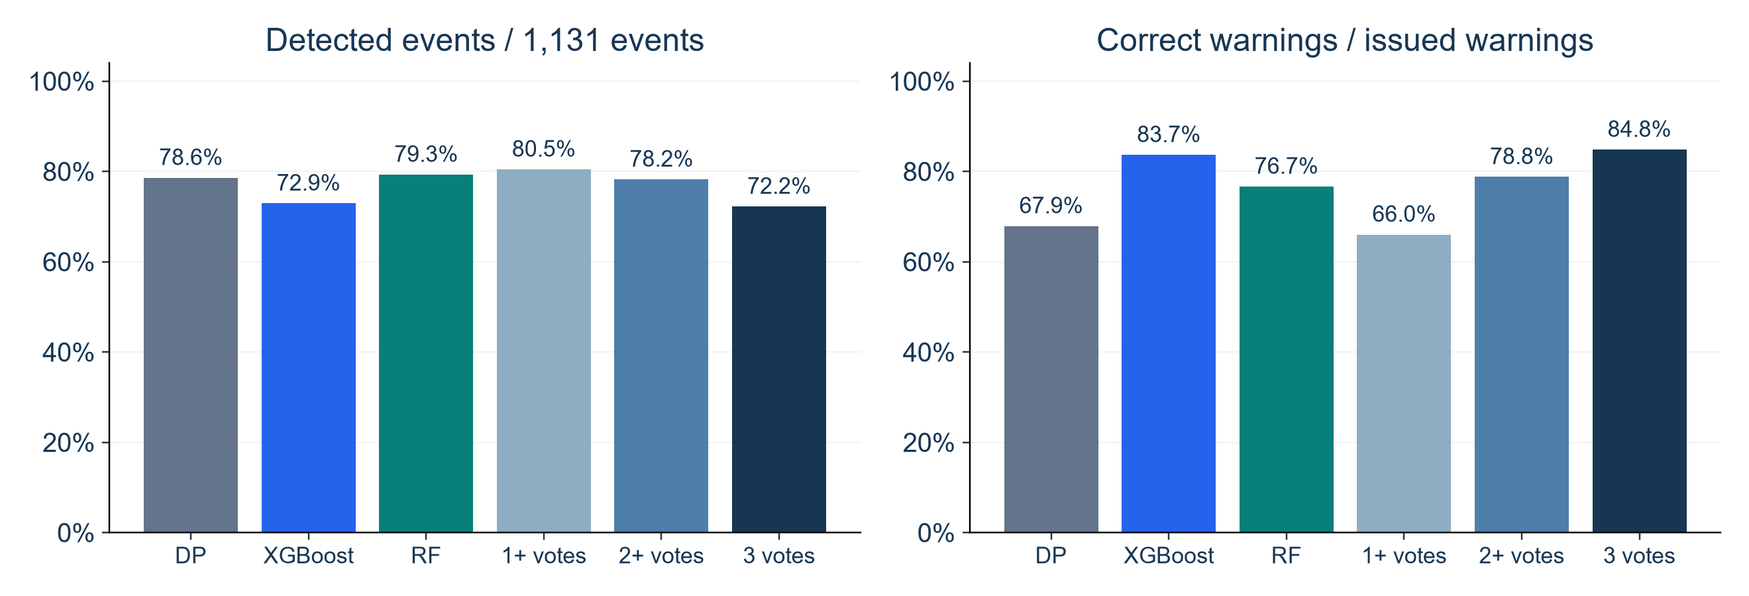
Voting Changes the Detection–False-Warning Trade-Off
Same events and forecast dates; different requirements for agreement
KEY FINDINGS
1+ votes catches more events. Three votes gives more reliable warnings.
WARNING ASSESSMENT: SEP–DEC 2020
5
Notes:
SUGGESTED NARRATION
The one-vote rule detects80.5 percent of events, but only66.0 percent of its warnings are correct. The two-vote rule detects78.2 percent, with78.8 percent warning precision. Requiring all three detects72.2 percent, with84.8 percent precision. So combination creates different choices rather than a clear overall winner. Compared with Random Forest, one-vote detection gains only13 events while false warnings rise from273 to468. Two votes is an intermediate option, not a proven optimum.
ANALYSIS AND SOURCES
warning_vote_metrics.csv. Original DP889detected/1309warnings/420false;XGB825/986/161;RF897/1170/273. Votes1:910/1378/468, votes2:885/1123/238, votes3:817/963/146. Eligibleevents1131 allrules. Recall=matched events/1131. Precision=matched warnings/allissuedwarnings. Combined cooldown and event matching recomputed. No formal statistical comparison or final rule selection.
Scope: only2020development/validation results. No2021–2023scores. Retrospective recorded-onset counts, missing-onset records excluded, historical availability unverified. Same585ZIPs and sameforecasttargets across models. Forecasts clippedat0. Original34candidates plus model-specific ZIPidentity. Exploratory previously inspected developmentdata.

Slide 6
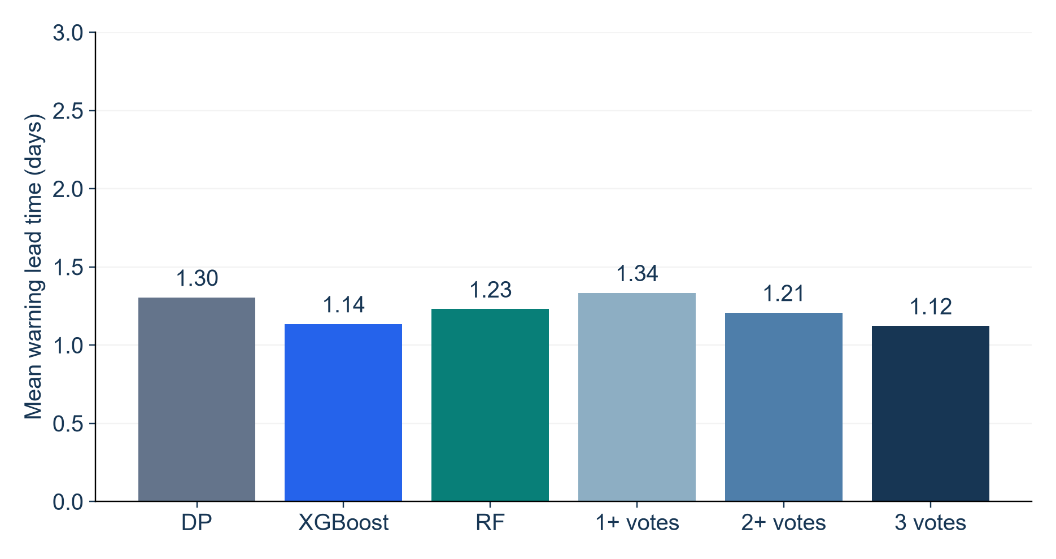
Combining Models Adds Little Warning Time
Lead time among successfully detected events
KEY FINDINGS
Median: 1 day for all
Average lead times range from 1.12 to 1.34 days.
Complementarity has limits
Voting changes detection and reliability; warnings remain close to event start.
Event start is the second abnormal day under our rule. Earlier abnormal activity may be visible.
WARNING ASSESSMENT: SEP–DEC 2020
6
Notes:
SUGGESTED NARRATION
All individual and combined systems have a median lead time of one day. Mean lead times range from1.12 to1.34days. The one-vote rule is slightly earlier on average, but it also creates more false warnings. These means describe different subsets of detected events and do not prove one method is better at early warning. Our event starts on the second consecutive qualifying day, so a one-day warning may already use the first abnormal day. Overall, models provide complementary information, but combination does not remove the trade-off or the short lead time.
ANALYSIS AND SOURCES
warning_vote_metrics.csv. MeanDP1.30484,XGB1.13576,RF1.23077,vote1 1.33516,vote2 1.20791,vote3 1.12362;allmedians1. Lead=rule-definedstart−earliestmatchedwarningdate,restricted1..3days. Missed events excluded from lead means. Compare alongside recall and precision. Retrospective onset availability unverified. No significance test of lead differences.
Scope: only2020development/validation results. No2021–2023scores. Retrospective recorded-onset counts, missing-onset records excluded, historical availability unverified. Same585ZIPs and sameforecasttargets across models. Forecasts clippedat0. Original34candidates plus model-specific ZIPidentity. Exploratory previously inspected developmentdata.

