Slide 1
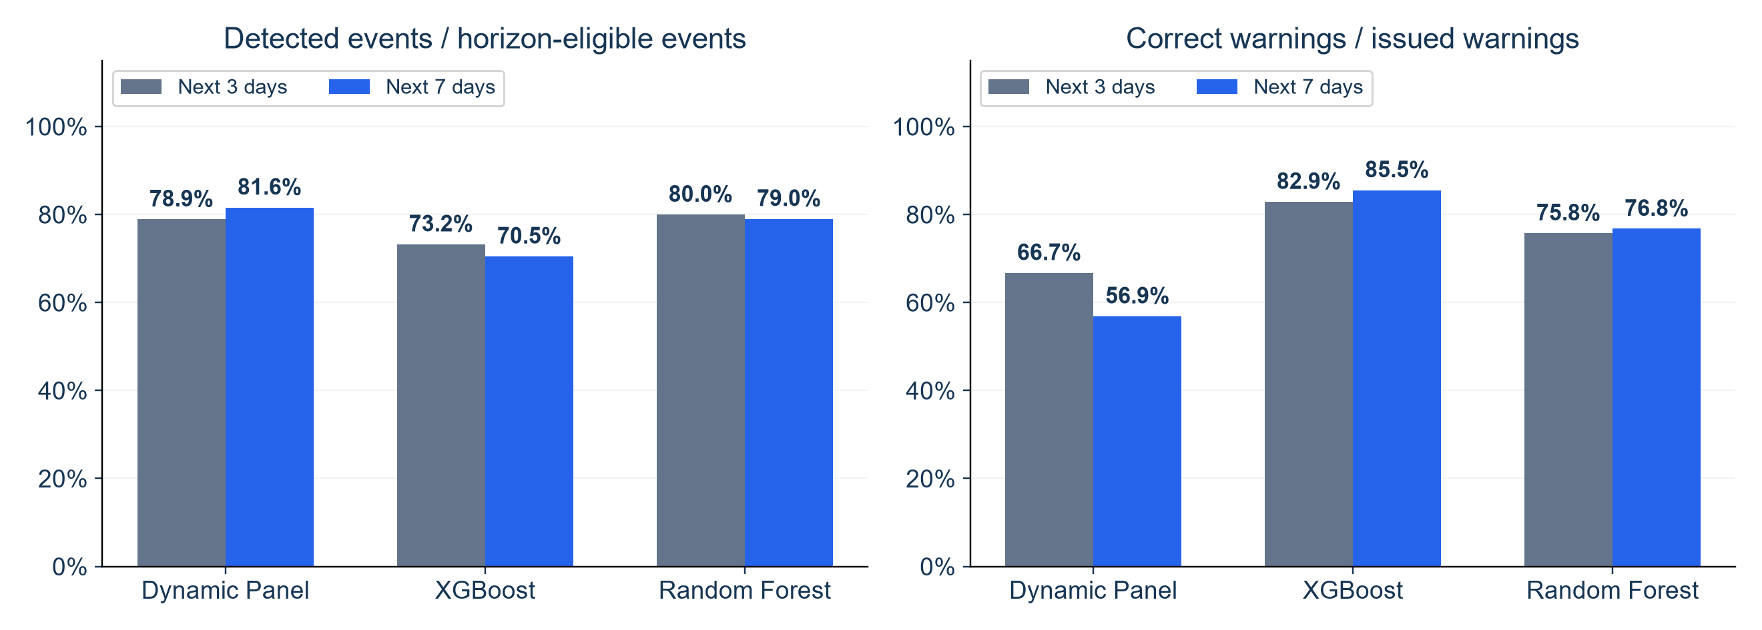
Does Seven Days Improve Outbreak Warnings?
Same outbreak rule and forecast dates, with a longer warning horizon
KEY FINDINGS
DP catches more events but adds false warnings. Tree-model changes are mixed.
3-day: 1,039 eligible events. 7-day: 1,125. Median lead remains 1 day for all.
NOTEBOOK 37: EXPLORATORY 2020 WARNING VALIDATION
1
Notes:
SUGGESTED NARRATION
We extend the prediction path to seven daily counts and use it to warn about an event within the next seven days. We keep the original outbreak rule unchanged, including its three-day average. We compare both warning horizons on the same September1 to December24 forecast dates, after calibrating thresholds on earlier dates. For Dynamic Panel, detection rises from78.9 to81.6percent, while warning precision falls from66.7 to56.9percent. XGBoost detection falls from73.2 to70.5percent, while precision rises from82.9 to85.5percent. Random Forest changes less: detection falls from80.0 to79.0percent, while precision rises from75.8 to76.8percent. Seven days does not give a clear overall improvement. Its longer matching window changes which events are eligible and what counts as a correct warning. Median lead remains one day for every model, so a seven-day forecast does not mean a seven-day warning.
ANALYSIS AND SOURCES
Notebook37 warning_horizon_metrics.csv. [{"model":"Dynamic Panel FE","horizon_days":3,"phase":"assessment","threshold":0,"AP":0.5235478458,"positive_zip_date_share":0.0568220101,"forecast_dates":115,"eligible_events":1039,"detected_events":820,"warning_episodes":1229,"false_warning_episodes":409,"event_detection_rate":0.7892204042,"warning_precision":0.6672091131,"mean_lead_days":1.3195121951,"median_lead_days":1,"false_warnings_per_30_at_risk_zip_days":0.2296462661,"at_risk_zip_days":53430,"common_eligible_events":1039,"common_detected_events":820,"common_event_detection_rate":0.7892204042},{"model":"Dynamic Panel FE","horizon_days":7,"phase":"assessment","threshold":0,"AP":0.3689962049,"positive_zip_date_share":0.1284297211,"forecast_dates":115,"eligible_events":1125,"detected_events":918,"warning_episodes":1614,"false_warning_episodes":696,"event_detection_rate":0.816,"warning_precision":0.5687732342,"mean_lead_days":2.0283224401,"median_lead_days":1,"false_warnings_per_30_at_risk_zip_days":0.3907916901,"at_risk_zip_days":53430,"common_eligible_events":1039,"common_detected_events":917,"common_event_detection_rate":0.8825794033},{"model":"XGBoost","horizon_days":3,"phase":"assessment","threshold":0,"AP":0.5441968953,"positive_zip_date_share":0.0568220101,"forecast_dates":115,"eligible_events":1039,"detected_events":761,"warning_episodes":918,"false_warning_episodes":157,"event_detection_rate":0.7324350337,"warning_precision":0.8289760349,"mean_lead_days":1.135348226,"median_lead_days":1,"false_warnings_per_30_at_risk_zip_days":0.0881527232,"at_risk_zip_days":53430,"common_eligible_events":1039,"common_detected_events":761,"common_event_detection_rate":0.7324350337},{"model":"XGBoost","horizon_days":7,"phase":"assessment","threshold":0,"AP":0.4860818965,"positive_zip_date_share":0.1284297211,"forecast_dates":115,"eligible_events":1125,"detected_events":793,"warning_episodes":927,"false_warning_episodes":134,"event_detection_rate":0.7048888889,"warning_precision":0.8554476807,"mean_lead_days":1.3278688525,"median_lead_days":1,"false_warnings_per_30_at_risk_zip_days":0.07523863,"at_risk_zip_days":53430,"common_eligible_events":1039,"common_detected_events":792,"common_event_detection_rate":0.7622714148},{"model":"Random Forest","horizon_days":3,"phase":"assessment","threshold":0,"AP":0.5433766129,"positive_zip_date_share":0.0568220101,"forecast_dates":115,"eligible_events":1039,"detected_events":831,"warning_episodes":1097,"false_warning_episodes":266,"event_detection_rate":0.7998075072,"warning_precision":0.7575205105,"mean_lead_days":1.238267148,"median_lead_days":1,"false_warnings_per_30_at_risk_zip_days":0.1493542953,"at_risk_zip_days":53430,"common_eligible_events":1039,"common_detected_events":831,"common_event_detection_rate":0.7998075072},{"model":"Random Forest","horizon_days":7,"phase":"assessment","threshold":0,"AP":0.489005187,"positive_zip_date_share":0.1284297211,"forecast_dates":115,"eligible_events":1125,"detected_events":889,"warning_episodes":1158,"false_warning_episodes":269,"event_detection_rate":0.7902222222,"warning_precision":0.7677029361,"mean_lead_days":1.6490438695,"median_lead_days":1,"false_warnings_per_30_at_risk_zip_days":0.1510387423,"at_risk_zip_days":53430,"common_eligible_events":1039,"common_detected_events":888,"common_event_detection_rate":0.85466795}] Same585ZIPs and115forecastdates Sep1–Dec24,targets throughDec31. Matched calibration originsApr30–Aug24,all7daytargets<=Aug31. Fixedoriginalgridfalsealertcriterion andallselectedthresholds0. No new model training: reuseNotebook35full34feature directpredictions. Same7dayissuecooldown andone-to-one eventmatching,1..Hdays. Nativeeligibleeventcatalog1039for3days vs1125for7days. Supplementary intersection1039events gives7dayrecall DP88.26%,XGB76.23%,RF85.47%; that restrictedsubset excludes86events withnoeligible3dayopportunity and mustnotbe called full7dayrecall. Original published3dayfigures used origins throughDec28 andcalibrationthroughAug28; do notsubstitute thosefigures inthismatchedcomparison. Seven-day AP .369/.486/.489 usesdifferentpositivelabels from3dayAP .524/.544/.543. Leadmeans3day DP1.320/XGB1.135/RF1.238,7dayDP2.028/XGB1.328/RF1.649,allmedians1. Warnings mayalreadyusefirstabnormalday. Widerwindowmakesmatchingdifferent; nodesignificanceorfinalmodelselectionclaim.
Scope: only2020development/validation results. No2021–2023scores. Retrospective recorded-onset counts, missing-onset records excluded, historical availability unverified. Same585ZIPs and sameforecasttargets across models. Forecasts clippedat0. Original34candidates plus model-specific ZIPidentity. Exploratory previously inspected developmentdata.

