Slide 1
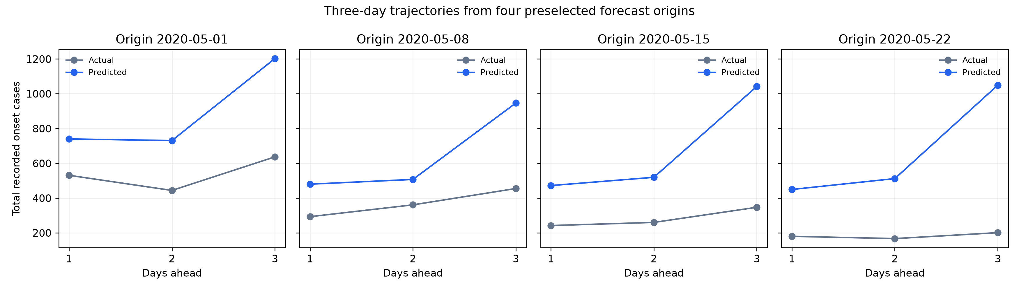
Three-Day Trajectory Benchmark
One forecast origin, three future daily case predictions
Actual vs. predicted: four forecast origins
KEY FINDINGS
Three days from one origin
Gray: actual cases. Blue: predictions.
Systematic overprediction
Mean bias is +0.673 cases per target.
Score each ZIP-level path
Curves show totals across 585 ZIPs
Aggregate curves illustrate the predictions.
Overall trajectory MAE: 0.981 cases
585 ZIPs × 28 forecast origins = 16,380 paths. Fixed 60-day training interval.
May 2020. Exploratory historical replay. Raw daily onset counts. Dynamic Panel FE.
Notes:
Figure: Notebook 21, 02_same_origin_trajectories.png, four preselected May forecast origins. Curves sum across 585 ZIPs. The displayed 0.981 MAE is scored on individual ZIP-origin paths, not these aggregate totals. Source: Notebook 22, Weikun/trajectory_benchmark_outputs/benchmark_20261027/. Definitions: benchmark_definition.json. Parameter training March1-April29 2020, fit April30; predictor history updates through each origin, no May labels in fitting. All34 candidates considered, 24 identifiable slopes per horizon plus ZIP fixed effects. Cohort/definitions developed later; this is exploratory historical replay, not an untouched test. overall_trajectory_scorecard.csv and horizon_diagnostics.csv. Primary metric: mean of three absolute errors within each ZIP-origin path, then average all 16,380 paths. Equal path lengths mean this equals pooled MAE. Day1 MAE0.84742657, Day2 0.97086287, Day3 1.12477338. Overall0.98102094 cases, pooled RMSE1.96217452, average prediction-minus-actual bias+0.67285469. The figures refer to individual region/day-count targets averaged overall, not 0.981 cases error in the state total. The exploratory seven-day date-block 95% interval for trajectory MAE is0.9233–1.0289, conditional on this model/cohort and only28 forecast origins. No new model training in Notebook22. Suggested narration: We now score three-day paths from one prediction date. Error increases with forecast distance, and the model tends to overpredict the May decline. These scores provide a common benchmark for the remaining models.

Slide 2
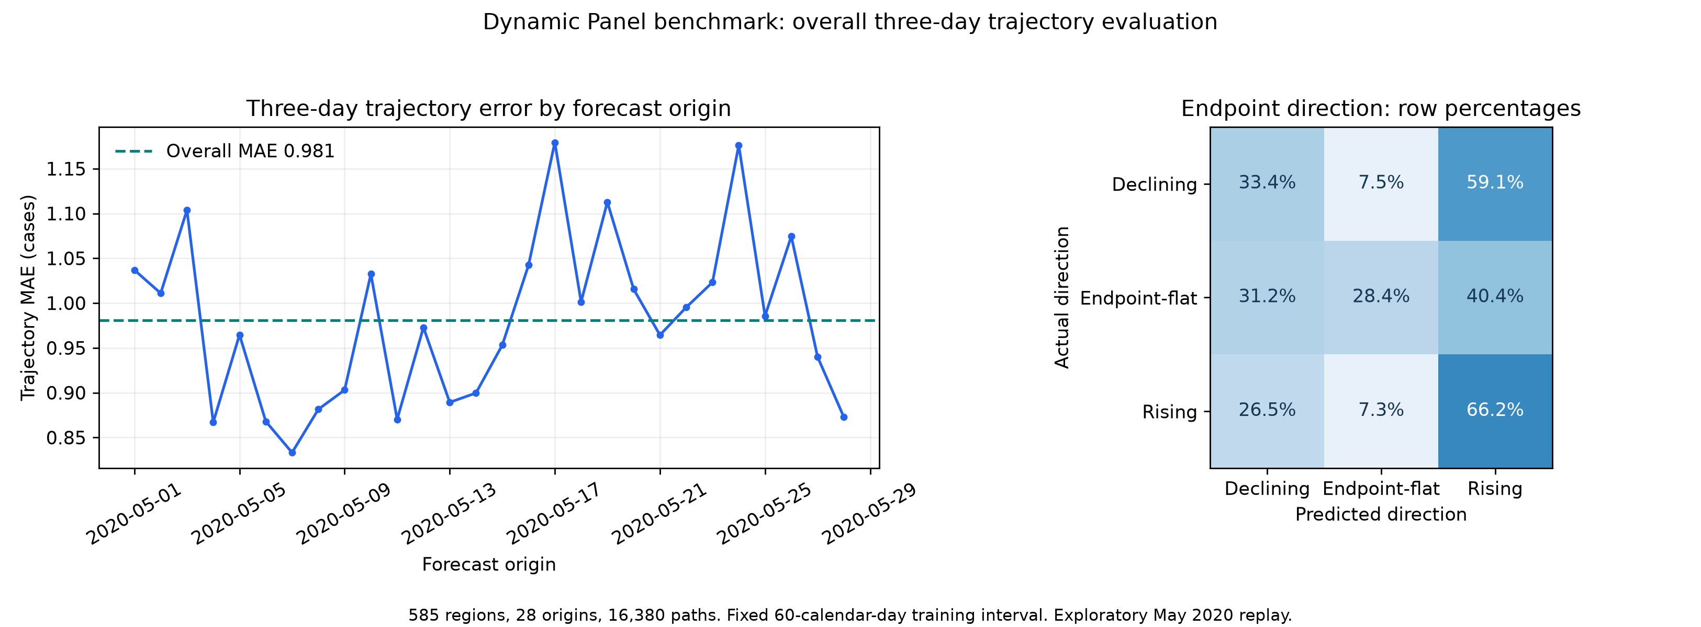
Which Trajectory Directions Does It Capture?
Correct classification within each actual direction group
Direction confusion matrix (row percentages)
KEY FINDINGS
Rising paths are easier
66.2% recall, versus 33.4% for declining paths.
Declines misread as rises
59.1% of actual declines are classified as rising.
Overall direction: 35.4%
Always endpoint-flat reference: 65.5%.
Endpoint-flat means Day 1 = Day 3
585 ZIPs × 28 forecast origins = 16,380 paths. Fixed 60-day training interval.
May 2020. Exploratory historical replay. Raw daily onset counts. Dynamic Panel FE.
Notes:
Source: Notebook 22, Weikun/trajectory_benchmark_outputs/benchmark_20261027/. Definitions: benchmark_definition.json. Parameter training March1-April29 2020, fit April30; predictor history updates through each origin, no May labels in fitting. All34 candidates considered, 24 identifiable slopes per horizon plus ZIP fixed effects. Cohort/definitions developed later; this is exploratory historical replay, not an untouched test. direction_confusion_counts.csv and overall_trajectory_scorecard.csv. Direction sign uses slope=(Day3-Day1)/2. Exact zero defines endpoint-flat, which may include an interior peak/trough and is not a fully flat path. Declining actual counts:1002correct,224endpoint-flat,1772rising (2998total); recall33.42%, 59.11% incorrectly rising. Endpoint-flat actual:3351declining,3050correct,4336rising (10737total); recall28.41%. Rising actual:700declining,193endpoint-flat,1752correct (2645total); recall66.24%. Overall agreement35.43%, balanced class recall42.69%. Always endpoint-flat gives65.55% overall direction agreement because of class imbalance; it is a direction-only diagnostic, not a replacement for the Dynamic Panel model benchmark. Strict classification treats tiny nonzero predicted slopes as changing. Do not call this percentage of ZIPs accurately predicted. Suggested narration: Overall accuracy alone hides an asymmetry. The model recognizes rising paths more often, but predicts rising cases for many paths that actually decline.

Slide 3
Changing Paths Are Harder to Predict
Overall MAE can hide poor performance on changing trajectories
Trajectory MAE by actual path type (cases)
KEY FINDINGS
52.7% of paths are all zero
Low-count paths strongly affect the overall score.
Changes: MAE 1.713
Versus 0.371 for all-zero paths.
Shape agreement: 15.2%
Both daily movement directions must match.
Selected non-overlapping groups, not the full sample
585 ZIPs × 28 forecast origins = 16,380 paths. Fixed 60-day training interval.
May 2020. Exploratory historical replay. Raw daily onset counts. Dynamic Panel FE.
Notes:
Source: Notebook 22, Weikun/trajectory_benchmark_outputs/benchmark_20261027/. Definitions: benchmark_definition.json. Parameter training March1-April29 2020, fit April30; predictor history updates through each origin, no May labels in fitting. All34 candidates considered, 24 identifiable slopes per horizon plus ZIP fixed effects. Cohort/definitions developed later; this is exploratory historical replay, not an untouched test. overall_path_subgroups.csv and overall_trajectory_scorecard.csv. All-zero actual paths8631/16380=52.6923%, trajectory MAE0.37129142. Actual endpoint-nonflat paths5643/16380=34.4505%, MAE1.71270082. These are disjoint selected groups, but do not exhaust the sample:2106 other paths include nonzero constant paths and endpoint-flat paths with interior movement. No arithmetic total of the two plotted groups is implied. Larger errors in changing paths can reflect larger case magnitudes as well as difficulty tracking change; this comparison alone does not establish a causal reason. Two-step strict shape agreement15.1526% across ALL paths requires correct signs for both Day2-Day1 and Day3-Day2, including exact-flat steps. Overall slope MAE0.41209879 cases/day. The exploratory95% interval for shape agreement is11.89–18.94%, not deployment assurance. May is mostly a decline period at aggregate level, and cannot establish outbreak-onset performance. Suggested narration: More than half of actual trajectories have zero cases on all three days. Errors are much larger on paths whose endpoints change, so the pooled average does not fully describe performance. We therefore retain shape and class diagnostics alongside MAE.

