Slide 1
From Case Records to Three-Day Paths
Can models capture short-term COVID case trajectories across NJ ZIPs?
KEY FINDINGS
2,656,888
1,040,394
873,678
60.65% missing onset
Source records
Eligible onset records
ZIP × date rows
These source records are excluded, not treated as zero.
Clean → aggregate → complete the calendar
NJ-only analysis
598 ZIPs × 1,461 days
One region × one date per row; forecasts use the common 585-ZIP cohort.
585 ZIPs in the common model comparison
2020 ROLLING VALIDATION
1
Notes:
SUGGESTED NARRATION
We now have a complete NJ region-by-day panel. We removed exact duplicate rows, checked ZIP identifiers and dates, aggregated eligible onset records, and completed the daily calendar. The current comparison uses585 common ZIPs so every model is evaluated on the same paths. A major limitation is the large share of source records without onset dates.
ANALYSIS / SOURCES
Sources: Weikun/random_forest_trajectory_outputs/rf60_weekly_development_20261027/comparison/; notebooks24–26. Same585 ZIPs and243 daily origins, Apr30–Dec28 2020. Retrospective recorded-onset evaluation, not an untouched test or validated real-time forecast. All34 candidate features including both pressure features retained. Cleaning source: outputs/real_covid_cleaning_20261022/processed/cleaning_manifest.json. Raw2,656,888; exact duplicates1,087; eligible onset1,040,394; raw missing onset1,611,499=60.6536%. Balanced598×1461=873678. Missing-onset records excluded. Absent eligible ZIP/date groups zero-filled under the user-confirmed source rule; this does not recover excluded cases or establish complete surveillance. Postal ZIP-to-ZCTA mapping remains unvalidated. These counts describe different units, so panel rows need not match source records.

Slide 2
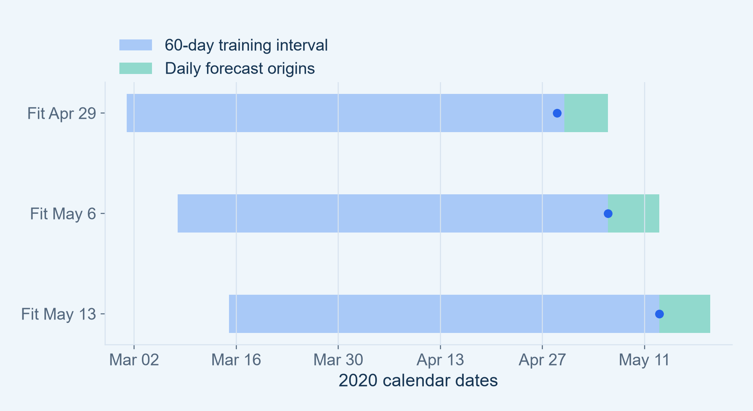
A Common Rolling Evaluation
Same regions, forecast dates, feature pool and targets for all three models
KEY FINDINGS
60 days of history
Refit every 7 days; each day predicts the next 3 daily counts.
142,155 matched paths
585 ZIPs × 243 origins. Score each ZIP-level path, then average.
2020 ROLLING VALIDATION
2
Notes:
SUGGESTED NARRATION
We compare Dynamic Panel, XGBoost and Random Forest under one protocol. Each fit uses a sixty-day history, and we refit weekly. At each daily forecast origin, we produce three separate daily predictions. Only training targets that have already occurred enter fitting. This gives142,155 matched region-level paths, rather than one long statewide forecast.
ANALYSIS / SOURCES
Sources: Weikun/random_forest_trajectory_outputs/rf60_weekly_development_20261027/comparison/; notebooks24–26. Same585 ZIPs and243 daily origins, Apr30–Dec28 2020. Retrospective recorded-onset evaluation, not an untouched test or validated real-time forecast. All34 candidate features including both pressure features retained. rolling_trajectory_outputs/rolling60_weekly_development_20261027/ and matched model training logs. Initial intervalMar1–Apr29 2020. First scored originApr30; lastDec28 so all3 future targets stay within2020. Weekly schedule anchoredApr29. All34 candidates retained; fixed effects/category coding differ by model. Fourteen-day within-window warmup and horizon maturity leave45/44/43 usable training origins per ZIP. Predictor history updates through origin, assuming retrospective onset availability; real-time availability is not established.

Slide 3
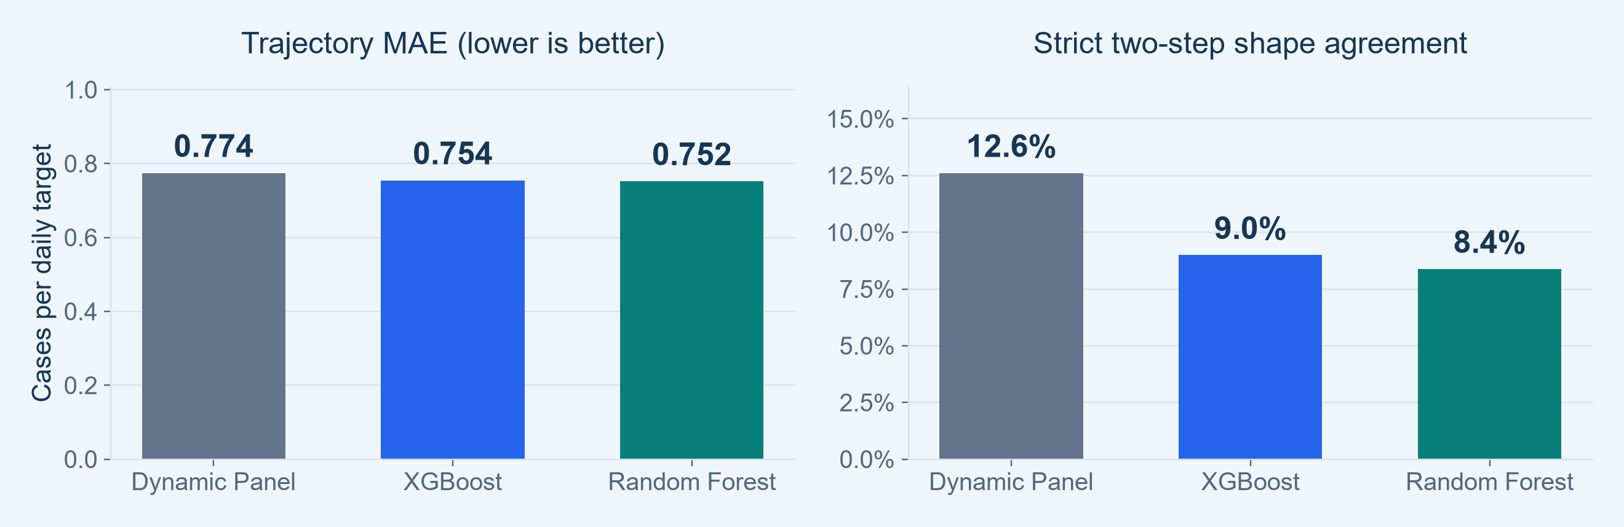
Lower Count Error Does Not Mean Better Shape
Case-count accuracy and trajectory agreement answer different questions
Count MAE: trees slightly lower
Strict shape: Dynamic Panel higher
RF 0.752; XGBoost 0.754; Dynamic Panel 0.774.
12.6% vs 9.0% XGBoost and 8.4% RF.
2020 ROLLING VALIDATION
3
Notes:
SUGGESTED NARRATION
The tree models slightly reduce average case-count error. However, Dynamic Panel more often matches both daily movement directions. So there is no winner across every objective. We retain count error as the primary measure and direction and shape as supporting diagnostics, rather than treating them as interchangeable accuracy scores.
ANALYSIS / SOURCES
Sources: Weikun/random_forest_trajectory_outputs/rf60_weekly_development_20261027/comparison/; notebooks24–26. Same585 ZIPs and243 daily origins, Apr30–Dec28 2020. Retrospective recorded-onset evaluation, not an untouched test or validated real-time forecast. All34 candidate features including both pressure features retained. three_model_overall.csv. Trajectory MAE averages abs errors across3 future targets, then paths. Strict shape requires both predicted movement signs to match actual signs, including exact-zero steps. Continuous predictions make exact-flat matching difficult. Dynamic Panel RMSE1.418 is lower than XGB1.431 and RF1.436; see appendix.

Slide 4
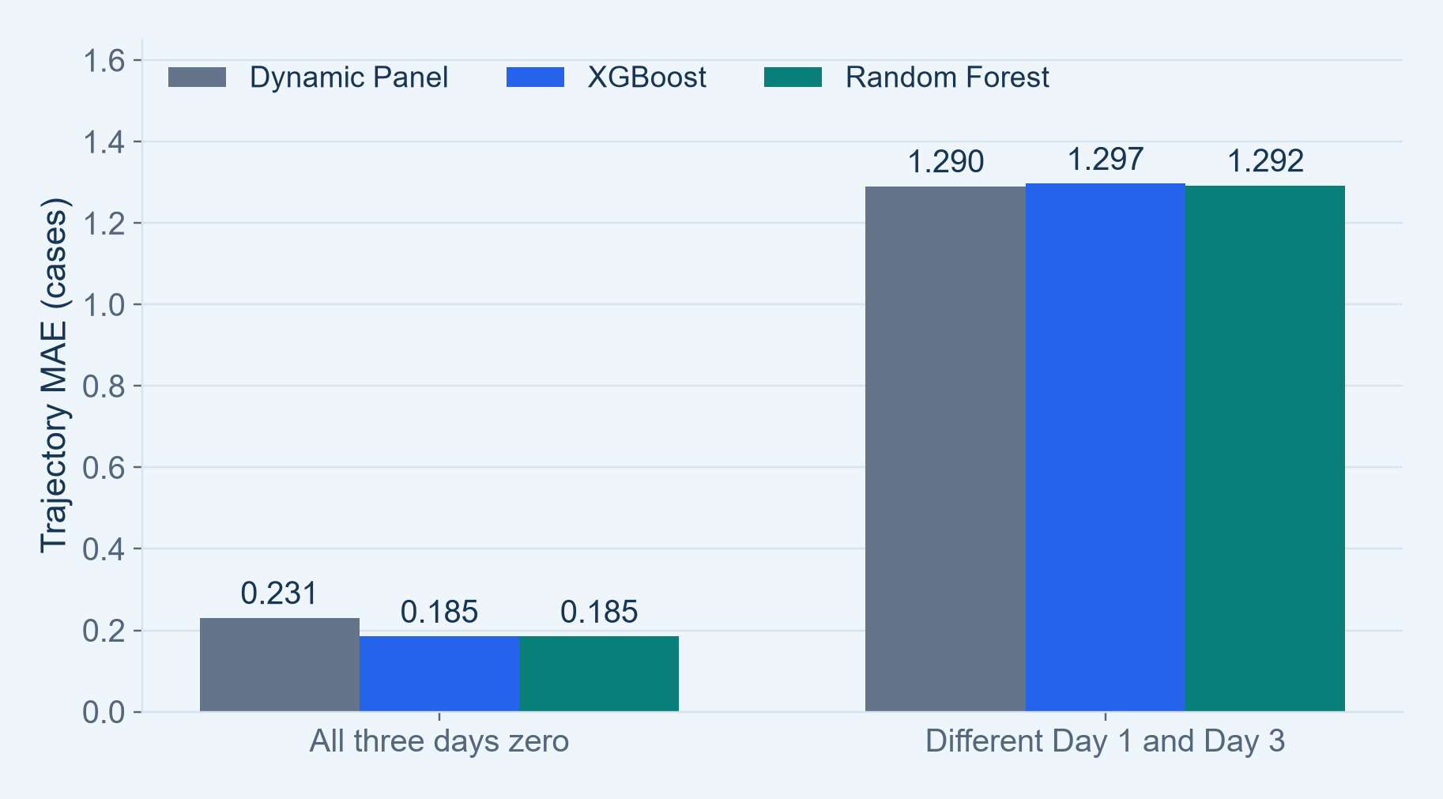
Where Do the MAE Gains Occur?
Split results by actual path type before interpreting the pooled average
KEY FINDINGS
42.8% are all-zero paths
Trees reduce MAE on zero and endpoint-flat paths.
Changing paths remain hard
When Day 1 differs from Day 3, tree MAE is not lower than Dynamic Panel.
2020 ROLLING VALIDATION
4
Notes:
SUGGESTED NARRATION
The pooled score hides an important difference. Nearly43 percent of paths have zero cases on all three days. The tree models improve these low-count and endpoint-flat paths. But for paths whose endpoints change, their MAE is slightly higher than Dynamic Panel. Therefore lower overall MAE alone does not demonstrate better outbreak or trajectory detection.
ANALYSIS / SOURCES
Sources: Weikun/random_forest_trajectory_outputs/rf60_weekly_development_20261027/comparison/; notebooks24–26. Same585 ZIPs and243 daily origins, Apr30–Dec28 2020. Retrospective recorded-onset evaluation, not an untouched test or validated real-time forecast. All34 candidate features including both pressure features retained. path_group_comparison.csv. All-zero60863/142155; endpoint-nonflat61441. Zero MAE DP.23059/XGB.18463/RF.18462; nonflat1.29047/1.29657/1.29229. Selected groups are disjoint but not exhaustive: other endpoint-flat paths exist. Differences may reflect count scale as well as tracking difficulty. Subgroups use observed outcomes for retrospective diagnosis, not features available at origin.

Slide 5
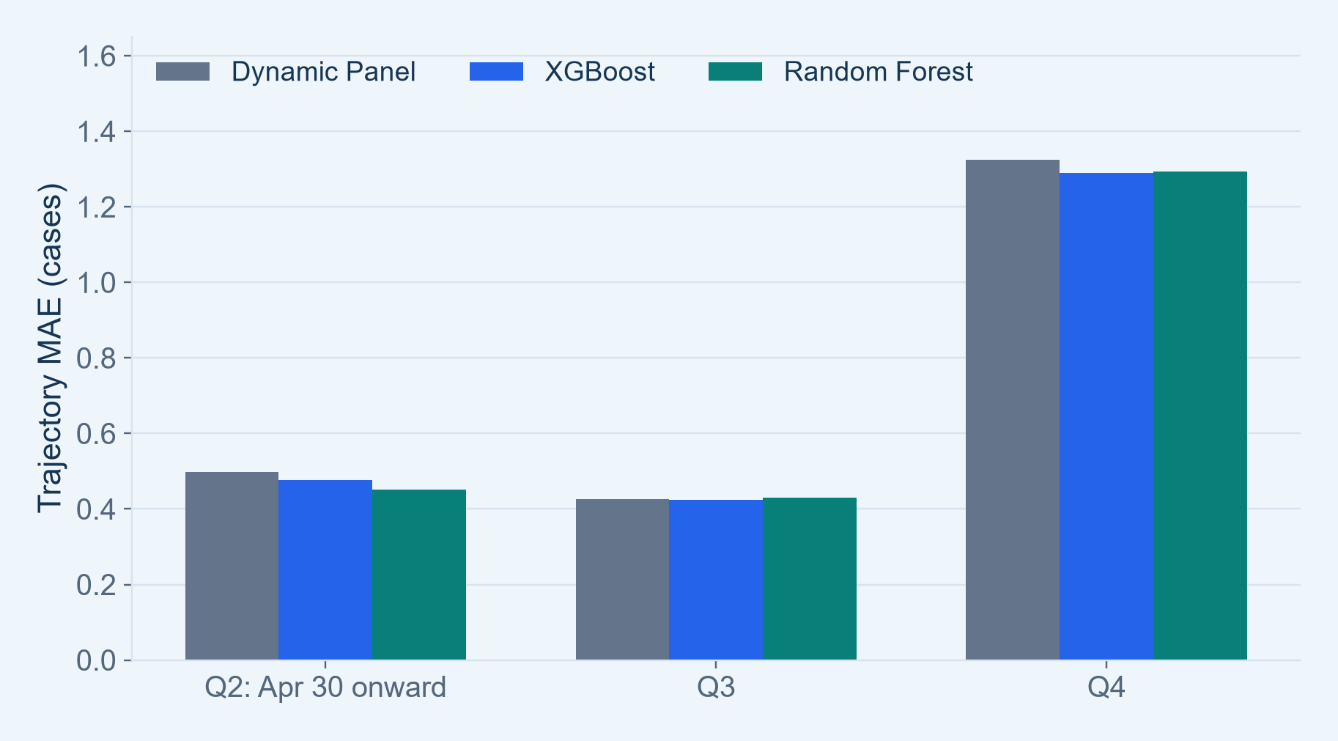
Performance Changes Across the Year
Compare periods to check whether one pooled score tells the whole story
KEY FINDINGS
No consistent winner
RF has the lowest Q2 MAE; XGBoost is slightly lower in Q3 and Q4.
Autumn errors are larger
Higher case activity changes the error scale; phase stability needs further evaluation.
2020 ROLLING VALIDATION
5
Notes:
SUGGESTED NARRATION
The model ranking changes by quarter. Random Forest is best in the partial second quarter, while XGBoost is slightly better in the third and fourth quarters. Absolute errors are also much higher in autumn. This motivates temporal assessment across later years, rather than selecting a model from one period alone.
ANALYSIS / SOURCES
Sources: Weikun/random_forest_trajectory_outputs/rf60_weekly_development_20261027/comparison/; notebooks24–26. Same585 ZIPs and243 daily origins, Apr30–Dec28 2020. Retrospective recorded-onset evaluation, not an untouched test or validated real-time forecast. All34 candidate features including both pressure features retained. quarter_comparison.csv. Q2Apr30–Jun30,62origins; Q3 92; Q4 89. DP MAE.49886/.42690/1.32525; XGB.47630/.42445/1.28893; RF.45200/.43048/1.29303. Descriptive quarterly differences, not separately established significant differences or causal effects. Raw-count errors tend to scale with activity.

Slide 6
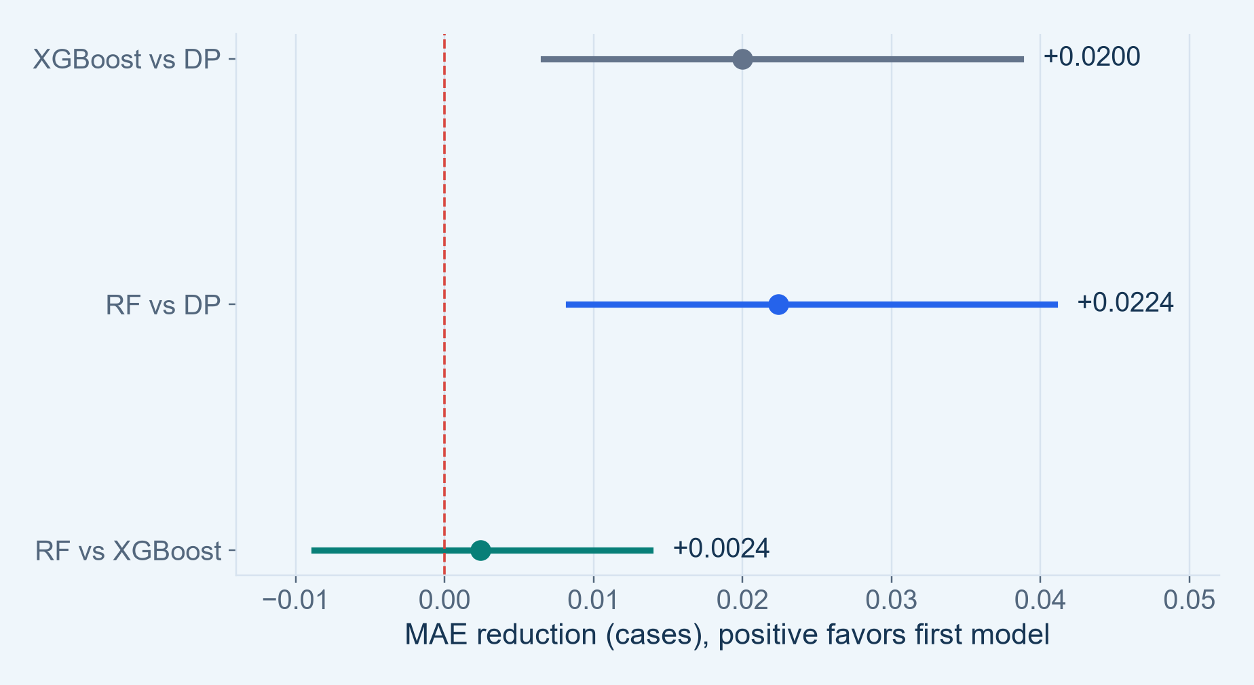
How Clear Are the MAE Differences?
Paired MAE differences with 95% date-block confidence intervals
KEY FINDINGS
Small gains over DP
MAE reductions are about 0.020–0.022 cases; intervals lie above zero.
RF vs XGBoost is unclear
The interval crosses zero. Holm-adjusted p=0.675.
2020 ROLLING VALIDATION
6
Notes:
SUGGESTED NARRATION
We also quantify uncertainty in paired loss differences. Positive values mean the first model has lower MAE. The two tree models show small reductions relative to Dynamic Panel in this development period. But the difference between Random Forest and XGBoost is much less clear, and its interval crosses zero. We should not claim Random Forest is definitively better.
ANALYSIS / SOURCES
Sources: Weikun/random_forest_trajectory_outputs/rf60_weekly_development_20261027/comparison/; notebooks24–26. Same585 ZIPs and243 daily origins, Apr30–Dec28 2020. Retrospective recorded-onset evaluation, not an untouched test or validated real-time forecast. All34 candidate features including both pressure features retained. paired_date_block_intervals.csv and HAC tests in comparison outputs. Seven-day moving-date-block bootstrap,2000resamples, all regions kept together: DP−XGB.0199839 CI.0066616–.0386838; DP−RF.0223975 CI.0083234–.0409482; XGB−RF.0024136 CI−.0087490–.0138143. Pointwise exploratory95% CIs, not prediction intervals. HAC lag7 forecast-loss tests, three planned MAE contrasts with Holm adjustment: XGBvsDP p.03415; RFvsDP.02296; RFvsXGB.67548. Not coefficient tests, selection-adjusted final inference or causal effects.

Slide 7
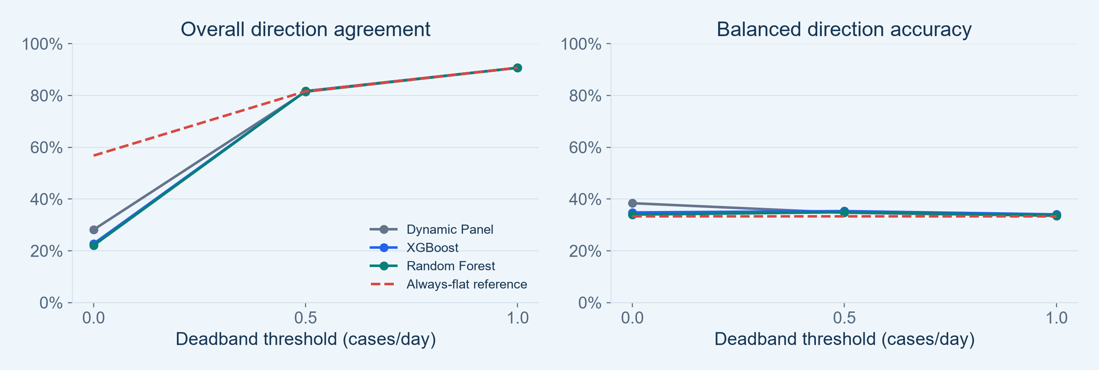
Direction Accuracy Depends on the Rule
A wider “flat” category can raise accuracy without improving useful discrimination
About 90.7% at the wider threshold
Keep the class breakdown
Always predicting flat also gives about 90.7%.
Balanced accuracy stays near 33–34% there.
2020 ROLLING VALIDATION
7
Notes:
SUGGESTED NARRATION
Direction accuracy is sensitive to how we define flat. When we allow a wider range to count as flat, overall agreement rises to about91 percent. But an always-flat reference performs about the same, while balanced accuracy remains close to one third. We will therefore keep the original strict rule and report sensitivity and class balance transparently.
ANALYSIS / SOURCES
Sources: Weikun/random_forest_trajectory_outputs/rf60_weekly_development_20261027/comparison/; notebooks24–26. Same585 ZIPs and243 daily origins, Apr30–Dec28 2020. Retrospective recorded-onset evaluation, not an untouched test or validated real-time forecast. All34 candidate features including both pressure features retained. direction_threshold_sensitivity.csv. Direction sign based on slope=(Day3−Day1)/2, deadbands0,.5,1 cases/day. At threshold1 actual flat share.90719; DP overall.90698, XGB.90706, RF.90701; balanced.33522,.34077,.33673. Threshold0 remains primary supporting definition; .5/1 are pre-existing Notebook21 sensitivity values. These redefine both truth and predictions and are not tuned to maximize displayed accuracy. Always-flat is a diagnostic reference, not seasonal naive or an extra model.

Slide 8
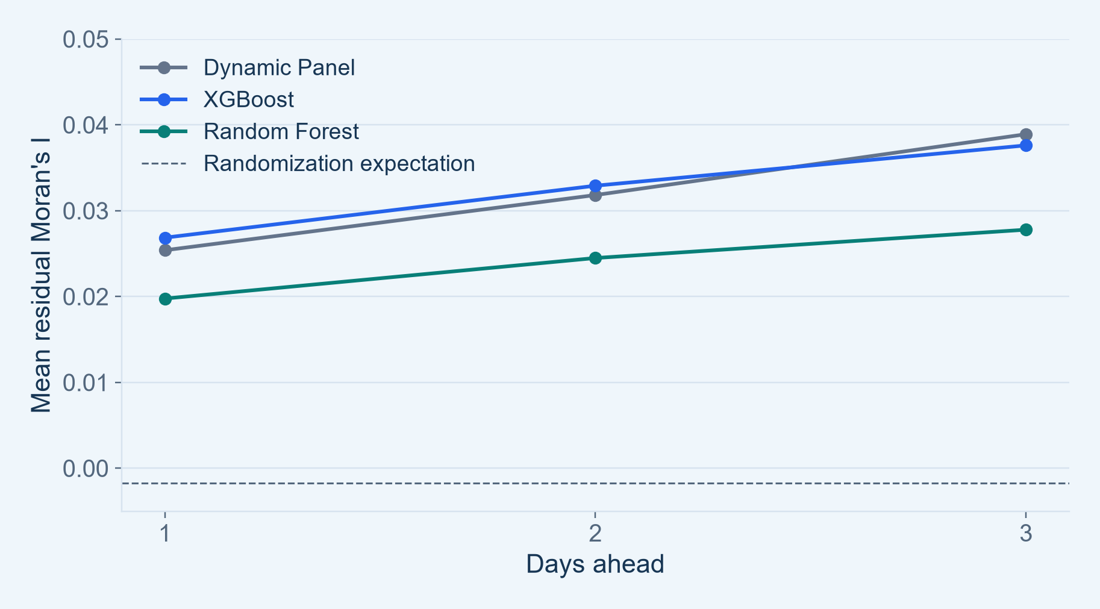
Geographic Error Remains
Residual Moran’s I diagnoses spatial structure left in forecast errors
KEY FINDINGS
RF is lower descriptively
Mean residual Moran’s I is lower at each forecast horizon.
Spatial structure remains
Low count error does not establish that geographic dependence is fully captured.
2020 ROLLING VALIDATION
8
Notes:
SUGGESTED NARRATION
We examine whether neighboring regions still make similar forecasting errors. Random Forest has lower average residual Moran’s I at all three horizons, but residual structure remains. This is a diagnostic finding, not proof of a statistically significant difference between models or evidence of transmission. It supports retaining spatial checks alongside predictive error.
ANALYSIS / SOURCES
Sources: Weikun/random_forest_trajectory_outputs/rf60_weekly_development_20261027/comparison/; notebooks24–26. Same585 ZIPs and243 daily origins, Apr30–Dec28 2020. Retrospective recorded-onset evaluation, not an untouched test or validated real-time forecast. All34 candidate features including both pressure features retained. residual_moran outputs for each model; residual_moran_comparison.csv. Geographic8nearest-neighbor graph from provided Gazetteer internal points; symmetric union then row standardization, so some rows have more than8neighbors. Not8ZIPs total or commuting weights. Randomization expectation−1/584. Means DP.02540,.03183,.03891; XGB.02686,.03291,.03761; RF.01977,.02449,.02779. 999two-sided permutations; BH over729date×horizon tests per model. No paired inference on mean differences; heteroskedasticity/spatial exchangeability caveats and unvalidated postalZIP/ZCTA mapping remain.

Slide 9
Next: Test Whether These Findings Persist
Carry the three models forward under one frozen retrospective protocol
01
Freeze the comparison
Same cohort, feature definitions and three-day targets
02
Evaluate 2021–2023
Compare years, quarters and changing-path groups
03
Define the outbreak task
Agree on outbreak labels before PR-AUC and warning lead time
2020 ROLLING VALIDATION
9
Notes:
SUGGESTED NARRATION
Our next step is to freeze the current comparison and assess all three models across2021 to2023 using the same rolling rules. We will report count errors, trajectory changes and geographic diagnostics by period. After that, we can define outbreak labels and risk scores. We will call the later analysis a retrospective temporal assessment because those years have already been inspected during earlier development.
ANALYSIS / SOURCES
Sources: Weikun/random_forest_trajectory_outputs/rf60_weekly_development_20261027/comparison/; notebooks24–26. Same585 ZIPs and243 daily origins, Apr30–Dec28 2020. Retrospective recorded-onset evaluation, not an untouched test or validated real-time forecast. All34 candidate features including both pressure features retained. This is a proposed next step, not completed evaluation. Do not reselect model/windows from later outcomes and then describe those outcomes as an untouched test. Maintain60-day window, weekly refit, mature training labels and daily forecasts. Carry all3models forward because current metrics differ. SEIR excluded at user request. PR-AUC needs binary labels and a continuous risk score; lead time needs event dates, alert threshold, matching and false-alert rules. Neither is available from trajectory sign alone.

Slide 10
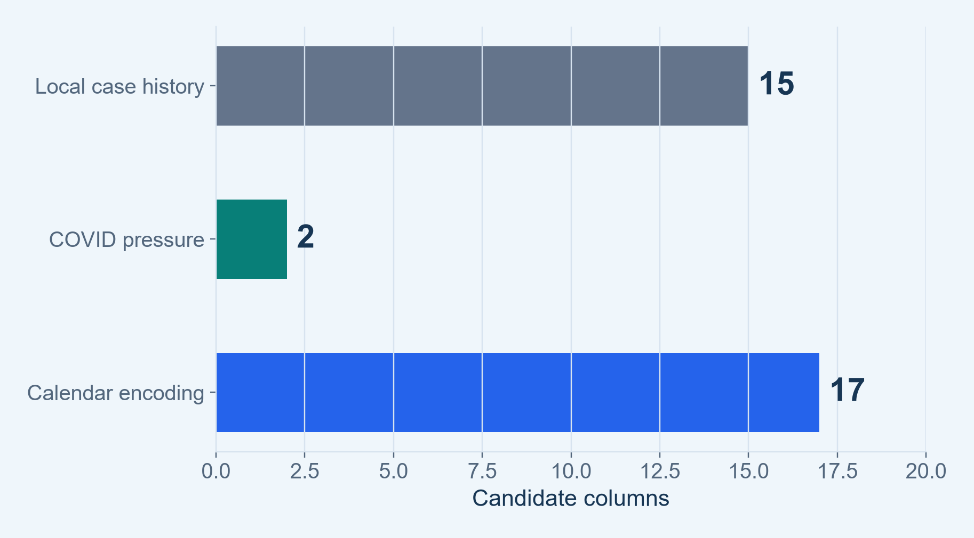
What Went Into Each Model?
All usable candidate features were retained for the current matched comparison
KEY FINDINGS
34 candidate features
15 local case-history + 2 pressure + 17 calendar columns.
Region identity is additional
Fixed effects for DP; category/one-hot coding for the tree models.
SUPPORTING ANALYSIS
10 | Appendix
Notes:
SUGGESTED NARRATION
The current comparison uses the full candidate feature pool, including both pressure features. Region identity is represented differently by each model, but all models receive the same underlying case-history, pressure and calendar information. Static regional attributes are not separate identifiable predictors in the fixed-effects baseline.
ANALYSIS / SOURCES
Sources: Weikun/random_forest_trajectory_outputs/rf60_weekly_development_20261027/comparison/; notebooks24–26. Same585 ZIPs and243 daily origins, Apr30–Dec28 2020. Retrospective recorded-onset evaluation, not an untouched test or validated real-time forecast. All34 candidate features including both pressure features retained. Feature lists: cases_today,lag1,lag7,lag14,mean7,mean14,std7,std14,acceleration,jerk,rate_today,rate7,rate14,gap_censored,no_previous flag=15. Two NJ-network pressures7/14; six weekday indicators plus eleven month indicators=17. Region identity:DPfixed effects,XGBnative ZIPcategory,RF585one-hot indicators. Candidate columns may be linearly dependent or constant within a training window; DP uses identifiable terms. No age/income additions. Population and commuting weights are static2021vintage; temporal mismatch and unvalidatedZIPZCTA mapping remain.

Slide 11
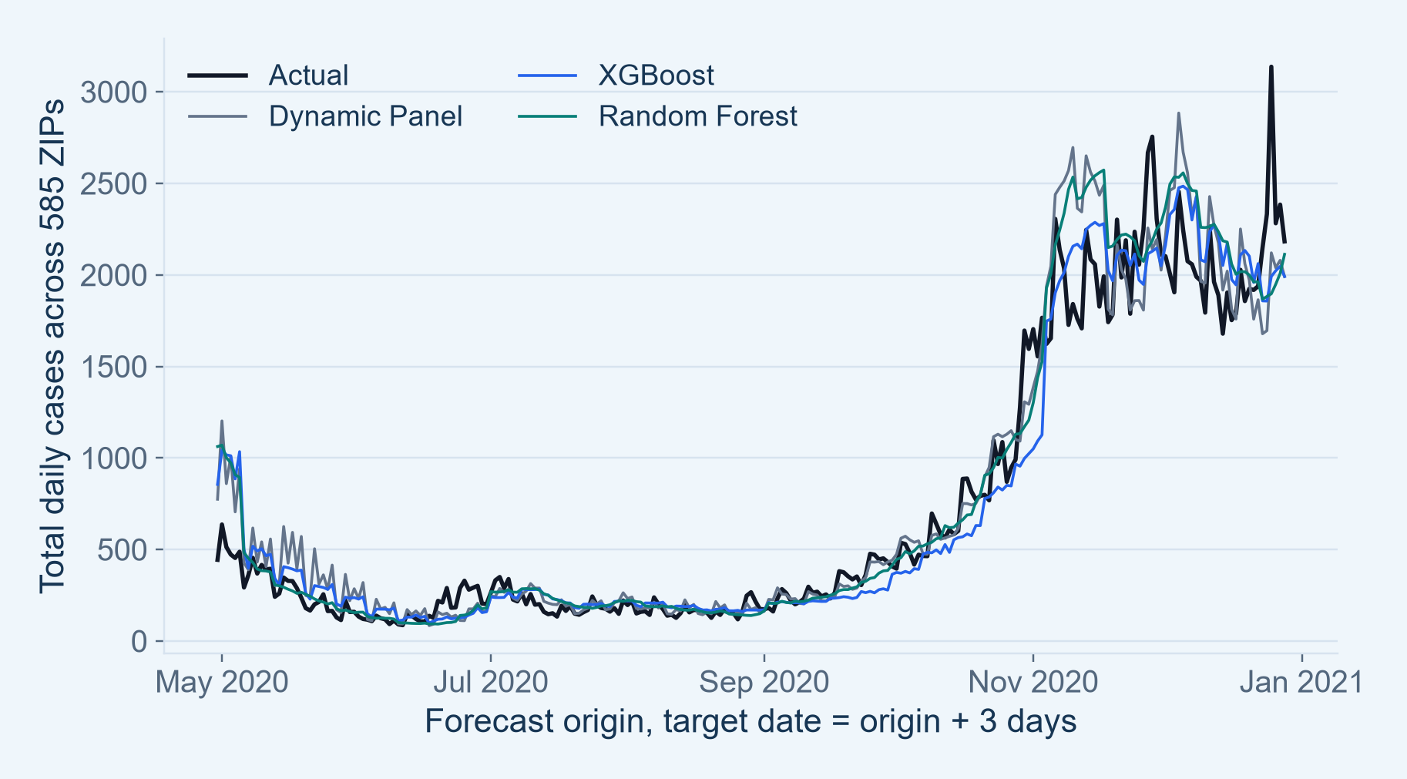
Actual and Predicted Case Activity
Three-day-ahead counts summed across the same 585 ZIPs
KEY FINDINGS
Broad activity is tracked
All three follow the low summer and higher autumn activity.
Totals can hide local errors
Overprediction in one ZIP may cancel underprediction in another.
SUPPORTING ANALYSIS
11 | Appendix
Notes:
SUGGESTED NARRATION
The models broadly follow the aggregate seasonal pattern, but they smooth or miss some changes. These curves sum predictions across regions. They illustrate case activity, while the primary accuracy score is computed on individual ZIP-level paths, where errors cannot cancel.
ANALYSIS / SOURCES
Sources: Weikun/random_forest_trajectory_outputs/rf60_weekly_development_20261027/comparison/; notebooks24–26. Same585 ZIPs and243 daily origins, Apr30–Dec28 2020. Retrospective recorded-onset evaluation, not an untouched test or validated real-time forecast. All34 candidate features including both pressure features retained. Matched NPZ predictions, horizon3, actual and predicted sums by origin. Targets are origin+3days. Each point is a newly issued prediction; this is not a single months-ahead trajectory. Aggregate visual tracking is not a regional accuracy score and does not establish outbreak detection.

Slide 12
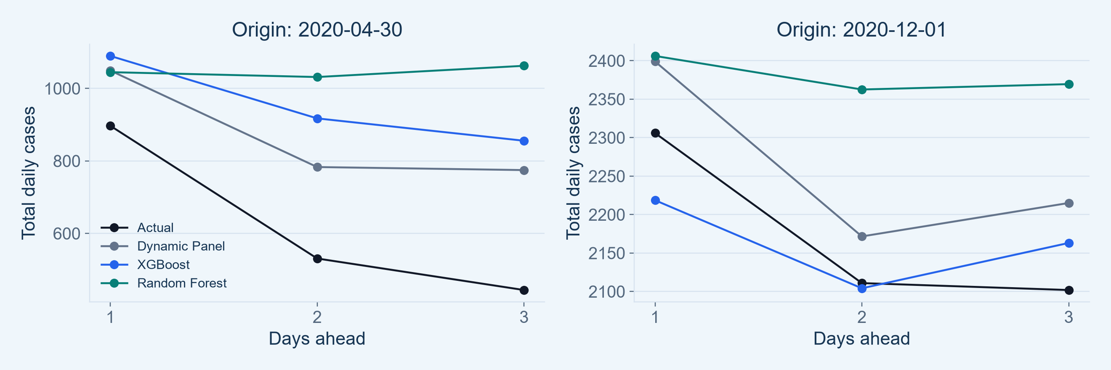
Three Future Days From the Same Origin
Illustrative paths show the output being evaluated
One origin → three predictions
Examples illustrate the errors
Day 1, Day 2 and Day 3 belong to one issued path.
These selected dates do not replace the full score.
SUPPORTING ANALYSIS
12 | Appendix
Notes:
SUGGESTED NARRATION
A three-day trajectory is the three daily predictions issued together from one forecast origin. Here we compare the model paths with the actual future counts on two illustrative dates. They help explain the forecast product, but we score every available path rather than choosing examples as evidence of overall performance.
ANALYSIS / SOURCES
Sources: Weikun/random_forest_trajectory_outputs/rf60_weekly_development_20261027/comparison/; notebooks24–26. Same585 ZIPs and243 daily origins, Apr30–Dec28 2020. Retrospective recorded-onset evaluation, not an untouched test or validated real-time forecast. All34 candidate features including both pressure features retained. Matched NPZ predictions, aggregate across585regions at originsApr30 andDec1,2020. Calendar examples chosen for illustration, not representative sampling or model selection. Daily origin paths overlap in target dates; uncertainty estimates use date blocks to account partly for dependence.

Slide 13
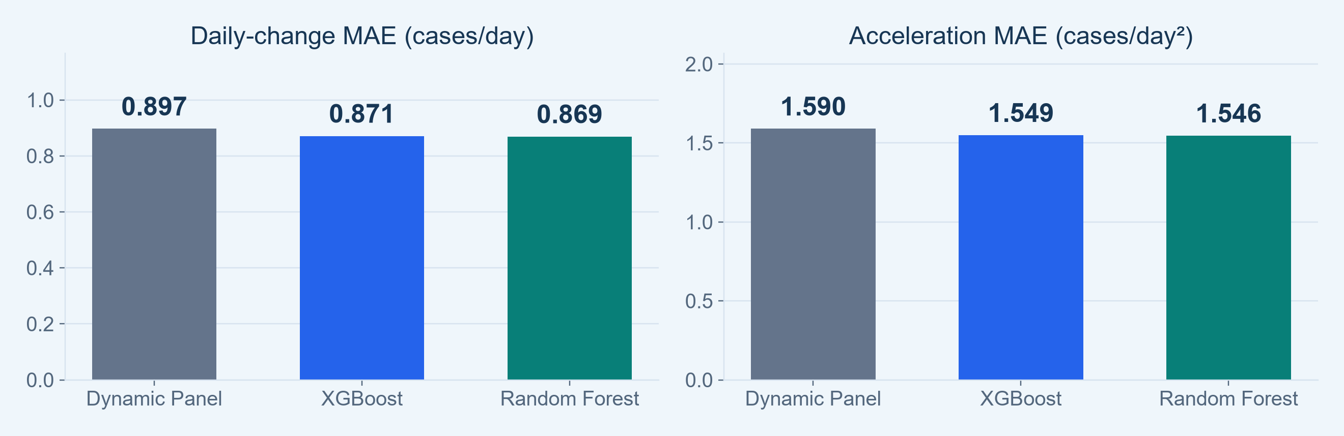
Changes and Acceleration Add Another Check
Compare the size of movements as well as their signs
Trees have slightly lower errors
Size and sign are different
For daily changes and the second difference.
Smaller movement error can coexist with lower strict shape agreement.
SUPPORTING ANALYSIS
13 | Appendix
Notes:
SUGGESTED NARRATION
We added errors for daily changes and acceleration without changing the three-day trajectory target. The tree models are slightly better at the numerical size of these movements, even though Dynamic Panel more often matches both movement signs. These measures help separate the magnitude of a change from its direction.
ANALYSIS / SOURCES
Sources: Weikun/random_forest_trajectory_outputs/rf60_weekly_development_20261027/comparison/; notebooks24–26. Same585 ZIPs and243 daily origins, Apr30–Dec28 2020. Retrospective recorded-onset evaluation, not an untouched test or validated real-time forecast. All34 candidate features including both pressure features retained. three_model_overall.csv. Change errors fromDay2−Day1 andDay3−Day2, averaged; accelerationDay3−2Day2+Day1. DP.896647 and1.589743; XGB.870869 and1.548966; RF.868983 and1.546024. Units cases/day andcases/day². No third difference from only3future values without an extra endpoint; historical jerk remains an input feature.

Slide 14
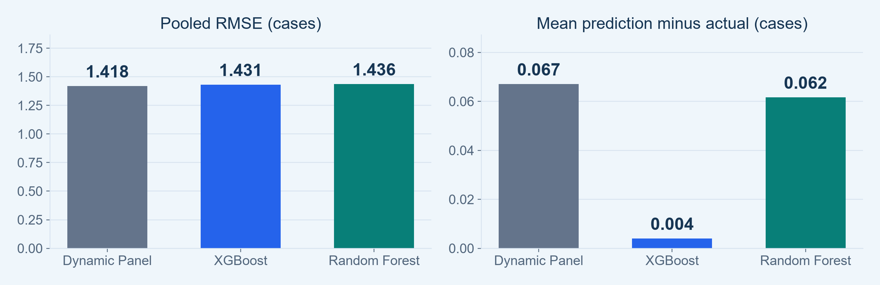
RMSE and Bias Change the Picture
A lower MAE does not guarantee smaller large errors or lower bias
Dynamic Panel: lowest RMSE
XGBoost: lowest mean bias
1.418 versus 1.431 XGB and 1.436 RF.
Average predicted−actual is about + 0.004 cases.
SUPPORTING ANALYSIS
14 | Appendix
Notes:
SUGGESTED NARRATION
Dynamic Panel has the lowest RMSE, which gives larger errors more weight. XGBoost has the smallest mean bias. Together with MAE and shape agreement, this reinforces that model choice depends on the objective and that a small difference in one metric should not be presented as universal superiority.
ANALYSIS / SOURCES
Sources: Weikun/random_forest_trajectory_outputs/rf60_weekly_development_20261027/comparison/; notebooks24–26. Same585 ZIPs and243 daily origins, Apr30–Dec28 2020. Retrospective recorded-onset evaluation, not an untouched test or validated real-time forecast. All34 candidate features including both pressure features retained. three_model_overall.csv. Pooled daily-target RMSE; mean bias prediction−actual. DP+.067025,XGB+.003984,RF+.061614. Small aggregate bias can hide offsetting local errors; it is not a measure of average absolute error. Same matched path rows used by allmodels.

Slide 15
Definitions and Limits for the Report
Retrospective analysis of recorded onset counts
Primary: trajectory MAE
Missing onset and availability
Average the 3 absolute count errors per ZIP-origin path, then average paths.
Excluded onset-missing records are not recovered; real-time availability is unverified.
Supporting: direction / shape
Geographic inputs
Direction uses Day 3−Day 1; shape requires both daily movement signs.
Static 2021 population/commuting; exact ZIP–ZCTA matches remain unvalidated.
Uncertainty
Later-year evaluation
Date-block CIs describe loss differences, not future prediction intervals.
2021–2023 have been inspected earlier; do not call them an untouched final test.
SUPPORTING ANALYSIS
15 | Appendix
Notes:
SUGGESTED NARRATION
These definitions make the analysis reproducible and prevent overclaiming. The current results concern recorded onset counts under a retrospective protocol. They do not yet establish prospective outbreak warnings, complete infection incidence, or causal cross-region transmission.
ANALYSIS / SOURCES
Sources: Weikun/random_forest_trajectory_outputs/rf60_weekly_development_20261027/comparison/; notebooks24–26. Same585 ZIPs and243 daily origins, Apr30–Dec28 2020. Retrospective recorded-onset evaluation, not an untouched test or validated real-time forecast. All34 candidate features including both pressure features retained. See dataset manifest, feature definitions, training logs, experiment manifests and three_model comparison CSVs. BH spatial corrections are performed within729tests per model; model mean Moran differences are descriptive. Candidate features/identifiability and current cohort were developed retrospectively. Current models use fixed starter hyperparameters, not a claim of globally optimized algorithms.

