Slide 1
Which Inputs Add Predictive Information?
Feature diagnostics under the current rolling three-day forecasting protocol
585
243
945
Same ZIPs
Daily forecast dates
Diagnostic model fits
Full model vs. removal of one feature group
15 local-history inputs 2 pressure inputs 17 calendar indicators
Same dates, horizons and settings. ZIP identity always remains.
60-day windows. Weekly refits. Main models keep all 34 features.
NOTEBOOK 33 — EXPLORATORY 2020 VALIDATION
1
Notes:
SUGGESTED NARRATION
We want to understand which information helps the models. We compare the full model with versions that remove one input group at a time. We use the same 585 ZIPs, 243 daily forecast dates and future days one, two and three. We retrain 945 diagnostic models under the same settings. These experiments do not change our main full-feature models.
ANALYSIS AND SOURCES
Sources protocol.json and training_audit.csv, feature_diagnostics_outputs/validation2020_20261102. 3 removals × 3 model types × 35 refits × 3 horizons=945 fits. Calendar 60 days including within-window warmup. Latest training target <= fit date. Dates Apr30–Dec28 2020, targets <= Dec31. ZIP identity remains. Removal of local history retains commuting pressure derived from origin case histories. No later-year evaluation or feature selection.
Scope: only2020development/validation results. No2021–2023scores. Retrospective recorded-onset counts, missing-onset records excluded, historical availability unverified. Same585ZIPs and sameforecasttargets across models. Forecasts clippedat0. Original34candidates plus model-specific ZIPidentity. Exploratory previously inspected developmentdata.

Slide 2
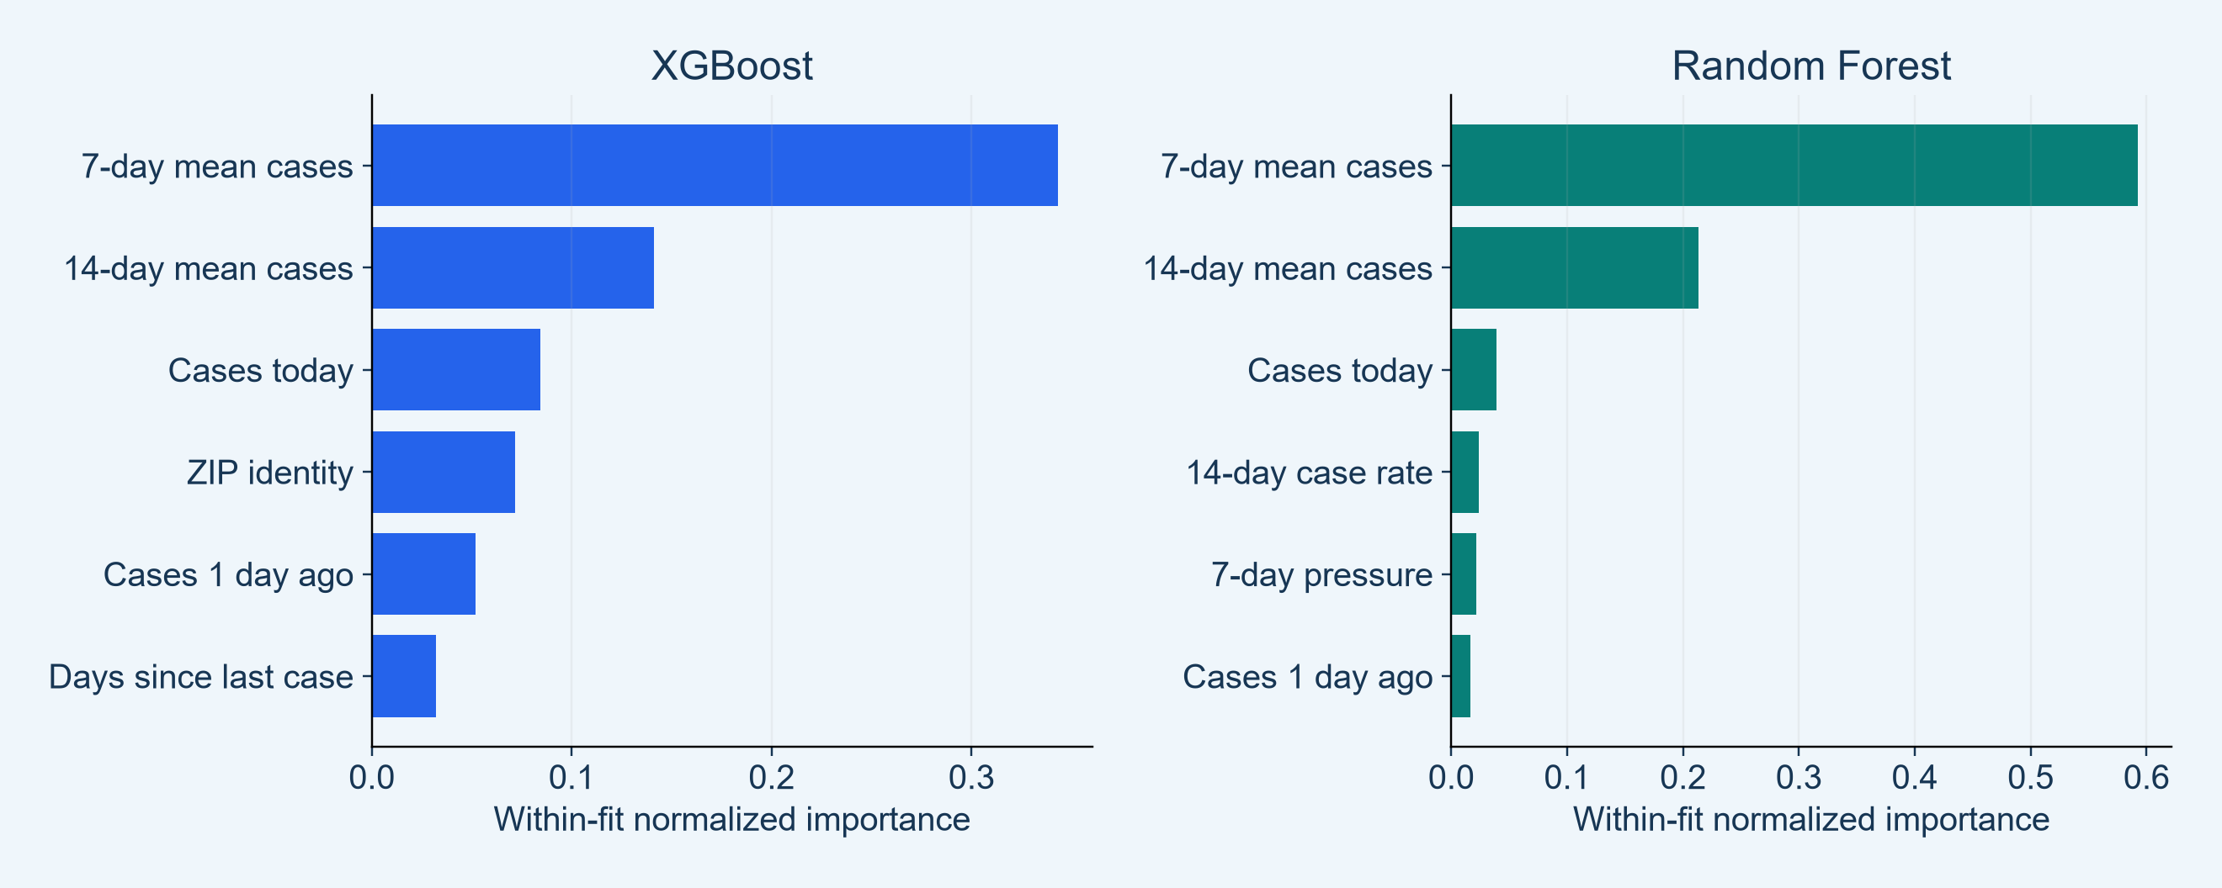
Recent Case Averages Dominate Tree Usage
Training importance describes how models use inputs
KEY FINDINGS
7-day and 14-day case means rank first in both tree models.
NOTEBOOK 33 — EXPLORATORY 2020 VALIDATION
2
Notes:
SUGGESTED NARRATION
Both tree models mainly use the seven-day and fourteen-day case averages. Other inputs also appear, including pressure. However, this is training importance. It does not prove that removing a feature will harm prediction. Related predictors can share information. XGBoost gain and Random Forest impurity importance are different measures, so their bar lengths should not be compared across models.
ANALYSIS AND SOURCES
training_importance_summary.csv and training_importance_by_fit.csv. 105 fits per model. Unused features zero-filled, normalized within fit and averaged equally. RF ZIP one-hot terms summed into ZIP identity. XGB split gain is different from RF impurity reduction. Correlated predictors and split opportunities affect rankings. All 34 candidates plus ZIP identity considered.
Scope: only2020development/validation results. No2021–2023scores. Retrospective recorded-onset counts, missing-onset records excluded, historical availability unverified. Same585ZIPs and sameforecasttargets across models. Forecasts clippedat0. Original34candidates plus model-specific ZIPidentity. Exploratory previously inspected developmentdata.

Slide 3
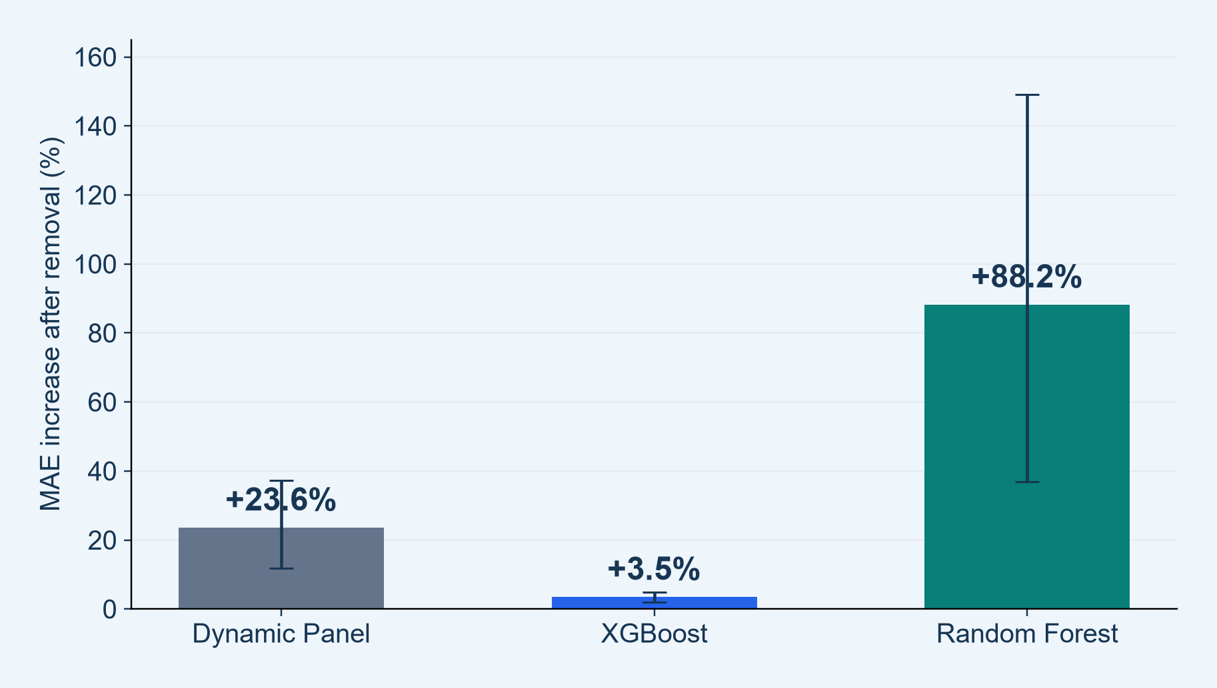
Removing Local History Raises Count Error
Other inputs, including pressure and ZIP identity, remain available
KEY FINDINGS
MAE rises in all models
DP +23.6%
XGBoost +3.5%
RF +88.2%
Local history adds information
Intervals describe uncertainty; p-value sensitivity follows.
NOTEBOOK 33 — EXPLORATORY 2020 VALIDATION
3
Notes:
SUGGESTED NARRATION
After removing local case history, MAE increases by 23.6 percent for Dynamic Panel, 3.5 percent for XGBoost and 88.2 percent for Random Forest. This shows that local history adds useful information under each fixed model specification. The differences do not directly measure an absolute degree of dependence across model types. The other input groups remain, and can partly substitute for the removed information.
ANALYSIS AND SOURCES
group_ablation_summary.csv. Delta=DROP MAE minus FULL MAE. FULL/DROP: DP .77428295/.956653, XGB .75429904/.780394, RF .75188541/1.415063. Plot transforms pointwise percentile14-day circular-date-block bootstrap CIs to percentages using the fixed observed FULL MAE denominator, B4000 seed20261102. All ZIP cross-sections and all horizons move together. Dynamic and RF HAC28 significance is weaker than HAC7; next p slide provides both.
Scope: only2020development/validation results. No2021–2023scores. Retrospective recorded-onset counts, missing-onset records excluded, historical availability unverified. Same585ZIPs and sameforecasttargets across models. Forecasts clippedat0. Original34candidates plus model-specific ZIPidentity. Exploratory previously inspected developmentdata.

Slide 4
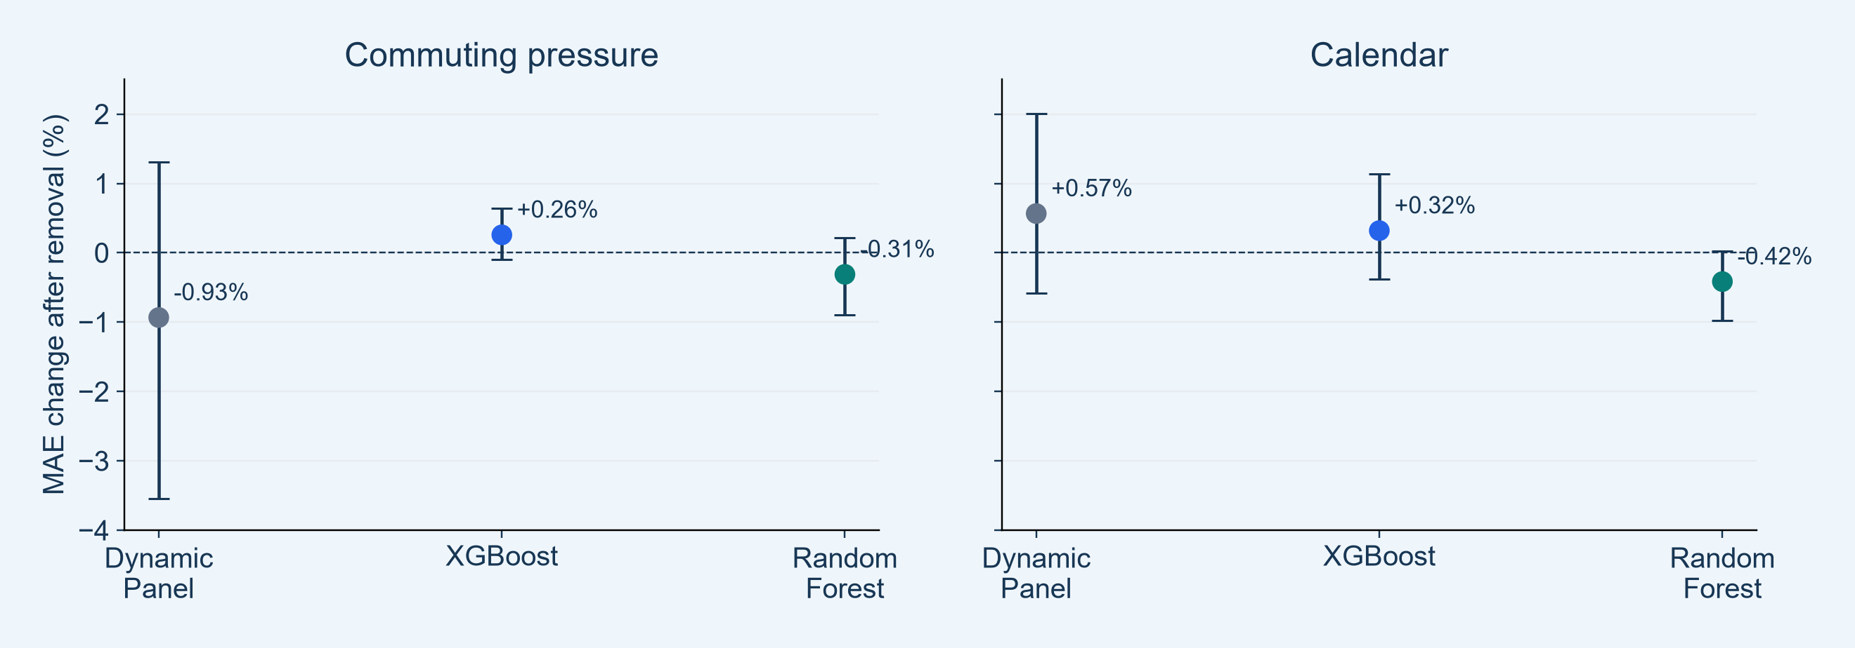
Pressure and Calendar Have Small Incremental Effects
Positive change means removing the group makes prediction worse
KEY FINDINGS
Effects are small and mixed. All intervals cross zero.
NOTEBOOK 33 — EXPLORATORY 2020 VALIDATION
4
Notes:
SUGGESTED NARRATION
Pressure and calendar produce smaller and mixed changes. Removing pressure slightly improves MAE for Dynamic Panel and Random Forest, but slightly worsens it for XGBoost. All intervals cross zero, and the adjusted tests do not provide stable evidence of an average contribution here. This does not prove that these inputs are useless. Pressure remains in the main models.
ANALYSIS AND SOURCES
group_ablation_summary.csv. Pressure relative deltaDP−.933342%,XGB+.258157%,RF−.311237%. CalendarDP+.565338%,XGB+.318900%,RF−.415206%. Both panels same vertical scale. Pointwise bootstrap95% CIs cross0 for all6 contrasts. HAC7/Holm adjusted p all>.05; HAC28/Holm also>.05. Exploratory previously inspected2020period, conditional on other retained features and fixed learner hyperparameters. No automatic removal.
Scope: only2020development/validation results. No2021–2023scores. Retrospective recorded-onset counts, missing-onset records excluded, historical availability unverified. Same585ZIPs and sameforecasttargets across models. Forecasts clippedat0. Original34candidates plus model-specific ZIPidentity. Exploratory previously inspected developmentdata.

Slide 5
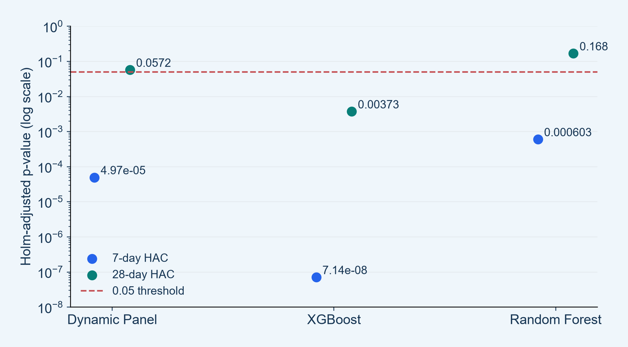
P-Value Conclusions Depend on Time Correlation
Local-history removal: Holm adjustment across all nine planned group contrasts
KEY FINDINGS
XGBoost remains below 0.05
Under both the 7-day and 28-day HAC settings.
DP and RF are sensitive
Longer time dependence weakens the significance evidence.
NOTEBOOK 33 — EXPLORATORY 2020 VALIDATION
5
Notes:
SUGGESTED NARRATION
We tested paired daily prediction-error differences while allowing for time correlation. Under the seven-day setting, local-history removal has small adjusted p-values for all three models. Under the longer twenty-eight-day setting, only XGBoost remains below 0.05. The estimated error increases do not change, but the uncertainty changes. We report both settings instead of choosing the more favorable p-value.
ANALYSIS AND SOURCES
group_ablation_summary.csv. Two-sided intercept-only daily-loss HAC tests with finite-sample correction, normal asymptotic p. Holm over all9 plannedprimarycontrasts; same9 family for sensitivity. PrimaryadjustedDP4.971981e−5,XGB7.137201e−8,RF.000603021;28lagDP.057218,XGB.003731,RF.168191. WholeZIPcross-section averaged before temporaltest; n243 dates, not426465 independenttargets. logpaxis. P-values are exploratory. Pointwise bootstrapCIs and multiplicity-adjustedHACtests differ and may disagree nearcutoffs.
Scope: only2020development/validation results. No2021–2023scores. Retrospective recorded-onset counts, missing-onset records excluded, historical availability unverified. Same585ZIPs and sameforecasttargets across models. Forecasts clippedat0. Original34candidates plus model-specific ZIPidentity. Exploratory previously inspected developmentdata.

Slide 6
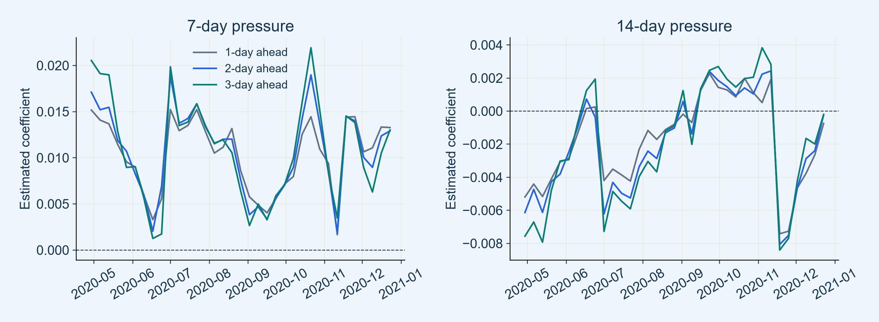
Pressure Associations Change Across Refits
Dynamic Panel coefficients across weekly training dates
KEY FINDINGS
7-day pressure stays positive; the 14-day coefficient changes sign.
Coefficient signs describe associations, not causal effects or predictive significance.
NOTEBOOK 33 — EXPLORATORY 2020 VALIDATION
6
Notes:
SUGGESTED NARRATION
The seven-day pressure coefficient is positive across all weekly fits and horizons. The fourteen-day coefficient changes sign. These are conditional associations within the full Dynamic Panel model. A positive coefficient does not mean pressure has a proven causal effect, or that it improves validation performance. Related pressure measures can share information, and overlapping training windows make the estimates dependent.
ANALYSIS AND SOURCES
dp_coefficients_by_fit.csv and dp_coefficient_stability.csv. 35fits×3horizons=105 estimates for each pressure feature. Pressure7positiveall105;pressure14positiveshare .3143/.3143/.3429 byhorizon. Different coefficientunitsandcorrelation preclude magnitude comparison. Raw slopes; not standardized. No individual slope p-value, CI or causal inference. DynamicFEbias and dependence remain.
Scope: only2020development/validation results. No2021–2023scores. Retrospective recorded-onset counts, missing-onset records excluded, historical availability unverified. Same585ZIPs and sameforecasttargets across models. Forecasts clippedat0. Original34candidates plus model-specific ZIPidentity. Exploratory previously inspected developmentdata.

Slide 7
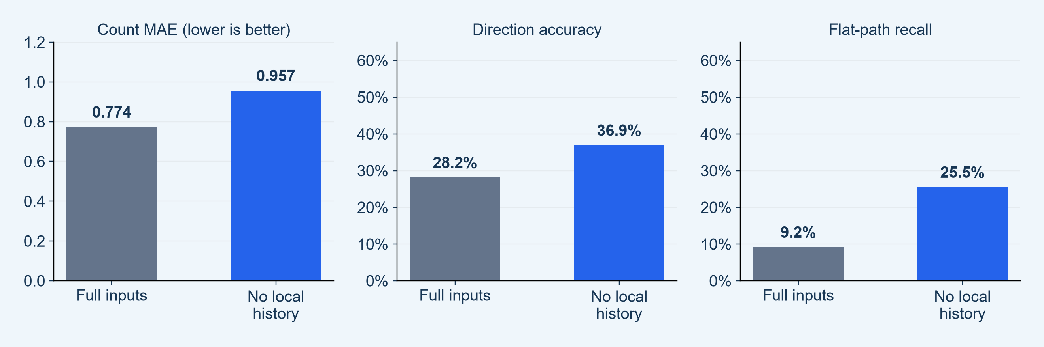
Count Accuracy and Direction Can Move Differently
Dynamic Panel example after removing local case history
KEY FINDINGS
Count error worsens, while direction improves as flat recall rises.
NOTEBOOK 33 — EXPLORATORY 2020 VALIDATION
7
Notes:
SUGGESTED NARRATION
For Dynamic Panel, removing local history makes count MAE worse, increasing it from 0.774 to 0.957. But direction accuracy rises from 28.2 to 36.9 percent, alongside higher flat-path recall. This shows that count accuracy and direction accuracy answer different questions. The example does not establish a better outbreak model, and we keep the full specification.
ANALYSIS AND SOURCES
group_ablation_trajectory_diagnostics.csv. DP localhistory FULLdirection .2815518,DROP .3694207;flatrecall .0918428/.2551726;countMAE .77428295/.956653. Actualendpointflatshare56.7789% unchanged. Supplementary descriptive classdiagnostics; no additional p tests. Otherclasseschangealso:declinerecall .474345/.484554,rise .585552/.553442. No causal attribution of the entire accuracy increase to flat recall alone. No warning/AP reanalysis here.
Scope: only2020development/validation results. No2021–2023scores. Retrospective recorded-onset counts, missing-onset records excluded, historical availability unverified. Same585ZIPs and sameforecasttargets across models. Forecasts clippedat0. Original34candidates plus model-specific ZIPidentity. Exploratory previously inspected developmentdata.

Slide 8
What the Feature Analysis Adds
Interpret effect size, uncertainty and model behavior together
Strongest count evidence
Local case history adds predictive information
Training behavior
Recent case averages dominate tree usage
Remaining uncertainty
Pressure/calendar gains are small; some p-values are sensitive
Trajectory lesson
Lower count error does not guarantee better direction
Main models retain all features. These are exploratory validation findings.
NOTEBOOK 33 — EXPLORATORY 2020 VALIDATION
8
Notes:
SUGGESTED NARRATION
This analysis explains more than the model rankings alone. Local case history adds information, and recent averages dominate tree usage. Pressure and calendar have smaller incremental effects in this period. Statistical conclusions depend partly on how we account for time correlation. Count accuracy and trajectory direction can also move differently. These are exploratory findings; our main full-feature models remain unchanged.
ANALYSIS AND SOURCES
Notebook33. All analyses2020Apr30–Dec28 dailyforecastdates585ZIPs3horizons. No2021–2023results, no new outbreak definition or warning calibration. No final feature selection basedonthisperiod. CIspointwise, pHolmfamily9, priorinspectionandfewindependentwaveslimitinference. Correlation does not prove causation.
Scope: only2020development/validation results. No2021–2023scores. Retrospective recorded-onset counts, missing-onset records excluded, historical availability unverified. Same585ZIPs and sameforecasttargets across models. Forecasts clippedat0. Original34candidates plus model-specific ZIPidentity. Exploratory previously inspected developmentdata.

