Slide 1
Data Cleaning and the Analysis Sample
Source preparation covers 2020–2023. This presentation evaluates 2020 only.
2,656,888
1,040,394
873,678
Raw source records
Eligible onset records
ZIP × date rows
598 ZIPs × 1,461 days in the prepared panel
585 ZIPs in the matched model comparison
60.65% of source records lack onset dates and are excluded.
Absent ZIP–date groups receive zero observed records. Missing onset records do not.
2020 TRAINING AND ROLLING VALIDATION
1
Notes:
SUGGESTED NARRATION
We prepared a complete region-by-day panel from the 2020 to 2023 source. The 2.66 million raw records become 1.04 million eligible onset records after cleaning. Aggregation and calendar completion produce 873,678 rows. Those are different units. Our matched forecasting cohort uses 585 ZIPs. Missing onset dates affect 60.65 percent of source records, so we report recorded onset counts rather than complete infection incidence.
ANALYSIS AND SOURCES
Sources cleaning_manifest.json in real_nj_cleaning_outputs, original NJ_COVID_2020_2023.xlsx. Exactduplicates1087. Eligibleonsetrecords1040394, missingonsetraw1611499. Balanced598×1461=873678. This is not1040394validatedindependent infectionepisodes. Invalid/unmatchedZIP anddateflagsalsoapply; overlappingexclusionflags mustnotbesummed. Allperiodsourcecoverage isshownonlyasdatapreparation context.
Scope: only2020development/validation results. No2021–2023scores. Retrospective recorded-onset counts, missing-onset records excluded, historical availability unverified. Same585ZIPs and sameforecasttargets across models. Forecasts clippedat0. Original34candidates plus model-specific ZIPidentity. Exploratory previously inspected developmentdata.

Slide 2
The Candidate Feature Pool
34 engineered inputs, plus a separate representation of ZIP identity
15
2
17
Local case history
Commuting pressure
Calendar indicators
Cases today and lags 1, 7, 14
Rolling levels, variability and dynamics
Population rates and sparse-case history
Inbound-weighted origin case rates
Trailing 7-day and 14-day windows
6 target-weekday indicators
11 target-month indicators
All three models use the full candidate pool, including both pressure features.
2020 TRAINING AND ROLLING VALIDATION
2
Notes:
SUGGESTED NARRATION
The model input pool has 34 candidate features: 15 local case-history variables, two commuting-pressure measures and 17 calendar indicators. ZIP identity is additional. All three models receive the full candidate pool, including pressure. The fixed-effects model cannot separately estimate columns that are constant or exactly dependent within a window.
ANALYSIS AND SOURCES
15local:cases_today,lag1/7/14,mean7/14,std7/14,acceleration,jerk,rate_today/7/14,gapcensored,nopreviousflag.2pressure7/14.17calendar=6weekday+11month. Noage/income. Static2021population/commuting inputs. DP dropsunidentifiableorconstantcolumns perwindow;34candidatecolumns do notmean34separatelyestimated slopes. Historicalfeatureselection exploratory; currentcomparisonretainsfullpool.
Scope: only2020development/validation results. No2021–2023scores. Retrospective recorded-onset counts, missing-onset records excluded, historical availability unverified. Same585ZIPs and sameforecasttargets across models. Forecasts clippedat0. Original34candidates plus model-specific ZIPidentity. Exploratory previously inspected developmentdata.

Slide 3
Training, Validation and Later Evaluation
60-day rolling history, weekly parameter updates, daily three-day forecasts
Initial training
Rolling validation
Later evaluation
Mar 1–Apr 29, 2020
Apr 30–Dec 28, 2020
2021–2023
First 60-day window
Targets end by Dec 31
Results excluded from this deck
585 ZIPs × 243 origins = 142,155 three-day paths
Every fit uses matured historical targets. Each new forecast uses available past data.
2020 TRAINING AND ROLLING VALIDATION
3
Notes:
SUGGESTED NARRATION
The first training window is March 1 through April 29, 2020. We then use a moving sixty-day history, refit weekly and issue predictions daily for the next three days. We evaluate 243 origins from April 30 to December 28. At each refit, training targets must already have occurred. Later-year results are outside this presentation.
ANALYSIS AND SOURCES
training_timing.csv verifieswindowcalendar60,warmup14insidewindow,45/44/43initialusabletrainingoriginsforh1/2/3; latesttrainingtarget<=fitdate. Trainingwindowscanincludealreadyobservedpastvalidationdata byfixedschedule, never futurelabels. Same585ZIPs,243dates andhorizons across models.2021–2023arelaterretrospectiveevaluations, notclaimeduntouched becausepriorinspection. Nofinalmodelselectionorwindowoptimizationclaim.
Scope: only2020development/validation results. No2021–2023scores. Retrospective recorded-onset counts, missing-onset records excluded, historical availability unverified. Same585ZIPs and sameforecasttargets across models. Forecasts clippedat0. Original34candidates plus model-specific ZIPidentity. Exploratory previously inspected developmentdata.

Slide 4
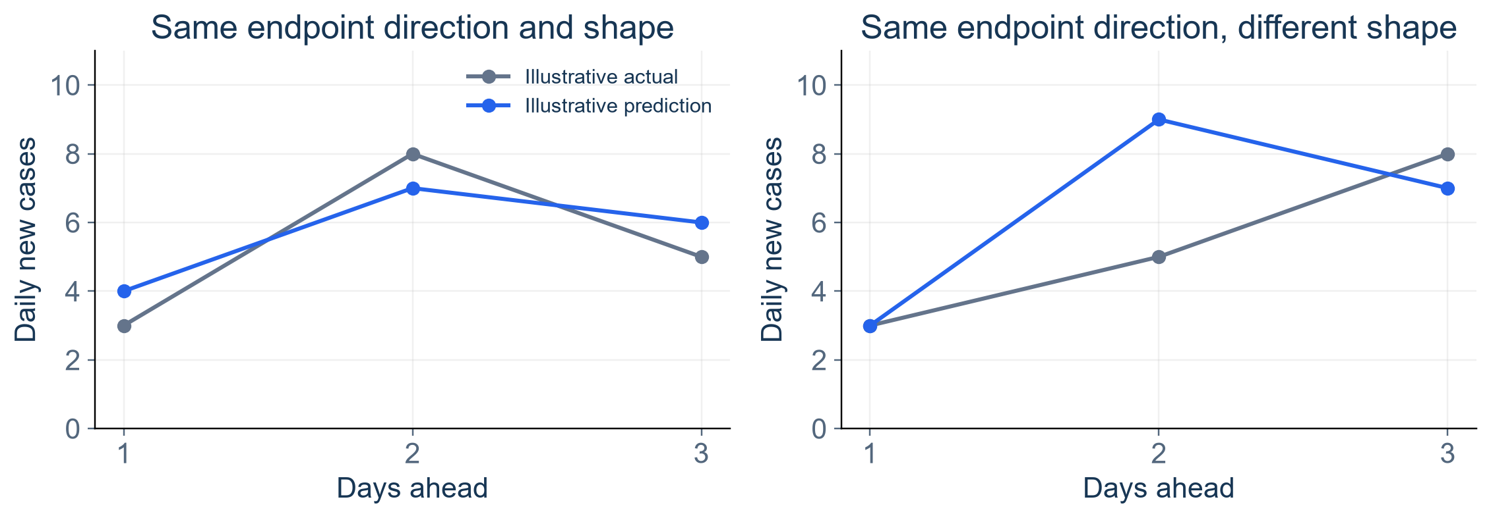
Our Three-Day Trajectory Definition
One ZIP, one forecast origin, three predicted daily case counts
Primary direction: compare Day 3 with Day 1
Supplementary shape: match both Day 2 − Day 1 and Day 3 − Day 2 signs.
2020 TRAINING AND ROLLING VALIDATION
4
Notes:
SUGGESTED NARRATION
A three-day trajectory contains the three daily case-count forecasts issued together for one ZIP and one forecast origin. Our primary direction measure compares Day 3 with Day 1. Strict shape is supplementary and requires both daily movement signs to match. The examples are illustrations, not study results. Daily new cases can be positive while their trend declines.
ANALYSIS AND SOURCES
Figureisexplicitlyillustrative,notempiricalresults. HorizonDay1=t+1,Day3=t+3. Flatrequires exactequality,notawidentolerance. Directionprioritywasrevisedafterreviewingresults andisexploratory. Sameoriginalpredictions,notretrained. CountMAE/RMSEremainlevelmetrics. Strictshapeisnotrestrictedtoallrisingpaths.
Scope: only2020development/validation results. No2021–2023scores. Retrospective recorded-onset counts, missing-onset records excluded, historical availability unverified. Same585ZIPs and sameforecasttargets across models. Forecasts clippedat0. Original34candidates plus model-specific ZIPidentity. Exploratory previously inspected developmentdata.

Slide 5
Our Outbreak Definition
A research-defined local case-surge event, evaluated separately for each ZIP
01
Abnormal activity
Trailing 3-day mean > historical mean + 2 SD
02
Minimum size
At least 5 recorded cases across the latest 3 days
03
Event confirmation
Two consecutive qualifying days. Confirm on Day 2.
Baseline: 28 earlier 3-day means, excluding the latest 3 positions.
Reset after 7 consecutive nonqualifying days.
2020 TRAINING AND ROLLING VALIDATION
5
Notes:
SUGGESTED NARRATION
We define a local case-surge event relative to each ZIP’s recent history. Its three-day mean must exceed the historical mean plus two standard deviations, with at least five cases across three days. Two consecutive qualifying days confirm an event on the second day. Seven consecutive nonqualifying days reset the event. This is a research label, not an official outbreak determination.
ANALYSIS AND SOURCES
Notebook27task_definition.json. For t,MA3=(C_t+C_t-1+C_t-2)/3;baselineMA3[t-30..t-3],28values,sampleSDddof1,strict>.Both activityandminimumgateoneachqualifyingday.No recurrentconfirmationwhileactive. Labelingusesobservedonsetcounts;forecastwarningsusethesamerulewithpredictedfuturecounts.
Scope: only2020development/validation results. No2021–2023scores. Retrospective recorded-onset counts, missing-onset records excluded, historical availability unverified. Same585ZIPs and sameforecasttargets across models. Forecasts clippedat0. Original34candidates plus model-specific ZIPidentity. Exploratory previously inspected developmentdata.

Slide 6
Evaluation Metrics Follow the Forecast Outputs
One set of predictions supports several complementary analyses
Daily cases
MAE and RMSE
How close are predicted counts?
Trajectory
Endpoint direction and supplementary shape
Does the model capture the path’s movement?
Spatial errors
Residual Moran’s I
Do neighboring ZIPs share forecast errors?
Outbreak warnings
AP, event recall, precision and lead time
Can we rank risk and issue useful warnings?
2020 TRAINING AND ROLLING VALIDATION
6
Notes:
SUGGESTED NARRATION
Each metric addresses a distinct question. MAE and RMSE evaluate count errors. Endpoint direction and strict shape evaluate trajectory movement. Residual Moran’s I diagnoses spatially patterned errors. Average Precision evaluates event-risk ranking. Recall, warning precision and lead time describe the warnings that we actually issue.
ANALYSIS AND SOURCES
AP=sklearnaverage_precision_score,step-integratedPRsummary,nottrapezoidPRareaandnotaccuracy. Leadreferstoeventconfirmation,soInflectionPointLeadTimeisrenamedWarningLeadTime. Idiagnosticconditionalongeographicgraph,mappingandexchangeability. Nooverallcomposite score.
Scope: only2020development/validation results. No2021–2023scores. Retrospective recorded-onset counts, missing-onset records excluded, historical availability unverified. Same585ZIPs and sameforecasttargets across models. Forecasts clippedat0. Original34candidates plus model-specific ZIPidentity. Exploratory previously inspected developmentdata.

Slide 7
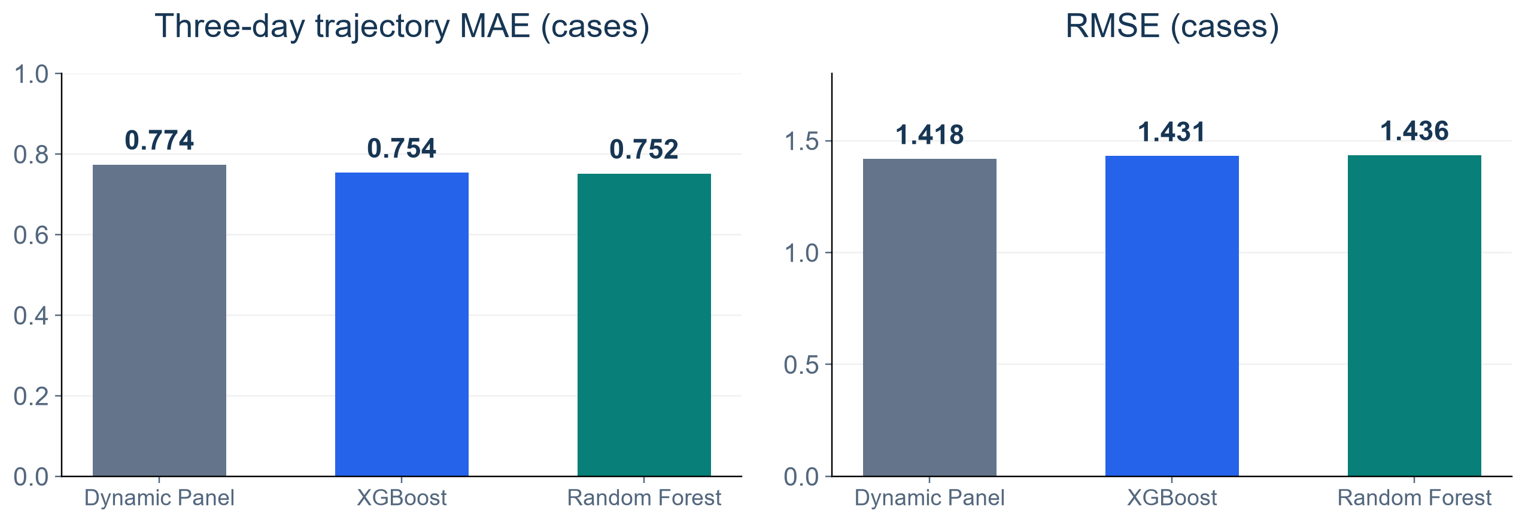
Daily Case Prediction: Small Average Gains
Dynamic Panel benchmark versus XGBoost and Random Forest
KEY FINDINGS
RF lowers MAE by 2.9%, but Dynamic Panel has the lowest RMSE.
2020 TRAINING AND ROLLING VALIDATION
7
Notes:
SUGGESTED NARRATION
Random Forest has the lowest trajectory MAE at 0.752 cases, compared with 0.774 for Dynamic Panel, a 2.9 percent reduction. XGBoost improves MAE by 2.6 percent. However, Dynamic Panel has the lowest RMSE, which emphasizes large errors. These small gains do not establish one model as best for every objective.
ANALYSIS AND SOURCES
Sources2020three_model_overall.csv,valuesDPMAE.7742829497,RMSE1.4183962469;XGB.754299044,1.431244582;RF.751885408,1.435766373. All585×243×3targets. TrajectoryMAEaverages3absoluteerrorsperpaththenpaths,identicaltoequalpooledMAEhere. RMSEcomputedfromalltargeterrors. Descriptivenumbers,nosignificanceclaimonthisslide.
Scope: only2020development/validation results. No2021–2023scores. Retrospective recorded-onset counts, missing-onset records excluded, historical availability unverified. Same585ZIPs and sameforecasttargets across models. Forecasts clippedat0. Original34candidates plus model-specific ZIPidentity. Exploratory previously inspected developmentdata.

Slide 8
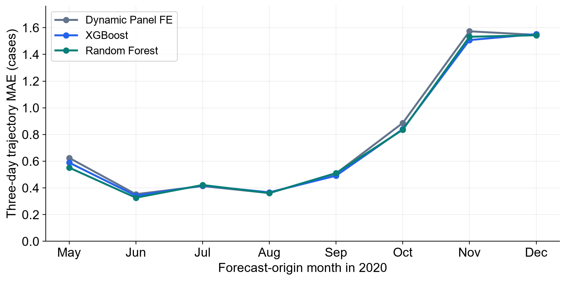
Validation Errors Change Over Time
Monthly trajectory MAE across the same 585 ZIPs
KEY FINDINGS
No universal winner
XGBoost beats DP in 5 of 8 months. RF does so in 6.
Late-year errors rise
Higher case activity also changes absolute error levels.
2020 TRAINING AND ROLLING VALIDATION
8
Notes:
SUGGESTED NARRATION
Overall averages hide changes over time. XGBoost has lower monthly MAE than Dynamic Panel in five of eight months, and Random Forest in six, although August is nearly tied. Dynamic Panel performs best in July. All models have larger absolute errors late in the year. Changing case volumes also affect absolute MAE.
ANALYSIS AND SOURCES
monthly_trajectory_metrics.csv. May–Deceightmonths;Apr30retainedoverallbutexcludedfrommonthlywinreport. Strictwins,noformalmonthlyinference.RFAugust.36139577vsDP.36140819,neartie. Monthbasedonorigin,sometargetscrossmonthboundarybutremain2020. CaselevelaffectsabsoluteMAE,notproofintrinsicdeterioration.
Scope: only2020development/validation results. No2021–2023scores. Retrospective recorded-onset counts, missing-onset records excluded, historical availability unverified. Same585ZIPs and sameforecasttargets across models. Forecasts clippedat0. Original34candidates plus model-specific ZIPidentity. Exploratory previously inspected developmentdata.

Slide 9
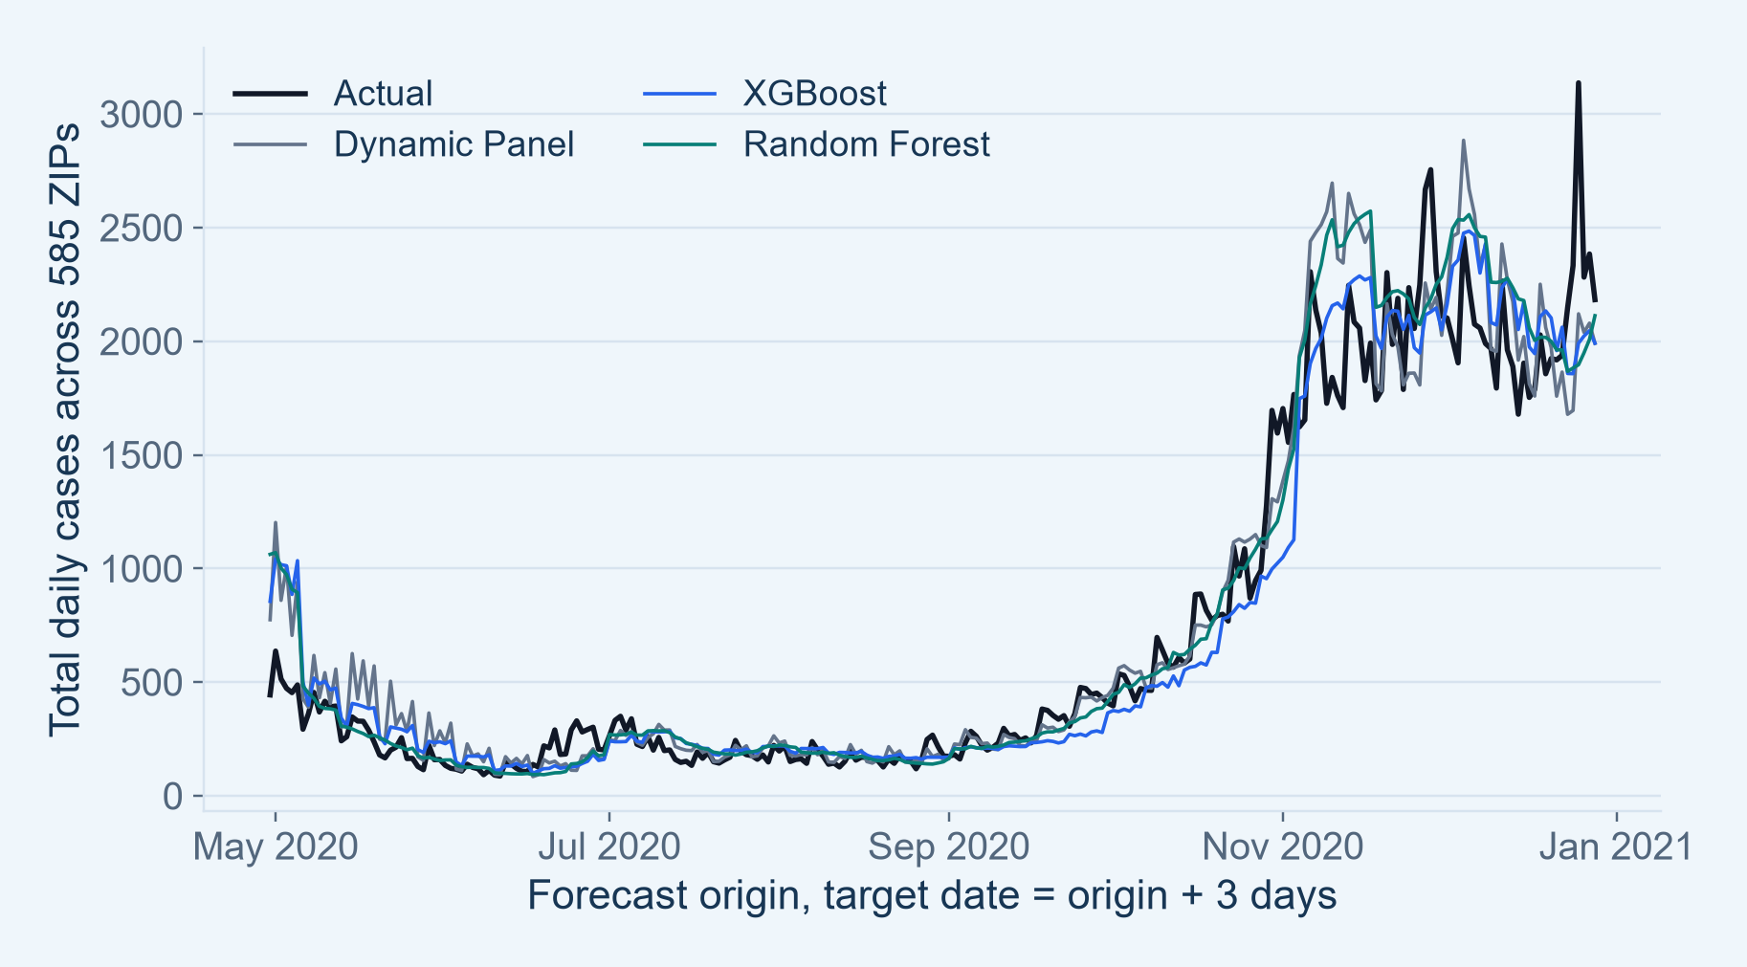
Actual and Predicted Daily Case Activity
Three-day-ahead case counts summed across the same 585 ZIPs
KEY FINDINGS
Broad activity is tracked
Low summer activity and the autumn increase appear in all models.
Totals can hide local errors
Overprediction and underprediction can cancel across ZIPs.
2020 TRAINING AND ROLLING VALIDATION
9
Notes:
SUGGESTED NARRATION
These curves show actual and predicted three-day-ahead counts summed across the same ZIPs. The models follow the broad activity pattern but miss some daily changes. Each point is a new three-day-ahead forecast, not one forecast for the entire year. Aggregate curves can conceal offsetting ZIP errors, which is why the main error scores use individual ZIP targets.
ANALYSIS AND SOURCES
Original figure09_actual_and_prediction.png from matched2020NPZ files. Horizon3 only. Forecast-origin x-axis, targetdate=origin+3. Aggregate illustration, not an accuracy score. No smoothing or model refit.
Scope: only2020development/validation results. No2021–2023scores. Retrospective recorded-onset counts, missing-onset records excluded, historical availability unverified. Same585ZIPs and sameforecasttargets across models. Forecasts clippedat0. Original34candidates plus model-specific ZIPidentity. Exploratory previously inspected developmentdata.

Slide 10
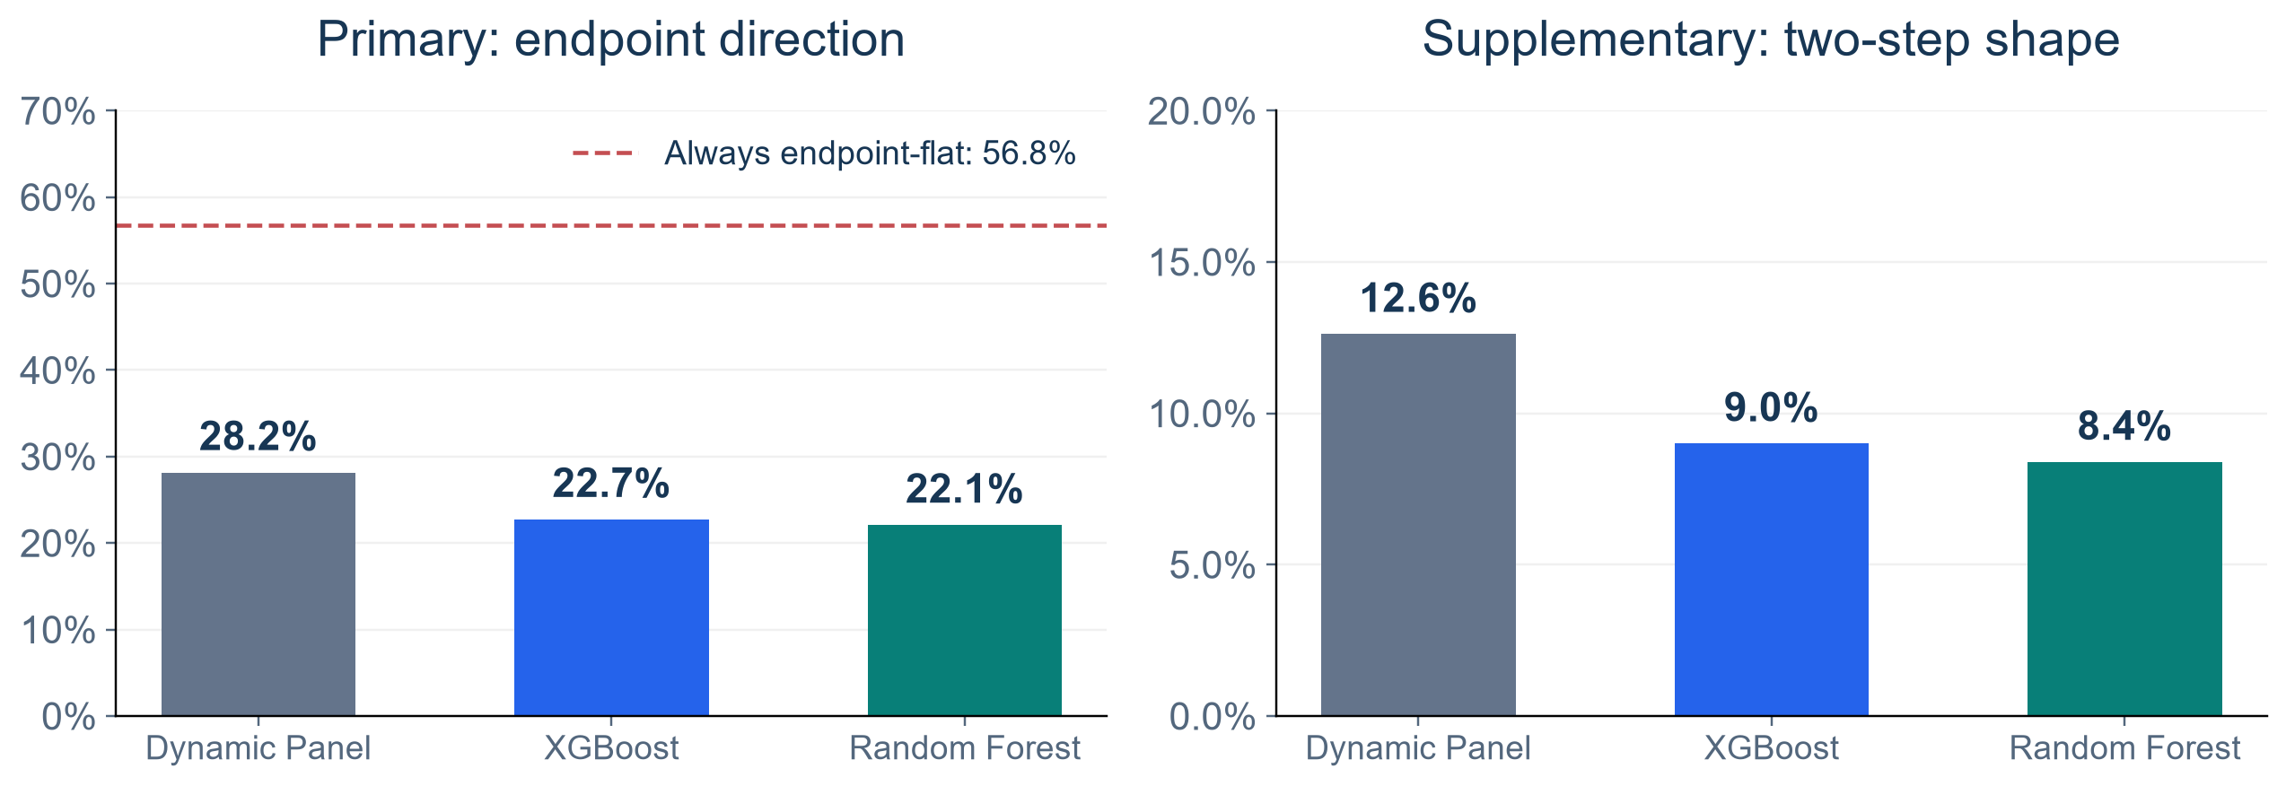
Trajectory Direction Remains Difficult
Primary direction uses Day 3 versus Day 1. Flat means exact equality.
KEY FINDINGS
DP leads at 28.2%, but all models fall below the 56.8% always-flat reference.
2020 TRAINING AND ROLLING VALIDATION
10
Notes:
SUGGESTED NARRATION
Dynamic Panel has the highest endpoint direction agreement at 28.2 percent, compared with 22.7 and 22.1 percent for the trees. But 56.8 percent of actual paths have equal endpoints. An always-flat reference therefore has higher overall agreement. We retain this comparison to avoid overstating trajectory performance.
ANALYSIS AND SOURCES
three_model_overall.csv2020DPdirection.2815518272,XGB.2273574619,RF.2207590306;shape.1261158594,.0899511097,.0838310295;flat.5677886814=80714/142155. Differentfrom2021reference42.4percent. Shapeissupplementary. Nochangedforecastafterchangingreportingpriority.
Scope: only2020development/validation results. No2021–2023scores. Retrospective recorded-onset counts, missing-onset records excluded, historical availability unverified. Same585ZIPs and sameforecasttargets across models. Forecasts clippedat0. Original34candidates plus model-specific ZIPidentity. Exploratory previously inspected developmentdata.

Slide 11
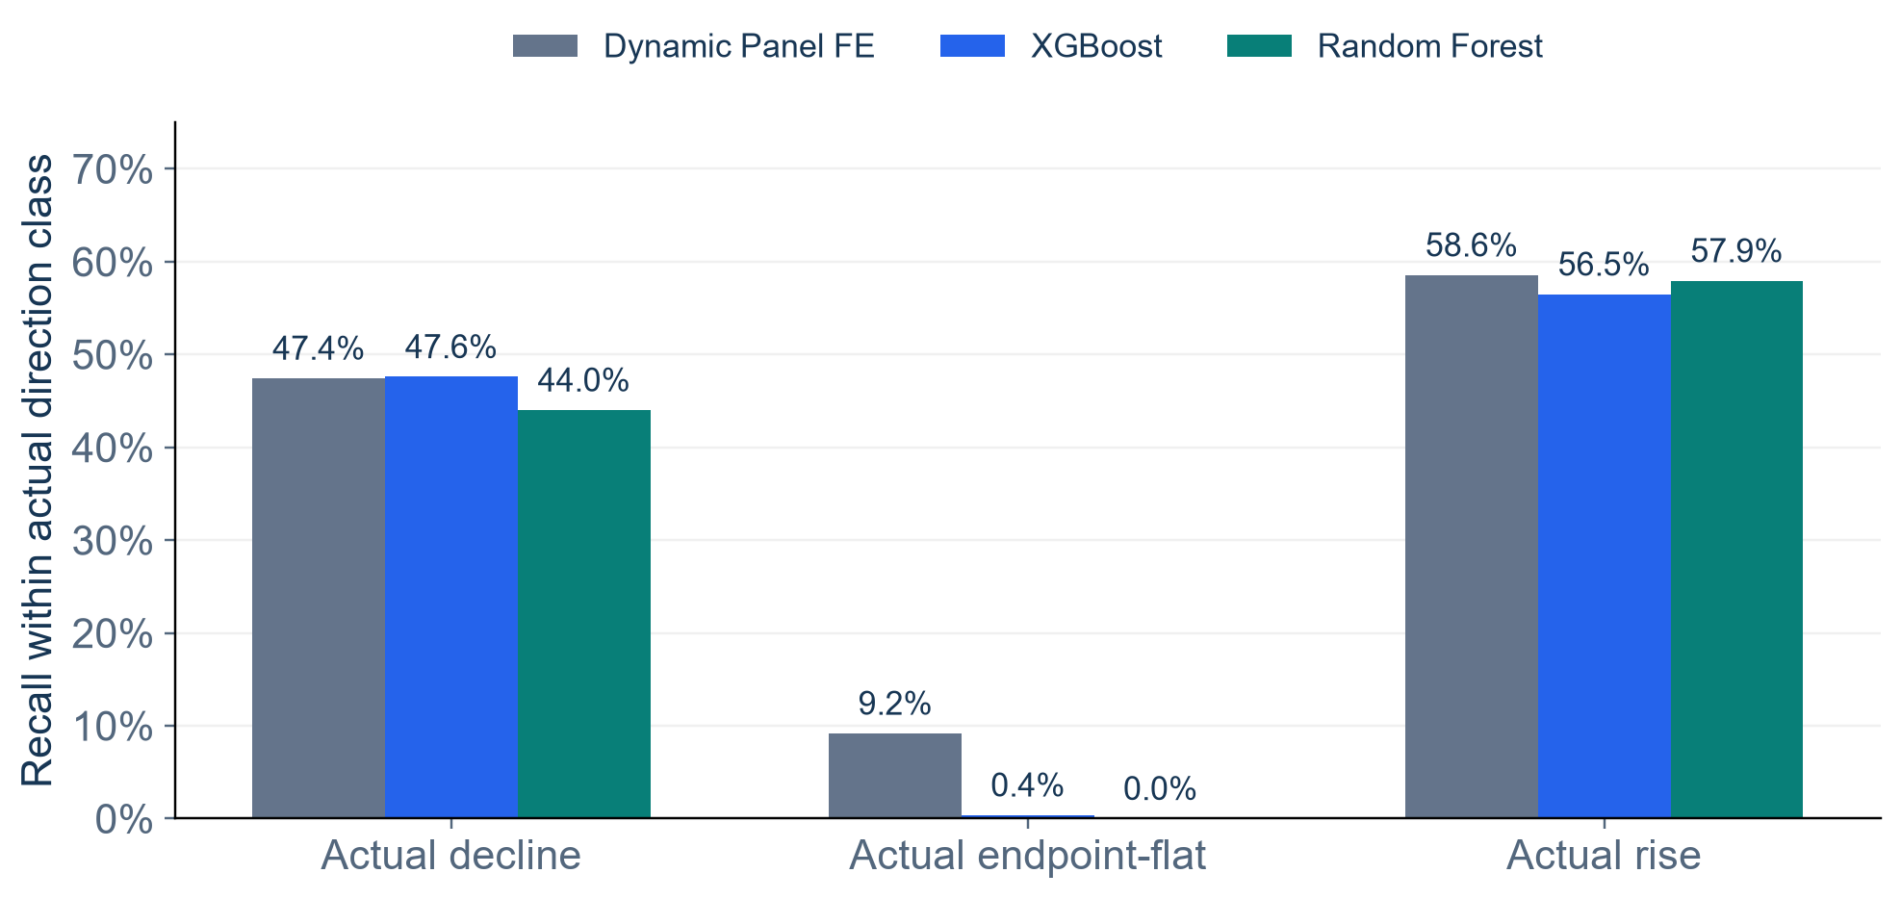
Why Overall Direction Accuracy Is Low
Class-specific recall exposes the endpoint-flat problem
KEY FINDINGS
Rises: 56–59% recall
Models identify some rising paths.
Flat paths are missed
Recall is 9.2% for DP and almost zero for the trees.
2020 TRAINING AND ROLLING VALIDATION
11
Notes:
SUGGESTED NARRATION
Class-specific recall helps explain the overall score. The models identify around 56 to 59 percent of actual rising paths, but they almost never predict exactly flat endpoints, especially the tree models. We therefore report direction classes separately rather than relying only on overall accuracy. We have not widened the flat tolerance to improve the score.
ANALYSIS AND SOURCES
direction_class_recall.csv.Declining30267,flat80714,rising31174. DPrecalls.474345/.091843/.585552;XGB.475964/.003779/.564862;RF.440116/0/.579361. Balancedaccuracy.383913/.348201/.339826. Nochangeinflat toleranceinthisanalysis;wideningafterseeingresultswouldchange taskandrequireseparatedsensitivityreport.
Scope: only2020development/validation results. No2021–2023scores. Retrospective recorded-onset counts, missing-onset records excluded, historical availability unverified. Same585ZIPs and sameforecasttargets across models. Forecasts clippedat0. Original34candidates plus model-specific ZIPidentity. Exploratory previously inspected developmentdata.

Slide 12
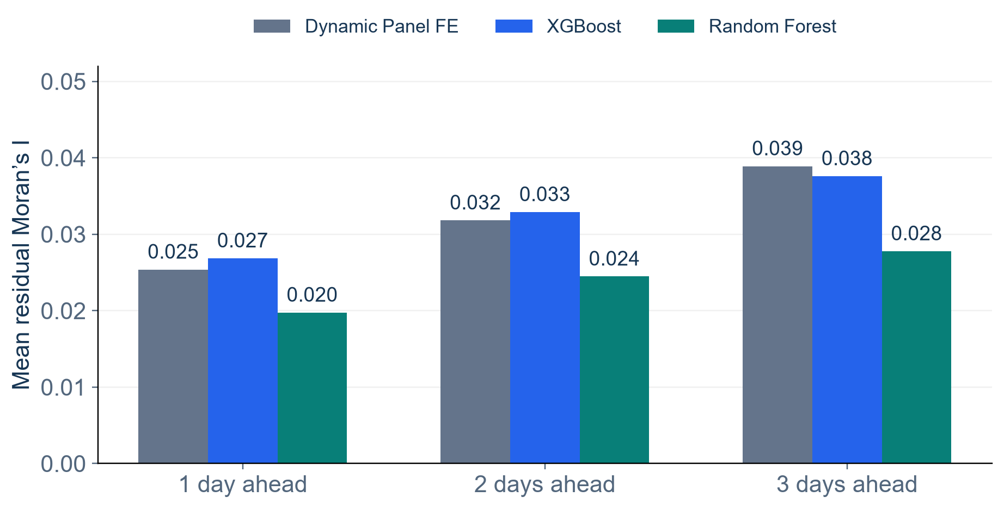
Residual Moran’s I: Spatial Structure Remains
Same geographic graph, computed separately for each date and forecast horizon
KEY FINDINGS
RF has lower mean I
A descriptive pattern across all three horizons.
Mean I remains positive
Nearby ZIPs still have similarly signed errors.
2020 TRAINING AND ROLLING VALIDATION
12
Notes:
SUGGESTED NARRATION
Residual Moran’s I checks whether nearby ZIPs have similarly signed forecast errors. Random Forest has lower mean values at all three horizons, but all averages remain positive. These are descriptive patterns under one geographic graph. We have not formally tested model differences in mean I, and a small I does not prove that spatial effects are fully explained.
ANALYSIS AND SOURCES
Source2020residual_moran_comparison.csv.DPmeans.025396/.031826/.038911;XGB.026861/.032914/.037613;RF.019768/.024491/.027791.585internalpointsfrom2021Gazetteer,symmetricunion8nearestneighbors,zero diagonal,rowstandardization,thusdegreecanexceed8.999two-sidedpermutationsandBHacross729dates×horizon testspermodel,not2021jointfamily. Nopooledpvalueforaverages. ZIPZCTAexactmatchingunvalidated;heteroskedasticcountresidualsviolateexchangeability,exploratory.
Scope: only2020development/validation results. No2021–2023scores. Retrospective recorded-onset counts, missing-onset records excluded, historical availability unverified. Same585ZIPs and sameforecasttargets across models. Forecasts clippedat0. Original34candidates plus model-specific ZIPidentity. Exploratory previously inspected developmentdata.

Slide 13
Warning Calibration Within the Validation Period
Calibration precedes the later warning assessment, with no model refit here
Threshold calibration
Warning assessment
Apr 30–Aug 28, 2020
Sep 1–Dec 28, 2020
All calibration targets end by Aug 31.
Retain the chosen warning threshold.
585 ZIPs
1,131 eligible local events
One warning matches one event within the next 1–3 days.
A 7-day cooldown limits repeat alerts. This is exploratory validation.
2020 TRAINING AND ROLLING VALIDATION
13
Notes:
SUGGESTED NARRATION
Warning evaluation requires a separate calibration step. We choose warning thresholds using April through August, with all calibration targets ending by August 31. We assess September through December with those thresholds fixed. We reuse existing rolling forecasts. One warning can match one event in the next three days, and a seven-day cooldown limits repeats.
ANALYSIS AND SOURCES
Notebook27task_definition.json. CalibrationoriginsApr30Aug28,alltargetsthroughAug31;Aug29–31originsomittedfromwarningcal/assessment. Threshold0forallmodels,strictscore>0,normalizedmarginriskincorporatingtwoqualifyingdaysandcountgate. 1131eligibleevents,onlywitheligibleinactiveorigins1–3daysbeforeconfirmation. Earliestwarningone-to-oneeventmatching. Cooldownandresetdifferentconcepts. Thresholdgridcalibrationusedfalsealertcriterionoriginally,butnoadditionalbudgetanalysisinthisdeck. Previouslyinspectedassessment,nountouchedtestclaim.
Scope: only2020development/validation results. No2021–2023scores. Retrospective recorded-onset counts, missing-onset records excluded, historical availability unverified. Same585ZIPs and sameforecasttargets across models. Forecasts clippedat0. Original34candidates plus model-specific ZIPidentity. Exploratory previously inspected developmentdata.

Slide 14

PR Performance: Ranking Future Event Risk
Average Precision summarizes precision–recall across score thresholds
KEY FINDINGS
AP: 0.520 / 0.542 / 0.540
Dynamic Panel / XGBoost / Random Forest
Positive share: 5.94%
AP measures ranking, not percentage accuracy.
WARNING VALIDATION: SEP–DEC 2020
14
Notes:
SUGGESTED NARRATION
Average Precision summarizes risk ranking across thresholds. The scores are approximately 0.520 for Dynamic Panel, 0.542 for XGBoost and 0.540 for Random Forest. Positive eligible origins account for 5.94 percent. AP is not percentage accuracy and is not the proportion of issued warnings that are correct.
ANALYSIS AND SOURCES
warning_metrics.csvassessment. APDP.5200263937,XGB.5420565706,RF.5400816447. Positive3299/55541eligibleorigins. Scorescontinuousnotcalibratedprobabilities. PRunit=eligibleZIP-origin,positiveifnewconfirmationwithin1–3days. APstepintegrated,nottrapezoidarea. Modelscomparedonsamelabelsandorigins. NoAPdifferenceinference.
Scope: only2020development/validation results. No2021–2023scores. Retrospective recorded-onset counts, missing-onset records excluded, historical availability unverified. Same585ZIPs and sameforecasttargets across models. Forecasts clippedat0. Original34candidates plus model-specific ZIPidentity. Exploratory previously inspected developmentdata.

Slide 15
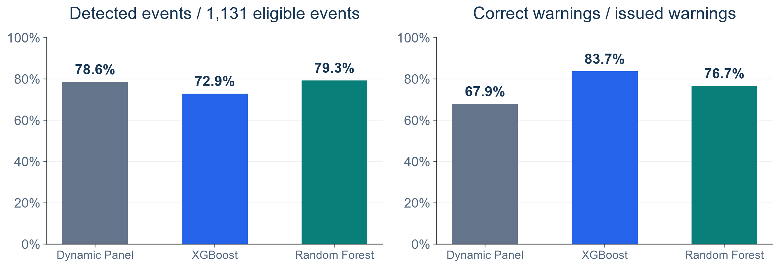
Event Detection and Warning Precision
Different denominators reveal the detection–false-warning trade-off
KEY FINDINGS
RF detects more events. XGBoost issues fewer false warnings.
WARNING VALIDATION: SEP–DEC 2020
15
Notes:
SUGGESTED NARRATION
Random Forest detects 79.3 percent of eligible events, Dynamic Panel 78.6 percent and XGBoost 72.9 percent. XGBoost has the highest warning precision at 83.7 percent and issues fewer false warnings. We therefore see a trade-off: detecting more events versus issuing more reliable warnings.
ANALYSIS AND SOURCES
DP889/1131detected,1309warnings420false;XGB825/1131,986warnings161false;RF897/1131,1170warnings273false. Precisiondetected/warningepisodesunderone-to-onematching. Eventrecallnotorigin-levelrecallandneednotmatchonepointonPRcurve. Noformalinferenceofdifferences,thresholdfixedfromcalibration.
Scope: only2020development/validation results. No2021–2023scores. Retrospective recorded-onset counts, missing-onset records excluded, historical availability unverified. Same585ZIPs and sameforecasttargets across models. Forecasts clippedat0. Original34candidates plus model-specific ZIPidentity. Exploratory previously inspected developmentdata.

Slide 16
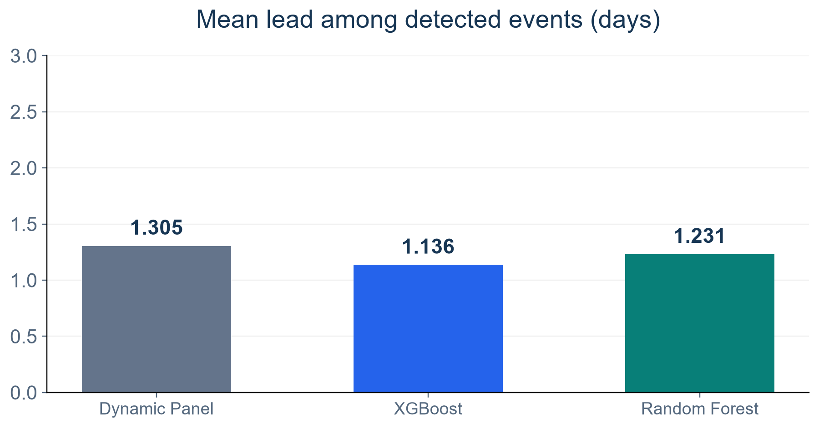
Warning Lead Time: Mostly Close to Confirmation
Lead time describes successfully detected events, alongside recall and false alerts
KEY FINDINGS
Median: 1 day for all
Mean leads range from 1.14 to 1.30 days.
First abnormal day may be known
Lead is measured before the second-day confirmation.
These results do not establish warning before all abnormal activity.
WARNING VALIDATION: SEP–DEC 2020
16
Notes:
SUGGESTED NARRATION
Among detected events, mean lead times are 1.30, 1.14 and 1.23 days, while all medians are one day. Lead refers to the second-day event confirmation. An alert one day before confirmation may already use the first abnormal day. These results do not establish warning before all abnormal activity, and missed events are excluded from the lead-time mean.
ANALYSIS AND SOURCES
warning_metrics.csvassessment mean1.3048368954/1.1357575758/1.2307692308,median1all. Lead=confirmation−earliestmatchedwarningorigin,1–3days.Missedeventsnotincludedinthemean.Differentsuccessfulsubsetsmeanmeanleadbyitselfcannotrankmodels.NoEDoutcomepredictionor7daywarningclaim.
Scope: only2020development/validation results. No2021–2023scores. Retrospective recorded-onset counts, missing-onset records excluded, historical availability unverified. Same585ZIPs and sameforecasttargets across models. Forecasts clippedat0. Original34candidates plus model-specific ZIPidentity. Exploratory previously inspected developmentdata.

Slide 17
What We Learned From Training and Validation
The analysis separates count accuracy, trajectory direction and warning utility
Count predictions
Small MAE gains, with a different RMSE ranking
Trajectory direction
DP leads, but exact-flat paths remain a major challenge
Spatial errors
All models retain positive average residual clustering
Warnings
Higher precision trades off against missed events
Limits: missing onset dates, few independent waves, correlated local events.
2020 TRAINING AND ROLLING VALIDATION
17
Notes:
SUGGESTED NARRATION
We have completed a connected analysis of counts, trajectories, spatial errors and warnings. The same model does not lead on every measure. Key limitations are missing onset dates, sparse ZIP-level counts and only a few independent epidemic waves. Numerous local events can belong to the same wave and cannot be treated as independent major outbreaks.
ANALYSIS AND SOURCES
Summarizes2020resultsonly.Currentdirectionemphasisandproxylabelsareexploratory,notprespecifiedclinicalvalidation.NoSEIR,NYprediction,otherdiseasetransferor2021–2023performanceclaiminthedeck. Rawdataspan2020–2023presentedonlyonthepreparationslide. Sourcecsvsandplotsbundled.
Scope: only2020development/validation results. No2021–2023scores. Retrospective recorded-onset counts, missing-onset records excluded, historical availability unverified. Same585ZIPs and sameforecasttargets across models. Forecasts clippedat0. Original34candidates plus model-specific ZIPidentity. Exploratory previously inspected developmentdata.

