Slide 1
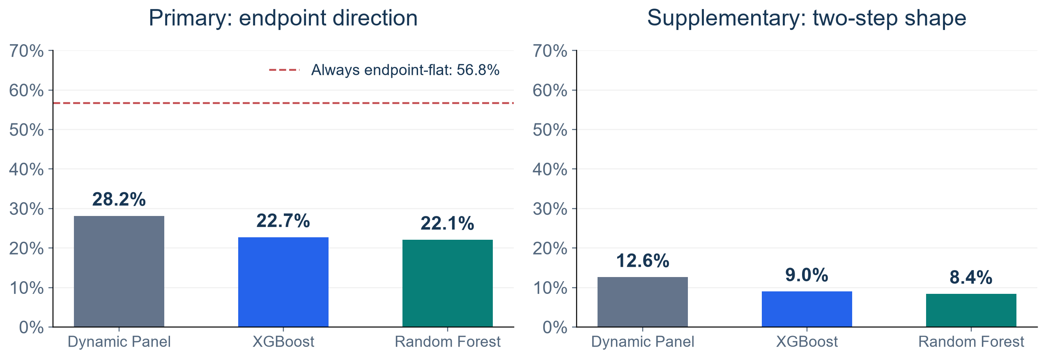
Trajectory Direction Remains Difficult
Primary direction uses Day 3 versus Day 1. Flat means exact equality.
KEY FINDINGS
DP leads at 28.2%, but all models fall below the 56.8% always-flat reference.
2020 TRAINING AND ROLLING VALIDATION
1
Notes:
SUGGESTED NARRATION
Dynamic Panel has the highest endpoint direction agreement at 28.2 percent, compared with 22.7 and 22.1 percent for the trees. But 56.8 percent of actual paths have equal endpoints. An always-flat reference therefore has higher overall agreement. We retain this comparison to avoid overstating trajectory performance.
ANALYSIS AND SOURCES
three_model_overall.csv2020DPdirection.2815518272,XGB.2273574619,RF.2207590306;shape.1261158594,.0899511097,.0838310295;flat.5677886814=80714/142155. Differentfrom2021reference42.4percent. Shapeissupplementary. Nochangedforecastafterchangingreportingpriority.
Scope: only2020development/validation results. No2021–2023scores. Retrospective recorded-onset counts, missing-onset records excluded, historical availability unverified. Same585ZIPs and sameforecasttargets across models. Forecasts clippedat0. Original34candidates plus model-specific ZIPidentity. Exploratory previously inspected developmentdata.

