Slide 1
Ray-Tracing Enhanced Time-Reversal Method for Microwave Imaging in Multipath Environments
Lukas Winklhofer
München, 17. Juni 2024

Slide 2
Contents
Problem Statement
State of the Art
Time Reversal Imaging
The Ray-Tracing Approach
Results
Learnings and Outlook

Slide 3
What is the Problem? Why is it relevant?
Reconstruct Reality from a Limited Amount of Measurements.
Main Task of Biological Senses
Process and Visualize Measured Information
Applications:
Security / Military
Geography
Healthcare
Notes:
Why do we need imaging algorithms
Create the knowledge upon which we act in the world.
Interpret and present information in a intuitive way for humans by (visualisation).

Slide 4
What are common approaches?
Security / Military:
Sonar
Thermal Imaging
Radar
Geography:
Seismic Tomography
Ground-Penetrating Radar
Electrical Resisitivity Tomography
Healthcare:
Computer Tomography (X-Ray)
Magnetic Resonance Tomography
Ultrasound

Slide 5
Microwave Imaging
Wavelengths between 1mm and 1m => Order of Size of Real World Objects
No Ionisation => Nondestructive
Based on Principle of Reflection
Variety of Algorithms i.e. Naive Backprojection (Assumes Homogenous Space)
Algorithms Differ in Their Consideration of A Priori Information
Notes:
Find scatter points

Slide 6
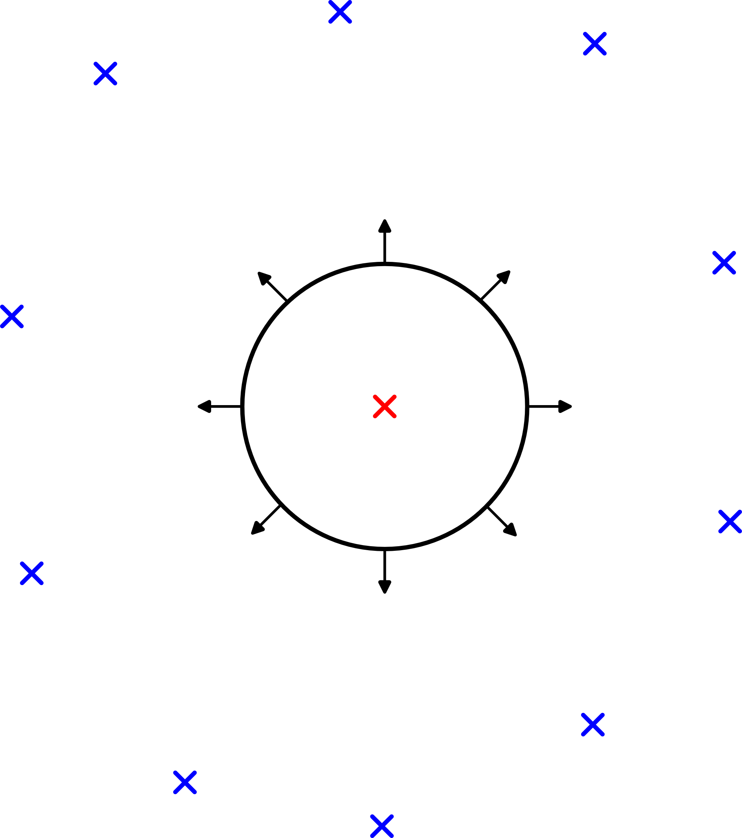
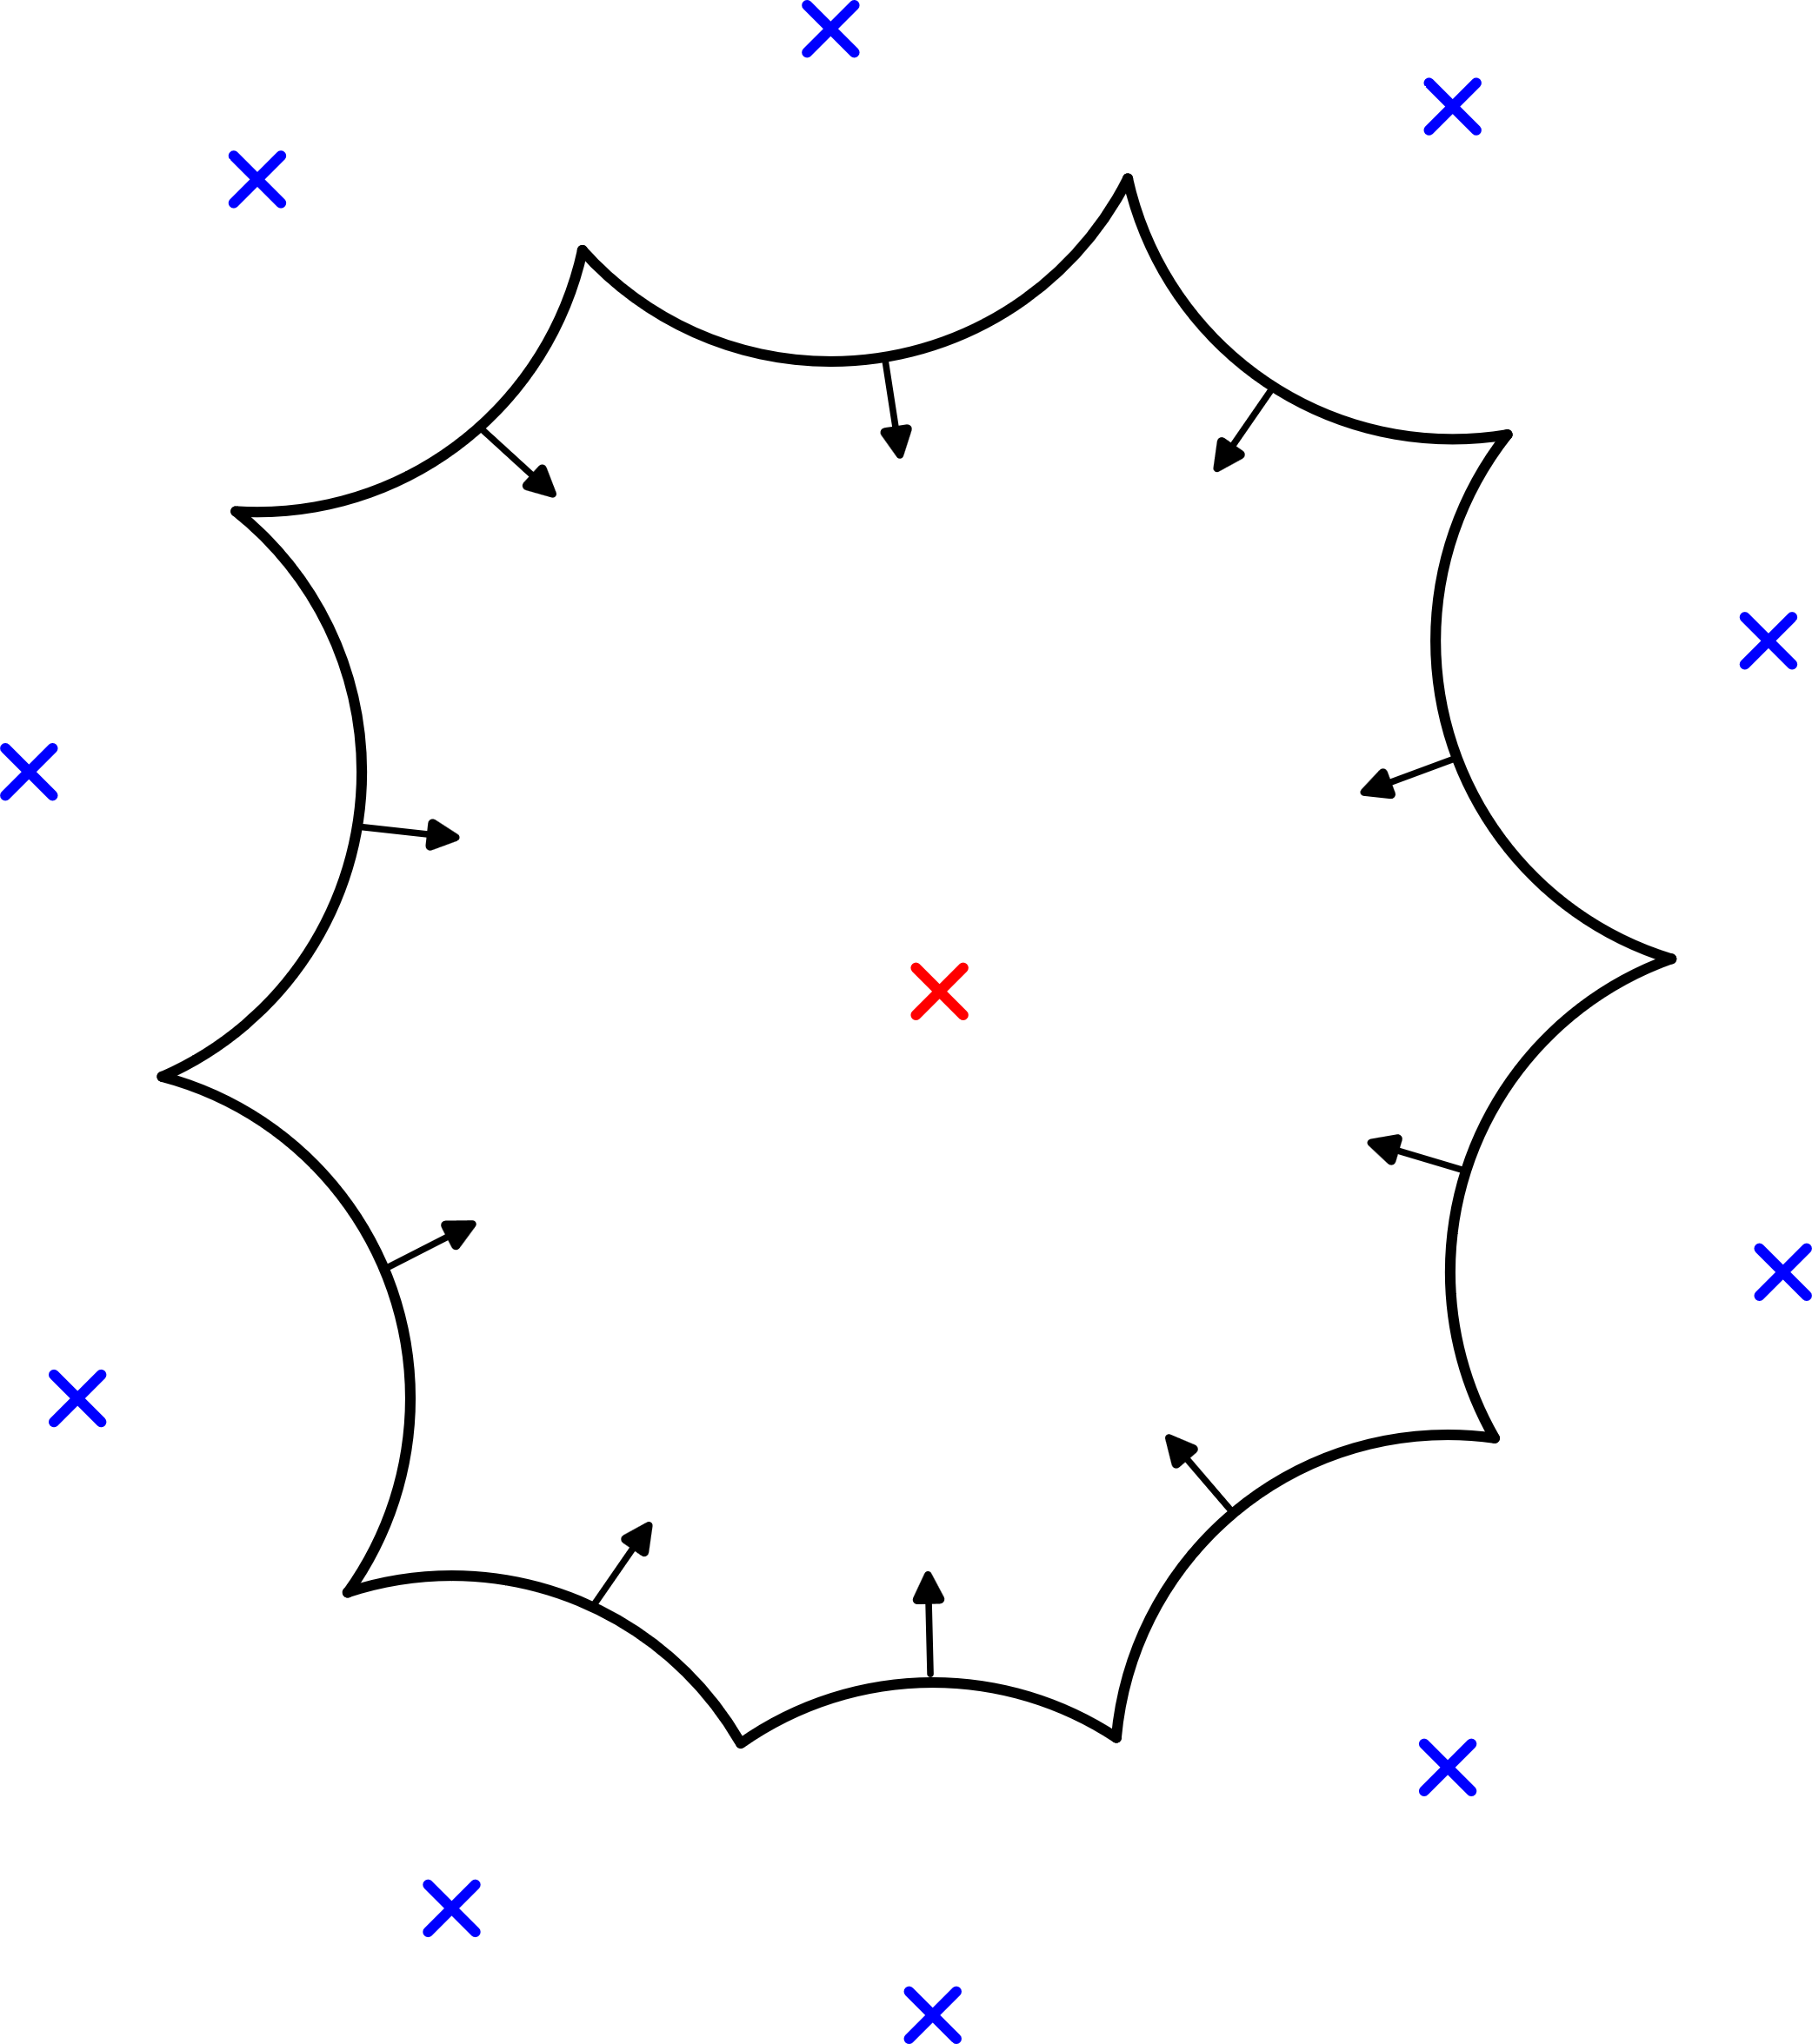
Time Reversal Imaging
Notes:
Basic Idea: Recreate the past from present measurements Expanding waves will contract at source and scatter locations
Signal is measured at a set of points create a closed surface
Compute the field that is created when the time-reversed signal is re-emitted at the measurement locations
Arbitrary amount of information can be taken into account to improve image

Slide 7
Time Reversal Imaging
PROBLEM: High Computational Costs for Full-Wave Simulations!
Notes:
Especially in complex environments with multipath propagation of the signals

Slide 8
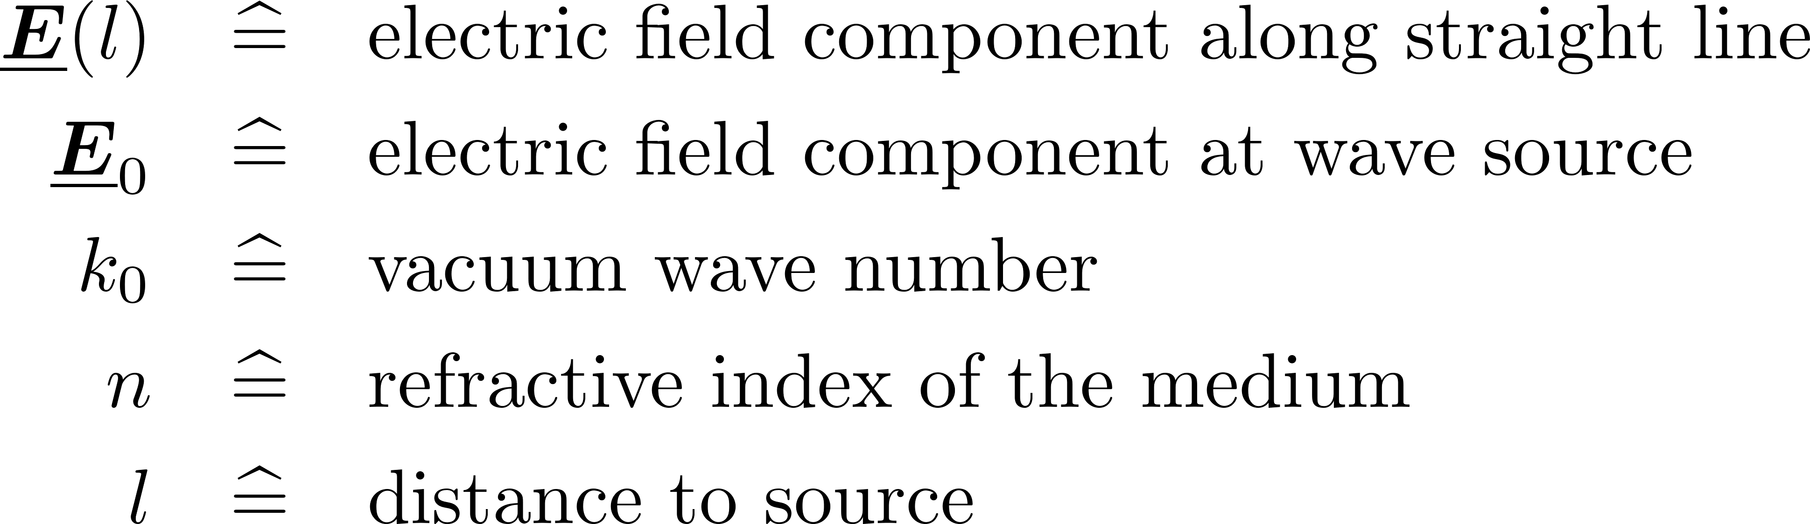
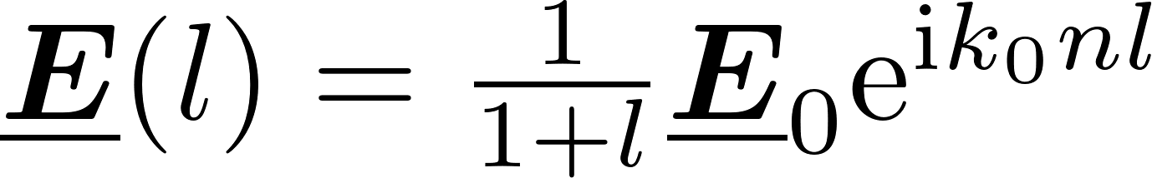
The Ray-Tracing Approach
Notes:
Small wavelengths compared to dimensions of surroundings
Observing the electric field component of a electromagnetic wave along a in a ray path is approximated by
Enables utilization of Ray Tracing Capabilities of GPUs to Compute multiple Raypaths

Slide 9
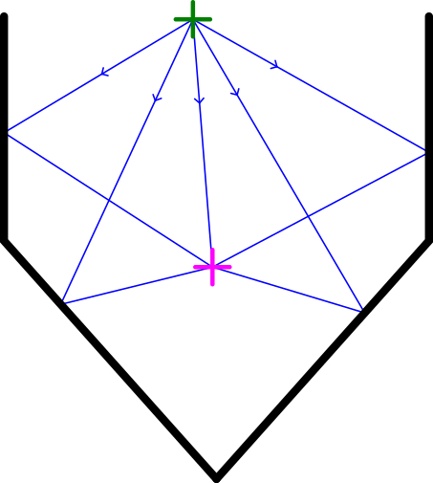
The Ray-Tracing Approach
GREEN - Receiver
MAGENTA – Imaging Point
Notes:
Utilize Multipath effects
Compute the Time-Reversed Field at every Imaging Point by Adding up Contributions from different paths
This is done for all receivers

Slide 10
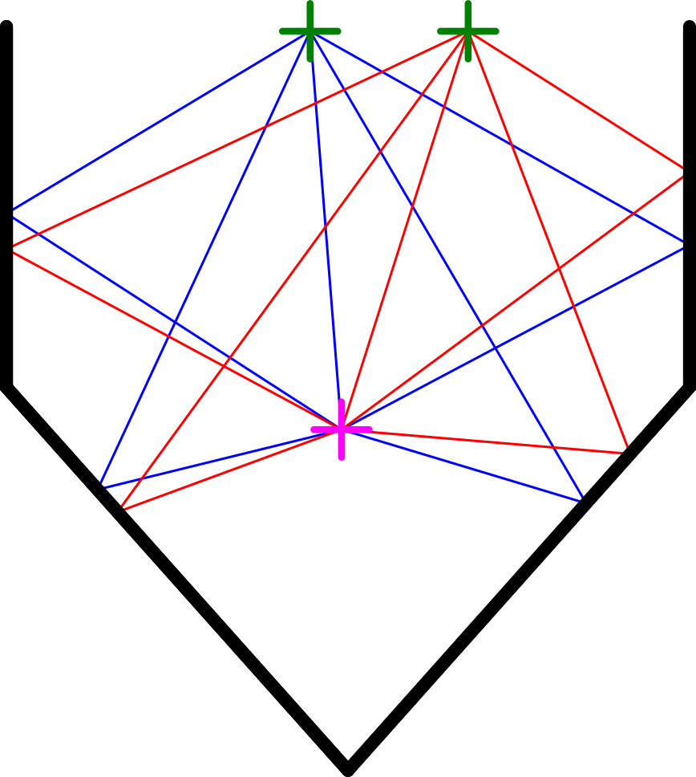
The Ray-Tracing Approach
GREEN - Receiver
MAGENTA – Imaging Point
Notes:
Compute the Time-Reversed Field at every Imaging Point by Adding up Contributions from different paths
This is done for all receivers

Slide 11
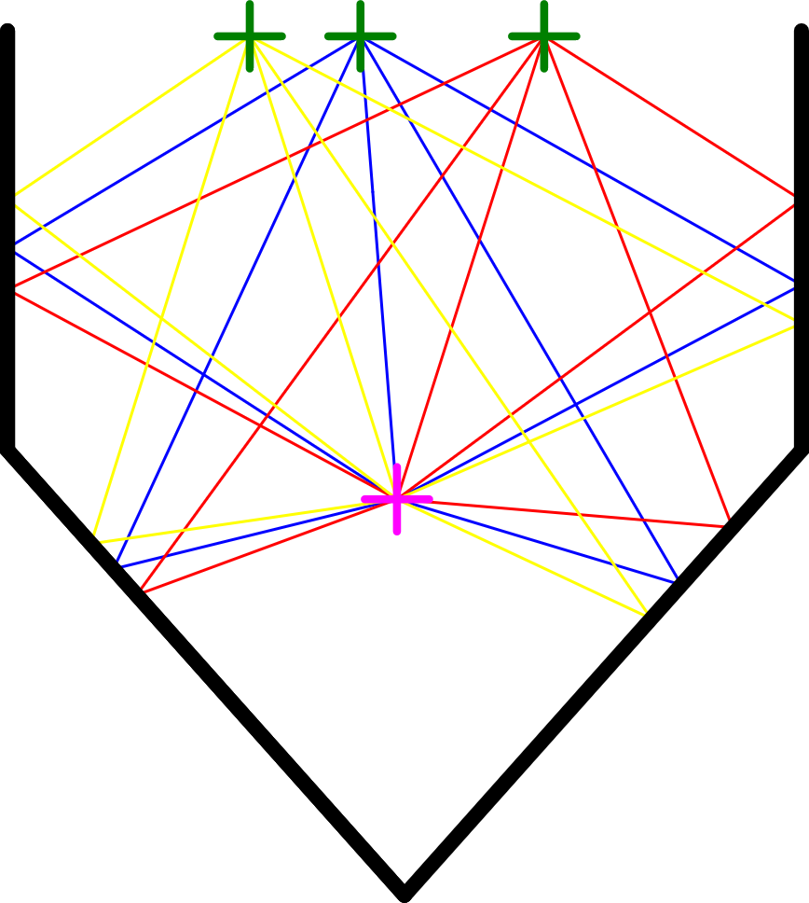
The Ray-Tracing Approach
GREEN - Receiver
MAGENTA – Imaging Point
Notes:
Compute the Time-Reversed Field at every Imaging Point by Adding up Contributions from different paths
This is done for all receivers

Slide 12
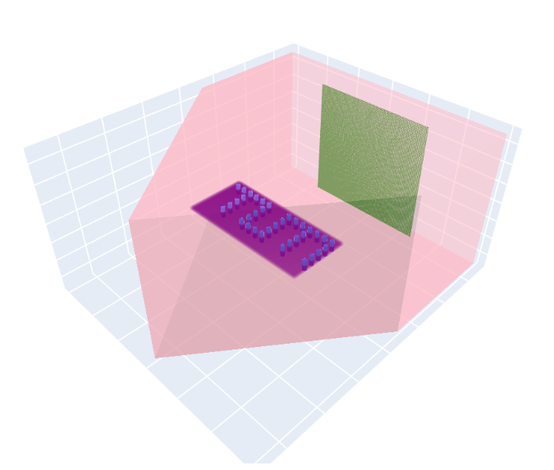
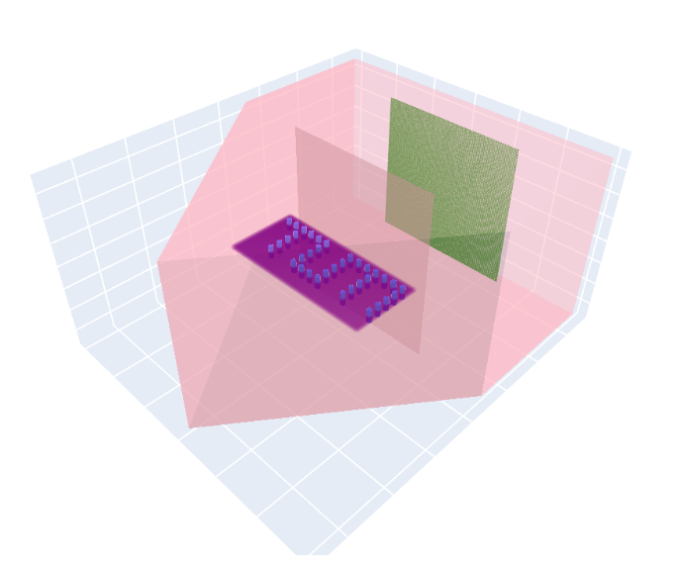
Scenarios
Line-Of-Sight (LOS):
Non-Line-Of-Sight (NLOS):
Notes:
Box made of perfectly electric conducting plates in pink
Antennas in blue emit harmonic waves at 20 different frequencies from 4.8 to 7.2 GHz
Green Receivers measure the signal.
Algorithm reconstructs the imaging domain in purple which should reveal the initial antenna locations
Compare results of my algorithm to naive algorithm which doesnt consider any knowledge about surroundings

Slide 13
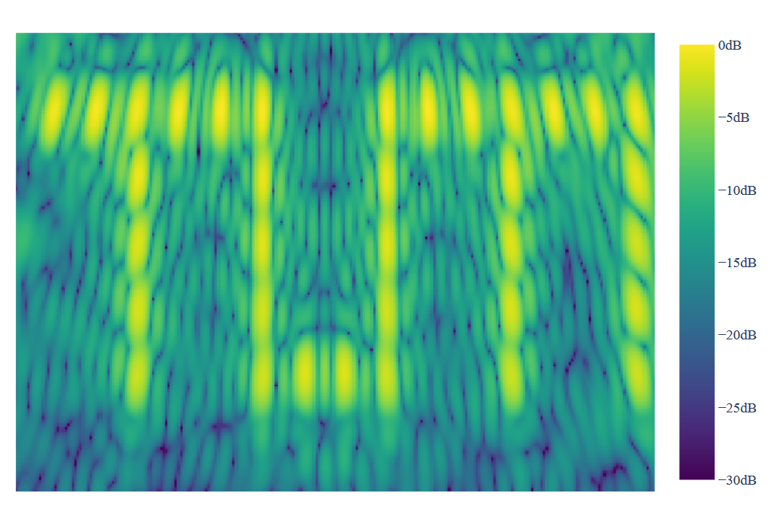
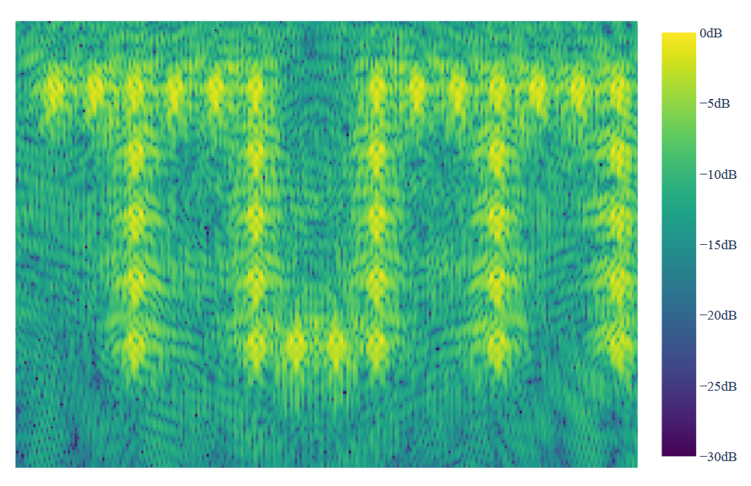
Results (LOS)
Naive:
Time-Reversal:
Notes:
Both reveal antenna locations
Sources appear sharper
No shadow coming from the receiver domain

Slide 14
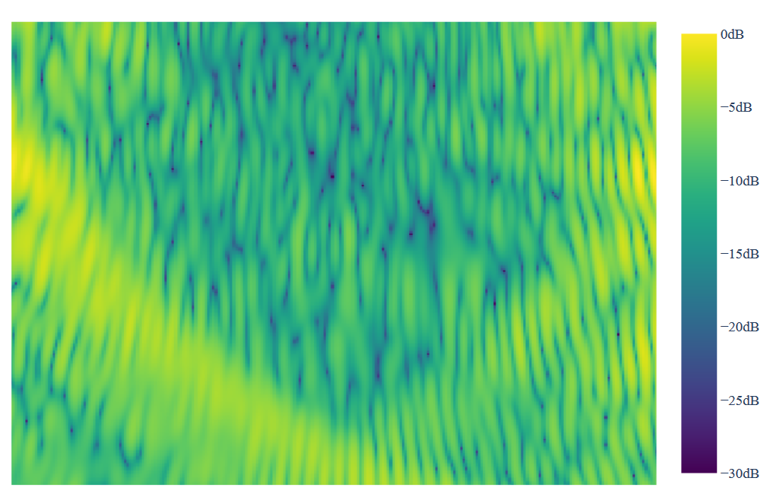
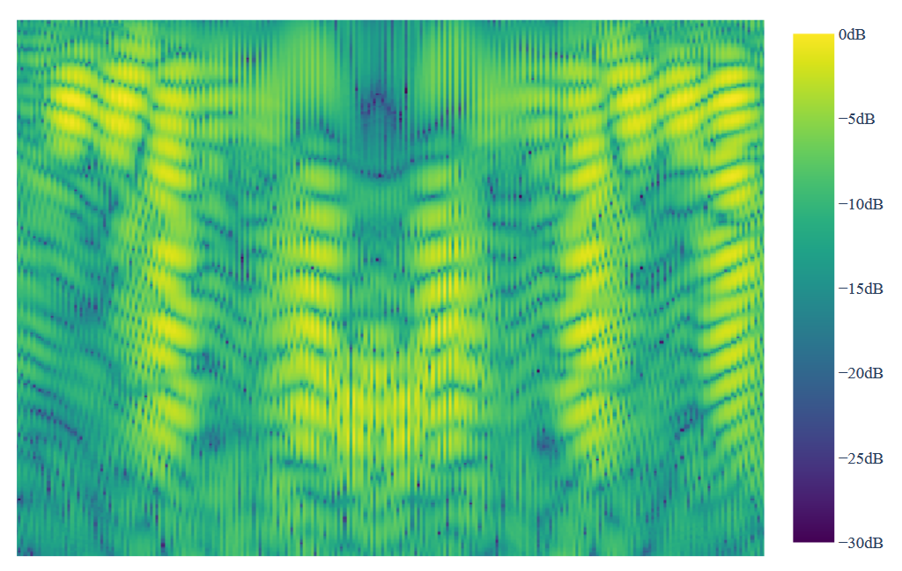
Results (NLOS)
Naive:
Time-Reversal:
Notes:
Image from naive approach not interpretable
Sources can be localized in time-reversal image

Slide 15
Learnings and Outlook
Learnings:
Considering Multi-Path Effects from Surroundings Improves Microwave Imaging
Ray-Tracing is a Valid Approach to Simulate Electromagnetic Waves in Certain Scenarios
GPU‘s can be Used to Speed Up Electromagnetic Simulation Programs
Outlook:
Extend Algorithm for Passive Scatter-Points
Consider Vector-Quantities for Electromagnetic Field
Test in Real-World Scenarios

Slide 16
Thank you for you attention!

