Slide 1

Fault tolerant microservices
Author: Łukasz Wojtaszek
Notes:
Aby zmienić obraz na tym slajdzie, zaznacz obraz i usuń go. Następnie kliknij ikonę Obrazy w symbolu zastępczym,aby wstawić swój własny obraz.

Slide 2
Case study
Service A
GET /v1/contents/{code}
GET /v1/contents/{code}
Client
GET /v1/contents/{code}
Service B
GET /v1/contents/{code}
Service C

Slide 3
Potential problems
Latency
What can we do in parallel?
„Asynchronous by default, synchronous when necessary”
Network issues
General network problems (network overloaded, peaks)
DNS problems
Wrong service host/port used for communication with Service
Applications issues
Service is not working
Service has performance issues (huge latentcies while processing requests)
Endpoints issues
Service endpoints were changed without telling Client
Error codes
Resource not found – 404
Other codes
Worst case scenario: Problem in one Service breaks everything and error is propagated to the whole system

Slide 4
Solutions
Latency
Solution: Feign + RxJava for async calls
Network issues
We can't guarantee that network won't have any problems but we can be prepared for this.
Solution: Feign (retryer) + Hystrix (fallback)
Applications issues
Solution: Hystrix (fallback + circuit breaker)
Endpoints issues
Solution: API versioning
Error codes
Solution: Feign (decode404) + Hystrix (fallback)

Slide 5
API Versioning – how to
Use internal model structures for logic in the application
Create api-model library (generated from swagger yaml file) per API version
Create separate controllers (generated from swagger yaml file), mappers per API version
<dependency> <groupId>com.luwojtaszek.client</groupId> <artifactId>client-api-model-v1</artifactId> <version>1.0.25</version> </dependency> <dependency> <groupId>com.luwojtaszek.client</groupId> <artifactId>client-api-model-v2</artifactId> <version>2.0.1</version> </dependency>

Slide 6
API Versioning – pros and cons
Pros:
Modules are separated – you can deploy them separately at any time, not in one bundle when you work on some feature
It is easier to rollback if something went wrong (just decrease api version in application.properties or Docker or Rancher)
Cons:
pom.xml grows up (dependency per API version)
code grows up (mappers, controllers per API version)
You can provide some cleanup policy that if all dependend modules (microservices) are bumped up to the latest version of some API then in this API you will remove old code and api-model libraries.

Slide 7
Asynchrony – what can we use and why RxJava?
What can we use?
Future / ListenableFuture
CompletableFuture
RxJava
Project Reactor (spring 5)
Why RxJava?
Well known and cross-language solution (Angular 2+ uses this)
Nice syntax (chaining - builder pattern)
Huge list of operators
Easy way of jumping between thread pools
Supported by Feign and Hystrix!

Slide 8
Feign
„Feign is a declarative web service client. It makes writing web service clients easier. To use Feign create an interface and annotate it.”
@FeignClient(name = "service1", url = "${client.service1.url}") public interface Service1Client { @RequestLine("GET /contents/{contentsCode}") Single<Optional<ServiceResponse>> getContents(@Param("contentsCode") String contentsCode); }
Feign
@FeignClient(name = "service1", url = "${client.service1.url}") public interface Service1Client { @GetMapping(value = "/contents/{contentsCode}") Single<Optional<ServiceResponse>> getContents(@PathVariable("contentsCode") String contentsCode); }
Feign + Spring

Slide 9
Feign – features
No implementation
Supports Spring annotations
Integrates with other Netflix libraries (Ribbon, Hystrix, etc.)
Resolves 404 error codes as empty values (null, emtpy list)
Contains retryer mechanism
Allows to declare own interceptors
PropagateIncomingHeaders interceptor
Oauth2 interceptor

Slide 10
Hystrix
„Hystrix is a latency and fault tolerance library designed to isolate points of access to remote systems, services and 3rd party libraries, stop cascading failure and enable resilience in complex distributed systems where failure is inevitable.”
Features:
Creates separate thread-pool for each Feign client (it uses name attribute)
Wraps each request into separate thread (async by default)
Supports: Future and RxJava types as a response
Fallback methods (handling timeouts, error codes, etc.)
Circuit Breaker (cut of failing service for a few seconds and let it heal itself)
Hystrix Dashboard – shows current status of calls made to services

Slide 11
Hystrix – usage with Feign
@FeignClient(name = "service1", url = "${client.service1.url}", fallbackFactory = Service1ClientFallbackFactory.class) public interface Service1Client { @GetMapping(value = "/contents/{contentsCode}") Single<Optional<ServiceResponse>> getContents(@PathVariable("contentsCode") String contentsCode); }
@Component public class Service1ClientFallbackFactory implements FallbackFactory<Service1Client> { @Override public Service1Client create(Throwable cause) { return new Service1ClientFallback(cause); } }
@RequiredArgsConstructor public class Service1ClientFallback implements BaseClientFallback, Service1Client { private final Throwable cause; @Override public Single<Optional<ServiceResponse>> getContents(String contentsCode) { handleCommonExceptions(cause); // Do whatever you want like: fetch from cache, return dummy object, etc. return Single.just(Optional.of(ServiceResponse.builder() .message("ServiceA - mocked response") .build())); } }

Slide 12
Hystrix – circuit breaker
10 Buckets
Time
1s
1s
1s
1s
1s
1s
1s
1s
1s
1s
Configuration:
Summary:
All requests: 20
Success requests: 9 = 45%
Failed requests: 11 = 55%
Circuit: Open (cut off for 5s)
hystrix.command.default.circuitBreaker.requestVolumeThreshold: 20 hystrix.command.default.circuitBreaker.sleepWindowInMilliseconds: 5000 hystrix.command.default.circuitBreaker.errorThresholdPercentage: 50 hystrix.command.default.metrics.rollingStats.timeInMilliseconds: 10000 hystrix.command.default.metrics.rollingStats.numBuckets: 10 hystrix.command.default.metrics.healthSnapshot.intervalInMilliseconds: 500

Slide 13
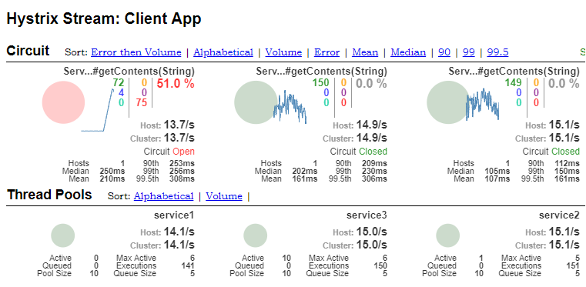
Hystrix – dashboard

Slide 14

Let’s see the code

Slide 15
Case 1 – calls are not dependent
Service A
Responds slowly
GET /v1/contents/{code}
GET /v1/contents/{code}
Client
GET /v1/contents/{code}
Service B
GET /v1/contents/{code}
Service C
We can send all requests asynchronously at the same time ☺

