Slide 1
Tamplate Title
Xiang
March.26.2018

Slide 2
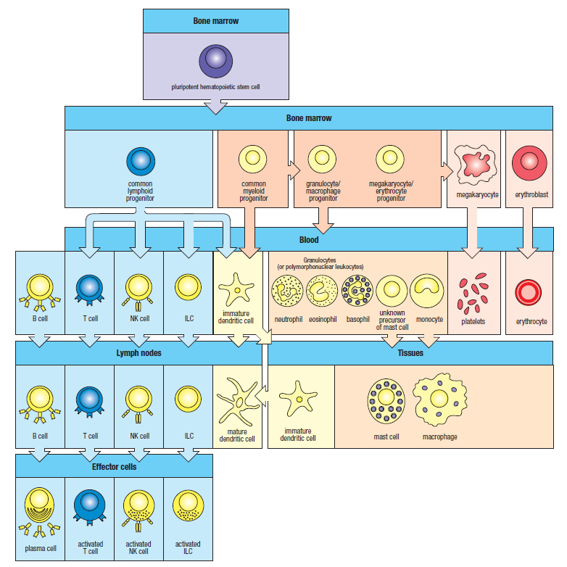
Cellular Elements of Blood

Slide 3
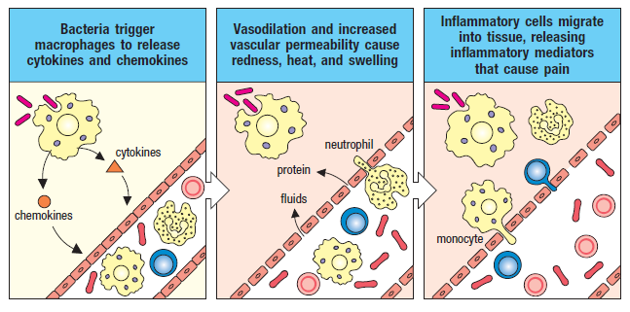
Innate Immunity

Slide 4
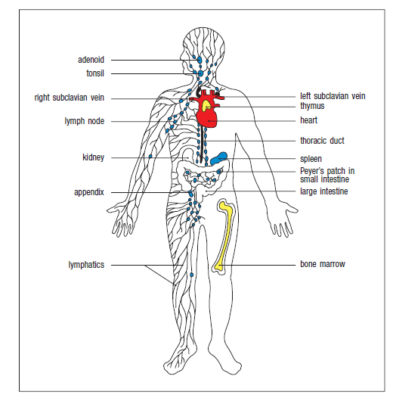
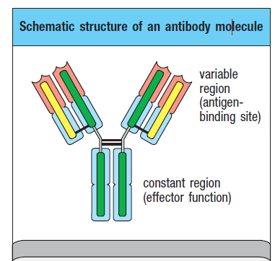
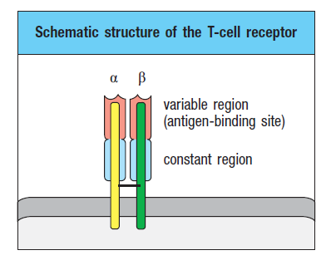
Lymphocytes
B-cell receptor, formed with antibodies
B cells in the bone marrow
and T cells in the thymus
T-cell receptor is distinct
in structure and recognition properties
Notes:
‘B’ in B lymphocytes originally stood for the bursa of Fabricius, a lymphoid organ in young chicks

Slide 5
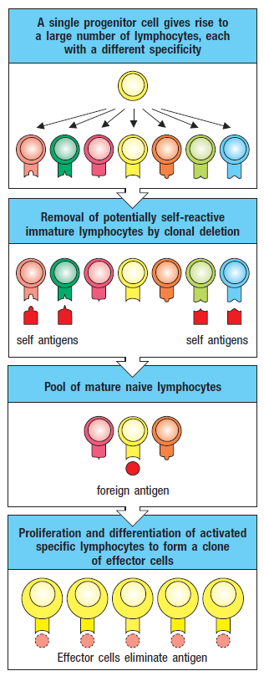
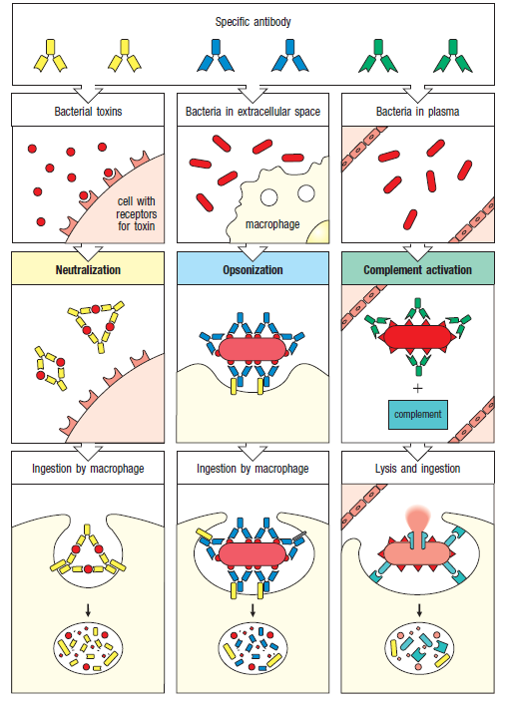
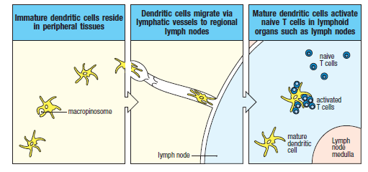
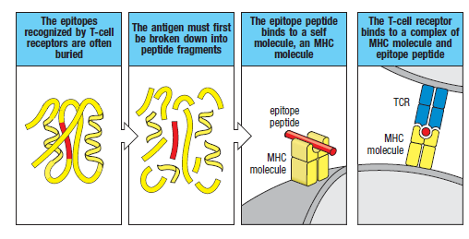
Adaptive Immunity
clonal selection
Notes:
Adaptive immunity relies on two major types of lymphocytes. B cells mature in
the bone marrow and are the source of circulating antibodies. T cells mature
in the thymus and recognize peptides from pathogens presented by MHC molecules on infected cells or antigen-presenting cells.

Slide 6
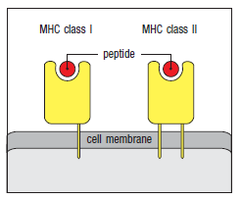
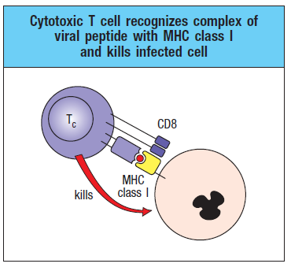
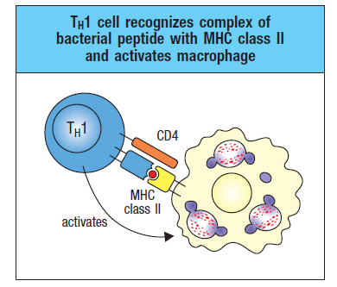
Cellular Elements of Blood
CD4 T cells recognize antigen presented by MHC class II proteins, which are
expressed by the predominant antigen-presenting cells of the immune system:
dendritic cells, macrophages, and B cells
Cytotoxic T cells carry CD8, and so recognize antigen presented by MHC class I molecules.Because MHC class I molecules are expressed on most cells of the body,they serve as an important mechanism to defend against viral infections

Slide 7
Cellular Elements of Blood

