Slide 1
Summary on Eed and Hdac1/2 deficient of Treg Cell
Xiang Li
Jan, 2019

Slide 2
Content Overview
0. Background Big Picture
1. Data & Quality Control
2. Alignment Information
3. Analysis
A. Appendix

Slide 3
Background Big Picture
11 samples, to compare Treg cell transcriptome (WT, Eed deficient, and Hdac1/2-defient).
Female cells were analyzed, which are Foxp3-Cre(GFP) m/+.
In these mice, half of the Treg cells are normal (GFP-negative), the other half (GFP+) are defective for Eed or Hdac1/2.
Because half of the Treg cells are normal, they are sufficient to suppress autoimmunity. Any changes in KO Treg cells are intrinsic to genetic ablation, not secondary to inflammation.

Slide 4
Part I Data & Quality Control
 | Software | Source Link
Quality Control | FastQC v0.11.8 | https://www.bioinformatics.babraham.ac.uk/projects/fastqc/

Slide 5
Data: Treg RNAseq
DKO is Tcf1 Lef1 double knock out

Slide 6
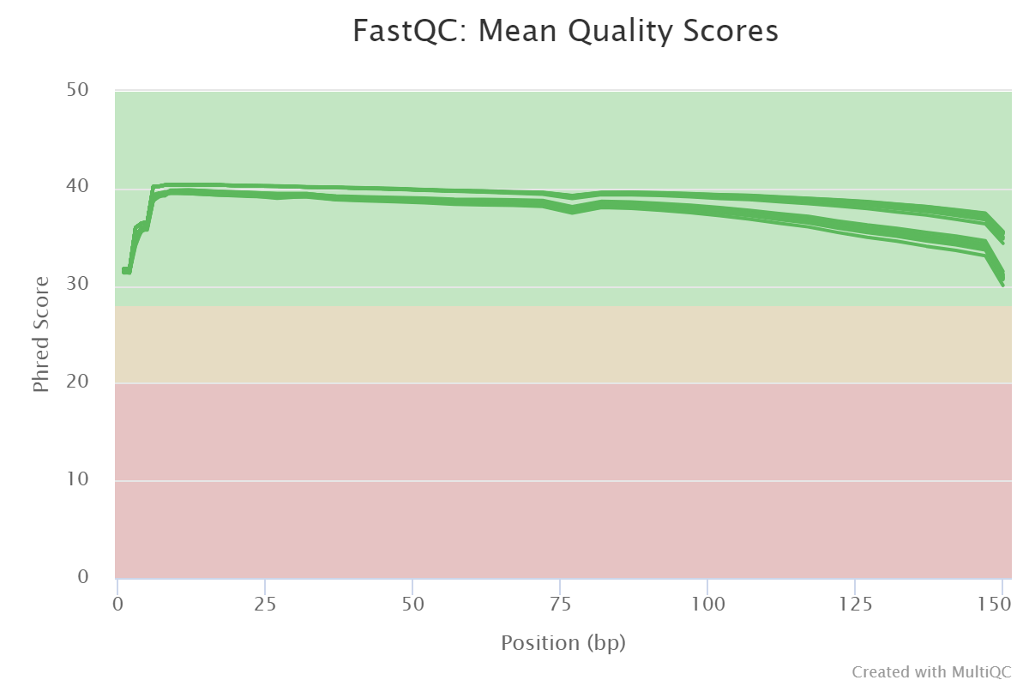
Sequence Quality
Sequence quality was assessed by FastQC and multiqc
Sequence length: paired end, 151 bps
22 samples passed

Slide 7
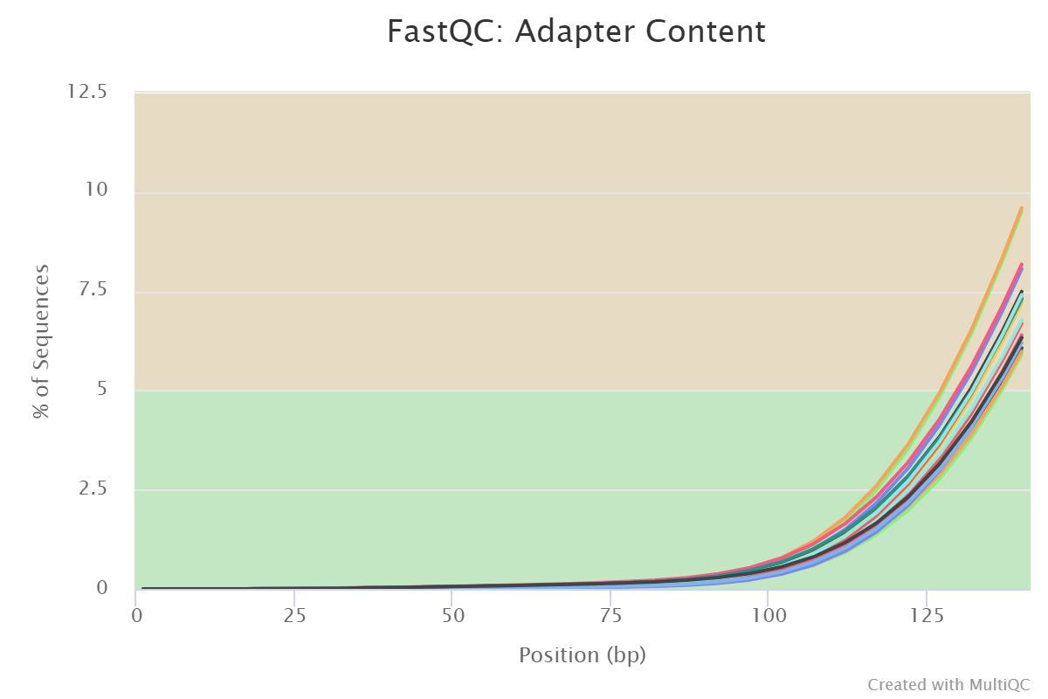
Sequence Quality
22 / 22 samples with warnings

Slide 8
Part II Alignment Information
 | Software | Source Link
Alignment | bowtie2 V2.3.4.3 | http://bowtie-bio.sourceforge.net/bowtie2/index.shtml Langmead B, Salzberg S. Fast gapped-read alignment with Bowtie 2. Nature Methods. 2012, 9:357-359.
 | Tophat v2.1.1 | https://ccb.jhu.edu/software/tophat/index.shtml

Slide 9
Tophat2 Alignment Quality Pair-End RNAseq
Name | # Raw Reads | Rate of Mapped (Multi-Align) % | Duplication Rate %
Eed_WT_0 | 26474784 | 73.7/2.6 | 42.69
Eed_WT_1 | 27492124 | 74.6/2.4 | 30.79
Hdac12_WT_0 | 29363126 | 74.6/2.7 | 43.77
Hdac12_WT_1 | 26448662 | 74.5/2.9 | 42.23
Eed_KO_0 | 23792012 | 75.2/2.4 | 50.94
Eed_KO_1 | 23874477 | 75.4/2.5 | 39.51
Eed_KO_2 | 28259364 | 74.7/2.8 | 62.85
Hdac12_KO_0 | 26476929 | 72.3/2.6 | 44.72
Hdac12_KO_1 | 27362139 | 74.9/2.6 | 39.34
Hdac12_KO_2 | 25703448 | 74.5/2.6 | 39.77
Hdac12_KO_3 | 26673538 | 72.0/2.5 | 59.63

Slide 10
Part III Analysis
 | Software | Source Link
Diff Sites | cufflinks V2.2.1 | http://cole-trapnell-lab.github.io/cufflinks/

Slide 11
DEG analyses
Pre- Tfh
Eed_WT
Treg
Pre- Th1
Eed_KO
Treg
Hdac12_WT
Treg Cells
Hdac12_KO
Treg Cells
Notes:
All expression data can be found in the following:
Shared-folder\XiangLi\Haihui\Treg\RNA_seq\Treg_Eed_Hdac12\3.Analysis\Expression\*

Slide 12
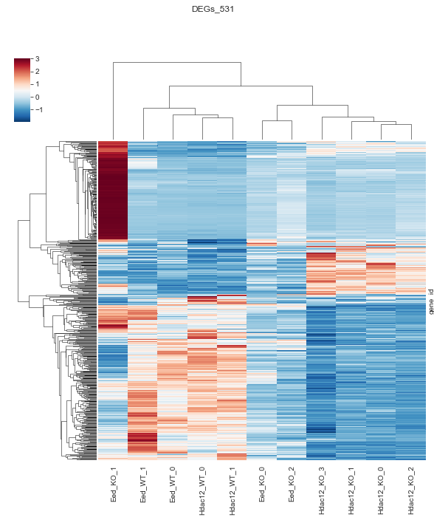
Get RPKM by Cuffdiff on DEGs
PCA for aggregation,
Pearson coefficient for reproducibility,
Identify DEGs, ≥2 fold, FDR <0.05.

Slide 13
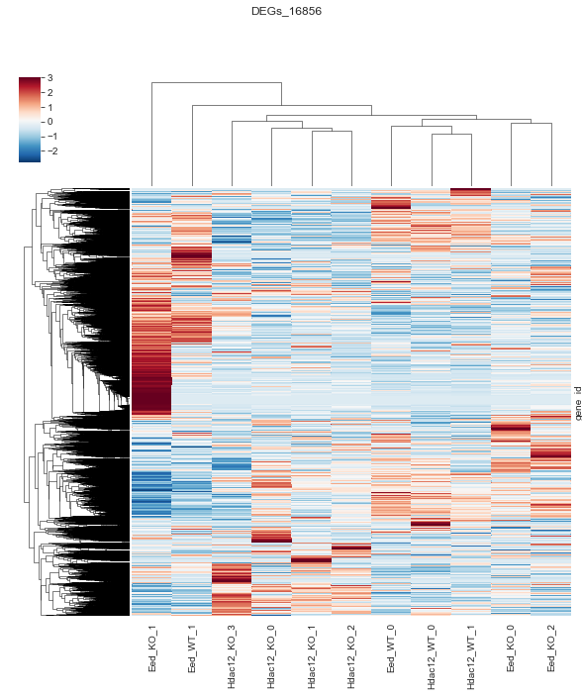
Get RPKM by Cuffdiff on All Genes
PCA for aggregation,
Pearson coefficient for reproducibility,
Identify DEGs, ≥2 fold, FDR <0.05.

Slide 14
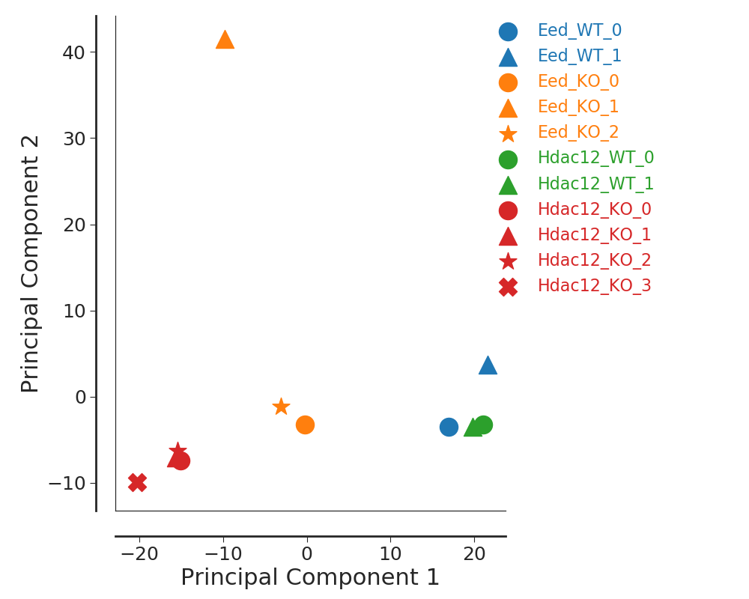
PCA by DEGs RPKM
PCA for aggregation,
Pearson coefficient for reproducibility,
Identify DEGs, ≥2 fold, FDR <0.05.

Slide 15
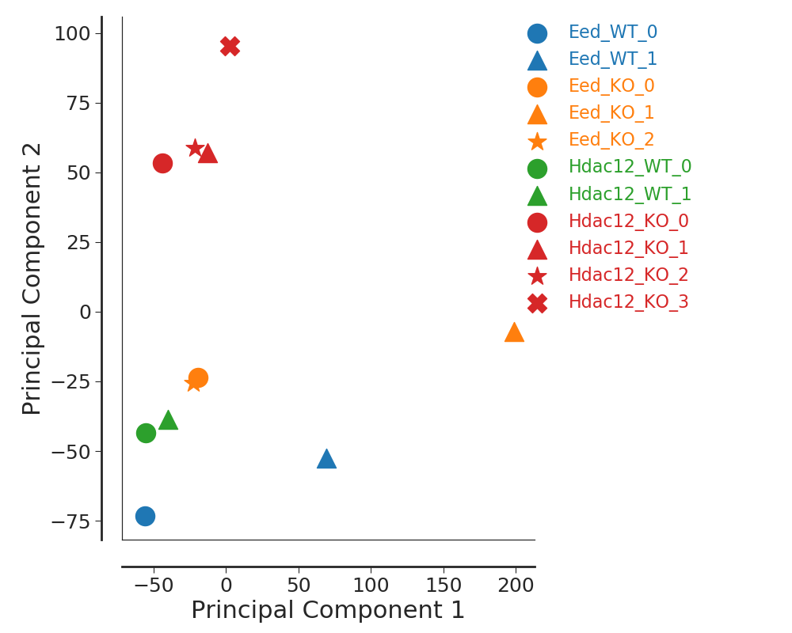
PCA by All Genes RPKM
PCA for aggregation,
Pearson coefficient for reproducibility,
Identify DEGs, ≥2 fold, FDR <0.05.

Slide 16
Pearson coefficient for reproducibility on DEGs
Name
Eed_WT_0 | Eed_WT_1 & Eed_WT_0 Pearson_r is: 0.9328 P_value is: 6.5e-243
Eed_WT_1
Hdac12_WT_0 | Hdac12_WT_1 & Hdac12_WT_0 Pearson_r is: 0.9893 P_value is: 0.0e+00
Hdac12_WT_1
Eed_KO_0 | Eed_KO_0 & Eed_KO_1 Pearson_r is: 0.5751 P_value is: 2.6e-49 Eed_KO_0 & Eed_KO_2 Pearson_r is: 0.9469 P_value is: 1.0e-269 Eed_KO_1 & Eed_KO_2 Pearson_r is: 0.7622 P_value is: 1.2e-104
Eed_KO_1
Eed_KO_2
Hdac12_KO_0 | Hdac12_KO_1 & Hdac12_KO_0 Pearson_r is: 0.9307 P_value is: 2.2e-239
Hdac12_KO_1 | Hdac12_KO_2 & Hdac12_KO_1 Pearson_r is: 0.9621 P_value is: 1.4e-308
Hdac12_KO_2 | Hdac12_KO_0 & Hdac12_KO_2 Pearson_r is: 0.9574 P_value is: 4.2e-295
Hdac12_KO_3 | Hdac12_KO_0 & Hdac12_KO_3 Pearson_r is: 0.9573 P_value is: 5.9e-295

Slide 17
Appendix
Genome Browser Link:
http://genome.ucsc.edu/cgi-bin/hgTracks?hgS_doOtherUser=submit&hgS_otherUserName=lux563624348&hgS_otherUserSessionName=Treg_Eed_Hdac12
Reference Link:
Notes:
FastQC v0.11.6
Bedtools V2.27.1
bowtie2 V2.3.4.3
cufflinks V2.2.1
homer V4.9.1
HTSeq V0.6.1
hisat2 V2.1.0
macs2 V2.1.1.20160309
samtools V1.8

