Slide 1
MSA

Slide 2
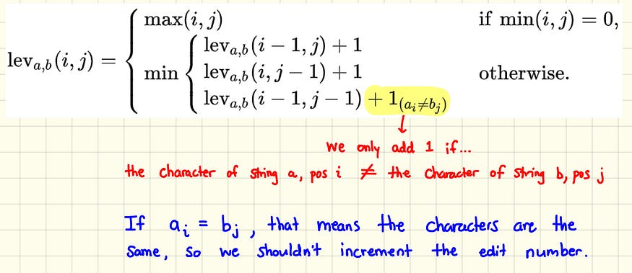
Ref: https://medium.com/@ethannam/understanding-the-levenshtein-distance-equation-for-beginners-c4285a5604f0

Slide 3
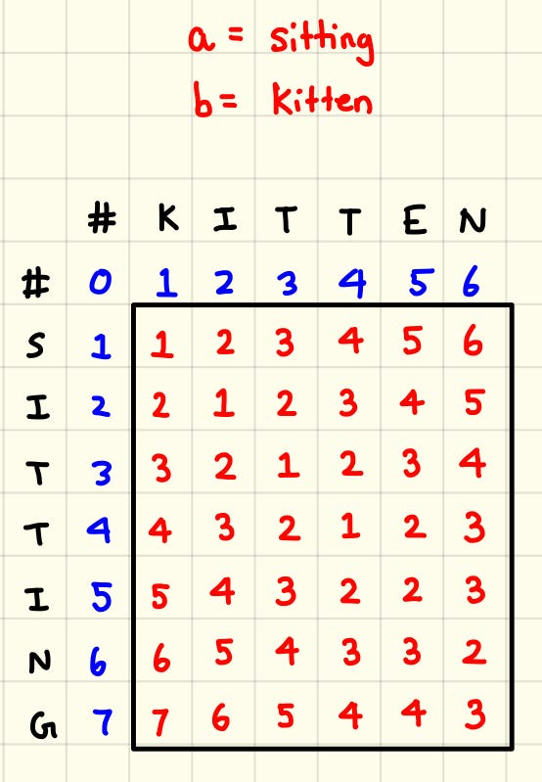
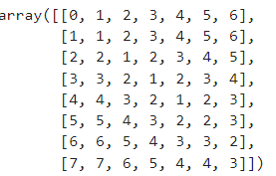

Slide 4
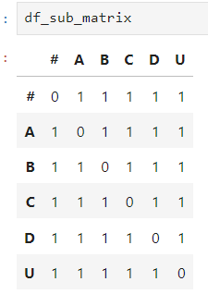
If test data:
seq1 = [('A', date(2024, 1, 1)),('B', date(2024, 1, 1)), ('C', date(2024, 1, 3)), ('D', date(2024, 1, 4))]#, ('E', date(2024, 1, 5))]
seq2 = [('C', date(2024, 1, 1)),('D', date(2024, 1, 1)), ('A', date(2024, 1, 1)), ('B', date(2024, 1, 2))]#, ('F', date(2024, 1, 5))]
If transposition date = 3
 | # | A1 | B1 | C3 | D4
# | 0 | 1 | 2 | 3 | 4
C1 | 1 | 0 | 1 | 2 | 3
D1 | 2 | 1 | 1 | 2 | 2
A1 | 3 | 2 | 1 | 1 | 2
B2 | 4 | 3 | 2 | 1 | 1
No transposition
transposition date = 1
If transposition date = 2
 | # | A | B | C | D
# | 0 | 1 | 2 | 3 | 4
C | 1 | 1 | 2 | 2 | 3
D | 2 | 2 | 2 | 3 | 2
A | 3 | 2 | 3 | 3 | 3
B | 4 | 3 | 2 | 3 | 4
 | # | A1 | B1 | C3 | D4
# | 0 | 1 | 2 | 3 | 4
C1 | 1 | 1 | 2 | 2 | 3
D1 | 2 | 2 | 2 | 3 | 2
A1 | 3 | 2 | 2 | 2 | 3
B2 | 4 | 3 | 2 | 3 | 3
 | # | A1 | B1 | C3 | D4
# | 0 | 1 | 2 | 3 | 4
C1 | 1 | 1 | 2 | 2 | 3
D1 | 2 | 2 | 2 | 3 | 2
A1 | 3 | 2 | 2 | 2 | 3
B2 | 4 | 3 | 2 | 2 | 2
If transposition date = 4
 | # | A1 | B1 | C3 | D4
# | 0 | 1 | 2 | 3 | 4
C1 | 1 | 0 | 1 | 2 | 3
D1 | 2 | 1 | 0 | 1 | 2
A1 | 3 | 2 | 1 | 0 | 1
B2 | 4 | 3 | 2 | 1 | 0
i=3, j=1
dp[3][1] = min(indel, sub) = 2
#for A1(seq1[3]), loop over seq2. ()
idx_seq2 in range(1, 4, 1)
date_diff1 = abs((dates1[i] - dates2[idx_seq2 ]).days)

