Slide 1
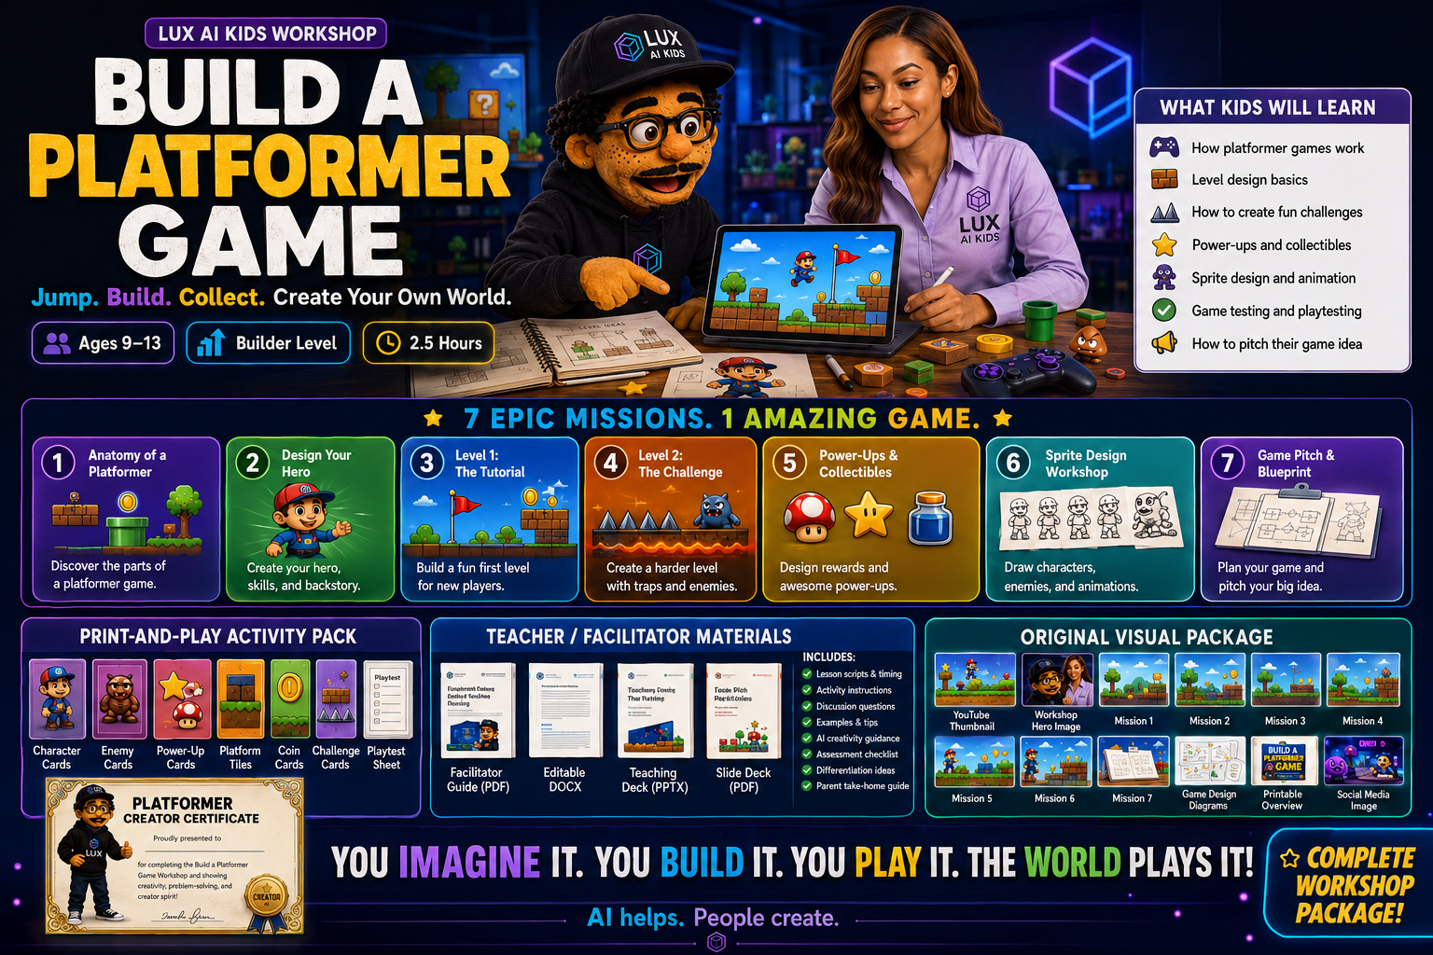
Build a Platformer Game
Jump. Build. Collect. Create Your Own World.
Build a Platformer Game - Slide 1

Slide 2
Today You Are Game Designers
You will make a hero, build levels, create rewards, sketch sprites, and pitch your game.
Build a Platformer Game - Slide 2

Slide 3
Lux Rule
AI helps. People create. Ask a grown-up first.
Build a Platformer Game - Slide 3

Slide 4
The 7 Mission Path
Anatomy, Hero, Tutorial, Challenge, Power-Ups, Sprites, Pitch.
Build a Platformer Game - Slide 4

Slide 5
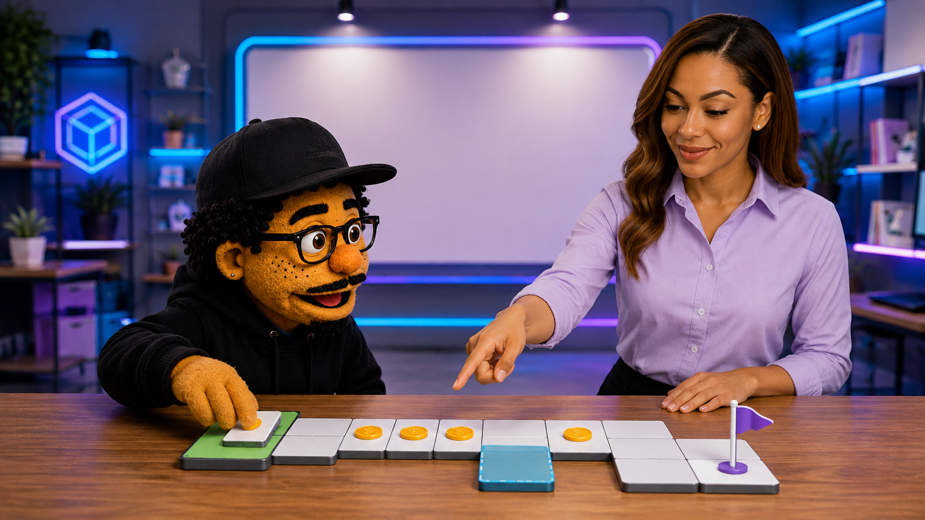
Mission 1: Anatomy
Find the hero, platforms, danger, rewards, and goal.
Build a Platformer Game - Slide 5

Slide 6
Activity: Spot the Parts
Look at a game level and label the parts.
Build a Platformer Game - Slide 6

Slide 7
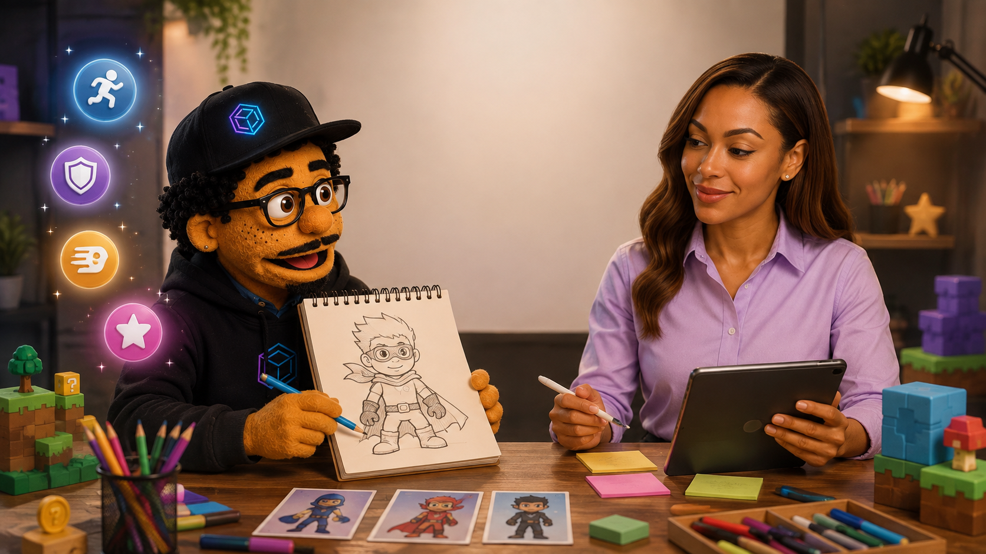
Mission 2: Design Your Hero
Create a hero with a mission and personality.
Build a Platformer Game - Slide 7

Slide 8
Hero Power Builder
Pick one fair power that makes the game fun.
Build a Platformer Game - Slide 8

Slide 9
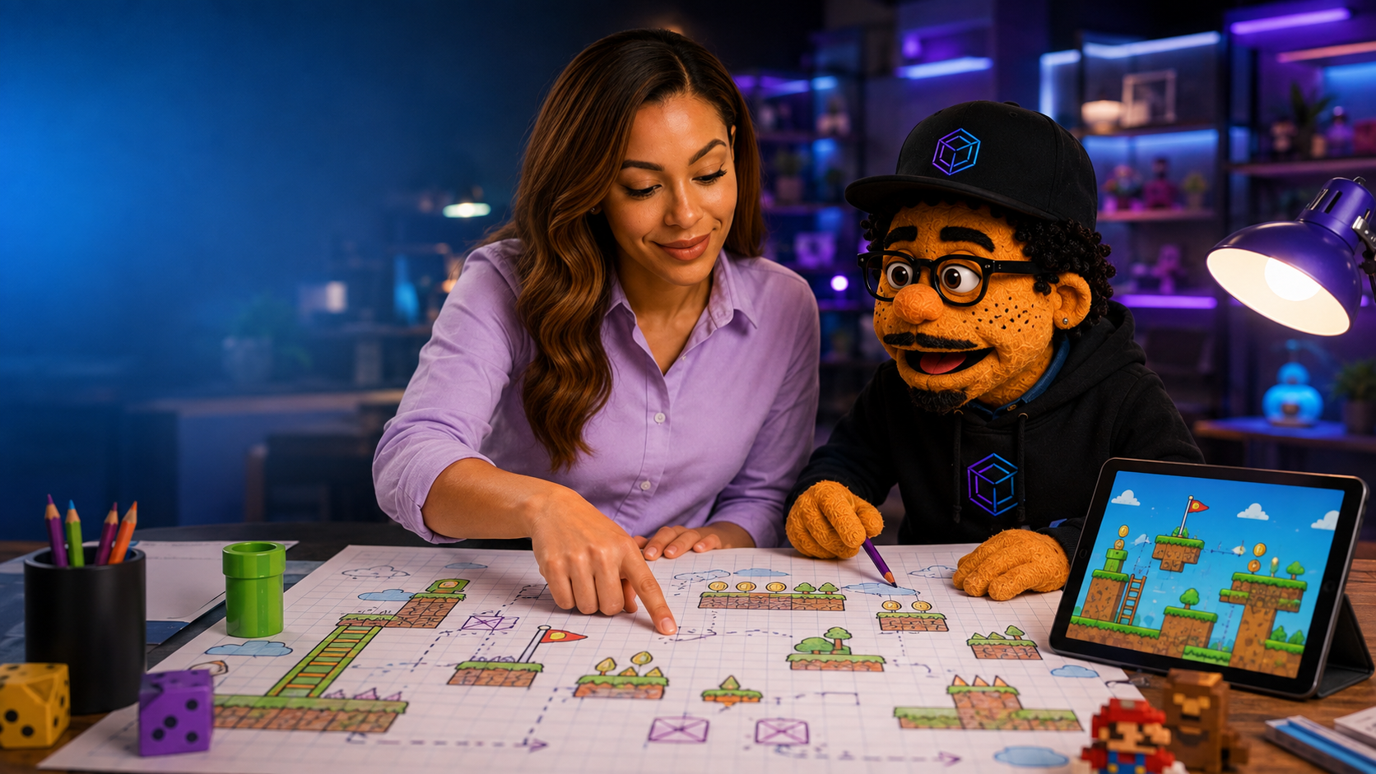
Mission 3: Level 1 Tutorial
Teach the player how to move and win.
Build a Platformer Game - Slide 9

Slide 10
Tutorial Level Checklist
Start easy. Show the path. Add one tiny challenge.
Build a Platformer Game - Slide 10

Slide 11
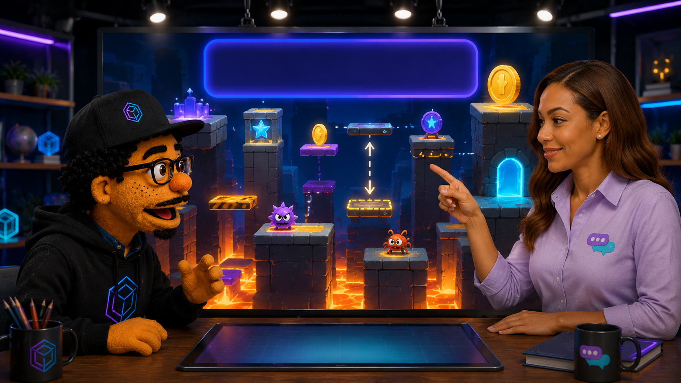
Mission 4: Level 2 Challenge
Make it harder, but keep it fair.
Build a Platformer Game - Slide 11

Slide 12
Challenge Ideas
Moving platforms, spikes, enemies, secrets, and rewards.
Build a Platformer Game - Slide 12

Slide 13
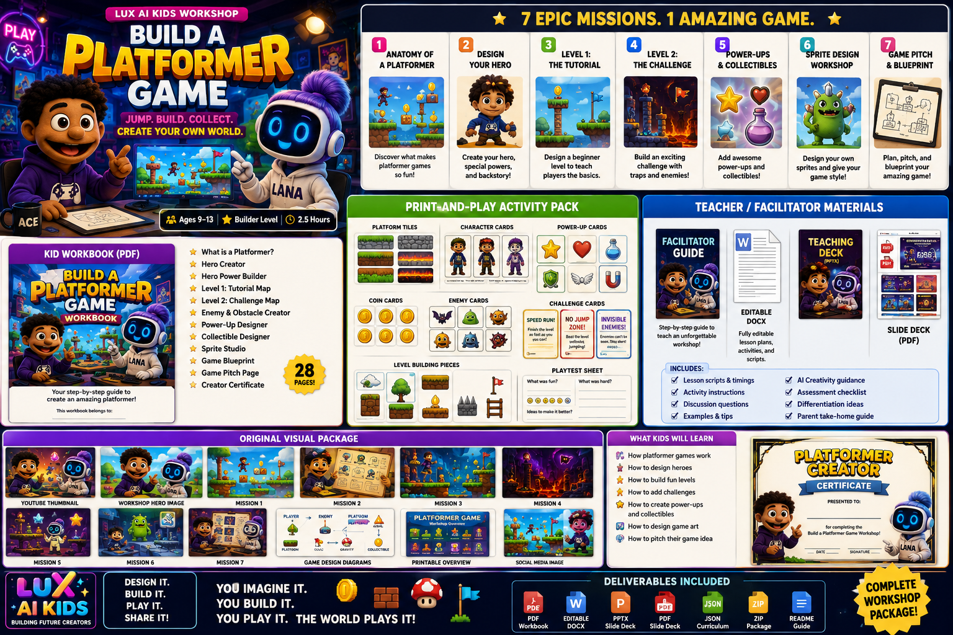
Mission 5: Power-Ups
Design helpful items and collectibles.
Build a Platformer Game - Slide 13

Slide 14
Power-Up Rules
Make them useful, fair, easy to understand, and fun.
Build a Platformer Game - Slide 14

Slide 15
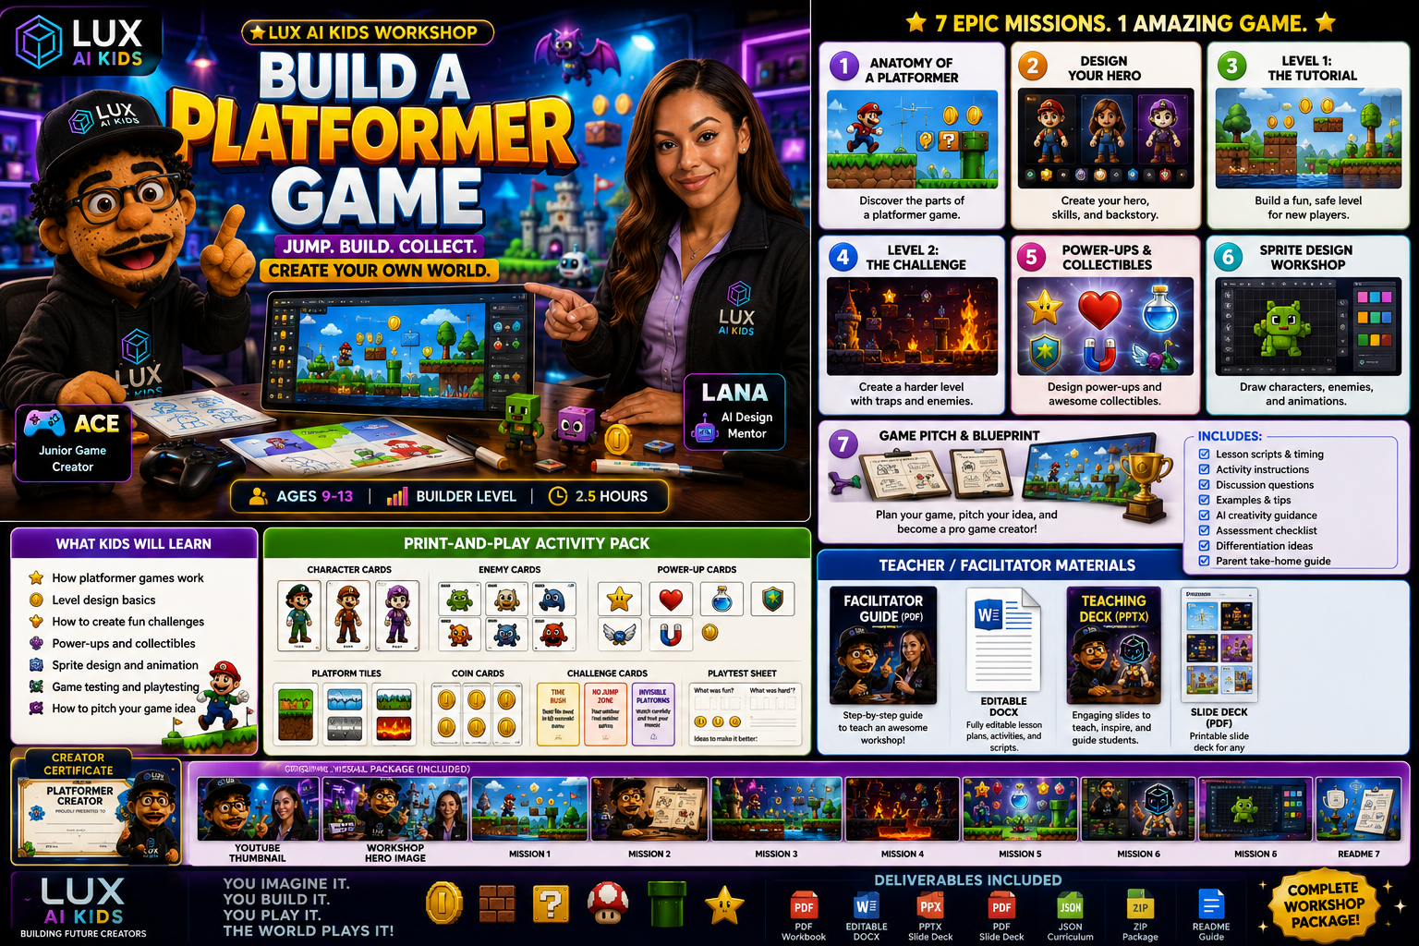
Mission 6: Sprite Studio
Draw characters, enemies, items, and animation frames.
Build a Platformer Game - Slide 15

Slide 16
Sprite Tip
Small pictures can show big personality.
Build a Platformer Game - Slide 16

Slide 17
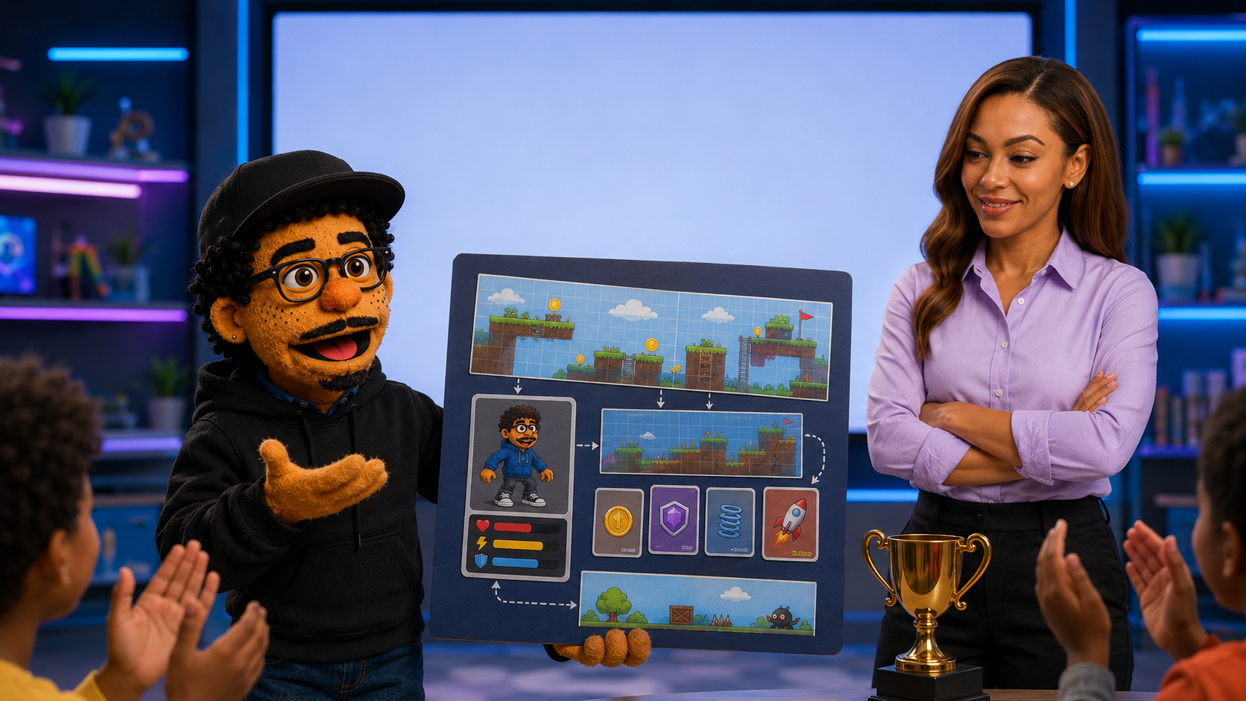
Mission 7: Game Pitch
Tell people what your game is and why it is fun.
Build a Platformer Game - Slide 17

Slide 18
30-Second Pitch Formula
Title, hero, goal, challenge, power-up, feeling.
Build a Platformer Game - Slide 18

Slide 19
Playtest Time
Watch a friend play. Notice what is fun and what is confusing.
Build a Platformer Game - Slide 19

Slide 20
Improve One Thing
Great games get better after testing.
Build a Platformer Game - Slide 20

Slide 21
Final Project Checklist
Hero, 2 levels, power-ups, sprites, pitch, playtest notes.
Build a Platformer Game - Slide 21

Slide 22
You Did It
You are a Platformer Creator!
Build a Platformer Game - Slide 22

Slide 23
Teacher Pause
Give students 3 minutes to finish this page.
Build a Platformer Game - Slide 23

Slide 24
Partner Share
Tell a partner your favorite idea.
Build a Platformer Game - Slide 24

Slide 25
Kind Feedback
Say: I like... I wonder... What if...
Build a Platformer Game - Slide 25

Slide 26
AI Helper Prompt
Make 5 safe, silly power-up ideas for a platformer about ____.
Build a Platformer Game - Slide 26

Slide 27
Family Share
Show your game blueprint at home.
Build a Platformer Game - Slide 27

Slide 28
Extension
Draw Level 3 or build a digital version with grown-up help.
Build a Platformer Game - Slide 28

Slide 29
Assessment
Can students explain their game clearly?
Build a Platformer Game - Slide 29

Slide 30
Celebrate
Every idea can become a better idea.
Build a Platformer Game - Slide 30

Slide 31
Credits
Lux AI Kids Creator Academy
Build a Platformer Game - Slide 31

Slide 32
Next Workshop
Puzzle Game Lab or Story Game Adventure
Build a Platformer Game - Slide 32

Slide 33
Finish
Imagine it. Build it. Play it. Share it.
Build a Platformer Game - Slide 33

Slide 34
Reminder
AI helps. People create.
Build a Platformer Game - Slide 34

